Slide 1
“Remember, Time is a greedy player who wins without cheating, every round!”
Charles Baudelaire - The Clock

Slide 2
I love deadlines. I like the whooshing sound they make as they fly by.
Douglas Adams

Slide 3
Take a break away from your computer work at least every hour. Frequent breaks help to rest both body and mind, and are much better than a single long break in the middle of the day.
10 Top Tips for Computer Users (6)
- WTSI H&S Advice

Slide 4
Do YOU want to get back YOUR DAY?

Slide 5
Do YOU want to get back YOUR FOCUS?

Slide 6
Do YOU want to get back YOUR HEALTH?

Slide 7
Then I can help you do just that!

Slide 8
Can you concentrate for just 25 minutes?

Slide 9
I mean really concentrate for 25 minutes...

Slide 10
...On Just
ONE THING AT A TIME!

Slide 11
NO MULTITASKING

Slide 12
NO THERE MIGHT BE AN IMPORTANT EMAIL

Slide 13
All you need is ...

Slide 14
No Really, that is it!

Slide 15
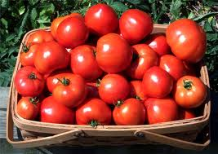
The Pomodoro Technique

Slide 16
So, we work for 25 minutes...
...on a single task!

Slide 17
Five minute break!

Slide 18
The Pomodoro Day.

Slide 19
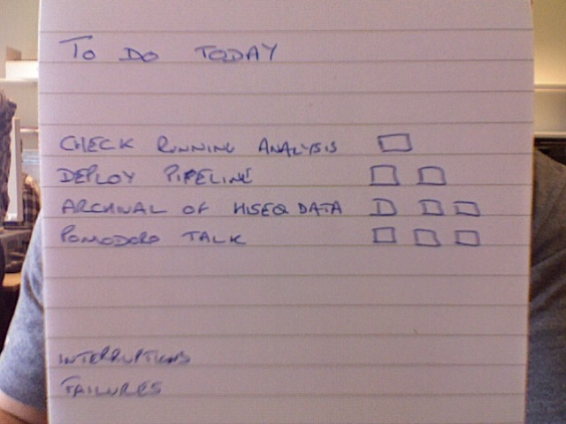

Slide 20
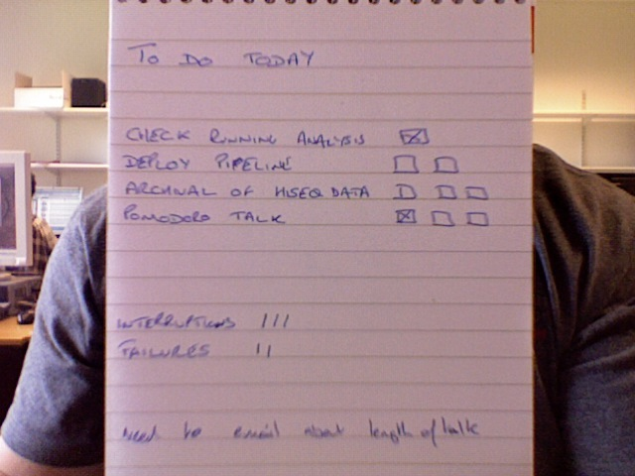

Slide 21
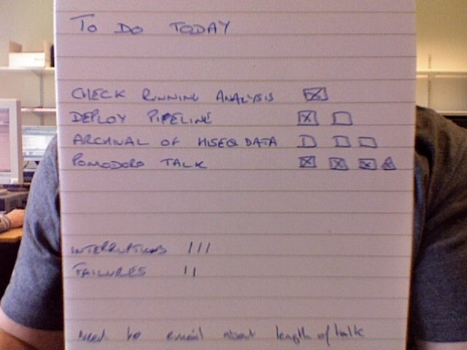

Slide 22
Notice the failures?

Slide 24
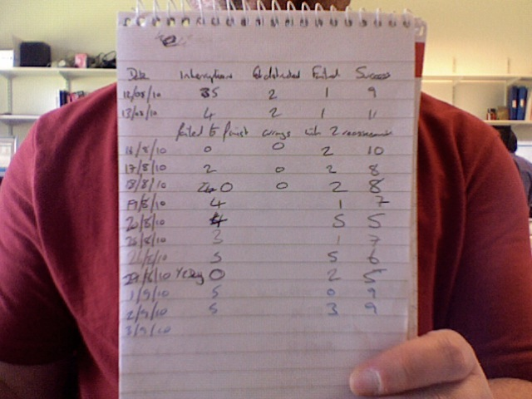

Slide 25
So, why not try this!

Slide 26
Just for 2 weeks

Slide 27

Free Download
www.pomodorotechnique.com

Slide 28
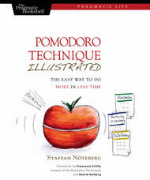
The book that started it for me.

Slide 29
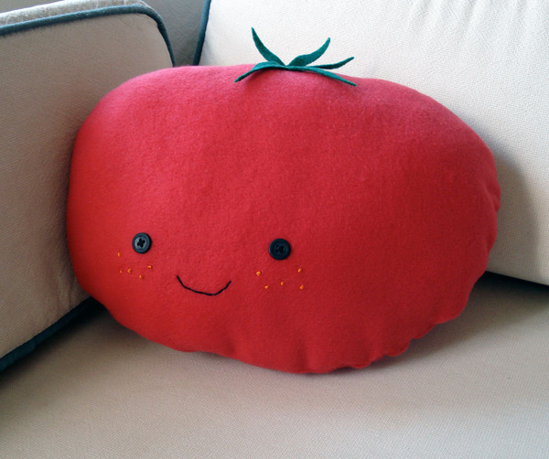
Thankyou, I've been Andy Brown, and I hope you have enjoyed this talk, I'm here all week.
Try the Tomatos

