Slide 1




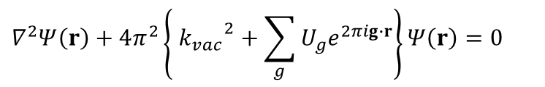



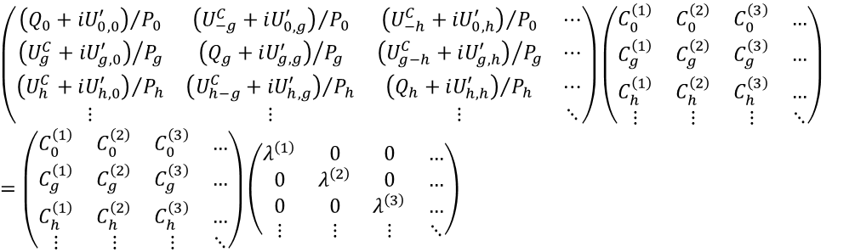












Definitions of vectors and scalars
Center of Ewald sphere
Surface
Vector
$$\overset{⃑}{n}$$
Scalar
$${\overset{⃑}{k}}_{vac}$$
$$γ^{j}$$
$$\frac{P_{g}}{2}$$
$$\overset{⃑}{n}:Unit vector normal$$
$to surface$
$$P_{g}=2\overset{⃑}{n}(\overset{⃑}{k}+\overset{⃑}{g})$$
$$Q_{g}={\left|\overset{⃑}{k}\right|}^{2}−{\left|\overset{⃑}{k}+\overset{⃑}{g}\right|}^{2}$$
$=−\overset{⃑}{g}(2\overset{⃑}{k}+\overset{⃑}{g})$
$$\overset{⃑}{k}$$
$$\overset{⃑}{k^{j}}$$
$$\overset{⃑}{k}+ \overset{⃑}{g}$$
$$S_{g}=\frac{\sqrt{P_{g}^{ 2}+{4Q}_{g}}−P_{g}}{2}$$
$$o$$
$$\overset{⃑}{g}$$
$$S_{g}$$
$$R=\left|\overset{⃑}{g}\right| Q_{g}^{2}$$
Ewald sphere
(Evaluation function)
Schrödinger's equation
$$∇^{2}Ψ\left(r\right)+4π^{2}\left\{ {k_{vac}}^{2}+\sum_{g}{U_{g}e^{2πig∙r}}\right\}Ψ\left(r\right)=0$$
$k_{vac}$: Wavenumber of electron in vacuum
U_{g} : Fourier component of potential
Bloch’s theorem
$$Ψ\left(r\right)=b\left(k^{(j)},r\right)=u\left(r\right)exp⁡(2πik^{(j)}∙r)$$
u(r) : Periodic function with the same periodicity as the crystal lattice
k^{(j)} : j^{th} Bloch wave vector
Bethe’s dynamical equation
$$\left[k^{2}−{\left(k^{(j)}+g\right)}^{2}+i {U^{′}}_{g,g}\right]C_{g}^{(j)}+\sum_{h≠g}{\left(U_{g−h}^{C}+i {U^{′}}_{g,h}\right)C_{h}^{(j)}=0}$$
Eigen values/vectors equation
$$\left(\begin{matrix}{\left(Q_{0}+iU_{0,0}^{′}\right)}/{P_{0}} & {\left(U_{−g}^{C}+iU_{0,g}^{′}\right)}/{P_{0}} & {\left(U_{−h}^{C}+iU_{0,h}^{′}\right)}/{P_{0}} & ⋯ \\ {\left(U_{g}^{C}+iU_{g,0}^{′}\right)}/{P_{g}} & {\left(Q_{g}+iU_{g,g}^{′}\right)}/{P_{g}} & {\left(U_{g−h}^{C}+iU_{g,h}^{′}\right)}/{P_{g}} & ⋯ \\ {\left(U_{h}^{C}+iU_{h,0}^{′}\right)}/{P_{h}} & {\left(U_{h−g}^{C}+iU_{h,g}^{′}\right)}/{P_{h}} & {\left(Q_{h}+iU_{h,h}^{′}\right)}/{P_{h}} & ⋯ \\ ⋮ & ⋮ & ⋮ & ⋱\end{matrix}\right)\left(\begin{matrix}C_{0}^{\left(1\right)} & C_{0}^{\left(2\right)} & C_{0}^{\left(3\right)} & … \\ C_{g}^{\left(1\right)} & C_{g}^{\left(2\right)} & C_{g}^{\left(3\right)} & … \\ C_{h}^{\left(1\right)} & C_{h}^{\left(2\right)} & C_{h}^{\left(3\right)} & … \\ ⋮ & ⋮ & ⋮ & ⋱\end{matrix}\right)=\left(\begin{matrix}C_{0}^{\left(1\right)} & C_{0}^{\left(2\right)} & C_{0}^{\left(3\right)} & … \\ C_{g}^{\left(1\right)} & C_{g}^{\left(2\right)} & C_{g}^{\left(3\right)} & … \\ C_{h}^{\left(1\right)} & C_{h}^{\left(2\right)} & C_{h}^{\left(3\right)} & … \\ ⋮ & ⋮ & ⋮ & ⋱\end{matrix}\right)\left(\begin{matrix}λ^{\left(1\right)} & 0 & 0 & … \\ 0 & λ^{\left(2\right)} & 0 & … \\ 0 & 0 & λ^{\left(3\right)} & … \\ ⋮ & ⋮ & ⋮ & ⋱\end{matrix}\right)$$
$U_{g}^{C}$: Crystal potential for elastic scattering
${U′}_{g}$: Imaginary (absorption) potential for thermal diffuse scattering
$P, Q$: Defined in above figure
$λ^{\left(j\right)}$: j ^{th} eigen value
$C_{∗}^{\left(j\right)}$: j ^{th} eigen vectors

Slide 2

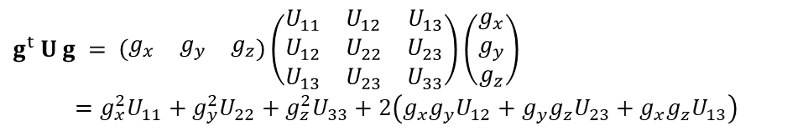
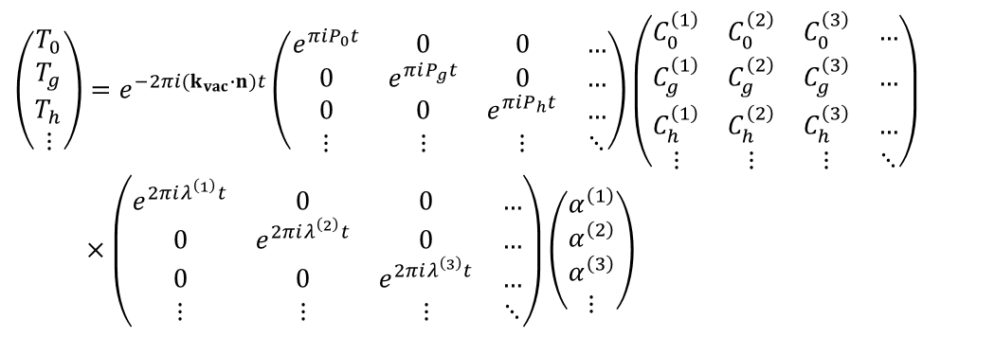


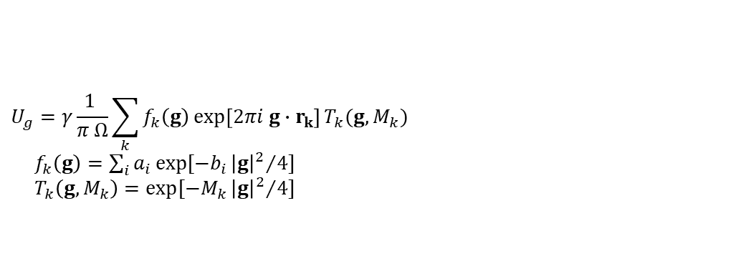
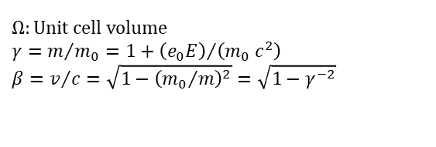
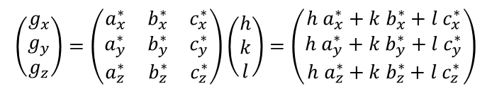
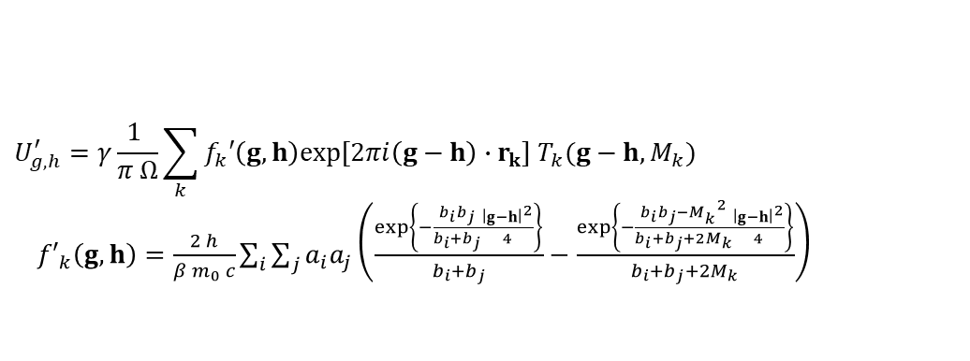
Optical potential (complex crystal potential)
注: ReciProのDetailsで表示されるテーブル中の$U_{g}$は、相対論補正項$γ$を掛ける前の数値.
Crystal potential for elastic scattering
$$U_{g}=γ\frac{1 }{π Ω}\sum_{k}{f_{k}\left(g\right)\exp\left[2πi g∙r_{k}\right]T_{k}(g, M_{k})}$$
$f_{k}\left(g\right)=\sum_{i}{a_{i}\exp{[−b_{i}{{\left|g\right|}^{2}}/4]}}$
$T_{k}\left(g, M_{k}\right)=\exp{[−M_{k}{{\left|g\right|}^{2}}/4]}$
Imaginary (absorption) potential for thermal diffuse
$$U_{g,h}^{′}=γ\frac{1 }{π Ω}\sum_{k}{f_{k}′\left(g,h\right)exp⁡[2πi\left(g−h\right)∙r_{k}] T_{k}(g−h, M_{k})}$$
${f′}_{k}\left(g,h\right)=\frac{2 h}{β m_{0} c}\sum_{i}{\sum_{j}{a_{i}a_{j}\left(\frac{exp\left\{−\frac{b_{i}b_{j}}{b_{i}+b_{j}}\frac{{\left|g−h\right|}^{2}}{4}\right\}}{b_{i}+b_{j}}−\frac{exp\left\{−\frac{b_{i}b_{j}−M_{k}^{ 2}}{b_{i}+b_{j}+2M_{k}}\frac{{\left|g−h\right|}^{2}}{4}\right\}}{b_{i}+b_{j}+2M_{k}}\right)}}$
$$Ω:Unit cell volume$$
$$γ=m/{m_{0}}=1+{\left(e_{0}E\right)}/{\left(m_{0} c^{2}\right)}$$
$$β=v/c=\sqrt{1−{\left({m_{0}}/m\right)}^{2}}=\sqrt{1−γ^{−2}}$$
Debye-Waller factor
$$T_{k}\left(g\right)=\exp{[−2π g^{t} U g]}$$
$$g^{t} U g = \left(\begin{matrix}g_{x} & g_{y} & g_{z}\end{matrix}\right)\left(\begin{matrix}U_{11} & U_{12} & U_{13} \\ U_{12} & U_{22} & U_{23} \\ U_{13} & U_{23} & U_{33}\end{matrix}\right)\left(\begin{matrix}g_{x} \\ g_{y} \\ g_{z}\end{matrix}\right)=g_{x}^{2}U_{11}+g_{y}^{2}U_{22}+g_{z}^{2}U_{33}+2\left(g_{x}g_{y}U_{12}+g_{y}g_{z}U_{23}+g_{x}g_{z}U_{13}\right)$$
$$\left(\begin{matrix}g_{x} \\ g_{y} \\ g_{z}\end{matrix}\right)=\left(\begin{matrix}a_{x}^{∗} & b_{x}^{∗} & c_{x}^{∗} \\ a_{y}^{∗} & b_{y}^{∗} & c_{y}^{∗} \\ a_{z}^{∗} & b_{z}^{∗} & c_{z}^{∗}\end{matrix}\right)\left(\begin{matrix}h \\ k \\ l\end{matrix}\right)=\left(\begin{matrix}h a_{x}^{∗}+k b_{x}^{∗}+l c_{x}^{∗} \\ h a_{y}^{∗}+k b_{y}^{∗}+l c_{y}^{∗} \\ h a_{z}^{∗}+k b_{z}^{∗}+l c_{z}^{∗}\end{matrix}\right)$$
Matrix representation of transmission coefficient T_{g}
$$\left(\begin{matrix}T_{0} \\ T_{g} \\ T_{h} \\ ⋮\end{matrix}\right)=e^{−2πi(k_{vac}∙n)t}\left(\begin{matrix}e^{πiP_{0}t} & 0 & 0 & … \\ 0 & e^{πiP_{g}t} & 0 & … \\ 0 & 0 & e^{πiP_{h}t} & … \\ ⋮ & ⋮ & ⋮ & ⋱\end{matrix}\right)\left(\begin{matrix}C_{0}^{\left(1\right)} & C_{0}^{\left(2\right)} & C_{0}^{\left(3\right)} & … \\ C_{g}^{\left(1\right)} & C_{g}^{\left(2\right)} & C_{g}^{\left(3\right)} & … \\ C_{h}^{\left(1\right)} & C_{h}^{\left(2\right)} & C_{h}^{\left(3\right)} & … \\ ⋮ & ⋮ & ⋮ & ⋱\end{matrix}\right)$$
$×\left(\begin{matrix}e^{2πiλ^{\left(1\right)}t} & 0 & 0 & … \\ 0 & e^{2πiλ^{\left(2\right)}t} & 0 & … \\ 0 & 0 & e^{2πiλ^{\left(3\right)}t} & … \\ ⋮ & ⋮ & ⋮ & ⋱\end{matrix}\right)\left(\begin{matrix}α^{\left(1\right)} \\ α^{\left(2\right)} \\ α^{\left(3\right)} \\ ⋮\end{matrix}\right)$
$α$: weighting coefficients
$t$: Specimen thickness

Slide 3



Center of Ewald sphere
Sample
surface
$$n$$
$$γ^{(j)}$$
$$Vector$$
$k_{vac}$
$$Scalar$$
$$k_{0}+g$$
$$\frac{P_{g}}{2}$$
$k_{0}$
$$k^{(j)}$$
$$g$$
$$S_{g}$$
$$o$$
Ewald sphere

