Slide 1
Lesson 9: Where does your son work
Lesson Objectives
Be able to ask where something is, and give a response.
Be able to ask where someone works/ eats/ reads ..etc., and give a response
Expressing location with 在 zài :
Ex: Je suis à l'ecole
wǒ zài xuéxiào 我在学校

Slide 2
The Different Uses of 在 zai in Chinese
❶.Expressing location with 在 (zài)
The 在 (zài) character can be used to indicate location and often be used to state ‘to be located at’.
subject + 在 zài + place
他在家 (tā zài jiā) He is at home.
The negation for 在 (zài) is 不在 (bú zài) :
他不在家 (tā bú zài jiā) He is not at home.

Slide 3
在 (zài) = en train de (lesson 13)
❷ Using 在 (zài) to suggest ongoing actions in the present (Lesson 13)
Ex: wǒ zài kàn shū
= I am reading a book
Ex: wǒ zài gōngzuò 我在工作
= I am working
= Je suis en train de travailler

Slide 4
Grammar: zài 在 is a verb. Typically indicating the location of somebody or something. (can be used as a Preposition)
❶ zài 在= to be at (Preposition) zài + location (place) + Verb
Ex. at the hospital to work, at school to work
= zài yīyuàn gōngzuò (在医院工作)
❷ nǎr ? = where (Interrogative Pronoun)
Ex. wǒ de péngyǒu zài nǎr ?
= Où sont mes amis? (where are my friends?)

Slide 5
呢ne !? (expressing I wonder = what about..?) 呢ne ?= La particule finale (Et…..?)
Nǐ ne 你呢?= what about you?
= et vous? (et toi?)
Example:
我是法国人，你呢?
wǒ shì Fàguó rén, nǐ ne?
= Je suis français(e), et toi?
= I am French. What about you?

Slide 6
Leçon 9
Examples:
subject + 在 zài + place
❶. Nǐ de érzi zài nǎr gōngzuò? 你 的儿子 在 哪ㄦ 工作 Your son is at where to work? (Where does your son work?)
❷ A: Yīshēng zài nǎr gōngzuò? 医生 在 哪儿 工作?
The doctor is at where to work?( Where does the doctor work)
B: Yīshēng + zài + yīyuàn gōngzuò 医生 +在+ 医院 工作.
The doctor is at the hospital to work. ( The doctor is working at the hospital).

Slide 7
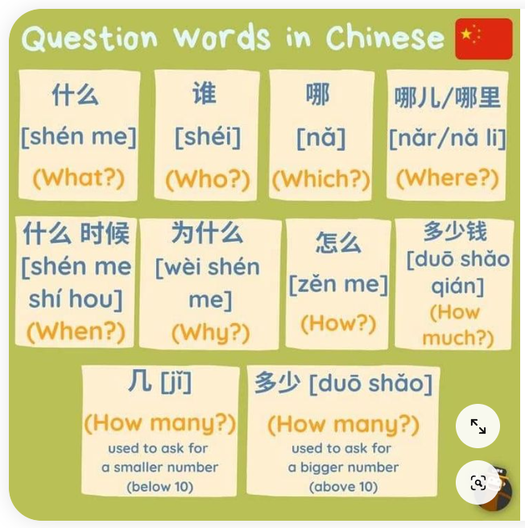

Slide 8
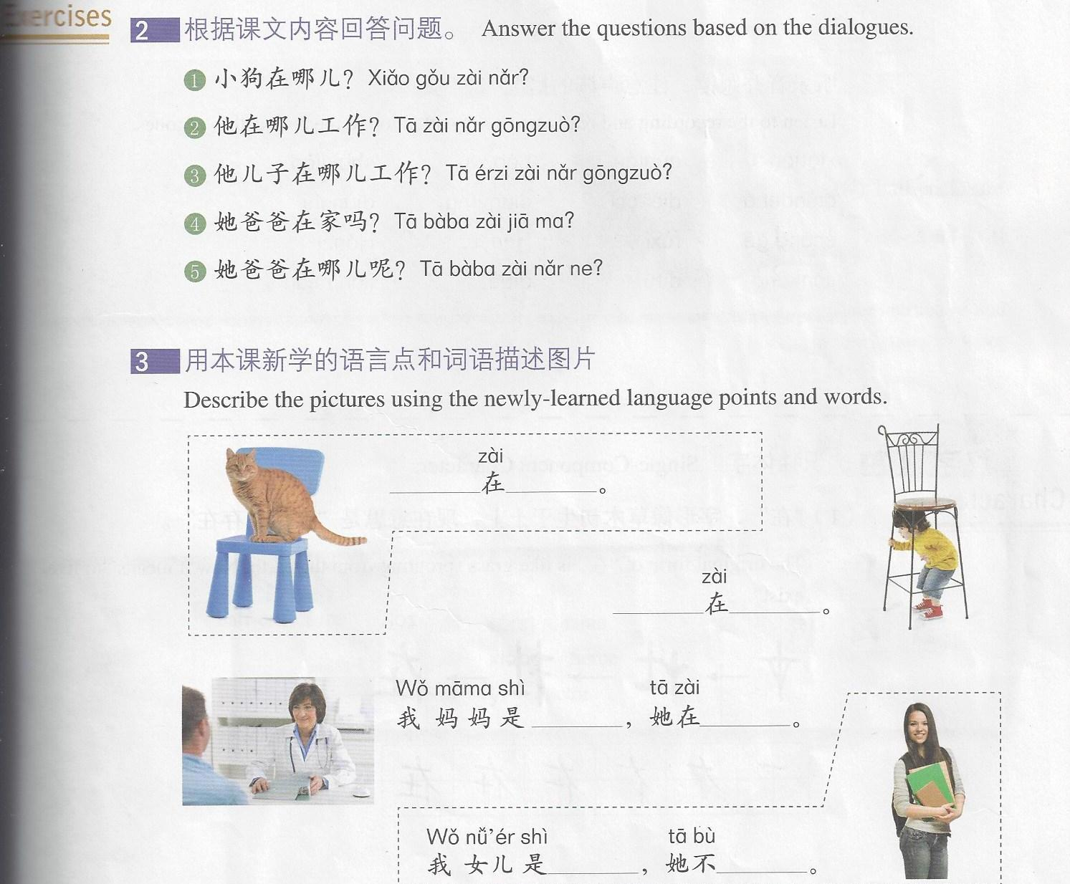
Lesson 9 Exercises

Slide 9
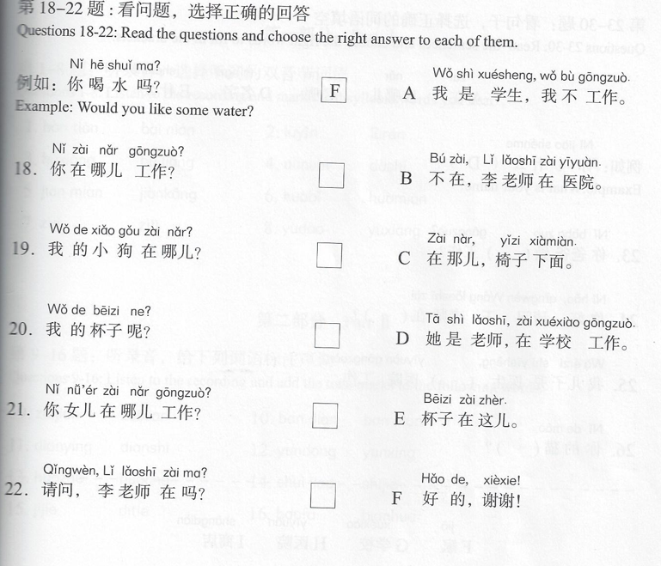

Slide 10
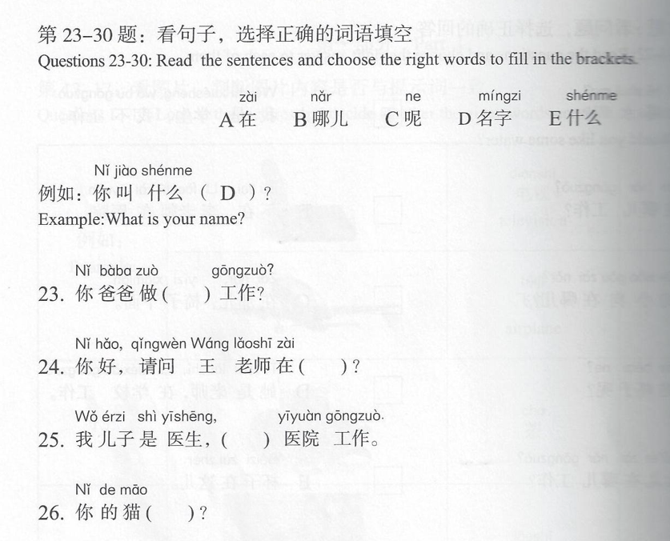

Slide 11
