Slide 1
From Torch to Projector:​ Fundamental Tradeoff of Integrated Sensing and Communications​
Yifeng Xiong, Member, IEEE, Fan Liu, Member, IEEE, Kai Wan, Member, IEEE, Weijie Yuan, Member, IEEE, Yuanhao Cui, Member, IEEE, and Giuseppe Caire, Fellow, IEEE​
Vojtech Haspl, Qizhi Pan, Brice Setra Robert​

Slide 2
Structure of the presentation
What is ISAC​
The Torch Metaphor and motivation for the Projector​
DRT and ST in PRACTICAL ISAC SYSTEMS
Video demo of ISAC

Slide 3
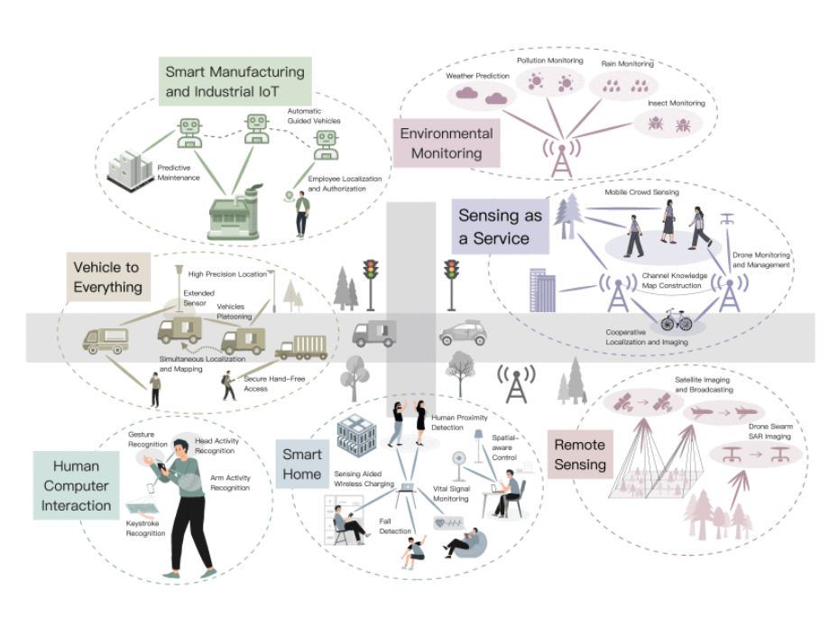
What is ISAC
Integrated Communication and sensing
Fan Liu et al.: Integrated Sensing and Communications: Toward Dual-Functional Wireless Networks for 6G and Beyond
Notes:
(i) improve spectral and energy efficiencies by merging two technologies
(ii) ISAC seeks to deep integration of both technologies (one aids the other)

Slide 4
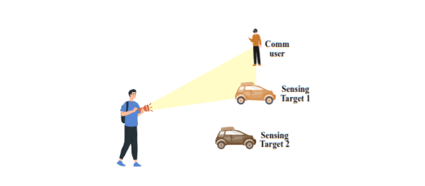
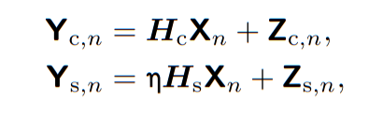
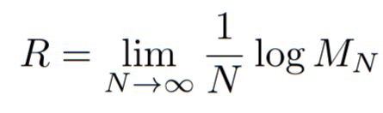
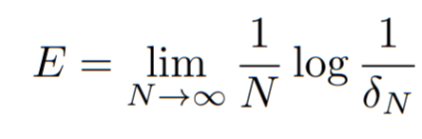
The Torch Metaphor
System model
Yifeng Xiong et al.: From Torch to Projector: Fundamental Tradeoff of Integrated Sensing and Communications
Performance metrics
Notes:
delta denotes maximum detection error probability over all codewords and target states

Slide 5
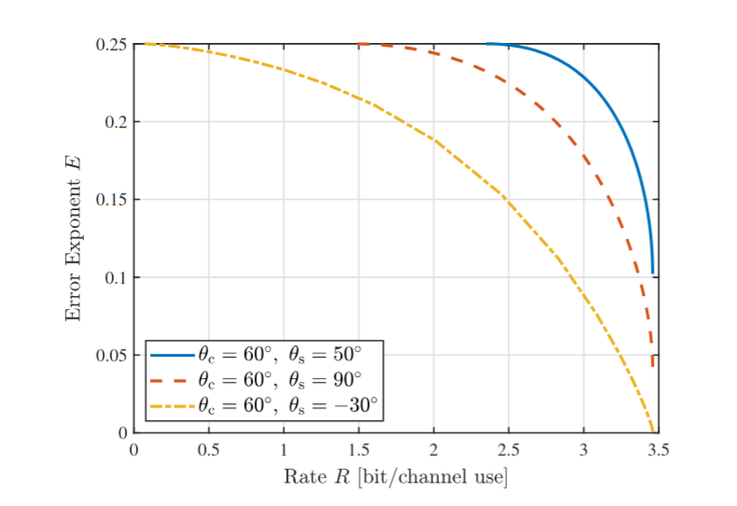
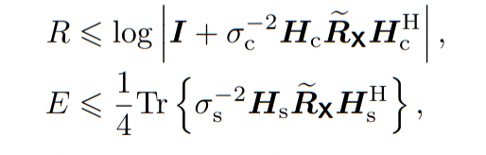
The Torch Metaphor
Notes:
Rx is the statistical covariance matrix of the tx signal
comm optimal Rx would have its eigenvectors matching those of Hc, while the eigenvalues are determined by the water-filling algorithm
sensing optimal Rx would be aligned with the dominant eigenvector of Hs.

Slide 6
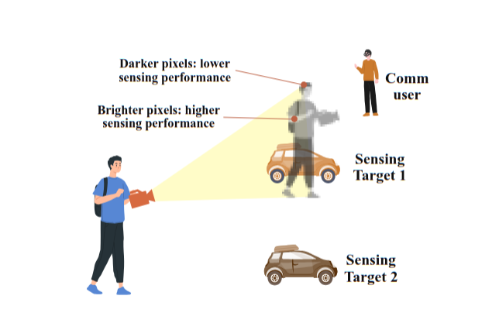
Towards The Projector
Problems with The Torch metaphor:
Does the tradeoff equation hold in general?
If not, under what conditions?
=> new approach is needed
What is the comms optimal vs sensing optimal waveform?
Deterministic-random Tradeoff (DRT)
Notes:
My idea is to introduce the limitations of the torch metaphor and provide firm ground for the introduction of the projector later.

Slide 7
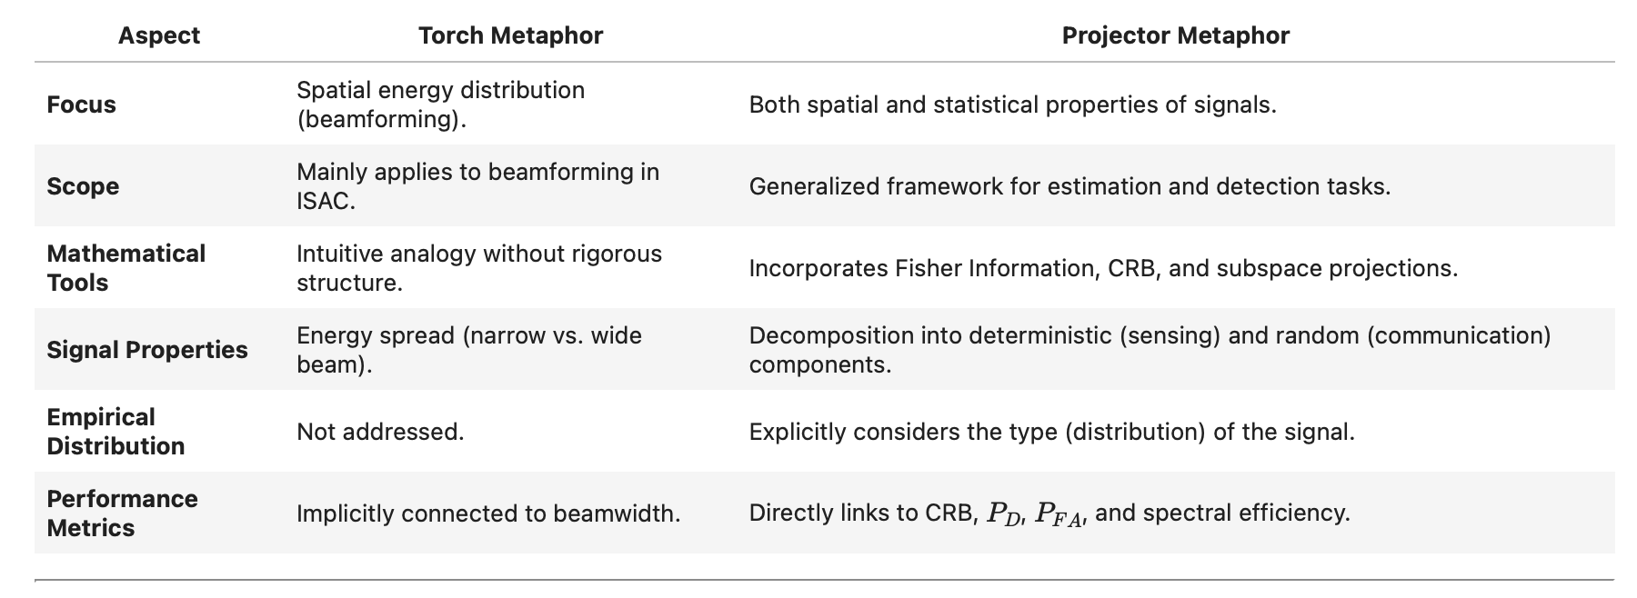
Torch to Projector Metaphor

Slide 8
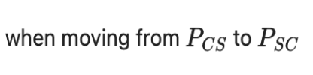
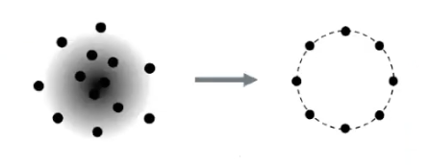
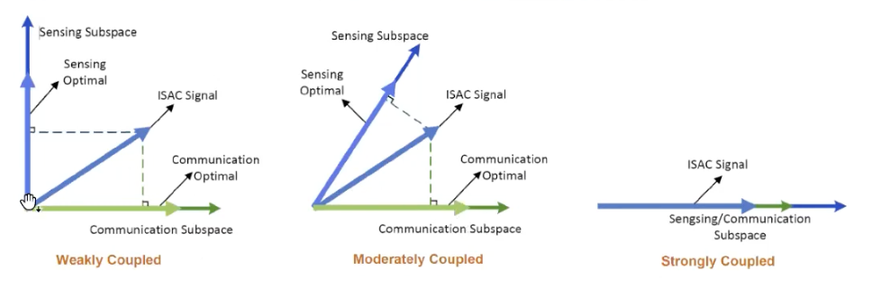
S&C Tradeoff as a Two-fold Tradeoff
Two things occur
Deterministic-Random Tradeoff (DRT): The randomness of the ISAC signal reduces
Subspace Tradeoff (ST): The signal power moves from the comms subspace to the sensing subspace
ISAC Gain closely related to coupling strength

Slide 9
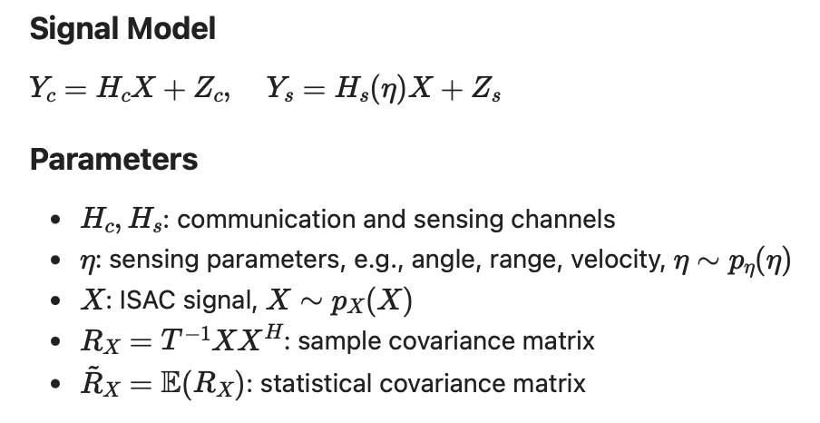
ISAC Signals

Slide 10
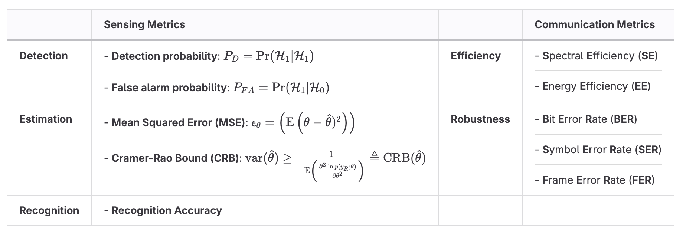
DRT - Deterministic-Random Trade Off

Slide 11
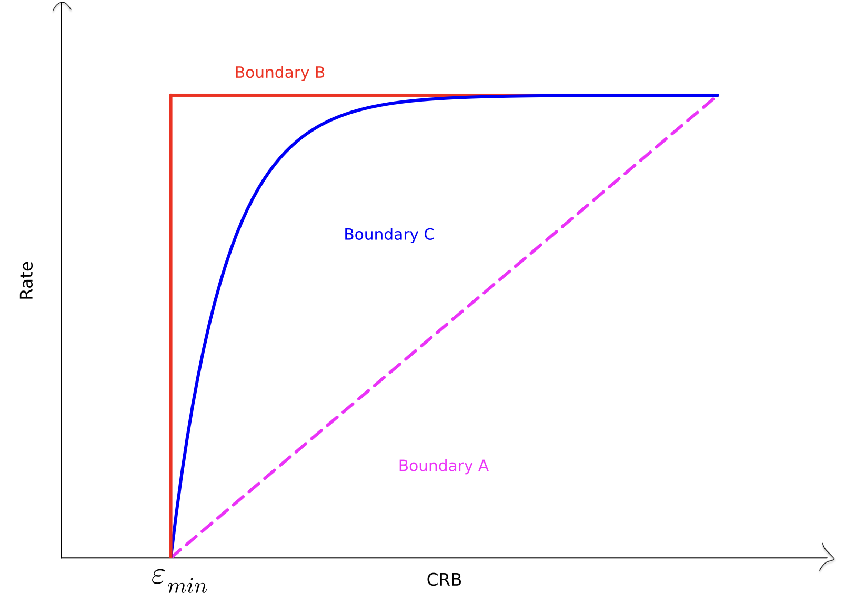
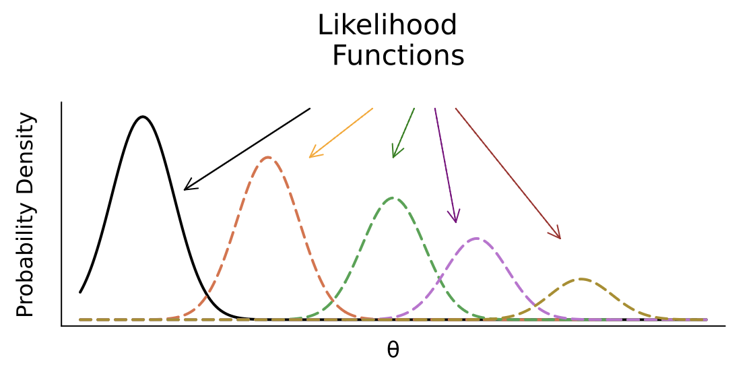
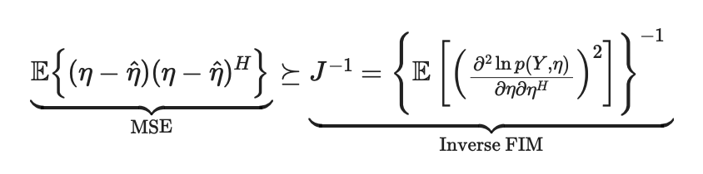
Cramer-Rao Bound (also the inverse FIM)
Trade-Off between sensing accuracy (minimizing CRB) and communication performance (rate)

Slide 12
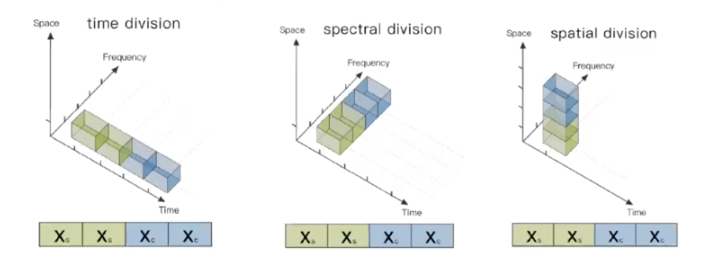
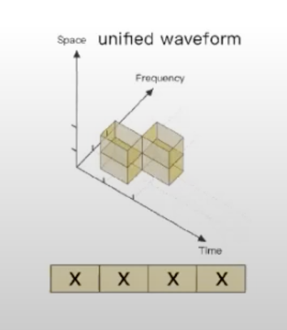
Unified Waveform
Orthogonal Resource Allocation
Unified Waveform
Sensing-Optimal Waveform Communication-Optimal Waveform

Slide 13
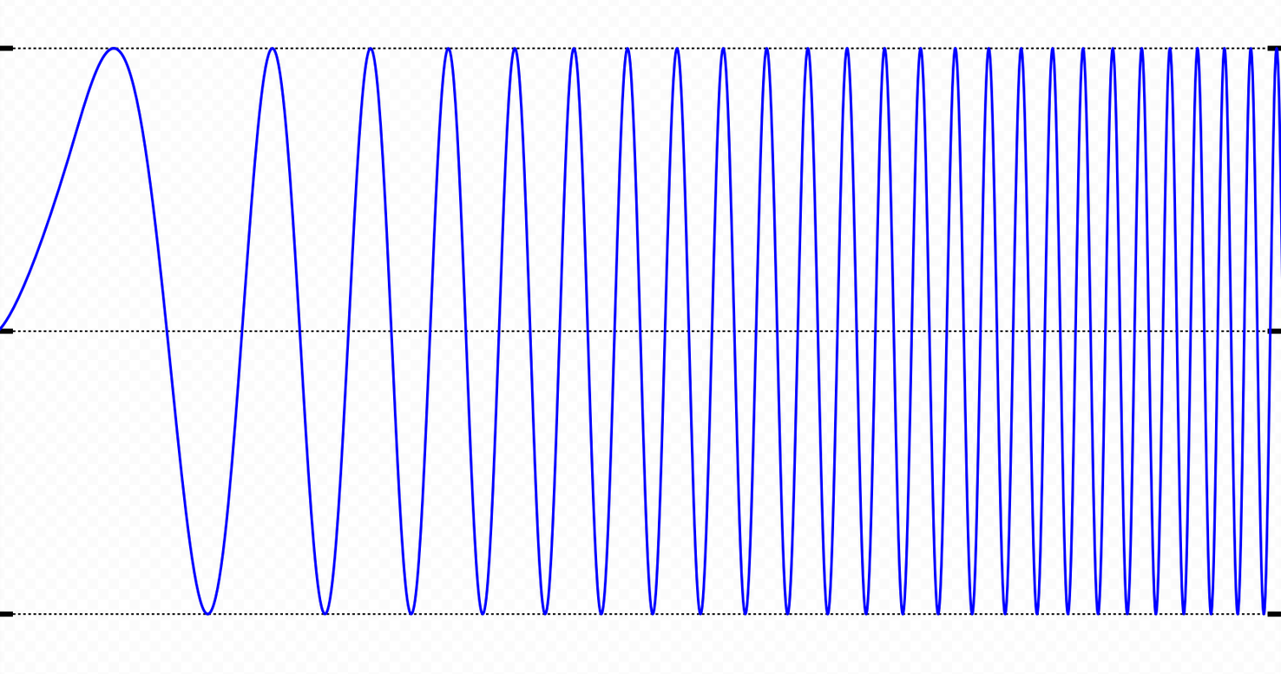
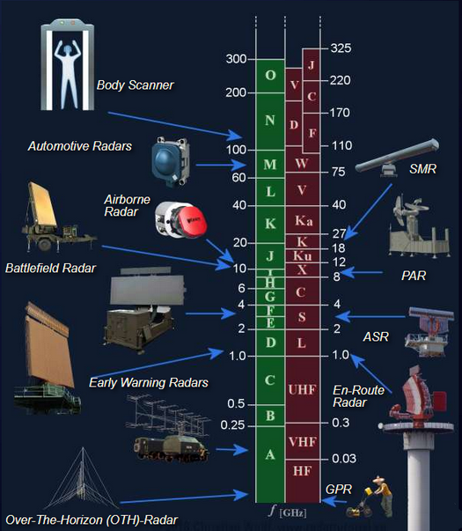
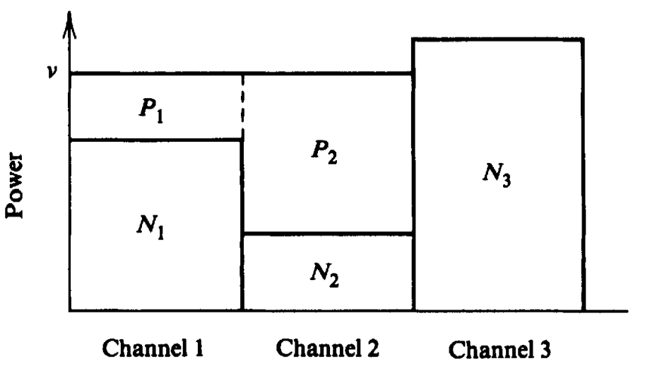

DRT And ST in Practical ISAC Systems
ST: Subspace tradeoff —>communication subspace and sensing subspace
DRT: Determination and randomness tradeoff

Slide 14

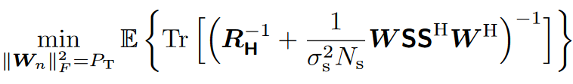
DRT: Sensing with Random Signals
Tools: Linear minimum MSE (LMMSE) estimator
· In precoding design the water-filling solution may not be optimal due to the randomness
Proposed 2 methods:
· Data-dependent design
Solve
· Data independent design
Solve
closed-form solution
SGD

Slide 15
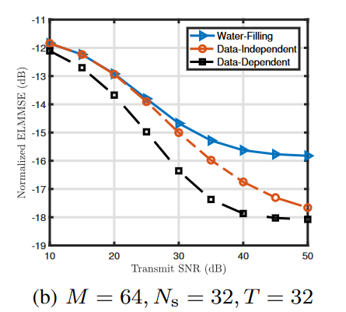
DRT: Sensing with Random Signals
Data-dependent design
· Pros: Low LMMSE error
· Cons: Huge cost in computation
Data-independent design
· Pros: Easy to compute
· Cons: Inferior performance (than data-dependent design)

Slide 16

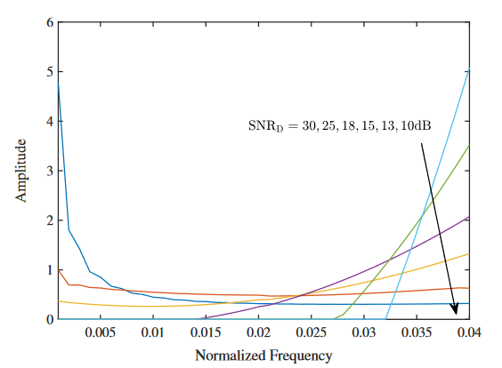
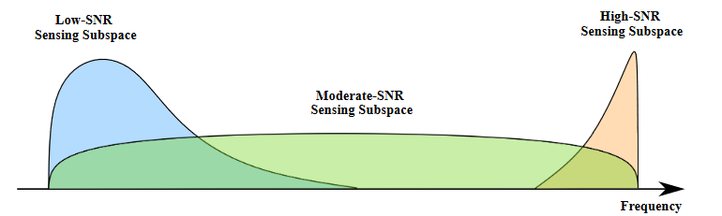
Frequency-domain ST: Valuating Sensing Resources
Tools: Ziv-Zakai bound (ZZB) to mesure MSE
Numerically computed PSDs of ZZB optimal waveforms in different SNRs

Slide 17
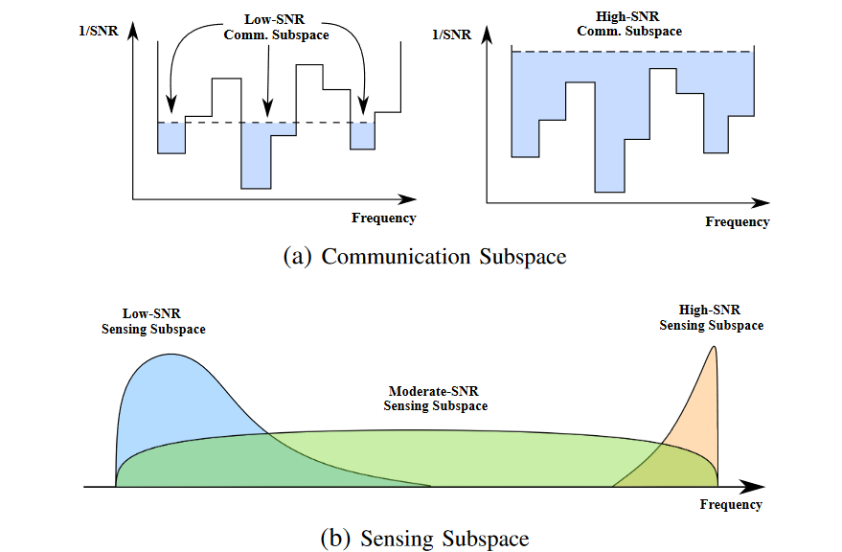
Frequency-domain ST: Different strategies in SNRs

Slide 18
Sum up to this paper
· Theoretical analysis
· Tradeoffs faced in ISAC being further clarified
· Designs to balance these tradeoffs might be the keys in future ISAC employment
· Lots of problems remaining to be solved

