Slide 1
OFDMA Transmission
OFDMA = Orthogonal Frequency-Division Multiple-Access
  Both modulation method (OFDM) and multiple-access method useful for broadband wireless communications which exhibit time-dispersion (multipath)
  Provides efficient (low-cost) transceiver structures based on FFT front-end processing when combined with a cyclic prefix
  Relatively simple high-performance channel estimation
  Optimal matched filtering due to orthogonalization of dispersive channel
Downside
  High peak-to-average power ratio
EURECOM - Digicom 2020 - OFDM overview

Slide 2





Blockwise Transmission with a Cyclic Prefix
OFDM symbol
samples
Information-bearing component -
samples
Cyclic-prefix :
samples
Cyclic-prefix chosen such that beginning and end of symbol are the same
i.e.
EURECOM - Digicom 2020 - OFDM overview

Slide 3
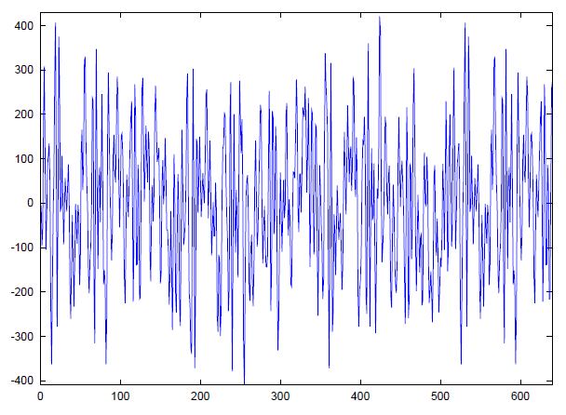
Blockwise Transmission with a Cyclic Prefix
PREFIX
(128)
INFORMATION
(512)
EURECOM - Digicom 2020 - OFDM overview

Slide 4
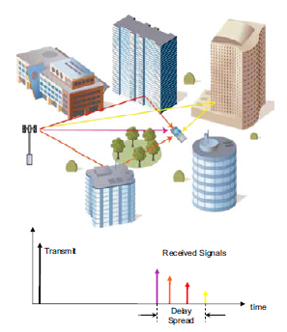
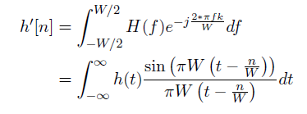
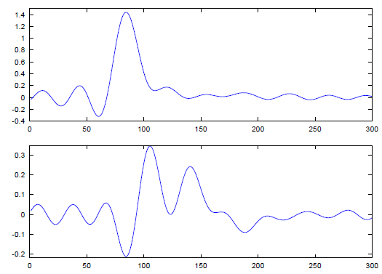

Multipath Propagation
Discrete-time channel seen by RX
EURECOM - Digicom 2020 - OFDM overview

Slide 5
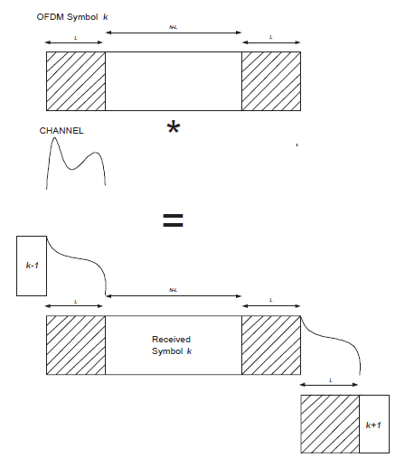
Multipath propagation
Cyclic prefix allows for block orthogonality if delay-spread of channel is shorter than L samples
Signal energy in prefix is neglected by receiver
Useful portion for RX,
energy from symbol k
only
EURECOM - Digicom 2020 - OFDM overview

Slide 6




Frequency-Domain Representation
In the frequency-domain, channel is completely orthogonalized due to cyclic prefix, for strictly time-limited channel (approximately true)
RX signal
noise
Circulant Convolution
EURECOM - Digicom 2020 - OFDM overview

Slide 7















Frequency-Domain Representation
EURECOM - Digicom 2020 - OFDM overview

Slide 8
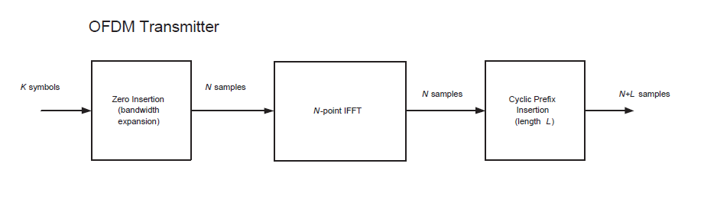


OFDM
Spectral
shaping
-ve freq
Is taken from a QAM alphabet
Null carriers
+ve freq
DC
EURECOM - Digicom 2020 - OFDM overview

Slide 9
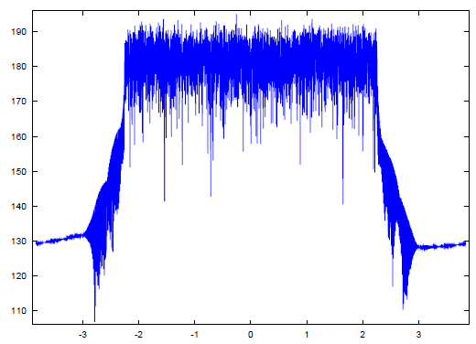
Typical OFDM Spectrum
(LTE 5MHz, with additional low-pass filter)
DC Null
4.515 MHz = (301/512)*7.68MHz
EURECOM - Digicom 2020 - OFDM overview

Slide 10
SC-FDMA
SC-FDMA is a single-carrier technique similar to OFDM. A key distinguishing point with 802.16e/m for PHY-layer.
A form of “DFT-precoded” OFDM
  Signals are conceived in the time-domain and then converted to frequency domain, frequency-translated and converted back.
Main advantage, less peaky => more efficient power-amplifier in UE TX chain
Main disadvantage, less flexible (for advanced techniques) RX structure in eNb.
  Note: implementation losses due to SC-FDMA in eNb, may reduce power savings in UE (time will tell …)
EURECOM - Digicom 2020 - OFDM overview

Slide 11

SC-FDMA
K-point
FFT
Spectral
Shaping +
Frequency
translation
-ve freq
Null carriers
+ve freq
Is taken from a QAM alphabet
DC
EURECOM - Digicom 2020 - OFDM overview

Slide 12
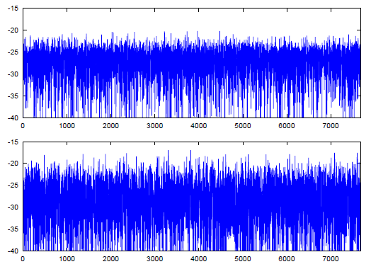
Peak-to-Average-Power Ratio Comparison
- 300 QPSK carriers (REs), 512 point IFFT
Squared Signal amplitude (dB)
6.2 dB (SC-FDMA,
LTE)
9.49 dB (OFDMA,
WiMAX)
EURECOM - Digicom 2020 - OFDM overview

Slide 13
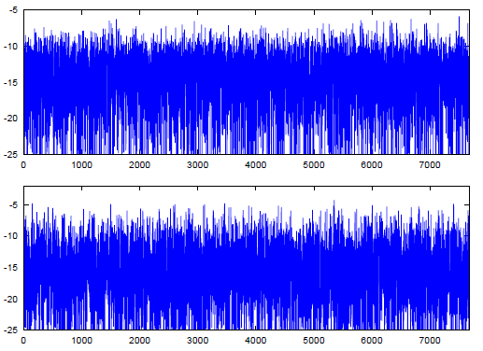
Peak-to-Average-Power Ratio Comparison
- 300 64QAM carriers (REs), 512 point IFFT
8.1 dB
10.7 dB
Smaller difference with 64QAM -> implementation loss due to sub-optimal eNb receiver will hurt more
EURECOM - Digicom 2020 - OFDM overview

Slide 14
OFDM (single-antenna) Inner Receiver (UE)
I[n]
Prefix
Extraction
FFT
I[k]
Channel
Compen-
sation
I[k]
LLR
Unit
Digital
Baseband
Inputs
Q[n]
Q[k]
Q[k]
BroadbandChannel
Estimates
Pilot
extraction
To timing (DAQ) and frequency correction units, and I/Q imbalance
Channel
Estimation
EURECOM - Digicom 2020 - OFDM overview

Slide 15



Channel Compensation
  Receiver sees
  Gets channel estimate
Estimation error
  Under perfect estimate, sufficient statistics for decoding would be
Scaled Signal
Component
Signal dependent
Noise term
  Along with
EURECOM - Digicom 2020 - OFDM overview

Slide 16
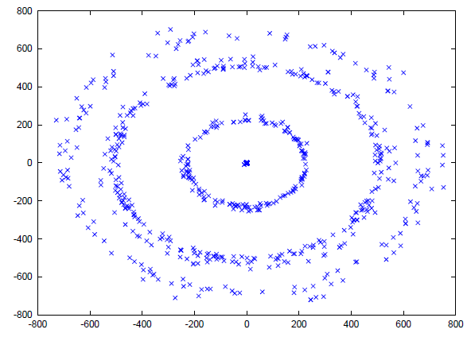
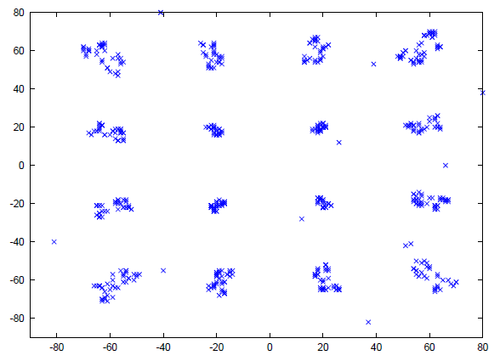
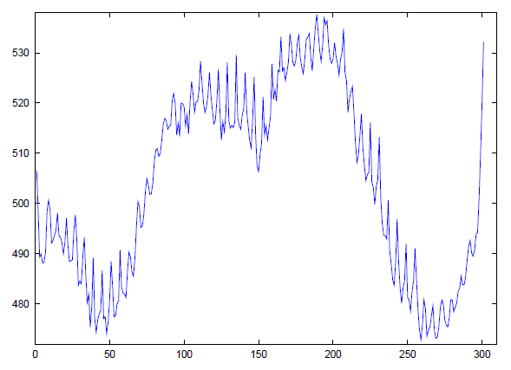
Channel Compensation (16QAM, 300 carriers)
At FFT output
After Channel compensation
Fairly “flat” channel (linear phase) after
channel estimation
EURECOM - Digicom 2020 - OFDM overview

Slide 17
Lab Session 2
Objective
  Perform full OFDM demodulation of SSS (Secondary Synchronization Signal)
    Cyclic prefix extraction and frequency-domain translation
    Channel Estimation using PSS
    Data detection (Maximum-Likelihood)
Introduction to NR Framing first …
EURECOM - Digicom 2020 - OFDM overview

Slide 18
Basic terms
gNodeB/gNB = basestations
UE = User equipment terminal
DL = Downlink
UL = Uplink
EURECOM - Digicom 2020 - OFDM overview

Slide 19
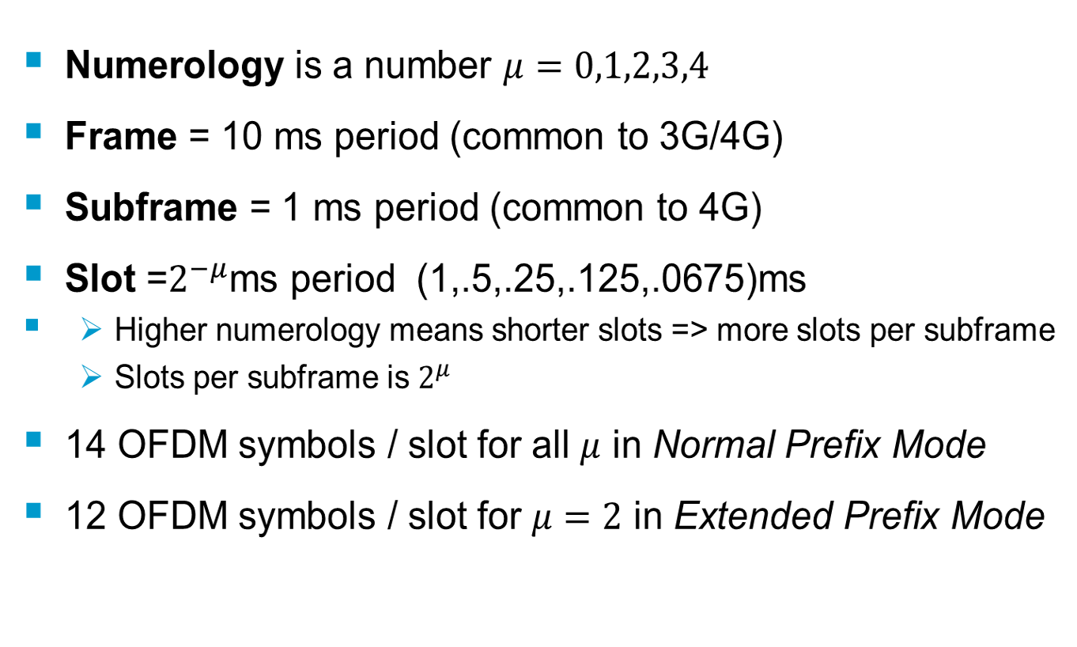
Frames, subframes, slots
EURECOM - Digicom 2020 - OFDM overview

Slide 20
Sub-frame and Frame
One frame = T_{f} =307200T_{s} = 10ms
T_{slot}= 15360T_{s}=500μs (here μ=1)
0
1
2
3
18
19
One subframe
Normal Prefix
Frequency
Domain
View
Here 14
OFDM
Symbols/slot
Extended Prefix
Time-domain
View
EURECOM - Digicom 2020 - OFDM overview

Slide 21
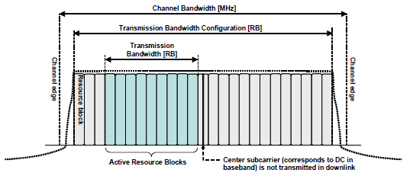
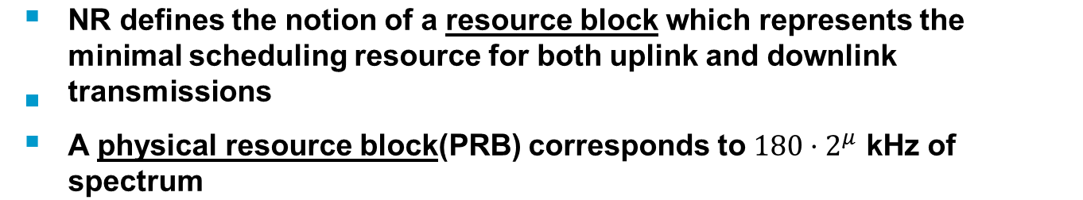
Resource blocks
EURECOM - Digicom 2020 - OFDM overview

Slide 22
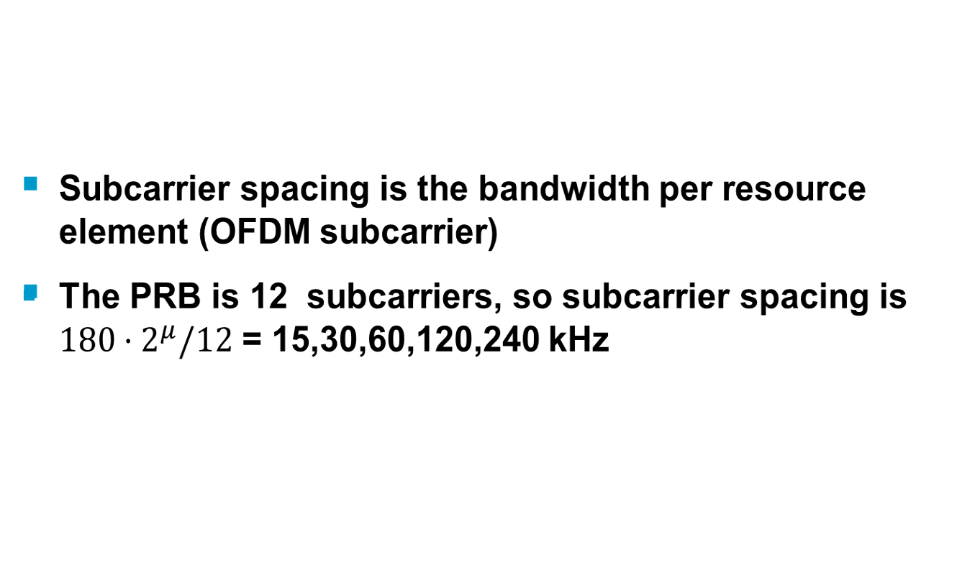
Subcarrier Spacing (SCS)
EURECOM - Digicom 2020 - OFDM overview

Slide 23
Common PRB Formats
Channel Bandwidth /SCS | Number PRB | Typical IDFT size (N) | Number of Non-Zero Sub-carriers (REs) (K) | Bandwidth
100MHz/30kHz | 273 | 4096 | 3276 | 98.28 MHz
100MHz/120kHz | 66 | 1024 | 792 | 95.04MHz
10MHz/15kHz | 52 | 1024 | 624 | 9.36 MHz
40MHz/30kHz | 106 | 1536 or 2048 | 1272 | 38.16 MHz
50MHz/30kHz | 133 | 2048 | 1596 | 47.88 MHz
PRBs are mapped onto contiguous OFDMA/SC-FDMA symbols in the time-domain with starting symbol in (1…14) and can have any length in (2…14). PRBs can be aggregated across slots when using repetitions
Each PRB is chosen to be equivalent to 12 sub-carriers of an OFDMA symbol in the frequency-domain
OFDMA/SC-FDMA Sub-carriers are termed “Resource Elements” (RE)
high-frequencies are nulled
  Spectral shaping
  Half the bandwidth loss w.r.t. WCDMA (22%)
EURECOM - Digicom 2020 - OFDM overview

Slide 24

Basic OFDM Transmission
DL is regular OFDM
UL can have a transform precoder (SC-FDMA), this is UE-specific and even physical channel specific
EURECOM - Digicom 2020 - OFDM overview

Slide 25
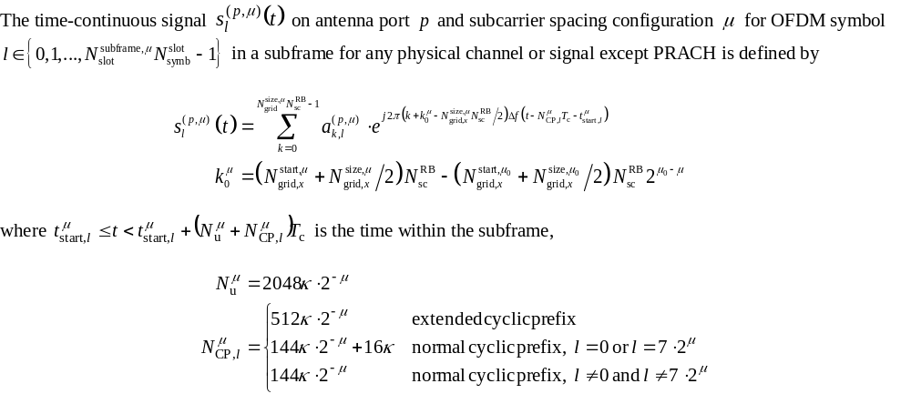
OFDM Waveform (except PRACH)
EURECOM - Digicom 2020 - OFDM overview

Slide 26
Synchronization Channels and PBCH Block
Used in standalone and non-standalone
Usually coincides with the initial BWP
A UE finds the gNodeB by detecting the “Synchronization” Channels
  Primary synchronization (PSS) channel gives initial timing and frequency measurements
  Secondary synchronization (SSS) channel gives additional frequency measurements and carries a small payload which conveys the “physical cell identifier”
Once timing/frequency/cell id are hypothesized
  Detection of PBCH => first real amount of System Information (MIB) for the network (a piece of the particular gNB configuration in standalone mode, just time information frame/slot in non-standalone)
EURECOM - Digicom 2020 - OFDM overview

Slide 27
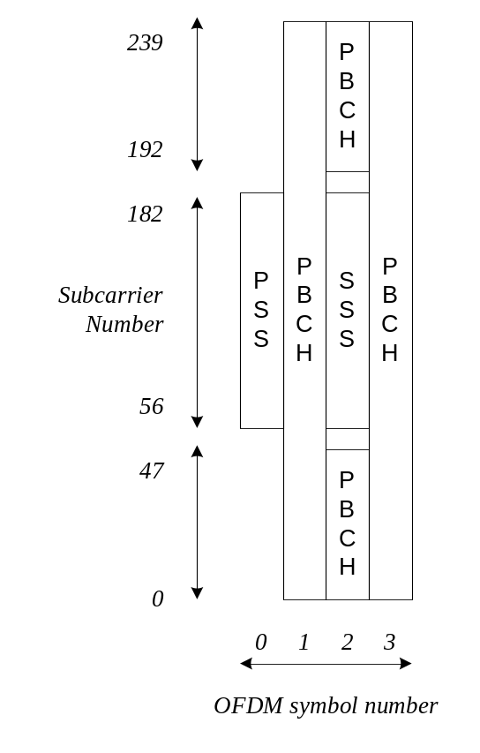
SSB allocations
Contains 4 signals
  PSS,SSS, PBCH, PBCH DMRS
  Over 4 symbols
  240 resource elements (20 PRBs)
This occurs in particular symbols in the first few slots of the first half-frame and repeats each frame
  Each SSB is mapped to a particular beam index
  A UE will try to measure multiple SSBs
EURECOM - Digicom 2020 - OFDM overview

Slide 28
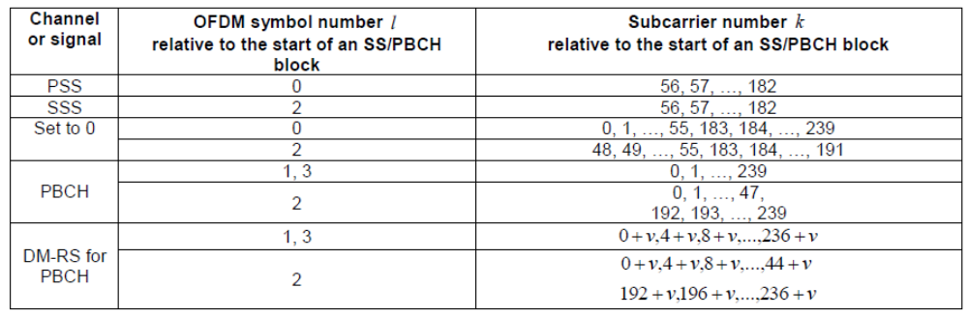
SSB time/frequency allocations
EURECOM - Digicom 2020 - OFDM overview

Slide 29
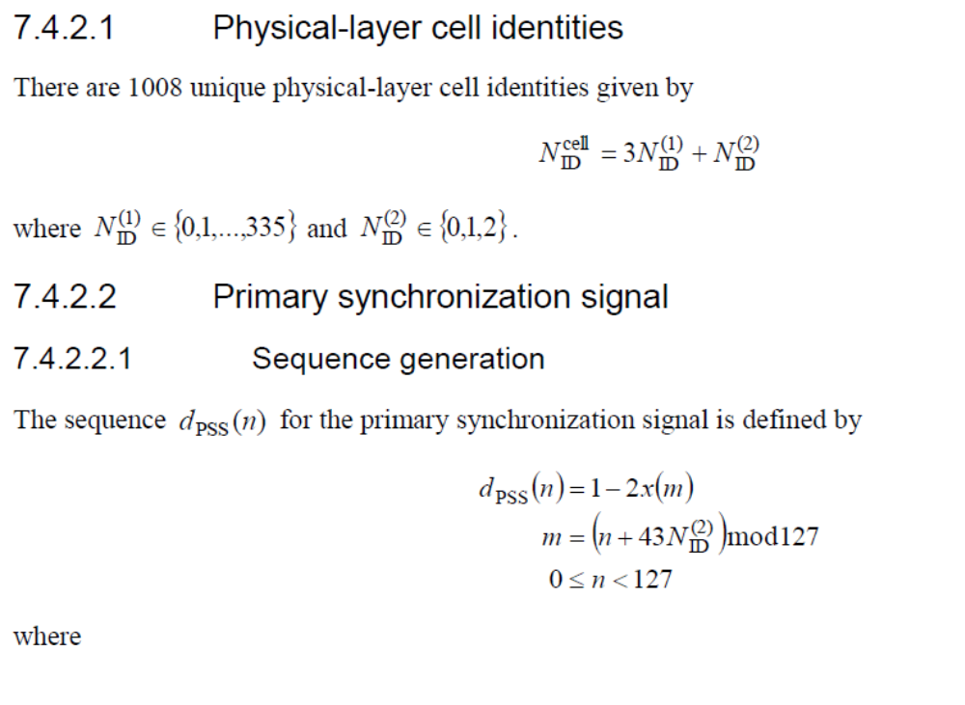
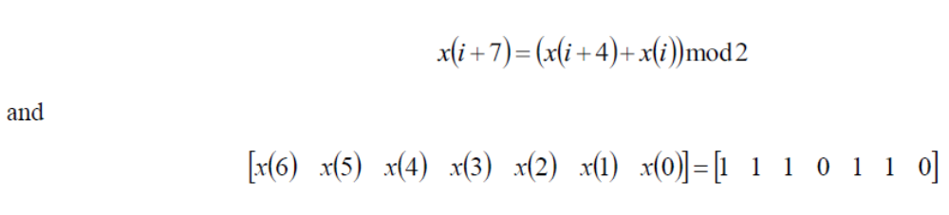
PSS Generation
EURECOM - Digicom 2020 - OFDM overview

Slide 30
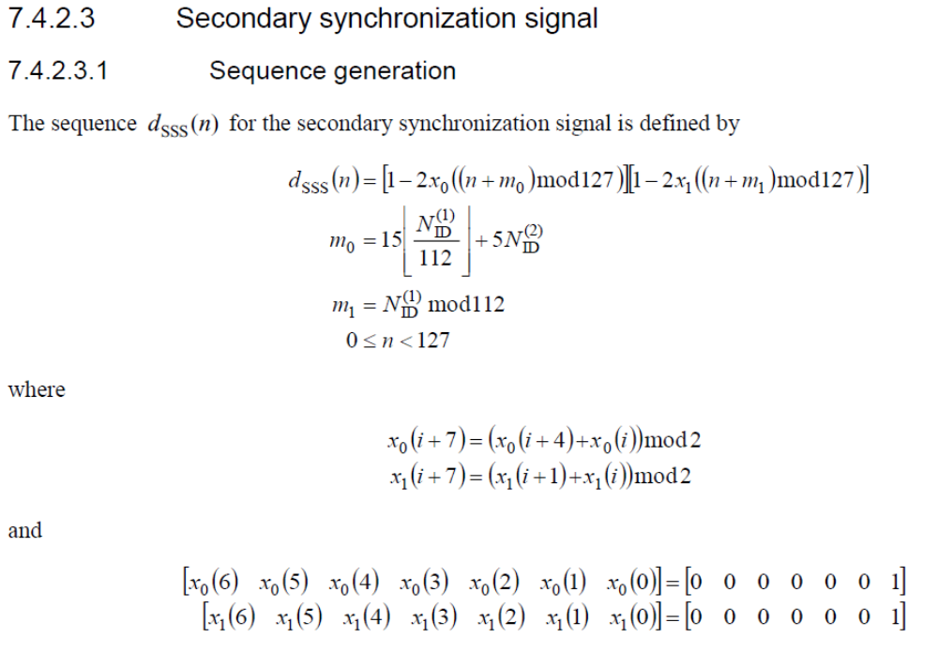
SSS Generation
EURECOM - Digicom 2020 - OFDM overview

Slide 31
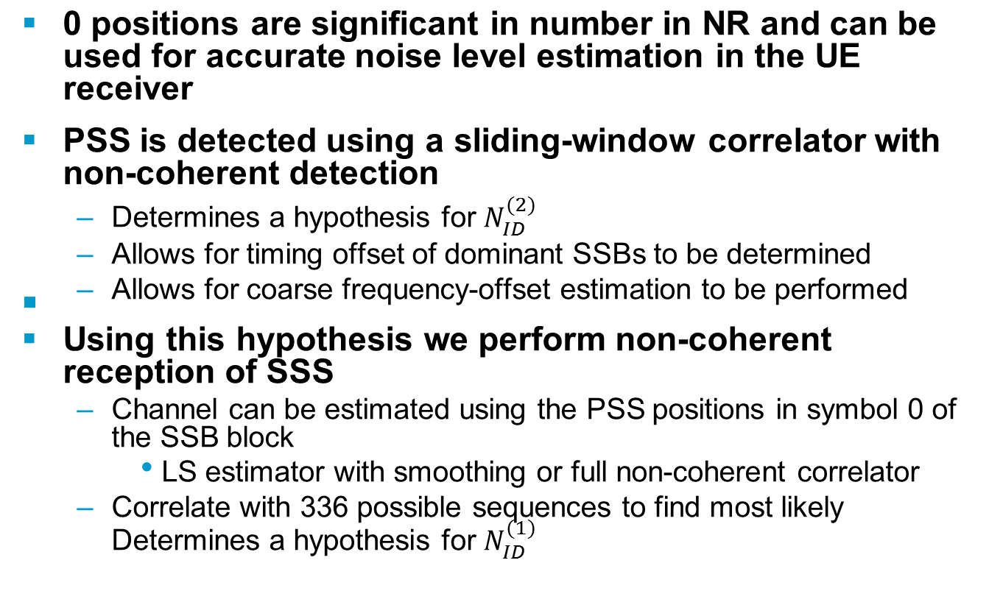
Notes on detection/estimation of PSS/SSS
EURECOM - Digicom 2020 - OFDM overview

Slide 32
Part 3: Uplink Example - PRACH
Our third exercise will deal with a particular OFDM signal used in the Uplink of 4G and 5G systems.
It is a M-ary signaling strategy that is fundamental to the connectivity of a 4G/5G terminal
EURECOM - Digicom 2020 - OFDM overview

Slide 33
5G Random-Access Procedures
During association PHY is responsible for transmission of the “Random access preamble” on a channel known as the PRACH (Physical Random Access Channel).
  Number in 0..63 chosen by UE (or by the gNodeB in “non-standalone” mode
  This is a form of orthogonal transmission
    Pulse-position modulation via a cyclic-shift and quasi-orthogonal sequences
      Extreme case (tiny cell): 1 sequence and 64 shifts
      Extreme case (huge cell): 64 sequences without a shift
      Typically we choose the number of shifts according to the size of the cell
    Remains orthogonal if the time-delay of the channel between UE and gNodeB is less than length of the cyclic-shift
      Bigger cells use longer shifts
PRACH comprises
  A (small) number of RBs in one or a set of consecutive slots reserved for random-access preambles
  A longer cyclic prefix
Main objectives
  Conveying the 6-bit payload
  Allowing the gNodeB to estimate the timing delay so it can correct it in the subsequent downlink message
EURECOM - Digicom 2020 - OFDM overview

Slide 34
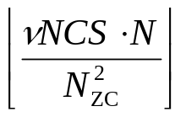
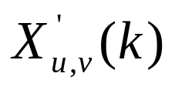
PRACH Transmitter
Preamble index from MAC (0…63) and rootSequenceIndex (1…838) from RRC prachConfigCommon OR
RRC mobilityControlInfo (during handover)
NCS from from RRC prachConfigCommon, indicates length of smallest cyclic shift
N-point
IDFT
Frequency-domain transform of
ZC-preamble sequence and
frequency-shifted according to
RRC parameter in prachConfigCommon
Cyclic shift
Cyclic prefix
N (format 0-3)
6144 (5 MHz,7.68 Ms/s)
12288 (10 MHz, 15.36 Ms.s)
24576 (20 MHz, 30.72 Ms/s)
49152 (40-50 MHz, 61.44 Ms/s)
98304 (80-100 MHz, 122.88 Ms/s)
N_{cp} (format 0)
(3168/4,7.68 Ms/s)
(3168/2, 15.36 Ms.s)
(3168, 30.72 Ms/s)
(3168*2, 61.44 Ms/s)
(3168*4, 122.88 Ms/s)
EURECOM - Digicom 2020 - OFDM overview

Slide 35
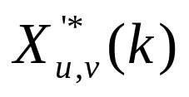

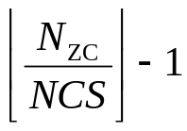
PRACH Receiver (once per rootSequenceIndex)
Remove prefix and
Then N-point
DFT
(according to sizes before)
1024-point
IDFT
Preamble
Detector
(non-coherent)
x
0
2
1
Signal
Presence
Indicates
Preamble is active
Time-offset in cyclic shift window is used to determine Timing advance for UE
Tradeoff between eNB PRACH detection procedure and maximum cell radius => many cyclic shifts = short timing offset tolerance
EURECOM - Digicom 2020 - OFDM overview
Notes:
r

Slide 36
What we will do together (next time)
I will build and give a 61.44 Ms/s PRACH uplink signal
  NCS (or number of cyclic shifts) will be known
  Set of preamble sequences will be known
Implement the OFDM prach receiver
  DFT, correlation, IDFT
Implement the detection/estimation
  Preamble index
  Timing delay
EURECOM - Digicom 2020 - OFDM overview

Slide 37
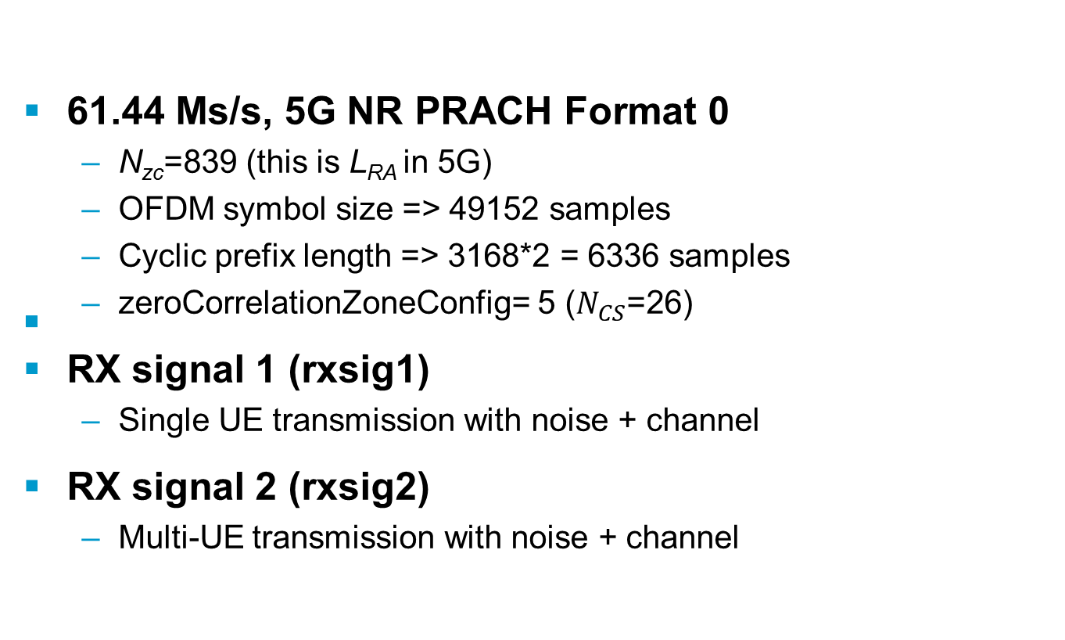
Two signals
EURECOM - Digicom 2020 - OFDM overview

Slide 38
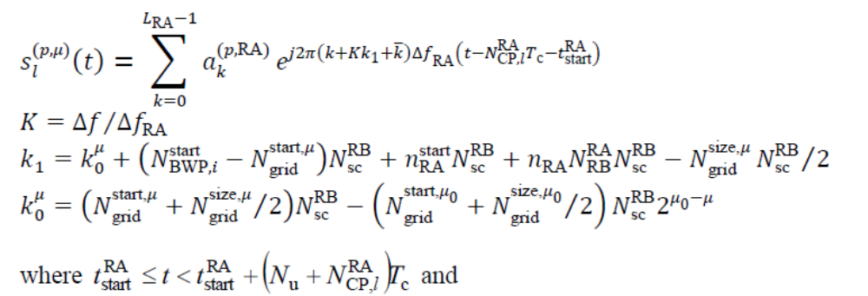
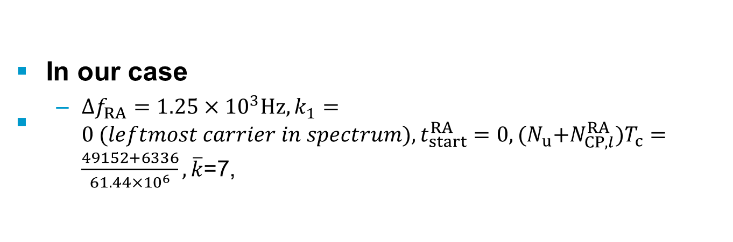
Details of PRACH waveform(1)
EURECOM - Digicom 2020 - OFDM overview

Slide 39
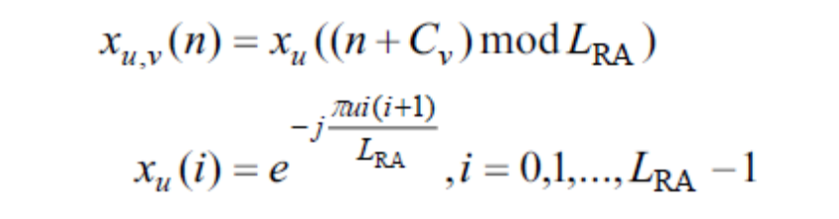
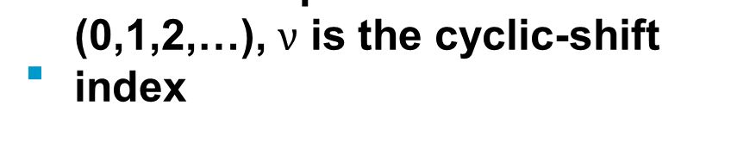
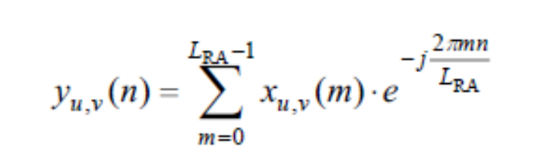
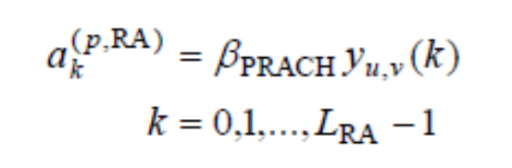
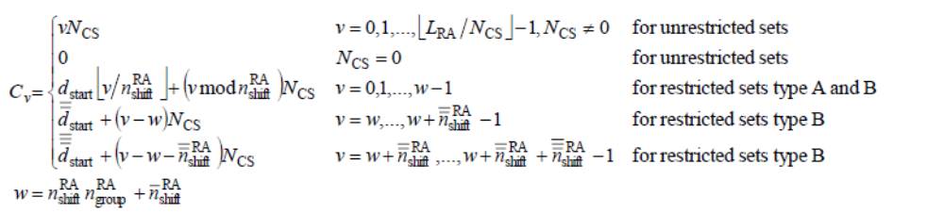
Details of PRACH waveform (2)
EURECOM - Digicom 2020 - OFDM overview

Slide 40
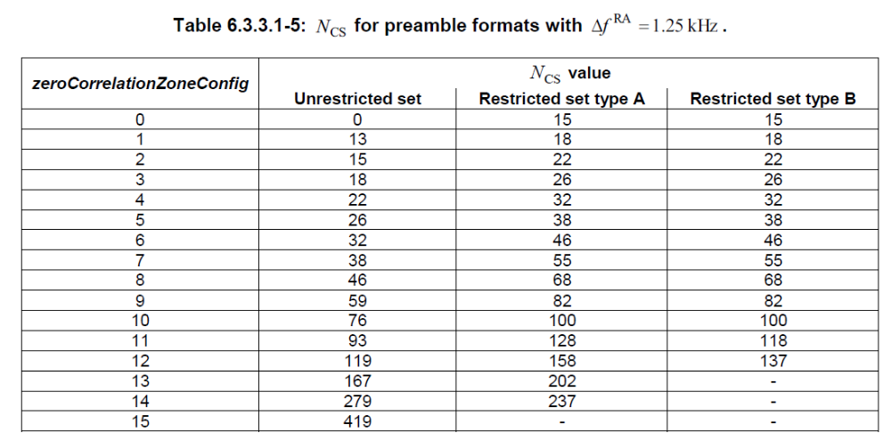
Details of PRACH Waveform (3)
EURECOM - Digicom 2020 - OFDM overview

Slide 41
Introduction to Lab Session 4
The 4th lab session will consider a coded OFDM waveform which is used for the 5G NR PUCCH format 3 transmission
There are 2 basic configurations
  Block-coded (Reed-Muller) for 3-11 bit payload
  Block-coded (Polar Code) for 12-~1000 bits
The transmission uses 4-14 symbols with 2 or 4 demodulation reference signals (pilots) in 1-15 physical resource blocks (PRBs)
We will consider the 3-11 bit case only this year
EURECOM - Digicom 2020 - OFDM overview

Slide 42
Transmission chain
Binary
Channel
Code
+
rate matching
E bits
Resource
mapping
DFT
Precoding
(for symbols
without DMRS)
OFDM
modulation
K bits
N_{RE}
REs
K is 3-11 bits in this case
E depends on the number of PRBs, modulation (BPSK or QPSK) and symbols
EURECOM - Digicom 2020 - OFDM overview

Slide 43
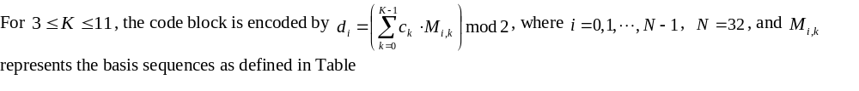
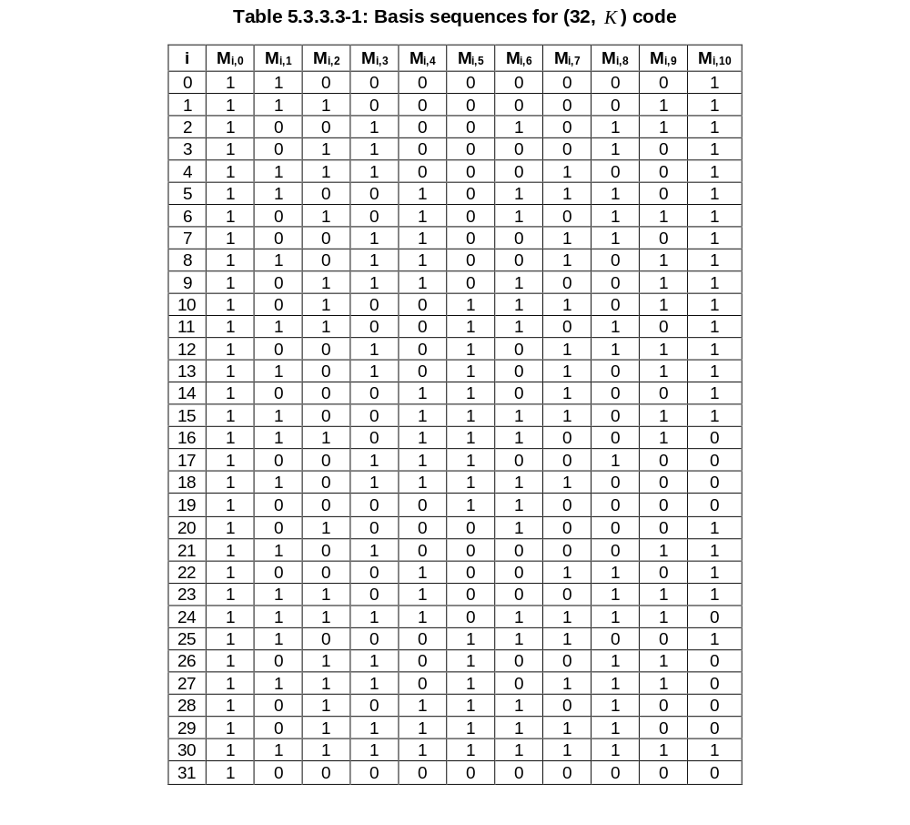
Channel Coding and Rate Matching
It turns out that this is a classic (N,K) block code called a Reed-Muller code where the block length N is 32. The information bitwidth is K (3-11 bits) and the number of code sequences to is 2^{K}
EURECOM - Digicom 2020 - OFDM overview

Slide 44
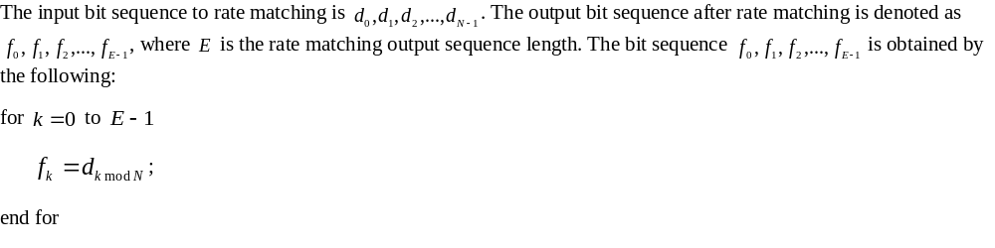
Channel Coding and Rate Matching
Rate matching in this case is simply repetition. We repeat the N output bits of the channel code circularly to the output buffer f
EURECOM - Digicom 2020 - OFDM overview

Slide 45
Resource Mapping
The purpose of resource mapping is to
  convert the sequence of E bits (f) to modulated symbols
  Insert the DMRS symbols to allow for non-coherent reception/channel estimation
Modulation can be done for so-called π/2-BPSK or QPSK. We will use π/2-BPSK which is a format that reduces the so-called peak-to-average power ratio
The total number of symbols is can be 4-14 and PRBs 1-15. We will use 14 symbols and 1 PRB, which is the most common format.
The DMRS occupy the whole set of resource elements of the allocation and we will try with both 2 and 4 DMRS configurations in this lab session
The DMRS are QPSK frequency domain sequences which have low peak-to-average power ratio (PAPR)
EURECOM - Digicom 2020 - OFDM overview

Slide 46
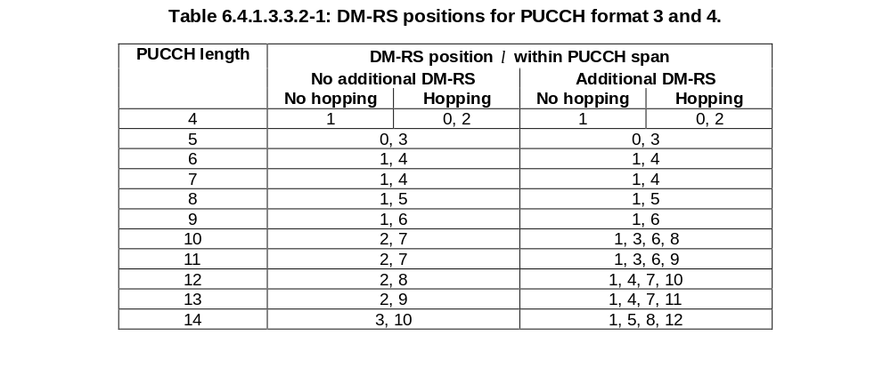
DMRS symbols
The DMRS symbols are distributed in each half of the transmission uniformly in time and occupy all frequency resources
The are 2 halves because frequency-hopping can be used so that each half of the transmitted waveform is transmitted on opposite ends of the spectrum
EURECOM - Digicom 2020 - OFDM overview

Slide 47
General resource mapping picture
2 DMRS symbols,
14 total symbols
Frequency hopping
Maximal frequency
separation for diversity
4 DMRS symbols
14 total symbols,
Frequency hopping
PUCCH DMRS
EURECOM - Digicom 2020 - OFDM overview

Slide 48
Computing E
If N_{RB} is the number of PRBs, S is the number of symbols and S_{DMRS} is the number of DMRS symbols, then the number of Resource Elements is N_{RE} = 12(S - S_{DMRS})
so for S=14, S_{DMRS} =2 and N_{RB} =1, we have N_{RE} = 12*12 = 144
This means that E = 144 for π/2-BPSK and E=288 for QPSK
Question 1: Explain these calculation
EURECOM - Digicom 2020 - OFDM overview

Slide 49
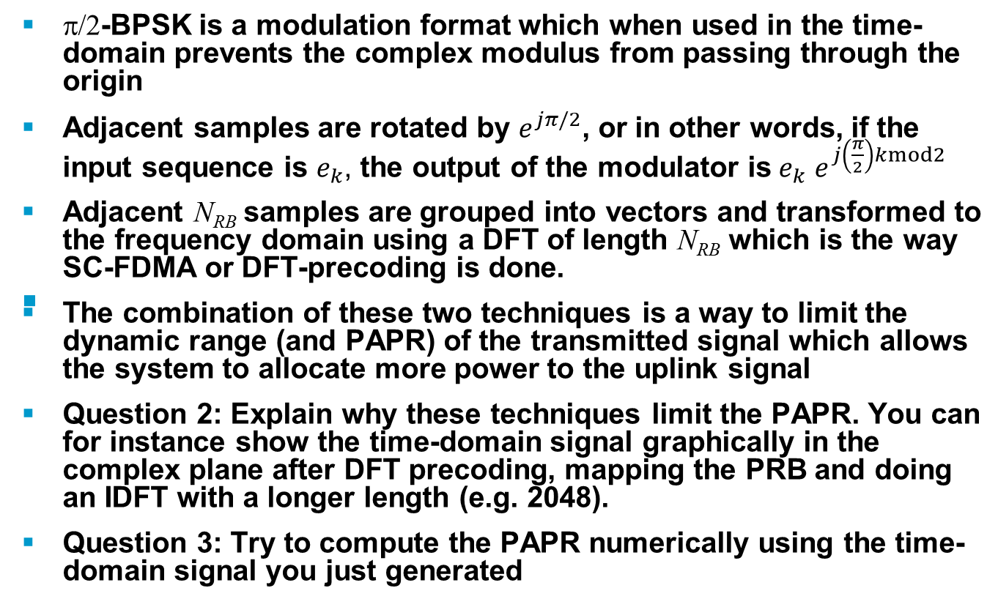
π/2-BPSK and DFT-precoding (SC-FDMA)
EURECOM - Digicom 2020 - OFDM overview

Slide 50
Remainder of the lab session
We will build the transmitter together
Question 4: Derive the ML receiver using DMRS as known signals at the receiver
Question 5: How is this receiver related to the coherent receiver with channel estimation (Lab session 2)
Question 6: How do this change with frequency-hopping (think about the ML receiver with 2 different channel realizations)
EURECOM - Digicom 2020 - OFDM overview

