Slide 1
OFDM Tx/Rx chain and detection challenges
Mr. Dmitry Pyatkov (dpyatkov@sequans.com), 4G Algo TechLead Dr. Elena Lukashova (elukashova@sequans.com) , 5G Algo TechLead
Guest lecturers of Professor Florian Kaltenberger as part of the Eurecom course “Radio Engineering”.
Sophia Antipolis, 17th of May 2024

Slide 2

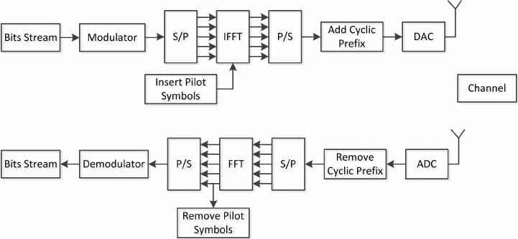
a Typical OFDM Receiver

Slide 3
Main Challenges of Transmission
Attenuation and signal loss
What are the main factors?
Multipath Fading and Interference
What are the main factors?
Mobility and roaming issues
What are the main factors?
Limited coverage
What are the main factors?

Slide 4
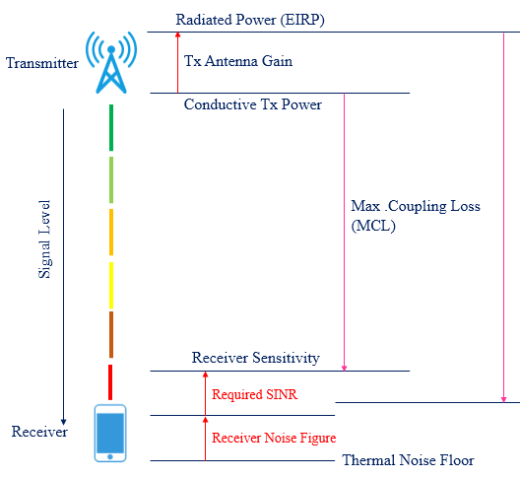
Coverage enhancement
How can we increase the coverage (minimize MCL)?
TTI bundling
Code spreading
Your suggestions?

Slide 5
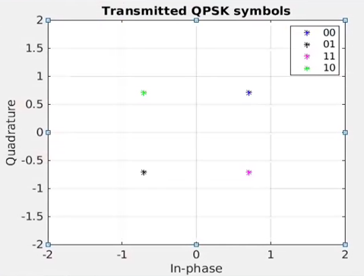
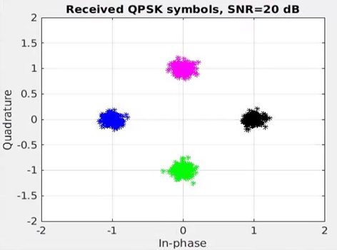
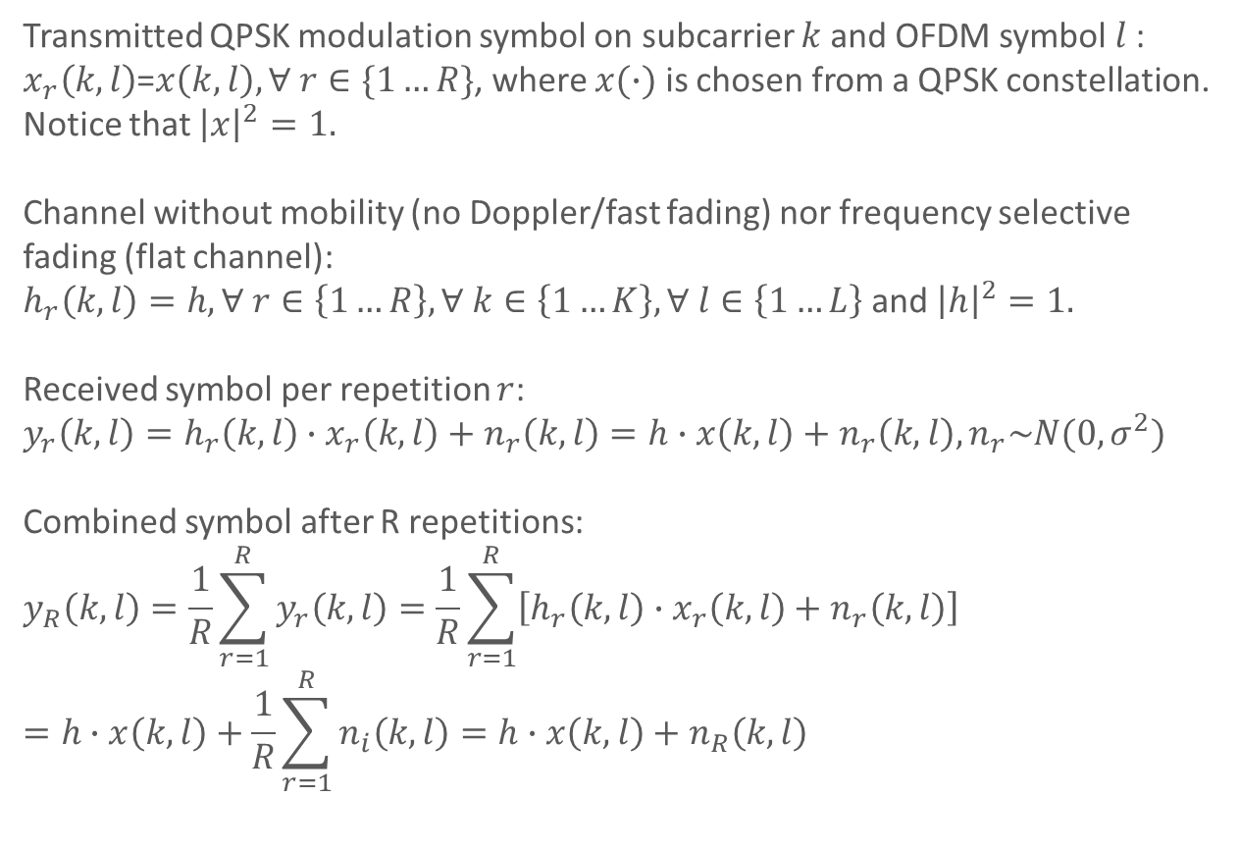
Coverage enhancement
Transmitted QPSK modulation symbol on subcarrier $k$and OFDM symbol $l$:
$x_{r}\left(k,l\right)$=$x\left(k,l\right), ∀ r∈\{1…R\}$, where $x(∙)$ is chosen from a QPSK constellation. Notice that ${\left|x\right|}^{2}=1.$
Channel without mobility (no Doppler/fast fading) nor frequency selective fading (flat channel):
$h_{r}\left(k,l\right)=h, ∀ r∈\left\{1…R\right\},∀ k∈\left\{1…K\right\},∀ l∈\left\{1…L\right\}$ and ${\left|h\right|}^{2}=1.$
Received symbol per repetition $r$:
$$y_{r}\left(k,l\right)=h_{r}\left(k,l\right)∙x_{r}\left(k,l\right)+n_{r}\left(k,l\right)=h∙x\left(k,l\right)+n_{r}\left(k,l\right),n_{r}\sim N(0, σ^{2})$$
Combined symbol after R repetitions:
$$y_{R}\left(k,l\right)=\frac{1}{R}\sum_{r=1}^{R}{y_{r}\left(k,l\right)}=\frac{1}{R}\sum_{r=1}^{R}{\left[h_{r}\left(k,l\right)∙x_{r}\left(k,l\right)+n_{r}\left(k,l\right)\right]}=h∙x\left(k,l\right)+\frac{1}{R}\sum_{r=1}^{R}{n_{i}\left(k,l\right)}=h∙x\left(k,l\right)+n_{R}\left(k,l\right)$$

Slide 6
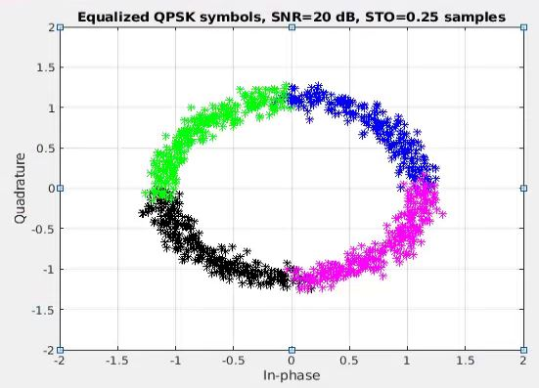
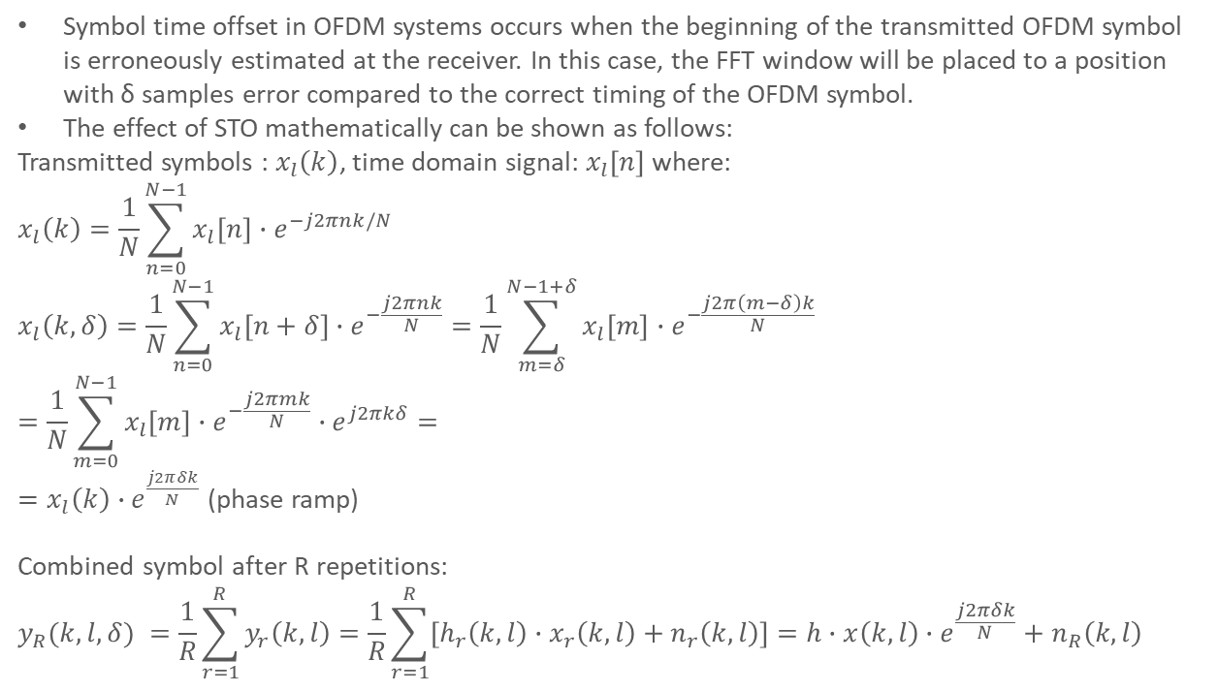
Effect of Symbol Time Offset (STO)
Symbol time offset in OFDM systems occurs when the beginning of the transmitted OFDM symbol is erroneously estimated at the receiver. In this case, the FFT window will be placed to a position with δ samples error compared to the correct timing of the OFDM symbol.
The effect of STO mathematically can be shown as follows:
Transmitted symbols : $x_{l}\left(k\right)$, time domain signal: $x_{l}\left[n\right]$ where:
$$x_{l}\left(k\right)=\frac{1}{N}\sum_{n=0}^{N−1}{x_{l}[n]}∙e^{−j2πnk/N}$$
$$x_{l}\left(k,δ\right)=\frac{1}{N}\sum_{n=0}^{N−1}{x_{l}[n+δ]}∙e^{−\frac{j2πnk}{N}}=\frac{1}{N}\sum_{m=δ}^{N−1+δ}{x_{l}\left[m\right]}∙e^{−\frac{j2π\left(m−δ\right)k}{N}}=\frac{1}{N}\sum_{m=0}^{N−1}{x_{l}\left[m\right]}∙e^{−\frac{j2πmk}{N}}∙e^{j2πkδ}=$$
$=x_{l}\left(k\right)∙e^{\frac{j2πδk}{N}}$ (phase ramp)
$$\text{Combined} \text{symbol} \text{after} \text{R} \text{repetitions}\text{: }$$
$$y_{R}(k,l,δ) =\frac{1}{R}\sum_{r=1}^{R}{y_{r}\left(k,l\right)}=\frac{1}{R}\sum_{r=1}^{R}{\left[h_{r}\left(k,l\right)∙x_{r}\left(k,l\right)+n_{r}\left(k,l\right)\right]}=h∙x\left(k,l\right)∙e^{\frac{j2πδk}{N}}+n_{R}\left(k,l\right)$$

Slide 7
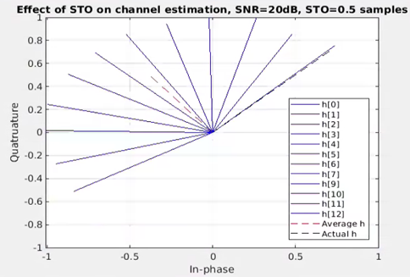
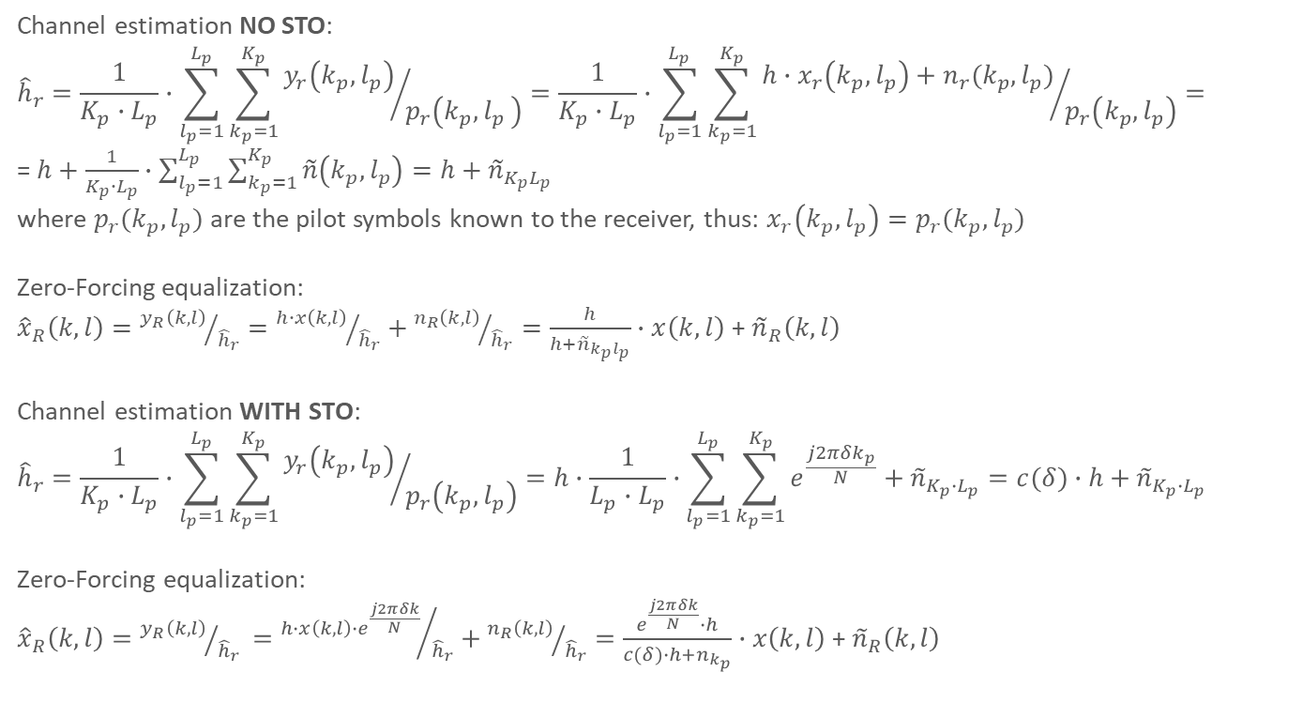
Channel Estimation and Equalization
Channel estimation NO STO:
$${\hat{h}}_{r}=\frac{1}{K_{p}∙L_{p}}∙\sum_{l_{p}=1}^{L_{p}}{\sum_{k_{p}=1}^{K_{p}}{{y_{r}\left(k_{p},l_{p}\right)}/{p_{r}\left(k_{p}{,l}_{p}\right)}=\frac{1}{K_{p}∙L_{p}}∙\sum_{l_{p}=1}^{L_{p}}{\sum_{k_{p}=1}^{K_{p}}{{h∙x_{r}\left(k_{p},l_{p}\right)+n_{r}(k_{p},l_{p})}/{p_{r}\left(k_{p},l_{p}\right)}}}}}=$$
= $h+\frac{1}{K_{p}∙L_{p}}∙\sum_{l_{p}=1}^{L_{p}}{\sum_{k_{p}=1}^{K_{p}}{\tilde{n}\left(k_{p},l_{p}\right)}}=h+{\tilde{n}}_{K_{p}L_{p}}$
where $p_{r}(k_{p},l_{p})$ are the pilot symbols known to the receiver, thus: ${x_{r}\left(k_{p},l_{p}\right)=p}_{r}(k_{p},l_{p})$
Zero-Forcing equalization:
${\hat{x}}_{R}\left(k,l\right)={y_{R}\left(k,l\right)}/{{\hat{h}}_{r}}={h∙x\left(k,l\right)}/{{\hat{h}}_{r}}+{n_{R}\left(k,l\right)}/{{\hat{h}}_{r}}=\frac{h}{h+{\tilde{n}}_{k_{p}l_{p}}}∙x\left(k,l\right)$ + ${\tilde{n}}_{R}\left(k,l\right)$
Channel estimation WITH STO:
$${\hat{h}}_{r}=\frac{1}{K_{p}∙L_{p}}∙\sum_{l_{p}=1}^{L_{p}}{\sum_{k_{p}=1}^{K_{p}}{{y_{r}\left(k_{p},l_{p}\right)}/{p_{r}\left(k_{p},l_{p}\right)}}}=h∙\frac{1}{L_{p}∙L_{p}}∙\sum_{l_{p}=1}^{L_{p}}{\sum_{k_{p}=1}^{K_{p}}{e^{\frac{j2πδk_{p}}{N}}}}+{\tilde{n}}_{K_{p}∙L_{p}}=c(δ)∙h+{\tilde{n}}_{K_{p}∙L_{p}}$$
Zero-Forcing equalization:
${\hat{x}}_{R}\left(k,l\right)={y_{R}\left(k,l\right)}/{{\hat{h}}_{r} }={h∙x\left(k,l\right)∙e^{\frac{j2πδk}{N}}}/{{\hat{h}}_{r}}+{n_{R}\left(k,l\right)}/{{\hat{h}}_{r}}=\frac{e^{\frac{j2πδk}{N}}∙h}{c(δ)∙h+n_{k_{p}}}∙x\left(k,l\right)$ + ${\tilde{n}}_{R}\left(k,l\right)$

Slide 8
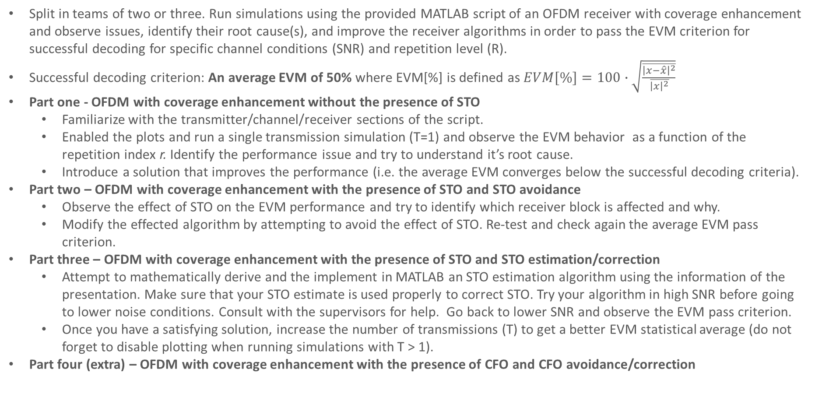
Lab Session
Split in teams of two or three. Run simulations using the provided MATLAB script of an OFDM receiver with coverage enhancement and observe issues, identify their root cause(s), and improve the receiver algorithms in order to pass the EVM criterion for successful decoding for specific channel conditions (SNR) and repetition level (R).
Successful decoding criterion: An average EVM of 50% where EVM[%] is defined as $EVM[\%]=100∙\sqrt{\frac{\overline{{\left|x−\hat{x}\right|}^{2}}}{\overline{{\left|x\right|}^{2}}}}$
Part one - OFDM with coverage enhancement without the presence of STO
Familiarize with the transmitter/channel/receiver sections of the script.
Enabled the plots and run a single transmission simulation (T=1) and observe the EVM behavior as a function of the repetition index r. Identify the performance issue and try to understand it’s root cause.
Introduce a solution that improves the performance (i.e. the average EVM converges below the successful decoding criteria).
Part two – OFDM with coverage enhancement with the presence of STO and STO avoidance
Observe the effect of STO on the EVM performance and try to identify which receiver block is affected and why.
Modify the effected algorithm by attempting to avoid the effect of STO. Re-test and check again the average EVM pass criterion.
Part three – OFDM with coverage enhancement with the presence of STO and STO estimation/correction
Attempt to mathematically derive and the implement in MATLAB an STO estimation algorithm using the information of the presentation. Make sure that your STO estimate is used properly to correct STO. Try your algorithm in high SNR before going to lower noise conditions. Consult with the supervisors for help. Go back to lower SNR and observe the EVM pass criterion.
Once you have a satisfying solution, increase the number of transmissions (T) to get a better EVM statistical average (do not forget to disable plotting when running simulations with T > 1).
Part four (extra) – OFDM with coverage enhancement with the presence of CFO and CFO avoidance/correction

