Slide 1



An Overview of Fronthaul Systems
Prof. Raymond KNOPP, EURECOM

Slide 2

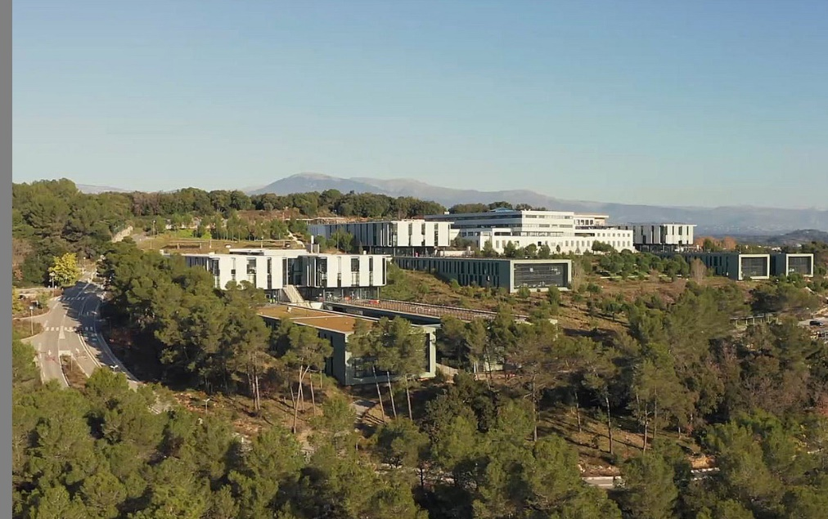
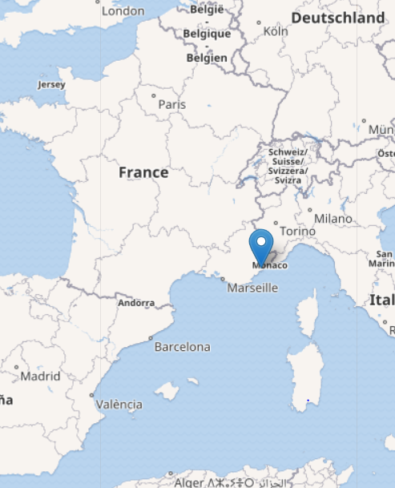
$ whoami
Raymond Knopp
Dept. Head Communication Systems @ EURECOM
President of the OpenAirInterface Software Alliance
Long-time SDR and RAN enthusiast

Slide 3
Outline
Part 1: High-level descriptions of SDRs when used as 3GPP radio-units
Fronthaul systems and protocols and associated challenges
Capabilities of off-the-shelf USRPs
Part 2: UHD and eCPRI
A look at UHD real-time interfacing for 5G NR
An ECPRI example (AW2S devices)
Part 3: Transitioning software radios like OAI to O-RAN Open Fronthaul Interface devices

Slide 4
Part 1 High-level descriptions of SDRs when used as 3GPP radio-units

Slide 5
Software-Defined Radio (SDR)
The canonical SDR is the National Instruments USRP (Universal Software Radio Peripheral)
Basic research tool for experimentation with radio-access network processing and protocols
Real-time interconnection of a PC-based application with a radio-frequency (RF) front-end
Many commonalities with current commercial radio-units
Similar RF chipsets (high-end USRPs like N3x0, X4x0)
FPGA logic making use of FPGA SoC (e.g. AMD-Xilinx Zynq Ultrascale)
Main differences with cellular industry-grade radio-units
Research focus
No built-in power circuits but wideband tuning
Different open-source fronthaul protocol (USRP Hardware Driver)
To make a USRP look like an eCPRI / O-RAN RRU, you need to either replace UHD or make a software wrapper which uses UHD under-the-hood (inefficient)

Slide 6
5G-capable USRPs
B210
USB3 interface
~40 MHz bandwidth (single antennas TX/RX)
Difficult to do MIMO above 10 MHz which is not really interesting for 5G
X300
1 or 2x10G PCIe, fronthaul interfaces
80 MHz bandwidth 2x2 MIMO
N300/N310
1 or 2x10 G fronthaul interface
100 MHz bandwidth 2x2 MIMO (RF impairments, high LO leakage)
60 MHz bandwidth 2x2 MIMO (N300), 4x4 MIMO (N310), (without impairments)
N320/N321
1 or 2x10G, 1x40 G fronthaul
2x2 MIMO 100 MHz without RF impairments (to be verified still)
2x2 MIMO 200 MHz with RF impairments (high LO leakage, to be verified still)
X410
Up to 100G fronthaul (or 10/25/40 G), in practice still 2x10G with UHD
4x4 MIMO up to 400 MHz without RF impairments (uses AMD-Xilinx RFSoC RF)

Slide 7
Why go beyond UHD support for experimentation
Often we need to build custom solutions for experimentation
USRP + custom RF power circuits
Need additional (real-time) interfacing to control external circuits
Need to calibrate combined solutions
Field-deployable and even outdoor solutions
This takes time and effort … off-the-shelf solutions exist
All-in-one radio-units (e.g. O-RU, CPRI or AW2S eCPRI) combine a UHD-like interface with high-power and field-deployable RF solutions
Usually limited to certain bands
sometimes require more complex synchronization and management protocols to function (e.g. PTP, netconf)

Slide 8
3GPP radio units are SDRs
Typical radio unit
Multi-channel RF front-end, amplification (power, low-noise), up/downconversion, A/D and D/A conversion
Digital processing (RF impairments, linearization, etc.)
for OFDM-tragetted frequency-domain devices, extra Fourier transforms and cyclic prefix handling (e.g. O-RAN Open Fronthaul 7.2 protocol)
real-time interfacing with baseband processing
Compression/Decompression
Control Plane Protocol (UHD control, ETSI ORI, ORAN FHI C-plane)
Packetization and transport
Packetization = radio protocol (UHD streamer, O-RAN Open Fronthaul U-plane, proprietary over eCPRI/CPRI)
Transport over standard bus protocol (e.g. USB3/C, PCIe)
Transport over Ethernet (ECPRI, CPRI,
Or a combination of both (PCIe + ECPRI, PCIe + CPRI )
Management protocol
Manual via telnet/ssh (e.g. USRP, AW2S)
Full management system via netconf (O-RAN RU)
Synchronization protocol/method

Slide 9
Example (AMD O-RAN IP for FPGA)
High Power/Low-noise
Front-end and
Duplexing

Slide 10
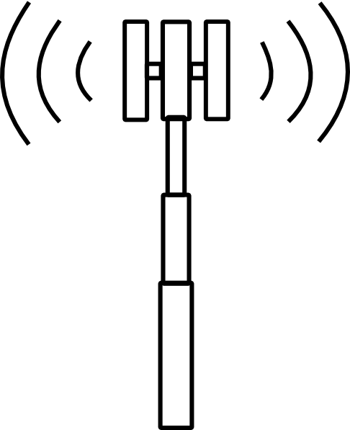
Fronthaul systems and protocols
Fronthaul = transport of radio signals over a network
Why ?
To allow distance between the baseband processing and the antenna (e.g. 10-10000m)
To allow for statistical multiplexing of multiple radio sites sharing common fiber links
To share processing between radio-units and baseband units
RRU
RRU
RRU
BBU (gNB-DU)
long distance
BBU (gNB-DU)
BBU (gNB-DU)
Central processing
location
Short distance

Slide 11
Fronthaul Systems and Protocols : Types
Types
Analog
Radio over Fiber (RoF) is used by some equipment vendors today
Modulate an RF or intermediate-frequency (IF) signal on an optical carrier
Can be efficient but will always be a proprietary solution
Can be good to minimize latency/costs
Digital
Packetize digitized signals at some point in the transceiver chain
Can reuse standard Ethernet equipment for radio
More flexible than analog solution (reuse existing fiber infrastructure, e.g. gPON)

Slide 12
Fronthaul Systems and Protocols : Types
Types of Digital Fronthaul Protocols
non-Ethernet based (CPRI)
CPRI is a partial non-3GPP specification (vendor-specific extensions)
Solely point-to-point
Good implementations in FPGA (e.g. AMD-Xilinx)
Usually coupled with PCIexpress on BBU side
Ethernet-based (eCPRI)
Raw or UDP
Also a partial non-3GPP specification (vendor-specific extensions)
Can be switched
For eCPRI, packetization (transport) can be as simple as fixed-rate time-domain I/Q samples or much more complex variable-rate frequency-domain signals (for OFDM/SC-FDMA waveforms)

Slide 13
Typical CPRI scenario
RRU/RE
PCIexpress
long distance
CPRI
CPRI Line
Card
(REC)
gNB
Central processing
location

Slide 14
eCPRI Specification
Developed by Ericsson, Huawei, NEC and Nokia
Meant to evolve P2P CPRI into a networked fronthaul
Does not specify but implies
Control and management
Synchronization
Clearly not meant to ensure any type of interoperability between vendors
Many vendor specific formats

Slide 15
eCPRI
RRU
/eRE
PCIexpress
Central processing
Location (eREC)
Standard or “smart” NIC
(with PTP)
long distance
eCPRI
gNB

Slide 16
Standard vs. “Smart NIC”
Packet processing for eCPRI can be done in software (e.g. OAI IF5 or O-RAN FHI) and then a standard NIC is sufficient
This requires using CPU cores to handle I/O from the NIC and to do the parsing of the protocol fields
To be efficient various data-plane acceleration techniques are used
SIMD
DPDK (O-RAN FHI) for almost zero-copy between NIC and application
Recent Linux kernel extensions for minimal copy
Especially needed for Split-7 O-RAN solutions
“Smart” NICs are emerging (e.g. AMD-Xilinx T1)
eCPRI and even O-RAN FHI packet parsing are offloaded to FPGA and DMA over PCIe is used to provide “stripped” PDUs to baseband processing unit

Slide 17
DHCP, Synchronization and Management
DHCP is often a requirement for O-RU and eCPRI
Sync-plane is typically PTPv2 or SyncE
Grandmaster functionality can be co-located with central processing nodes (eREC)
Management is open, but typically based on netconf/yang nowadays

Slide 18
Current CPRI/eCPRI Networking
CPRI nodes (LTE) remain P2P but use interworking functions (IWF) to integrate with eCPRI network

Slide 19
O-RAN Functional Split (7.2)
eCPRI allows for a transport protocol which provides a functional split between the radio-unit (eRE) and central processing node (eREC)
Adopted in O-RAN Open Fronthaul Interface
Usefulness is debatable
Can allow for sharing bandwidth/load between radio-units on common network/fiber (statistical multiplexing)
To be proven in large-scale deployments. Network has to be dimensioned for full-load or service could suffer
Frequency-domain processing allows for compression of fronthaul link
Can pack more radio bandwidth into a 10/20/40/100G link instead of using multiple links
Significant increase in protocol complexity compared to simple time-domain protocol

Slide 20
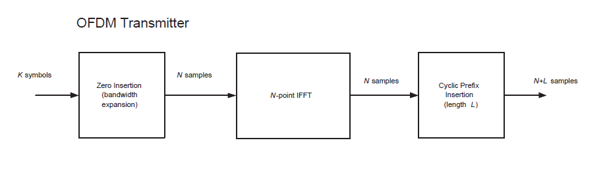



OFDMA Transmitter
Split-8 (Time-Domain)
Central Node output is here
Split-7 (Freq-Domain)
Central node output is here
Spectral
Shaping and
Multiple-access
-ve freq
Is taken from a QAM alphabet, which can be different for each i, and with a different amplitude (power). Each chunk can be for a different user and/or service class.
Null carriers
+ve freq
DC

Slide 21


OFDMA Inner Receiver
Split-8 (Time-Domain)
Radio-unit input is here
Split-7 (Freq-Domain)
Radio-unit input is here
I[n]
Prefix
Extraction
FFT
I[k]
Channel
Compen-
sation
I[k]
LLR
Unit
Digital
Baseband
Inputs
Q[n]
Q[k]
Q[k]
BroadbandChannel
Estimates
Pilot
extraction
To timing (DAQ) and frequency correction units, and I/Q imbalance
Channel
Estimation

Slide 22
Current Flavours
Category A
Small radio units (e.g. 4T4R, 8T8R)
Multiple for distributed antenna systems (DAS)
Category B
Beamforming radios (e.g. Massive-MIMO like 64T64R)
Ability to send multiple beams over fronthaul interface which are steered in the radio unit
Currently under lots of discussion due to interest by Ericsson to align this format with current 5G products
Creating a new functional split with more processing in the radio units on the receive path (channel estimation)

Slide 23
Part 2 High-level descriptions of SDRs when used as 3GPP radio-units

Slide 24
UHD Interfacing for 5G NR (OAI examples)
Start with describing how UHD can be used for the 5G air-interface
See online USRP Hardware Driver and USRP Manual (https://files.ettus.com/manual/)
ssh (N3x0/X410)
USB3,
PCIe,
UDP/ETH
USRP
UHD
Radio application
(OAI/srsRAN)
Control Interface
BUS
User interface (streamer)

Slide 25
In OAI
Between the OAI main thread there is a UHD wrapper
targets/ARCH/USRP/USERSPACE/LIB/usrp_lib.cpp
Contains all the needed functions to interface with UHD
Set frequency
Set gain
Write to TX
Receive from RX
etc

Slide 26
UHD Interfacing for 5G NR (OAI examples)
Control interface
Carrier frequencies
Amplifier gains
Sampling frequencies
RF impairment corrections
Fronthaul format (float, int16, etc.)
Start/stop streaming
User-plane interface (TX/RX streamers)
Timestamped packet transfers => synchronization comes from radio-unit
Basically “wrapped” sendto/recvfrom socket interface, multi-threaded under-the-hood, libusb for usb3, linux (or DPDK) UDP sockets (jumbo frames) for Ethernet.

Slide 27
Example snippets
int trx_usrp_set_freq(openair0_device *device, openair0_config_t *openair0_cfg, int dont_block) {
usrp_state_t *s = (usrp_state_t *)device->priv;
pthread_t f_thread;
printf("Setting USRP TX Freq %f, RX Freq %f, tune_offset: %f, dont_block: %d\n",
openair0_cfg[0].tx_freq[0],openair0_cfg[0].rx_freq[0],
openair0_cfg[0].tune_offset, dont_block);
// spawn a thread to handle the frequency change to not block the calling thread
if (dont_block == 1)
pthread_create(&f_thread,NULL,freq_thread,(void *)device);
else {
uhd::tune_request_t tx_tune_req(openair0_cfg[0].tx_freq[0], openair0_cfg[0].tune_offset);
uhd::tune_request_t rx_tune_req(openair0_cfg[0].rx_freq[0], openair0_cfg[0].tune_offset);
s->usrp->set_tx_freq(tx_tune_req);
s->usrp->set_rx_freq(rx_tune_req);
}
return(0);
}

Slide 28
UHD Streaming principles
Receive: Ask for nsamps in buff
n = s->rx_stream->recv(buff,nsamps,s->rx_md);
Blocks and returns samples and timestamp when available
Timestamp is used to derive basic frame timing information (frame,slot in 4G/5G)
Can be used as the basic timer of the radio application
In main application thread we
Call the receive stream to get an appropriate size (e.g. 1 slot or 500us of signal)
Upon return, we save the timestamp, say slot N, and spawn RX processing (if any) for N and TX processing for N+k
The resulting TX signal use the TX streamer with the appropriate timestamp
ret = s->tx_stream->send(buff, nsamps, s->tx_md);
UHD hides the underlying socket mechanisms under the rx/tx_stream API
Advantage: simple API
Disadvantage : you don’t really know what happens under-the-hood (number of underlying threads, CPU/OS optimizations are hidden). For instance, on Ethernet-based TX in OAI, we need to add a queing thread because tx_stream->send can block

Slide 29
What about eCPRI (AW2S example)
Control/management plane is partial ETSI ORI implementation with 5G extensions
ssh/telnet
AW2S
Jaguar
Or
Panther
libori.so
Radio Application
Control Interface
UDP/ETH
linux/dpdk
User interface (streamer)

Slide 30
ETSI ORI
Control and Management procedures to go alongside CPRI (eCPRI now)
Similar spirit to O-RAN but under ETSI and …
No specification of user-plane transport. Defaults to CPRI which is basically proprietary

Slide 31
Snippets from OAI aw2sori.c
else if (openair0_cfg->duplex_mode == duplex_mode_TDD && openair0_cfg->nr_flag == 1) {
txParams.TxNRTDD.antPort = ORI_FindObject(ori, ORI_ObjectType_AntennaPort, 0, NULL);
txParams.TxNRTDD.axcW = 1;
txParams.TxNRTDD.axcB = 0;
txParams.TxNRTDD.chanBW = openair0_cfg->tx_bw/100e3;
txParams.TxNRTDD.AWS_arfcn = to_nrarfcn(openair0_cfg->nr_band,(long long int)openair0_cfg->tx_freq[0],openair0_cfg->nr_scs_for_raster,(uint32_t)openair0_cfg->tx_bw);
txParams.TxNRTDD.maxTxPwr = 430-((int)openair0_cfg->tx_gain[0]*10);
printf("AW2S: Configuring for NR TDD, NRARFCN %u, Power %d, BW %d\n",
txParams.TxNRTDD.AWS_arfcn,txParams.TxNRTDD.maxTxPwr,txParams.TxNRTDD.chanBW);
}
else {
aw2s_oricleanup(device);
return -1;
}
result = ORI_ObjectCreation(ori, txTypeRef, txParams, txParamList, num_txparams, txParamResult, &tx0, &RE_result);
if(RE_result != ORI_Result_SUCCESS) {
printf("ORI_ObjectCreation (txParams0.TxEUtra/NR/FDD/TDD) failed with error: %s (%s,%s,%s,%s,%s,%s\n", ORI_Result_Print(RE_result),

Slide 32
Streaming with ECPRI (UDP)
Very simple:
open a regular UDP socket with the RRU and provide information to RRU about gNB fronthaul networking
Turn on RX and TX streaming (very similar to UHD) via ORI_ObjectStateModification on the desired RX and TX channels to “unlock” the streamers
AW2S RRU will start streaming in RX via the socket using a “Vendor Specific” packet format which mimics UHD timestamp mechanism.
Like UHD, it is also a synchronous protocol with the RRU as a synchronization source. Multiple RRU are synchronized by GPS. PTP is not used and gNB doesn’t need PTP (unlike O-RAN)
Use regular recv to grab each packet
RX packets
Transport headers (Ethernet, UDP), ECPRI header, Application header (64-bit Timestamp, antenna port, 256 32-bit I/Q Samples (16 bit I, 16 bit Q), no compression

Slide 33
ECPRI Packet format

Slide 34
OAI snippet
buff2=(void*)&buff_tx[2] - APP_HEADER_SIZE_BYTES;
// ECPRI Protocol revision + reserved bits (1 byte)
*(uint8_t *)buff2 = ECPRIREV;
// ECPRI Message type (1 byte)
*(uint8_t *)(buff2 + 1) = 64;
openair0_timestamp TS = timestamp + fhstate->TS0;
TS = (6*device->sampling_rate_ratio_d*TS)/device->sampling_rate_ratio_n;
TS -= device->txrx_offset;
int TSinc = (6*256*device->sampling_rate_ratio_d)/device->sampling_rate_ratio_n;
int len=256;
for (int offset=0;offset<nsamps;offset+=256,TS+=TSinc) {
// OAI modified SEQ_ID (4 bytes)
*(uint64_t *)(buff2 + 6) = TS;
if ((offset + 256) <= nsamps) len=1024;
else len = (nsamps-offset)<<2;
// ECPRI Payload Size (2 bytes)
*(uint8_t *)(buff2 + 2) = len>>8; *(uint8_t *)(buff2 + 3) = len&0xff;
for (int aid = 0; aid<nant; aid++) {
// ECPRI PC_ID (2 bytes)
*(uint16_t *)(buff2 + 4) = aid;
// … some IQ sample processing removed here
bytes_sent = sendto(eth->sockfdd[0],buff2,
UDP_PACKET_SIZE_BYTES(len>>2), sendto_flag,
(struct sockaddr*)&eth->dest_addrd,
eth->addr_len);
ECPRI message type is “Vendor Specific” ☺
SEQ_ID contains UHD-like timestamp
PC_ID contains Antenna Port

Slide 35
Some notes on non O-RAN ECPRI in OAI
Simple implementation of a limited set of ECPRI PDUs for AW2S RRU
One vendor-specific format for AW2S
Makes use of basic linux sockets (no DPDK)
One RX thread (CPU core) constantly listening to a socket - recvfrom()
Linux kernel is quite efficient in the end. A single 3GHz Xeon core is sufficient for 4 antenna streaming @ 61.44 Msps (50 MHz 5G channel)
One TX thread (CPU core) with queue-based messages triggering sendto()
One socket per RRU (can aggregate multiple RRU on common synch)
So, 2 CPUs cores per socket is enough for a 4-antenna RRU. This is very likely less than what is used by UHD (hard to tell) and certainly less than DPDK

Slide 36
Now O-RAN Open FHI
O-RAN FHI is quite a bit more complex than AW2S ECPRI, but to their credit :
SW version is fully open-source and distributed by O-RAN software community (Intel implementation)
Really optimized for Intel-based x86-64 (will not run as intended today on AMD, some routines use AVX512 and would need to be rewritten for AVX2)
Still uses ECPRI as transport, but the application packets are more complex (control and user plane use the ECPRI protocol). Recall, control for AW2S ECPRI made use of ORI for control.
Main differences
Management protocol based on netconf and yang data models is required on compliant O-RU
Raw Ethernet is used on most O-RU ,at least ones we have started using
Usually 2-3 different VLAN tags required (need sriov): management, control/user plane
DHCP is required on compliant O-RU
PTP is required and NIC in O-DU (gNB) needs PTP HW timestamping support
Need to intervene higher in the RAN L1 protocol (multiple physical channels)
Non-zero TX PRBs need to be sent according O-RAN protocol
Non-zero RX PRBs for PUSCH/PUCCH/SRS are requested from O-RU along with special PRACH PDUs (different OFDM numerology)
C-plane packets contain configuration information for transmitted and requests PDUs (a bit like (N)FAPI

Slide 37
Part 3 Transitioning software radios like OAI to O-RAN Open Fronthaul Interface devices

Slide 38
High-level overview of O-RAN FHI integration
DHCP server
ssh (manual control of O-RU)
ETH vlan1
Netconf Client
(e.g. netopeer2-cli)
Netconf get/
edit_config messages
ETH vlan1
O-RAN OSC Development
O-RU
(e.g. Mavenir)
Open FHI
Radio Application
Control Interface
ETH vlan1
dpdk
ETH vlan2
User interface (streamer)
10/25/40/100G ECPRI link(s)

Slide 39
Example deployment architecture - O-RAN O-Cloud

Slide 40
O-RAN Fronthaul @ EURECOM
GPS
Spine #1
(Cisco GX)
Spine #2
(Cisco GX)
RAN Server #1
O-RU #1
FH Swtich
(Cisco FX3)
RAN Server #2
O-RU #2
O-RU #N

Slide 41
Example configuration @ EURECOM
eurecom@peafowl:~$ ip link show enp193s0f1
5: enp193s0f1: <BROADCAST,MULTICAST,UP,LOWER_UP> mtu 9216 qdisc mq state UP mode DEFAULT group default qlen 1000
link/ether 3c:ec:ef:d2:af:bd brd ff:ff:ff:ff:ff:ff
vf 0 link/ether 00:11:22:33:44:66 brd ff:ff:ff:ff:ff:ff, vlan 3, spoof checking off, link-state auto, trust off
vf 1 link/ether 00:11:22:33:44:67 brd ff:ff:ff:ff:ff:ff, vlan 3, spoof checking off, link-state auto, trust off
vf 2 link/ether 00:11:22:33:44:77 brd ff:ff:ff:ff:ff:ff, spoof checking off, link-state auto, trust off
C-Plane
U-Plane
M-Plane
Virtual interfaces (sriov) created for O-RAN FHI
Seen from machine acting as gNB (O-DU)

Slide 42
Example configuration @ EURECOM (PTP)
eurecom@peafowl:~$ sudo systemctl status ptp4l
● ptp4l.service - Precision Time Protocol (PTP) service
Loaded: loaded (/lib/systemd/system/ptp4l.service; enabled; vendor preset: enabled)
Active: active (running) since Thu 2024-06-06 09:25:11 CEST; 1 day 3h ago
Main PID: 1732 (ptp4l)
Tasks: 1 (limit: 129654)
Memory: 656.0K
CPU: 2h 44min 16.356s
CGroup: /system.slice/ptp4l.service
└─1732 /usr/sbin/ptp4l -f /etc/ptp4l.cfg
Jun 07 13:06:51 peafowl ptp4l[1732]: ptp4l[99833.430]: rms 11 max 31 freq -13200 +/- 18 delay 238 +/- 2
Jun 07 13:06:51 peafowl ptp4l[1732]: [99833.430] rms 11 max 31 freq -13200 +/- 18 delay 238 +/- 2
Jun 07 13:06:52 peafowl ptp4l[1732]: ptp4l[99834.432]: rms 11 max 35 freq -13197 +/- 19 delay 238 +/- 1
Jun 07 13:06:52 peafowl ptp4l[1732]: [99834.432] rms 11 max 35 freq -13197 +/- 19 delay 238 +/- 1
Jun 07 13:06:53 peafowl ptp4l[1732]: ptp4l[99835.428]: rms 23 max 52 freq -13181 +/- 36 delay 237 +/- 1
Jun 07 13:06:53 peafowl ptp4l[1732]: [99835.428] rms 23 max 52 freq -13181 +/- 36 delay 237 +/- 1
Jun 07 13:06:54 peafowl ptp4l[1732]: ptp4l[99836.433]: rms 14 max 34 freq -13204 +/- 22 delay 236 +/- 1
Jun 07 13:06:54 peafowl ptp4l[1732]: [99836.433] rms 14 max 34 freq -13204 +/- 22 delay 236 +/- 1
Jun 07 13:06:55 peafowl ptp4l[1732]: ptp4l[99837.430]: rms 18 max 46 freq -13190 +/- 29 delay 238 +/- 2
Jun 07 13:06:55 peafowl ptp4l[1732]: [99837.430] rms 18 max 46 freq -13190 +/- 29 delay 238 +/- 2

Slide 43
Example of netconf get (with netopeer2-cli)
<data xmlns="urn:ietf:params:xml:ns:netconf:base:1.0">
<hardware xmlns="urn:ietf:params:xml:ns:yang:ietf-hardware">
<component>
<name>ZillnkRU</name>
<class xmlns:o-ran-hw="urn:o-ran:hardware:1.0">o-ran-hw:O-RAN-RADIO</class>
<description>Zillnk Radio Unit</description>
<contains-child>FPGAMainTempSensor</contains-child>
<contains-child>PA0TempSensor</contains-child>
<contains-child>PA1TempSensor</contains-child>
<contains-child>PA2TempSensor</contains-child>
<contains-child>PA3TempSensor</contains-child>
<hardware-rev>1.00</hardware-rev>
<firmware-rev>1.00</firmware-rev>
<software-rev>1.00</software-rev>
<serial-num>Z122601202135000331</serial-num>
<mfg-name>Zillnk</mfg-name>
<model-name>Zillnk O-RU</model-name>
<is-fru>true</is-fru>
<uuid>11111111-1111-1111-1111-111111111111</uuid>
<state>
<state-last-changed>1970-01-01T01:00:33+01:00</state-last-changed>
<admin-state>unlocked</admin-state>
<oper-state>enabled</oper-state>
Piece of M-plane capture from
Mavenir O-RU (manufacturer Zillnk)
M-Plane required to
Get O-RU capabilities
Edit configuration
Change state of O-RU (inactive to running)
Monitor events/faults

Slide 44
Example wireshark trace of O-RAN Open FHI
Capture from
Benetel O-RU

Slide 45
Conclusions
Provided an overview of current fronthaul interfaces and their integration in OAI codebase
UHD
ECPRI
ECPRI + ORAN Open FHI
Experimental networks (SLICES-RI, PAWR evolutions) will go beyond UHD in some deployment scenarios
USRPs may soon start to support O-RAN Open FHI for experimentation with O-RAN based protocols (X410 devices)

Slide 46
Thank you

