Slide 1
Mobile Communication Systems
(MobSys)

Slide 2
MobSys in 2023-2024
Three parts
  1. 3GPP System Architecture and Layer 1 Procedures
    Raymond Knopp, Oct.
  2. 3GPP Layer 2/3 Radio Access Network Protocols and RAN Controller Architectures
    Navid Nikaein
  3. 3GPP Core Network Protocols
    Adlen Ksentini
Lab sessions
  In part 2/3
MobSys 1 2020

Slide 3
Overview of Part 1
1. high-level 4G/5G architecture (node definitions, interface overview, channels)
- spectrum
- 3GPP EPC and 5GC entities
- 3GPP eNB/gNB/CU/DU/RU and underlying entities
- Small-Cell Forum VNF/PNF
- Reasons for Fronthaul/Midhaul/Backhaul
1 Lecture
2. Basic L1 concepts
- OFDM/SC-FDMA modulation
- channel coding
- multi-antenna processing (MIMO/Beamforming concepts)
1 Lectures
3. L1 interfaces and procedures relating to
- cell synch
- random-access
- uplink control
- downlink control
- uplink data
- downlink data
- example MAC/PHY interfacing (FAPI/NFAPI) in an implementation
3 Lectures
MobSys 1 2020

Slide 4
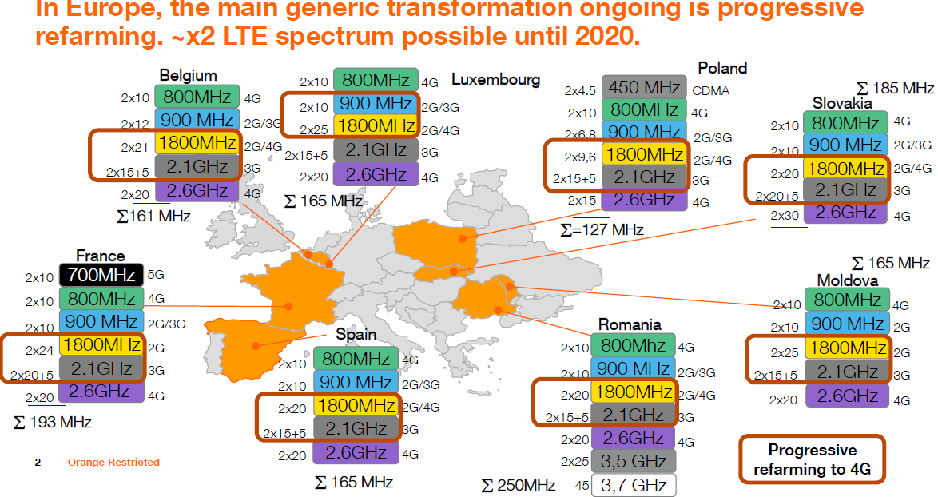
EUROPE Spectrum
MobSys 1 2020

Slide 5
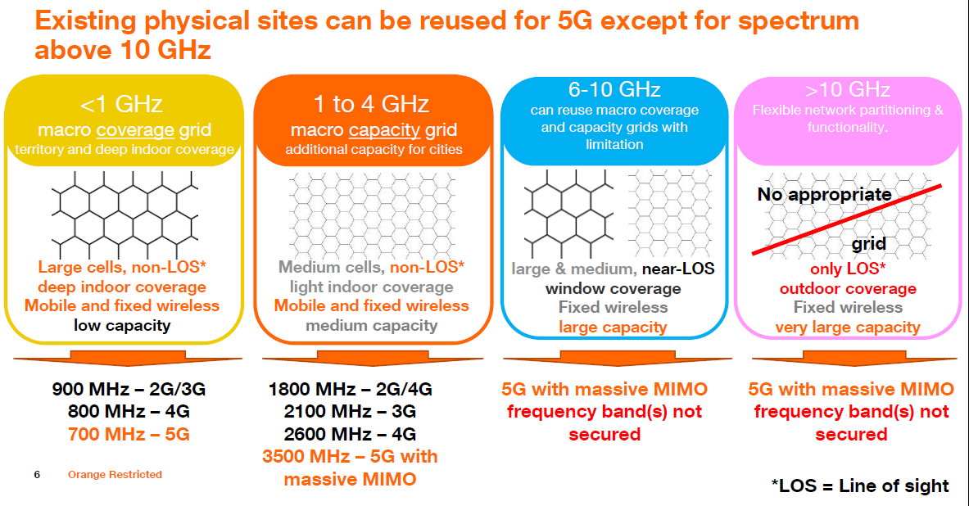
EUROPE Spectrum
MobSys 1 2020

Slide 6
Main Objectives of 5G
Ultra-flexible radio-access configurations
  Higher bandwidth
  Higher spectral efficiency (bits/s/Hz/m²)
  Bandwidth parts
    Tailor bandwidth to UE class (like eMTC narrowbands/widebands)
  New abstractions for service classification down to L1 (slicing)
Compatibility with 4G/5G core network
  5G dual-connectivity (non-standalone operation)
  Interconnection of evolved 4G eNodeB (ng-eNB) with 5G core
5G core cloud-native architecture
MobSys 1 2020

Slide 7
Vertical Use-cases (Rel 15/16)
Public Networks
  Mobile broadband
    Gbit/s to mobile device
    IMS-based voice services
    New low-latency services (gaming)
  Fixed broadband
    Especially USA for now (mmWave acces)
  NR-V2X
    Non-critical
Professional Networks
  Surveillance
    Security (low-latency), dense networks (stadium)
    Smart Agriculture/Aquaculture
  Industrial Networks
    Control of machines (tooling, farming equipment)
MobSys 1 2020

Slide 8
Rel17 extensions
NR-V2X
  Critical services
  Public-safety
Massive machine-type communications
  Coverage enhancement (CovEnh)
  Reduced Capacity Devices (RedCap)
Further URLLC for Industrial IoT
  Time-sensitive networking
MobSys 1 2020

Slide 9

Rel18 Extensions
MobSys 1 2020

Slide 10
A LOOK AT CURRENT 5G STANDARDIZATION
MobSys 1 2020

Slide 11
About the IMT/3GPP/NGMN/SCF/ORAN
IMT = International Mobile Telecommunications
  UN (Internation Telecommunications Union - ITU) standardization body to produce specifications for networking requirements. A big specification release ~ every 10 years
3GPP = Third Generation Parternship Project
  Created at the onset of 3G to federate the standardization process to generate a system
    Core Network
    Radio-Access Network
    Service Architecture
    Testing Architecture
NGMN = Next Generation Mobile Networks
  Operator-driven consortium to produce “recommendations” for implementation of mobile communication systems
  Example: famous “white-paper” in 2015 to help define 5G from the operator perspective.
SCF = Small-Cell Forum
  Produce functional specifications for non-3GPP interfaces tailored to “small-cell” network topologies
O-RAN = Operator Defined Next Generation RAN Architecture and Interfaces
  Produce functional specifications for non-3GPP interfaces aiding the deployment of disaggregated 3GPP network
MobSys 1 2020

Slide 12
IMT 2020 Requirements for 5G
Capability | Description | 5G requirement | Usage scenario
Downlink peak data rate | Minimum maximum data rate technology must support | 20 Gbit/s | eMBB
Uplink peak data rate |  | 10 Gbit/s | eMBB
User experienced downlink data rate | Data rate in dense urban test environment 95% of time | 100 Mbit/s | eMBB
User experienced uplink data rate |  | 50 Mbit/s | eMBB
Latency | Radio network contribution to packet travel time | 4 ms | eMBB
 |  | 1 ms | URLLC
Mobility | Maximum speed for handoff and QoS requirements | 500 km/h | eMBB/URLLC
Connection density | Total number of devices per unit area | 10⁶/km² | mMTC
Energy efficiency | Data sent/received per unit energy consumption (by device or network) | Equal to 4G | eMBB
Area traffic capacity | Total traffic across coverage area | 10 Mbps/m² | eMBB
Peak downlink spectrum efficiency | Throughput per unit wireless bandwidth and per network cell | 30 bit/s/Hz | eMBB
MobSys 1 2020

Slide 13
3GPP
3GPP is a consortium with seven national or regional telecommunication standards organizations as primary members ("organizational partners")
variety of other organizations as associate members ("market representation partners"), like 4G Americas, 5G Infrastructure Association (5GIA), NGMN, etc.
,
Organization | Country/region | Website
Association of Radio Industries and Businesses (ARIB) | Japan | ARIB
Alliance for Telecommunications Industry Solutions (ATIS) | USA | ATIS
China Communications Standards Association (CCSA) | China | CCSA
European Telecommunications Standards Institute (ETSI) | Europe | ETSI
Telecommunications Standards Development Society (TSDSI) | India | TSDSI
Telecommunications Technology Association (TTA) | South Korea | TTA
Telecommunication Technology Committee (TTC) | Japan | TTC
MobSys 1 2020

Slide 14
3GPP
The 3GPP organizes its work into three different streams:
  Radio Access Networks (RAN)
  Services and Systems Aspects (SA)
  Core Network and Terminals (CT)
The three groups produce documents ultimately resulting in specifications.
3GPP standards are structured as Releases which represent an evolving set of functionalities.
MobSys 1 2020

Slide 15
3GPP Standards
GSM and related 2G and 2.5G standards, including GPRS and EDGE
UMTS and related 3G standards, including HSPA and HSPA+
LTE and related 4G standards, including LTE Advanced and LTE Advanced Pro
5G NR and related 5G standards
An evolved IP Multimedia Subsystem (IMS) developed in an access independent manner
MobSys 1 2020

Slide 16
3GPP Releases
Version^{[8]} | Released^{[3]} | Info
Phase 1 | 1992 | GSM Features
Phase 2 | 1995 | GSM Features, EFR Codec,
Release 96 | 1997 Q1 | GSM Features, 14.4 kbit/s User Data Rate,
Release 97 | 1998 Q1 | GSM Features, GPRS
Release 98 | 1999 Q1 | GSM Features, AMR codec, EDGE, GPRS for PCS1900
Release 99 | 2000 Q1 | Specified the first UMTS 3G networks, incorporating a CDMA air interface^{[9]}
Release 4 | 2001 Q2 | Originally called the Release 2000 – added features including an all-IP Core Network^{[10]}
Release 5 | 2002 Q1 | Introduced IMS and HSDPA^{[11]}
Release 6 | 2004 Q4 | Integrated operation with Wireless LAN networks and adds HSUPA, MBMS, enhancements to IMS such as Push to Talk over Cellular (PoC), GAN^{[12]}
Release 7 | 2007 Q4 | Focuses on decreasing latency, improvements to QoS and real-time applications such as VoIP.^{[13]} This specification also focus on HSPA+ (High Speed Packet Access Evolution), SIM high-speed protocol and contactless front-end interface (Near Field Communication enabling operators to deliver contactless services like Mobile Payments), EDGE Evolution.
Release 8 | 2008 Q4 | First LTE release. All-IP Network (SAE). New OFDMA, FDE and MIMO based radio interface, not backwards compatible with previous CDMA interfaces. Dual-Cell HSDPA. UMTS HNB.
Release 9 | 2009 Q4 | SAES Enhancements, WiMAX and LTE/UMTS Interoperability. Dual-Cell HSDPA with MIMO, Dual-Cell HSUPA. LTE HeNB.
Release 10 | 2011 Q1 | LTE Advanced fulfilling IMT Advanced 4G requirements. Backwards compatible with release 8 (LTE). Multi-Cell HSDPA (4 carriers).
Release 11 | 2012 Q3 | Advanced IP Interconnection of Services. Service layer interconnection between national operators/carriers as well as third party application providers. Heterogeneous networks (HetNet) improvements, Coordinated Multi-Point operation (CoMP). In-device Co-existence (IDC).
Release 12 | 2015 Q1 | Enhanced Small Cells (higher order modulation, dual connectivity, cell discovery, self configuration), Carrier aggregation (2 uplink carriers, 3 downlink carriers, FDD/TDD carrier aggregation), MIMO (3D channel modeling, elevation beamforming, massive MIMO), New and Enhanced Services (cost and range of MTC, D2D communication, eMBMS enhancements)^{[14]}
Release 13 | 2016 Q1 | LTE in unlicensed, LTE enhancements for Machine-Type Communication. Elevation Beamforming / Full-Dimension MIMO, Indoor positioning.^{[15]} LTE-Advanced Pro.
Release 14 | 2017 Q2 | Energy Efficiency, Location Services (LCS), Mission Critical Data over LTE, Mission Critical Video over LTE, Flexible Mobile Service Steering (FMSS), Multimedia Broadcast Supplement for Public Warning System (MBSP), enhancement for TV service, massive Internet of Things, Cell Broadcast Service (CBS)^{[16]}
Release 15 | 2018 Q2 | First NR ("New Radio") release. Support for 5G Vehicle-to-x service, IP Multimedia Core Network Subsystem (IMS), Future Railway Mobile Communication System^{[17]}
Release 16 | 2020 Q3 | The 5G System - Phase 2. 5G enhancements, NR-based access to unlicensed spectrum (NR-U), Satellite access^{[18]}
MobSys 1 2020

Slide 17

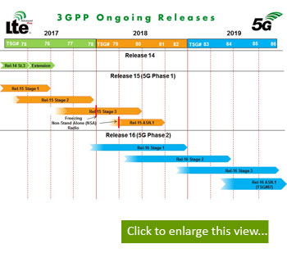
Current Rel 15 timeline
MobSys 1 2020

Slide 18
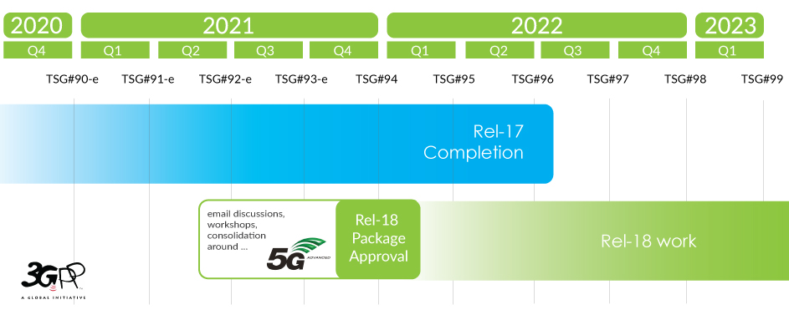
Meetings 2021-22
MobSys 1 2020

Slide 19
Key RAN specifications (L2)
3GPP TS 23.501: "System Architecture for the 5G System; Stage 2".
3GPP TS 38.401: "NG-RAN; Architecture description".
3GPP TS 33.501: "Security Architecture and Procedures for 5G System".
3GPP TS 37.340: "NR; Multi-connectivity; Overall description; Stage-2".
3GPP TS 38.321: "NR; Medium Access Control (MAC) protocol specification".
3GPP TS 38.322: "NR; Radio Link Control (RLC) protocol specification".
3GPP TS 38.323: "NR; Packet Data Convergence Protocol (PDCP) specification".
3GPP TS 37.324: "NR; Service Data Protocol (SDAP) specification".
3GPP TS 38.304: "NR; User Equipment (UE) procedures in idle mode".
3GPP TS 38.306: "NR; User Equipment (UE) radio access capabilities".
3GPP TS 38.331: "NR; Radio Resource Control (RRC); Protocol specification".
3GPP TS 38.133: "NR; Requirements for support of radio resource management".
MobSys 1 2020

Slide 20
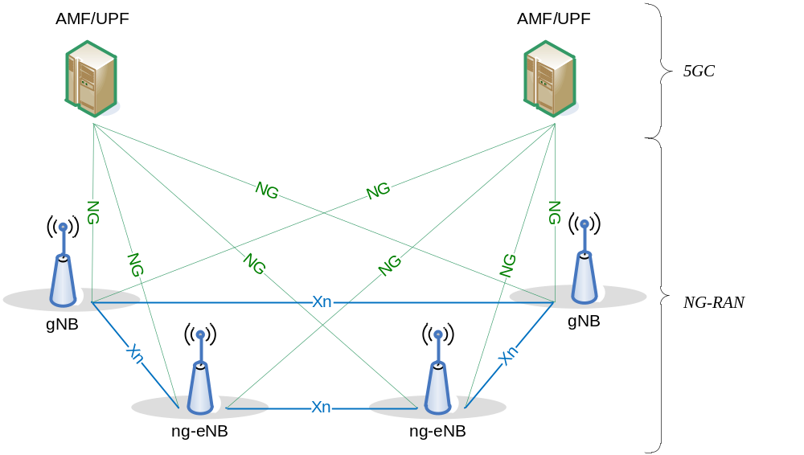
Overall Architecture (with 5G core)
MobSys 1 2020

Slide 21
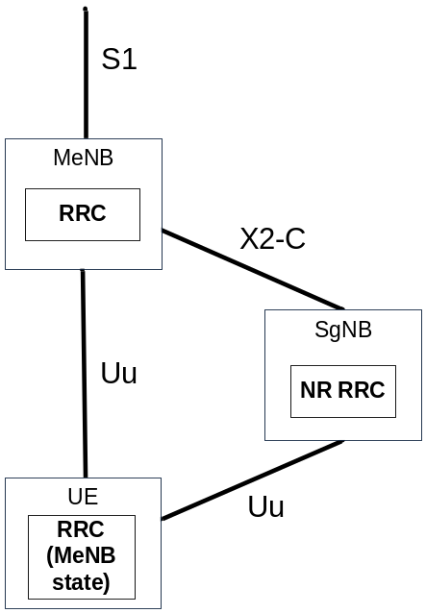
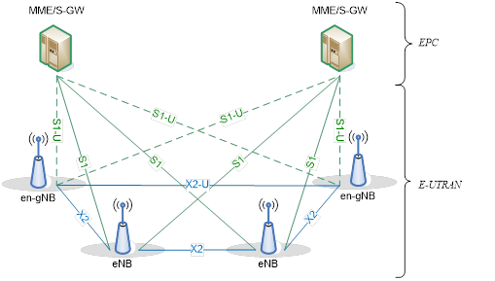
Overall Architecture (with 4G core) – EN-DC
MobSys 1 2020

Slide 22

Example Deployment
MobSys 1 2020

Slide 23
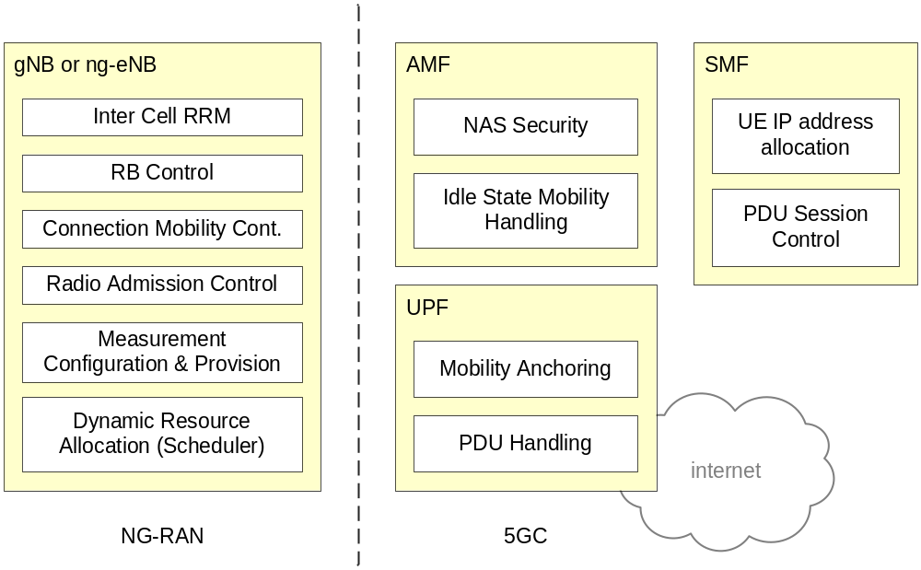
Functional Split between RAN and 5G Core
MobSys 1 2020

Slide 24
Functional Split (gNB, ng-eNB)
The gNB and ng-eNB host the following functions:
  Functions for Radio Resource Management: Radio Bearer Control, Radio Admission Control, Connection Mobility Control, Dynamic allocation of resources to UEs in both uplink and downlink (scheduling);
  IP header compression, encryption and integrity protection of data;
  Selection of an AMF at UE attachment when no routing to an AMF can be determined from the information provided by the UE;
  Routing of User Plane data towards UPF(s);
  Routing of Control Plane information towards AMF;
  Connection setup and release;
  Scheduling and transmission of paging messages (originated from the AMF);
  Scheduling and transmission of system broadcast information (originated from the AMF or O&M);Measurement and measurement reporting configuration for mobility and scheduling;
  Transport level packet marking in the uplink;
  Session Management;
  Support of Network Slicing;
  QoS Flow management and mapping to data radio bearers;
  Support of UEs in RRC_INACTIVE state;
  Distribution function for NAS messages;
  Radio access network sharing;
  Dual Connectivity;
  Tight interworking between NR and E-UTRA.
MobSys 1 2020

Slide 25
Functional Split (AMF)
The AMF hosts the following main functions (see 3GPP TS 23.501):
  NAS signalling termination;
  NAS signalling security;
  AS Security control;
  Inter CN node signalling for mobility between 3GPP access networks;
  Idle mode UE Reachability (including control and execution of paging retransmission);
  Registration Area management;
  Support of intra-system and inter-system mobility;
  Access Authentication;
  Access Authorization including check of roaming rights;
  Mobility management control (subscription and policies);
  Support of Network Slicing;
  SMF selection.
MobSys 1 2020

Slide 26
Functional Split (UPF)
The UPF hosts the following main functions (see 3GPP TS 23.501):
  Anchor point for Intra-/Inter-RAT mobility (when applicable);
  External PDU session point of interconnect to Data Network;
  Packet routing & forwarding;
  Packet inspection and User plane part of Policy rule enforcement;
  Traffic usage reporting;
  Uplink classifier to support routing traffic flows to a data network;
  Branching point to support multi-homed PDU session;
  QoS handling for user plane, e.g. packet filtering, gating, UL/DL rate enforcement;
  Uplink Traffic verification (SDF to QoS flow mapping);
  Downlink packet buffering and downlink data notification triggering.
MobSys 1 2020

Slide 27
Functional Split (SMF)
The Session Management function (SMF) hosts the following main functions (see 3GPP TS 23.501):
  Session Management;
  UE IP address allocation and management;
  Selection and control of UP function;
  Configures traffic steering at UPF to route traffic to proper destination;
  Control part of policy enforcement and QoS;
  Downlink Data Notification.
MobSys 1 2020

Slide 28
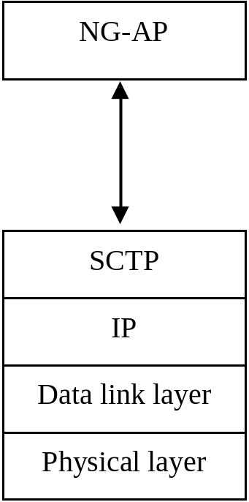
NG-C Interface
NG-C provides the following functions:
  NG interface management;
  UE context management;
  UE mobility management;
  Transport of NAS messages;
  Paging;
  PDU Session Management;
  Configuration Transfer;
  Warning Message Transmission.
MobSys 1 2020

Slide 29
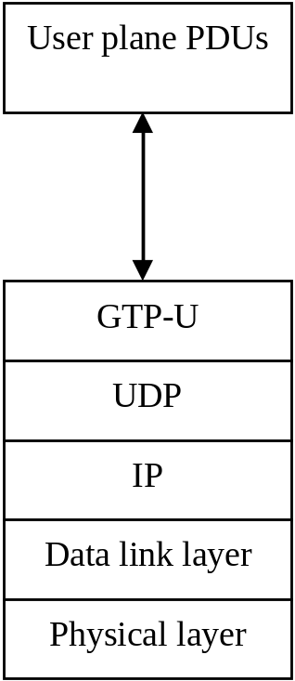
NG-U Interface
NG-U provides non-guaranteed delivery of user plane PDUs between the NG-RAN node and the UPF.
MobSys 1 2020

Slide 30
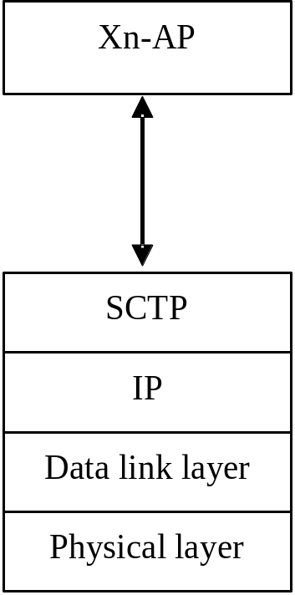
Xn-C Interface
The Xn-C interface supports the following functions:
  Xn interface management;
  UE mobility management, including context transfer and RAN paging:
  Dual connectivity;
MobSys 1 2020

Slide 31
Xn-U Interface
Xn-U provides non-guaranteed delivery of user plane PDUs and supports the following functions:
  Data forwarding;
  Flow control.
MobSys 1 2020

Slide 32
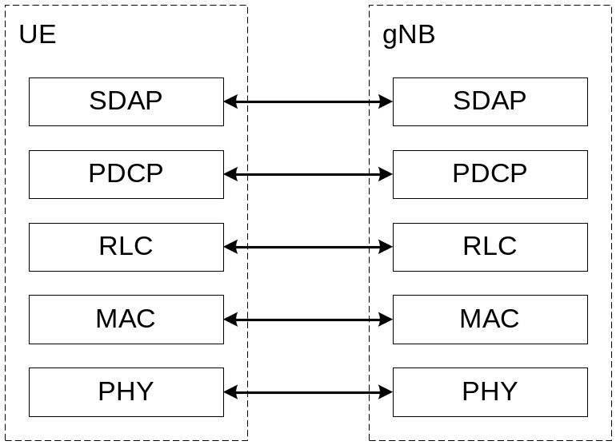
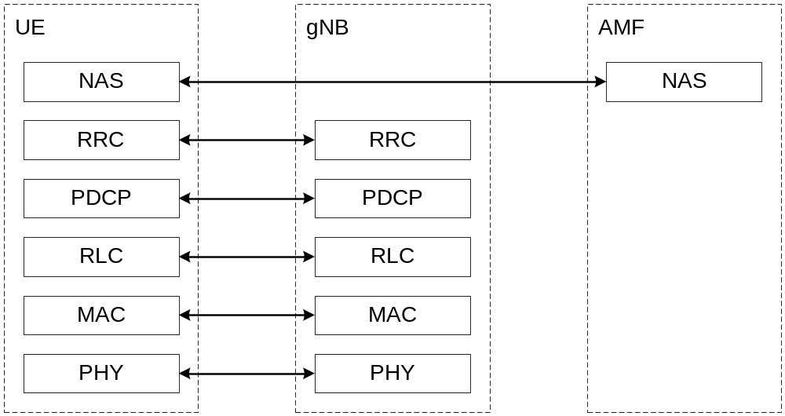
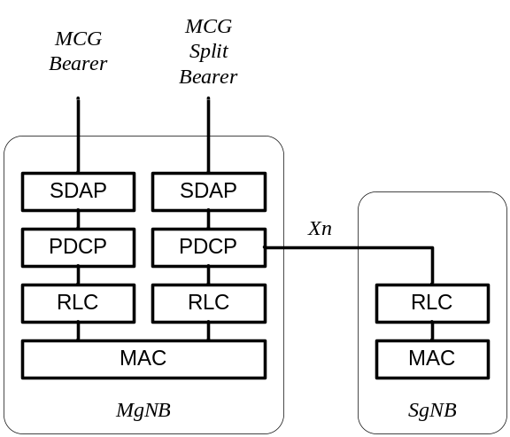
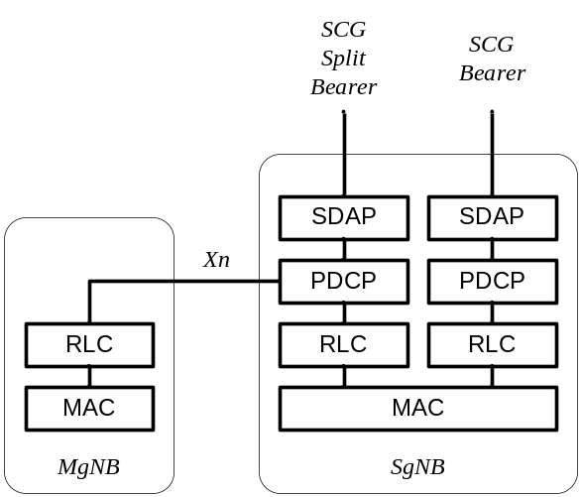
Radio Protocol
MobSys 1 2020

Slide 33
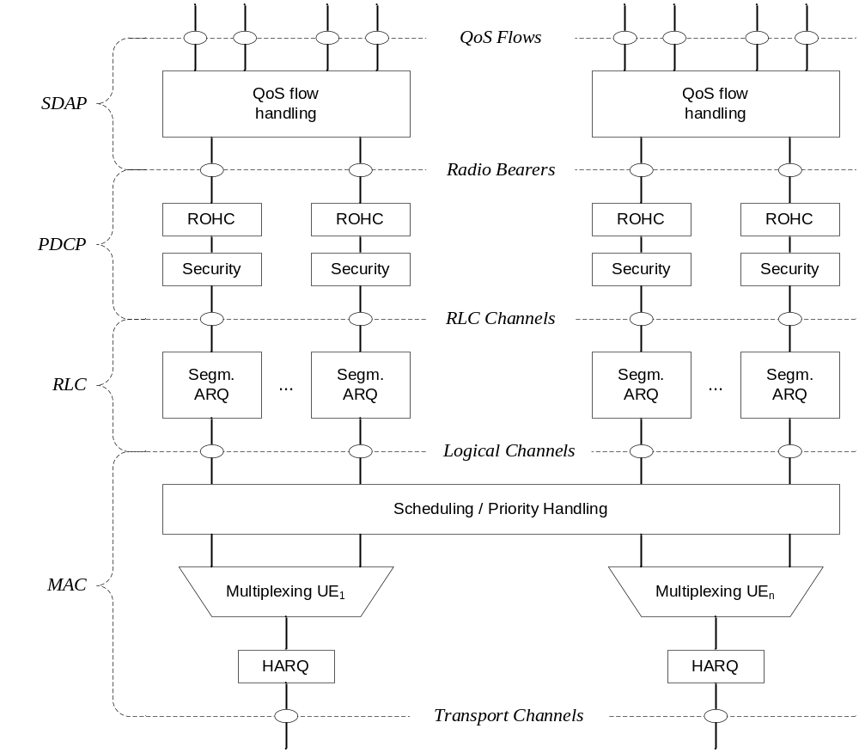
Layer 2 Architecture (Downlink)
MobSys 1 2020

Slide 34
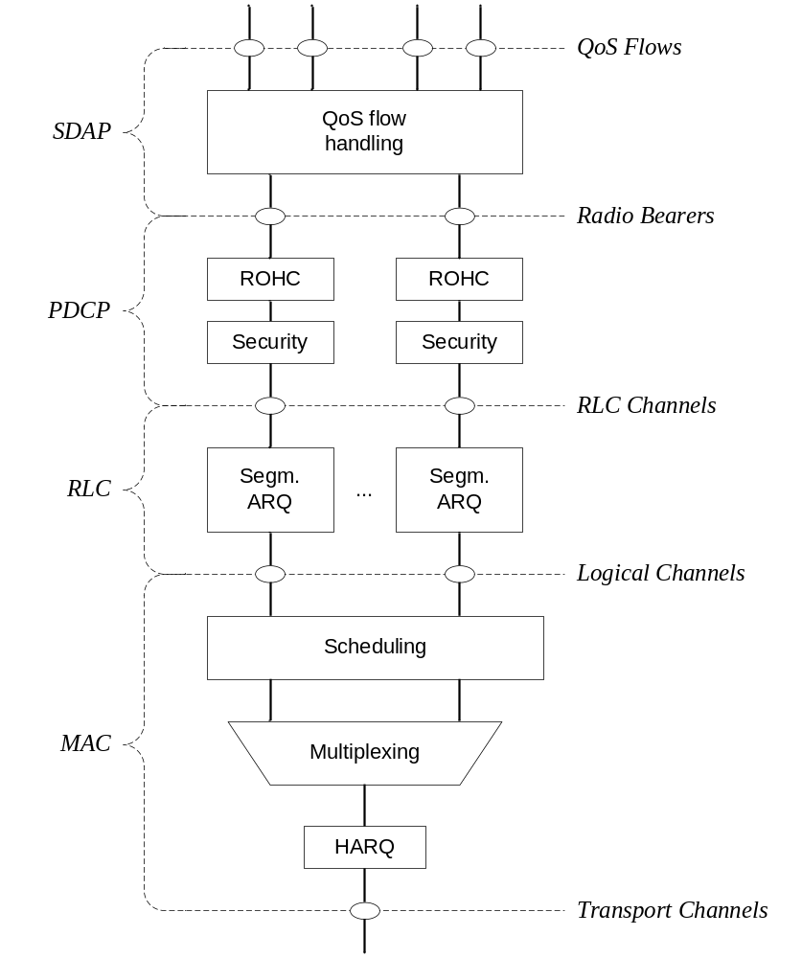
Layer 2 (Uplink)
MobSys 1 2020

Slide 35
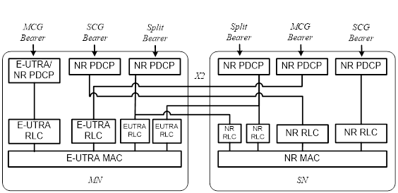
Overall dual-connectivity Architecture (with 4G core)
MobSys 1 2020

Slide 36
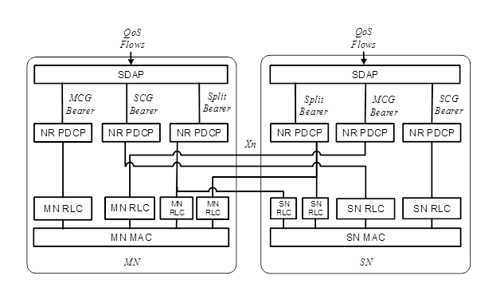
Overall dual-connectivity Architecture (with 5G core)
MobSys 1 2020

Slide 37
MAC Layer
The main services and functions of the MAC sublayer include:
  Mapping between logical channels and transport channels;
  Multiplexing/demultiplexing of MAC SDUs belonging to one or different logical channels into/from transport blocks (TB) delivered to/from the physical layer on transport channels;
  Scheduling information reporting;
  Error correction through HARQ (one HARQ entity per carrier in case of CA);
  Priority handling between UEs by means of dynamic scheduling;
  Priority handling between logical channels of one UE by means of logical channel prioritisation;
  Padding.
MobSys 1 2020

Slide 38
Logical Channels
Broadcast Control Channel (BCCH): a downlink channel for broadcasting system control information.
Paging Control Channel (PCCH): a downlink channel that transfers paging information and system information change notifications.
Common Control Channel (CCCH): channel for transmitting control information between UEs and network. This channel is used for UEs having no RRC connection with the network.
Dedicated Control Channel (DCCH): a point-to-point bi-directional channel that transmits dedicated control information between a UE and the network. Used by UEs having an RRC connection.
Traffic channels are used for the transfer of user plane information only:
Dedicated Traffic Channel (DTCH): point-to-point channel, dedicated to one UE, for the transfer of user information. A DTCH can exist in both uplink and downlink.
MobSys 1 2020

Slide 39
Mapping of Logical to Transport/Physical Channels
In Downlink, the following connections between logical channels and transport channels exist:
  BCCH can be mapped to BCH;
  BCCH can be mapped to DL-SCH;
  PCCH can be mapped to PCH;
  CCCH can be mapped to DL-SCH;
  DCCH can be mapped to DL-SCH;
  DTCH can be mapped to DL-SCH.
In Uplink, the following connections between logical channels and transport channels exist:
  CCCH can be mapped to UL-SCH;
  DCCH can be mapped to UL- SCH;
  DTCH can be mapped to UL-SCH.
MobSys 1 2020

Slide 40
RLC (Radio-Link Control)
The RLC sublayer supports three transmission modes:
  Transparent Mode (TM);
  Unacknowledged Mode (UM);
  Acknowledged Mode (AM).
The main services and functions of the RLC sublayer depend on the transmission mode and include:
  Transfer of upper layer PDUs;
  Sequence numbering independent of the one in PDCP (UM and AM);
  Error Correction through ARQ (AM only);
  Segmentation (AM and UM) and re-segmentation (AM only) of RLC SDUs;
  Reassembly of SDU (AM and UM);
  Duplicate Detection (AM only);
  RLC SDU discard (AM and UM);
  RLC re-establishment;
  Protocol error detection (AM only).
MobSys 1 2020

Slide 41
PDCP (Packet Data Convergence Protocol)
The main services and functions of the PDCP sublayer for the user plane include:
  Sequence Numbering;
  Header compression and decompression: ROHC only;
  Transfer of user data;
  Reordering and duplicate detection;
  PDCP PDU routing (in case of split bearers);
  Retransmission of PDCP SDUs;
  Ciphering, deciphering and integrity protection;
  PDCP SDU discard;
  PDCP re-establishment and data recovery for RLC AM;
  Duplication of PDCP PDUs.
The main services and functions of the PDCP sublayer for the control plane include:
  Sequence Numbering;
  Ciphering, deciphering and integrity protection;
  Transfer of control plane data;
  Reordering and duplicate detection;
  Duplication of PDCP PDUs (see subclause 16.1.3).
MobSys 1 2020

Slide 42
SDAP (Service Data Adaptation Protocol)
New entity w.r.t. 4G
The main services and functions of SDAP include:
  Mapping between a QoS flow and a data radio bearer;
  Marking QoS flow ID (QFI) in both DL and UL packets.
MobSys 1 2020

Slide 43
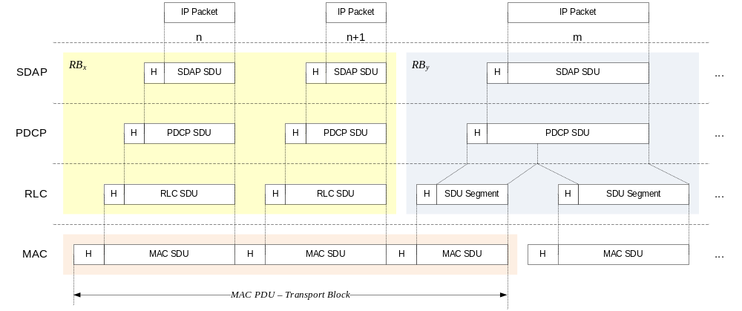
Example L2 Data Flow
An example of the Layer 2 Data Flow is depicted on Figure 6.6-1, where a transport block is generated by MAC by concatenating two RLC PDUs from RB_{x} and one RLC PDU from RB_{y}. The two RLC PDUs from RB_{x} each corresponds to one IP packet (n and n+1) while the RLC PDU from RB_{y} is a segment of an IP packet (m).
MobSys 1 2020

Slide 44
RRC (5G)
The main services and functions of the RRC sublayer include:
  Broadcast of System Information related to AS and NAS;
  Paging initiated by 5GC or NG-RAN;
  Establishment, maintenance and release of an RRC connection between the UE and NG-RAN including:
    Addition, modification and release of carrier aggregation;
    Addition, modification and release of Dual Connectivity in NR or between E-UTRA and NR.
  Security functions including key management;
  Establishment, configuration, maintenance and release of Signalling Radio Bearers (SRBs) and Data Radio Bearers (DRBs);
  Mobility functions including:
    Handover and context transfer;
    UE cell selection and reselection and control of cell selection and reselection;
    Inter-RAT mobility.
  QoS management functions;
  UE measurement reporting and control of the reporting;
  Detection of and recovery from radio link failure;
  NAS message transfer to/from NAS from/to UE.
MobSys 1 2020

Slide 45
New RRC States
RRC supports the following states which can be characterised as follows:
  RRC_IDLE:
    PLMN selection;
    Broadcast of system information;
    Cell re-selection mobility;
    Paging for mobile terminated data is initiated by 5GC;
    Paging for mobile terminated data area is managed by 5GC;
    DRX for CN paging configured by NAS.
  RRC_INACTIVE:
    Broadcast of system information;
    Cell re-selection mobility;
    Paging is initiated by NG-RAN (RAN paging);
    RAN-based notification area (RNA) is managed by NG- RAN;
    DRX for RAN paging configured by NG-RAN;
    5GC - NG-RAN connection (both C/U-planes) is established for UE;
    The UE AS context is stored in NG-RAN and the UE;
    NG-RAN knows the RNA which the UE belongs to.
  RRC_CONNECTED:
    5GC - NG-RAN connection (both C/U-planes) is established for UE;
    The UE AS context is stored in NG-RAN and the UE;
    NG-RAN knows the cell which the UE belongs to;
    Transfer of unicast data to/from the UE;
    Network controlled mobility including measurements.
MobSys 1 2020

Slide 46
RAN/Core Disaggregation
Different deployment topologies for the RAN (and Core) are proposed in 3GPP driven by operators and vertical industries
  Allow for optimizing geographic distribution of processing
  Allow for multi-vendor solutions (end-to-end networking equipment from more than one vendor)
  Allow tailoring solutions to specific vertical industry use-cases (industrial IoT, automotive, public-safety, etc.)
MobSys 1 2020

Slide 47
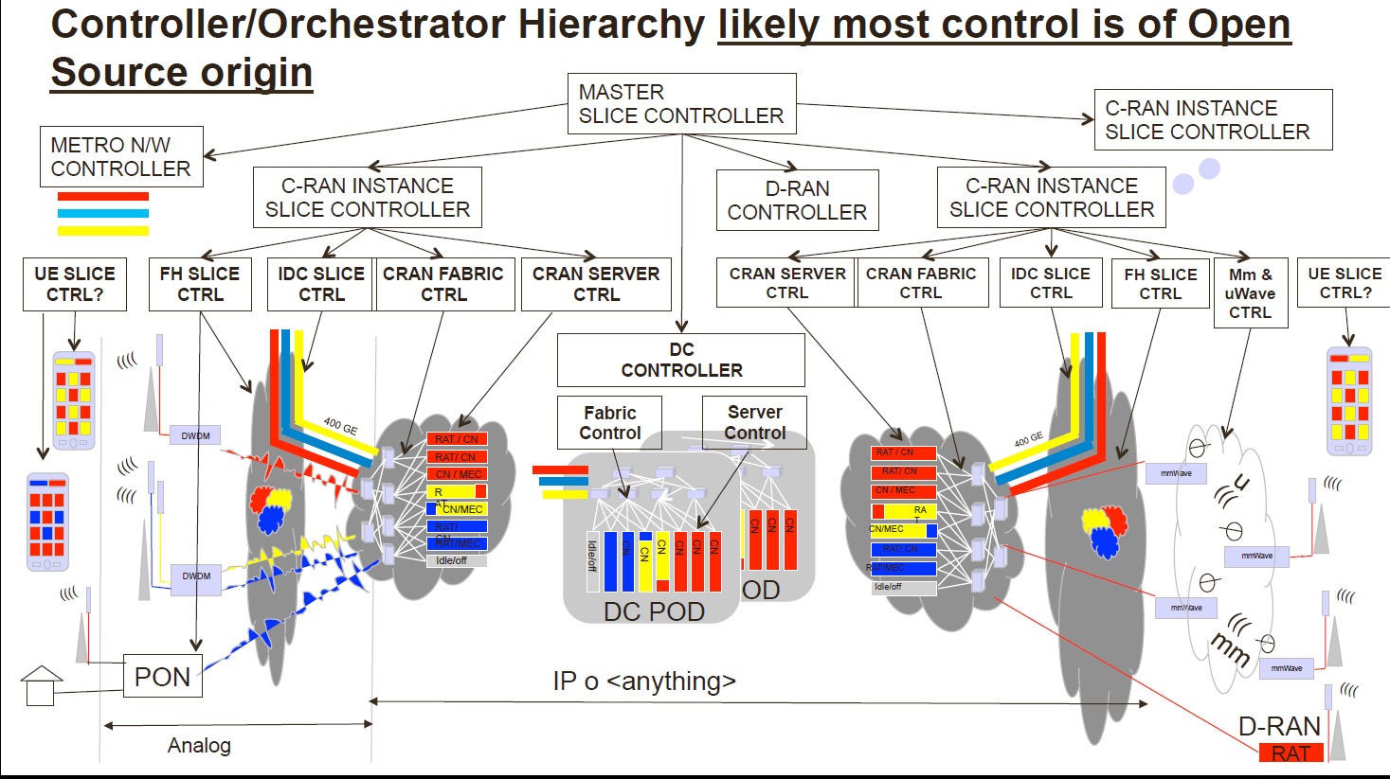
ITU IMT2020 FG Vision (primary networks)
Source: https://www.itu.int/en/ITU-T/Workshops-and-Seminars/itu-ngmn/Documents/Abstracts_and_Presentations/Peter-Ashwood-Smithv2.pdf
MobSys 1 2020

Slide 48
Considered RAN Splits in 3GPP evolution
5G CORE
Fronthaul/Midhaul
  Lowlatency FH
  Highlatency FH
UDM
AMF
UPF
AUSF
Capacity-Limited Backhaul
High capacity Backhaul
Central Unit (CU)
PDCP
MEC
AMF
RRC
UPF
Distributed Unit (DU)
Higher latency FH Split
< 200 km
LTE-RLC
LTE-MAC
LTE-PHY
5G-RLC
5G-MAC
5G-PHY
Low latency FH Split
< 20km
5G-RLC
5G-MAC
5G-PHY
LTE-RLC
LTE-MAC
LTE-PHY
WIFI
MAC
WIFI
PHY
LTE-PHY
Radio
5G-PHY
Radio
Overview of OAI Functional Splits

Slide 49
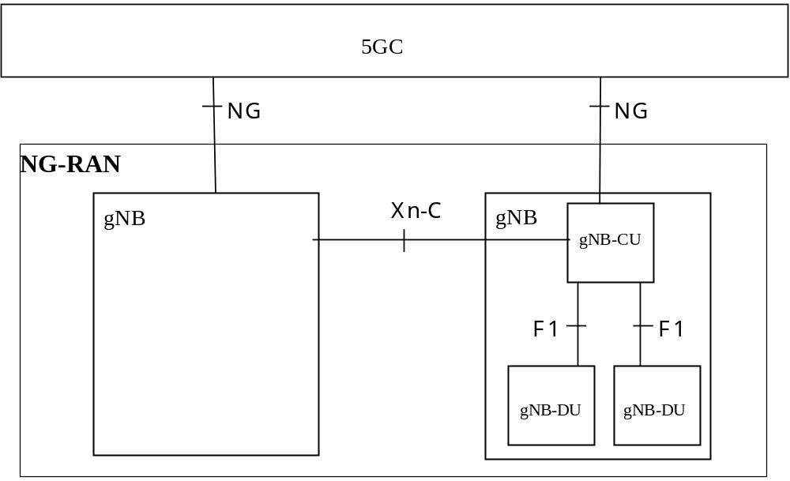
3GPP NG-RAN Functional Split
Introduction of F1 interface to split the RAN (gNodeB) in to two logical entities : gNB-CU, gNB-DU
MobSys 1 2020

Slide 50
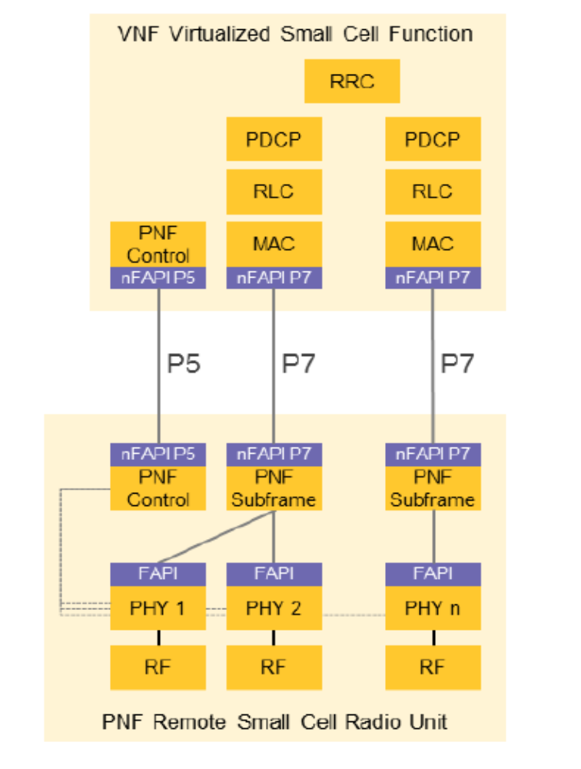
Small Cell Forum Functional Split
MobSys 1 2020

