Slide 1
Mobile Communication Systems
(MobSys)

Slide 2
OFDMA Transmission
OFDMA = Orthogonal Frequency-Division Multiple-Access
  Both modulation method (OFDM) and multiple-access method useful for broadband wireless communications which exhibit time-dispersion (multipath)
  Provides efficient (low-cost) transceiver structures based on FFT front-end processing when combined with a cyclic prefix
  Relatively simple high-performance channel estimation
  Optimal matched filtering due to orthogonalization of dispersive channel
Downside
  High peak-to-average power ratio
MobSys 2 2020

Slide 3





Blockwise Transmission with a Cyclic Prefix
OFDM symbol
samples
Information-bearing component -
samples
Cyclic-prefix :
samples
Cyclic-prefix chosen such that beginning and end of symbol are the same
i.e.
MobSys 2 2020

Slide 4
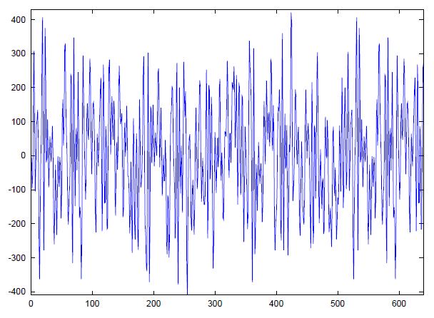
Blockwise Transmission with a Cyclic Prefix
PREFIX
(128)
INFORMATION
(512)
MobSys 2 2020

Slide 5
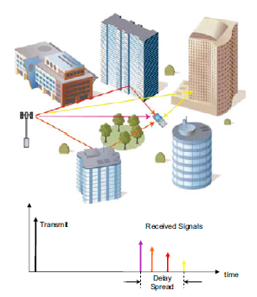
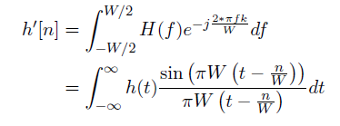
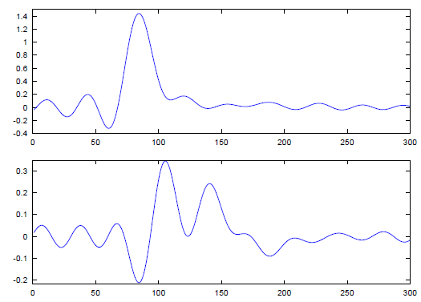

Multipath Propagation
Discrete-time channel seen by RX
MobSys 2 2020

Slide 6
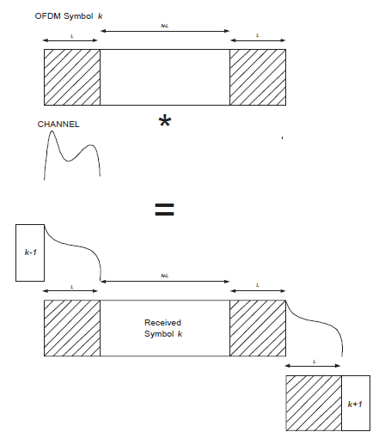
Multipath propagation
Cyclic prefix allows for block orthogonality if delay-spread of channel is shorter than L samples
Signal energy in prefix is neglected by receiver
Useful portion for RX,
energy from symbol k
only
MobSys 2 2020

Slide 7




Frequency-Domain Representation
In the frequency-domain, channel is completely orthogonalized due to cyclic prefix, for strictly time-limited channel (approximately true)
RX signal
noise
Circulant Convolution
MobSys 2 2020

Slide 8















Frequency-Domain Representation
MobSys 2 2020

Slide 9
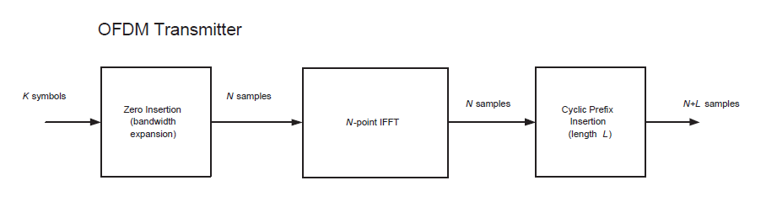


OFDM
Spectral
shaping
-ve freq
Is taken from a QAM alphabet
Null carriers
+ve freq
DC
MobSys 2 2020

Slide 10
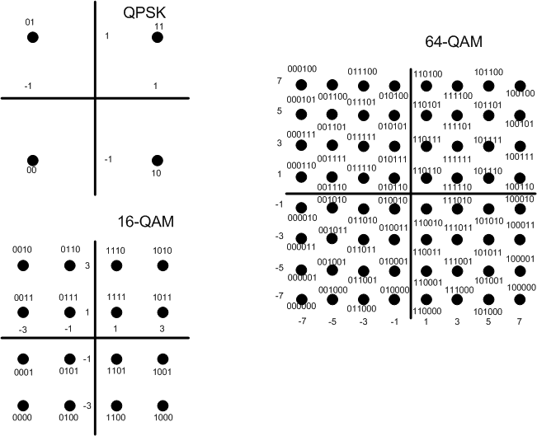
QAM modulation alphabets (common)
MobSys 2 2020

Slide 11
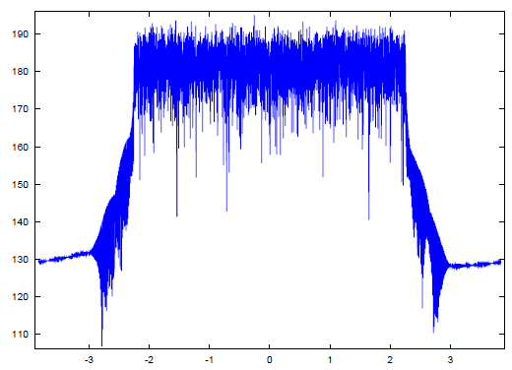
Typical OFDM Spectrum
(LTE 5MHz, with additional low-pass filter)
DC Null
4.515 MHz = (301/512)*7.68MHz
MobSys 2 2020

Slide 12

OFDMA
Spectral
Shaping and
Multiple-access
-ve freq
Is taken from a QAM alphabet, which can be different for each i, and with a different amplitude (power). Each chunk can be for a different user and/or service class.
Null carriers
+ve freq
DC
MobSys 2 2020

Slide 13
SC-FDMA
SC-FDMA is a single-carrier technique similar to OFDM. A key distinguishing point with 802.16e/m for PHY-layer.
A form of “DFT-precoded” OFDM
  Signals are conceived in the time-domain and then converted to frequency domain, frequency-translated and converted back.
Main advantage, less peaky => more efficient power-amplifier in UE TX chain
Main disadvantage, less flexible (for advanced techniques) RX structure in eNb.
  Note: implementation losses due to SC-FDMA in eNB/gNB reduce power savings in UE somewhat => use in 5G can be limited to coverage-limited scenarios / low-frequency bands and low-cost devices.
MobSys 2 2020

Slide 14

SC-FDMA
K-point
FFT
Spectral
Shaping +
Frequency
translation
-ve freq
Null carriers
+ve freq
Is taken from a QAM alphabet
DC
MobSys 2 2020

Slide 15
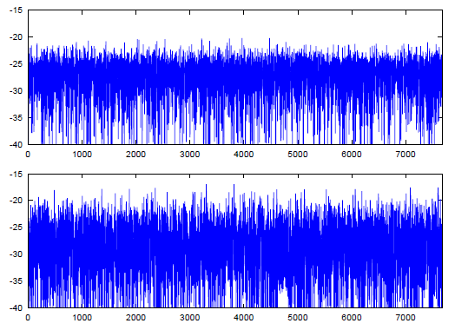
Peak-to-Average-Power Ratio Comparison
- 300 QPSK carriers (REs), 512 point IFFT
Squared Signal amplitude (dB)
6.2 dB (SC-FDMA,
4G LTE/5G)
9.49 dB (OFDMA,
WiMAX/5G)
MobSys 2 2020

Slide 16
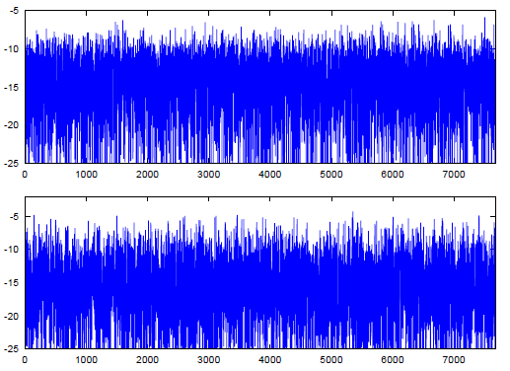
Peak-to-Average-Power Ratio Comparison
- 300 64QAM carriers (REs), 512 point IFFT
8.1 dB
10.7 dB
Smaller difference with 64QAM -> implementation loss due to sub-optimal eNb receiver will hurt more
MobSys 2 2020

Slide 17
OFDM (single-antenna) Inner Receiver (UE)
Zero-IF
RF
I
A/D + DAQ
(10-12 bit)
I
I/Q
Imbalance
Correction
I
Frequency
Correction
I[n]
Digital
Baseband
Inputs
Q
Q
Q
Q[n]
I[n]
Timing
Acquisition
From channel
Estimation unit
Q[n]
I[n]
Initial
Frequency
Acquisition
Q[n]
MobSys 2 2020

Slide 18
OFDM (single-antenna) Inner Receiver (UE)
Synchronization Elements
  Temporal acquisition
    Tends to be specific to standardized waveform, later for LTE
    Usually time-domain correlation with synchronization waveform, followed by coarse frequency offset estimation
    Detection of secondary synchronization signals (for framing) and BCH (channel estimation + decoding + CRC) allow for initial setup of UE
  Channel estimation and tracking
    Least-squares based with or without interpolation/smoothing depending on waveform (covered later for LTE pilots)
    Tracking usually IFFT and peak search
MobSys 2 2020

Slide 19
OFDM (single-antenna) Inner Receiver (UE)
I[n]
Prefix
Extraction
FFT
I[k]
Channel
Compen-
sation
I[k]
LLR
Unit
Digital
Baseband
Inputs
Q[n]
Q[k]
Q[k]
BroadbandChannel
Estimates
Pilot
extraction
To timing (DAQ) and frequency correction units, and I/Q imbalance
Channel
Estimation
MobSys 2 2020

Slide 20



Channel Compensation
  Receiver sees
  Gets channel estimate
Estimation error
  Under perfect estimate, sufficient statistics for decoding would be
Scaled Signal
Component
Signal dependent
Noise term
  Along with
MobSys 2 2020

Slide 21
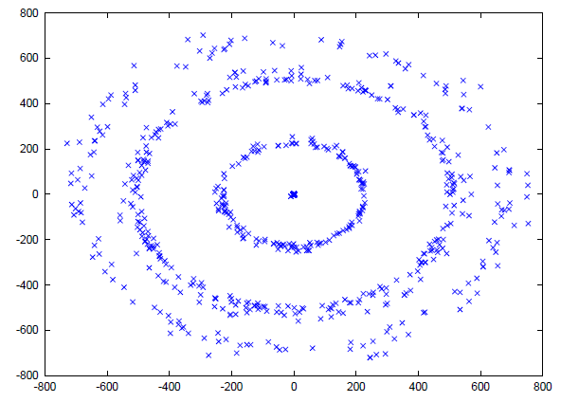
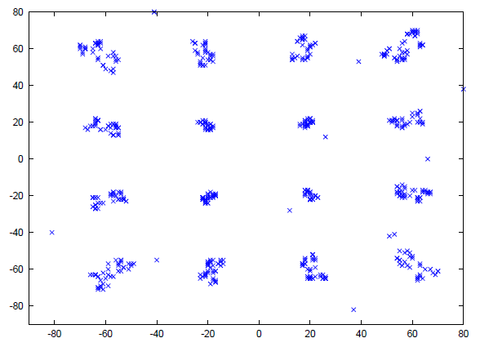
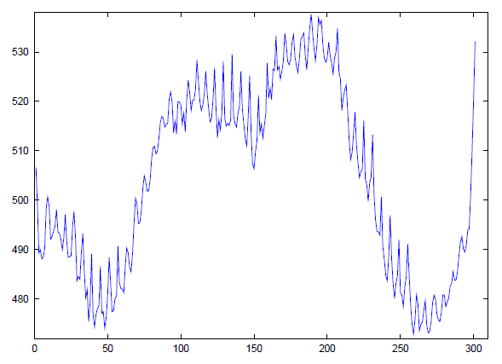
Channel Compensation (16QAM, 300 carriers)
At FFT output
After Channel compensation
Fairly “flat” channel (linear phase) after
channel estimation
MobSys 2 2020

Slide 22
Multiple-Antenna Transmission
MIMO = Multiple-Input Multiple-Output (e.g. 2 transmit antennas, 2 receive antennas)
MISO = Multiple-Input Single-Output (e.g. 2 transmit antennas, 1 receive antenna)
SIMO = Single-Input Multiple Output (e.g. 1 transmit antenna, 2 receive antennas)
Two goals
  Signal diversity (two channels are better than one)
  Multiplexing, send multiple data streams at the same time
MobSys 2 2020

Slide 23

MIMO Transmission
Encoder
IFFT
FFT
MIMO
LLR
Unit
IFFT
FFT
MIMO
Channel
Est.
  Looking at a particular dimension from an OFDM symbol
MobSys 2 2020

Slide 24
Channel Coding and HARQ
NR makes use of standard binary channel codes
  Multirate Rate LDPC codes for all data channels (Uplink and Downlink)
  3GPP Polar code for low-layer control channels and broadcast channel
Special low-rate coding for control channels (repetition) is also used
MobSys 2 2020

Slide 25
Incremental-Redundancy HARQ
Coded Bitstream
Punctured/Repeated into different “Redundancy Versions”
Round 1
Round 2
Round 3
Round 4
IR-based HARQ can be synchronous or asynchronous. Typically asynchronous
HARQ is used when sufficient control signaling is available to provide the round index
in parallel with the data. This allows the receiver to decode each round.
MobSys 2 2020

Slide 26
Incremental-Redundancy HARQ (pipelined Stop-and-wait)
slot duration
TX
R1
RX
R1
TX
NAK
R1
TX
R2
RX
R2
TX
NAK
R2
TX
R3
RX
R3
TX
ACK
R3
TX
R1
RX
R1
TX
NAK
R1
TX
R2
RX
R2
TX
ACK
R2
TX
R3
RX
R3
TX
ACK
R3
TX
R1
RX
R1
TX
NAK
R1
TX
R2
RX
R2
TX
NAK
R2
TX
R3
RX
R3
TX
ACK
R3
TX
R1
RX
R1
TX
ACK
R1
TX
R2
RX
R2
TX
NAK
R2
TX
R3
RX
R3
TX
ACK
R3
Because of processing delay (RX) and round-trip time, a simple stop-and-wait
HARQ protocol will be inefficient for high-throughput data. For this reason, new packets
are stored in parallel processes (pipeline stages) such that the transmitter does not have
to wait to send pending packets. In asynchronous (DL) HARQ, any process can occur in
any slot (since the process id is signalled), where as in synchronous (UL|) HARQ
each process is assigned to a particular slot and the number of processes is fixed.
MobSys 2 2020

Slide 27

Combining HARQ and Adaptive Modulation and Coding
The combination of HARQ and adaptive modulation allows for trading off rate and throughput on time-varying channels
Code Rate/Modulation chosen by AMC
bits/s/Hz
Average number of retransmissions
Experienced by protocol
T(R)
Long-term average rate (infinite interleaving)
Increasing rate gives more
throughput and more
Delay, but with diminishing
returns
R
MobSys 2 2020

Slide 28
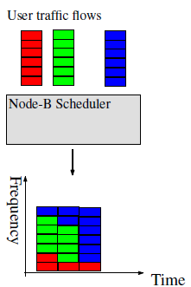
Multiuser Scheduling
Wideband Multiuser Scheduling
  Use feedback to let basestation select bands (as narrow as possible) to optimize cell throughput
  DL : requires feedback from UE on channel quality over whole system bandwidth
  UL : requires occasional wideband pilots from UE (sounding signals)
Channel
Quality
Indicators,
Queuing
Indicators (local
and remote)
MobSys 2 2020

Slide 29
Fairness based scheduling
Unfair
  Maximum cell throughput is achieved by allocating frequency to user who is strongest on that frequency
  Only fair if the number of frequency channels F is large compared to the number of users N
  Probability of a user getting no rate, e^{-F/U}
Proportionally-fair
  Tradeoff SNR gain for fairness, for large throughput measuring windows, it amounts to the maximum throughput policy
Max-min fairness
  Strict fairness on wideband channels
  Find permutation of users to bands such that minimum channel strength is maximum
MobSys 2 2020

Slide 30
Bands, Channels, Bandwidth Parts
NR operating band | Uplink (UL) operating band BS receive / UE transmit F_{UL,low} – F_{UL,high} | Downlink (DL) operating band BS transmit / UE receive F_{DL,low} – F_{DL,high} | Duplex Mode
n1 | 1920 MHz – 1980 MHz | 2110 MHz – 2170 MHz | FDD
n2 | 1850 MHz – 1910 MHz | 1930 MHz – 1990 MHz | FDD
n3 | 1710 MHz – 1785 MHz | 1805 MHz – 1880 MHz | FDD
n5 | 824 MHz – 849 MHz | 869 MHz – 894 MHz | FDD
n7 | 2500 MHz – 2570 MHz | 2620 MHz – 2690 MHz | FDD
n8 | 880 MHz – 915 MHz | 925 MHz – 960 MHz | FDD
n12 | 699 MHz – 716 MHz | 729 MHz – 746 MHz | FDD
n20 | 832 MHz – 862 MHz | 791 MHz – 821 MHz | FDD
n25 | 1850 MHz – 1915 MHz | 1930 MHz – 1995 MHz | FDD
n28 | 703 MHz – 748 MHz | 758 MHz – 803 MHz | FDD
n34 | 2010 MHz – 2025 MHz | 2010 MHz – 2025 MHz | TDD
n38 | 2570 MHz – 2620 MHz | 2570 MHz – 2620 MHz | TDD
n39 | 1880 MHz – 1920 MHz | 1880 MHz – 1920 MHz | TDD
n40 | 2300 MHz – 2400 MHz | 2300 MHz – 2400 MHz | TDD
n41 | 2496 MHz – 2690 MHz | 2496 MHz – 2690 MHz | TDD
n50 | 1432 MHz – 1517 MHz | 1432 MHz – 1517 MHz | TDD
n51 | 1427 MHz – 1432 MHz | 1427 MHz – 1432 MHz | TDD
n65 | 1920 MHz – 2010 MHz | 2110 MHz – 2200 MHz | FDD
n66 | 1710 MHz – 1780 MHz | 2110 MHz – 2200 MHz | FDD
n70 | 1695 MHz – 1710 MHz | 1995 MHz – 2020 MHz | FDD
n71 | 663 MHz – 698 MHz | 617 MHz – 652 MHz | FDD
n74 | 1427 MHz – 1470 MHz | 1475 MHz – 1518 MHz | FDD
n75 | N/A | 1432 MHz – 1517 MHz | SDL
n76 | N/A | 1427 MHz – 1432 MHz | SDL
n77 | 3300 MHz – 4200 MHz | 3300 MHz – 4200 MHz | TDD
n78 | 3300 MHz – 3800 MHz | 3300 MHz – 3800 MHz | TDD
n79 | 4400 MHz – 5000 MHz | 4400 MHz – 5000 MHz | TDD
n80 | 1710 MHz – 1785 MHz | N/A | SUL
n81 | 880 MHz – 915 MHz | N/A | SUL
n82 | 832 MHz – 862 MHz | N/A | SUL
n83 | 703 MHz – 748 MHz | N/A | SUL
n84 | 1920 MHz – 1980 MHz | N/A | SUL
n86 | 1710 MHz – 1780 MHz | N/A | SUL
Band = indicator of range of potential frequencies for the network
Frequency range designation | Corresponding frequency range
FR1 | 450 MHz – 6000 MHz
FR2 | 24250 MHz – 52600 MHz
NR operating band | Uplink (UL) and Downlink (DL) operating band BS transmit/receive UE transmit/receive F_{UL,low} – F_{UL,high} F_{DL,low} – F_{DL,high} | Duplex Mode
n257 | 26500 MHz – 29500 MHz | TDD
n258 | 24250 MHz – 27500 MHz | TDD
n260 | 37000 MHz – 40000 MHz | TDD
n261 | 27500 MHz – 28350 MHz | TDD
MobSys 2 2020

Slide 31
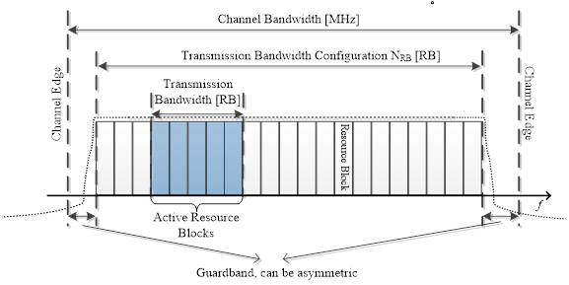
Bands, Channels, Bandwidth Parts
MobSys 2 2020

Slide 32
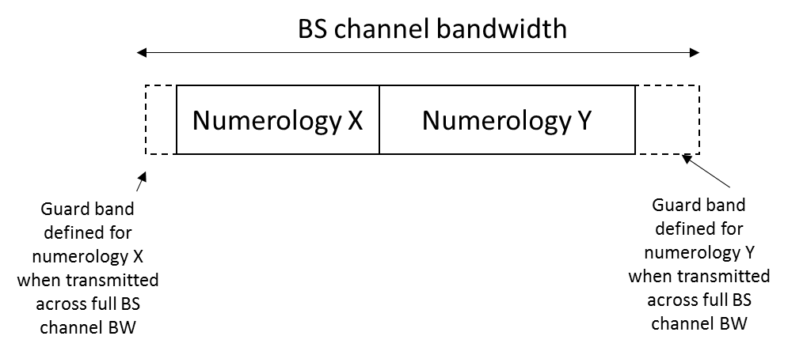
Bands, Channels, Bandwidth Parts
Bandwidth parts
  Partition of channel bandwidth with
    Subset of resource blocks
    Different numerology per part
      Sub-carrier spacing/slot timing
MobSys 2 2020

