Slide 1
Mobile Communication Systems
(MobSys)

Slide 2
Outline of Basic 5G (and a bit of 4G) procedures
Visit the procedures via the connection of a call from the perspective of the UE (User Equipment)
  Basic exchanges at the physical layer
  Synchronization and Broadcast Channels
  Random-Access
  Steady-state procedures
    Downlink
      Downlink Control Information (DCI) for Scheduling control
      Downlink Data transmission
    Uplink
      Uplink control information (UCI) for feedback
      Uplink data transmission
We will learn
  Time-frequency grid and 5G numerologies
  Notion of physical channels
  The roles of the different channels in the establishment and maintenance of a connection to the network
MobSys 3 2020

Slide 3
Basic terms
gNodeB/gNB = basestations
UE = UE equipment terminal
DL = Downlink
UL = Uplink
MobSys 3 2020

Slide 4
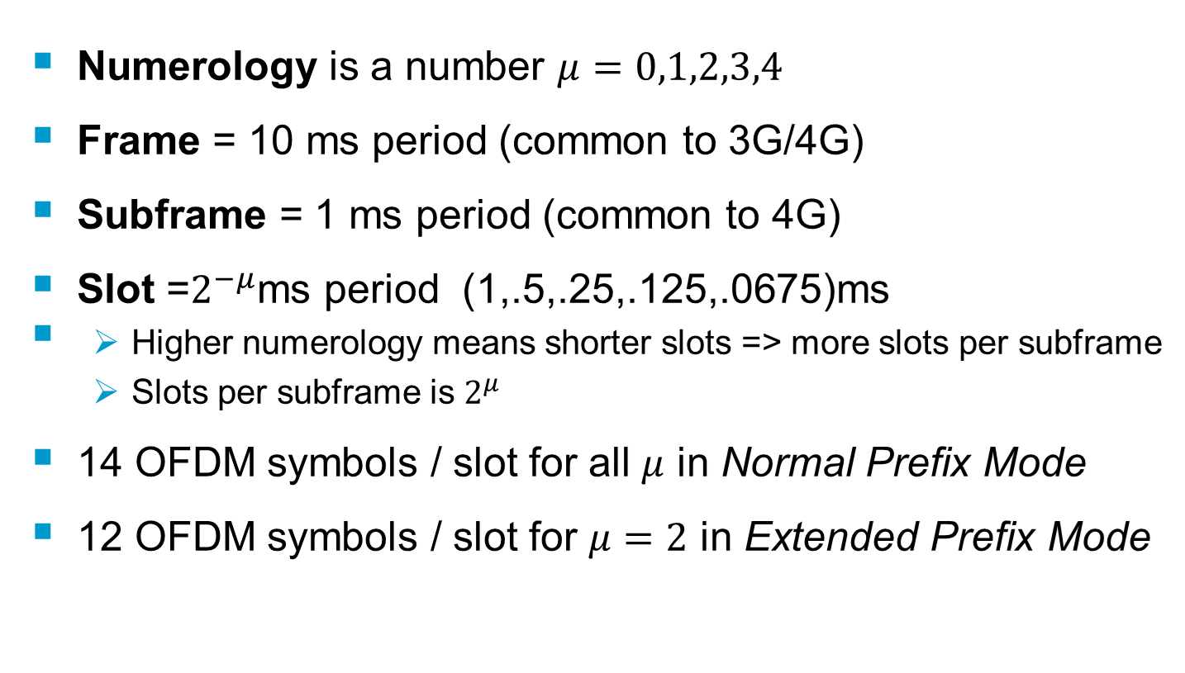
Frames, subframes, slots
MobSys 3 2020

Slide 5
Sub-frame and Frame
One frame = T_{f} =307200T_{s} = 10ms
T_{slot}= 15360T_{s}=500μs (here μ=1)
0
1
2
3
18
19
One subframe
Normal Prefix
Frequency
Domain
View
Here 14
OFDM
Symbols/slot
Extended Prefix
Time-domain
View
MobSys 3 2020

Slide 6
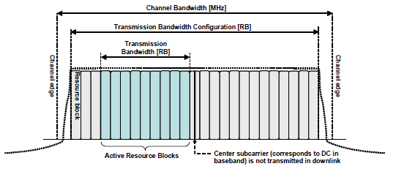
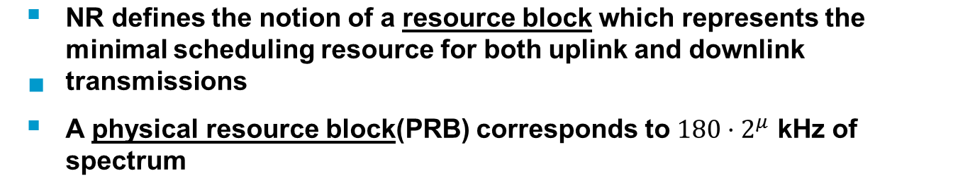
Resource blocks
MobSys 3 2020

Slide 7
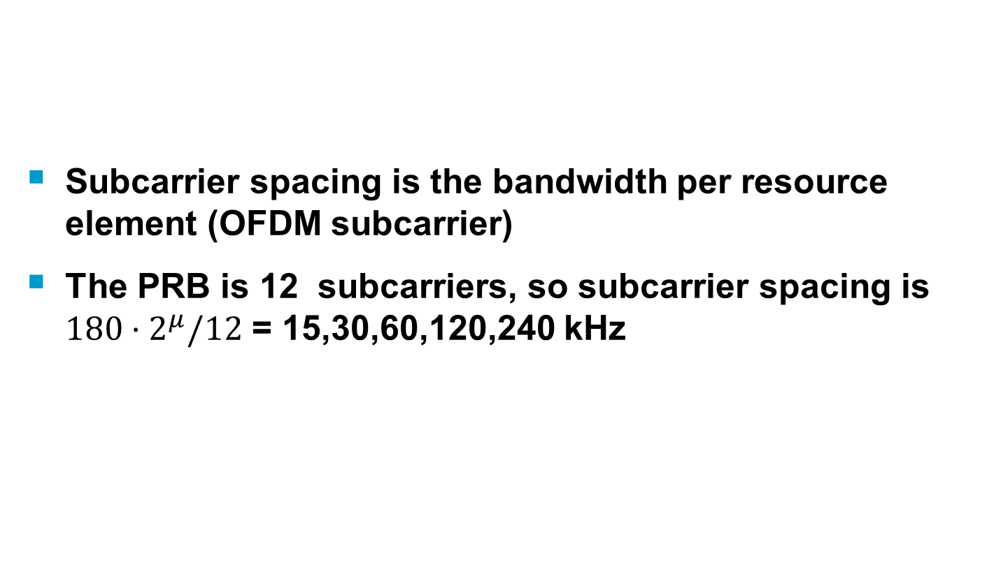
Subcarrier Spacing (SCS)
MobSys 3 2020

Slide 8
Common PRB Formats
Channel Bandwidth /SCS | Number PRB | Typical IDFT size | Number of Non-Zero Sub-carriers (REs) | Bandwidth
100MHz/30kHz | 273 | 4096 | 3276 | 98.28 MHz
100MHz/120kHz | 66 | 1024 | 792 | 95.04MHz
10MHz/15kHz | 52 | 1024 | 624 | 9.36 MHz
40MHz/30kHz | 106 | 1536 or 2048 | 1272 | 38.16 MHz
50MHz/30kHz | 133 | 2048 | 1596 | 47.88 MHz
PRBs are mapped onto contiguous OFDMA/SC-FDMA symbols in the time-domain with starting symbol in (1…14) and can have any length in (2…14). PRBs can be aggregated across slots when using repetitions
Each PRB is chosen to be equivalent to 12 sub-carriers of an OFDMA symbol in the frequency-domain
OFDMA/SC-FDMA Sub-carriers are termed “Resource Elements” (RE)
high-frequencies are nulled
  Spectral shaping
  Half the bandwidth loss w.r.t. WCDMA (22%)
MobSys 3 2020

Slide 9


Bandwidth parts
Channel Bandwidth is partitioned into so-called bandwidth parts (BWP)
  Defined by a starting PRB and size
  Can be overlapping
  Can have different numerologies (μ)
  Are UE-dependent except index 0 which is gNB-dependent (i.e. common to all UEs connected to the gNB)
One BWP is special – the SSB -
  Subcarrier-spacing is not arbitrary (15 or 30 for FR1, 120 or 240 for FR2)
Resource blocks in the grid are called the Common Resource Block (CRB)
  A BWP comprises a number of CRBs less than or equal to the total number of CRBs for the bandwidth configuration
SSB
InitialBWP
BWP2
BWP3
MobSys 3 2020

Slide 10
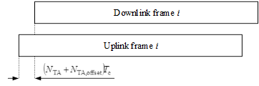
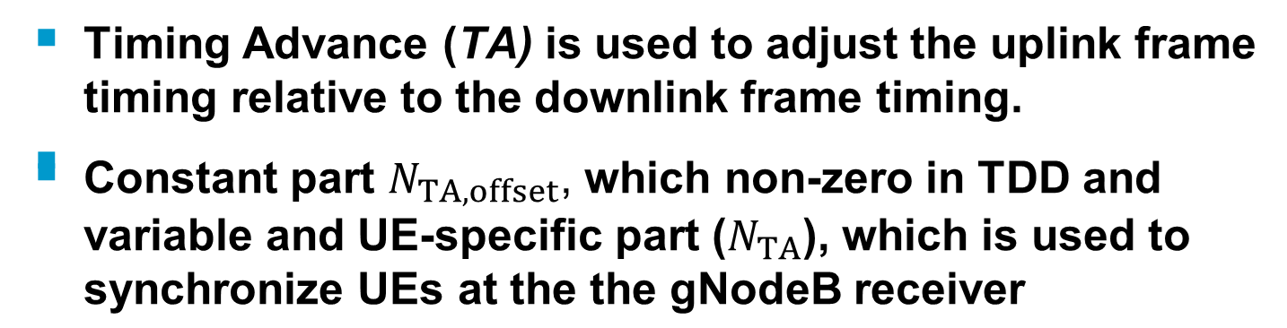
Timing Advance
MobSys 3 2020

Slide 11
Antenna Ports
An antenna port is defined such that the channel over which a symbol on the antenna port is conveyed can be inferred from the channel over which another symbol on the same antenna port is conveyed.
  Note: This is a purely “virtual” antenna port, also sometimes called logical antenna port
  Symbol here is Resource Element
A gNodeB can have any number of physical antenna ports
  64,128,192 are common sizes for so-called “Massive-MIMO” or “Active” Antenna arrays
  Through spatial signal processing the UE is made to believe that the antenna has a certain (smaller) number of logical antenna ports
  Each logical antenna port (which can be UE-specific) is associated with a signal that can be used to estimate the channel between the gNB and UE (or UE and gNB for the UL). This can be the SSB DMRS (Demodulation Reference Signal - later) or the PDSCH CSI-RS (Channel State Information Reference Signal – later)
MobSys 3 2020

Slide 12

Basic OFDM Transmission
DL is regular OFDM
UL can have a transform precoder (SC-FDMA), this is UE-specific and even physical channel specific
MobSys 3 2020

Slide 13
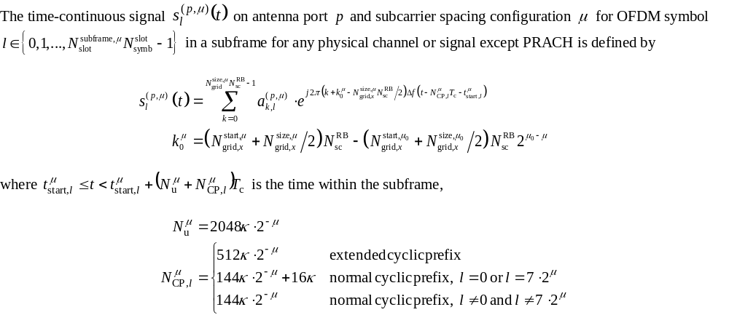
OFDM Waveform (except PRACH)
MobSys 3 2020

Slide 14
Synchronization Channels and PBCH Block
Used in standalone and non-standalone
Usually coincides with the initial BWP
A UE finds the gNodeB by detecting the “Synchronization” Channels
  Primary synchronization (PSS) channel gives initial timing and frequency measurements
  Secondary synchronization (SSS) channel gives additional frequency measurements and carries a small payload which conveys the “physical cell identifier”
Once timing/frequency/cell id are hypothesized
  Detection of PBCH => first real amount of System Information (MIB) for the network (a piece of the particular gNB configuration in standalone mode, just time information frame/slot in non-standalone)
MobSys 3 2020

Slide 15
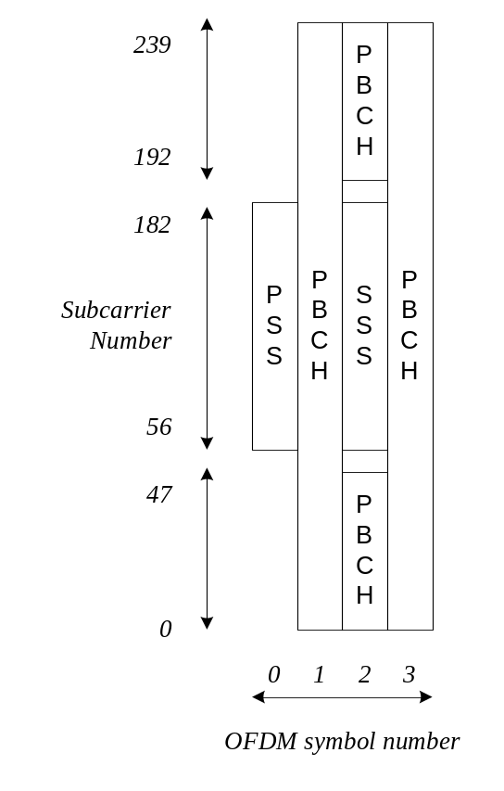
SSB allocations
Contains 4 signals
  PSS,SSS, PBCH, PBCH DMRS
  Over 4 symbols
  240 resource elements (20 PRBs)
This occurs in particular symbols in the first few slots of the first half-frame and repeats each frame
  Each SSB is mapped to a particular beam index
  A UE will try to measure multiple SSBs
MobSys 3 2020

Slide 16




SSB Beams and Time multiplexing
gNodeB Antenna
10ms
MobSys 3 2020

Slide 17
SSB Beams and Time multiplexing (2)
UE determines the strongest SSB index (Beam) and camps on it, while doing measurements of the other ones in case beam pattern changes because of mobility or another reason
SSB index is used later for transmission of the first uplink message to connect to the gNodeB (PRACH, later)
MobSys 3 2020

Slide 18
PBCH
The PBCH carries the MIB (24 bits)
It is coded using
  a binary polar code + rate-matching
  32-bit payload + 24-bit CRC
MobSys 3 2020

Slide 19
System Information
This is used only in Standalone operation
  Non-standalone provides the full NR radio configuration via LTE link and can skip this step
  In Standalone, UE has to receive radio configuration messages over NR link, in addition to the necessary protocol information
System information uses 2 types of DL transmission
  Physical Downlink Control Channel (PDCCH) carrying DCI
  Phyiscal Downlink Shared Channel (PDSCH) carrying payload
This information is conveyed over the initial BWP (SIB2,3,…) except for SIB1 which is special and linked to SSB resources
MobSys 3 2020

Slide 20
PDCCH
This is a special signaling channel which provides
  Scheduling information for DL traffic and signaling (PDSCH)
  Scheduling information for UL traffic and signaling (PUSCH)
  Power-control information
  RAN and 5GC Paging-related information
MobSys 3 2020

