Slide 1
Mobile Communication Systems
(MobSys)

Slide 2
Outline of Basic 5G (and a bit of 4G) procedures
Visit the procedures via the connection of a call from the perspective of the UE (User Equipment)
  Basic exchanges at the physical layer
  Synchronization and Broadcast Channels
  Random-Access
  Steady-state procedures
    Downlink
      Downlink Control Information (DCI) for Scheduling control
      Downlink Data transmission
    Uplink
      Uplink control information (UCI) for feedback
      Uplink data transmission
We will learn
  Time-frequency grid and 5G numerologies
  Notion of physical channels
  The roles of the different channels in the establishment and maintenance of a connection to the network
MobSys 4 2020

Slide 3
PDSCH (Physical Downlink Shared Channel)
Main workhorse for transmitting DL information (control and user-plane data)
Comprises many different transmission formats
  Low to high spectral efficiency through adaptive modulation
  Potential for spatio-frequency-time coding : Beamforming, superposition coding (MIMO)
Basic sub-functions
  The downlink physical-layer processing of transport channels consists of the following steps:
    Transport block CRC attachment;
    Code block segmentation and code block CRC attachment;
    Channel coding: LDPC coding;
    Physical-layer hybrid-ARQ processing;
    Rate matching;
    Scrambling;
    Modulation: QPSK, 16QAM, 64QAM and 256QAM;
    Layer mapping;
    Mapping to assigned resources and antenna ports.
MobSys 4 2020

Slide 4
PDSCH : DMRS + CSI-RS
The PDSCH has 2 associated reference signals
  DMRS (DeModulation Reference Signal)
    Used by receiver in UE to estimate the channel that is used PDSCH
      Channel = propagation channel AND gNodeB beamforming, i.e. UE knows that the beamforming applied by gNodeB on PDSCH is same as that applied on DMRS
    One set of orthogonal resources per logical antenna port
  CSI-RS (Channel State Information Reference Signal)
    Used by receiver in UE to estimate the real channel
      Used to feed the scheduler + beamforming algorithms in the gNodeB via feedback channels on the UL
MobSys 4 2020

Slide 5
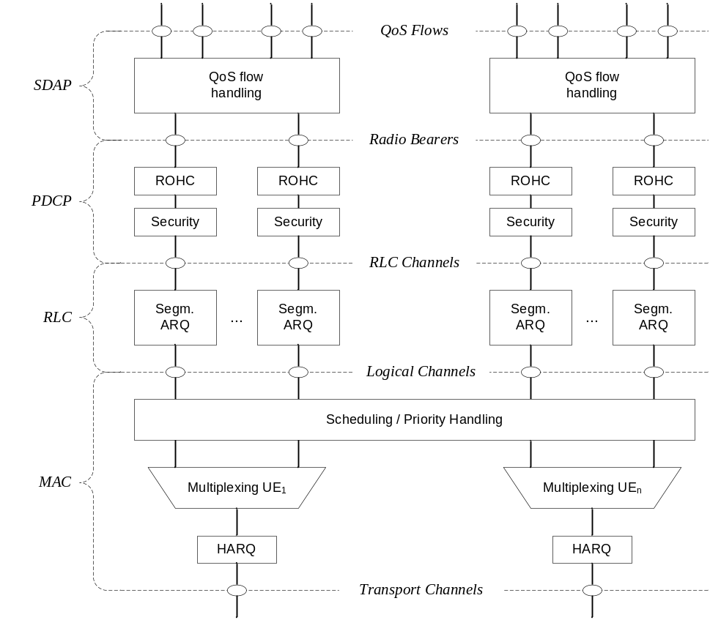
DLSCH (Downlink Shared Channel)
The transport channel that uses the PDSCH (this is the interface with the MAC layer)
  Downlink Shared Channel (DL-SCH) characterised by:
    support for HARQ;
    support for dynamic link adaptation by varying the modulation, coding and transmit power;
    possibility to be broadcast in the entire cell;
    possibility to use beamforming;
    support for both dynamic and semi-static resource allocation;
    support for UE discontinuous reception (DRX) to enable UE power saving.
MobSys 4 2020

Slide 6
HARQ
HARQ is a cross layer mechanism for PDSCH
  L2 (MAC) controls the retransmissions of DLSCH transport blocks based on low-layer signaling conveyed on the UL (via either PUCCH or PUSCH)
  With each retransmission L2 can change
    Redundancy version (instruction to channel encoder/decoder)
    Number of PRBs
    Modulation order
      Adaptive modulation via HARQ, can reduce latency after first failed transmission, “push the packet through by force”
  L1 uses a different code sequence for the same data for each redundancy version
    Incremental redundancy
    Coupled with LDPC channel code
MobSys 4 2020

Slide 7
Where we are
DL Synchronization channels (SSB)
PDCCH (DCI) for scheduling information
  Standalone. uses Initial BWP
PDSCH for transmitting DL data (until now only control signaling for System Information – standalone)
  Uses Initial BWP
System Information or 4G RRC (non-standalone) provide the Radio Configuration for UL transmission and initial DL configuration (standalone)
  Uplink now ready
MobSys 4 2020

Slide 8
Uplink Physical Channels
Uplink physical channels
  Physical uplink shared channel (PUSCH): Uplink data and/or feedback information for gNB scheduler
  Physical uplink control channel (PUCCH): Feedback information for gNB scheduler
  Physical random access channel (PRACH): Preambles for association
Signals
  DeModulation Reference Signal (DMRS) : For UL channel estimation in resources corresponding to PUSCH and PUCCH
  Sounding Reference signal (SRS)
  PTRS (Phase-Tracking Reference Signal)
MobSys 4 2020

Slide 9
Random-Access Procedures
During association PHY is responsible for transmission of
  Random access preamble (on PRACH). Number in 0..63 chosen by UE MAC
  Random access response grant (on PUSCH)
UE receives PRACH configurations and root sequences from BCH which allows for generation of PRACH
PRACH comprises
  Variable number of PRBs in one or a set of consecutive subframes reserved for random-access preambles
  It does not always use the same time/frequency grid as PUSCH/PDSCH! (can have small carrier spacing for large cells)
  Note: gNB can decide to schedule PUSCH for other users during PRACH slots
gNodeB
UE
Msg1 (PRACH)
Msg2 (RAR)
msg3
msg4
ACK/PUCCH
MobSys 4 2020

Slide 10
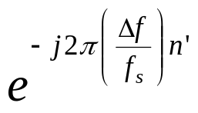
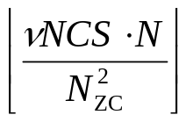
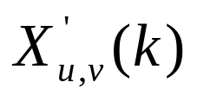
PRACH Transmitter
Preamble index from MAC (0…63) and rootSequenceIndex (1…838) from RRC prachConfigCommon OR
RRC mobilityControlInfo (during handover)
NCS from from RRC prachConfigCommon
N-point
IDFT
x
Frequency-domain transform of
ZC-preamble sequence and
frequency-shifted according to
RRC parameter in prachConfigCommon
Cyclic shift
MobSys 4 2020

Slide 11
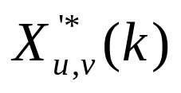


PRACH Receiver (gNB, once per rootSequenceIndex)
N-point
DFT
1024-point
IDFT
Preamble
detector
x
0
1
2
Signal
Presence
Indicates
Preamble is active
Time-offset in cyclic shift window is used to determine Timing advance for UE
Tradeoff between eNB PRACH detection procedure and maximum cell radius => many cyclic shifts = short timing offset tolerance
MobSys 4 2020
Notes:
r

Slide 12
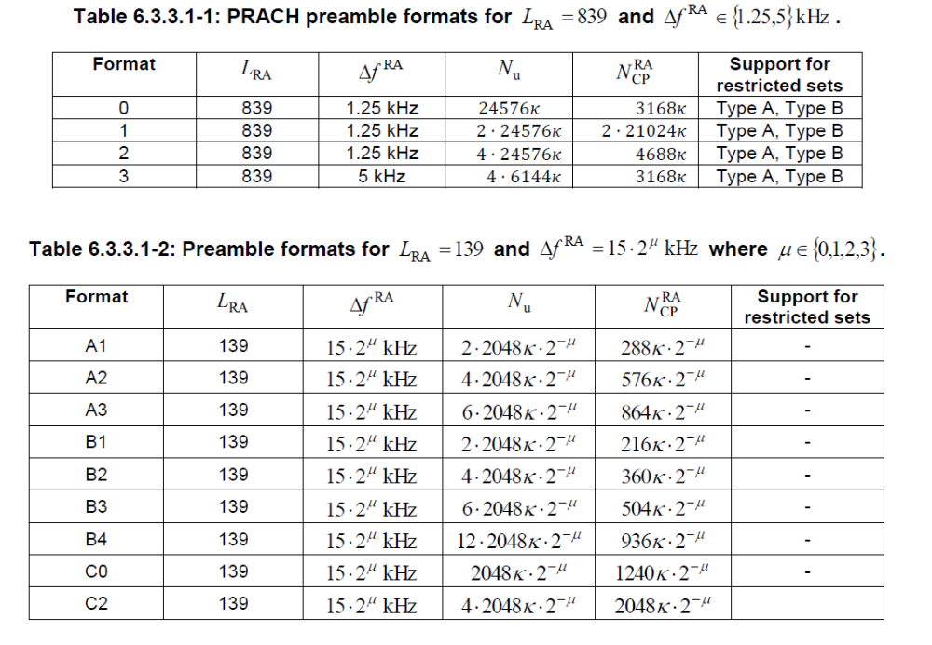
PRACH Formats
MobSys 4 2020

Slide 13
L1 Random Access
  PHY receives preamble index, target power, RA-RNTI and PRACH resource
  Power is set to
  Preamble is chosen using index and transmitted
  UE waits to detect PDCCH with the indicated RA-RNTI (temporary indicator during RA procedure verified with CRC mask) and delivers the associated PDSCH to MAC if decoding is sucessful
MobSys 4 2020

Slide 14
Random Access: Timing
After transmission of PRACH preamble UE waits for the period defined by the random access response window and 3 outcomes are possible:
  At the end of the window, if no response is received (or correctly decoded) on PDCCH, the UE PHY must be ready to re-transmit within 4 sub-frames upon request by higher layers
  If the random-access response is received within the window, but the corresponding payload does not contain a response to the transmitted preamble, the UE PHY must be ready to re-transmit within 5 sub-frames upon request by higher layers
  If a PDCCH with RA-RNTI is detected, the UE PHY will transmit on PUSCH, based on information in the grant message, within 6 sub-frames. If delay is configured in grant message, transmission will be postponed to next available UL slot.
MobSys 4 2020

Slide 15
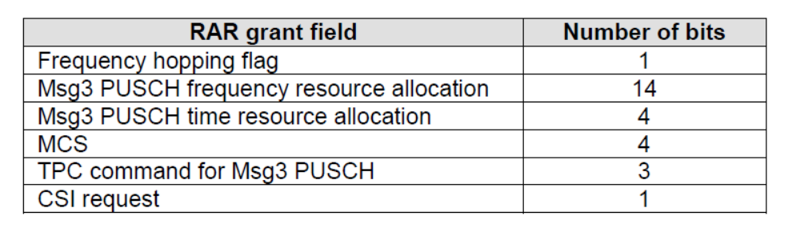
Random Access Response Grant (RAR grant)
27-bit PDSCH message from gNB MAC comprising
MobSys 4 2020

Slide 16
Timing Adjustments
The need for timing advance is fundamental in SC-FDMA/OFDMA systems (even FDD).
  Multiple-access nature of channel and requirement for orthogonality between users. This is because the users signals overlap in time, but not in frequency (unless SDMA is performed on uplink). Orthogonality ensures
    that no inter-user interference is present
    The gNB can use a common time reference for detection of all users
  Timing adjustments required to follow mobility of UE
  If timing difference plus channel duration is less than cyclic-prefix length, then orthogonality is maintained
MobSys 4 2020

Slide 17




Need for Timing Advance
Synchronization point of eNb RX
Superposition of
3 users
(time domain)
Uncertainty in symbol timing of UE signals
OFDM/SC-FDMA transmissions must be roughly synchronous at the gNB
The asynchronism is absorbed by the prefix at the gNB
MobSys 4 2020

Slide 18
Timing advance
UE receives timing advance commands from gNB and adjusts its timing for PUCCH/PUSCH/SRS transmissions
  It is a differential measure in multiples of 520.83333 ns (16 samples at 30.72 Ms/s, 1/9 of the cyclic prefix duration)
Two cases:
  Random-access phase
    UE Receives 11-bit command on RAR (random-access response, see MAC lecture) : multiples from 0 … 1282 (0-667 us, 0 – 200 km round-trip, 100 km cell)
    Here initial delay (due to propagation) is absorbed at gNB by cyclic structure and guard-time of PRACH and used to compute offset sent in RAR
  Steady-state
    Received by gNB MAC signaling
    A command received in slot (tti) n is to be applied in slot n+k
    Changes applied affect signal in slot n, not n-1 (i.e. samples are lost from frame n only)
MobSys 4 2020

Slide 19
Timing Advance
Subframe n (Timing advance
Sent by gNB MAC)
Subframe n+6
Lost samples in
Subframe n+6
Subframe n (Timing delay
sent by gNB MAC)
Subframe n+6
gained samples in
Subframe n+6
MobSys 4 2020

Slide 20
Back to the story … PUSCH
Now we have to describe the ULSCH/PUSCH
ULSCH is coded similary to DLSCH comprising
  Can use DFT precoding (SC-FDMA) or just regular OFDM
    SC-FDMA can be better for coverage in long-range networks
    OFDM is more suited for small-cells
    Configurable per-UE anyway
  LDPC coding
  Rate-matching
  Incremental redundancy
BUT
  It also contains PHY control information for feedback to gNB
MobSys 4 2020

Slide 21
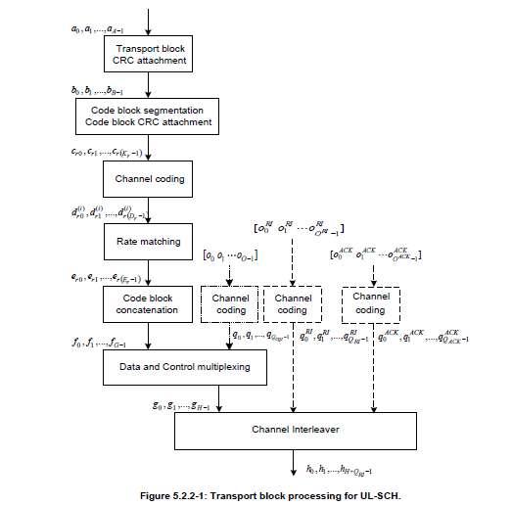
ULSCH Coding Chain
MIMO
RI
CSI
ACK/NAK
Control Information
MobSys 4 2020

Slide 22
Physical Uplink Control CHannel (PUCCH)
PUCCH is used to convey basic control information in absense of PUSCH allocations
  Occupies minimal resources (often 1 PRB) but can grow for payloads of up to a hundred (more usual sizes are around 11-22 bits for CQI)
  Primary functions are
    Periodic Scheduling Request
    ACK/NAK for DLSCH/PDSCH, usually 1 or 2 bits, but in some cases many more (TDD slots + MIMO + Carrier Aggregation)
    Periodic CQI reporting up to tens of bits
Formats
  0 : 2 bits ACK/NAK, 1 bit scheduling request, not for coverage-limited scenarios : 1 or 2 OFDM symbols , 1 PRB
  1 : 1-2 bits ACK/NAK (4-14 symbols, 1PRB), good for coverage
  2 : up to hundreds of bits, 1 or 2 OFDM symbols, multiple PRBs, not for coverage-limited scenarios => small-cell scenarios
  3 : up to hundreds of bits, (4-14 symobls, 1 or more PRBs), good for coverage
  4 : moderate payload, (4-14 symbols, 1 PRB, multiple-UE), good for coverage
MobSys 4 2020

Slide 23
PUCCH (formats 1)
Maximal frequency
separation for diversity
Spread-spectrum signal with, BPSK or QPSK and low-PAPR sequence
PUCCH RS (same as DRS)
MobSys 4 2020

Slide 24
CSI Reporting
CSI reporting serves several purposes
  Drive the gNB scheduler performing resource allocation. gNB gets broadband measurements can optimizes spectral allocation
  Provide stimulus for the gNB AMC algorithm by allowing the gNB to control spectral efficiency and error rates/delay seen be the UE
  Provide rank indications of the spatio-frequencial-temporal channel for MIMO mode selection
  Provide precoding information for MU-MIMO
CSI reports can be periodic or aperiodic as configured by the gNB
  Periodic on PUCCH
  Aperiodic along with data on PUSCH
Round trip times for feedback are 8ms (or less)
  AMC is possible (and effective) for slow mobile speeds (< 10 km/h)
MobSys 4 2020

Slide 25
AMC
AMC
Algorithm
gNB
TX
Inner
RX
LLR
Units
Channel
Decoder
DL
gNB
RX
CSI/RI/PMI
algorithms
UL
All units in RX contribute to CQI/RI/PMI
determination
MobSys 4 2020

Slide 26
Periodic CSI reporting
Reports scheduled on PUCCH
Wideband and UE-selected sub-band/beam reports
Type of signaling configured by gNB RRC
Period of reporting is configurable (1 ms is possible)
MobSys 4 2020

Slide 27
Scheduling process (gNB perspective)
Determine which UEs should be granted resources on the uplink (based on information from SRS and queuing feedback) and what resources to grant
Determine which UEs should be granted resources on the downlink (based on CQI, RI, and local queuing information)
Identify common control channel messages for format 2-x (TPC)
For each message decide on PDCCH format (1,2,4 or 8, 16 CCEs), and any power offset to be applied
Determine how much PDCCH resources (in terms of CCEs) will be required, how many OFDM symbols would be needed for these PDCCHs
If any PDCCH cannot be mapped to a CCE location (no more room)
  Increase OFDM symbol count for PDCCH (if possible)
  Drop some DLSCH allocations (lowest priority)
Allocate resources to PDCCHs
Check powers
Transmit
MobSys 4 2020

