Slide 1


Sales management system
By
20CE153 – Shruti unadkat
20CE154 – vismay vachhani
20CE155 – adnan vahora

Slide 2

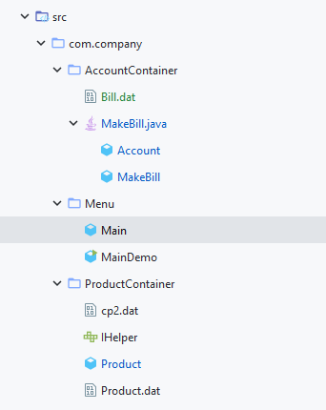
Packages
Account Container
Deals with user account
Menu
Deals with flow of program (Entry point)
Product Container
Deals with product attributes

Slide 3
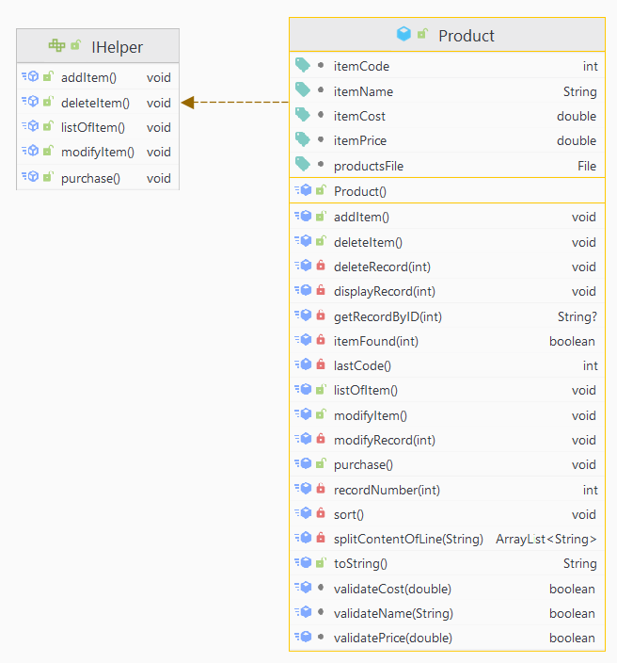
Product class
IHelper interface
To dealwith must have public methods
Uses Product.dat as product database

Slide 4
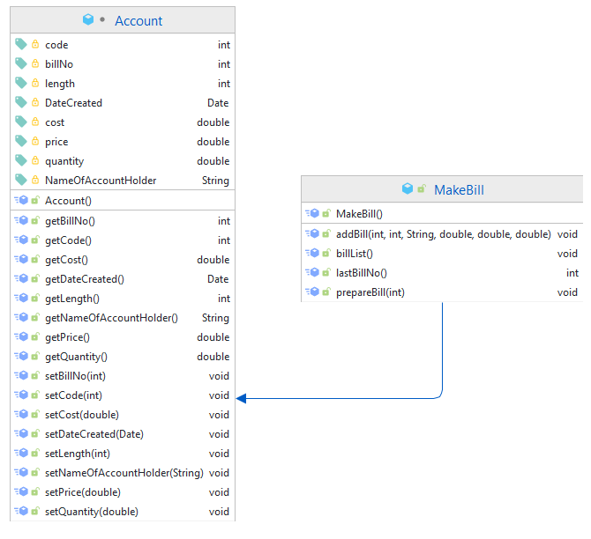
Account class
Basically deals with bill related methods and manage bill.dat

Slide 5
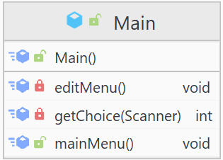
Main package
Deals with flow of program

Slide 6
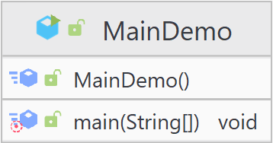
MainDemo class
Entrance point of program

Slide 7
Features according to rubrics
Classes and Objects
Inheritance
Packages
Exception Handling
Interfaces or Abstract classes

Slide 8
Consider visiting GitHub repository
SalesManagementSystem

