Slide 1


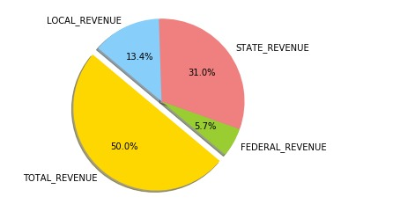
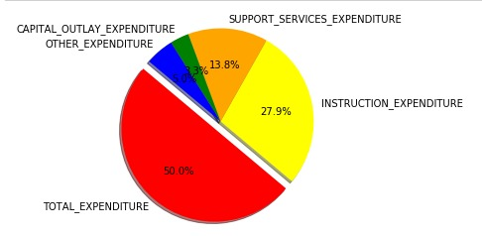
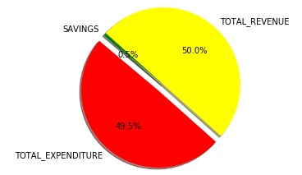
Comparing Revenue generated by schools in different State
Sachin Setty
School of Computer Science and Information Systems, Northwest Missouri State University
INTRODUCTION
THE RESULTS
Conclusions
Relationship between the revenue and expenditure of schools in a state in a particular year.
Different types of revenue and different kinds of expenditure is clearly seen
Different states with different percentages
Lot different difference between total expenditure and total revenue
Savings or difference between revenue earned and expenditure spent should be as less as possible, for this case we show is around 0.5%
MATERIALS / METHORDS
Different amount of revenues that are collected in a state.
Performed linear regression to train the model.
Used Decision Tree Classifier to implicitly perform feature selection
Poster Repository
Additional Resources
Acknowledgements
POSTERER REPOLINK
https://git-scm.com/downloads/logos
https://www.kaggle.com/revenue-and-expenditure/schooling-in-us#20 states_all.csv
https://scikit-learn.org/stable/modules/generated/sklearn.tree.DecisionTreeClassifier.html
.
https://github.com/settysachin16/MLProjectPoster

