Slide 1
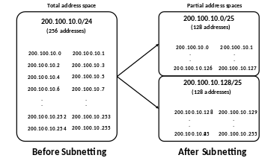
IPv4 Subnetting By: Mujahid Tabassum - 2026

Slide 2
Agenda – Part 1
IP Addressing Problem
Subnetting Advantages
Subnetting
On a boundary
Within a boundary

Slide 3
IP Addressing: Subnets

Slide 4
Recap – Network/Broadcast/Host Addresses
Example 198.22.45.105/25
Network Address : 198.22.45.0/25
Broadcast Address: 198.22.45.127
Host Address Range : 198.22.45.1 -> 198.22.45.126 (2⁷-2 = 126 hosts)
IP Address: 198.22.45.105 Binary: 11000110.00010110.00101101.01101001
Subnet mask: 255.255.255.128 Binary: 11111111.11111111.11111111.10000000
Network Address: 198.22.45.0/25 Binary: 11000110.00010110.00101101.00000000
Broadcast Address: 198.22.45.127 Binary: 11000110.00010110.00101101.01111111
first Host Address : 198.22.45.1 Binary: 11000110.00010110.00101101.00000001
Last Host Address : 198.22.45.126 Binary: 11000110.00010110.00101101.01111110

Slide 5
Recap – Network/Broadcast/Host Addresses
Example 10.1.50.143/16
Network Address : 10.1.0.0/16
Broadcast Address: 10.1.255.255
Host Address Range: 10.1.0.1 -> 10.1.255.254 (2¹⁶-2 = 65534 hosts)
IP Address: 10.1.50.143 Binary: 00001010.00000001.00110010.10001111
Subnet mask: 255.255.0.0 Binary: 11111111.11111111.00000000.00000000
Network Address: 10.1.0.0/16 Binary: 00001010.00000001.00000000.00000000
Broadcast Address: 10.1.255.255 Binary: 00001010.00000001.11111111.11111111
first Host Address : 10.1.0.1 Binary: 00001010.00000001.00000000.00000001
Last Host Address : 10.1.255.254 Binary: 00001010.00000001.11111111.11111110

Slide 6
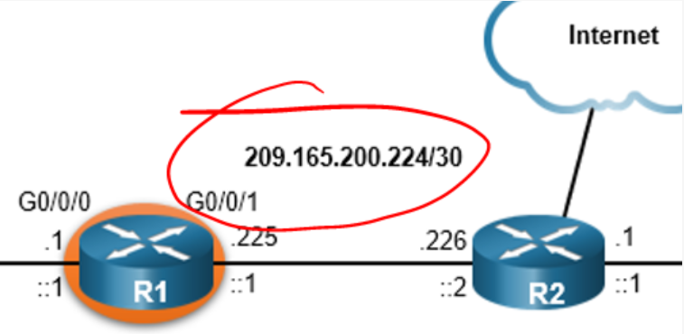
Recap – Network/Broadcast/Host Addresses
From Last Slide Deck (Week6, talk 1):
Network Address
Broadcast Address
Number of Hosts
First host address
Last host address
IP Address: 209.165.200.224 Binary: 11010001.10100101.11001000.11100000
Subnet mask: 255.255.255.252 Binary: 11111111.11111111.11111111.11111100
Network Address: 209.165.200.224/30 Binary: 11010001.10100101.11001000.11100000
Broadcast Address: 209.165.200.227 Binary: 11010001.10100101.11001000.11100011
first Host Address : 209.165.200.225 Binary: 11010001.10100101.11001000.11100001
Last Host Address : 209.165.200.226 Binary: 11010001.10100101.11001000.11100010
Number of Hosts: 2² – 2 = 2

Slide 7
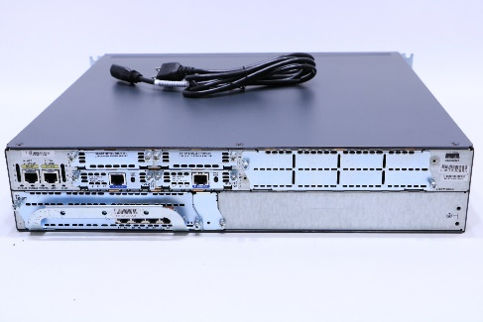
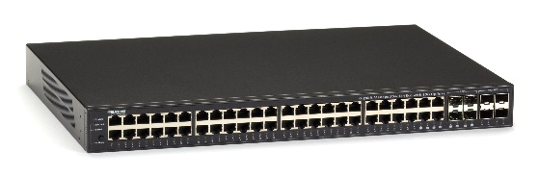




Router
Shop
Warehouse
Office
Switch

Slide 8
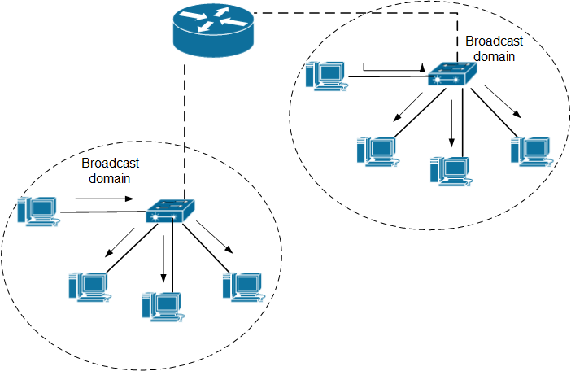
IP Addressing: Problem
Many protocols (e.g. ARP) need to use broadcast
As you know – switches send broadcasts on all ports
Only device that stops broadcast is a Router
PROBLEM: hosts generating excessive broadcasts and negatively affect the network
This Photo by Unknown Author is licensed under CC BY-SA
Notes:
A collection of interconnected switches forms a single broadcast domain. Only a network layer device, such as a router, can divide a Layer 2 broadcast domain. Routers are used to segment broadcast domains, but will also segment a collision domain.
When a device sends a Layer 2 broadcast, the destination MAC address in the frame is set to all binary ones.
The Layer 2 broadcast domain is referred to as the MAC broadcast domain. The MAC broadcast domain consists of all devices on the LAN that receive broadcast frames from a host.
When a switch receives a broadcast frame, it forwards the frame out each of its ports, except the ingress port where the broadcast frame was received. Each device connected to the switch receives a copy of the broadcast frame and processes it.
Broadcasts are sometimes necessary for initially locating other devices and network services, but they also reduce network efficiency. Network bandwidth is used to propagate the broadcast traffic. Too many broadcasts and a heavy traffic load on a network can result in congestion, which slows down network performance.
When two switches are connected together, the broadcast domain is increased, as seen in the second half of the animation. In this case, a broadcast frame is forwarded to all connected ports on switch S1. Switch S1 is connected to switch S2. The frame is then also propagated to all devices connected to switch S2.

Slide 9
IP Addressing: Broadcast
Reduce the size of the network into smaller Subnets to create smaller broadcast domains: Subnetting
IP Address
Before
Subnetting
Network portion
Host portion
After
Subnetting
Network portion
Subnet portion
Host portion

Slide 10
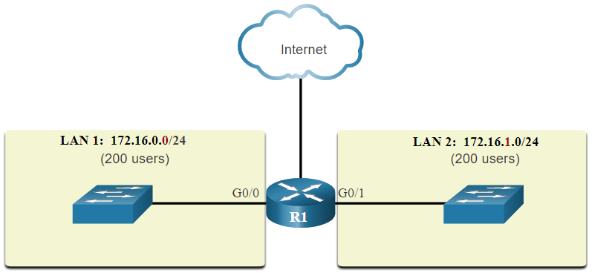
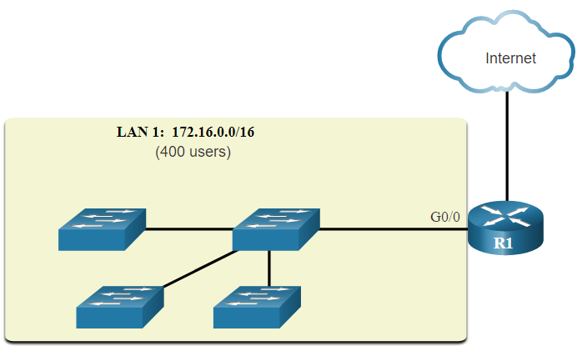
IP Addressing: Broadcast
Reduce the size of the network into smaller Subnets to create smaller broadcast domains: Subnetting
subnetting
172.16.0.0 /16 is “subnetted” into two subnets of 200 users each: 172.16.0.0 /24 and 172.16.1.0 /24
Before
Subnetting
Network portion
Host portion
After
Subnetting
Network portion
Subnet portion
Host portion

Slide 11
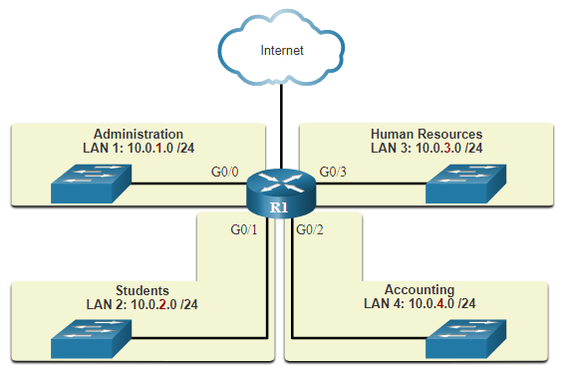
IP Addressing: Subnetting Advantages
10.0.0.0 /8 is divided into four subnets: 10.0.1.0/24, 10.0.2.0/24, 10.0.3.0/24 and 10.0.4.0/24
Subnetting advantages:
Reduces overall network
Improves network performance
implement security policies between subnets
Protects devices from abnormal broadcast traffic

Slide 12
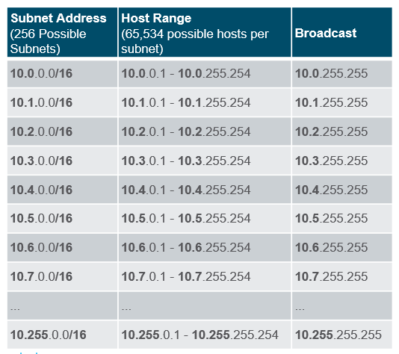
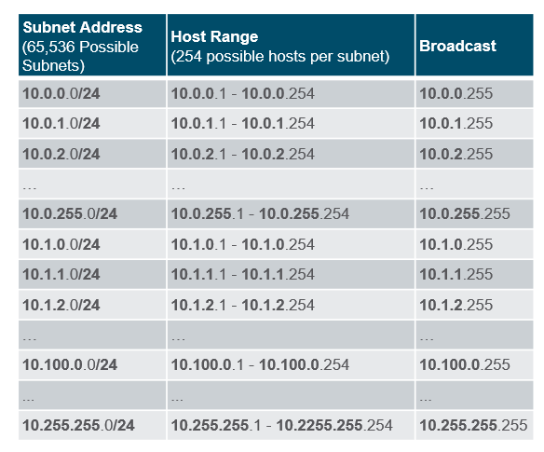
IP Addessing: Subnetting on a Boundary
Networks are most easily subnetted at the octet boundary of /8, /16, and /24.
Example: 10.0.0.0/8 subnetted using /16 and /24

Slide 13
IP Addressing: Subnetting within a Boundary
Example: subnetting the 192.168.1.0/24 network
Prefix | Subnet mask | Subnet mask (binary, last octet) | # subnets | #hosts
/25 | 255.255.255.128 | .10000000 | 2 | 126
/26 | 255.255.255.192 | .11000000 | 4 | 62
/27 | 255.255.255.224 | .11100000 | 8 | 30
/28 | 255.255.255.240 | .11110000 | 16 | 14
/29 | 255.255.255.248 | .11111000 | 32 | 6
/30 | 255.255.255.252 | .11111100 | 64 | 2

Slide 14
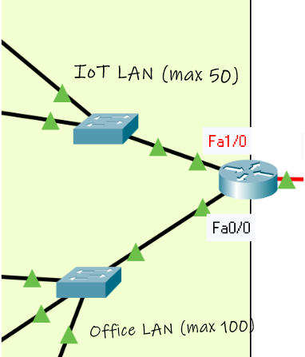
IP Subnetting: Example Problem
You’re asked to design a subnetting solution for a SOHO (small office/home office)
Given a network address of 192.168.100.0/24, create a subnet that supports the following:
Create 2 LANs: IoT LAN and Employee LAN
Hosts on IoT LAN: 50
Hosts Office LAN: 100

Slide 15
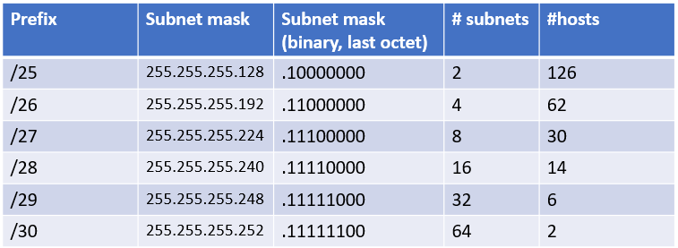
IP Subnetting: Example Problem
Select subnet mask that satisfies criteria: Create 2 LANs: hosts on IoT LAN: 50, hosts Office LAN: 100
Subnetting 192.168.100.0/24 to /25 gives the following subnets:
Create Table with all possible subnet masks and choose one that matches criteria.
Subnet | Host Range | Broadcast
192.168.100.0/25 | 192.168.100.1->192.168.100.126 | 192.168.1.127
192.168.100.128/25 | 192.168.100.129->192.168.100.254 | 192.168.1.255

Slide 16
Special Use IPv4 addresses
Network and Broadcast addresses - within each network the first and last addresses cannot be assigned to hosts
Loopback address - 127.0.0.1 a special address that hosts use to direct traffic to themselves
Link-Local address - 169.254.0.0 to 169.254.255.255 (169.254.0.0/16) addresses can be automatically assigned to the local host
There are more – referred to as Bogon Addresses
Not routed publicly

Slide 17
Classless Inter-Domain Routing(CIDR)
Using this approach to Subnetting is also called CIDR
Breaks from the old classful addressing approach in the old days
Used be IANA to issue address “blocks”
Rules:
All IP addresses must be contiguous
Block size must be the power of 2 (2^{n})
First IP address of the Block must be evenly divisible by the size of the block.(always true if the host part of 1st address is all 0s)

Slide 18
Question
Your Router has the following IP address on FastEthernet0/0: 172.16.2.1/23. Which of the following are valid host addresses on the LAN connected to FastEthernet0/0.
172.16.1.99
172.16.1.198
172.16.2.255
172.16.3.0

