Slide 1
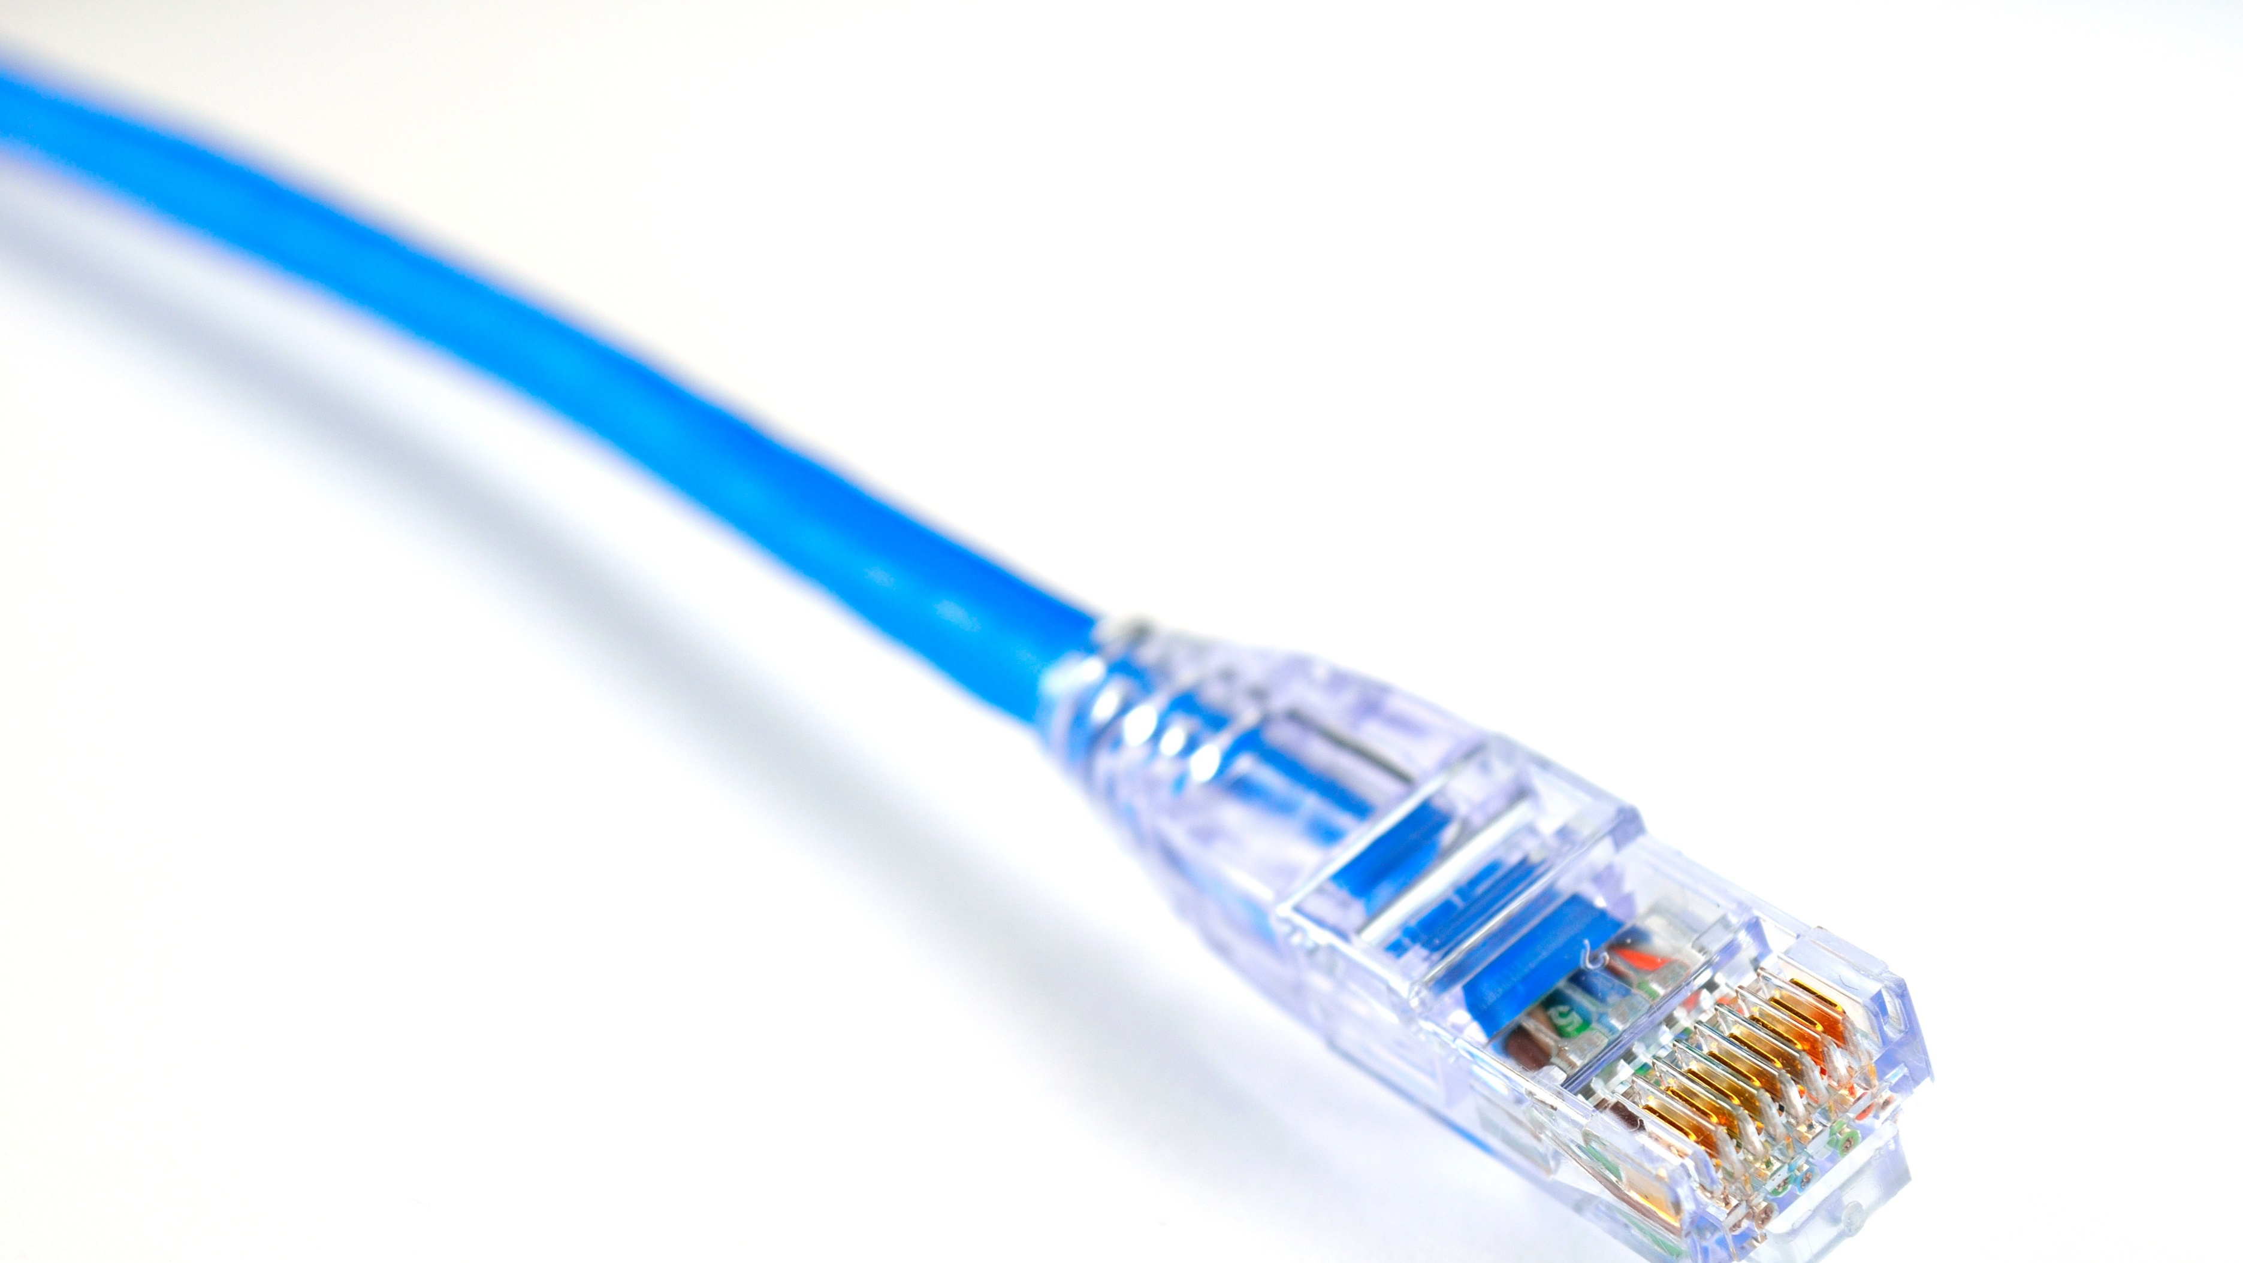
Ethernet Cables
Overview of Ethernet Cable Standards
Mujahid Tabassum 2026

Slide 2
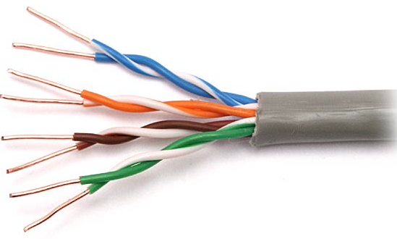
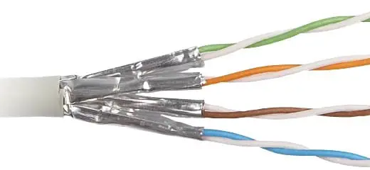



Introduction
Ethernet cables connect devices within local networks.
Developed over the years to support higher speeds & reduce interference.
Classified by "Category" and Construction Type
(e.g. Unshielded Twisted Pair, Shielded Twisted Pair/Foil Twisted Pair).

Slide 3
Main Ethernet Categories
Cat5e
Speeds up to 1 Gbps.
Enhanced to reduce crosstalk
Cat6
1 Gbps possible for distances up to 100 meters. 10 Gbps possible under 55 meters.
Better performance and reduced crosstalk compared to Cat 5e.
Cat6a (augmented offers 10 Gbps up to 100 meters)
Cat7
Speeds up to 10 Gbps. Uses shielded twisted pairs for less crosstalk. Stricter standards for shielding
Cat8
Designed for Data Centres where 25-40Gbps is required
Shielded

Slide 4
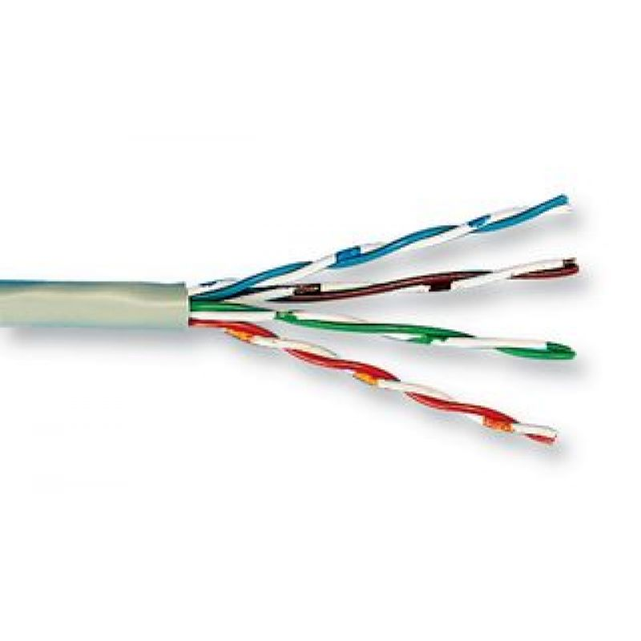
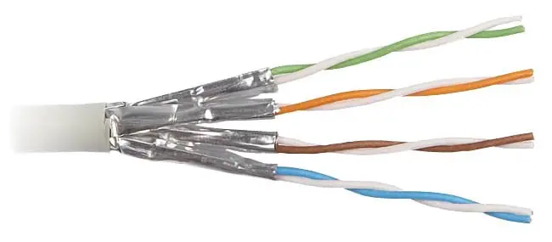
Construction
UTP (Unshielded Twisted Pair)
The most common type used in most installations.
STP (Shielded Twisted Pair)
Has shielding to prevent external interference.

Slide 5
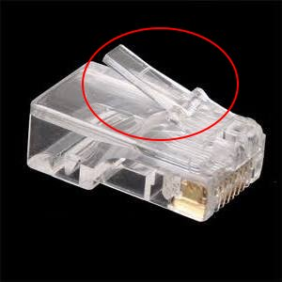
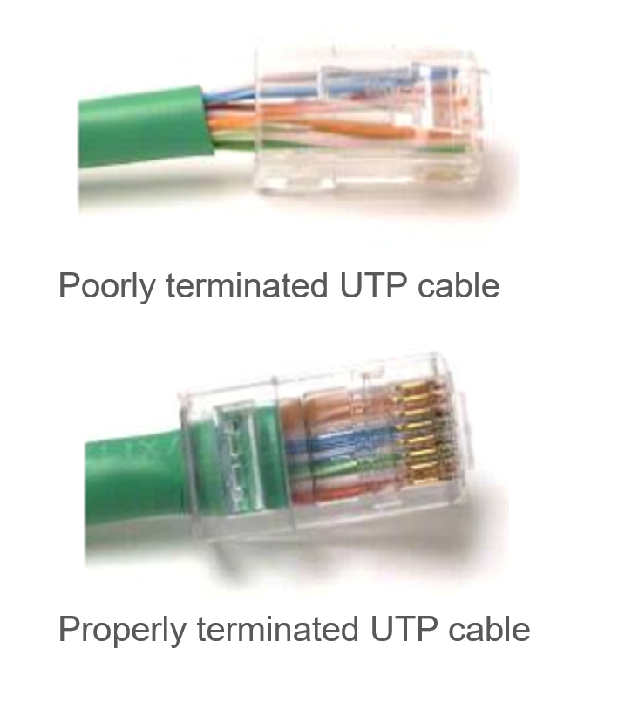
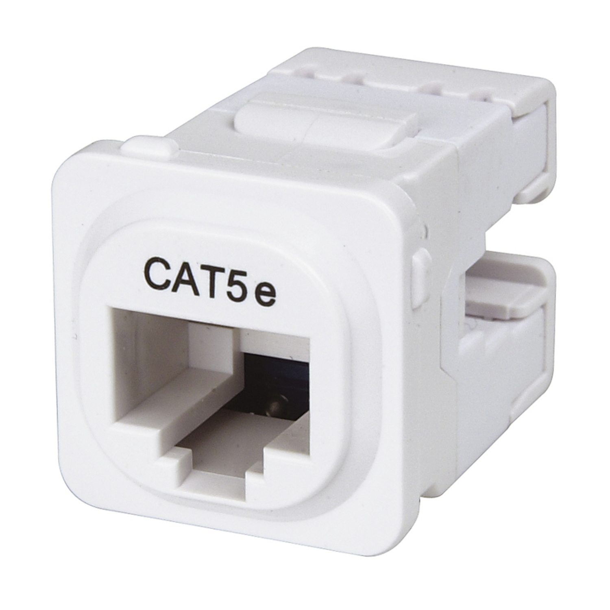
Connectors
RJ45 connectors used on cables
RJ45 sockets used on devices/walls
E.g. switches
This Photo by Unknown Author is licensed under CC BY-SA

Slide 6
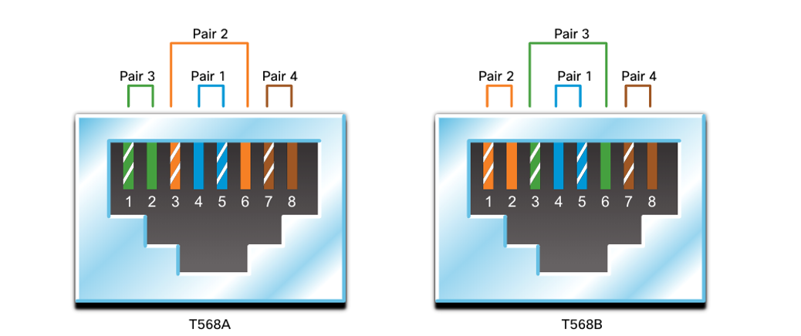
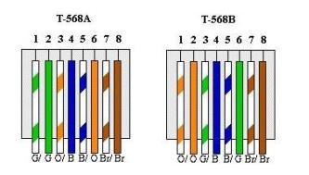
Wiring Standards
8 wires, how/what order do you connect them?
The two most common standards for Ethernet cable wiring are T568A and T568B.
Once the same standard is used at each end, there should be no problem.
This Photo by Unknown Author is licensed under CC BY-SA

