Slide 1
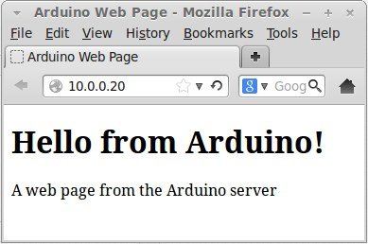
Application Layer: HTTP
Frank Walsh

Slide 2
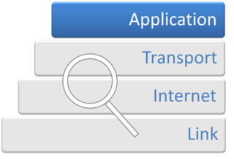
Application Layer
The application layer provides the interfaces and protocols needed by users/applications to access the network
It facilitates the users/network-based applications to use the services of the network.
Provides services/protocols that support user authentication, naming network devices, formatting messages, and e-mails, transfer of files etc.
This Photo by Unknown Author is licensed under CC BY-SA

Slide 3
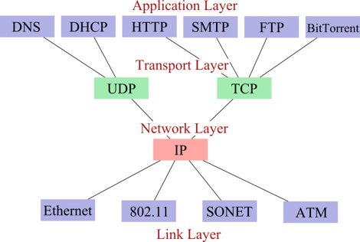
TCP/IP Protocol Stack
MQTT

Slide 4
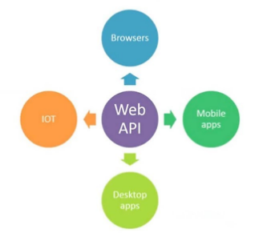
Web APIs
Programmatic interface exposed via the web
Uses open standards typically with request-response messaging.
Messages in well known format(e.g. JSON)
HTTP as transport
URLs
Example would be Restful web service
Typical use:
Expose application functionality via the web
Machine to machine communication
Distributed systems

Slide 5

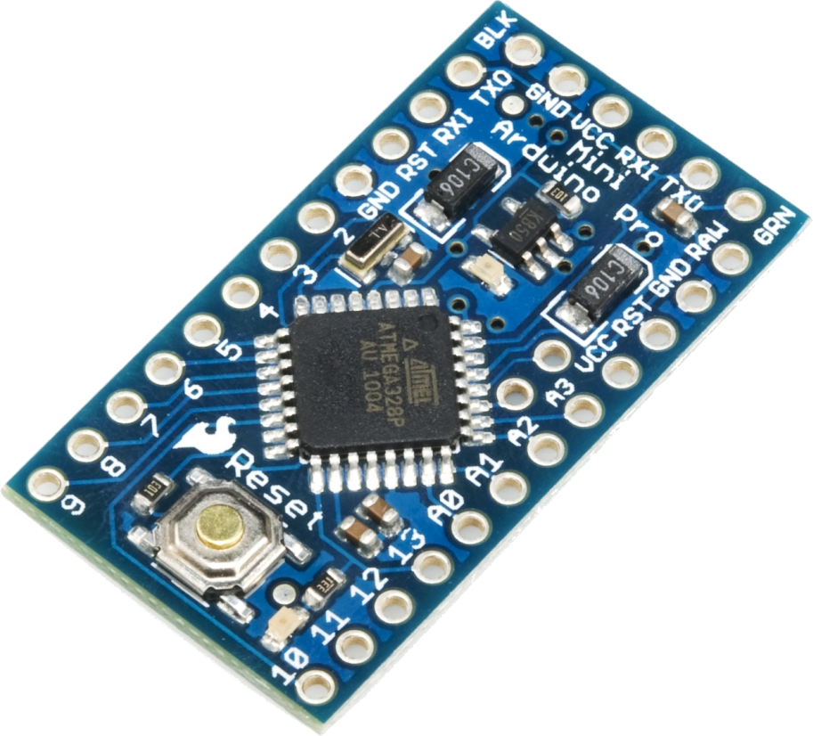
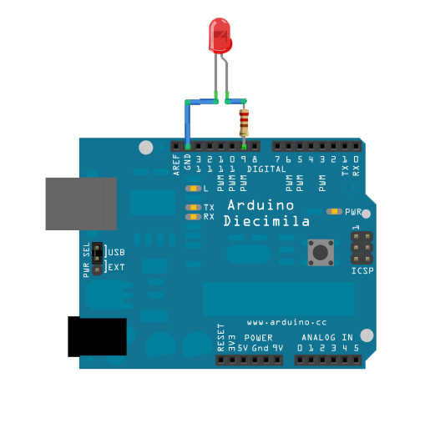
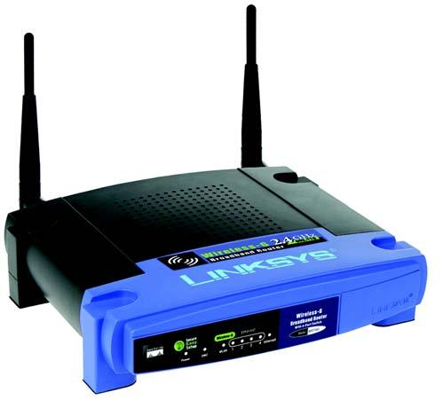
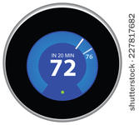
What's a Web API
Typically implements HTTP
processes HTTP requests
Usually runs on machine connected to a network
Has an IP address
Serves up resources
Ideally in a "restful" manner
Many different types of devices can run a web API...

Slide 6
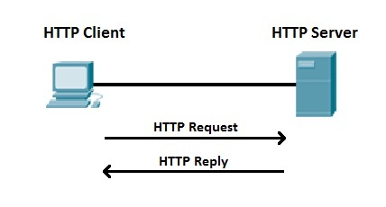
What’s HTTP
HyperText Transfer Protocol
Protocol used in World Wide Web
http://www.setu.ie
Your browser communicates using HTTP (HTTP Client)
Devices communicate using HTTP
Simple, ubiquitous.

Slide 7
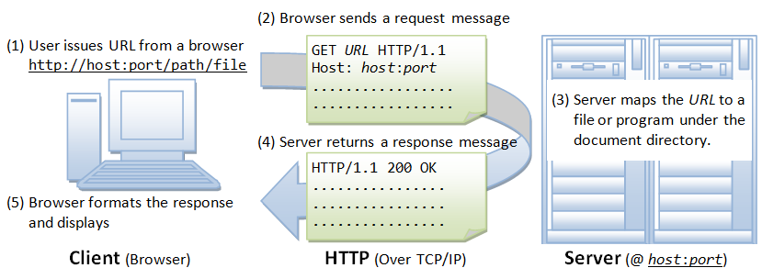

HTTP request from an application.
(1) URL used to create HTTP request http://host:port/path/to/resource
(2) App sends a request message
GET /path HTTP 1.1
(5) App processes response
This Photo by Unknown Author is licensed under CC BY-NC

Slide 8
HTTP: The Method/Verb
HTTP method
(1) URL used to create HTTP request http://host:port/path/to/resource
(2) App sends a request message
GET /path HTTP 1.1
(5) App processes response
This Photo by Unknown Author is licensed under CC BY-NC

Slide 9
HTTP: The URL
A URL (Uniform Resource Locator) uniquely identifies a resource over the web. protocol://hostname:port/path
There are 4 parts in a URL:
Protocol: The application-level protocol used by the client and server, e.g., HTTP, FTP, and telnet.
Hostname: The domain name (e.g., www.nowhere123.com) or IP address (e.g., 192.128.1.2) of the server.
Port: The TCP port number that the server is listening for incoming requests from the clients.
Path-and-file-name: The name and location of the requested resource, under the server document base directory.
Example, for http://www.nowhere123.com/docs/index.html
the communication protocol is HTTP
he host is www.nowhere123.com.
The port number was not specified, and takes default number, which is TCP port 80 for HTTP.
The path for the resource to be located is "/docs/index.html".

Slide 10
HTTP: The Request
HTTP clients (e.g. a browser or Python module) translates a URL into a request message according to the specified protocol; and sends the request message to the server.
For example, the client translated the URL http://www.nowhere123.com/doc/index.html into the following request message:
GET /docs/index.html HTTP/1.1 Host: www.nowhere123.com Accept: image/gif, image/jpeg, */* Accept-Language: en-us Accept-Encoding: gzip, deflate User-Agent: Mozilla/4.0 (compatible; MSIE 6.0; Windows NT 5.1) (blank line)

Slide 11
HTTP: The Response
When this request message reaches the server, the server can take either one of these actions:
The server interprets the request received, maps the request into a file under the server's document directory, and returns the file requested to the client.
The server interprets the request received, maps the request into a program kept in the server, executes the program, and returns the output of the program to the client.
The request cannot be satisfied, the server returns an error message.
An example of the HTTP response message is below:
HTTP/1.1 200 OK
Date: Sun, 18 Oct 2009 08:56:53 GMT
Server: Apache/2.2.14 (Win32)
Last-Modified: Sat, 20 Nov 2004 07:16:26 GMT
Content-Length: 44
Connection: close
Content-Type: text/html
<html><body><h1>It works!</h1></body></html>

Slide 12

HTTP Protocol: Content-Type Header
The Content-Type tells the client what the content type of the returned content.
Also known as “MIME” ,”media type”, "content type")
a video file might be audio/mpeg, or an image file image/png).
The Internet Assigned Numbers Authority (IANA) is the official authority for the standardization and publication of these classifications.

Slide 13
HTTP: The URL Query String
Query string used to include data in a URL. For example
https://www.myhome.com/heating?key=jkfgjsdkdfhg
The server can use the query string to execute logic associated with that resource. For example, check if the key is valid
Remember OpenWeather API…
Query String

Slide 14
HTTP Methods (“typical uses”)
GET
Request resource without sending data
PUT
Modify/replace resource with data that you are sending
POST
Create new resource with data that you are sending
DELETE
Delete resource without sending data

Slide 15
HTTP: The Body
An optional body containing data associated with the message.
For a HTTP request, the body can contain:
content of an HTML form
commands for a device
For a HTTP response, the body can be:
data associated with a response.
The presence of the body and its format is specified by the start-line and HTTP headers.

Slide 16


cURL - Client for URLs
A command-line tool for transferring data using HTTP, HTTPS, and many other protocols.
Lets you talk directly to web APIs or servers.
Works from any terminal - no browser required.
Great for testing IoT devices, REST APIs, and web services.
Send GET, POST, PUT, DELETE requests. Example:
This Photo by Unknown Author is licensed under CC BY

Slide 17
cURL Options
Option | Meaning | Example
-X | Specify method (GET, POST, PUT, DELETE) | -X PUT
-H | Add HTTP header | -H "Content-Type: application/json"
-d | Send data in the request body | -d '{"state":"on"}'
-i | Show response headers | -i
-v | Verbose output (debug) | -v
-o | Save output to file | -o result.json
Example:
Curl.exe -X PUT https://api.example.com/light/1 -H "Content-Type: application/json" -d '{"state":"off"}'

Slide 18



HTTP API for IOT Example
PUT {“state”:”on”} to the resource at /device/123/power

Slide 19
HTTP Put
Pass request to resource at /device/123 (it's actually a program)
HTTP Request
PUT /device/123/power {“state”:”on”}
…....

Slide 20

HTTP Put
Display "Light is on"
HTTP Response
200 OK
{"status":"on", "colour":"white"}

Slide 21
External Data Representations XML
eXtensible Markup Language(XML)
Same heritage as HTML(but XML is NOT HTML)
XML data items are tagged with ‘markup’ strings
used to describe the logical structure of the data
XML has many uses. For now we confine ourselves to external data representations
Has many cool features including
Extensible
Textual
Kind of human readable and machine readable...

Slide 22
XML
namespace
<person id="123456789">
<name>Smith</name>
<place>London</place>
<year>1984</year>
<!-- a comment -->
</person >
<person pers:id="123456789" xmlns:pers = "http://www.cdk5.net/person">
<pers:name> Smith </pers:name>
<pers:place> London </pers:place >
<pers:year> 1984 </pers:year>
</person>
Above shows XML definitions of the Person structure.
As with xHTML, tags enclose character data.
Tags : <name>, <place>,<year> data:”Smith”, “London”…
Namespaces provide a means for scoping names

Slide 23
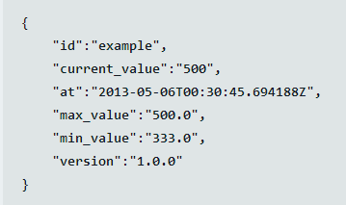
JSON
JavaScript Object Notation
Lightweight text-based open standard designed for human readable data interchange.
Can represent simple data structures and associative arrays.
Good for serializing and transmitting structured data across a network

Slide 24
JSON
JSON is a data interchange format technique
A collection of name/value pairs.
Application programming interfaces(APIs) exist for most programming languages
{
"person": {
"id": "123456789",
"name": "Smith",
"place": "London",
"year": "1984"
}
}
{ "temperature" : 72.55 }

Slide 25
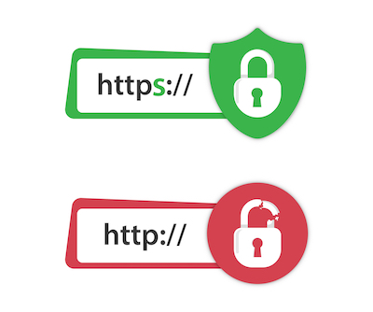
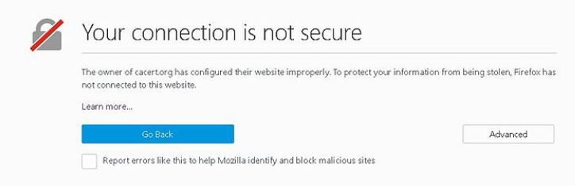
HTTPS
HTTP is not a secure protocol
HTTPS (Secure HTTP) should be used for internet communications
Components:
HTTP
SSL/TLS: Secure Sockets Layer (SSL) or Transport Layer Security (TLS) encrypts the data between the client and server
Features:
Data Encryption: Protects sensitive information from being intercepted
Authentication: Verifies the identity of websites, preventing “man-in-the-middle” attacks
Notes:
Enhanced Security:Protects sensitive data (like passwords, credit card numbers) from attackers.
Trust and Credibility:Builds user confidence; HTTPS is recognized as a sign of a trustworthy website.
Many browsers display a lock icon or flag sites as “Not Secure” if they lack HTTPS.
SEO Benefits:Google and other search engines prioritize HTTPS sites in search rankings.
Legal and Compliance Requirements:Many industries require HTTPS for handling personal and financial data.

Slide 26

HTTP in Python - Flask
Flask is a lightweight web framework for Python
Simple and flexible for web development
Simple and flexible for web development
Good for beginners and for building small to medium-sized web applications/APIs
This Photo by Unknown Author is licensed under CC BY-SA

Slide 27
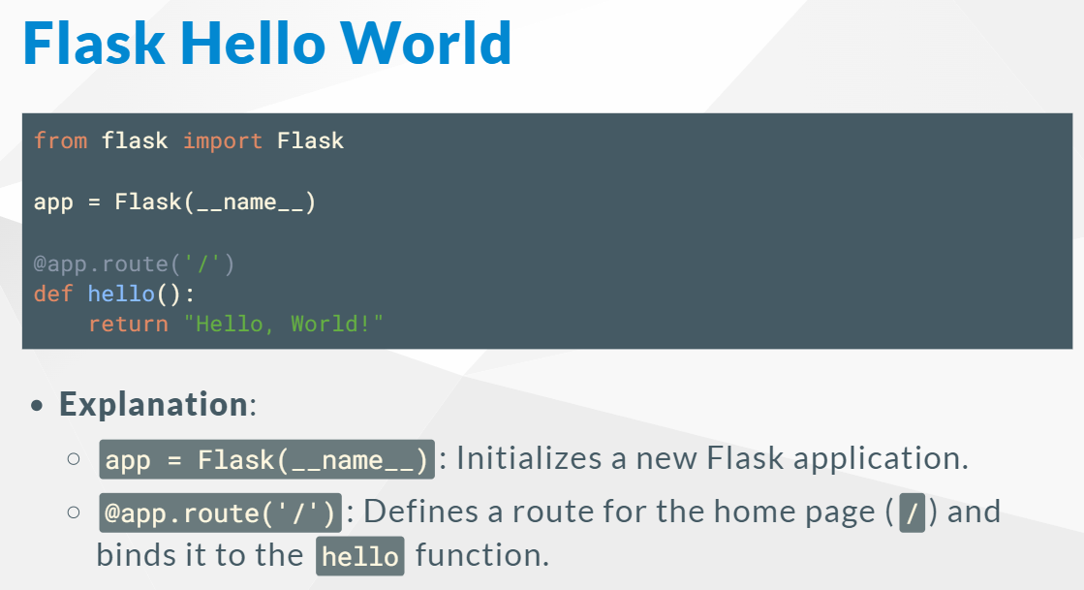
Flask Example

