Slide 1
Indirect Messaging
Frank Walsh

Slide 2
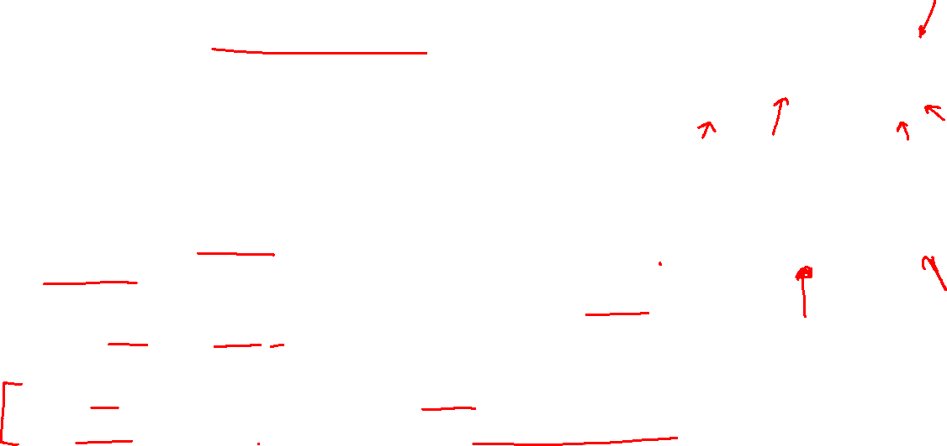
Using the “Middleman”
Direct Communication
A
B
Communication between processes using an intermediary
Sender → “The middle-man” → Receiver
No direct coupling
Up to now, only considered Direct Coupling
Introduces a degree of rigidity
Consider…
What happens if a device fails during communication in Direct Coupling?
What if you'd like to add
Two important properties of intermediary in communication
Space uncoupling (devices don't need to "know" about each other)
Time uncoupling (devices don't need to be "available" at the same time)
Indirect Communication
A
B
Intermediary

Slide 3

MQTT
MQ Telemetry Transport (MQTT)
Telemetry
Remote measurements
Created by IBM
from message queueing (MQ) architecture used by IBM for service oriented networks.
Telemetry data goes from devices to a server or broker.
Uses a publish/subscribe mechanism.
Lightweight both in bandwidth and code footprint

Slide 4
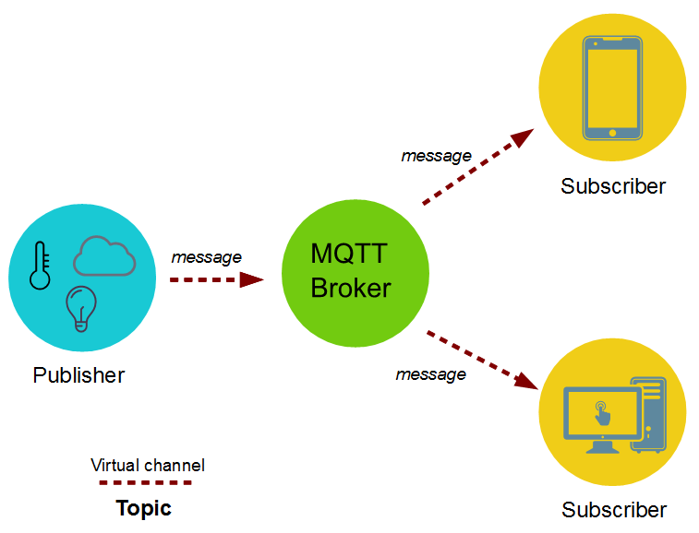

MQTT – publish subscribe
Topics/Subscriptions: Messages are published to topics.
Clients can subscribe to a topic or a set of related topics
Publish/Subscribe: Clients can subscribe to topics or publish to topics.

Slide 5

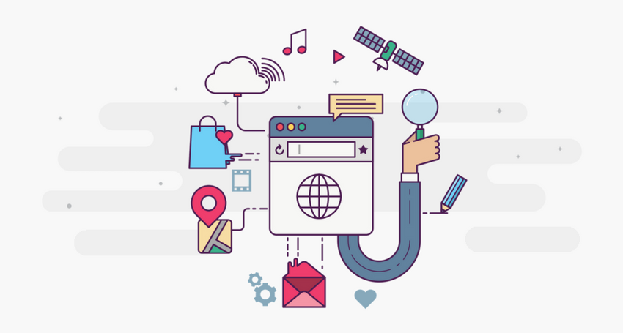

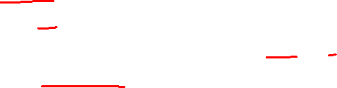
MQTT is Open Source
Lots of implementations:
Mosquitto
Micro broker
Really small message broker (RSMB): C
Cloud broker services

Slide 6
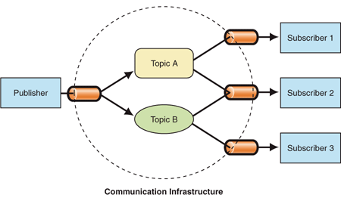
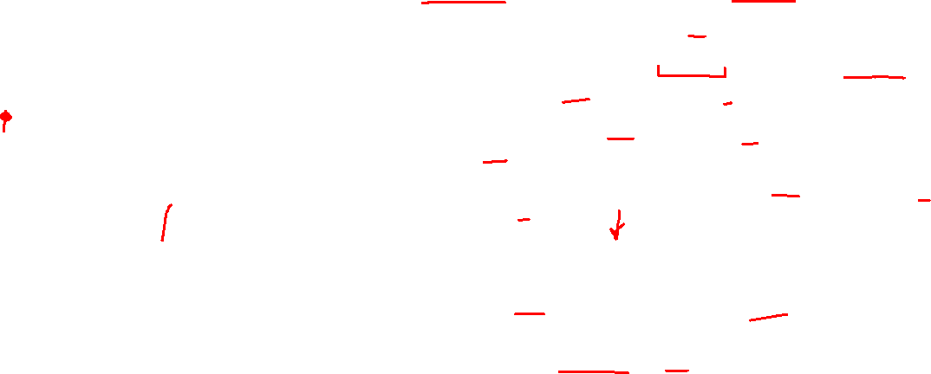
Publish Subscribe Process
A message is published once by a publisher.
Many things can receive the message.
The messaging service, or “broker”, provides decoupling between the producer and consumer(s)
A producer sends (publishes) a message (publication) on a topic (subject)
A consumer subscribes (makes a subscription) for messages on a topic (subject)
A message server / broker matches publications to subscriptions
If no matches the message is discarded
If one or more matches the message is delivered to each matching subscriber/consumer

Slide 7
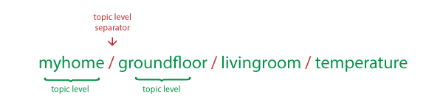


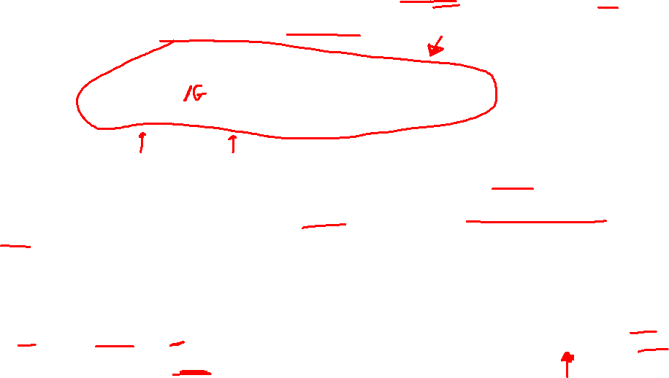
MQTT Topics
In MQTT, the word topic refers to the string that the broker uses to filter messages for each connected client.
Note that each topic must contain at least 1 character and that the topic string permits empty spaces. Topics are case-sensitive.
Topic Wildcards:

Slide 8
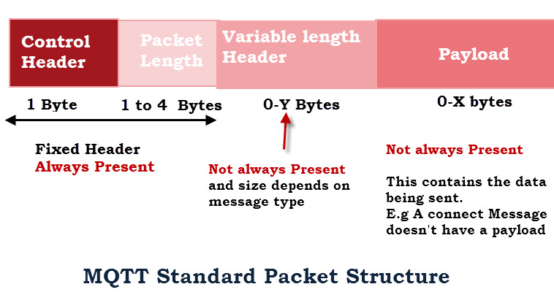
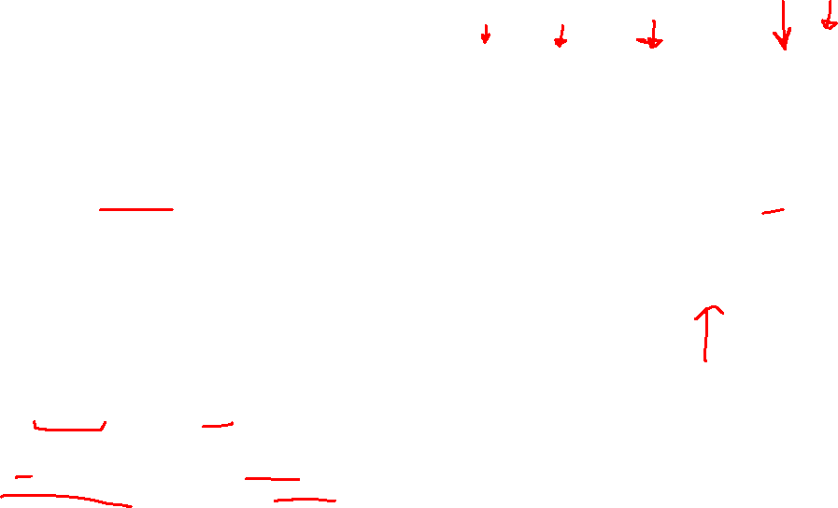
MQTT Characteristics
MQTT protocol compresses to small number of bytes
Smallest packet size 2 bytes
Supports always-connected and sometimes connected
Provides Session awareness
“Last will and testament” enable applications to know when a client goes offline abnormally
Typically utilises TCP-based networks.
Max size:
Theoretical 256MB for MQTT 5.0
Configured at broker:
Mosquitto: Default maximum is 1 MB
AWS IoT: Limits MQTT messages to 128 KB

Slide 9
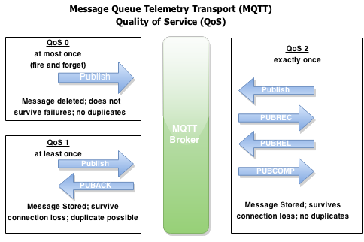

MQTT Characteristics
Three quality of service levels:
0 The message is delivered at most once, without any acknowledgment from the receiver. This means the message is sent, and no retries are attempted if it’s lost in transit.
1 The message is delivered at least once, meaning the sender keeps resending the message until it receives an acknowledgment (PUBACK) from the receiver.
2 The message is delivered exactly once through a four-step handshake between sender and receiver (using PUBREC, PUBREL, and PUBCOMP messages to ensure no duplication).
https://dzone.com/articles/internet-things-mqtt-quality

Slide 10
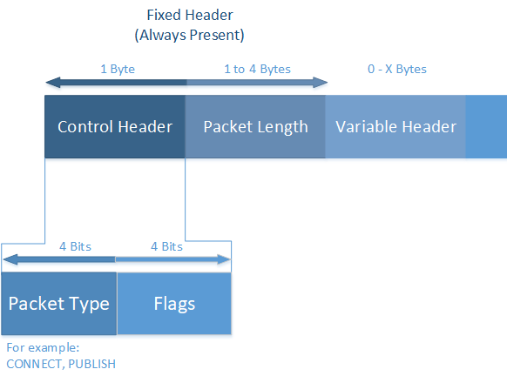
MQTT Control Packets
The MQTT protocol uses MQTT Control Packets using the Control Header.
Control Packet consists of three parts:
fixed header(present in all packets),
variable header(optional)
Payload(optional)
https://docs.devicewise.com/Content/Products/IoT_Portal_API_Reference_Guide/MQTT_Interface/MQTT-Control-Packets.htm

Slide 11
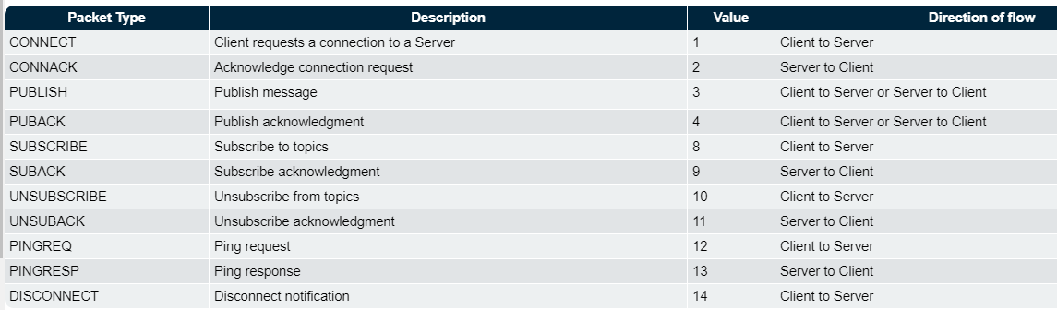
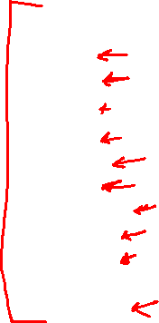
MQTT Control Packets
MQTT Control Packet Types

Slide 12
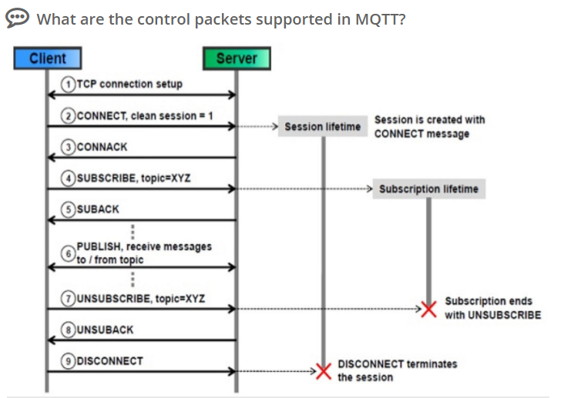
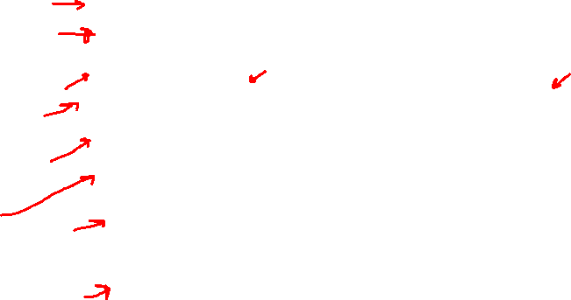
Connection

Slide 13
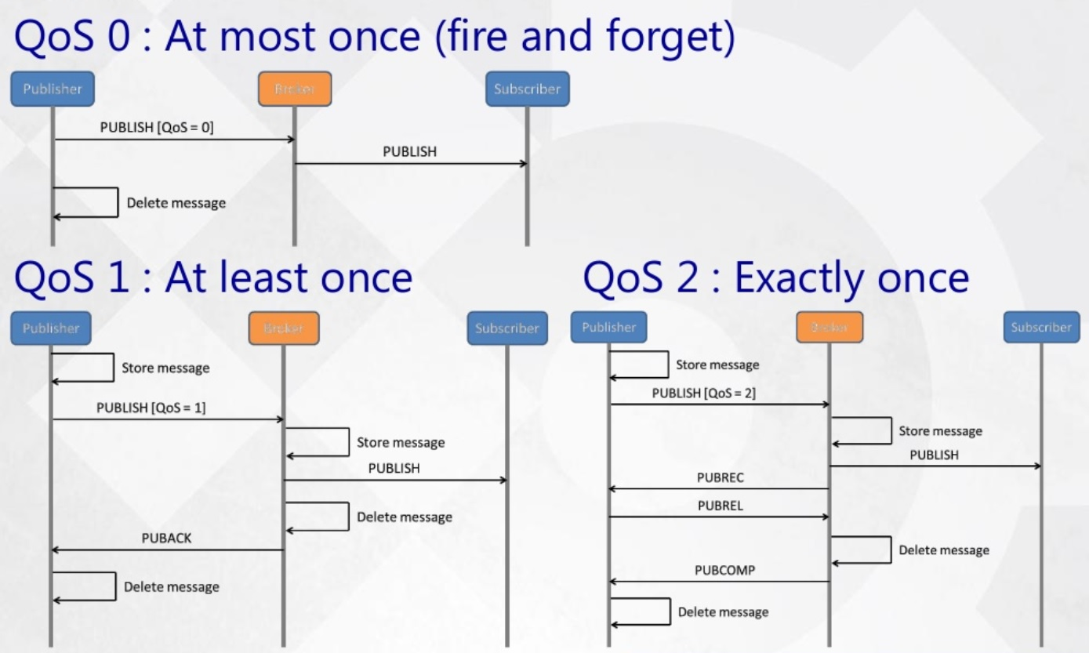
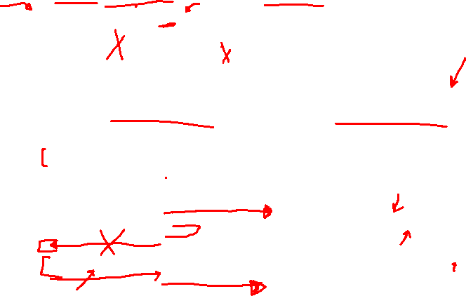
MQTT QoS

Slide 14
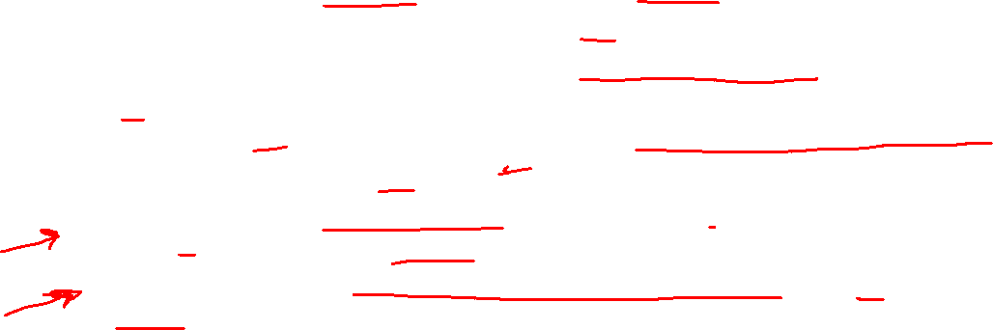
Publish-Subscribe Characteristics
A published messages may be retained
Retained messages are used to ensure that when a client subscribes to a topic, it immediately receives the most recent message for that topic
A publisher can mark a message as “retained”
The broker / server remembers the last known good message of a retained topic
The broker / server gives the last known good message to new subscribers
A Subscription can be durable
Durable: messages forwarded to subscriber immediately, if subscriber not connected, message is stored and forwarded when connected
Non-Durable: subscription only active when subscriber is connected to the server / broker

Slide 15
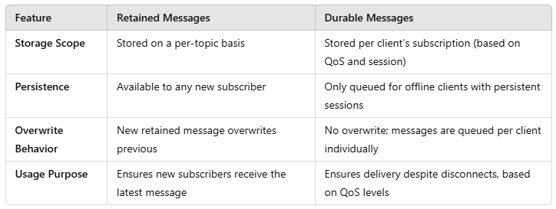
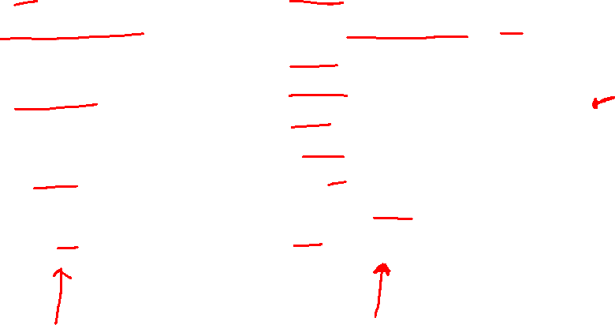

Slide 16
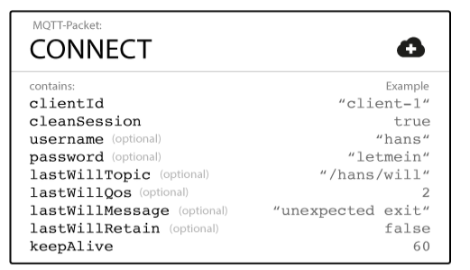
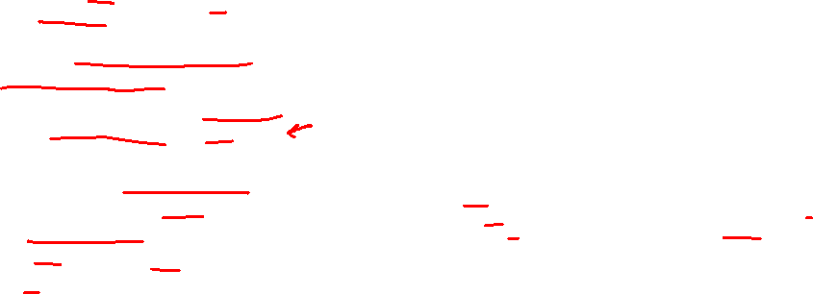
MQTT Last Will and Testament
Notify other clients about an ungraceful disconnected client.
Client can specify its last will message when it connects to a broker.
normal MQTT message with a topic, retained message flag, QoS, and payload
When an “ungraceful disconnect” occurs, the broker sends the last-will message to all subscribed clients of the last-will message topic.
https://www.hivemq.com/blog/mqtt-essentials-part-9-last-will-and-testament/

Slide 17

MQTT vs HTTP
Push delivery of messages / data / events
MQTT – low latency push delivery of messages from client to server and server to client. Helps bring an event oriented architecture to the web
HTTP – push from client to server but poll from server to client
Reliable delivery over fragile network
MQTT will deliver message to QOS even across connection breaks
Decoupling and publish subscribe – one to many delivery

Slide 18
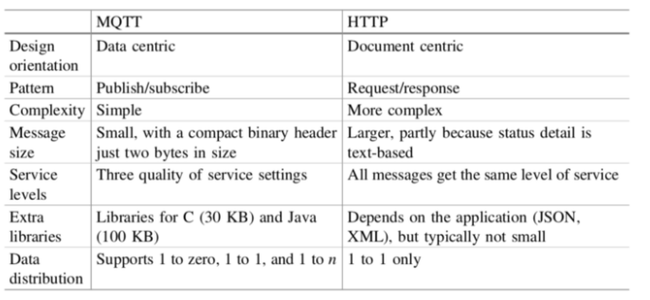
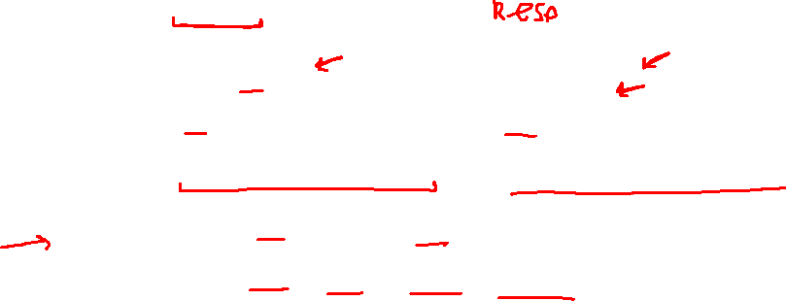
MQTT vs HTTP

Slide 19
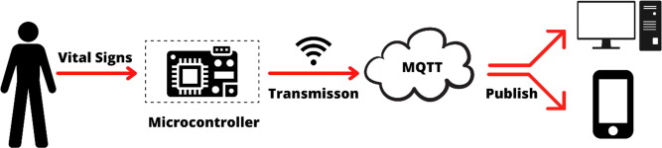
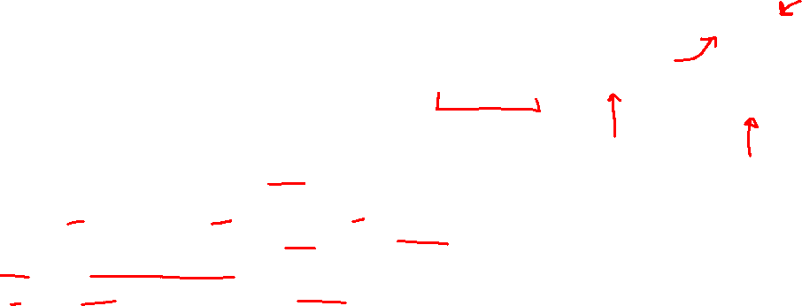
Application Example
Home care monitoring solution
Home and patient instrumented with sensors.
E.g. door motion, blood pressure, pacemaker/defib.
Collected by monitoring service (broker) using MQTT
Subscribed by a health care service in the hospital
Alerts relations/health care profs. if anything is out-of-order

Slide 20






Infrastructure Devices
Broker
End Devices

Slide 21
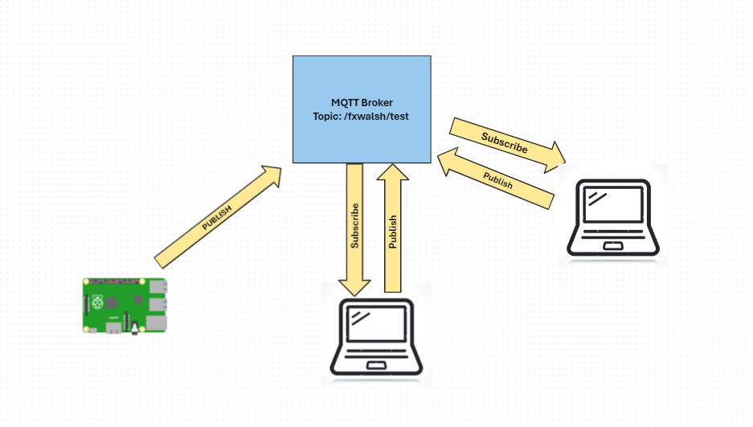
Demo

