Slide 1
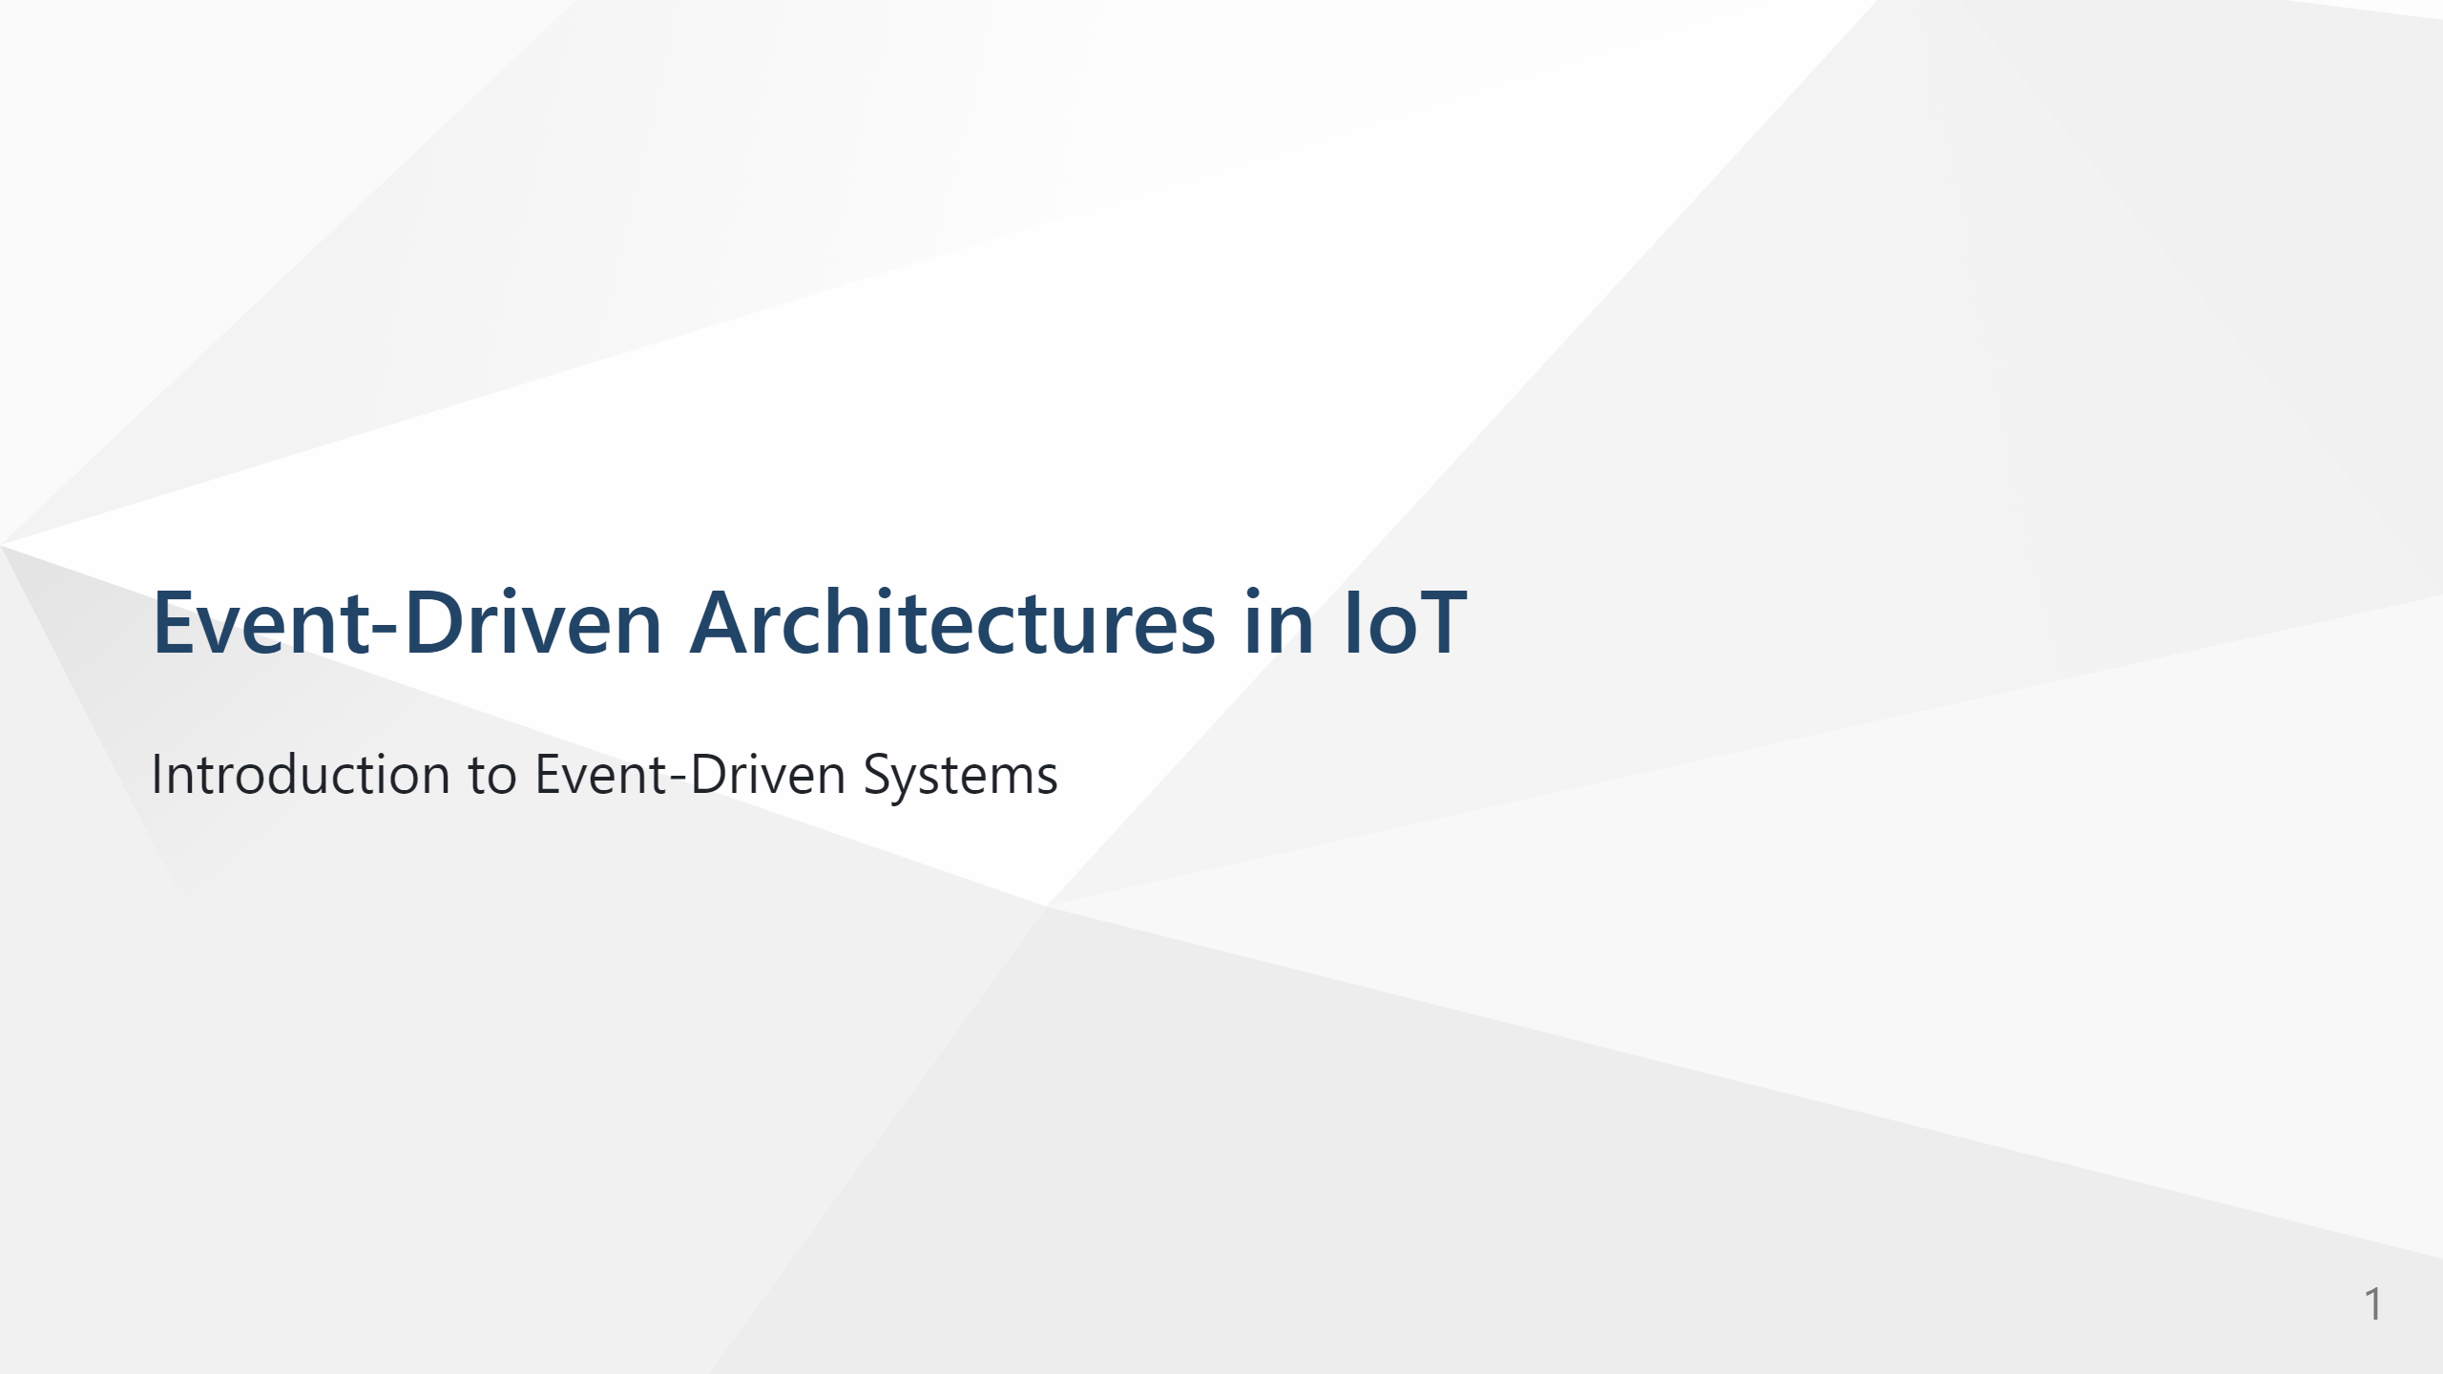

Slide 2
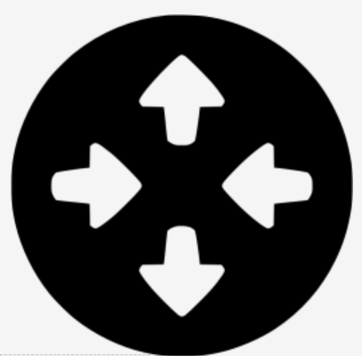
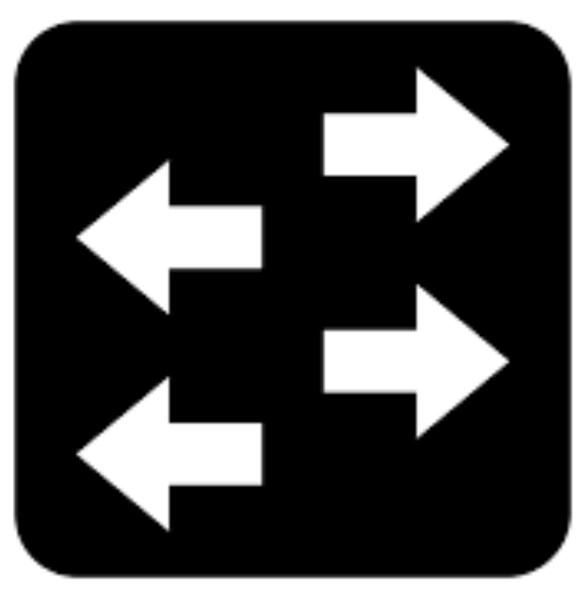
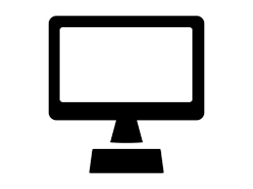
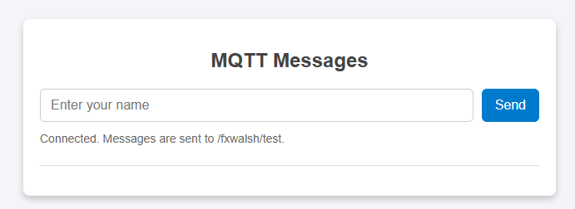



Infrastructure Devices
Broker
End Devices
Notes:
This demo is a nice example of Event-Driven Architecture because
+ nothing in the system talks to anything else directly. Instead, each part reacts to events that are sent through the MQTT broker. That loose coupling is the key EDA idea:
Producers create events.
A broker or event bus distributes them.
Consumers react when events arrive.
In this demo:
The browser is both a producer and a consumer.
+ MQTT is the event transport.
+ The broker is the middleman.
+ The topic is the channel where events are published.
A simple lecture-friendly summary would be:
“Event-Driven Architecture is a way of building systems where components communicate by publishing and reacting to events, instead of calling each other directly. In this demo, a user publishes a name as an MQTT message, the broker distributes it, and any subscribed client can respond in real time.”
If you want, I can also give you a 30-second spoken version for class, or a slide-sized bullet list.

Slide 3
Event Driven Architectures (EDA)
Key Components of EDA
Benefits of EDA
EDA Examples
Smart Home
Proactive Mainenance
Lab Example
Agenda

Slide 4
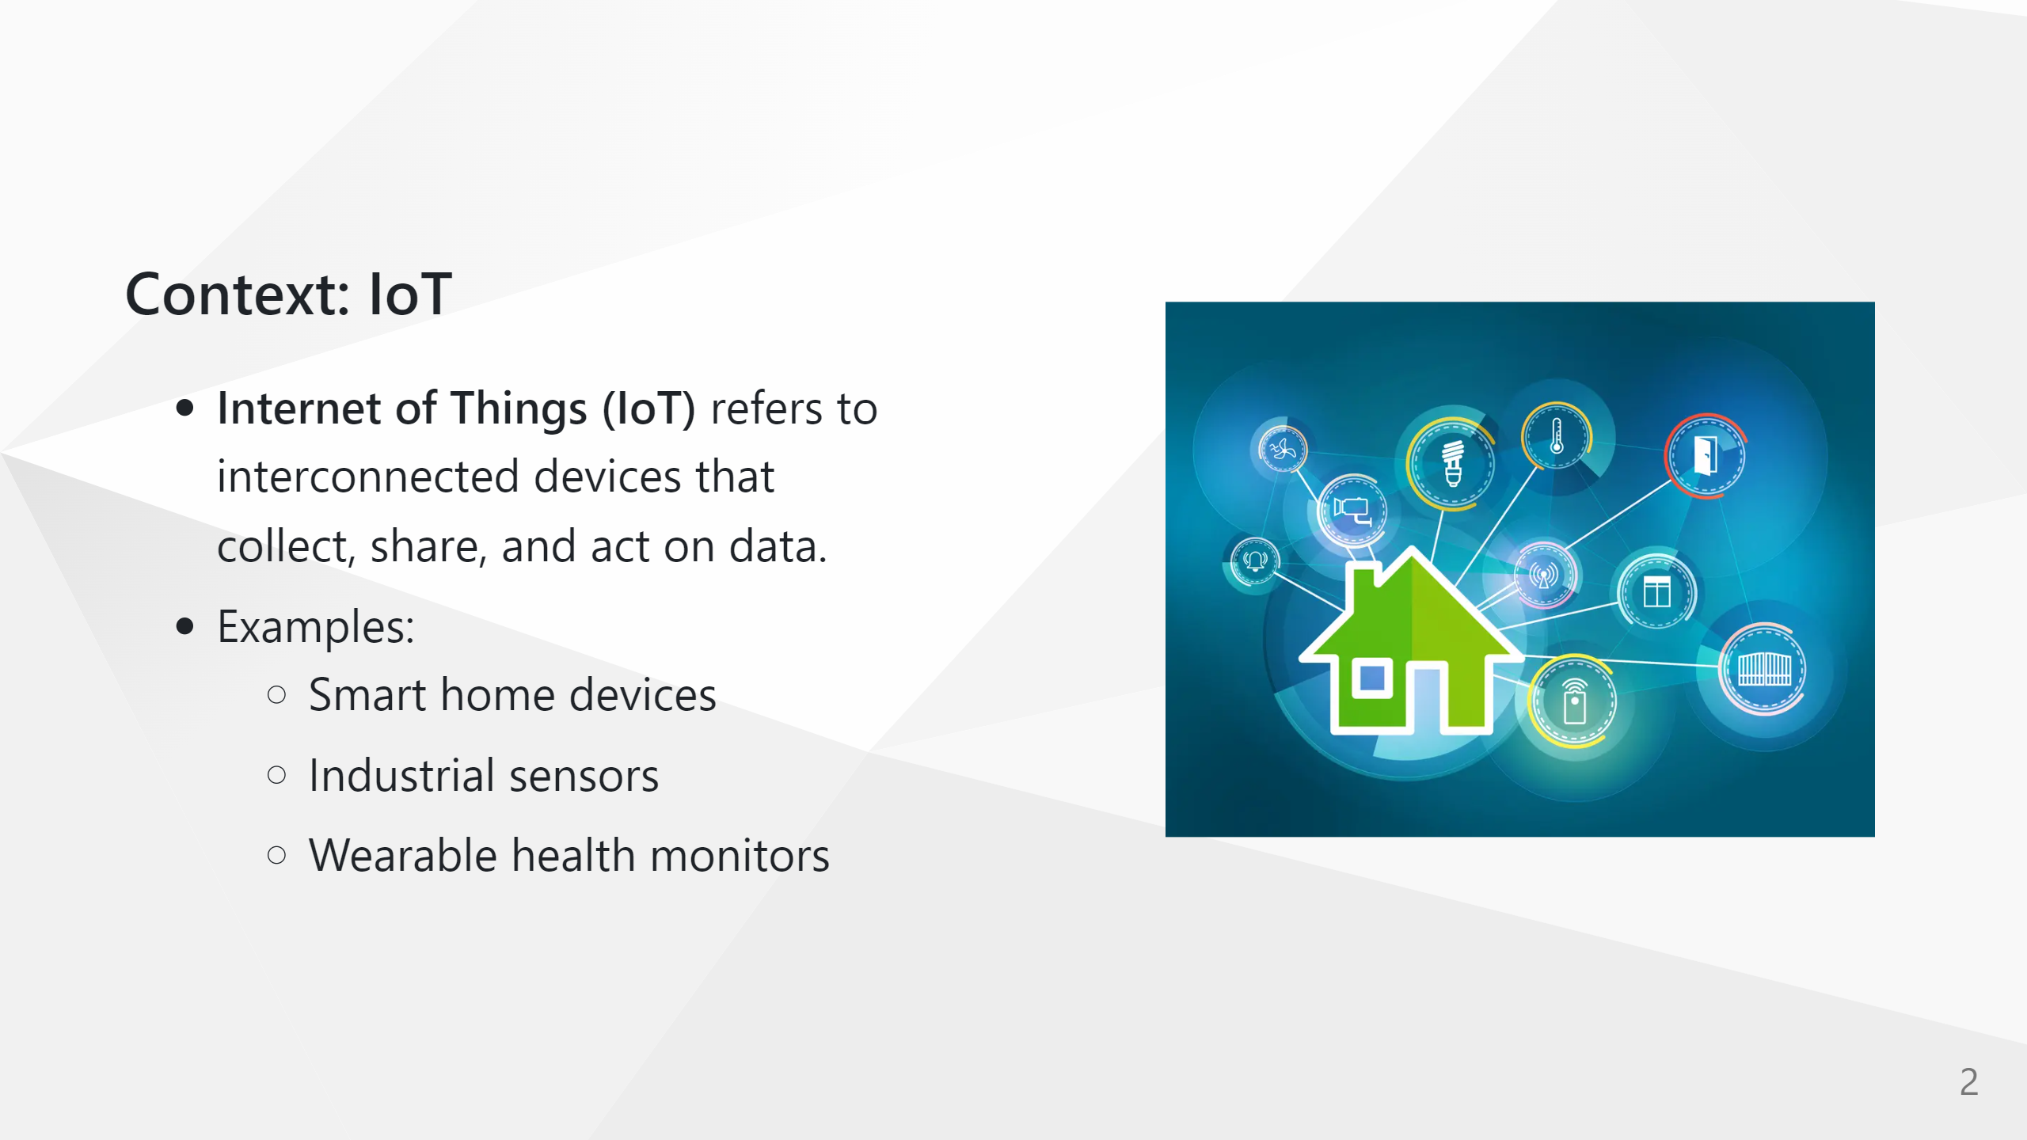

Slide 5
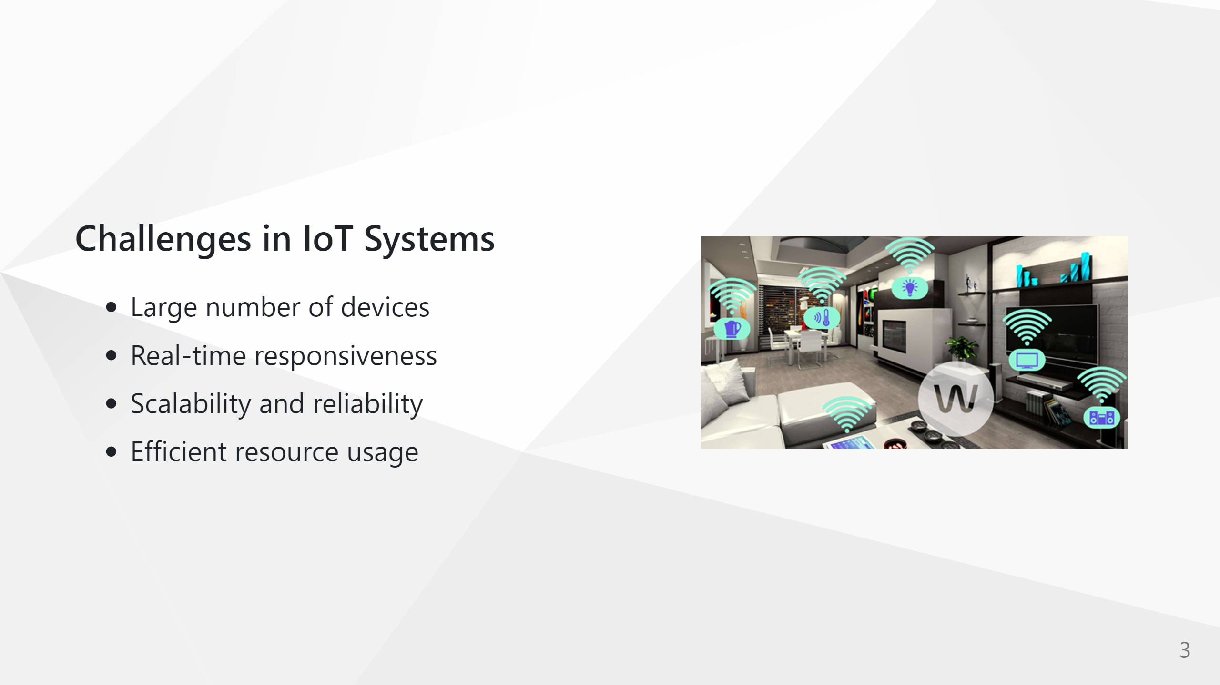

Slide 6
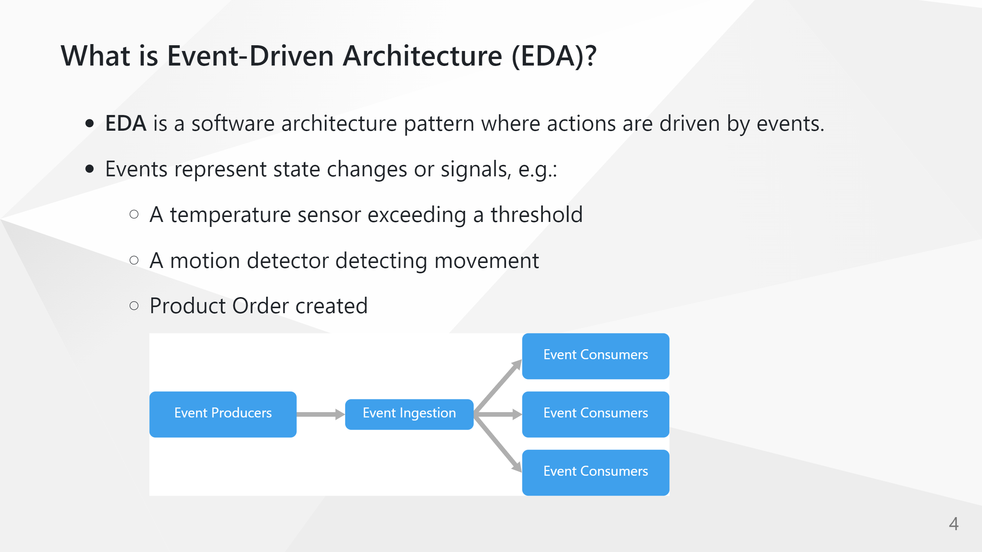

Slide 7
Software Architecture Pattern?????
A software architecture pattern is a reusable solution to a design problem in software systems.
A blueprint for how to structure the big pieces of an application and how they interact.
Some popular software architecture patterns:
Layered (n-tier) – UI → business logic → data access → database
Client–Server – clients send requests to a central server
Microservices – many small, independent services communicating over the network
Event-Driven – components react to and emit events
Patterns help with maintainability, scalability, testability, and communication—because everyone on the team can say “we’re using a layered architecture” and immediately share a mental model of how the system is structured.
Notes:
It doesn’t specify exact classes, function names, or programming languages, but it does define:
Main components (e.g., UI, business logic, data store)
How they communicate (e.g., events, APIs, message queues)
Responsibility boundaries (who does what, and where)

Slide 8
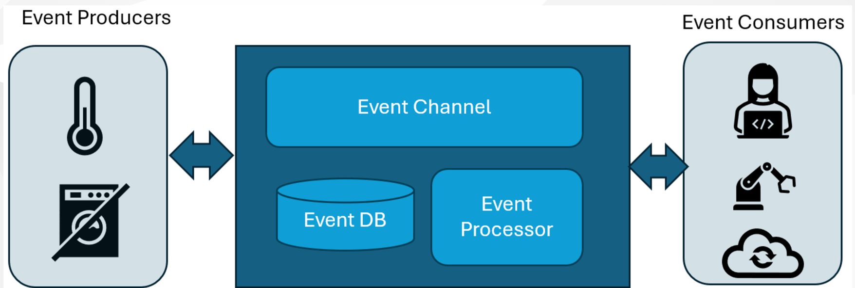
EDA Architecture Overview

Slide 9
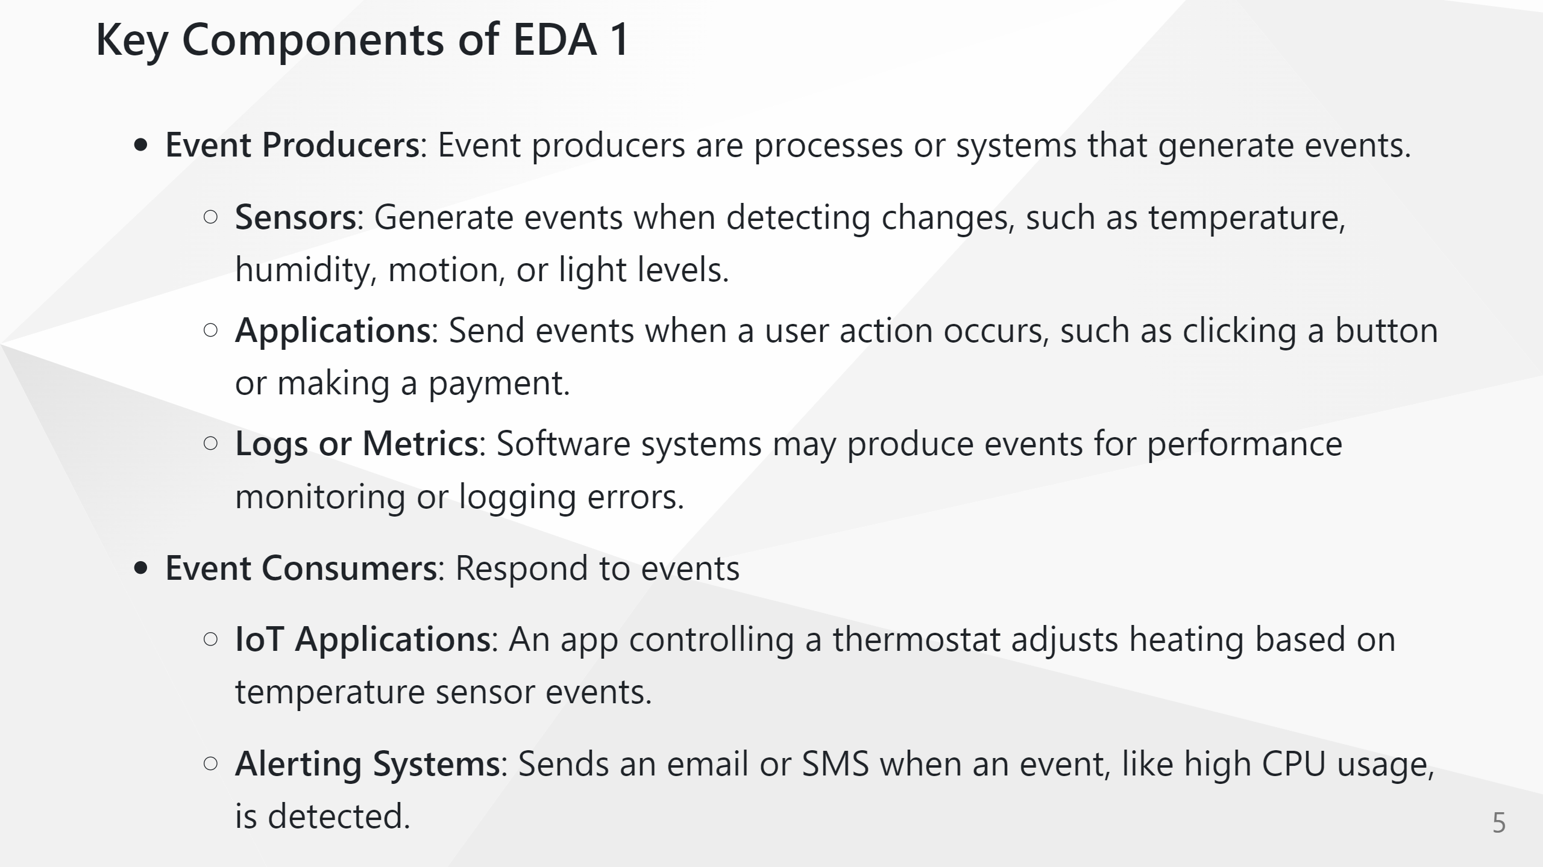

Slide 10
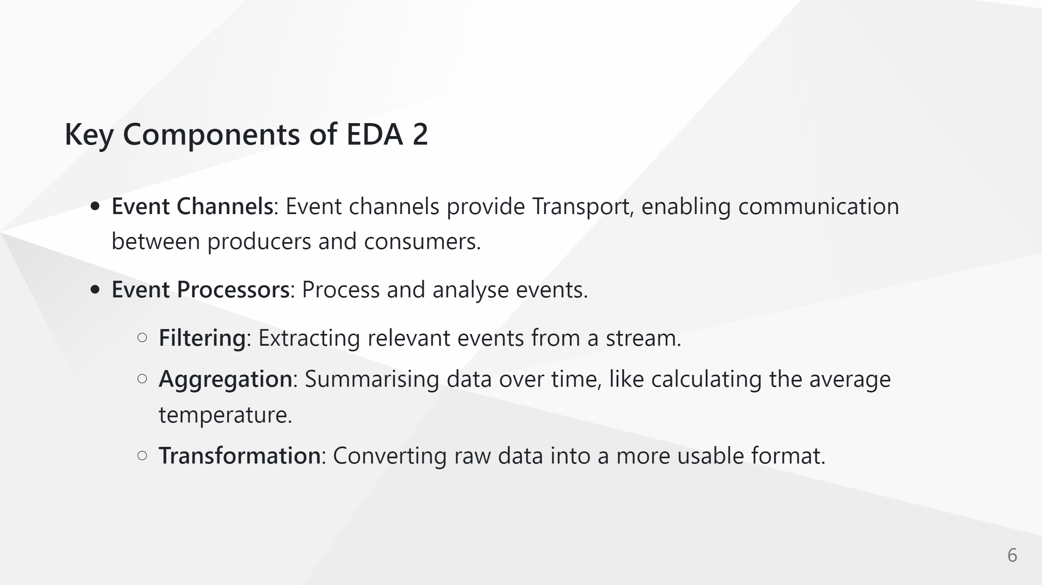

Slide 11
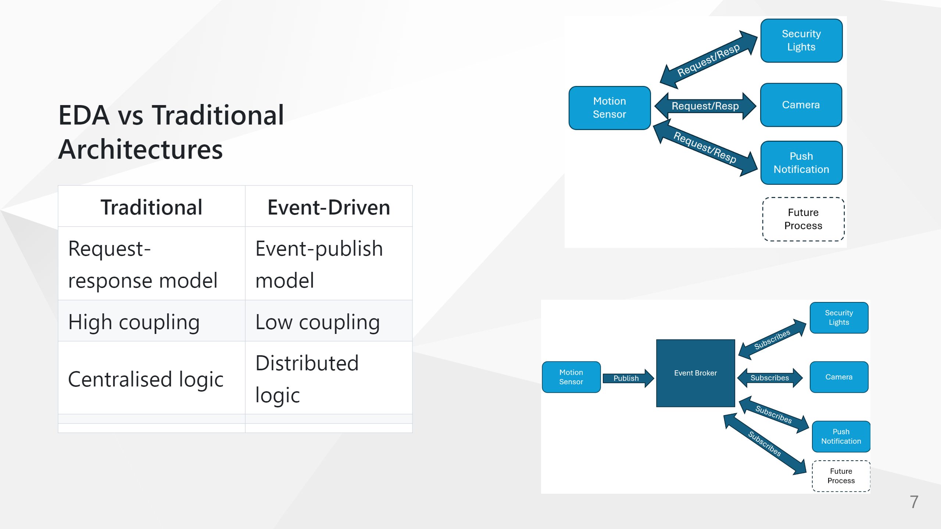

Slide 12
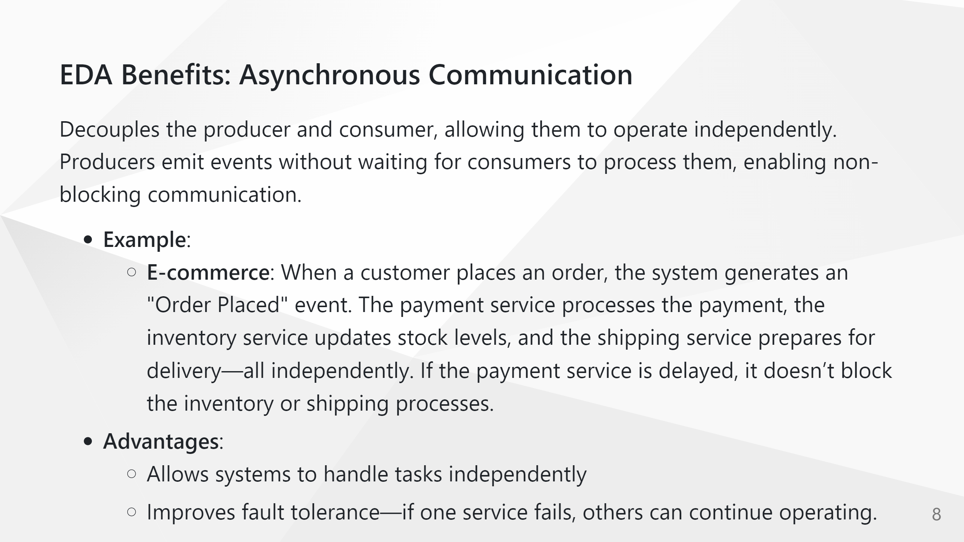

Slide 13
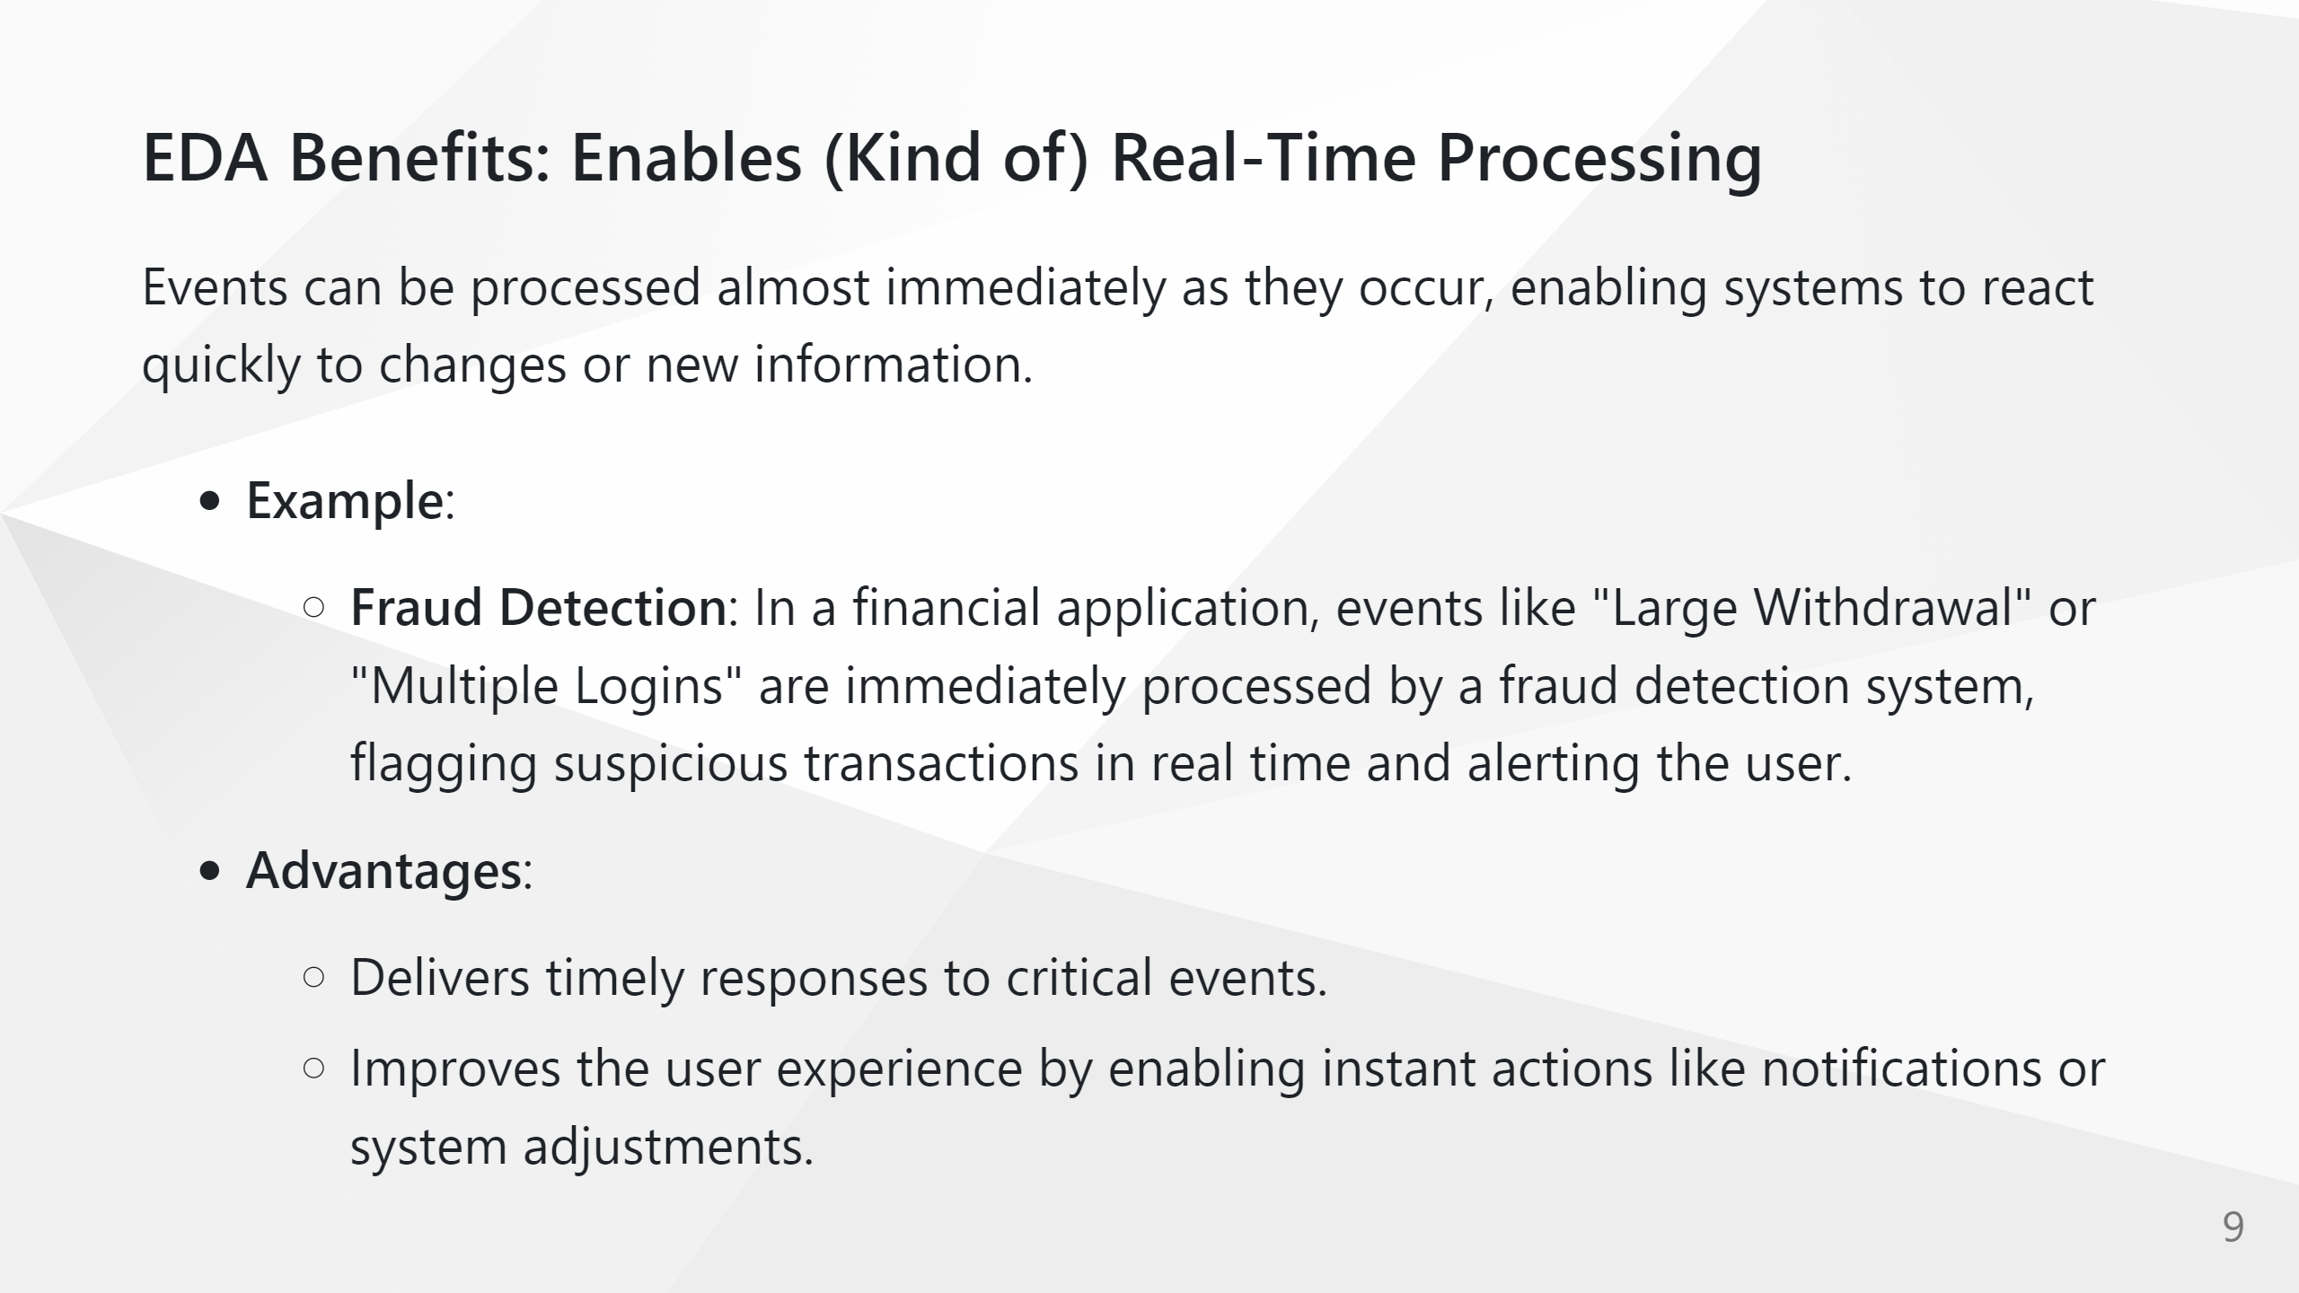

Slide 14
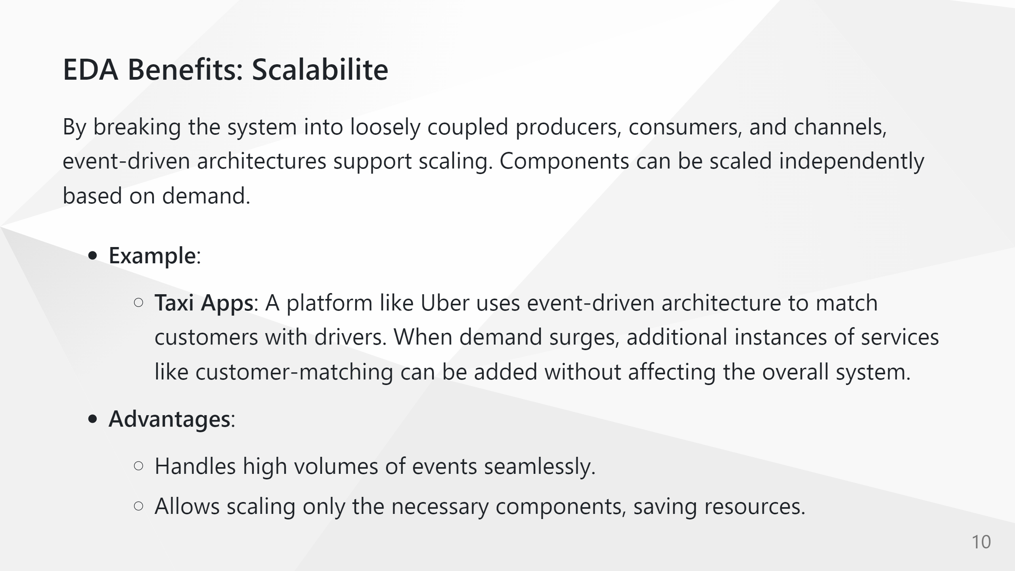

Slide 15
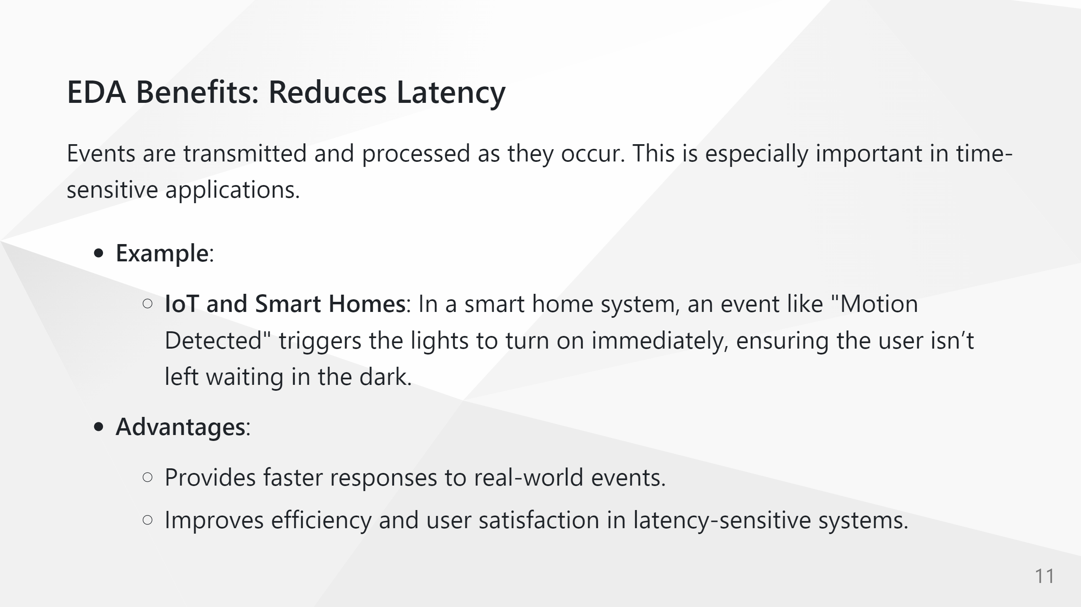

Slide 16
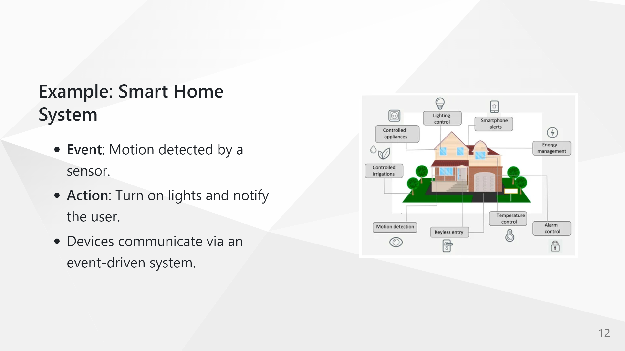

Slide 17
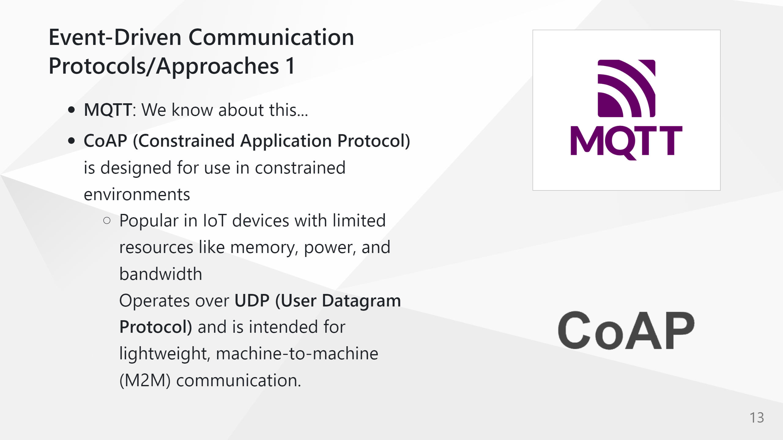

Slide 18
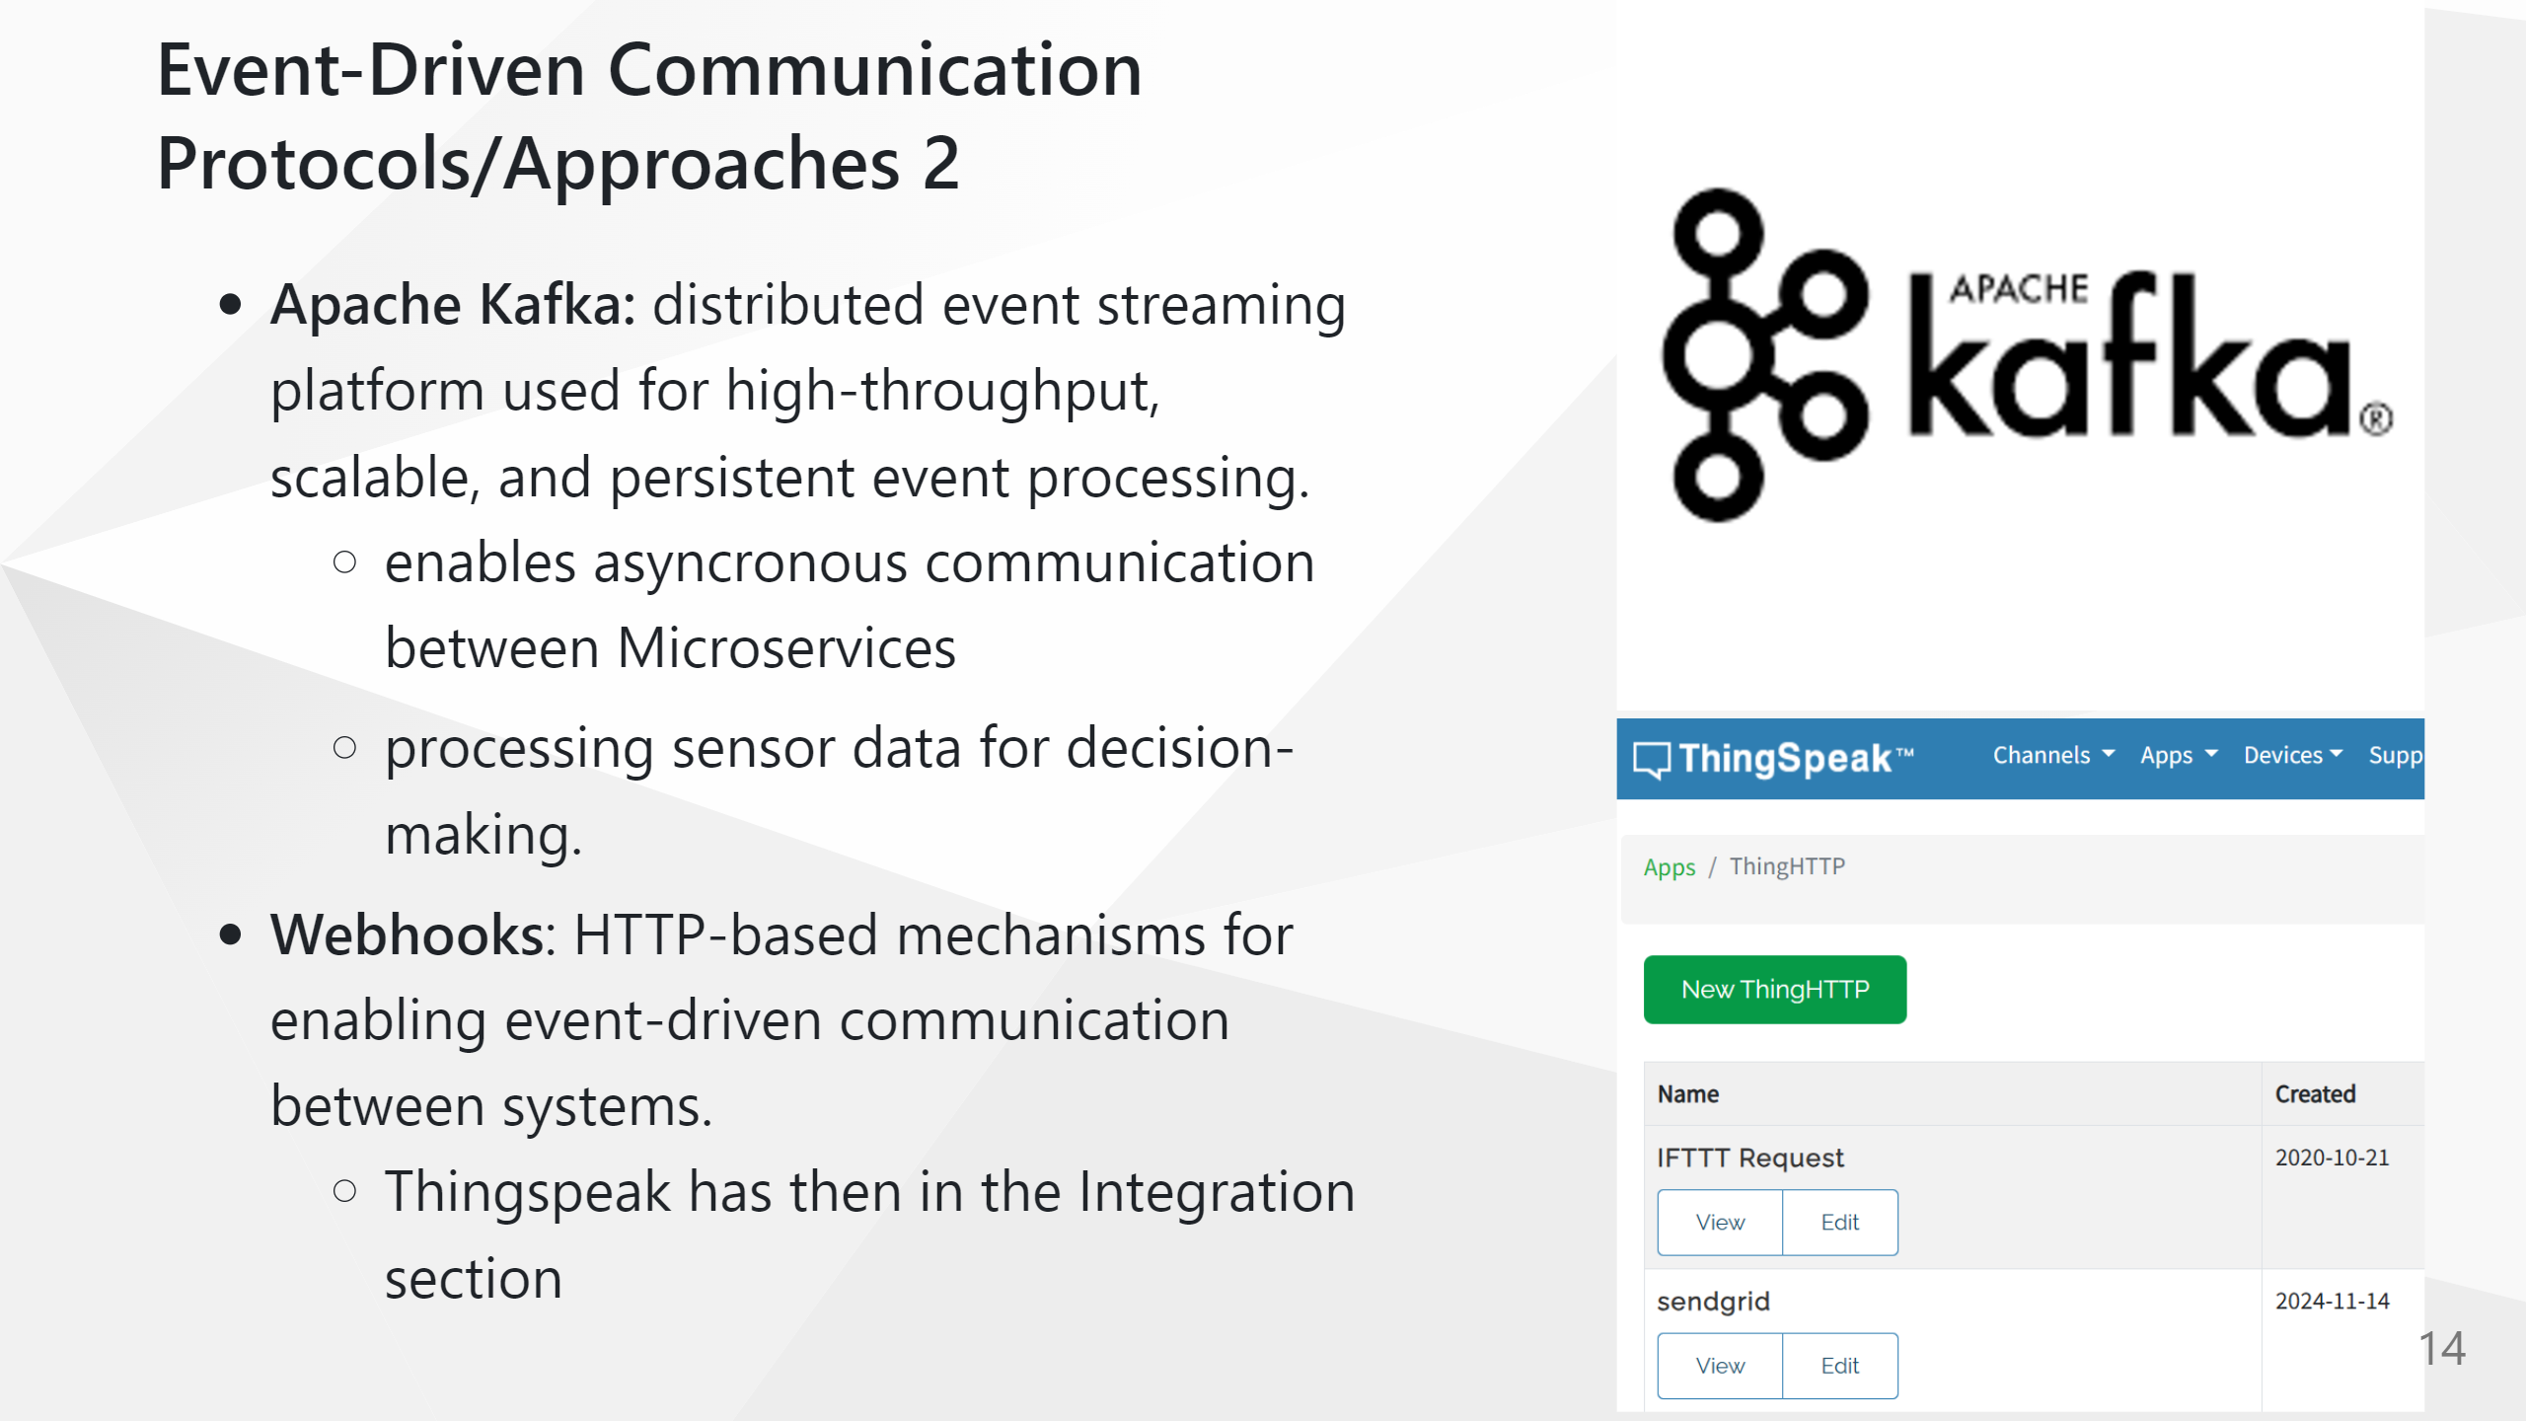

Slide 19
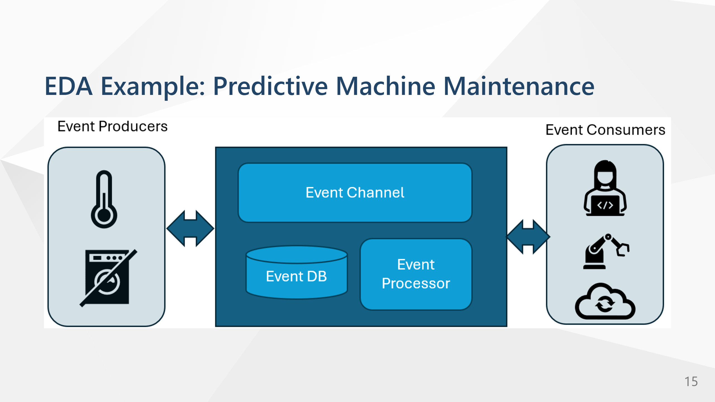

Slide 20
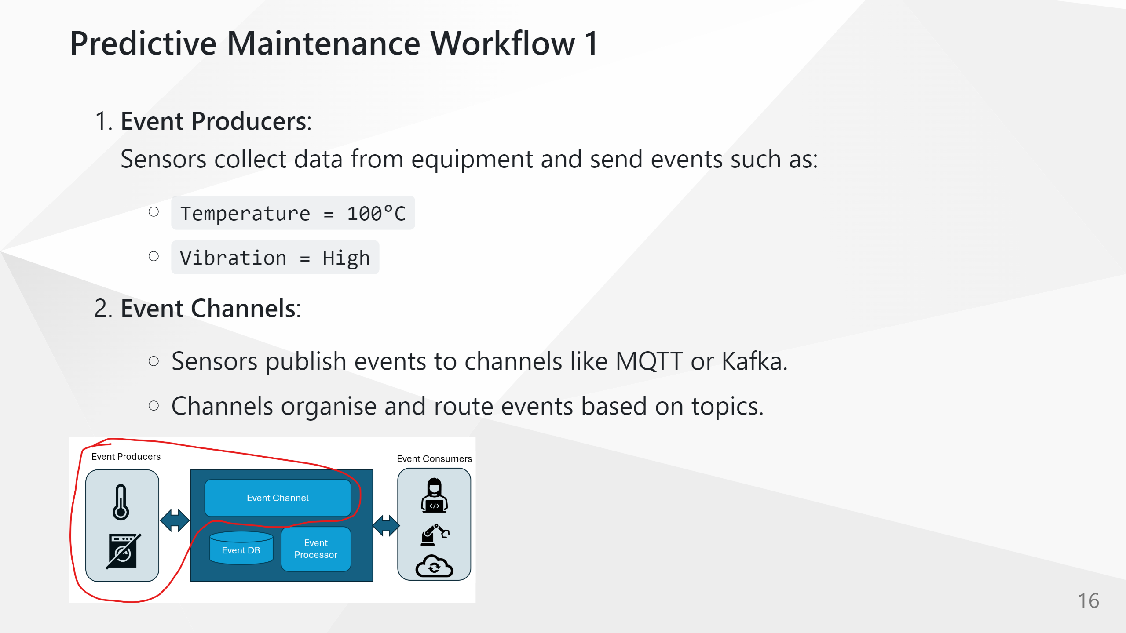

Slide 21
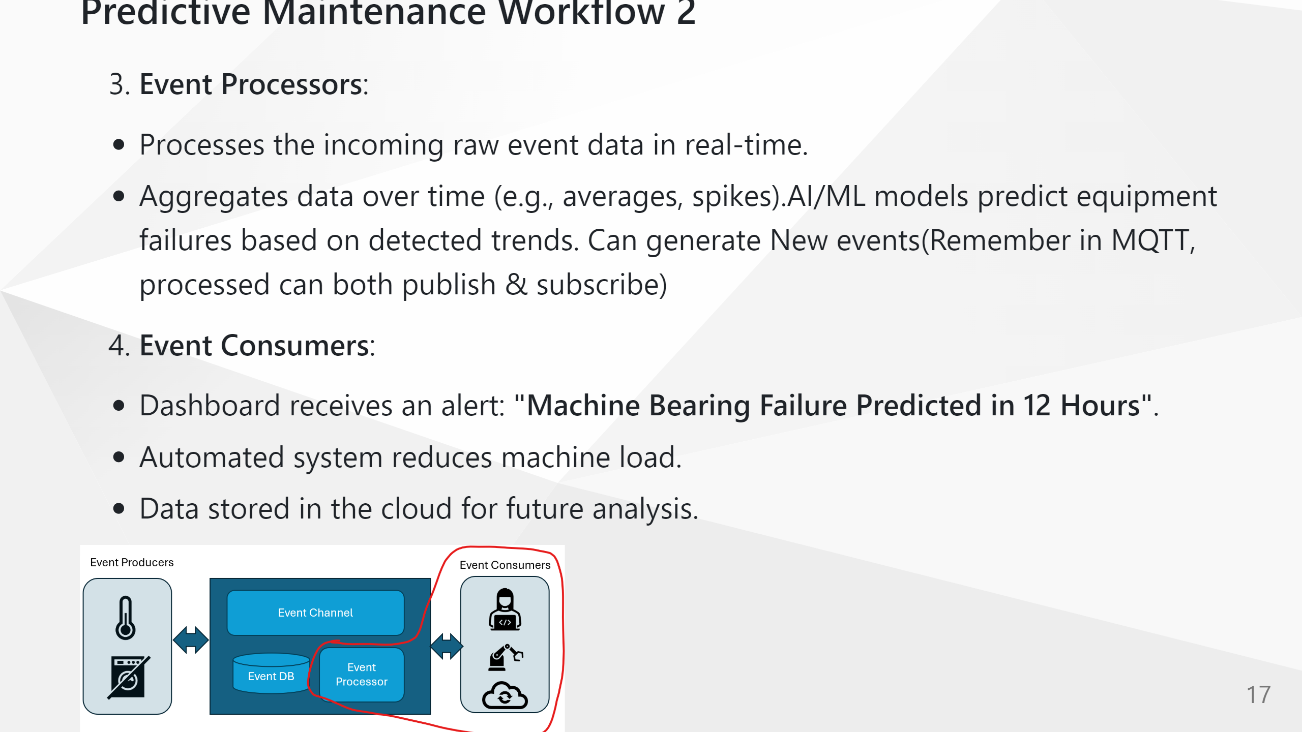

Slide 22
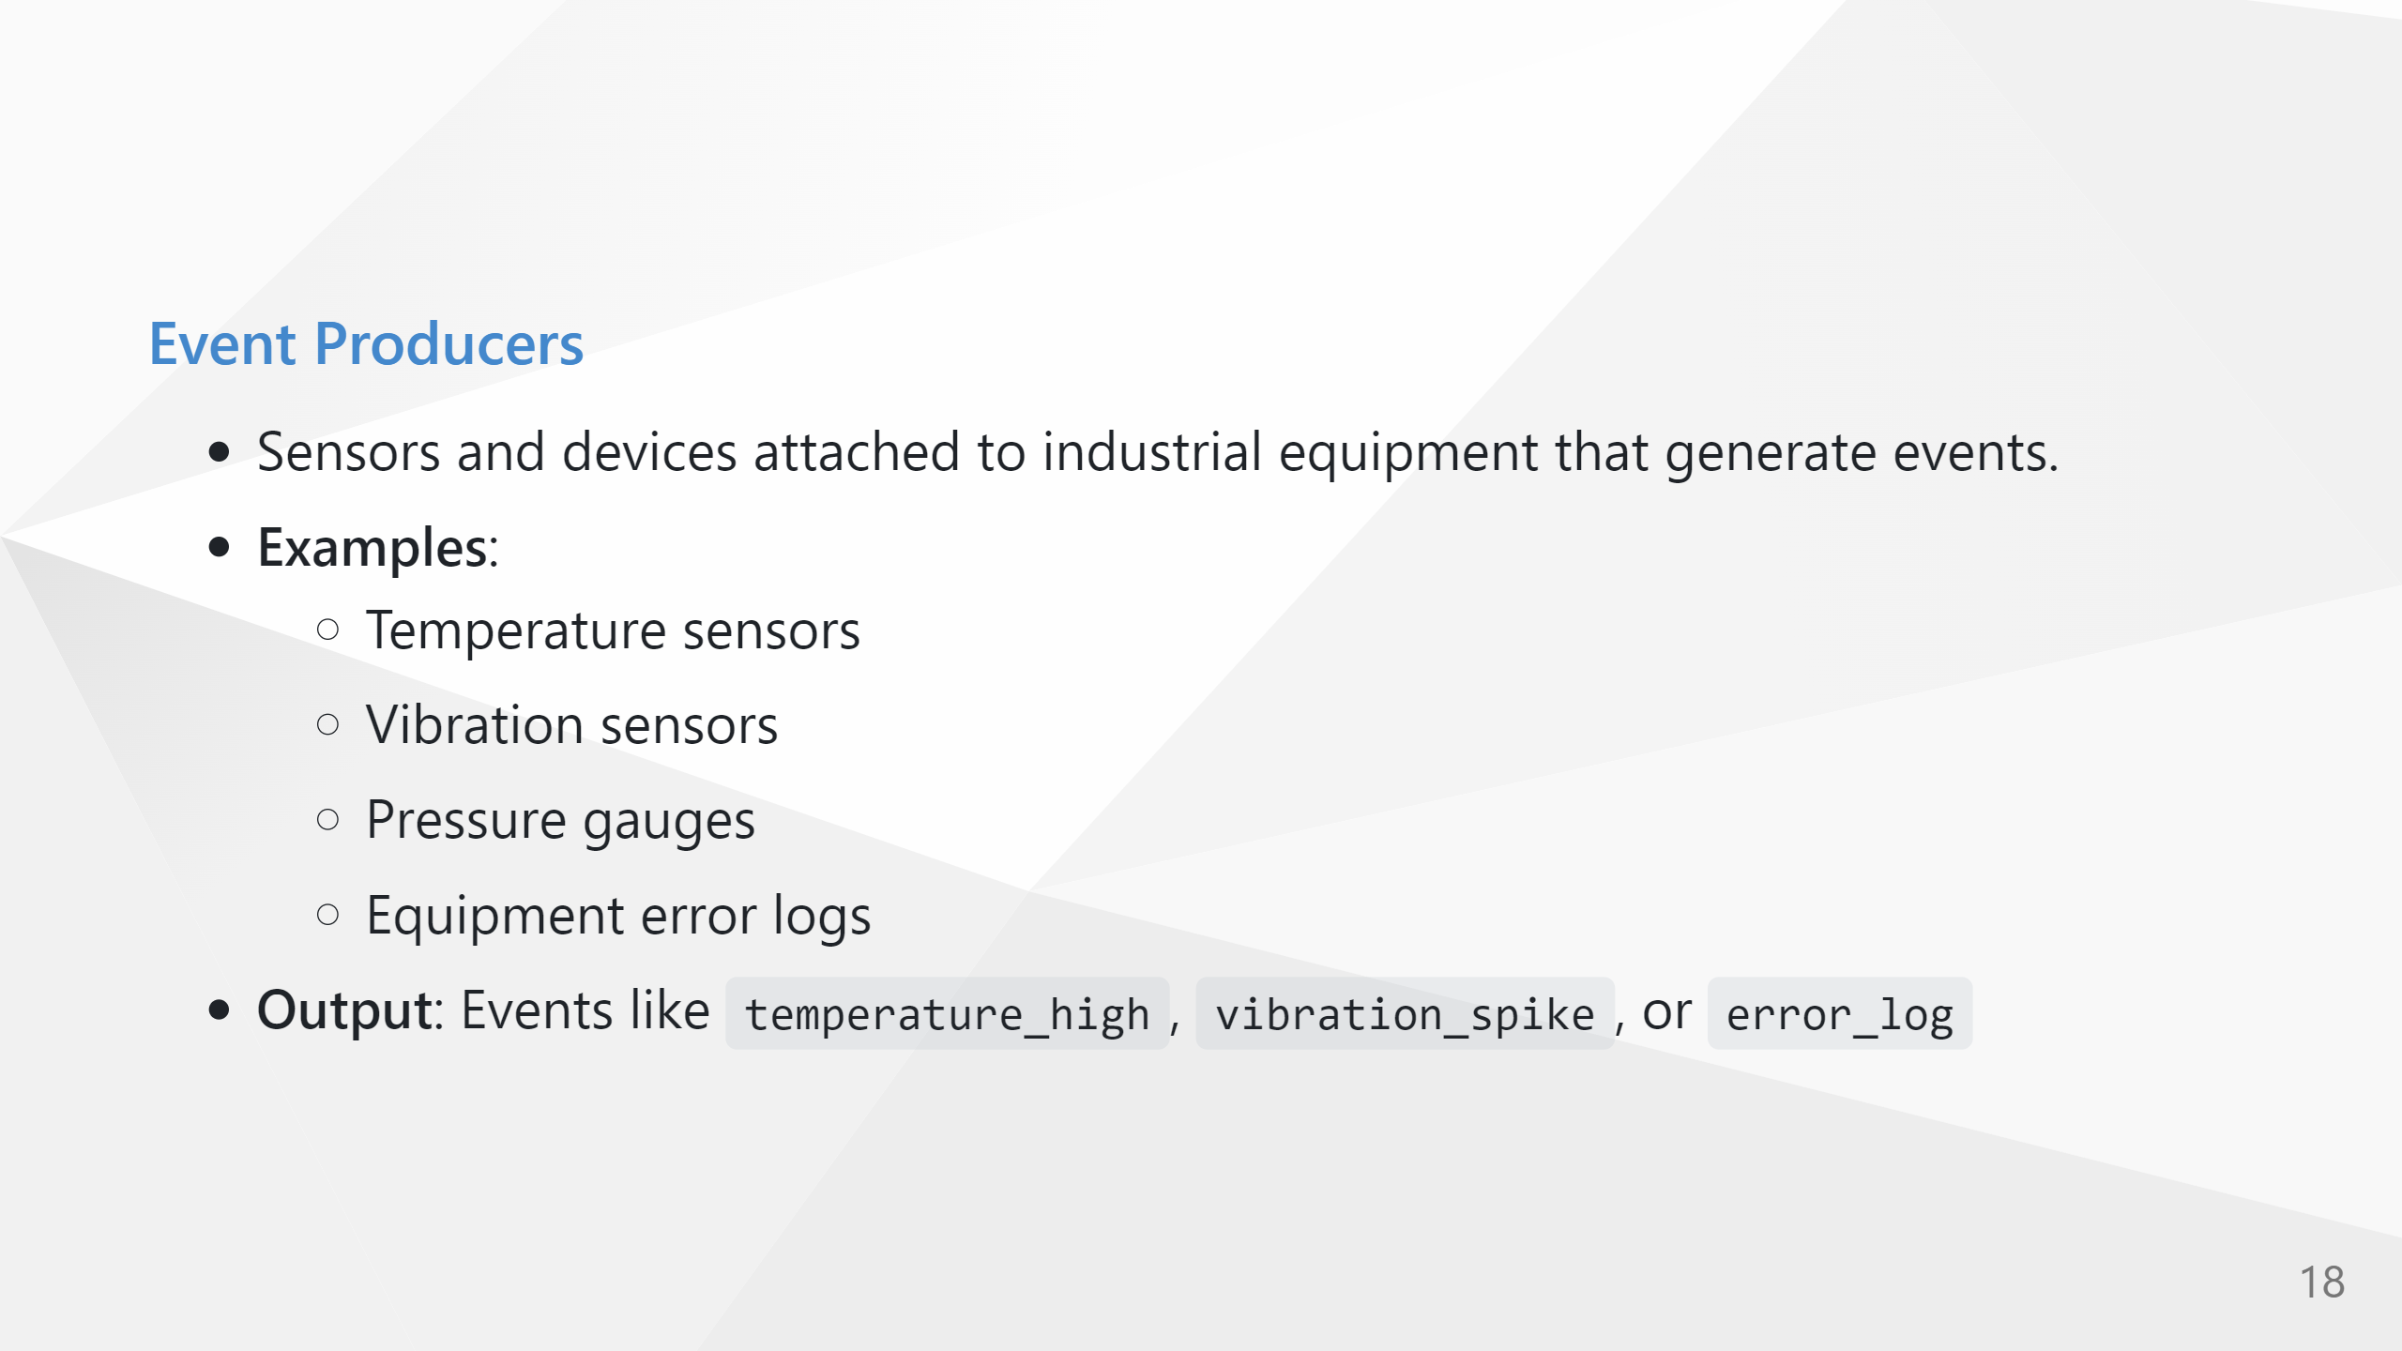

Slide 23
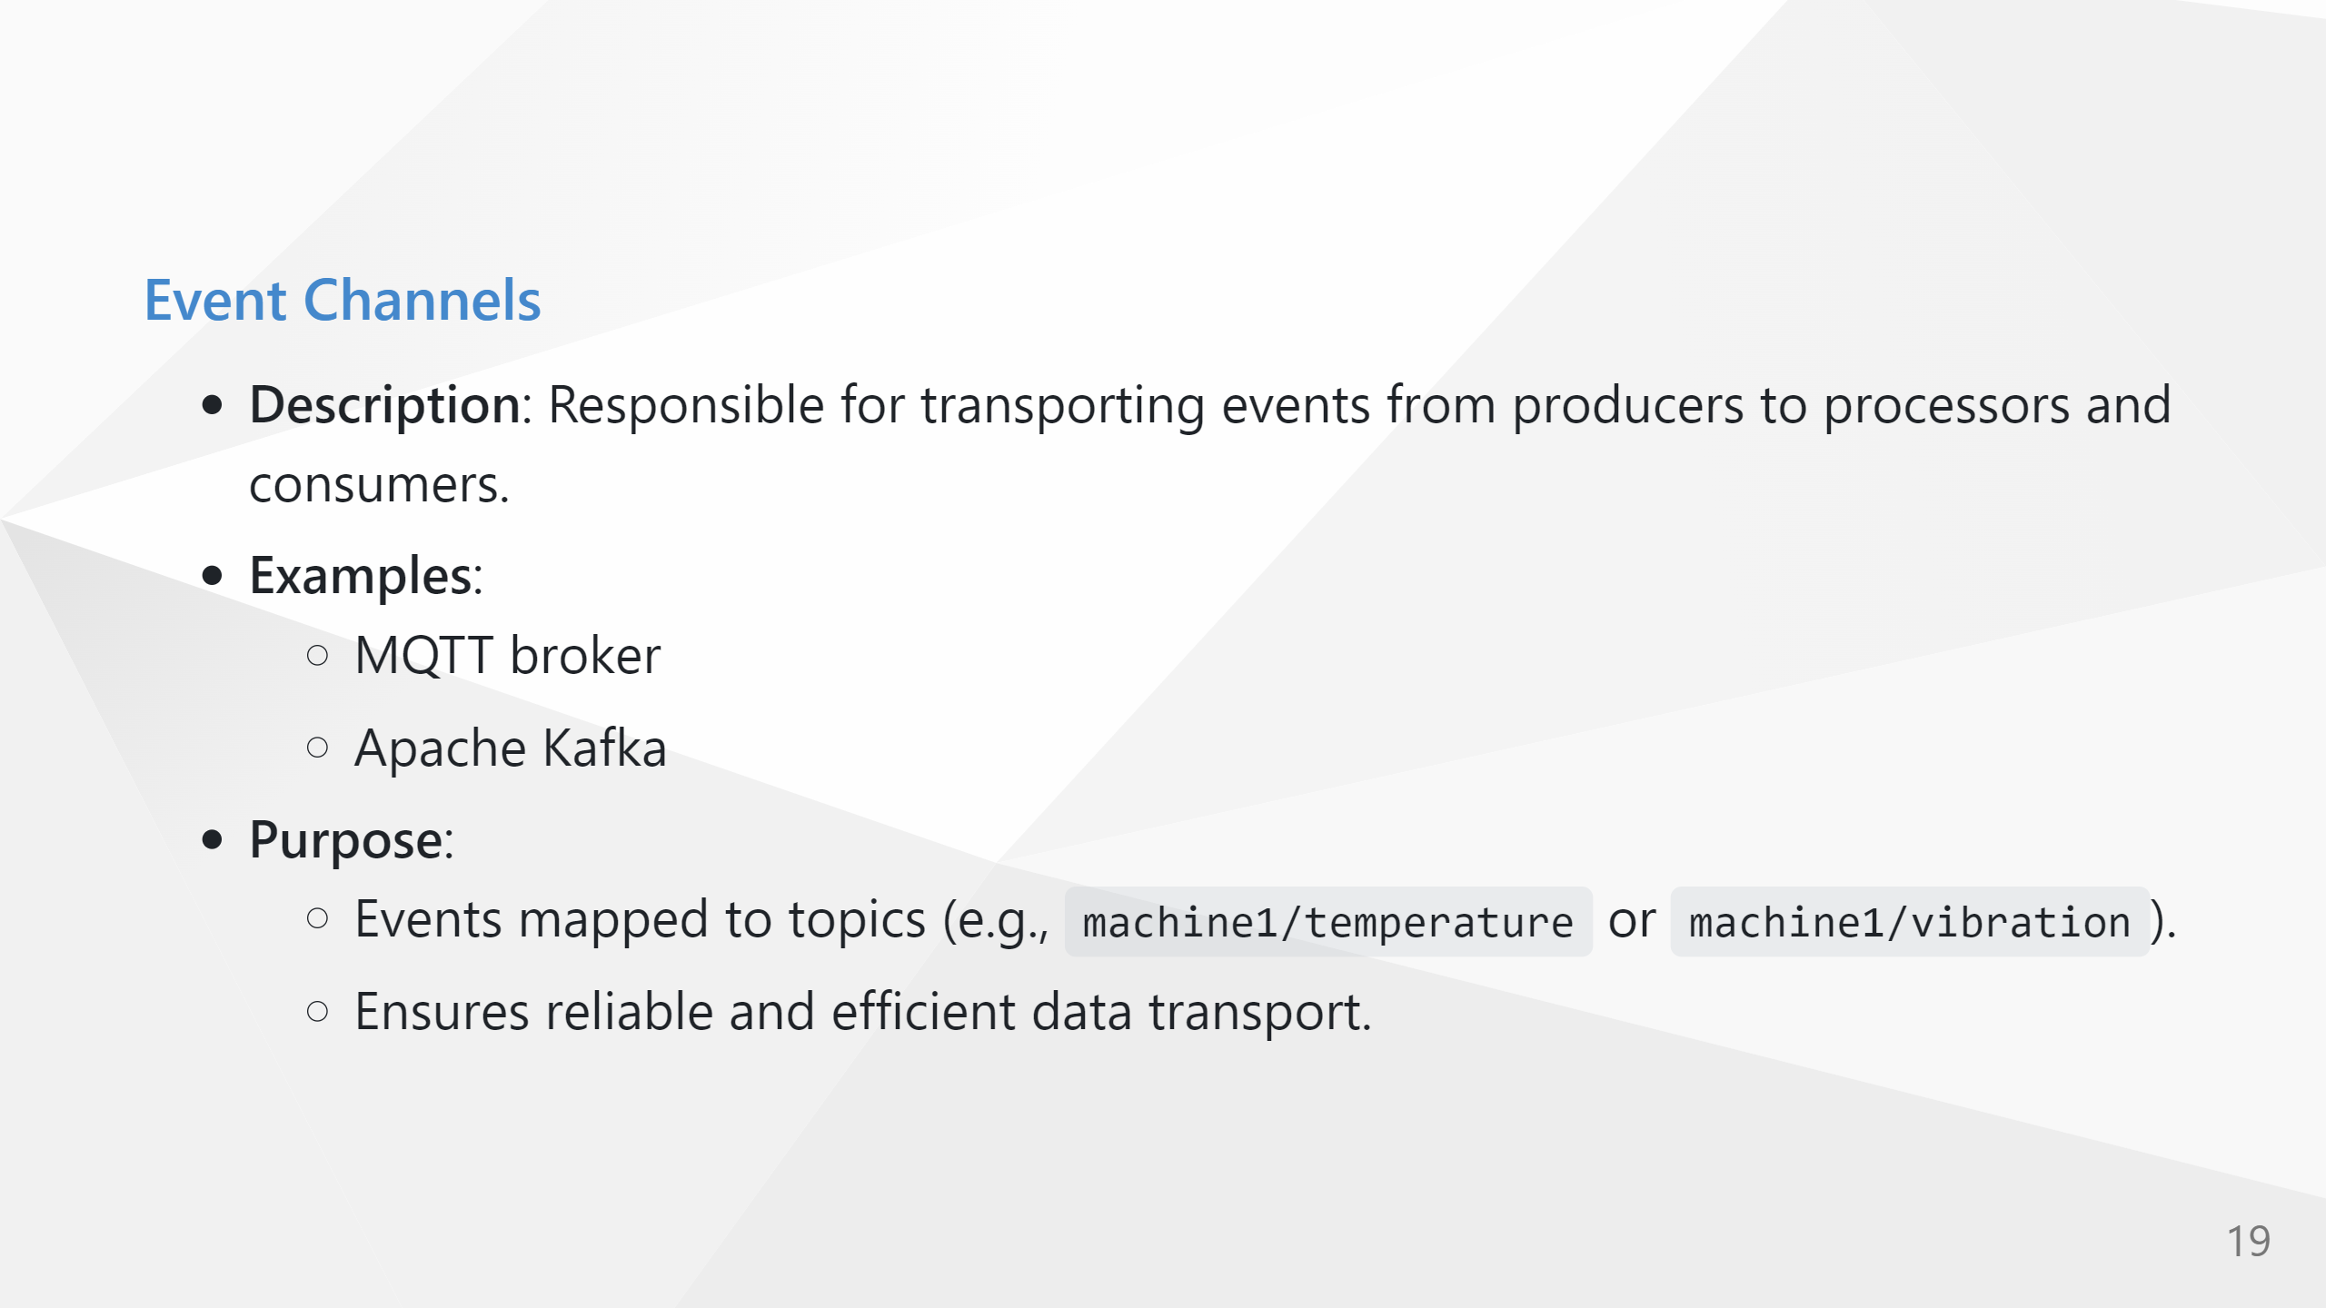

Slide 24
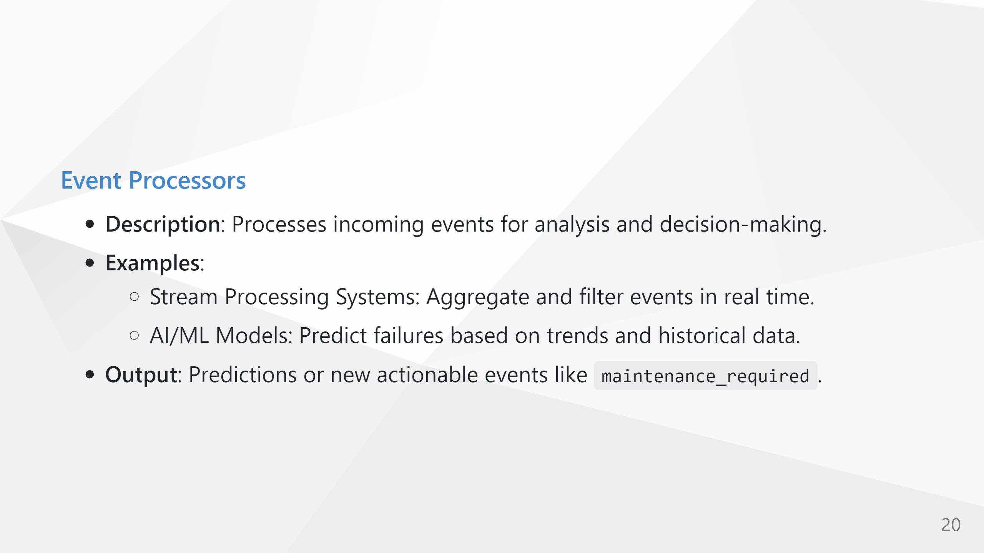

Slide 25
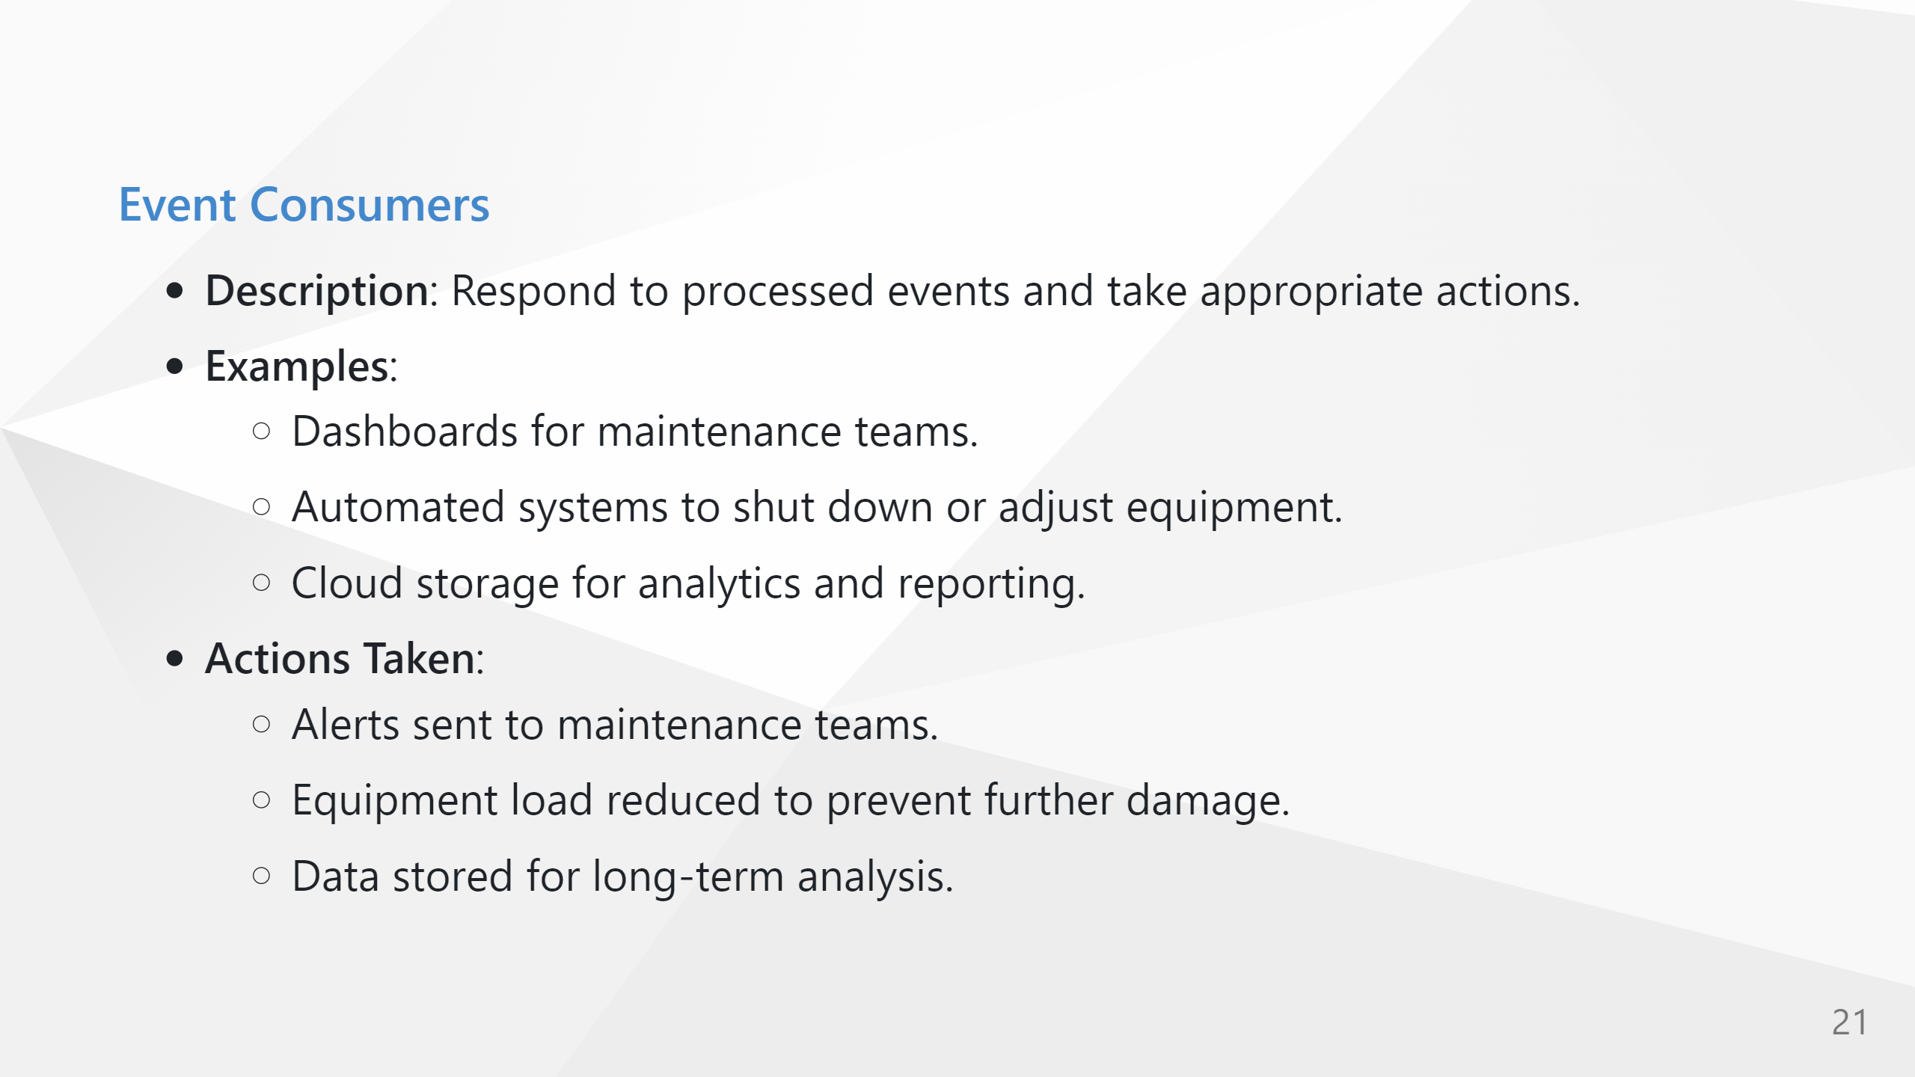

Slide 26
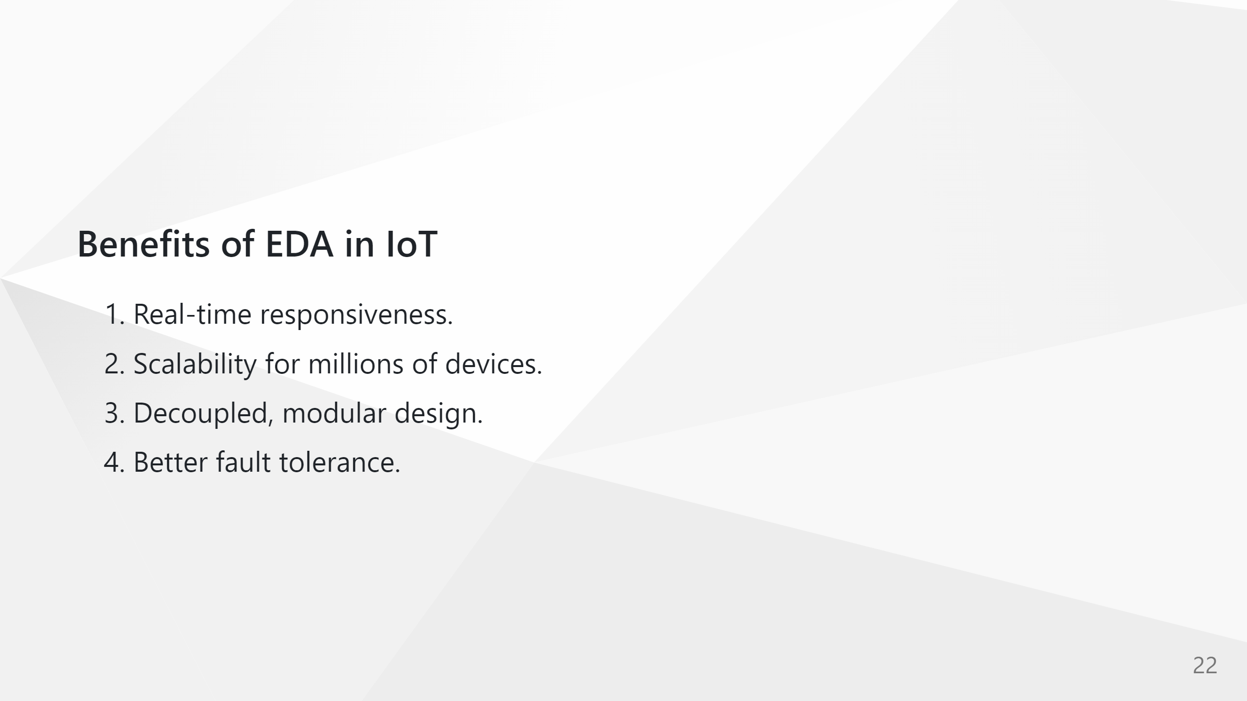

Slide 27
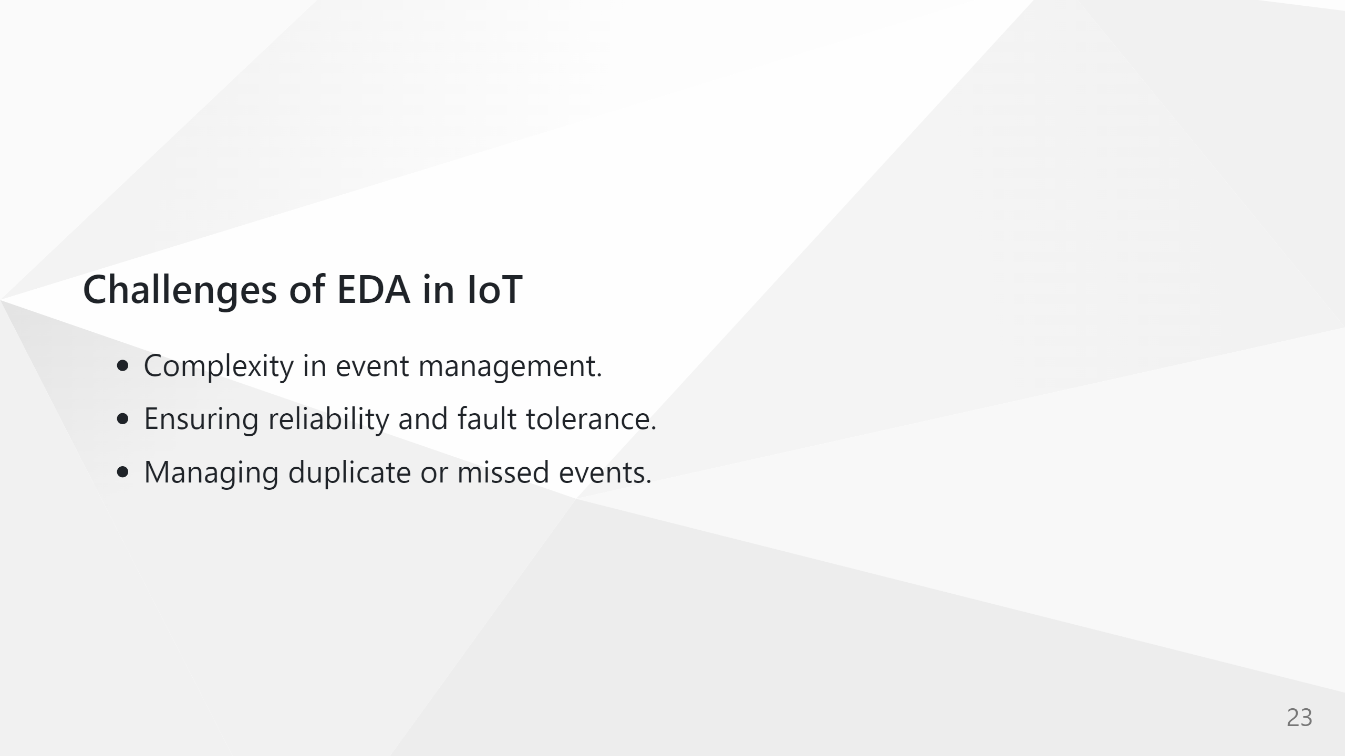

Slide 28
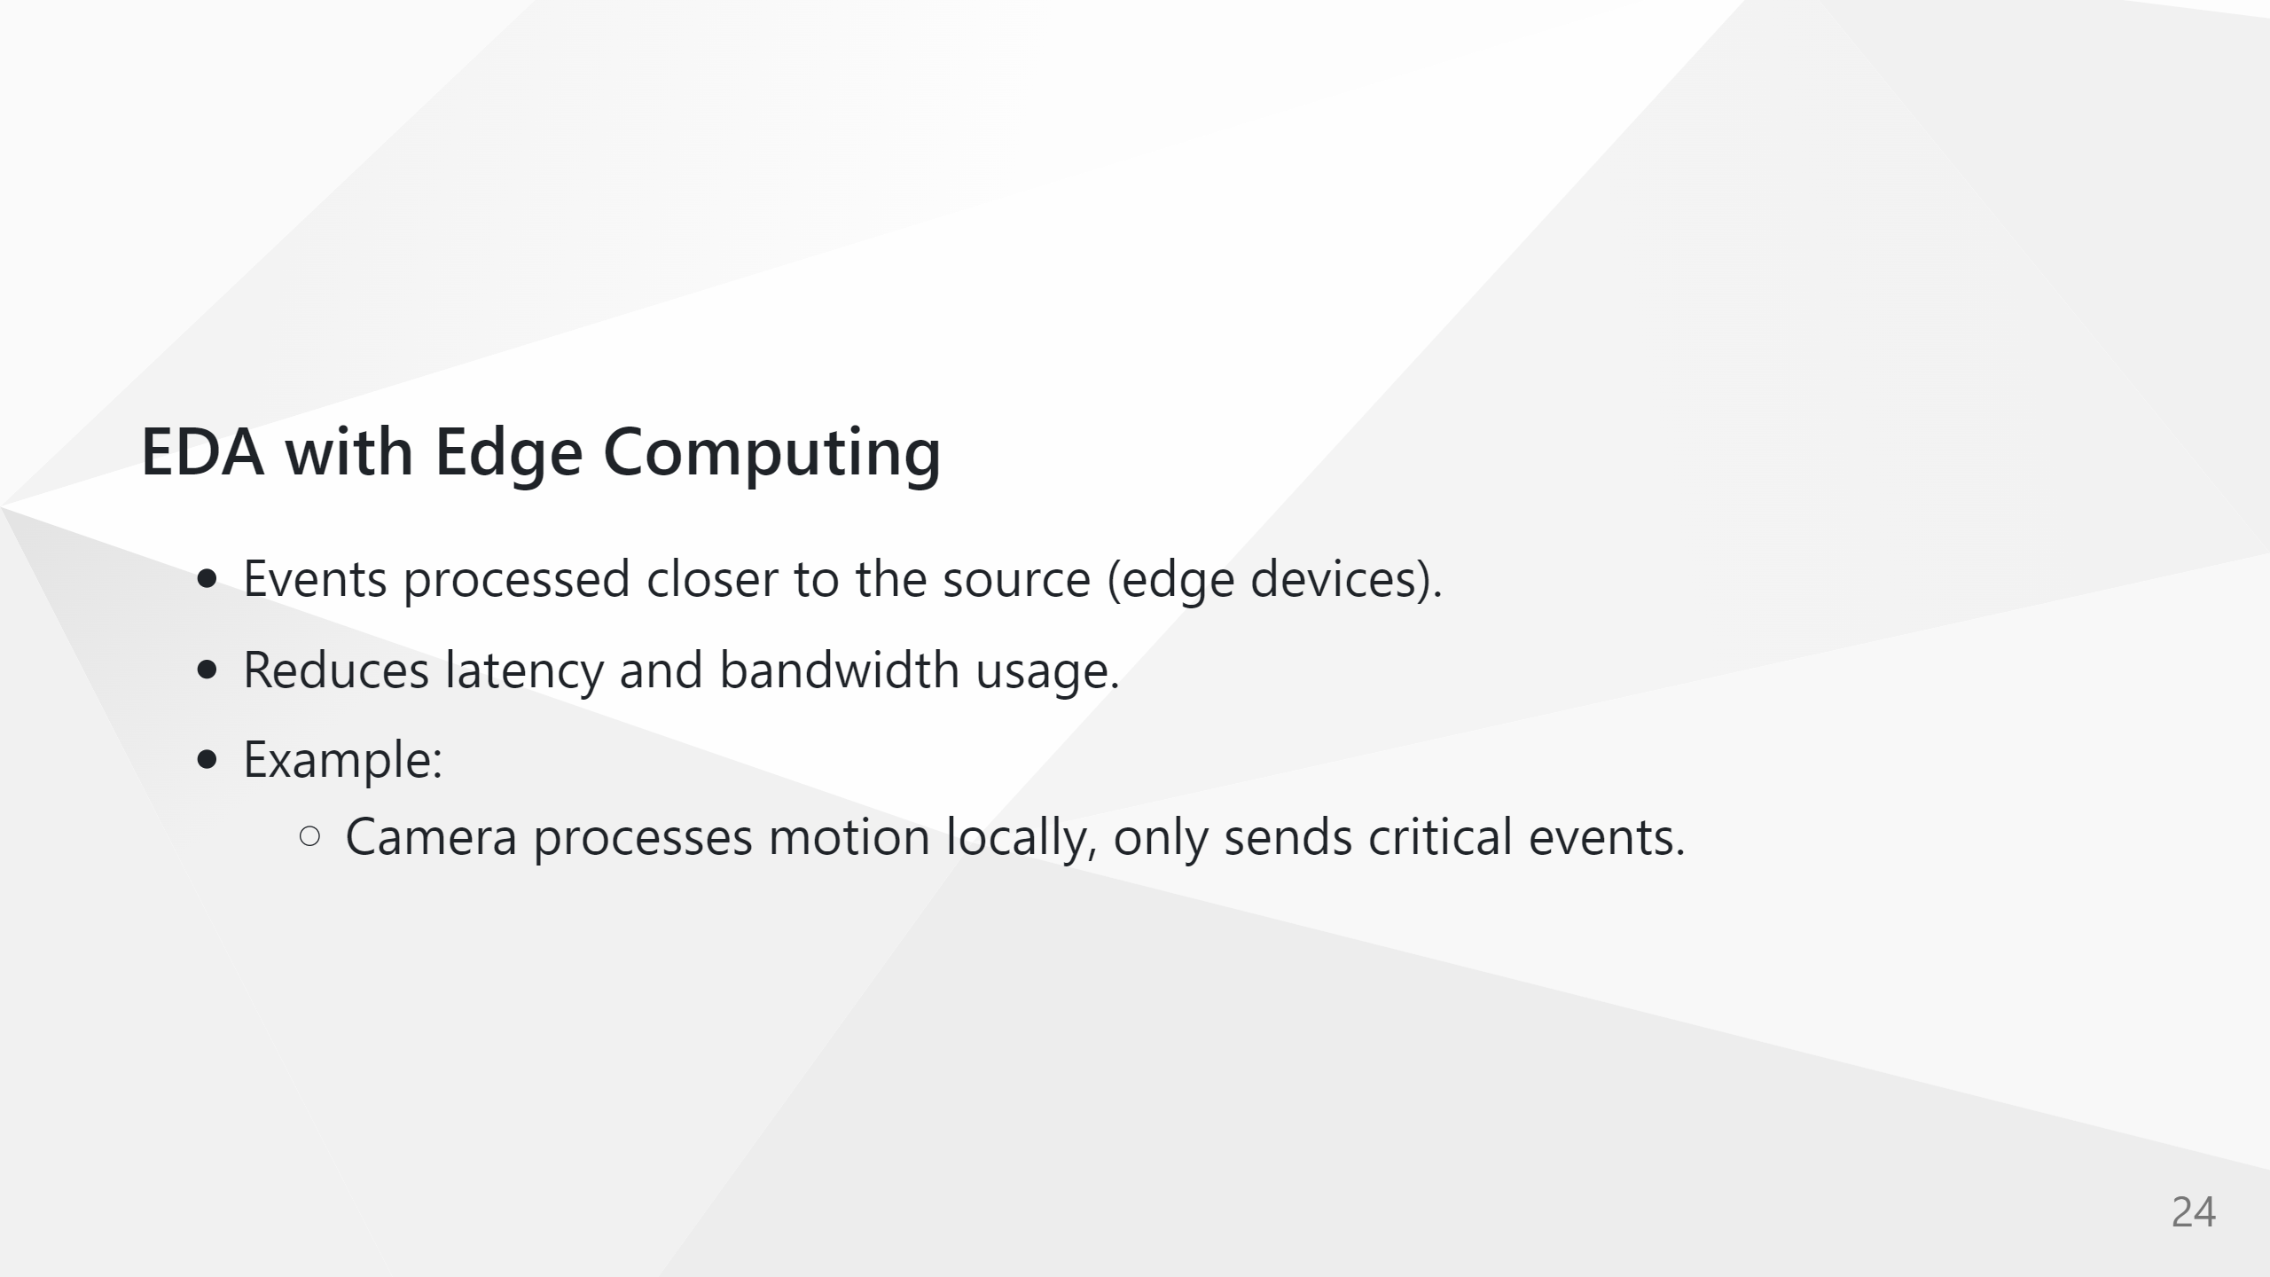

Slide 29
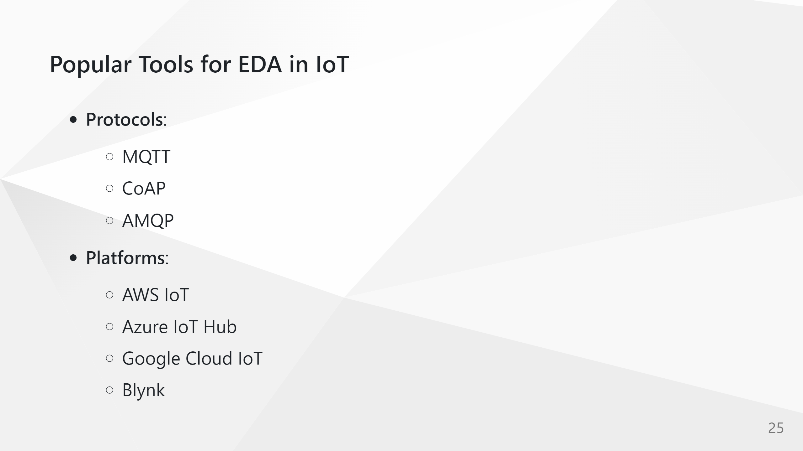

Slide 30
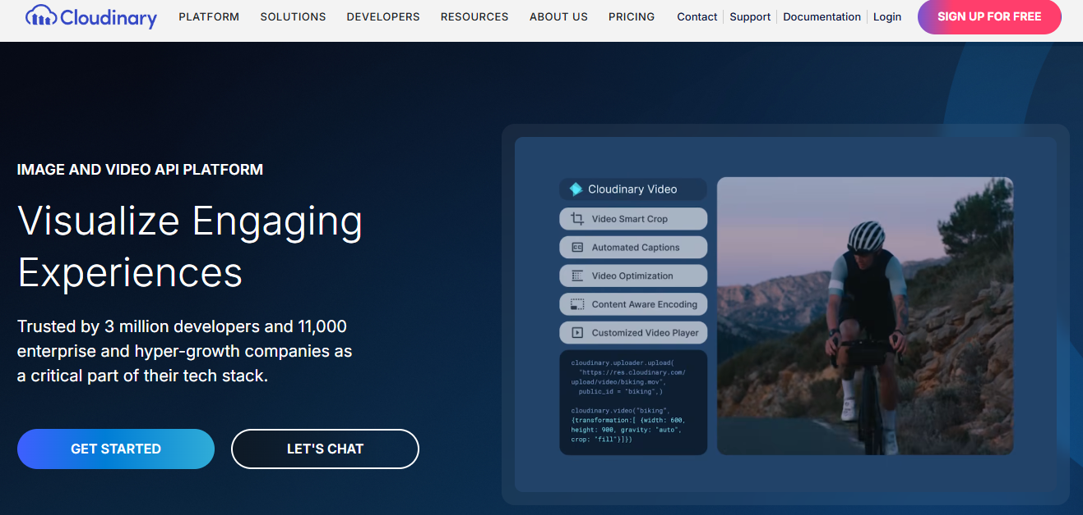
Lab Week 10 – Rpi Camera & Cloudinary

Slide 31
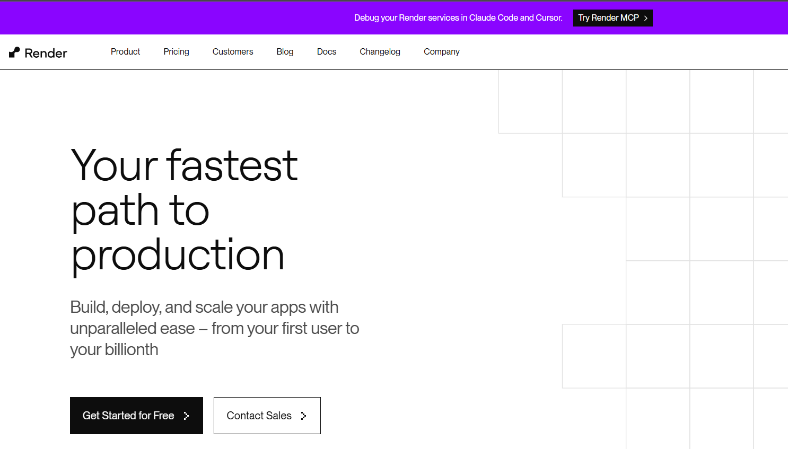
Lab Week 10 – Python on Render

Slide 32


Week 10 Lab: Step1
Raspberry Pi
doorbell_camera App
HTTP
Flask App http://hdip rpi.local:8080

Slide 33
Week 10 Lab: Step2
Cloud
Raspberry Pi
Cloudinary
doorbell_camera App
Render
HTTPS
Flask App http://door_bell.onrender

Slide 34
Week 10 Lab: Step 3
Cloud
Raspberry Pi
Cloudinary
Render
1
doorbell_camera App
Flask App http://door_bell.onrender
MQTT Broker
HTTPS
2
3

Slide 35
