Slide 1
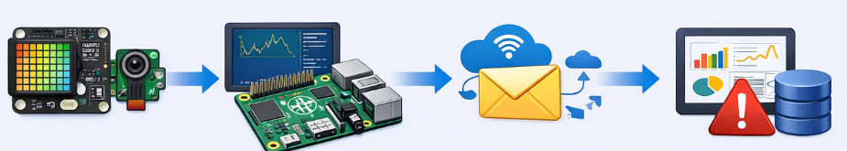
Assignment 2 Specification
Networking using Connected Devices
Produced by: Frank Walsh
Computer Systems and Networks
Certificate/HDip Computer Science 2026

Slide 2
Context
40% of your overall mark
Project ethos (1 overall project)
For this assignment you will design and build a small connected device project:
Propose a project.
Create a working project.
Typically includes a "physical" aspect – sensors/devices(Rpi/SenseHat)
Present and communicate your work in a clear manner.

Slide 3
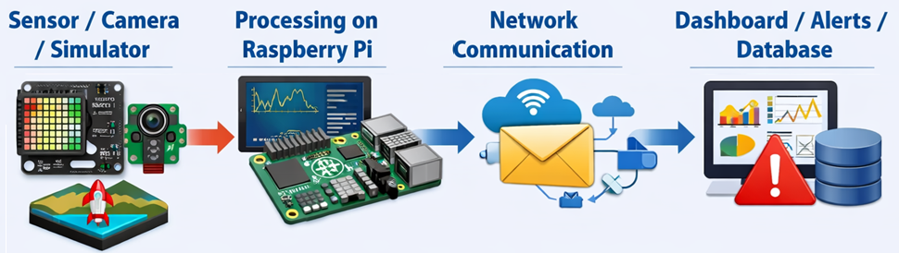
Requirements: Include the different layers (Sensors, processing,Network , Application) in a connected Project.
Data Source
SenseHAT, Camera, Packet Tracer, External API
Processing
Some programmed logic: Theshold checks, Status Calculation, Event Detection(e.g. movement), Rules, Data processing(e.g. average, statistical analysis)
Networking
Use applicable networking/comms tech (MQTT, HTTP, TCP, UDP, or library that uses this (e.g. Blynk)
Application
At least one of: User facing output: Console, Web App/Dashboard (Blynk Mobile App/Web Dash), DB log/history, Alerts/Notifications(e.g. email notification), Device-based(SenseHAT LED matrix)

Slide 4
Proposed Timeline(5 Weeks)
April 26th
Proposal document
Doesn't need to be exact/long!
Sections:
Proposed Tools (IDEs, cloud platforms)
May 29th
Presentation and interview:
Git Repository submission(all code/resources)
10 min Zoom Interview
Deliverable: One page pdf or markdown document with general concept.
Deliverable: Accessible Github repo. Link to video.
Include a max 5 min video demoing your project. (YouTube video)
Introduction
Proposed technologies (protocols/devices/prog lang)

Slide 5
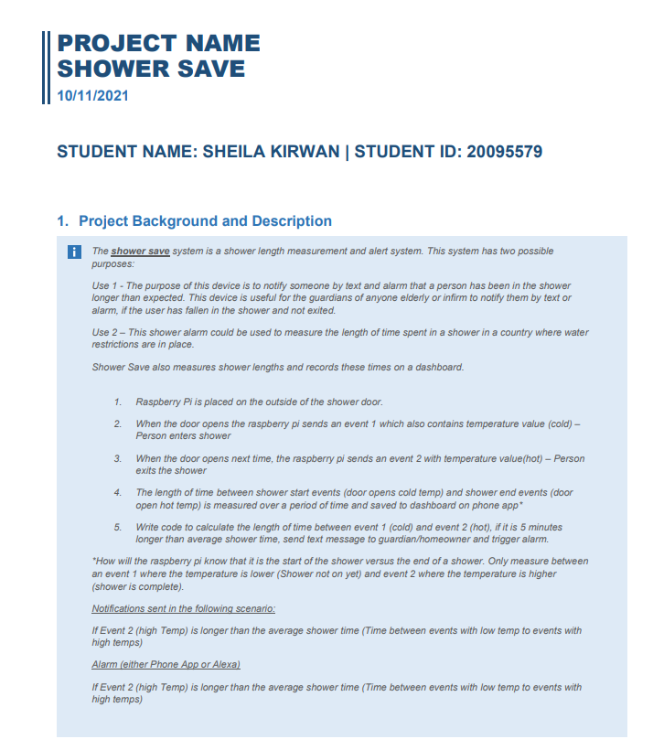
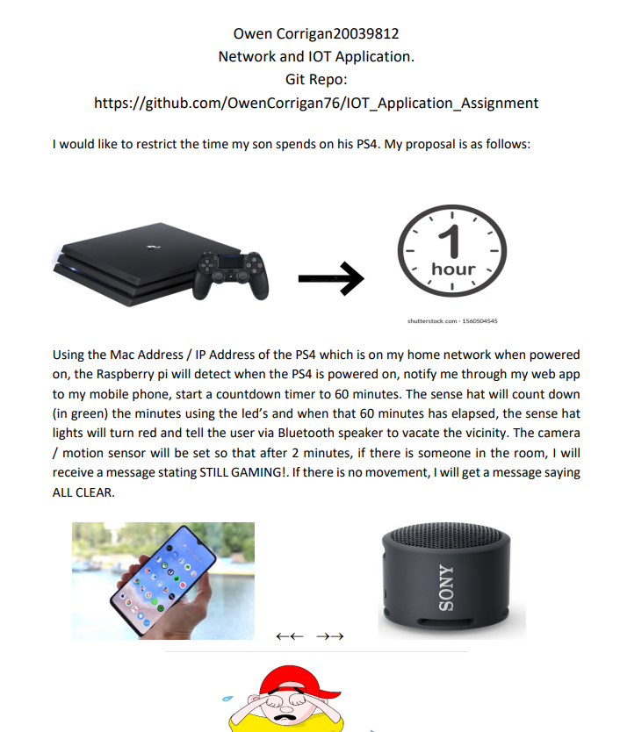
Proposal Document

Slide 6
Git and GitHub
Git and GitHub are mandatory for this assignment.
Your repo should:
Have regular commits
Clear commit messages
All your resources for the project
Source code
Documentation(e.g. proposal doc)
A README.md
Setup notes/supporting resources.

Slide 7
Scope
This is a 5-week project, keep things manageable:
one Raspberry Pi is enough
simulated data is acceptable where appropriate
One network protocol is enough
Simple dashboard is enough
Cloud/server deployment is optional – not required
You are not expected to build a production ready system. Think of it as a proof of concept demonstration.

Slide 8
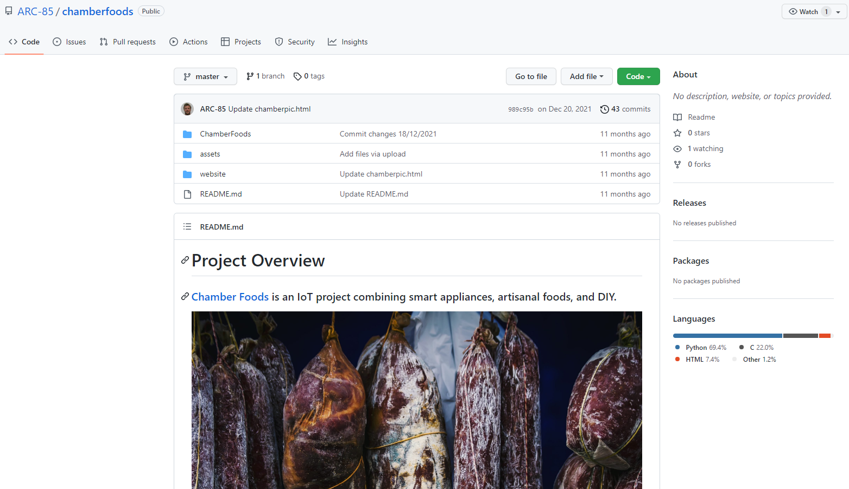
Final Project Submission

Slide 9
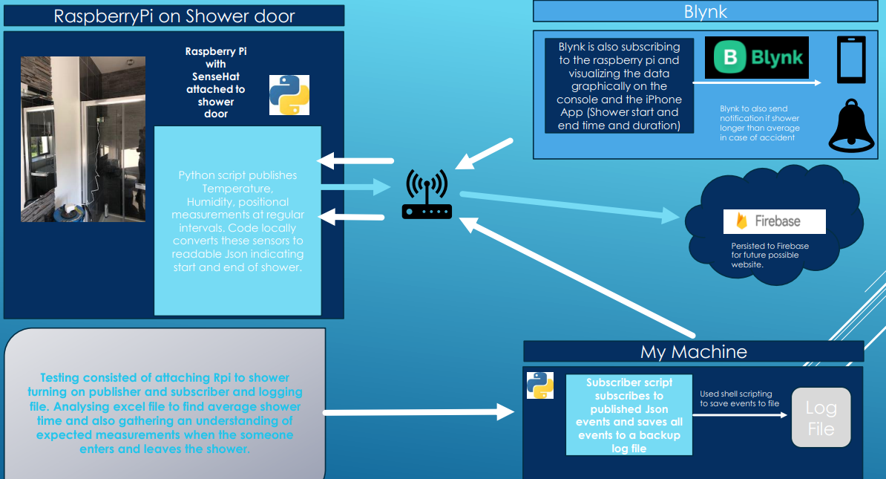
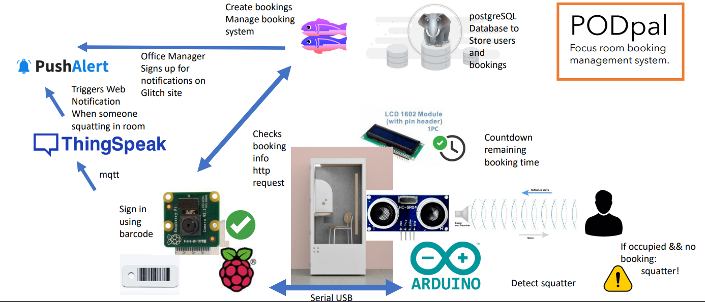
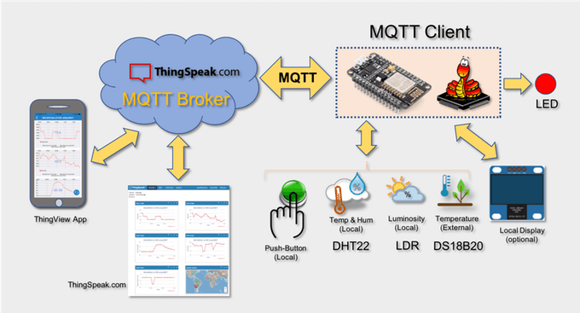
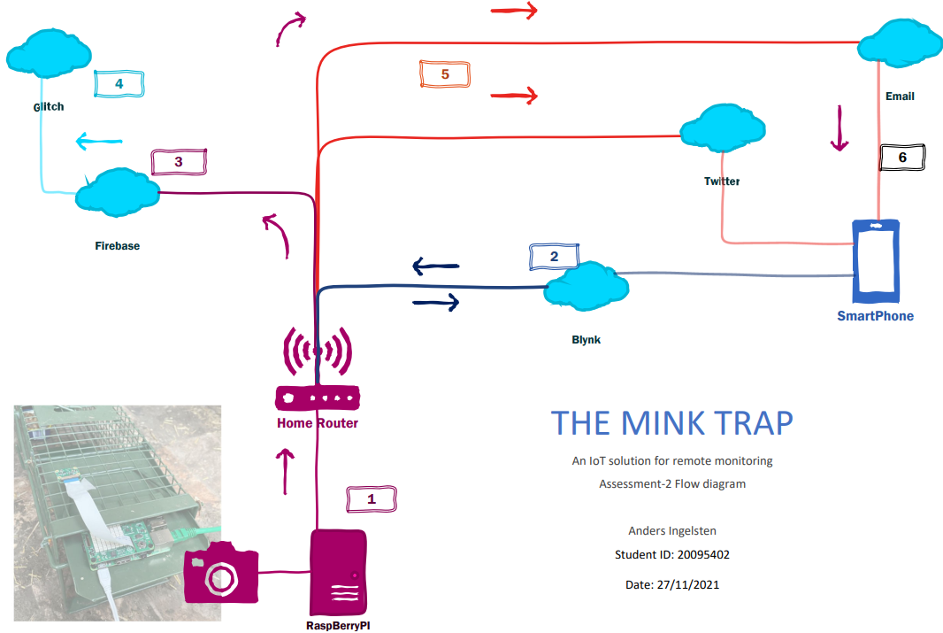
Project Graphic

Slide 10

Proposed Timeline
Week1
Project idea, proposal, and approval
Week2
Get input/data source working on the Raspberry Pi
Week3
Implement networking/connection with other component/platform/service
Week4
Add output layer such as dashboard, logging, alerts, or storage
Week5
Testing, refinement, documentation, GitHub cleanup, and demo preparation

Slide 11

Grade Spectrum Guide
 | IoT Solution | Networking/IoT Technologies Used | Combined knowledge | Communication
Release 1 Base (30-49) | One input source to Device | Physical/Data link layer solution. Basic one way connection between device/processes. | 2 programme strands present in output. Basic knowledge of each exhibited. (e.g. programming, database, computer systems) | Zip file and/or basic Repo: Minimal (1) communication resource used (e.g. simple readme.md) and video.
Release 2 Good (50-64) | At least one real or simulated input source | Wireless/Wired protocols including network and transport layer. Interconnected device(s) and or processes. | Apply and combine concepts from more than two modules/strands.. | Good Github Rep: Repository includes clear structure, documentation.
Release 3 Excellent (65-80) | Connected Application of good prototypical standard. Used to evaluate overall suitability for a full project. | Lightweight messaging. Network/API programming. Architecture/ IOT Framework that mediates between devices and components. | >2 strands as above including more advanced knowledge and concepts. | Excellent Github Repo: Additional communication resources (e.g. instruction video, learning resources, Excellent ReadMe/installation guide)
Release 4 Outstanding (80-100) | Novel solution of clear applicability to specific domain. Could result in employment/internship offer. | All previous to excellent level. Excellent Use of Cloud/IoT specific platforms | All above, including self-acquired knowledge over and above module content. | All the above to excellent level, accessible project platform (e.g. web site, Social Media)

Slide 12
What Releases might look like:
Release 1(Core)
At least one sensor or simulated data source (e.g. temperature, button, motion, External API).
Regular data collection.
Some local processing of raw values (e.g. thresholds, states, simple rules).
One running program that shows behaviour clearly (console output acceptable).
Basic logging/display (print values, write to file, simple terminal UI).
Clear project description: problem, aim, and what you're building.
“My RPi reads sensor values every few seconds, checks if it's above a threshold, logs it, and shows a warning on screen.”

Slide 13
What Releases might look like:
Release 2(Good)
Two distinct components/processes (e.g. sensor/edge node + service/dashboard).
At least one network connection (MQTT, API, TCP/UDP, HTTP).
Structured data messages (JSON recommended).
Meaningful data handling beyond raw logging (averages, states, or simple analytics).
Basic dashboard or visualisation (web page, terminal UI, or simple graph).
Initial architecture diagram (boxes + arrows is fine).
“Edge device sends JSON readings to a second service via MQTT/HTTP. The service logs the messages and shows a simple dashboard page.”

Slide 14
What Releases might look like:
Release 3(Excellent)
Multi-node or multi-service architecture (device → service → UI).
Clear message schema / API contract documented in README.
Historical data handling (DB/CSV with queries, charting, trend indicators).
Live updates (MQTT subscription, WebSocket updates, or auto-refresh UI).
Derived metrics or smart behaviour (alerts, recommendations, rules engine).
Refined UI showing both current and historical data.
Clear, well-explained architecture diagram (separation of concerns).
“My device publishes readings to an MQTT broker. A backend service stores them and exposes API endpoints. A web dashboard graphs trends and shows alerts when readings exceed limits. . If <some event> occurs, application does <x>””

Slide 15
What Releases might look like:
Release 4(Outstanding “stretch” features )
Cloud or remote deployment (Azure IoT, running your broker/UI, or remote database).
Multiple communication methods (e.g. MQTT + REST, or device → broker → cloud).
Configurable system (thresholds, settings editable via UI or config file).
Robustness features (reconnect logic, message validation, retry/backoff).
Advanced UI (charts, filters, zones, device status, colour-coded alerts).
Self-learned technology beyond module basics (e.g. advanced programming, containerisation, cloud services/DevOps etc.).
Insightful reflection in video and readme : trade-offs, architecture choices, limitations.
“My sensor node publishes to an MQTT broker on a cloud VM. A backend API ingests data into a cloud DB. A deployed dashboard visualises long-term trends, alerts, and device status. Thresholds can be changed from the web UI.”

Slide 16

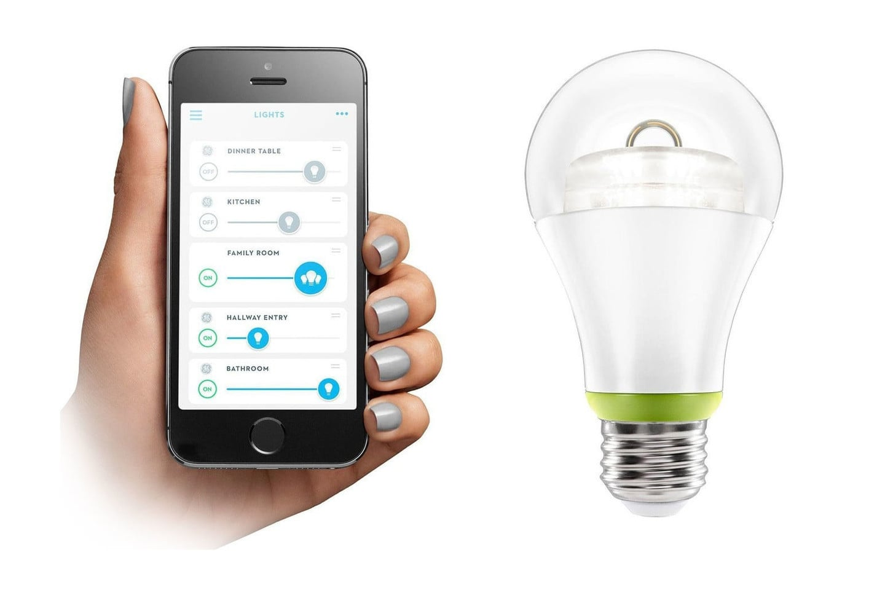
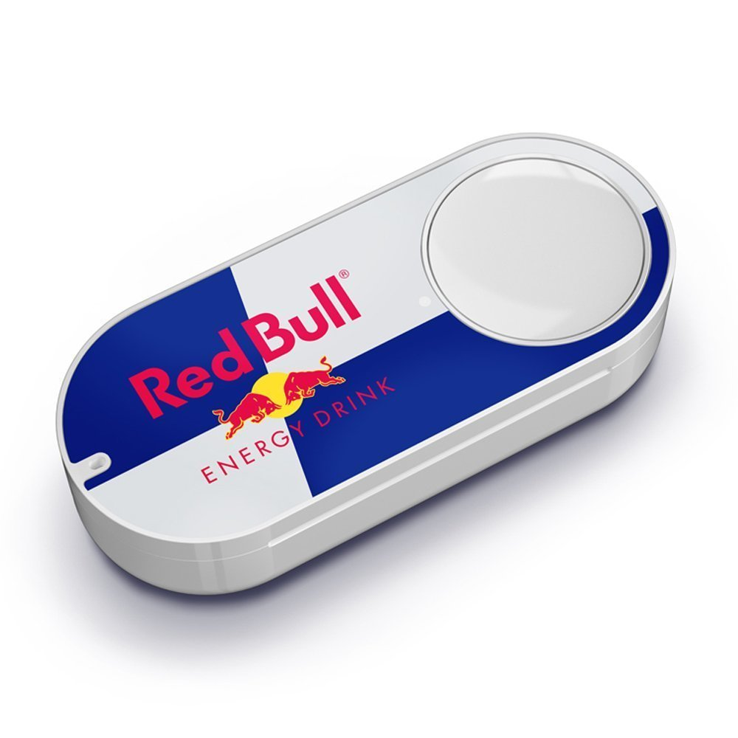
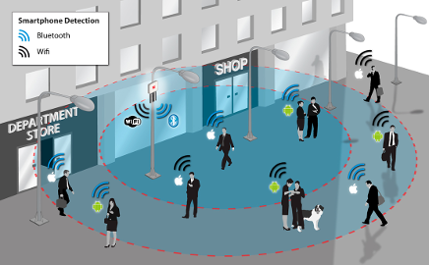
Sample Project Ideas
Smart home/Monitoring device:
Access and control a home device
Monitor/analyse home environment (medical/care apps)
Smart Plant Monitor
Who's there?:
Detect and monitor devices on the home network(enhance lab work with cloud platform, extend to general smart home solution, use camera, use acceerometer/Gyro…)
Wether Weather 2.0?
Extend/modify Web App assignment from last semester to connect/use your own environment device.
Already getting current/forecasted weather conditions. Combine with home environment data to analyse and/or control stuff(e.g. rain warning – take in the washing! Clear/Windy – hang out the washing!).

Slide 17

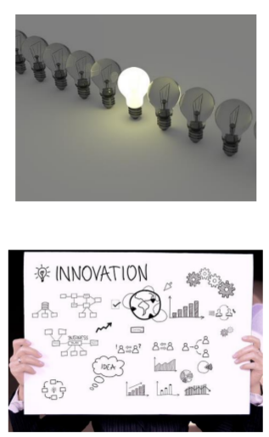
Other Considerations
"Permissionless Innovation"!
You don’t have to limit yourself to SenseHAT/RPi or module technologies. You can integrate other devices/ systems
We used Python but you can use any other programming languages/ frameworks if you want. (Remember, the RPi can run Node/Java/JavaScript)
Have a look at other IoT project examples for inspiration.
It's OK to "simulate" sensors
Use Packet Tracer
We realise you don’t have a lab at your disposal. You can simulate data (e.g. GPS location.)

