Slide 1
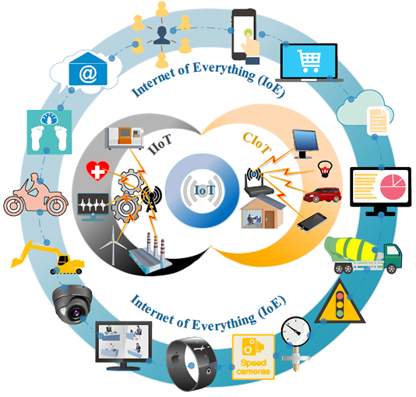
Packet Tracer
IoT Devices
Config and Programming
This Photo by Unknown Author is licensed under CC BY

Slide 2
Agenda
IoT Devices in Packet Tracer
Programming IoT Devices in PT
Linking PT simulation to real world!

Slide 3
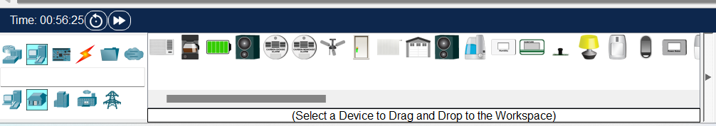
IoT Components in Packet Tracer
Packet Tracer can be used as a prototyping tool for IoT.
Packet Tracer can simulate smart networks that make use of IoT devices.
Many IoT devices for a Smart Home/Industrial/Power Grid network.
Can build your own “custom” IoT device
Direct interaction with a device:
Hold down the Alt key and click on the device to turn it on or off.
Control remotely over the network via a web browser

Slide 4
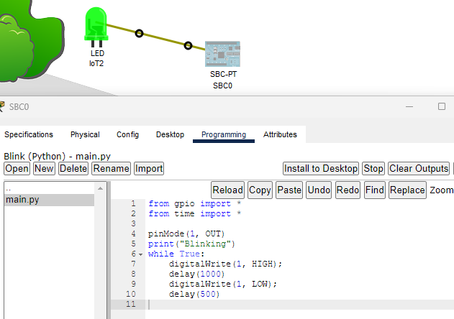
MCU/SBC/Sensor and Actuators
PT contains a set of common sensors and actuators (components)
LED, Button
Components can't be directly connected to the Network
Connect to Single Board Computer or Microcontroller, you can create/prototype electronic circuits.
Connect them using IoT Custom Cable

Slide 5
Program a Device or Custom Component
Packet Tracer provides support for JavaScript, Phyton and Visual Programming language called Blocky for most IoT devices/components, including Custom devices
Access the Programming environment via advanced->Programming tab
Usually, a default example Project(s) present
Can create new programming project or edit an existing one

Slide 6
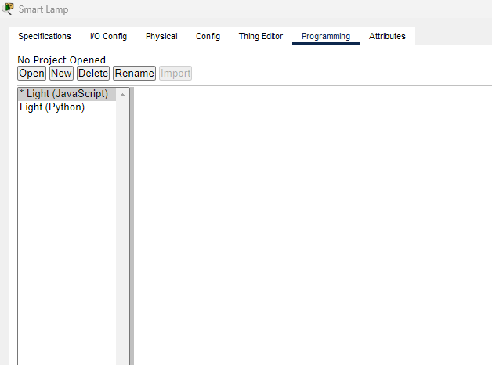
Programming: Projects
1. Select Programming Tab
2. Left Panel shows projects available on device
3. Asterix indicates which Project is running
4. Use buttons to Open/Delete/Create/Stop/Start projects

Slide 7
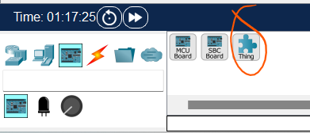
Create a new Component
To Create a new Thing:
Add a Thing from Components list
Click the Advanced to access the /Thing Editor
Associate the new graphics to their respective states(e.g. on/off)
Click on the Config tab to select the network adaptor to be used to connect to the network (if applicable).
Save it for later:
Select Tools/Custom Device Dialog from the toolbar.
Click on Select and click on the Thing to be saved.
Modify the template and description.
Click on the type of new Thing.
Click on Add - The new template will be saved in the PT template file on the local disk and the customized Thing will now display with the other sensors.

Slide 8
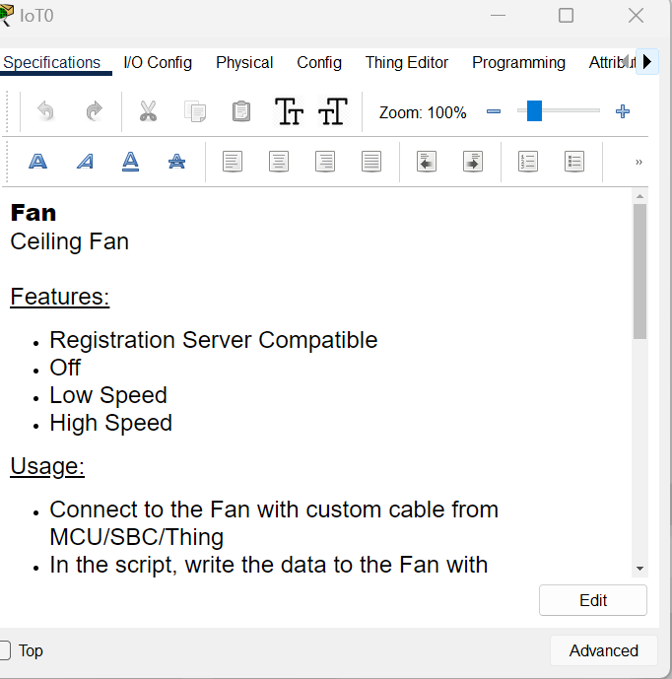
IoT Components: Configuration
The Config window of a device allows you to:
Specifications - describes the features, usage, local and remote control of the device.
Physical - available modules and power connections.
Config - show display name, serial number, network configuration and IoT server.
Attributes - display the devices attributes such as MTBF, power consumption and cost.
Advanced config also possible including programming/behaviour

Slide 9
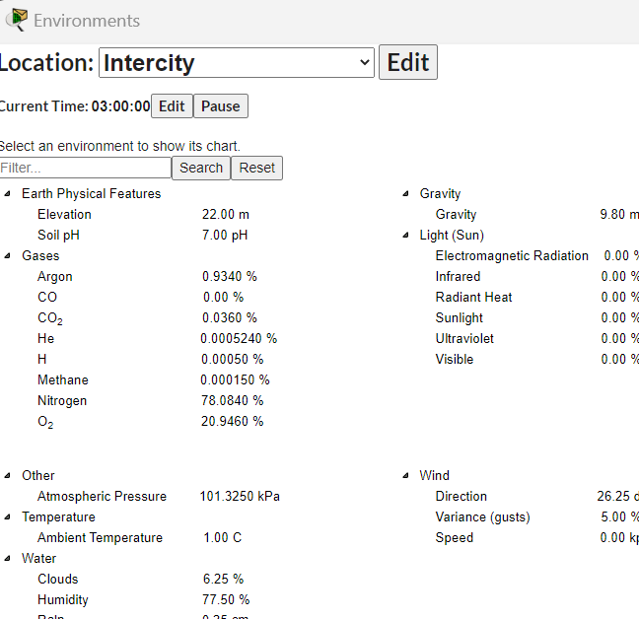
Packet Tracer Environment Controls
The Physical Workspace uses containers.
Each container (intercity, buildings, and wiring closets) can have their own set of environmental values.
There are 24 default environmental elements, such as temperature, rain, water level, wind speed, and snow.
A heater will increase ambient temperature when turned on.
A smoke detector can be used to trigger an alarm when the smoke in environment increases to a certain point.
Notes:
. A fire sprinkler will raise the water level and humidity in a container. An old car will increase various gases and ambient temperature when turned on. A smoke detector can be used to trigger an alarm when the smoke in environment increases to a certain point.

Slide 10
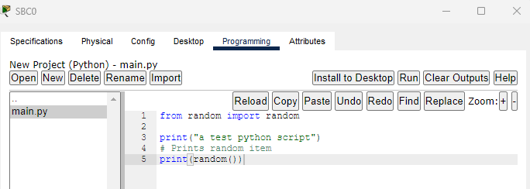
Programming: Creating a new Project
Select the Template to suit
Many available in Python/Javascript
Modify the code to suit your means
Good idea to look at similar devices code as an example

