Slide 1
Variable Length Subnet Mask
Mujahid Tabassum
2026

Slide 2

Learning Objectives
To understand about IPv4 Addressing and subnetting concept.
Able to create subnets for any IPv4 given address.
To understand the need of VLSM and able to create VLSM for any given IPv4 address.
Notes:
2

Slide 3
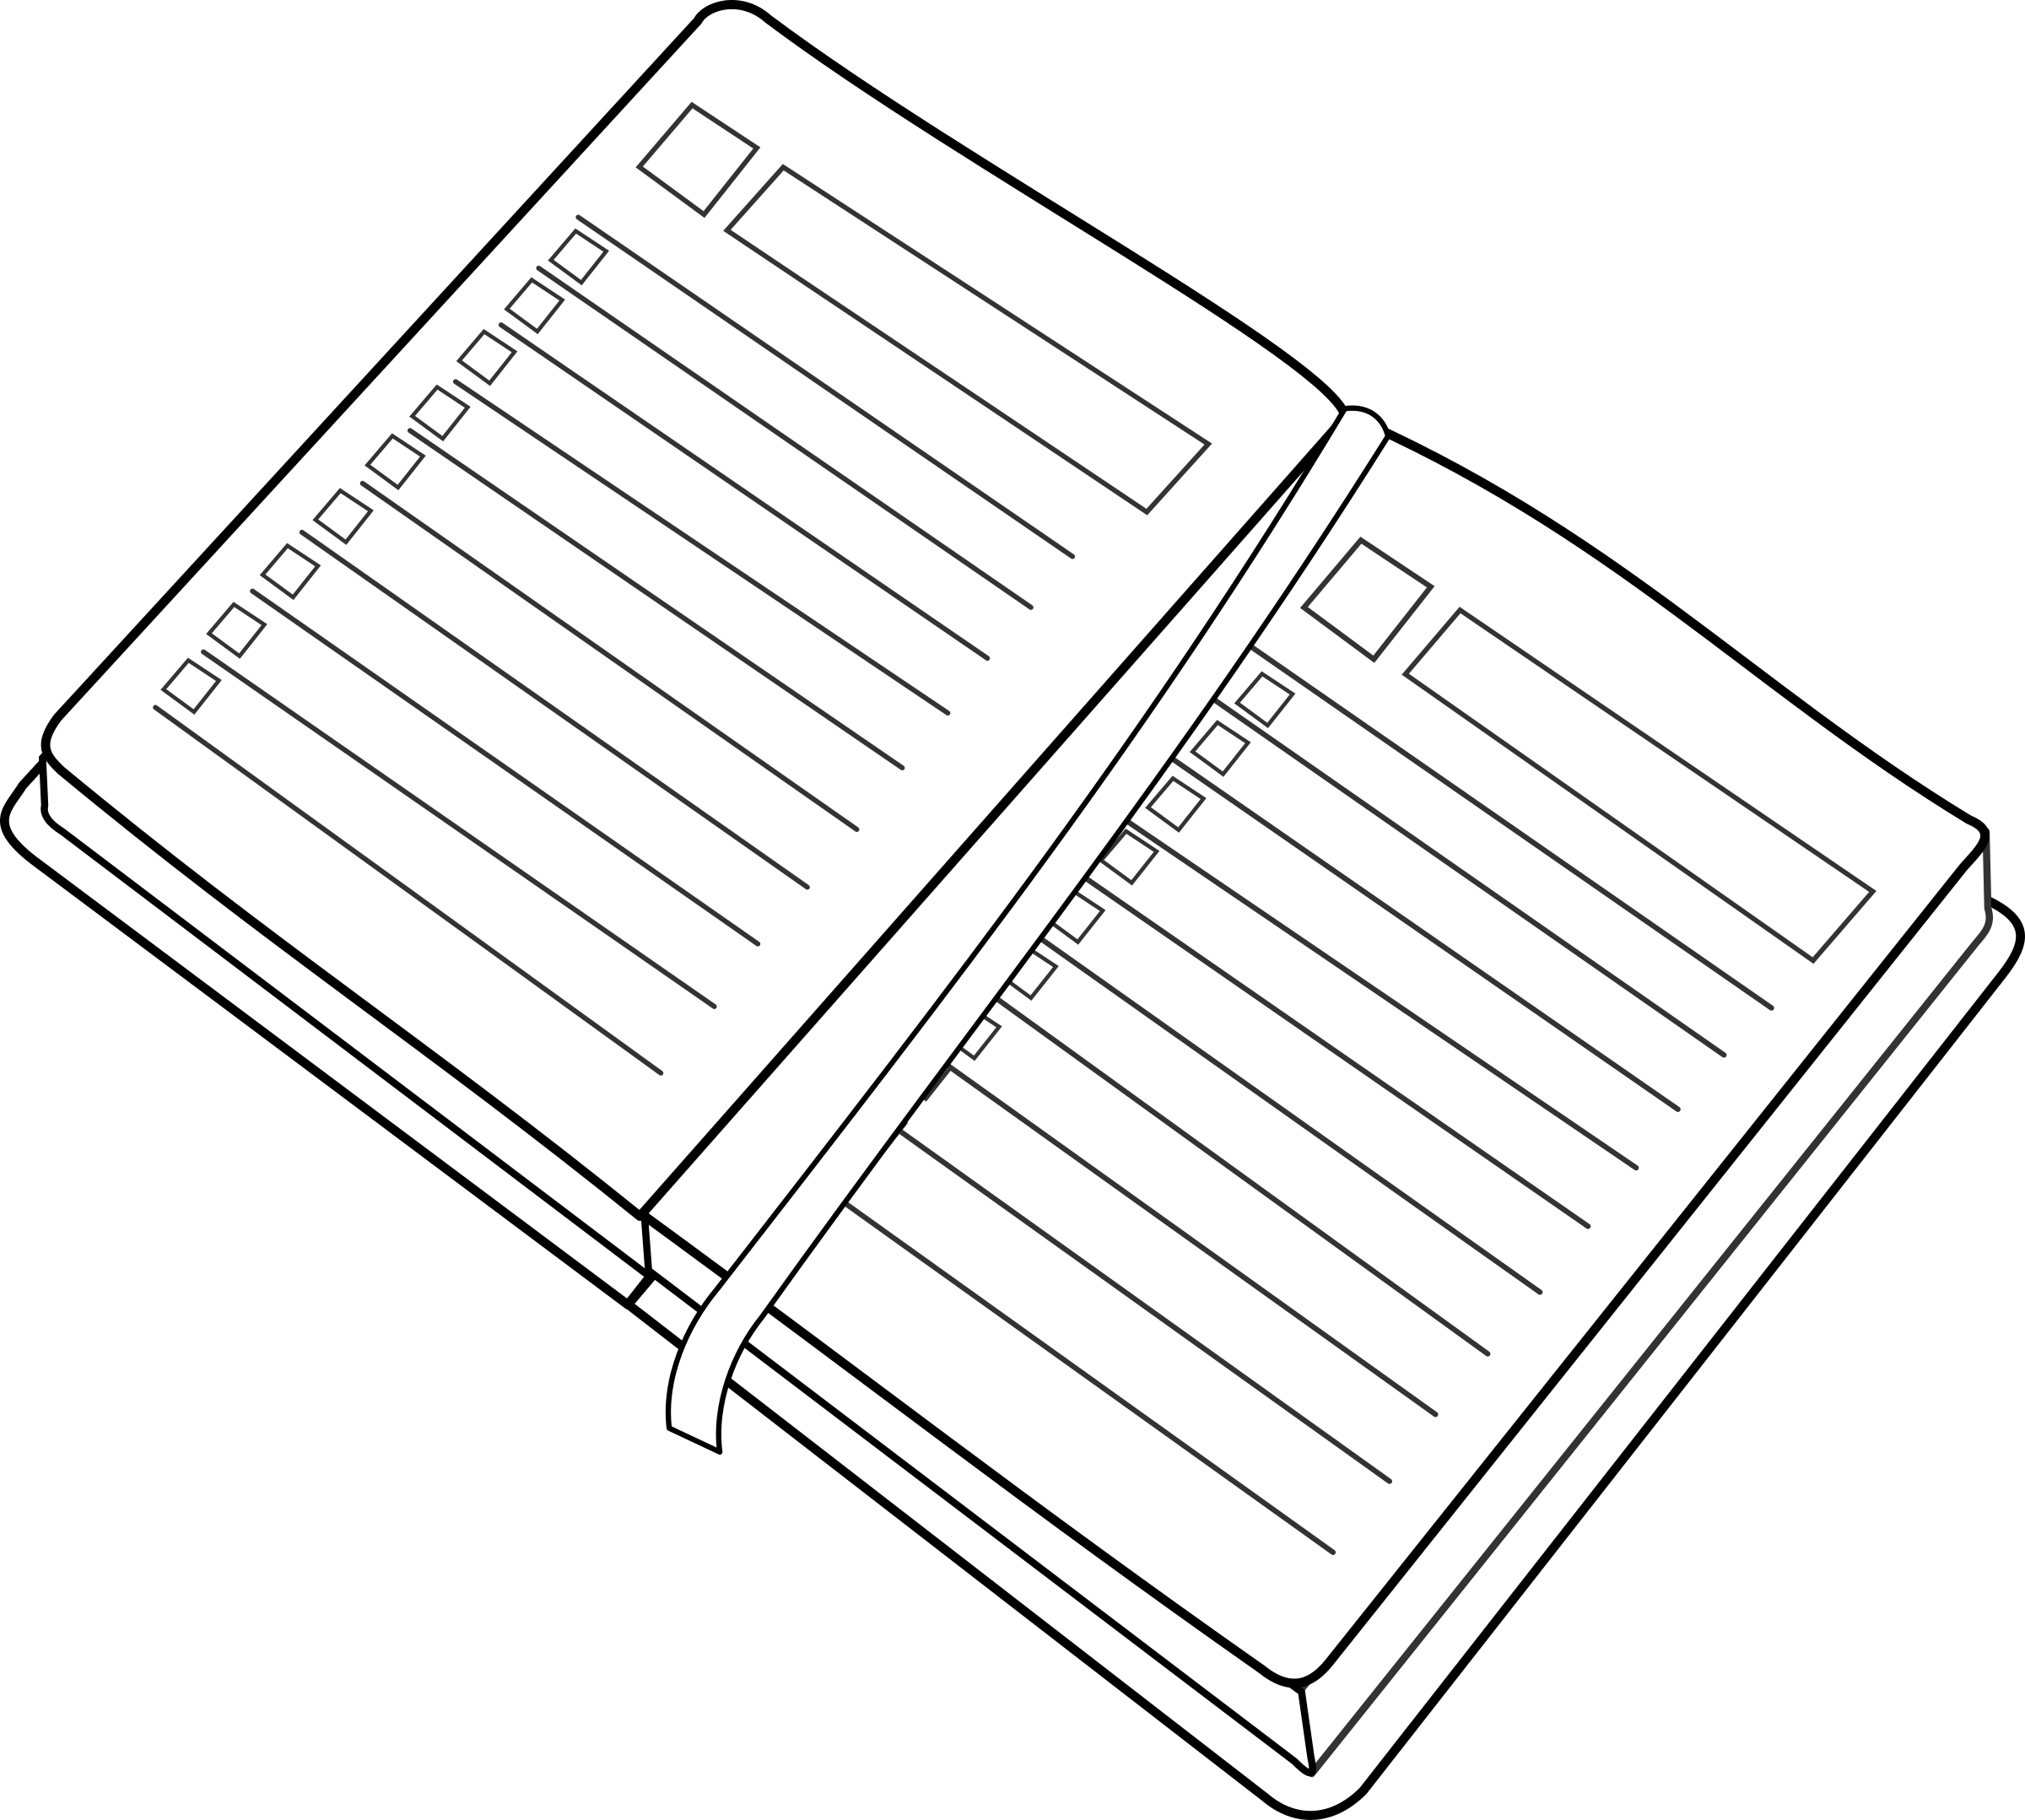
Agenda
The problem of Fixed Length Subnet Mask and “Wasted” addresses
Variable Length Subnet Masks
Example: VLSM Network Design
Supernetting

Slide 4
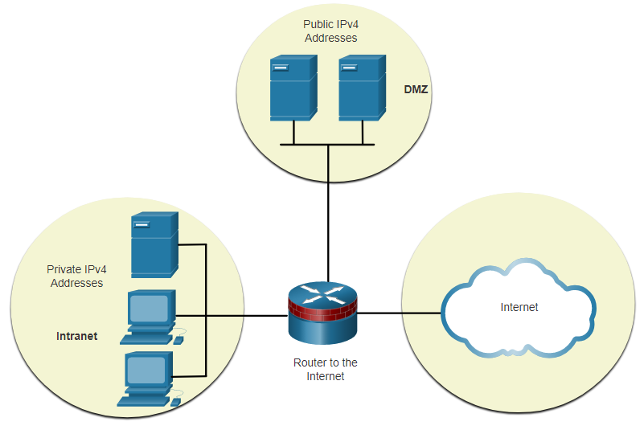
Subnet to Meet Requirements Subnet Private versus Public IPv4 Address Space
Enterprise networks will have an:
Intranet - A company’s internal network typically using private IPv4 addresses.
DMZ – A companies internet facing servers. Devices in the DMZ use public IPv4 addresses.
A company could use the 10.0.0.0/8 and subnet on the /16 or /24 network boundary.
The DMZ devices would have to be configured with public IP addresses.
Notes:
While it is nice to quickly segment a network into subnets, your organization’s network may use both public and private IPv4 addresses. This affects how you will subnet your network.
The figure shows a typical enterprise network:
Intranet - This is the internal part of a company’s network, accessible only within the organization. Devices in the intranet use private IPv4 addresses.
DMZ - This is part of the company’s network containing resources available to the internet such as a web server. Devices in the DMZ use public IPv4 addresses.

Slide 5
Subnetting: Minimise “Wasted” Addresses
When planning subnets, generally want most efficient use of Network space
Table below relates to subnetting a /24 network (e.g. 192.168.20.0/24).
Enough subnets?
Enough Hosts?
Prefix Length | Subnet Mask | Subnet Mask in Binary (n = network, h = host) | # of subnets | # of hosts
/25 | 255.255.255.128 | nnnnnnnn.nnnnnnnn.nnnnnnnn.nhhhhhhh 11111111.11111111.11111111.10000000 | 2 | 126
/26 | 255.255.255.192 | nnnnnnnn.nnnnnnnn.nnnnnnnn.nnhhhhhh 11111111.11111111.11111111.11000000 | 4 | 62
/27 | 255.255.255.224 | nnnnnnnn.nnnnnnnn.nnnnnnnn.nnnhhhhh 11111111.11111111.11111111.11100000 | 8 | 30
/28 | 255.255.255.240 | nnnnnnnn.nnnnnnnn.nnnnnnnn.nnnnhhhh 11111111.11111111.11111111.11110000 | 16 | 14
/29 | 255.255.255.248 | nnnnnnnn.nnnnnnnn.nnnnnnnn.nnnnnhhh 11111111.11111111.11111111.11111000 | 32 | 6
/30 | 255.255.255.252 | nnnnnnnn.nnnnnnnn.nnnnnnnn.nnnnnnhh 11111111.11111111.11111111.11111100 | 64 | 2
Notes:
To minimize the number of unused host IPv4 addresses and maximize the number of available subnets, there are two considerations when planning subnets: the number of host addresses required for each network and the number of individual subnets needed.
There are two considerations when planning subnets:
The number of host addresses required for each network
The number of individual subnets needed
The table displays the specifics for subnetting a /24 network. Notice how there is an inverse relationship between the number of subnets and the number of hosts. The more bits that are borrowed to create subnets, the fewer host bits remain available. If more host addresses are needed, more host bits are required, resulting in fewer subnets.
The number of host addresses required in the largest subnet will determine how many bits must be left in the host portion. Recall that two of the addresses cannot be used, so the usable number of addresses can be calculated as 2n-2.
Network administrators must devise the network addressing scheme to accommodate the maximum number of hosts for each network and the number of subnets. The addressing scheme should allow for growth in both the number of host addresses per subnet and the total number of subnets

Slide 6
Create Subnets with a Slash 16 prefix
Prefix Length | Subnet Mask | Network Address (n = network, h = host) | # of subnets | # of hosts
/17 | 255.255.128.0 | nnnnnnnn.nnnnnnnn.nhhhhhhh.hhhhhhhh 11111111.11111111.10000000.00000000 | 2 | 32766
/18 | 255.255.192.0 | nnnnnnnn.nnnnnnnn.nnhhhhhh.hhhhhhhh 11111111.11111111.11000000.00000000 | 4 | 16382
/19 | 255.255.224.0 | nnnnnnnn.nnnnnnnn.nnnhhhhh.hhhhhhhh 11111111.11111111.11100000.00000000 | 8 | 8190
/20 | 255.255.240.0 | nnnnnnnn.nnnnnnnn.nnnnhhhh.hhhhhhhh 11111111.11111111.11110000.00000000 | 16 | 4094
/21 | 255.255.248.0 | nnnnnnnn.nnnnnnnn.nnnnnhhh.hhhhhhhh 11111111.11111111.11111000.00000000 | 32 | 2046
/22 | 255.255.252.0 | nnnnnnnn.nnnnnnnn.nnnnnnhh.hhhhhhhh 11111111.11111111.11111100.00000000 | 64 | 1022
/23 | 255.255.254.0 | nnnnnnnn.nnnnnnnn.nnnnnnnh.hhhhhhhh 11111111.11111111.11111110.00000000 | 128 | 510
/24 | 255.255.255.0 | nnnnnnnn.nnnnnnnn.nnnnnnnn.hhhhhhhh 11111111.11111111.11111111.00000000 | 256 | 254
/25 | 255.255.255.128 | nnnnnnnn.nnnnnnnn.nnnnnnnn.nhhhhhhh 11111111.11111111.11111111.10000000 | 512 | 126
/26 | 255.255.255.192 | nnnnnnnn.nnnnnnnn.nnnnnnnn.nnhhhhhh 11111111.11111111.11111111.11000000 | 1024 | 62
/27 | 255.255.255.224 | nnnnnnnn.nnnnnnnn.nnnnnnnn.nnnhhhhh 11111111.11111111.11111111.11100000 | 2048 | 30
/28 | 255.255.255.240 | nnnnnnnn.nnnnnnnn.nnnnnnnn.nnnnhhhh 11111111.11111111.11111111.11110000 | 4096 | 14
/29 | 255.255.255.248 | nnnnnnnn.nnnnnnnn.nnnnnnnn.nnnnnhhh 11111111.11111111.11111111.11111000 | 8192 | 6
/30 | 255.255.255.252 | nnnnnnnn.nnnnnnnn.nnnnnnnn.nnnnnnhh 11111111.11111111.11111111.11111100 | 16384 | 2
The table highlights all the possible scenarios for subnetting a /16 prefix.
Notes:
In a situation requiring a larger number of subnets, an IPv4 network is required that has more hosts bits available to borrow. For example, the network address 172.16.0.0 has a default mask of 255.255.0.0, or /16. This address has 16 bits in the network portion and 16 bits in the host portion. The 16 bits in the host portion are available to borrow for creating subnets. The table highlights all the possible scenarios for subnetting a /16 prefix.

Slide 7
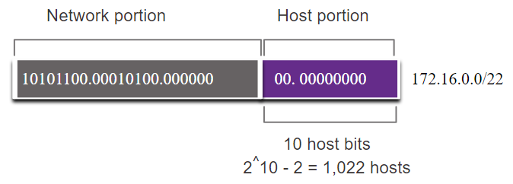
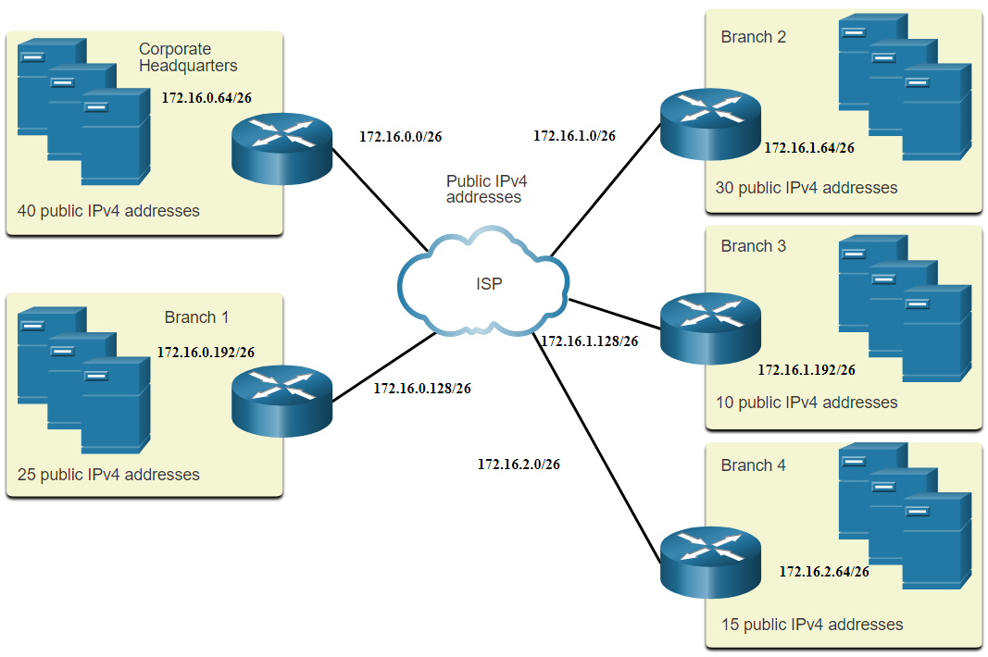
Subnet to Meet Requirements Example: Efficient IPv4 Subnetting
In this example, corporate headquarters has been allocated a public network address of 172.16.0.0/22 (10 host bits) by its ISP providing 1,022 host addresses.
There are five sites and therefore five internet connections which means the organization requires 10 subnets with the largest subnet requires 40 addresses.
It allocated 10 subnets with a /26 (i.e., 255.255.255.192) subnet mask.
Notes:
The 172.16.0.0/22 network address has 10 host bits.
The largest subnet requires 40 hosts, a minimum of 6 host bits are needed to provide addressing for 40 hosts. This is determined by using this formula: 2⁶ - 2 = 62 hosts.

Slide 8
Basic IPv4 Subnetting Explanation – Video

Slide 9
Basic VSLM Explanation – Video

Slide 10
VSLM Explanation – Video

Slide 11
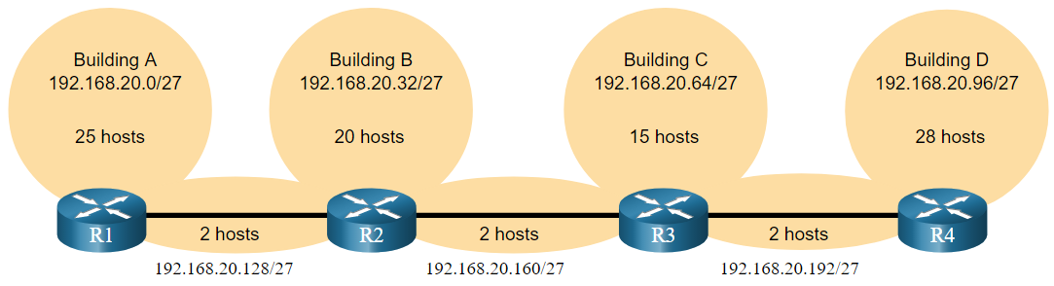
Subnetting Problem/Task
Given 192.168.20.0/24, create 7 subnets, largest subnet: 28 hosts, smallest: 2 hosts

Slide 12
Minimise “wasted IP” addresses
Generally you wish to conserve IP addresses:
Given 192.168.20.0/24, create 7 subnets, largest subnet: 28 hosts, smallest: 2 hosts
Using Fixed Length Subnet Masks, the following would result from subnetting 192.168.20.0/24 for the following topology:
Point to Point links between Routers only need 2 addresses. 28 “wasted” addresses
Notes:
Using traditional subnetting with the given address of 192.168.20.0/24, three bits can be borrowed from the host portion in the last octet to meet the subnet requirement of seven subnets.
As shown in the figure, borrowing 3 bits creates 8 subnets and leaves 5 host bits with 30 usable hosts per subnet. This scheme creates the needed subnets and meets the host requirement of the largest LAN.
However, the point-to-point WAN links only require two addresses and therefore waste 28 addresses each for a total of 84 unused addresses.
These seven subnets could be assigned to the LAN and WAN networks, as shown in the figure.
Although this traditional subnetting meets the needs of the largest LAN and divides the address space into an adequate number of subnets, it results in significant waste of unused addresses.
For example, only two addresses are needed in each subnet for the three WAN links. Because each subnet has 30 usable addresses, there are 28 unused addresses in each of these subnets. As shown in the figure, this results in 84 unused addresses (28x3).
Further, this limits future growth by reducing the total number of subnets available. This inefficient use of addresses is characteristic of traditional subnetting. Applying a traditional subnetting scheme to this scenario is not very efficient and is wasteful.
The variable-length subnet mask (VLSM) was developed to avoid wasting addresses by enabling us to subnet a subnet.
Applying a traditional subnetting scheme to this scenario is not very efficient and is wasteful.
VLSM was developed to avoid wasting addresses by enabling us to subnet a subnet.

Slide 13
Visual Representation
192.168.20.0/24
192.168.20.32/27
192.168.20.64/27
192.168.20.0/27
192.168.20.96/27
192.168.20.0/24
192.168.20.224/27
192.168.20.128/27
192.168.20.192/27
192.168.20.160/27

Slide 14
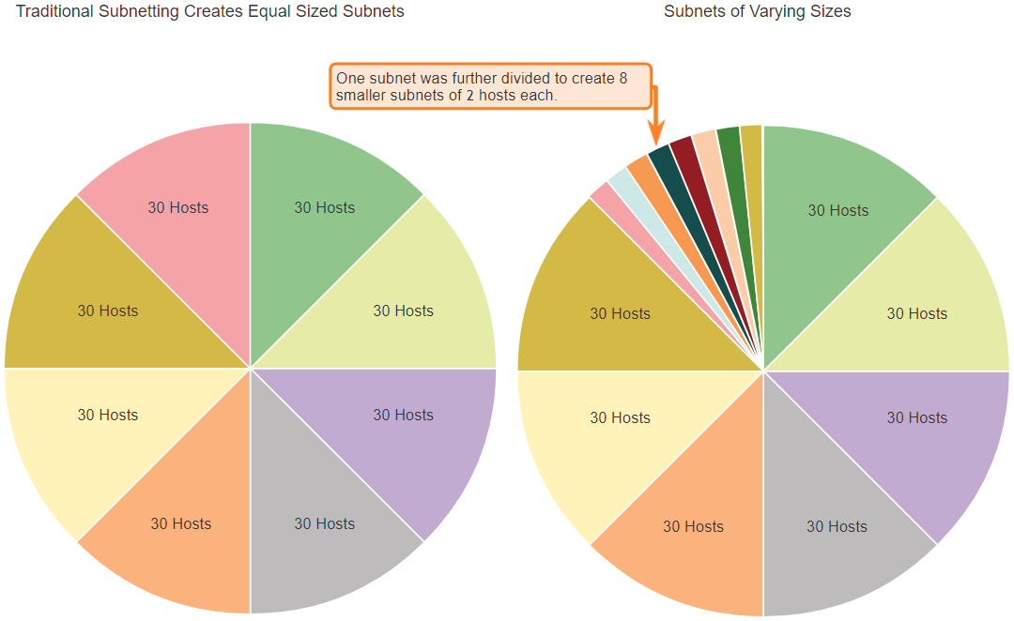
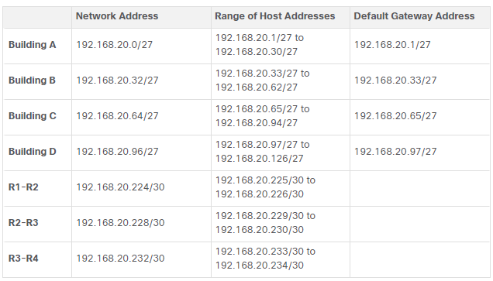
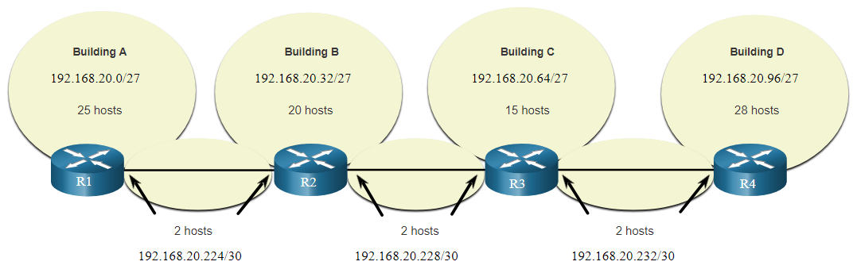
VLSM
VLSM was developed to avoid wasting addresses by enabling us to subnet a subnet.
VLSM can be used to subnet a subnet
In this case, divided the last subnet into eight /30 subnets.
Notes:
The left side displays the traditional subnetting scheme (i.e., the same subnet mask) while the right side illustrates how VLSM can be used to subnet a subnet and divided the last subnet into eight /30 subnets.
When using VLSM, always begin by satisfying the host requirements of the largest subnet and continue subnetting until the host requirements of the smallest subnet are satisfied.
The resulting topology with VLSM applied.
In all of the previous subnetting examples, the same subnet mask was applied for all the subnets. This means that each subnet has the same number of available host addresses. As illustrated in the left side of the figure, traditional subnetting creates subnets of equal size. Each subnet in a traditional scheme uses the same subnet mask. As shown in the right side of the figure, VLSM allows a network space to be divided into unequal parts. With VLSM, the subnet mask will vary depending on how many bits have been borrowed for a particular subnet, thus the “variable” part of the VLSM.
VLSM is just subnetting a subnet. Again, we will use the 192.168.20.0/24 network and subnet it for seven subnets, one for each of the four LANs, and one for each of the three connections between the routers.
The figure shows how network 192.168.20.0/24 subnetted into eight equal-sized subnets with 30 usable host addresses per subnet. Four subnets are used for the LANs and three subnets could be used for the connections between the routers.
However, the connections between the routers require only two host addresses per subnet (one host address for each router interface). Currently all subnets have 30 usable host addresses per subnet. To avoid wasting 28 addresses per subnet, VLSM can be used to create smaller subnets for the inter-router connections.
To create smaller subnets for the inter-router links, one of the subnets will be divided. In this example, the last subnet, 192.168.20.224/27, will be further subnetted. The figure shows the last subnet has been subnetted further by using the subnet mask 255.255.255.252 or /30.
Using the VLSM subnets, the LAN and inter-router networks can be addressed without unnecessary waste.
The figure shows the network address assignments and the IPv4 addresses assigned to each router interf
Using a common addressing scheme, the first host IPv4 address for each subnet is assigned to the LAN interface of the router. Hosts on each subnet will have a host IPv4 address from the range of host addresses for that subnet and an appropriate mask. Hosts will use the address of the attached router LAN interface as the default gateway address.
The table shows the network addresses and range of host addresses for each network. The default gateway address is displayed for the four LANs.
ace.

Slide 15
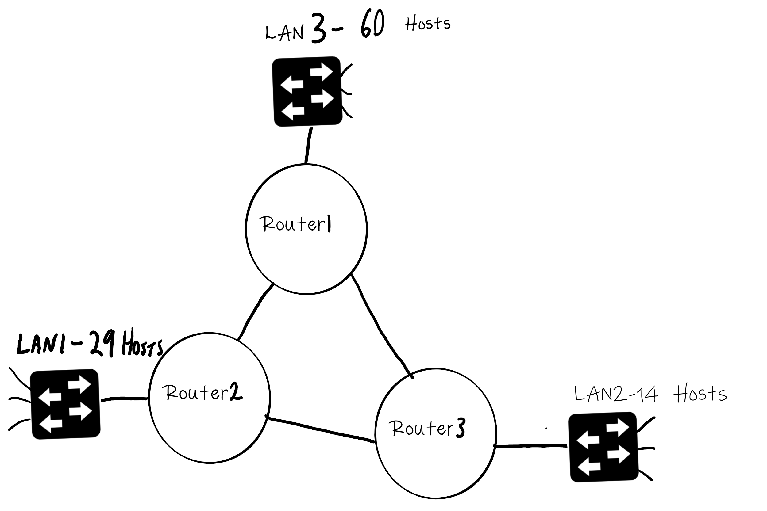
Example: VLSM
Using the VLSM technique, design a network with an IP range of 192.168.4.0/24.

Slide 16
Example: Subnetting Reference Table
Prefix Length | Subnet Mask | Subnet Mask in Binary (n = network, h = host) | # of subnets | # of hosts
/25 | 255.255.255.128 | nnnnnnnn.nnnnnnnn.nnnnnnnn.nhhhhhhh 11111111.11111111.11111111.10000000 | 2 | 126
/26 | 255.255.255.192 | nnnnnnnn.nnnnnnnn.nnnnnnnn.nnhhhhhh 11111111.11111111.11111111.11000000 | 4 | 62
/27 | 255.255.255.224 | nnnnnnnn.nnnnnnnn.nnnnnnnn.nnnhhhhh 11111111.11111111.11111111.11100000 | 8 | 30
/28 | 255.255.255.240 | nnnnnnnn.nnnnnnnn.nnnnnnnn.nnnnhhhh 11111111.11111111.11111111.11110000 | 16 | 14
/29 | 255.255.255.248 | nnnnnnnn.nnnnnnnn.nnnnnnnn.nnnnnhhh 11111111.11111111.11111111.11111000 | 32 | 6
/30 | 255.255.255.252 | nnnnnnnn.nnnnnnnn.nnnnnnnn.nnnnnnhh 11111111.11111111.11111111.11111100 | 64 | 2

Slide 17
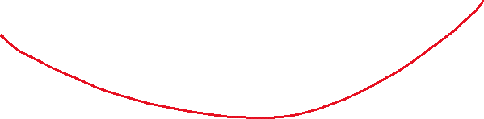

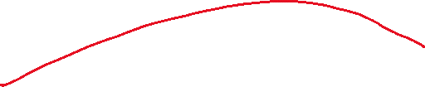
Example: Network Sizes
LAN | # Host
LAN 3 | 60
LAN 1 | 29
LAN 2 | 14
Link Router 1-2 | 2
Link Router 1-3 | 2
Link Router 2-3 | 2

Slide 18
1. Sort Networks, by max hosts, in descending order
LAN | # Host
LAN 3 | 60
LAN 1 | 29
LAN 2 | 14
Link Router 1-2 | 2
Link Router 1-3 | 2
Link Router 2-3 | 2

Slide 19
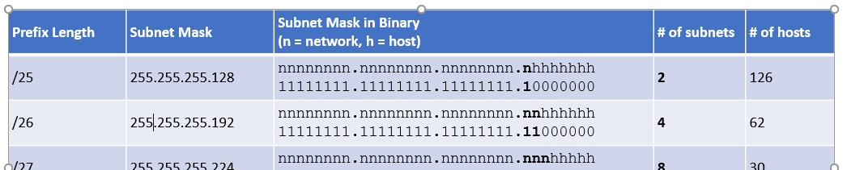
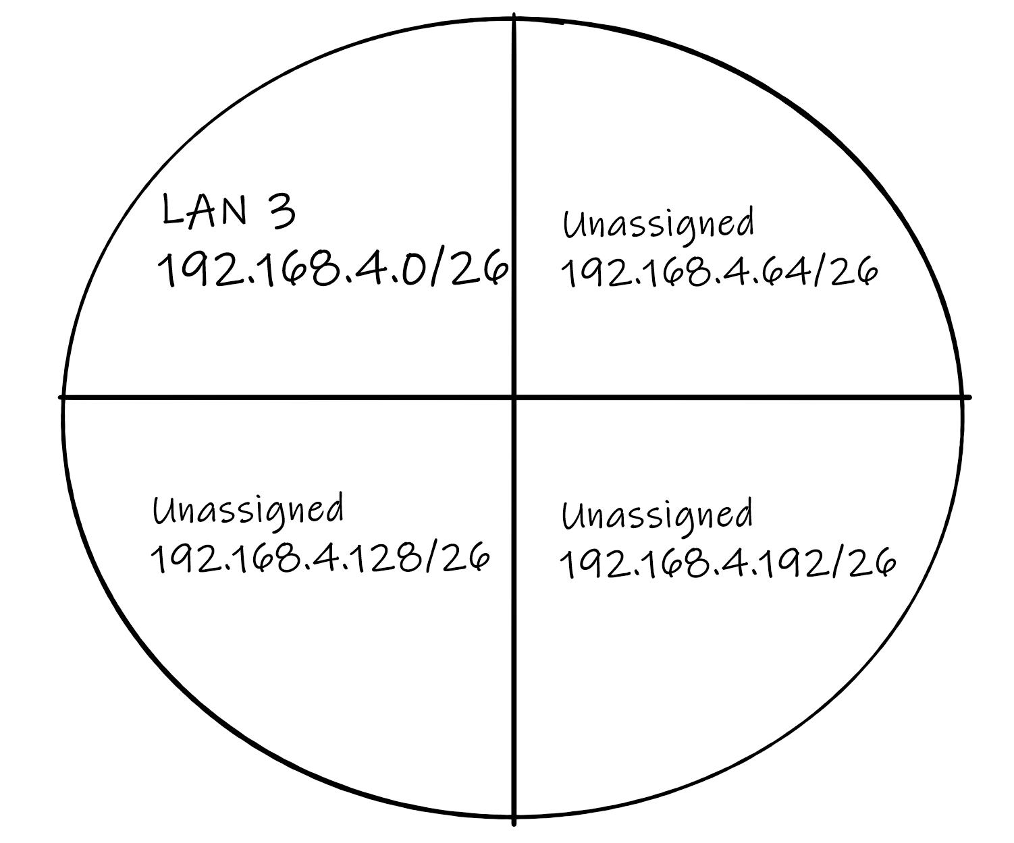


2: Assign Network Address to Largest Network (LAN 3)
We need 60 hosts (LAN 3)
Refer to Subnetting Table, closest match that accommodates 60 hosts is /26 ( 64-2 = 62 useable addresses)
192.168.4.0/24
Network Address | Subnet Mask | Last Octet of Subnet Mask | Host Addresses(2⁶ -2) | Usable Host Range | Name of LAN
192.168.4.0 | /26 | .00000000 | 62 | 192.168.4.1–192.168.4.62 | LAN 3
192.168.4.64 | /26 | .01000000 | 62 |  | Unassigned
192.168.4.128 | /26 | .10000000 | 62 |  | Unassigned
192.168.4.192 | /26 | .11000000 | 62 |  | Unassigned

Slide 20
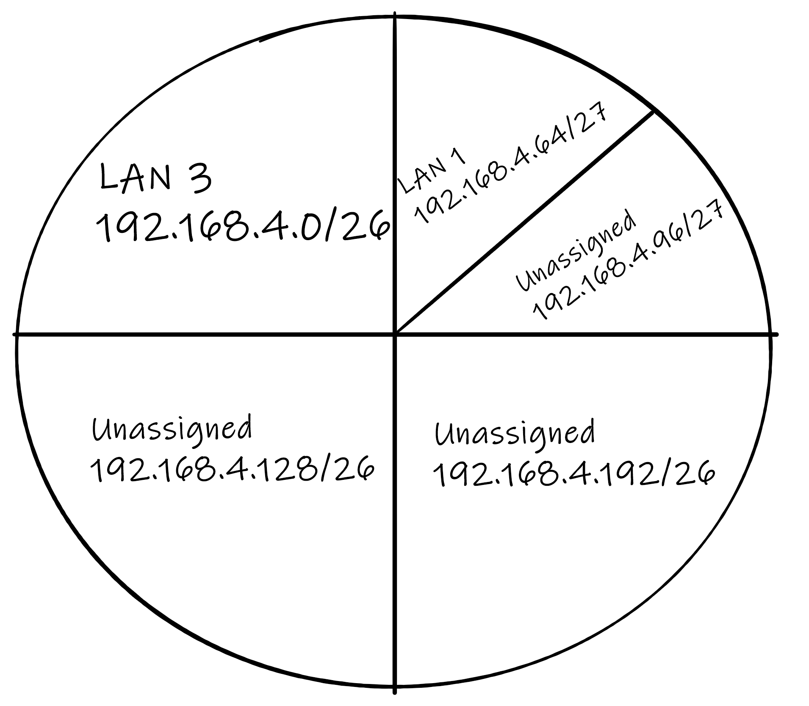







2. Second Largest Network (LAN 1)
29 Hosts (LAN 1)
Refer to Subnet Table, closest match that accommodates 29 hosts is /27 ( 32-2 = 30 useable addresses)
Select the first unassigned large subnet in previous step and subdivide into two smaller subnets, 192.168.4.64/27 and 192.168.4.96/27
Network ID | Subnet Mask | Host Addresses(2⁵ -2) | Usable Host Range | Name of LAN
192.168.4.64 | /27 | 30 | 192.168.4.65 – 192.168.4.94 | LAN 1
192.168.4.96 | /27 | 30 |  | Unassigned

Slide 21
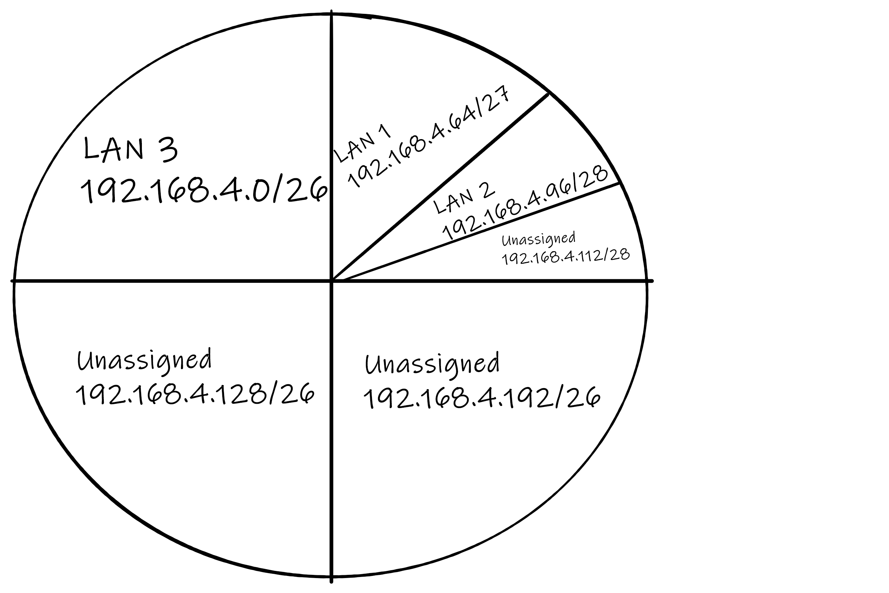

3. Third Largest Network
14 Hosts (LAN 2)
Refer to Subnet Table, closest match that accommodates 14 hosts is /28 ( 16-2 = 14 useable addresses)
Select the first unassigned large subnet in previous step and subdivide into two smaller subnets, 192.168.4.96/28 and 192.168.4.112/28
Network ID | Subnet Mask | Host Addresses(2⁴ -2) | Usable Host Range | Name of LAN
192.168.4.96 | /28 | 14 | 192.168.4.97– 192.168.4.110 | LAN 2
192.168.4.112 | /28 | 14 |  | Unassigned

Slide 22
4. Links
Assign three smaller subnets for links between Routers1-2,1-3 and 2-3
Just 2 Hosts/interfaces per link
Refer to Subnet Table, closest match that accommodates 2 hosts is /30 ( 4-2 = 2 useable addresses)
Select the first unassigned large subnet in previous step and subdivide into four smaller subnets, 192.168.4.112/30, 192.168.4.114/30….
Network ID | Subnet Mask | Host Addresses(2² -2) | Usable Host Range | Name of LAN
192.168.4.114 | /30 | 2 | 192.168.4.113–192.168.4.114 | Router1-2
192.168.4.116 | /30 | 2 | 192.168.4.117–192.168.4.118 | Router1-3
192.168.4.120 | /30 | 2 | 192.168.4.121–192.168.4.122 | Router2-3
192.168.4.124 | /30 | 2 |  | Unassigned

Slide 23
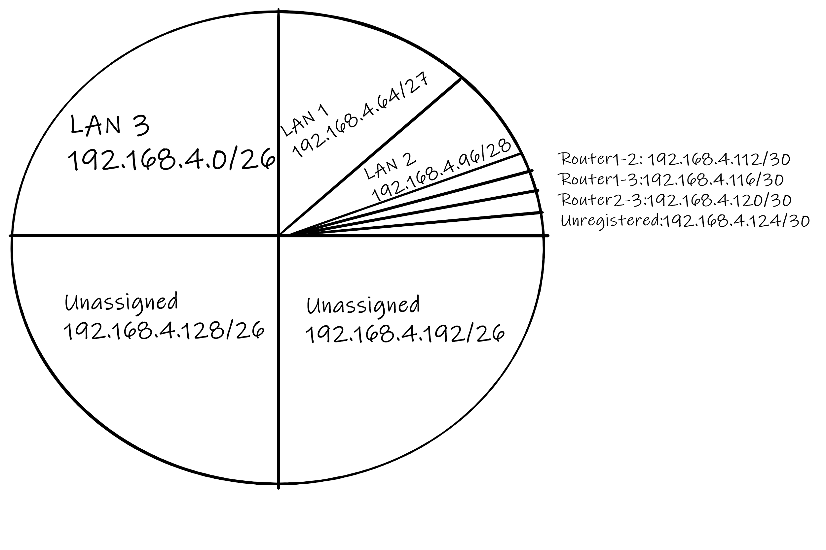






Slide 24
Final Network Design
Network ID | Subnet Mask | Total Addresses(Inc. Network and Broadcast) | Usable Host Range | Name of LAN
192.168.4.0 | /26 | 64 | 192.168.4.1–192.168.4.62 | LAN 3
192.168.4.64 | /27 | 32 | 192.168.4.65 – 192.168.4.94 | LAN 1
192.168.4.96 | /28 | 16 | 192.168.4.97– 192.168.4.110 | LAN 2
192.168.4.112 | /30 | 4 | 192.168.4.113–192.168.4.114 | LINK Router1-2
192.168.4.116 | /30 | 4 | 192.168.4.117–192.168.4.118 | LINK Router1-3
192.168.4.120 | /30 | 4 | 192.168.4.121–192.168.4.122 | LINK Router2-3

Slide 25
Summary: VLSM Network Design Method
Sort Subnets in descending order by Max number of hosts
Select Largest Network and assign the most suitable network address by subnetting base network address.
Assign address to next Largest Network (Subnet next unassigned network if possible)
Repeat until all network address.

Slide 26
Fixed Length Subnet Masks vs Variable Length Subnet Masks
FLSM (Fixed Length Subnet Masks) Subnetting | VLSM (Variable Length Subnet Masks) Subnetting
Old-fashioned | Modern
Subnets are equal in size | Subnets are variable in size.
Subnets have an equal number of hosts | Subnets have a variable number of hosts
Supports both classful and classless routing protocols | Supports only classless routing protocols
Wastes more IP addresses | Wastes fewer IP addresses
Subnets use the same subnet mask | Subnets use different subnet masks
Simple configuration and administration | Complex configuration and administration
Source: https://www.comparitech.com/net-admin/variable-length-subnet-mask-vlsm-tutorial/

Slide 27
Structured Design IPv4 Network Address Planning
IP network planning is crucial to develop a scalable solution to an enterprise network.
To develop an IPv4 network wide addressing scheme, you need to know how many subnets are needed, how many hosts a particular subnet requires, what devices are part of the subnet, which parts of your network use private addresses, and which use public, and many other determining factors.
Examine the needs of an organization’s network usage and how the subnets will be structured.
Perform a network requirement study by looking at the entire network to determining how each area will be segmented.
Determine how many subnets are needed and how many hosts per subnet.
Determine DHCP address pools and Layer 2 VLAN pools.
Notes:
Before you start subnetting, you should develop an IPv4 addressing scheme for your entire network. You will need to know how many subnets you need, how many hosts a particular subnet requires, what devices are part of the subnet, which parts of your network use private addresses, and which use public, and many other determining factors. A good addressing scheme allows for growth. A good addressing scheme is also the sign of a good network administrator.
Planning IPv4 network subnets requires you to examine both the needs of an organization’s network usage, and how the subnets will be structured. Performing a network requirement study is the starting point. This means looking at the entire network, both the intranet and the DMZ, and determining how each area will be segmented. The address plan includes determining where address conservation is needed (usually within the DMZ), and where there is more flexibility (usually within the intranet).
Where address conservation is required, the plan should determine how many subnets are needed and how many hosts per subnet. As discussed earlier, this is usually required for public IPv4 address space within the DMZ. This will most likely include using VLSM.
Within the corporate intranet, address conservation is usually less of an issue This is largely due to using private IPv4 addressing, including 10.0.0.0/8, with over 16 million host IPv4 addresses.
For most organizations, private IPv4 addresses allow for more than enough internal (intranet) addresses. For many larger organizations and ISPs, even private IPv4 address space is not large enough to accommodate their internal needs. This is another reason why organizations are transitioning to IPv6.
For intranets that use private IPv4 addresses and DMZs that use public IPv4 addresses, address planning and assignment is important.
Where required, the address plan includes determining the needs of each subnet in terms of size. How many hosts there will be per subnet? The address plan also needs to include how host addresses will be assigned, which hosts will require static IPv4 addresses, and which hosts can use DHCP for obtaining their addressing information. This will also help prevent the duplication of addresses, while allowing for monitoring and managing of addresses for performance and security reasons.
Knowing your IPv4 address requirements will determine the range, or ranges, of host addresses that you implement and help ensure that there are enough addresses to cover your network needs.

Slide 28
Structured Design Device Address Assignment
Within a network, there are different types of devices that require addresses:
End user clients – Most use DHCP to reduce errors and burden on network support staff. IPv6 clients can obtain address information using DHCPv6 or SLAAC.
Servers and peripherals – These should have a predictable static IP address.
Servers that are accessible from the internet – Servers must have a public IPv4 address, most often accessed using NAT.
Intermediary devices – Devices are assigned addresses for network management, monitoring, and security.
Gateway – Routers and firewall devices are gateway for the hosts in that network.
When developing an IP addressing scheme, it is generally recommended that you have a set pattern of how addresses are allocated to each type of device.
Notes:
Within a network, there are different types of devices that require addresses:
End user clients - Most networks allocate IPv4 addresses to client devices dynamically, using Dynamic Host Configuration Protocol (DHCP). This reduces the burden on network support staff and virtually eliminates entry errors. With DHCP, addresses are only leased for a period of time, and can be reused when the lease expires. This is an important feature for networks that support transient users and wireless devices. Changing the subnetting scheme means that the DHCP server needs to be reconfigured, and the clients must renew their IPv4 addresses. IPv6 clients can obtain address information using DHCPv6 or SLAAC.
Servers and peripherals - These should have a predictable static IP address. Use a consistent numbering system for these devices.
Servers that are accessible from the internet - Servers that need to be publicly available on the internet must have a public IPv4 address, most often accessed using NAT. In some organizations, internal servers (not publicly available) must be made available to the remote users. In most cases, these servers are assigned private addresses internally, and the user is required to create a virtual private network (VPN) connection to access the server. This has the same effect as if the user is accessing the server from a host within the intranet.
Intermediary devices - These devices are assigned addresses for network management, monitoring, and security. Because we must know how to communicate with intermediary devices, they should have predictable, statically assigned addresses.
Gateway - Routers and firewall devices have an IP address assigned to each interface which serves as the gateway for the hosts in that network. Typically, the router interface uses either the lowest or highest address in the network.
When developing an IP addressing scheme, it is generally recommended that you have a set pattern of how addresses are allocated to each type of device. This benefits administrators when adding and removing devices, filtering traffic based on IP, as well as simplifying documentation.

Slide 29
Supernetting
Also known as route aggregation or CIDR
Often used in “route summarisation”
Routes to multiple networks/subnets with similar network prefixes are combined into a single routing entry
Common in larger networks and on the internet to ensure efficient use of IP addresses and to reduce the size of routing tables.
Notes:
Supernetting is a technique in computer networking for combining multiple smaller network addresses into a single larger network address. Doing it allows more efficient routing and reduces the size of the routing table. The reason for supernetting is to improve the efficiency of routing in large-scale networks.
Supernetting is the process of aggregating routes to multiple smaller networks. Thus saving storage space in the routing table, simplifying routing decisions, and reducing route advertisements to neighboring gateways. Supernetting has helped address the increasing size of routing tables as the Internet has expanded. Supernetting is mainly used in Route Summarization, where routes to multiple networks with similar network prefixes are combined into a single routing entry, with the routing entry pointing to a Super network, encompassing all the networks. This in turn significantly reduces the size of routing tables and also the size of routing updates exchanged by routing protocols.
More specifically,
When multiple networks are combined to form a bigger network, it is termed super-netting
Super netting is used in route aggregation to reduce the size of routing tables and routing table updates

Slide 30
Superneting and Subnetting
At the local level, an organisation might use subnetting to segment its internal networks(like the example above)
At a higher hierarchical level, when advertising routes to external entities or upstream providers, supernetting can be used. Instead of advertising each individual subnet, the organization can advertise a summarized or aggregated route.
This reduces the number of routes that external entities need to know about, which in turn reduces the size of their routing tables.
This combination allows for detailed network organization internally (through subnetting) while presenting a simplified view to the outside world (through supernetting).
Notes:
First, at the local or internal level, organisations use subnetting to split a larger network into smaller networks. This helps with things like department separation, security boundaries, performance, and easier troubleshooting. For example, HR, Finance, and Students could each be on different subnets.
However, when we move to a higher level, especially when advertising routes to an ISP or external networks, advertising every single subnet would create too many routes. That’s where supernetting comes in.
With supernetting, instead of advertising multiple separate subnet routes, the organisation advertises one summarized or aggregated route. This reduces the number of routes other networks must store, which makes routing tables smaller and routing more efficient.
So the key idea is: Subnetting gives detailed control internally, while supernetting gives a simplified view externally. Together, they allow networks to stay organised inside, but scalable and efficient when communicating with the outside world.”

Slide 31







Supernetting example
Combine the following into one summarised route 192.168.0.0/24
192.168.1.0/24
192.168.2.0/24
192.168.3.0/24
11000000.10101000.00000000.00000000
11000000.10101000.00000001.00000000
11000000.10101000.00000010.00000000
11000000.10101000.00000011.00000000
11000000.10101000.00000000.00000000 = 192.168.0.0
Write Network IP addresses in binary
Find matching bits from left to right
Keep the matching numbers and add the remaining zeros, this is your SuperNet (Summarised network address
For the subnet mask. Put “1s” in the matching networking part
11111111.11111111.11111100.00000000 = 255.255.252.0
Notes:
We are given four /24 networks: 192.168.0.0/24, 192.168.1.0/24, 192.168.2.0/24, and 192.168.3.0/24.
Step one is to write the network addresses in binary. Notice that the first two octets, 192.168, are identical in all cases. The difference happens in the third octet, where we have 0, 1, 2, and 3. In binary, those are: 0 = 00 1 = 01 2 = 10 3 = 11
Now step two: we compare from left to right and find the bits that match across all four networks. The key observation is that in the third octet, only the first 6 bits match, and the last 2 bits vary — that’s why we can summarise these four networks together.
Step three: we keep the matching bits, and set the remaining bits to zero. That gives the summarised network address: 192.168.0.0
Step four: we build the new subnet mask by placing 1s in the matching portion. Because we grouped four /24 networks, we reduce the prefix by 2 bits, so the summarised prefix becomes /22.
So the final result is: ✅ 192.168.0.0/22 with subnet mask: ✅ 255.255.252.0
This means one route, 192.168.0.0/22, now represents all four networks from 192.168.0.0 to 192.168.3.255, making routing tables smaller and routing more efficient.”

Slide 32
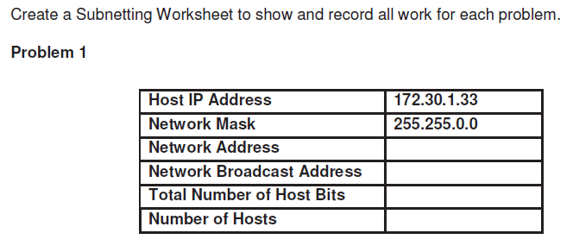
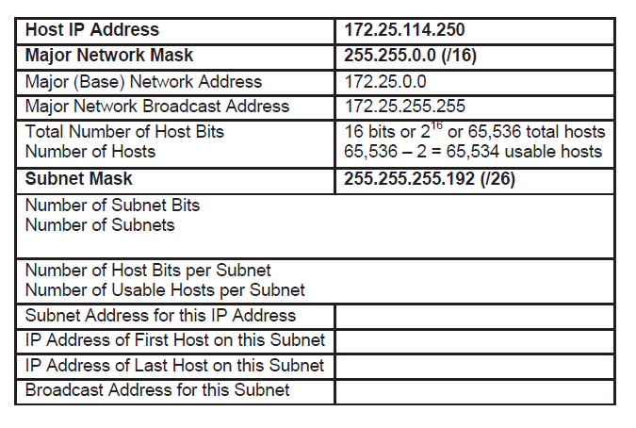
IPv4 Address Subnetting Exercises

