Slide 1
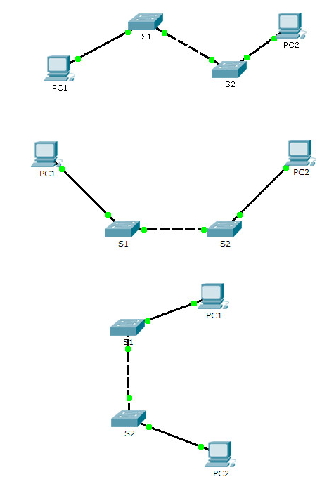
Basic Switch Configuration
By: Mujahid Tabassum
2026

Slide 2
Agenda
Cisco IOS
Configure a Cisco Switch
Save a Config
Basic Switch Security

Slide 3

Cisco IOS
Cisco Internetwork Operating System (IOS)
Used on Cisco Systems switches and routers

Slide 4
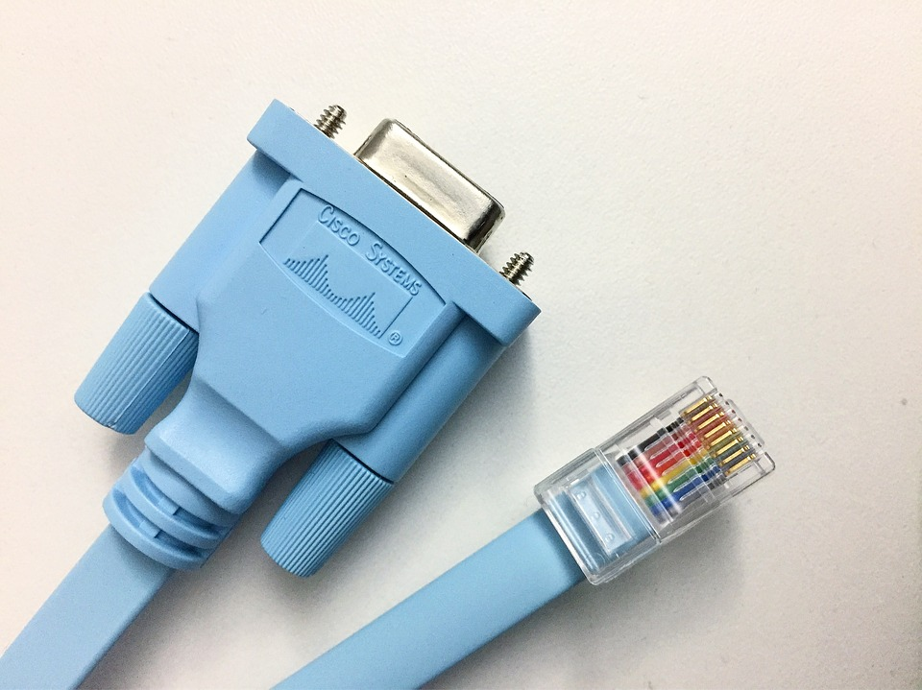
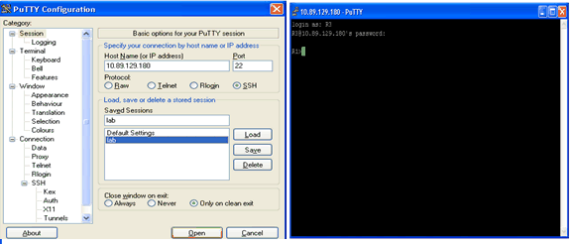
Access Methods
Console – A physical management port used to access a device in order to provide maintenance, such as performing the initial configurations.
Secure Shell (SSH) – Establishes a secure remote CLI connection to a device, through a virtual interface, over a network. (Note: This is the recommended method for remotely connecting to a device.)
Telnet – Establishes an insecure remote CLI connection to a device over the network. (Note: User authentication, passwords and commands are sent over the network in plaintext.)
Notes:
2 – Basic Switch and End Device Configuration
2.1 – Cisco IOS Access
2.1.4 – Access Methods

Slide 5
Terminal Emulation Programs
Terminal emulation programs are used to connect to a network device by either a console port(directly to the device) or by an SSH/Telnet connection(usually over a network).
There are several terminal emulation programs to chose from such as PuTTY, Tera Term and SecureCRT.
Notes:
2 – Basic Switch and End Device Configuration
2.1 – Cisco IOS Access
2.1.5 – Terminal Emulation Programs
2.1.6 – Check Your Understanding - Cisco IOS Access

Slide 6
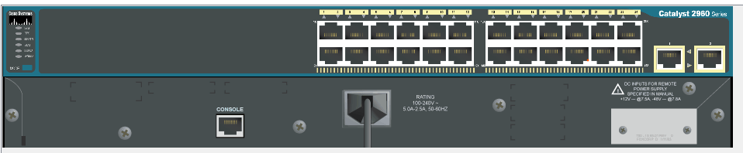
Cisco Device interfaces: Port naming Convention
Cisco router interfaces are named with the following convention:
Media-type slot-number/port-number OR
Media-type slot-number/interface-slot-number/port-number
FastEthernet 0/1 fa0/1
GigabitEthernet 0/1
G0/1

Slide 7
IOS Navigation

Slide 8
Primary Command Modes
User EXEC Mode:
Allows access to only a limited number of basic monitoring commands
Identified by the CLI prompt that ends with the > symbol
Privileged EXEC Mode:
Allows access to all commands and features
Identified by the CLI prompt that ends with the # symbol
Notes:
2 – Basic Switch and End Device Configuration
2.2 – IOS Navigation
2.2.1 – Primary Command Modes

Slide 9
Configuration Mode and Subconfiguration Modes
Global Configuration Mode:
Used to access configuration options on the device
Line Configuration Mode:
Used to configure console, SSH, Telnet or AUX access
Interface Configuration Mode:
Used to configure a switch port or router interface
Notes:
2 – Basic Switch and End Device Configuration
2.2 – IOS Navigation
2.2.2 – Configuration Mode and Subconfiguration Modes

Slide 10
Navigation Between IOS Modes
Privileged EXEC Mode:
To move from user EXEC mode to privilege EXEC mode, use the enabled command.
Global Configuration Mode:
To move in and out of global configuration mode, use the configure terminal command. To return to privilege EXEC mode, use the exit command.
Line Configuration Mode:
To move in and out of line configuration mode, use the line command followed by the management line type. To return to global configuration mode, use the exit command.
Notes:
2 – Basic Switch and End Device Configuration
2.2 – IOS Navigation
2.2.4 – Navigate Between IOS Modes

Slide 11
Navigation Between IOS Modes (Cont.)
Subconfiguration Modes:
To move out of any subconfiguration mode to get back to global configuration mode, use the exit command. To return to privilege EXEC mode, use the end command or key combination Ctrl +Z.
To move directly from one subconfiguration mode to another, type in the desired subconfiguration mode command. In the example, the command prompt changes from (config-line)# to (config-if)#.
Notes:
2 – Basic Switch and End Device Configuration
2.2 – IOS Navigation
2.2.4 – Navigate Between IOS Modes

Slide 12
IOS Command Structure

Slide 13
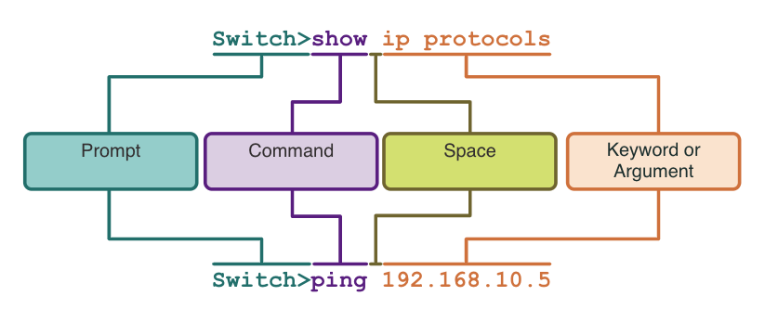
Basic IOS Command Structure
Keyword – This is a specific parameter defined in the operating system (in the figure, ip protocols).
Argument - This is not predefined; it is a value or variable defined by the user (in the figure, 192.168.10.5).
Notes:
2 – Basic Switch and End Device Configuration
2.3 – The Command Structure
2.3.1 – Basic IOS Command Structure

Slide 14
IOS Help Features
The IOS has two forms of help available: context-sensitive help and command syntax check.
Context-sensitive help enables you to quickly find answers to these questions:
Which commands are available in each command mode?
Which commands start with specific characters or group of characters?
Which arguments and keywords are available to particular commands?
Command syntax check verifies that a valid command was entered by the user.
If the interpreter cannot understand the command being entered, it will provide feedback describing what is wrong with the command.
Notes:
2 – Basic Switch and End Device Configuration
2.3 – The Command Structure
2.3.3 – IOS Help Features

Slide 15
Hot Keys and Shortcuts
The IOS CLI provides hot keys and shortcuts that make configuring, monitoring, and troubleshooting easier.
Commands and keywords can be shortened to the minimum number of characters that identify a unique selection. For example, the configure command can be shortened to conf because configure is the only command that begins with conf.
Keystroke | Description
Tab | Completes a partial command name entry.
Backspace | Erases the character to the left of the cursor.
Left Arrow or Ctrl+B | Moves the cursor one character to the left.
Right Arrow or Ctrl+F | Moves the cursor one character to the right.
Up Arrow or Ctrl+P | Recalls the commands in the history buffer, beginning with the most recent commands.
Notes:
2 – Basic Switch and End Device Configuration
2.3 – The Command Structure
2.3.5 – Hot Keys and Shortcuts

Slide 16
Basic Device Configuration

Slide 17
Basic Device Configuration Device Names
The first configuration command on any device should be to give it a unique hostname.
By default, all devices are assigned a factory default name. For example, a Cisco IOS switch is "Switch.”
Guideline for naming devices:
Start with a letter
Contain no spaces
End with a letter or digit
Use only letters, digits, and dashes
Be less than 64 characters in length
Note: To return the switch to the default prompt, use the no hostname global config command.
Notes:
2 – Basic Switch and End Device Configuration
2.4 – Basic Device Configuration
2.4.1 – Device Names

Slide 18

Password Guidelines
The use of weak or easily guessed passwords are a security concern.
All networking devices should limit administrative access by securing privileged EXEC, user EXEC, and remote Telnet access with passwords. In addition, all passwords should be encrypted and legal notifications provided.
Password Guidelines:
Use passwords that are more than eight characters in length.
Use a combination of upper and lowercase letters, numbers, special characters, and/or numeric sequences.
Avoid using the same password for all devices.
Do not use common words because they are easily guessed.
Note: Most of the labs in this course use simple passwords such as cisco or class. These passwords are considered weak and easily guessable and should be avoided in production environments.
Notes:
2 – Basic Switch and End Device Configuration
2.4 – Basic Device Configuration
2.4.2 – Password Guidelines

Slide 19
Configure Passwords
Securing user EXEC mode access:
First enter line console configuration mode using the line console 0 command in global configuration mode.
Next, specify the user EXEC mode password using the password password command.
Finally, enable user EXEC access using the login command.
Securing privileged EXEC mode access:
First enter global configuration mode.
Next, use the enable secret password command.
Notes:
2 – Basic Switch and End Device Configuration
2.4 – Basic Device Configuration
2.4.3 – Configure Passwords

Slide 20
Configure Passwords (Cont.)
Securing VTY(Virtual Teletype) line access:
First enter line VTY configuration mode using the line vty 0 15 command in global configuration mode.
Next, specify the VTY password using the password password command.
Finally, enable VTY access using the login command.
Note: VTY lines enable remote access using Telnet or SSH to the device. Many Cisco switches support up to 16 VTY lines that are numbered 0 to 15.
Notes:
2 – Basic Switch and End Device Configuration
2.4 – Basic Device Configuration
2.4.3 – Configure Passwords

Slide 21
Encrypt Passwords
Use the show running-config command to verify that the passwords on the device are now encrypted.
The startup-config and running-config files display most passwords in plaintext.
To encrypt all plaintext passwords, use the service password-encryption global config command.
Notes:
2 – Basic Switch and End Device Configuration
2.4 – Basic Device Configuration
2.4.4 – Encrypt Passwords

Slide 22

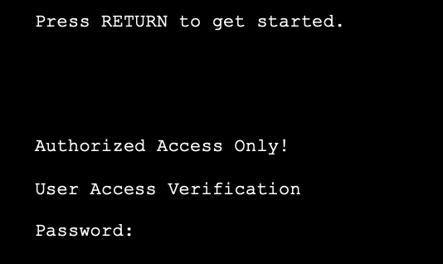
Banner Messages
A banner message is important to warn unauthorized personnel from attempting to access the device.
To create a banner message of the day on a network device, use the banner motd # the message of the day # global config command.
The banner will be displayed on attempts to access the device.
Note: The “#” in the command syntax is called the delimiting character. It is entered before and after the message.
Notes:
2 – Basic Switch and End Device Configuration
2.4 – Basic Device Configuration
2.4.5 – Banner Messages

Slide 23
Save Configurations

Slide 24
Save Configuration Files
There are two system files that store the device configuration:
startup-config - This is the saved configuration file that is stored in NVRAM. It contains all the commands that will be used by the device upon startup or reboot. Flash does not lose its contents when the device is powered off.
running-config - This is stored in Random Access Memory (RAM). It reflects the current configuration. Modifying a running configuration affects the operation of a Cisco device immediately. RAM is volatile memory. It loses all of its content when the device is powered off or restarted.
To save changes made to the running configuration to the startup configuration file, use the copy running-config startup-config privileged EXEC mode command.
Notes:
2 – Basic Switch and End Device Configuration
2.5 – Save Configurations
2.5.1 – Configuration Files

Slide 25
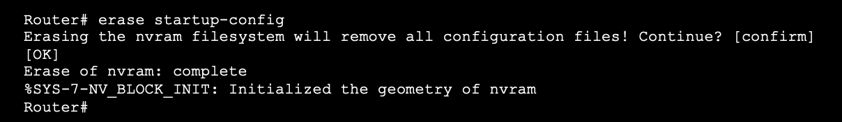
Alter the Running Configurations
If changes made to the running config do not have the desired effect and the running-config has not yet been saved, you can restore the device to its previous configuration. To do this you can:
Remove the changed commands individually.
Reload the device using the reload command in privilege EXEC mode. Note: This will cause the device to briefly go offline, leading to network downtime.
If the undesired changes were saved to the startup-config, it may be necessary to clear all the configurations using the erase startup-config command in privilege EXEC mode.
After erasing the startup-config, reload the device to clear the running-config file from RAM.
Notes:
2 – Basic Switch and End Device Configuration
2.5 – Save Configurations
2.5.2 – Alter the Running Configuration

Slide 26
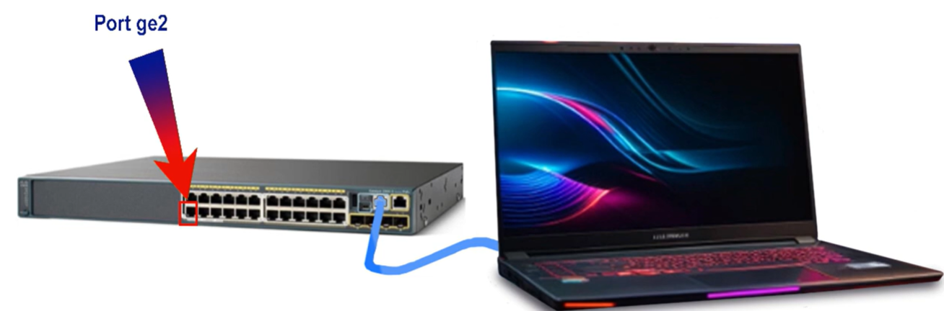
LAN Security Concept

Slide 27
Endpoint Security
The news media commonly covers attacks on enterprise networks. Simply search the internet for “latest network attacks” to find up-to-date information on current attacks. Most likely, these attacks will involve one or more of the following:
Distributed Denial of Service (DDoS) – This is a coordinated attack from many devices, called zombies, with the intention of degrading or halting public access to an organization’s website and resources.
Data Breach – This is an attack in which an organization’s data servers or hosts are compromised to steal confidential information.
Malware – This is an attack in which an organization’s hosts are infected with malicious software that cause a variety of problems. For example, ransomware such as WannaCry encrypts the data on a host and locks access to it until a ransom is paid.

Slide 28
Network Security Devices
Various network security devices are required to protect the network perimeter from outside access. These devices could include the following:
Virtual Private Network (VPN) enabled router - provides a secure connection to remote users across a public network and into the enterprise network. VPN services can be integrated into the firewall.
Next-Generation Firewall (NGFW) - provides stateful packet inspection, application visibility and control, a next-generation intrusion prevention system (NGIPS), advanced malware protection (AMP), and URL filtering.
Network Access Control (NAC) - includes authentication, authorization, and accounting (AAA) services. In larger enterprises, these services might be incorporated into an appliance that can manage access policies across a wide variety of users and device types. The Cisco Identity Services Engine (ISE) is an example of a NAC device.

Slide 29
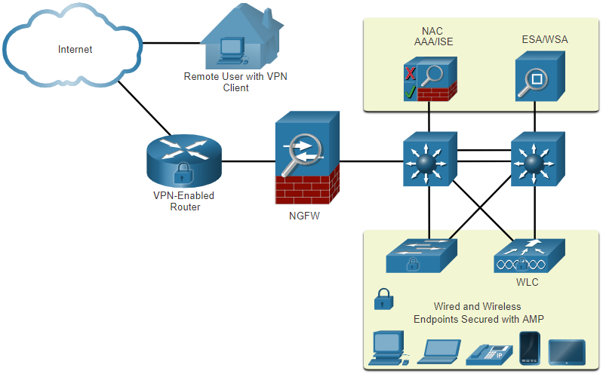
Endpoint Protection
Endpoints are hosts which commonly consist of laptops, desktops, servers, and IP phones, as well as employee-owned devices. Endpoints are particularly susceptible to malware-related attacks that originate through email or web browsing.
Endpoints have typically used traditional host-based security features, such as antivirus/antimalware, host-based firewalls, and host-based intrusion prevention systems (HIPSs).
Endpoints today are best protected by a combination of NAC, AMP software, an email security appliance (ESA), and a web security appliance (WSA).

Slide 30

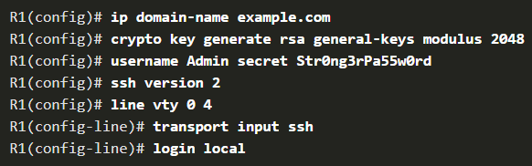
Access Control using Authentication
Many types of authentication can be performed on networking devices, and each method offers varying levels of security.
The simplest method of remote access authentication is to configure a login and password combination on console, vty lines, and aux ports.
SSH is a more secure form of remote access:
It requires a username and a password.
The username and password can be authenticated locally.
The local database method has some limitations:
User accounts must be configured locally on each device which is not scalable.
The method provides no fallback authentication method.

Slide 31
AAA Components
AAA stands for Authentication, Authorization, and Accounting, and provides the primary framework to set up access control on a network device.
AAA is a way to control who is permitted to access a network (authenticate), what they can do while they are there (authorize), and to audit what actions they performed while accessing the network (accounting).
Local and server-based are two common methods of implementing AAA authentication.
Local AAA Authentication
Server-Based AAA Authentication
AAA authorization is automatic and does not require users to perform additional steps after authentication. Authorization governs what users can and cannot do on the network after they are authenticated.
AAA accounting collects and reports usage data. This data can be used for such purposes as auditing or billing. The collected data might include the start and stop connection times, executed commands, number of packets, and number of bytes.
Notes:
Local AAA Authentication:
Method stores usernames and passwords locally in a network device (e.g., Cisco router).
Users authenticate against the local database.
Local AAA is ideal for small networks.
Server-Based AAA Authentication:
With the server-based method, the router accesses a central AAA server.
The AAA server contains the usernames and password for all users.
The router uses either the Remote Authentication Dial-In User Service (RADIUS) or Terminal Access Controller Access Control System (TACACS+) protocols to communicate with the AAA server.
When there are multiple routers and switches, server-based AAA is more appropriate
Authorization uses a set of attributes that describes the user’s access to the network. These attributes are used by the AAA server to determine privileges and restrictions for that user.
A primary use of accounting is to combine it with AAA authentication.
The AAA server keeps a detailed log of exactly what the authenticated user does on the device, as shown in the figure. This includes all EXEC and configuration commands issued by the user.
The log contains numerous data fields, including the username, the date and time, and the actual command that was entered by the user. This information is useful when troubleshooting devices. It also provides evidence for when individuals perform malicious acts.

Slide 32
Switch Port Security
Physically unsecured switched can have unauthorised devices attached.
Potential hacker can pull out ethernet cable and plug in another device.
Solution:
Administratively shut down unused switch ports
Filter MAC addresses at switch port level (configure the switch ports to allow frames from authorised devices only using MAC address)

Slide 33
Switch Port Security: Secure Unused Ports
Layer 2 attacks are some of the easiest for hackers to deploy but these threats can also be mitigated with some common Layer 2 solutions.
All switch ports (interfaces) should be secured before the switch is deployed for production use. How a port is secured depends on its function.
A simple method that many administrators use to help secure the network from unauthorized access is to disable all unused ports on a switch. Navigate to each unused port and issue the Cisco IOS shutdown command. If a port must be reactivated at a later time, it can be enabled with the no shutdown command.
To configure a range of ports, use the interface range command.
Switch(config)# interface range type module/first-number – last-number

Slide 34
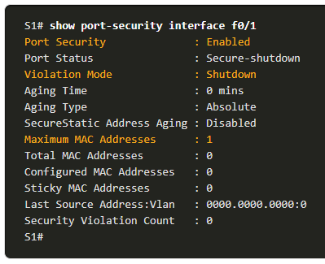
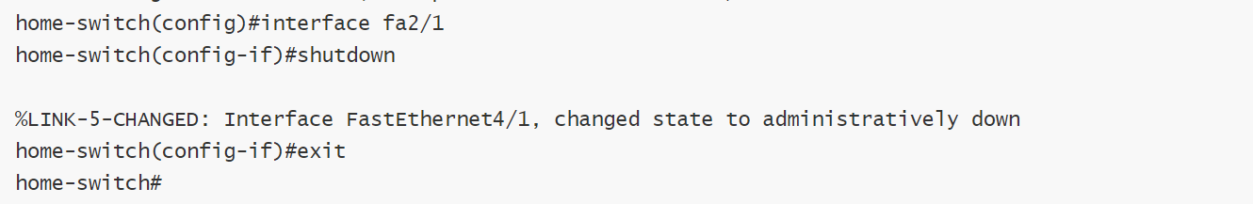
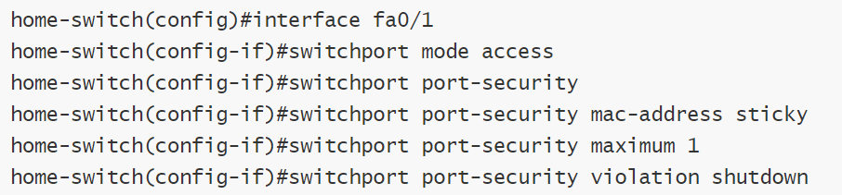
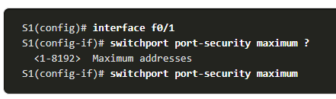
Switch Port Security
Shut down switch port
Restrict Access to Port
Notes:
Port security is enabled with the switchport port-security interface configuration command.
Use the show port-security interface command to display the current port security settings for FastEthernet 0/1.
Notice how port security is enabled, the violation mode is shutdown, and how the maximum number of MAC addresses is 1.
If a device is connected to the port, the switch will automatically add the device’s MAC address as a secure MAC. In this example, no device is connected to the port.
Note: If an active port is configured with the switchport port-security command and more than one device is connected to that port, the port will transition to the error-disabled state.
To set the maximum number of MAC addresses allowed on a port, use the following command:
The default port security value is 1.
The maximum number of secure MAC addresses that can be configured depends the switch and the IOS.
In this example, the maximum is 8192.

Slide 35
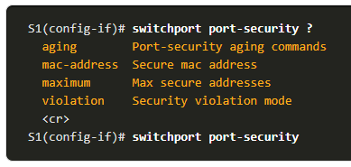
Switch Port Security
After port security is enabled, other port security specifics can be configured, as shown in the example.

Slide 36
Limit and Learn MAC Addresses
The switch can be configured to learn about MAC addresses on a secure port in one of three ways:
Manually Configured: The administrator manually configures a static MAC address(es) by using the following command for each secure MAC address on the port:
Switch(config-if)# switchport port-security mac-address mac-address
Dynamically Learned: When the switchport port-security command is entered, the current source MAC for the device connected to the port is automatically secured but is not added to the running configuration. If the switch is rebooted, the port will have to re-learn the device’s MAC address.
Dynamically Learned – Sticky: The administrator can enable the switch to dynamically learn the MAC address and “stick” them to the running configuration by using the following command:
Switch(config-if)# switchport port-security mac-address sticky
Saving the running configuration will commit the dynamically learned MAC address to NVRAM.

Slide 37
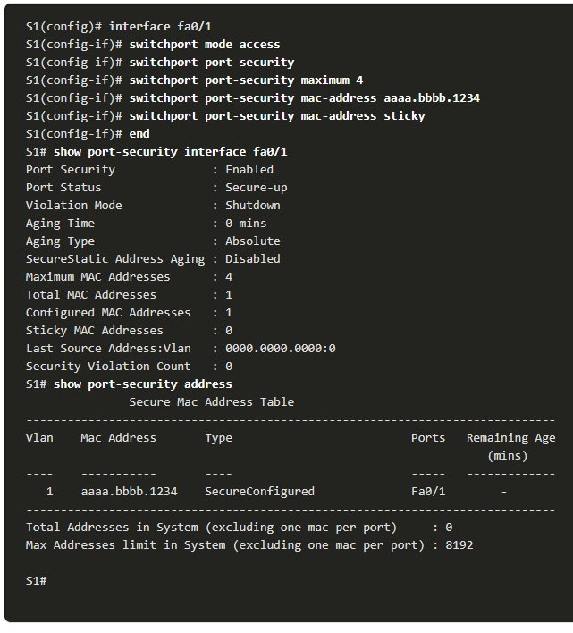
Limit and Learn MAC Addresses
The example demonstrates a complete port security configuration for FastEthernet 0/1.
The administrator specifies a maximum of 4 MAC addresses, manually configures one secure MAC address, and then configures the port to dynamically learn additional secure MAC addresses up to the 4 secure MAC address maximum.
Use the show port-security interface and the show port-security address command to verify the configuration.

