Slide 1
Thingspeak

Slide 2
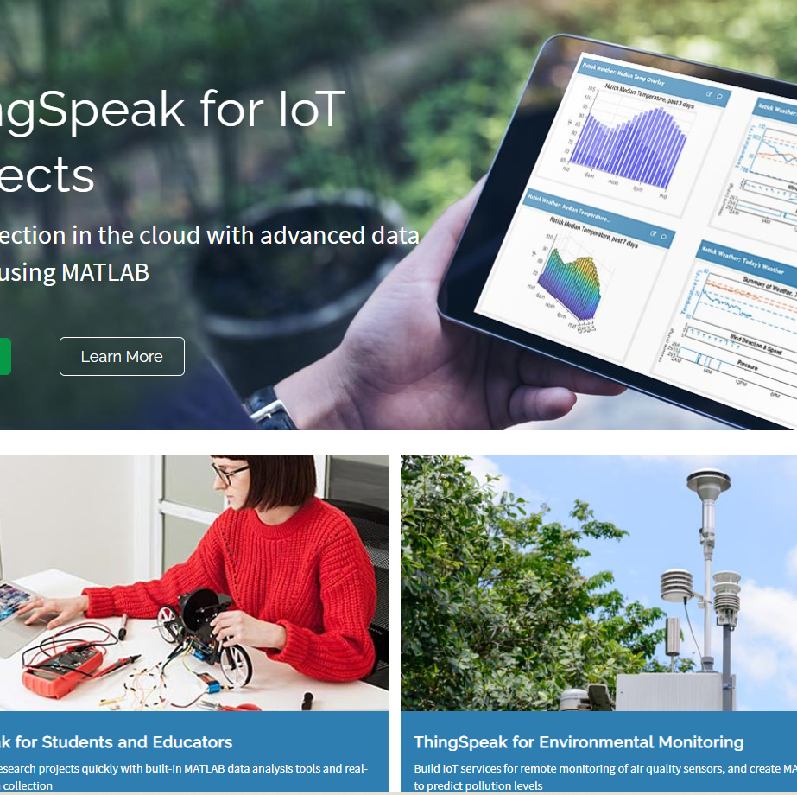
Thingspeak
ThingSpeak is a cloud-based IoT platform to store and retrieve data from devices.
Uses HTTP protocol/Restful APIs
MQTT
"Collect and analyse data quickly and easily"

Slide 3
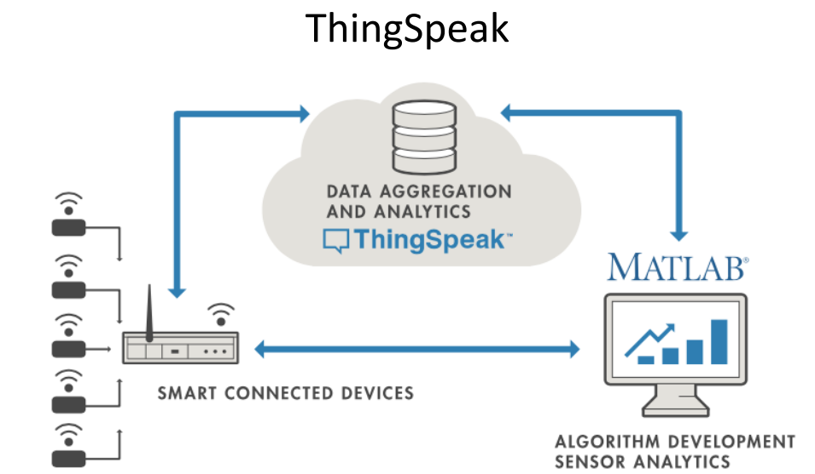
Thingspeak Overview
Account-based
Can create free account online
Brought to you by the people who made Matlab/Simulink
Uses Matlab features/toolboxs
SDKs/librarys for popular languages/devices
Restful API means should work with any device

Slide 4
Thingspeak – basic use
Create a new channel
Test for certain conditions and perform actions
Act on the data
Run analytical algorithms/visualise your data
Analyse the data
Devices write data to channels
Collect data in the channel
Channels collect data

Slide 5
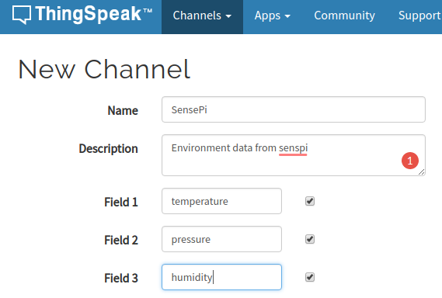
ThingSpeak – Create new channel
Create a new channel to collect data from devices
Define data fields for the channel(max 8)
Can also input location(lat/long) of channel source)

Slide 6
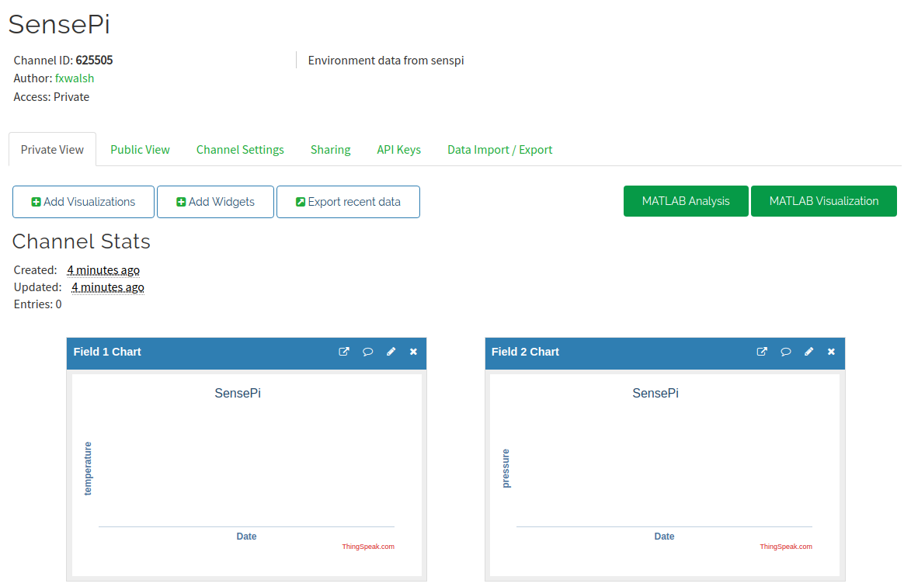
Thingspeak - New channel
Once saved you can access channel page:

Slide 7
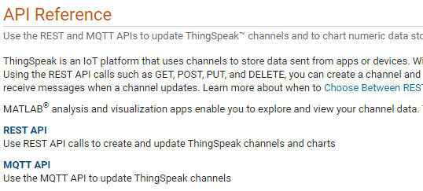

Thingspeak - Add data to channel
Programmatically, many ways!
Construct HTTP GET request and include field values in query string
MQTT (see in Lab)
GET https://api.thingspeak.com/update?api_key=<WRITE-KEY>&field1=12
Using HTTP GET request, can test from a browser:

Slide 8
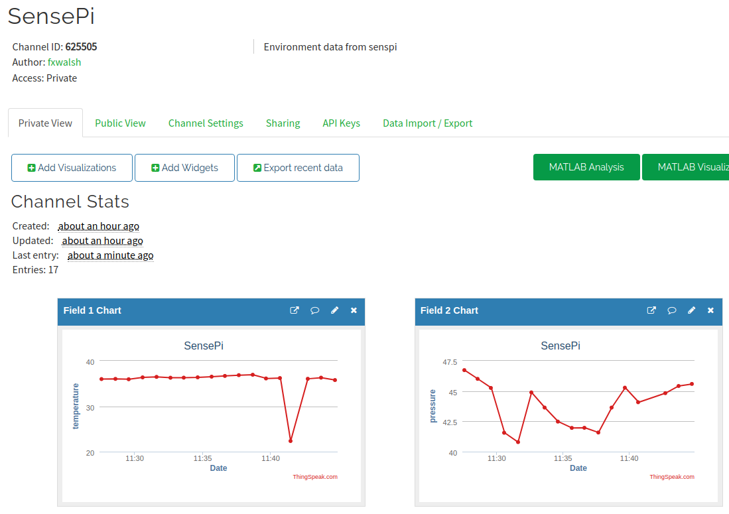
Think Speak – Analyse data
Thingspeak will visualise each field by default in channel view

Slide 9
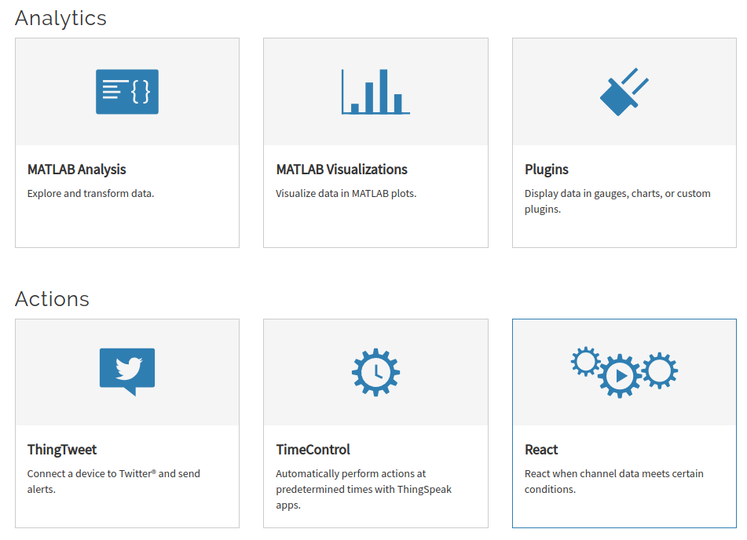
Thingspeak - Apps
The Apps tab provides various mechanism to transform, analyse,visualise and act on data.

Slide 10
ThingSpeak Example: Analysis
Can write Matlab Code to analyse and transform data
Possible uses:
Clean data (remove outliers)
Statistical analysis
Transfomations
Data Fusion
Generally write results to second channel for further analysis/visualisation.

Slide 11
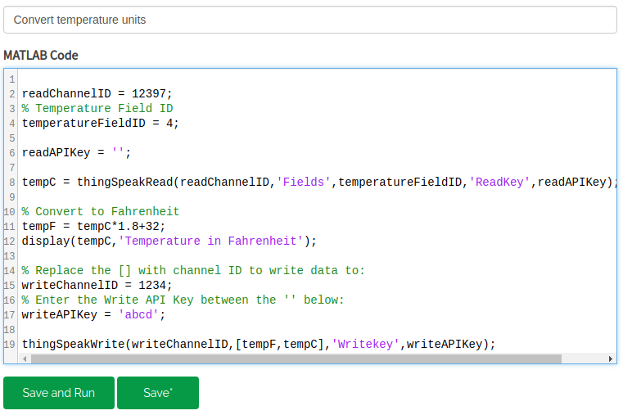
Thinkspeak: Convert Celcius to Fahrenheit

Slide 12
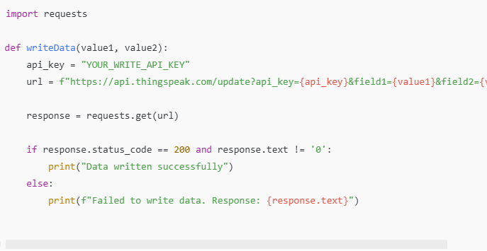
Thingspeak – Add data with HTTP
Make HTTP request from Python:

Slide 13
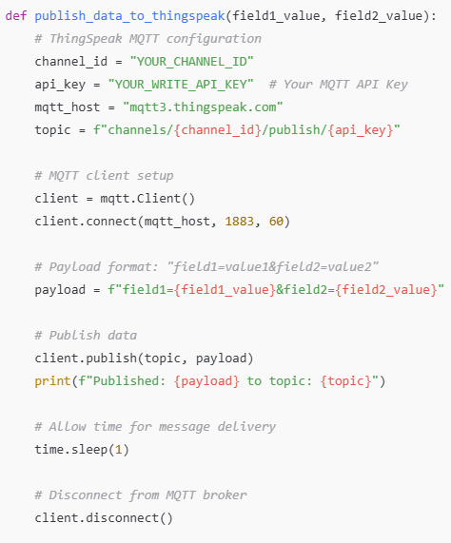
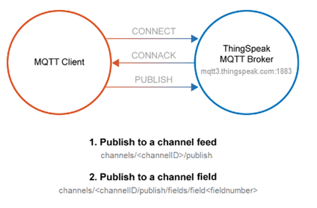
Thingspeak – Add data with MQTT

Slide 14
Which to use: HTTP or MQTT API
HTTP (REST) API
You need to retrieve any historical data, such as data within a defined time range.
You want to Create Channel, Read Settings, Clear Channel, Delete Channel, or Create Chart.
You need a response!
MQTT
Your device is power-constrained, and you want lower battery consumption to send data to ThingSpeak. Also, an MQTT PUBLISH operation is typically faster in this scenario.
Your device connectivity is intermittent, and you have limited bandwidth usage.
You want immediate updates of data posted to a channel.
You want messages pushed to you instead of needing to poll the server for new messages.

Slide 15
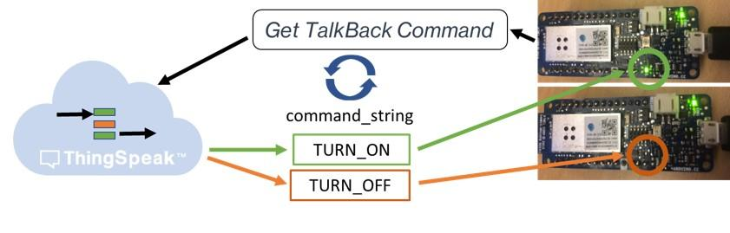
New - Talkback
TalkBack is a cloud-side command queue in ThingSpeak.
You (or an app) enqueue commands; devices poll and execute them later.
Workflow:
App/User adds a command to a TalkBack queue (e.g., SET_FAN=ON)
Device polls TalkBack periodically (HTTP request)
ThingSpeak returns the next pending command
Device executes it and (optionally) logs status to a channel field
API ideas (common pattern)
Add command: .../talkbacks/<ID>/commands.json?api_key=...&command_string=...
Get next command: .../talkbacks/<ID>/commands/execute.json?api_key=..

