Slide 1
Transport Layer TCP/UDP
Notes:
1

Slide 2
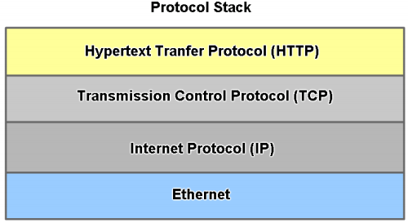
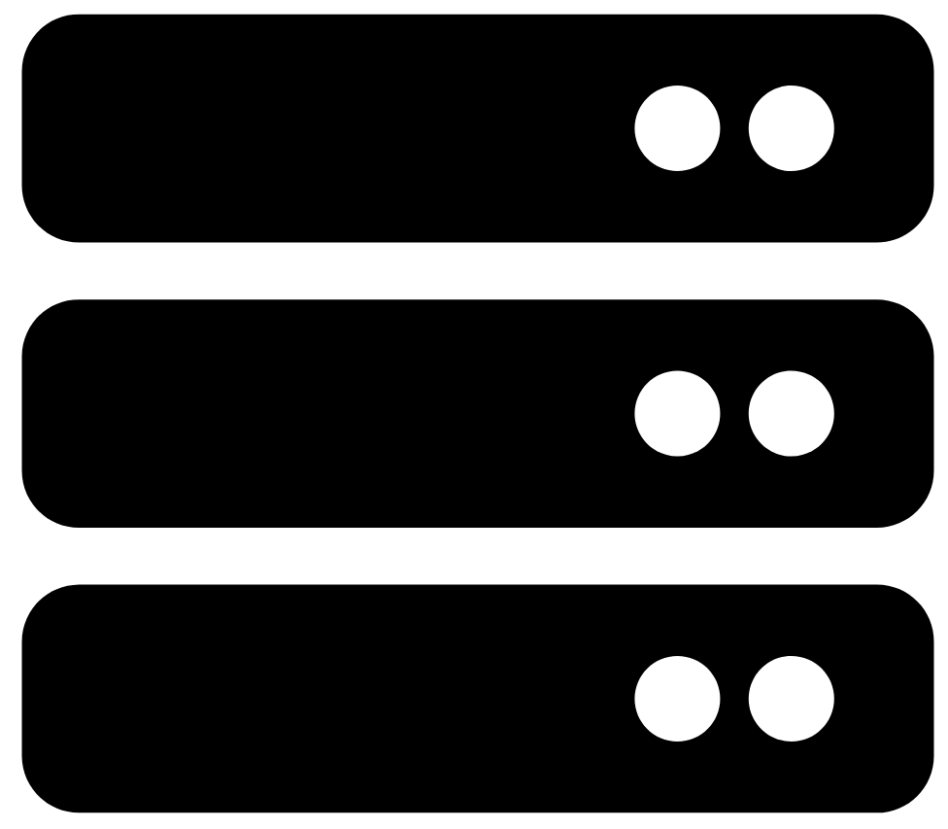
Recap: Layered Model Network Comms
Layers
Web Server
Application
Transport
Network
Data Link/ Physical
Benefits of Layered Model:
assists in protocol design
fosters competition
changes in one layer do not affect other layers
provides a common language

Slide 3
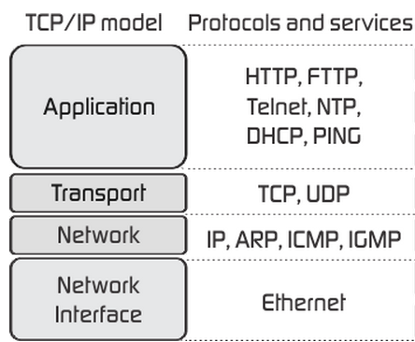
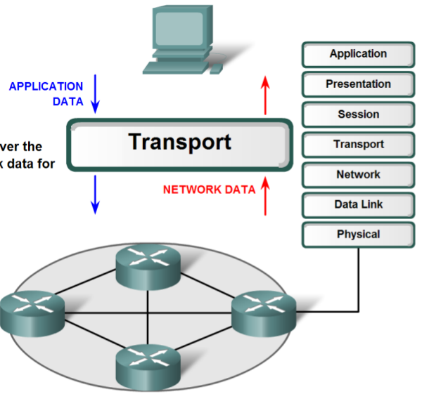
Transport Layer Role
Provides logical communications between applications running on different hosts.
Provides the link between the application layer and the lower layers that are responsible for network transmission.
Prepares application data for transport over a network
Processes network data for use by apps
This Photo by Unknown Author is licensed under CC BY-SA

Slide 4
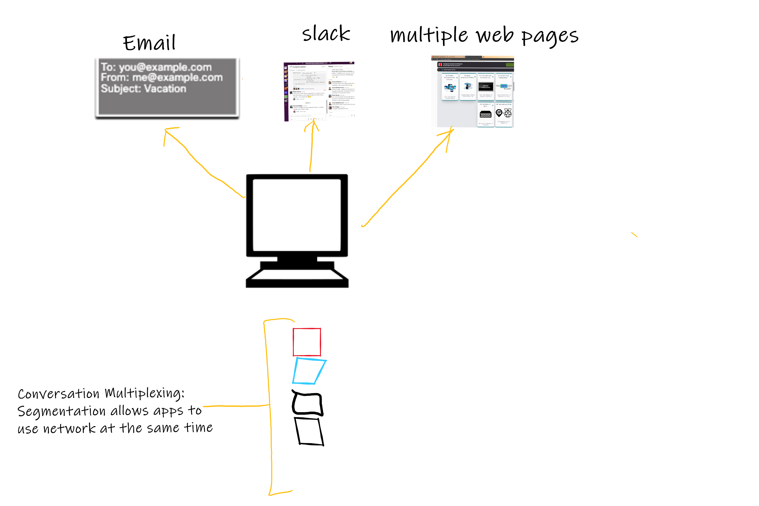
Transport Layer Purpose
Segments data and reassembles segments into various communication streams:
Tracks individual communication between apps on source and destination hosts
A host can have multiple simultaneous networked apps (e.g. browser, slack etc.
Segments data and manages each piece
The Transport layer segments data from the Application layer
Each piece of application data requires headers to indicate to which communication it is associated with
Reassembles segments into application data
At a receiving host, individual pieces of data must also be reconstructed into a complete data stream that is useful to the Application layer.
Identifies different applications
Transport layer must be able to identify target apps: Uses Port Numbers

Slide 5
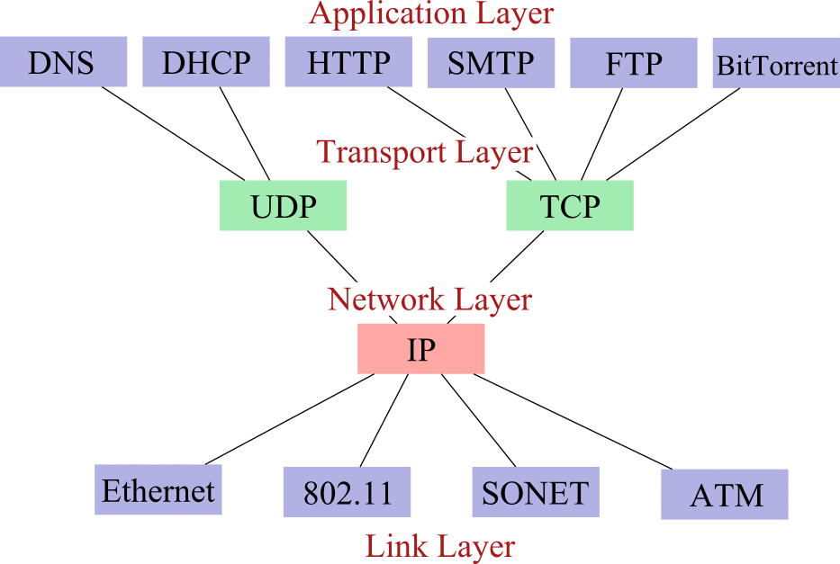
TCP only part of the Transport layer
ICMP(ping), ARP & RARP
802.3
WiFi
TCP/IP
5

Slide 6
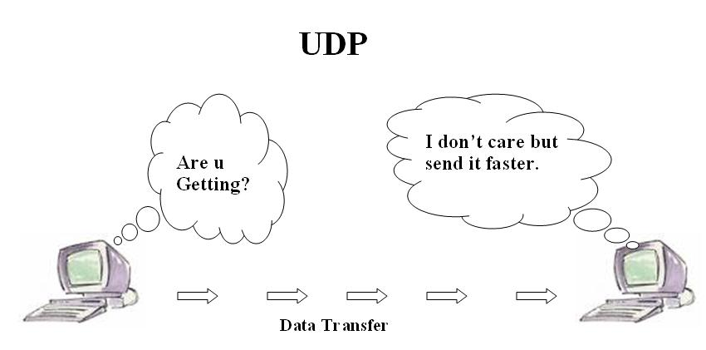
UDP - User Datagram Protocol
UDP is a transport protocol, that provides the basic functions for delivering datagrams between the appropriate applications,
communication between processes
UDP is a connectionless best-effort delivery
there is no acknowledgment that the data is received at the destination.
UDP uses ports to provide communication services to individual apps/processes.
This Photo by Unknown Author is licensed under CC BY-SA

Slide 7
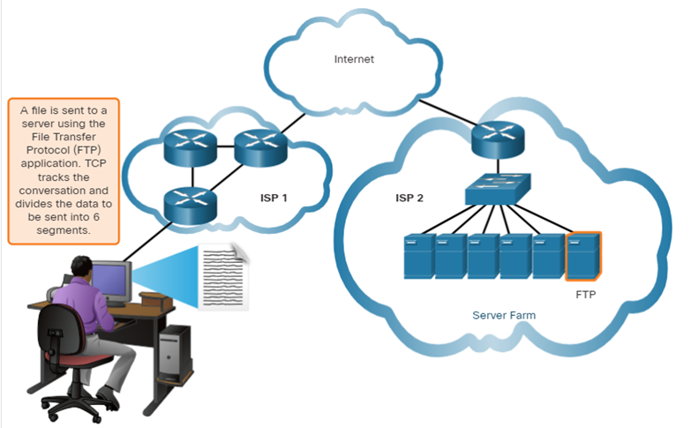
Transmission Control Protocol(TCP)
TCP provides reliability and flow control. TCP basic operations:
Number and track data segments transmitted to a specific host from a specific application
Acknowledge received data
Retransmit any unacknowledged data after a certain amount of time
Sequence data that might arrive in wrong order
Send data at an efficient rate that is acceptable by the receiver

Slide 8
Choosing Transport Layer Protocols…
Application developers choose based on the nature of the app
IP Telephony
Video Streaming
Frequent Sensor data
Online Gaming(Fortnite/Call of Duty)
Email(SMTP/POP)
Web Pages(HTTP)
Command data(turn on Heating)
Requirements:
Fast
Low overhead
No need for acknowedgements
No need to resend lost data
Delivers data as it arrives.
Requirements:
Reliable
Acknowedge data
Resend lost data
Delivers data in order sent.

Slide 9
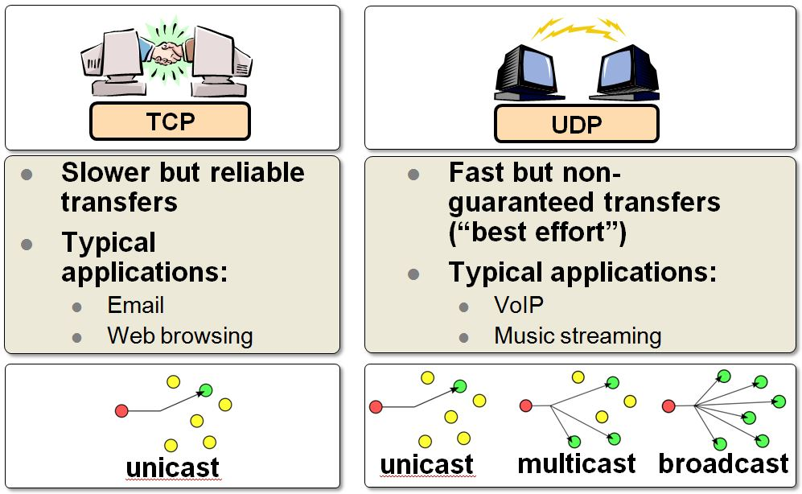
Choosing Transport Layer Protocols…
Q: Which protocol is better ?
This Photo by Unknown Author is licensed under CC BY-SA-NC

Slide 10
Ports
TCP/IP uses an abstract destination point called a protocol port.
Ports are identified by a positive integer.
Port number & IP address allow any process/application in any computer on Internet to be uniquely identified
Operating systems provide a mechanism that apps & processes use to specify a port.
Host A
Host B
Process
Process
Process
Process
Process
Process

Slide 11
Ports
Source/destination port: port numbers identify sending & receiving processes
Ports can be static or dynamic
Static (< 1024) assigned centrally, known as well known ports
Dynamic (can be used by any computer application program to communicate with any other application program, 49152-65535 for Windows)

Slide 12
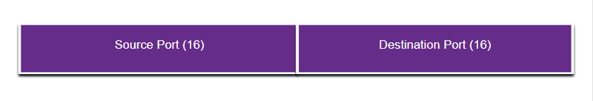
Ports: Multiple communications
Port numbers used in TCP and UDP to manage multiple, simultaneous conversations.
The source port number is associated with the originating application on the local host whereas the destination port number is associated with the destination application on the remote host.

Slide 13
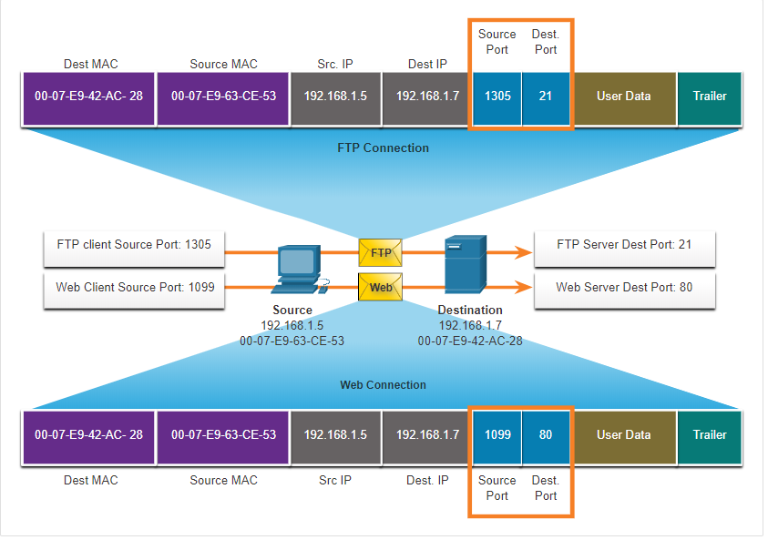
Ports: Socket Pairs
The source and destination ports are placed within the segment
The segments are then encapsulated within an IP packet.
The combination of the source IP address and source port number, or the destination IP address and destination port number is known as a socket.
Sockets enable multiple processes, running on a client, to distinguish themselves from each other, and multiple connections to a server process to be distinguished from each other

Slide 14
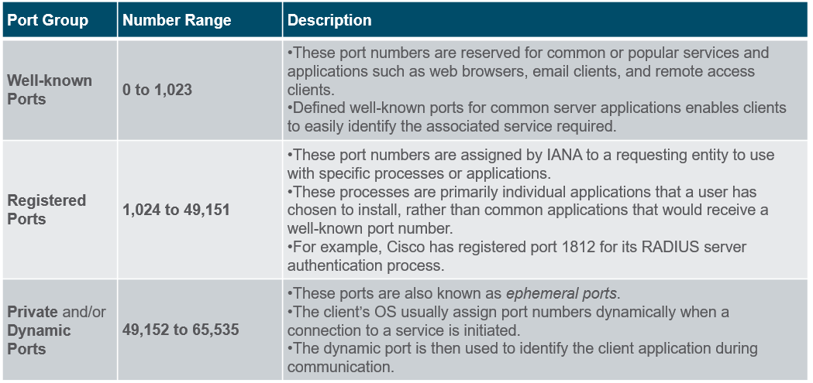
Ports: Groups

Slide 15
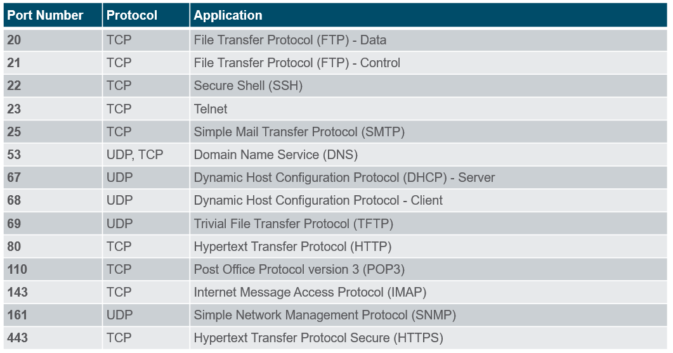
Well-Known Port Numbers

Slide 16
UDP Datagram Format
Source Port
Destination Port
Length
Checksum
Data

Slide 17
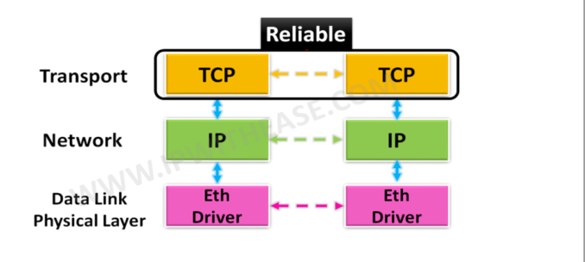
TCP Transmission Control Protocol
TCP is a transport layer protocol supported by TCP/IP stack.
TCP provides:
Connection-oriented
Reliable
Full-duplex
Byte-Stream

Slide 18
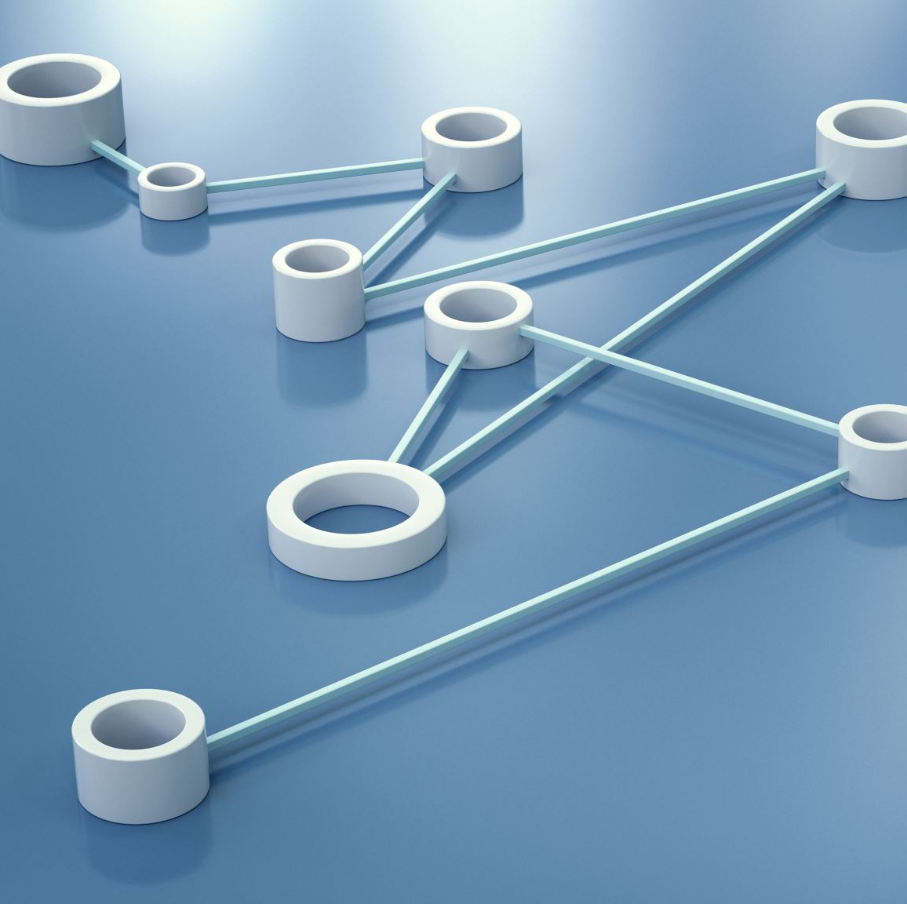
Connection-Oriented
Connection oriented means that a virtual connection is established before any user data is transferred.
If the connection cannot be established, the user program is notified (finds out).
If the connection is ever interrupted, the user program(s) is finds out there is a problem.

Slide 19
Reliable
Reliable means that every transmission of data is acknowledged by the receiver.
Reliable does not mean that things don't go wrong, it means that we find out when things go wrong.
If the sender does not receive acknowledgement within a specified amount of time, the sender retransmits the data.

Slide 20
Full Duplex
TCP provides transfer in both directions (over a single virtual connection).
To the application program these appear as 2 unrelated data streams, although TCP can piggyback control and data communication by providing control information (such as an ACK) along with user data.

Slide 21
Buffering
TCP is responsible for buffering data and determining when it is time to send a datagram.
It is possible for an application to tell TCP to send the data it has buffered without waiting for a buffer to fill up.

Slide 22
TCP Segment Format
1 byte
1 byte
1 byte
1 byte
Source Port
Destination Port
Sequence Number
Request/Acknowledgement Number
offset
Reser.
Control
Window
Checksum
Urgent Pointer
Options (if any)
Data

Slide 23
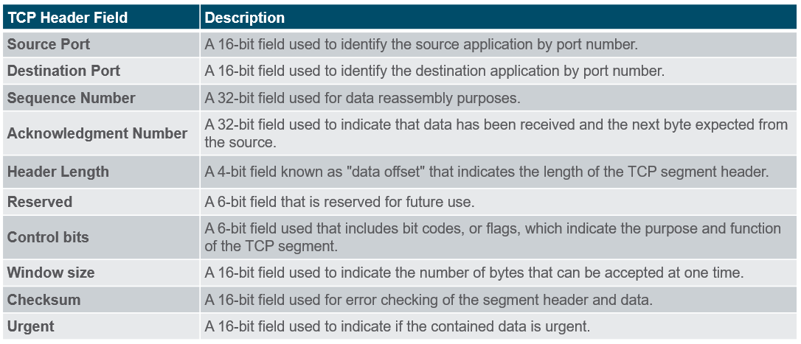
TCP Header Fields

Slide 24
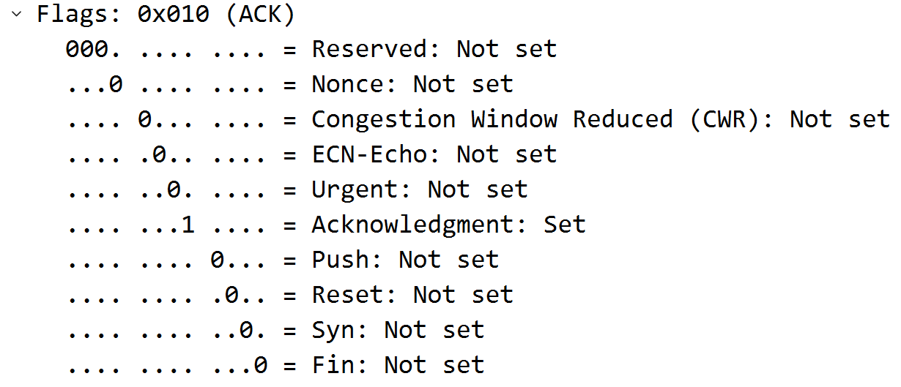
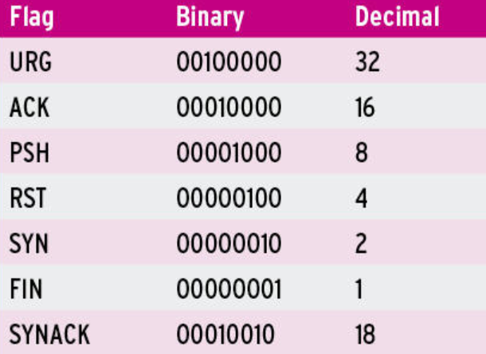
TCP Control Flags
There are a bunch of control flags:
URG: urgent data included.
ACK: this segment is (among other things) an acknowledgement.
RST: error - abort the session.
SYN: synchronize Sequence Numbers (setup)
FIN: polite connection termination.

Slide 25
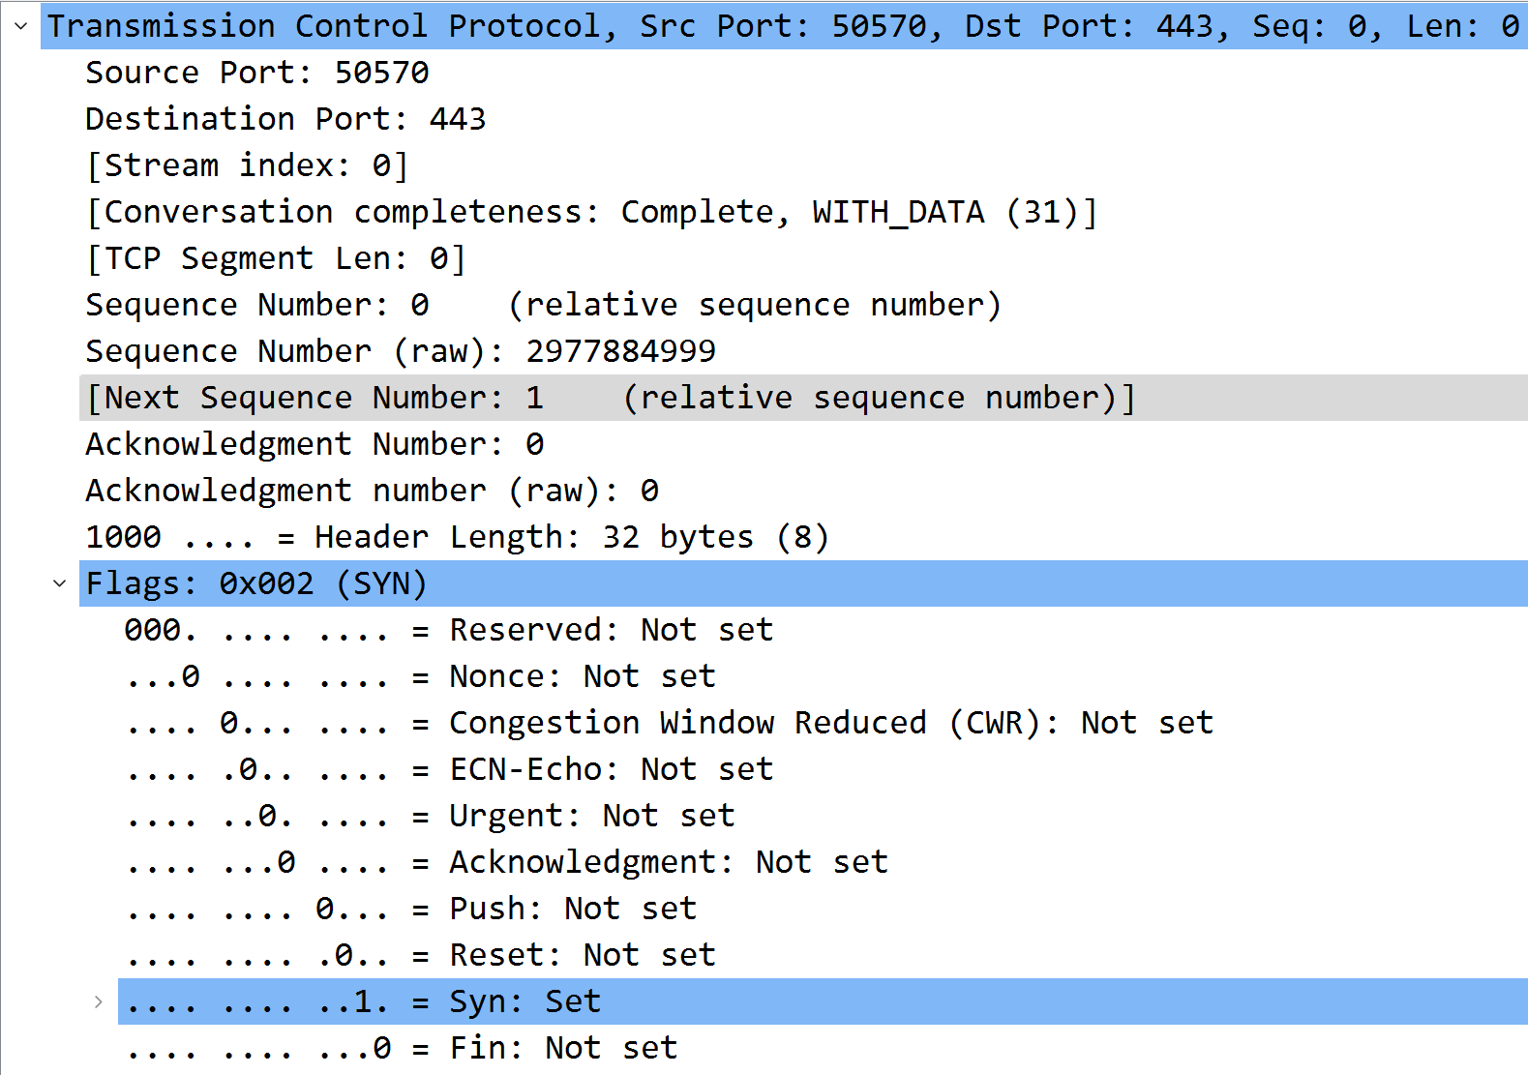
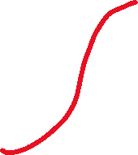
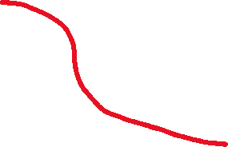
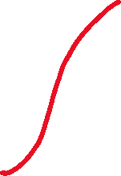
TCP Segment: Synchronise
When a client requests a connection, it sends a “SYN” segment (a special TCP segment) to the server port.
SYN stands for synchronize. The SYN message includes the client’s ISN. ISN is Initial Sequence Number.
Every TCP segment includes a Sequence Number that refers to the first byte of data included in the segment.
Every TCP segment includes a Request Number (Acknowledgement Number) that indicates the byte number of the next data that is expected to be received.
All bytes up through this number have already been received.

Slide 26
TCP Segment: Segment Size & Window
MSS: Maximum segment size (A TCP option) is the largest amount of data, in bytes, that a device can receive in a single TCP segment, not including the TCP header or the IP header
The default TCP Maximum Segment Size is 536
A host can set the MSS to a value other than the default in the TCP SYN . The value cannot be changed after the connection is established
Window: Window Size
tells the sender how many bytes it can send before the receiver will have to toss it away (due to the buffer bing full).
used by the receiver to indicate to the sender, the amount of data that it can accept

Slide 27
TCP Connection Creation
Programming details later - for now we are concerned with the actual communication.
A server accepts a connection.
Must be looking for new connections!
A client requests a connection.
Must know where the server is!

Slide 28
Client Starts
A client starts by sending a SYN segment with the following information:
Client’s ISN (generated pseudo-randomly)
Maximum Receive Window for client.
Optionally (but usually) MSS (largest segment accepted).
No payload! (Only TCP headers)

Slide 29
Sever Response
When a waiting server sees a new connection request, the server sends back a SYN segment with:
Server’s ISN (generated pseudo-randomly)
Acknowledgement Number is Client ISN+1
Maximum Receive Window for server.
Optionally (but usually) MSS
No payload! (Only TCP headers)

Slide 30
Finally
When the Server’s SYN is received, the client sends back an ACK with:
Acknowledgement Number is Server’s ISN+1

Slide 31
Client
Server
SYN
ISN=X
1
SYN
ISN=Y ACK=X+1
time
2
ACK=Y+1
3

Slide 32
TCP Data and ACK
Once the connection is established, data can be sent.
Each data segment includes a sequence number identifying the first byte in the segment.
Each segment (data or empty) includes a request number indicating what data has been received.

Slide 33
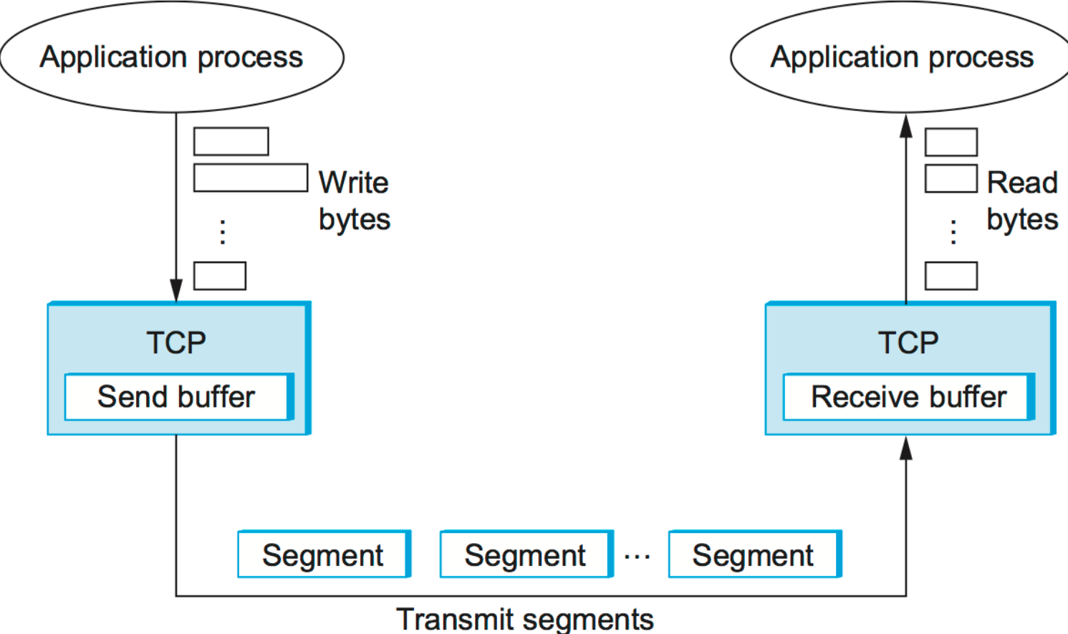
TCP Buffers
The TCP layer doesn’t know when the application will ask for any received data.
TCP buffers incoming data so it’s ready when we ask for it.
Both the client and server allocate buffers to hold incoming and outgoing data
The TCP layer does this.
Both the client and server announce with every ACK how much buffer space remains (the Window field in a TCP segment).

Slide 34
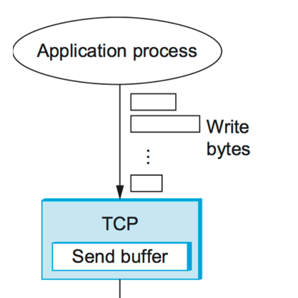
TCP Send Buffers
The application gives the TCP layer some data to send.
The data is put in a send buffer, where it stays until the data is ACK’d.
it has to stay, as it might need to be sent again!
The TCP layer won’t accept data from the application unless (or until) there is buffer space.

Slide 35
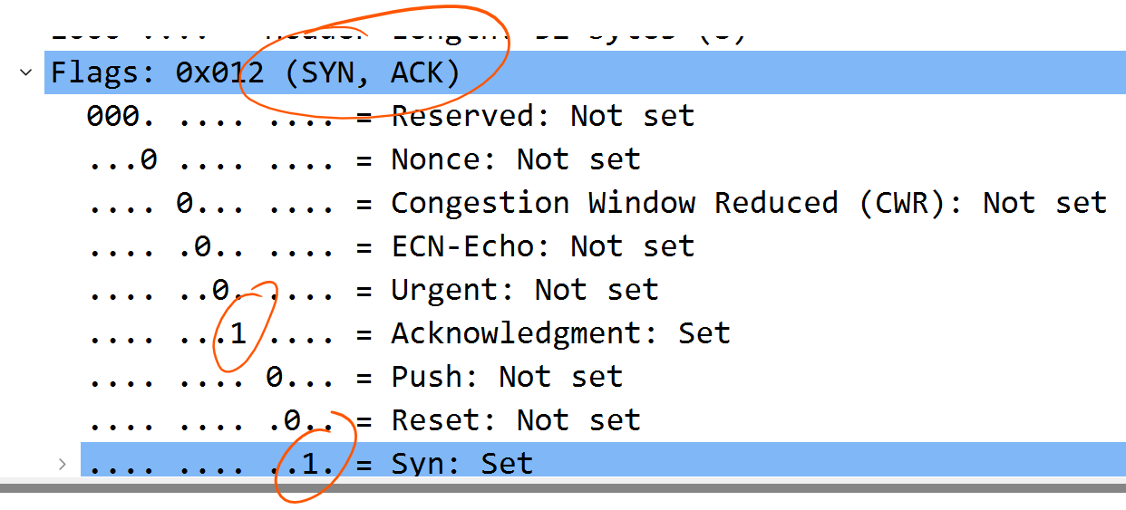
Acknowledgements
A receiver doesn’t have to ACK every segment (it can ACK many segments with a single ACK segment).
Each ACK can also contain outgoing data (piggybacking).
If a sender doesn’t get an ACK after some time limit (MSL) it resends the data.

Slide 36
TCP Segment Order
Most TCP implementations will accept out-of-order segments (if there is room in the buffer).
Once the missing segments arrive, a single ACK can be sent for the whole thing.
Remember: IP delivers TCP segments, and IP in not reliable - IP datagrams can be lost or arrive out of order.

Slide 37
Termination
The TCP layer can send a RST segment that terminates a connection if something is wrong.
When a non-SYN segment was received for a non-existing TCP connection.
An invalid header is received. This will prevent attacks by closing the corresponding connection.
Lack of resources to support the connection
Usually the application tells TCP to terminate the connection politely with a FIN segment.

Slide 38
FIN
Either end of the connection can initiate termination.
A FIN is sent, which means the application is done sending data.
The FIN is ACK’d.
The other end must now send a FIN.
That FIN must be ACK’d.

Slide 39
App1
App2
FIN
SN=X
1
ACK=X+1
2
...
FIN
SN=Y
3
ACK=Y+1
4

Slide 40
TCP Termination
1
App1: “I have no more data for you”.
App2: “OK, I understand you are done sending.”
dramatic pause…
App2: “OK - Now I’m also done sending data”.
App1: “Roger, Over and Out, Goodbye, Astalavista Baby, Adios, It’s been real ...”
camera fades to black ...
2
3
4

Slide 41
TCP TIME_WAIT
Once a TCP connection has been terminated (the last ACK sent) there is some unfinished business:
What if the ACK is lost? The last FIN will be resent and it must be ACK’d.
What if there are lost or duplicated segments that finally reach the destination after a long delay?
TCP hangs out for a while to handle these situations.

Slide 42
QI
Why is a 3-way handshake necessary?
HINTS: TCP is a reliable service, IP delivers each TCP segment, IP is not reliable.
Who sends the first FIN - the server or the client?
Once the connection is established, what is the difference between the operation of the server’s TCP layer and the client’s TCP layer?

