Slide 1
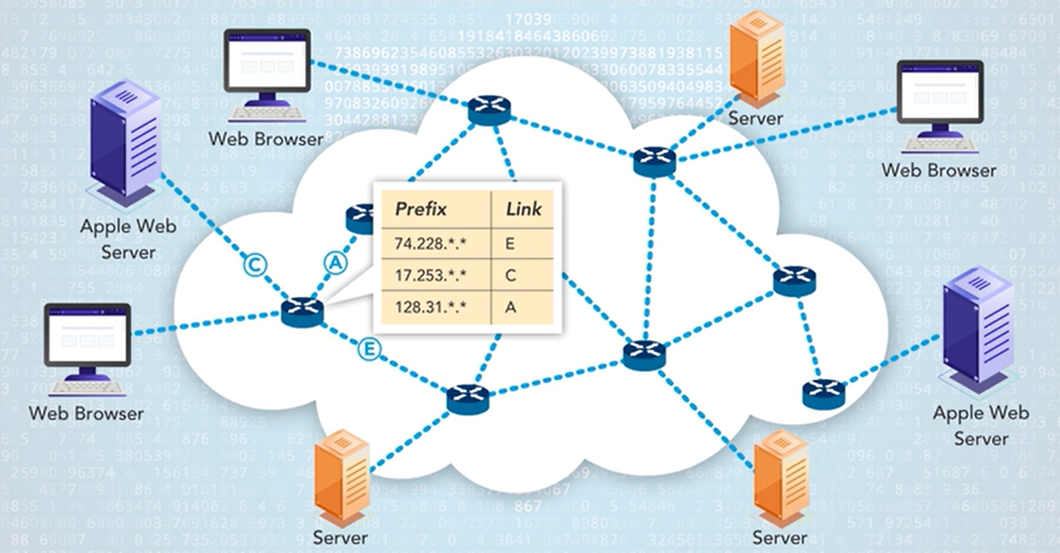
Ethernet: Switching
Mujahid Tabassum
2024
IPv4 Addressing & Network Layer
By: Mujahid Tabassum - 2025

Slide 2
Agenda
Network layer
IP Characteristics
IP Addressing
IP Network Mask
Introduction to Routing
Host Routing
Router Routing

Slide 3
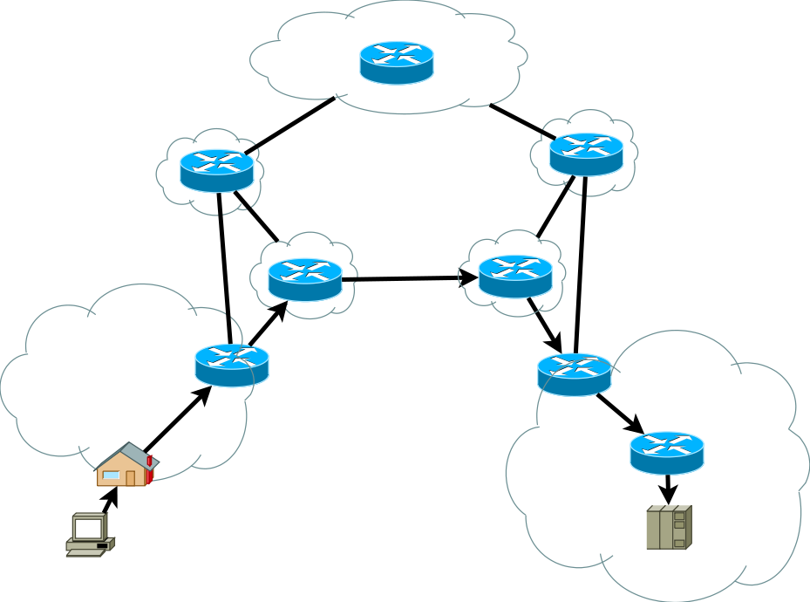
Recap: Internet Layer Communication
Internet/Network layer protocols primary function is to move data from one network to another network
Network addresses(IP Addresses) must have a mechanism to locate hosts on different networks
Routers use the network portion of this address to determine which path to use to reach its destination.
IP/Network Packet
Destination IP Address
Source IP Address
Data
Network
Host
Network
Host

Slide 4
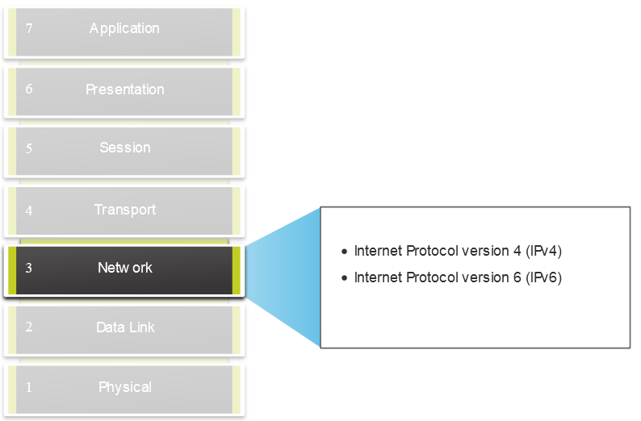
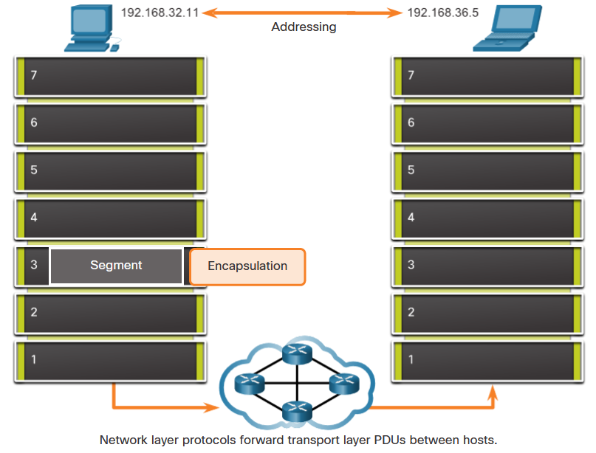
The Network Layer
Provides services to allow end devices to exchange data
IP version 4 (IPv4) and IP version 6 (IPv6) are the principle of network layer communication protocols.
The network layer performs four basic operations:
Addressing end devices
Encapsulation
Routing
De-encapsulation

Slide 5
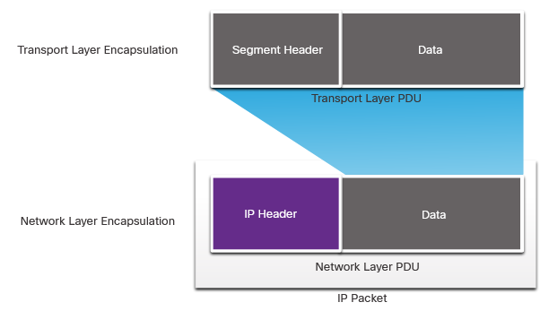
IP Encapsulation
IP encapsulates the transport layer segment.
IP can use either an IPv4 or IPv6 packet and not impact the layer 4 segment.
IP packet will be examined by all layer 3 devices as it traverses the network.
The IP addressing does not change from source to destination.
Note: NAT will change addressing, but will be discussed in a later module.

Slide 6
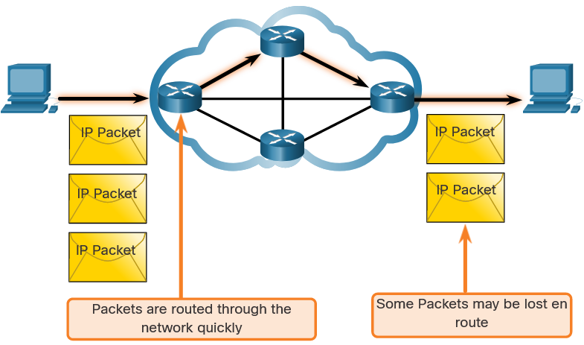
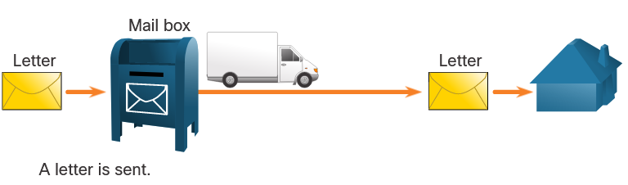
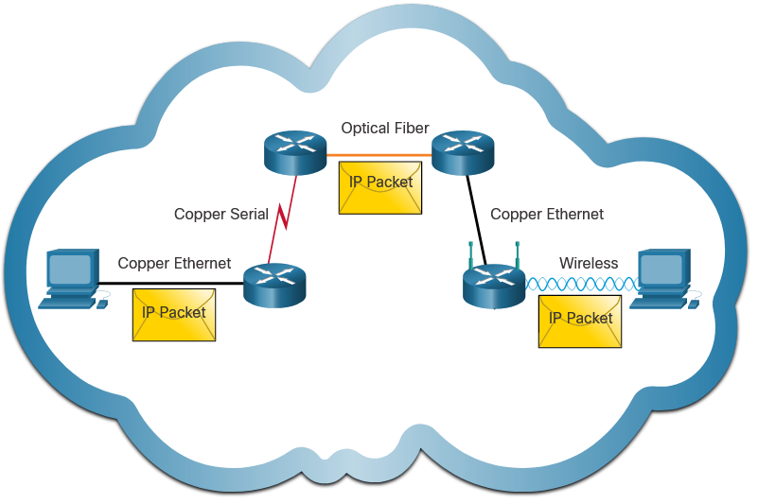
Characteristics of IP
IP is meant to have low overhead and may be described as:
Connectionless
Best Effort
Media Independent

Slide 7
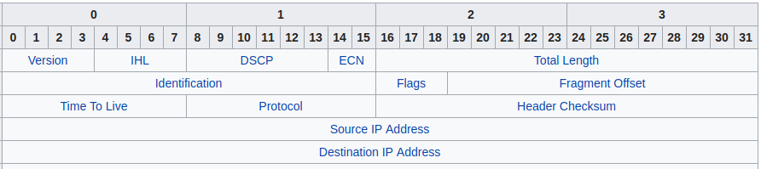
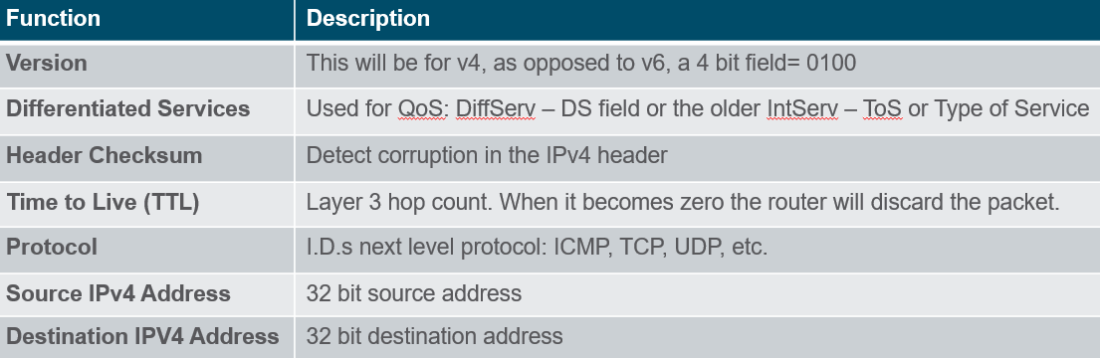
The IP Packet Header
Options(if any)
Segment Header
Data
Network Header
Segment Header
Data
Frame Header
Network Header
Segment Header
Data
Frame Trailer
Notes:
The term "hop count" typically refers to the number of network devices (such as routers) an IP packet passes through.
The TTL field in an IPv4 header is a one-byte value, so it can be any number between 0 and 255. The primary purpose of the TTL field is to prevent IP packets from looping indefinitely within a network due to routing loops. Every time an IP packet passes through a router, the TTL value is decremented by one.
Here's a general breakdown of common initial TTL values, depending on the operating system:
Linux/Unix: The default TTL is usually set to 64.
Windows: The default TTL value is typically 128.
Cisco Routers (IOS): The default TTL value when originating an IP packet (e.g., a ping) is 255.

Slide 8
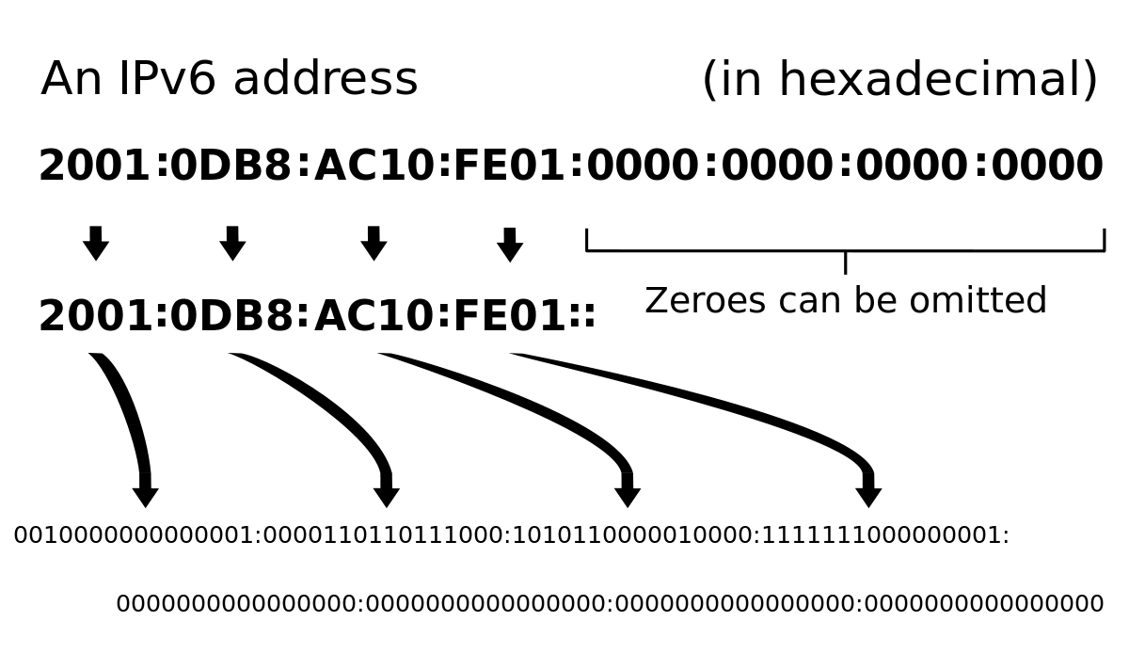
Aside: IPv4 Limitations
Running out of IPv4 addresses
Because of this, lack of end to end connectivity
Overcome using private IP addressing and Network Address Translation
NAT is everywhere, but was only intended as a temporary solution
Solution: IPv6
Increased address space – based on 128 bit address, not 32 bits
Improved packet handling – simplified header with fewer fields
Eliminates the need for NAT
IPv4 remains dominant choice for various reasons…
This Photo by UnknownAuthor is licensed under CC BY-SA

Slide 9
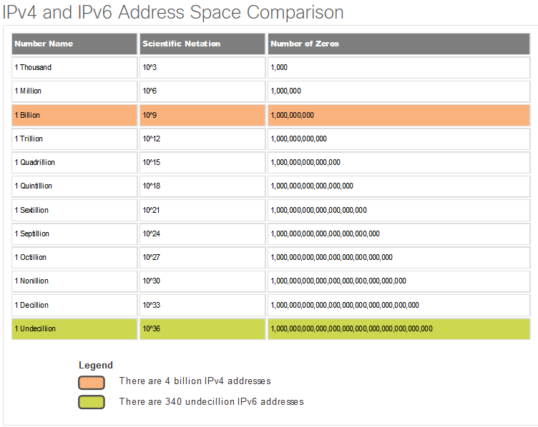
IPv6 Overview
IPv6 was developed by Internet Engineering Task Force (IETF).
IPv6 overcomes the limitations of IPv4.
Improvements that IPv6 provides:
Increased address space – based on 128-bit address, not 32 bits
Improved packet handling – simplified header with fewer fields
Eliminates the need for NAT – since there is a huge amount of addressing, there is no need to use private addressing internally and be mapped to a shared public address

Slide 10
IPV4 Addressing

Slide 11
IPv4 Address: Phone number analogy
Phone numbers are like network addresses
Area Code – similar to network portion
Phone number – similar to host portion
051-3025635

Slide 12
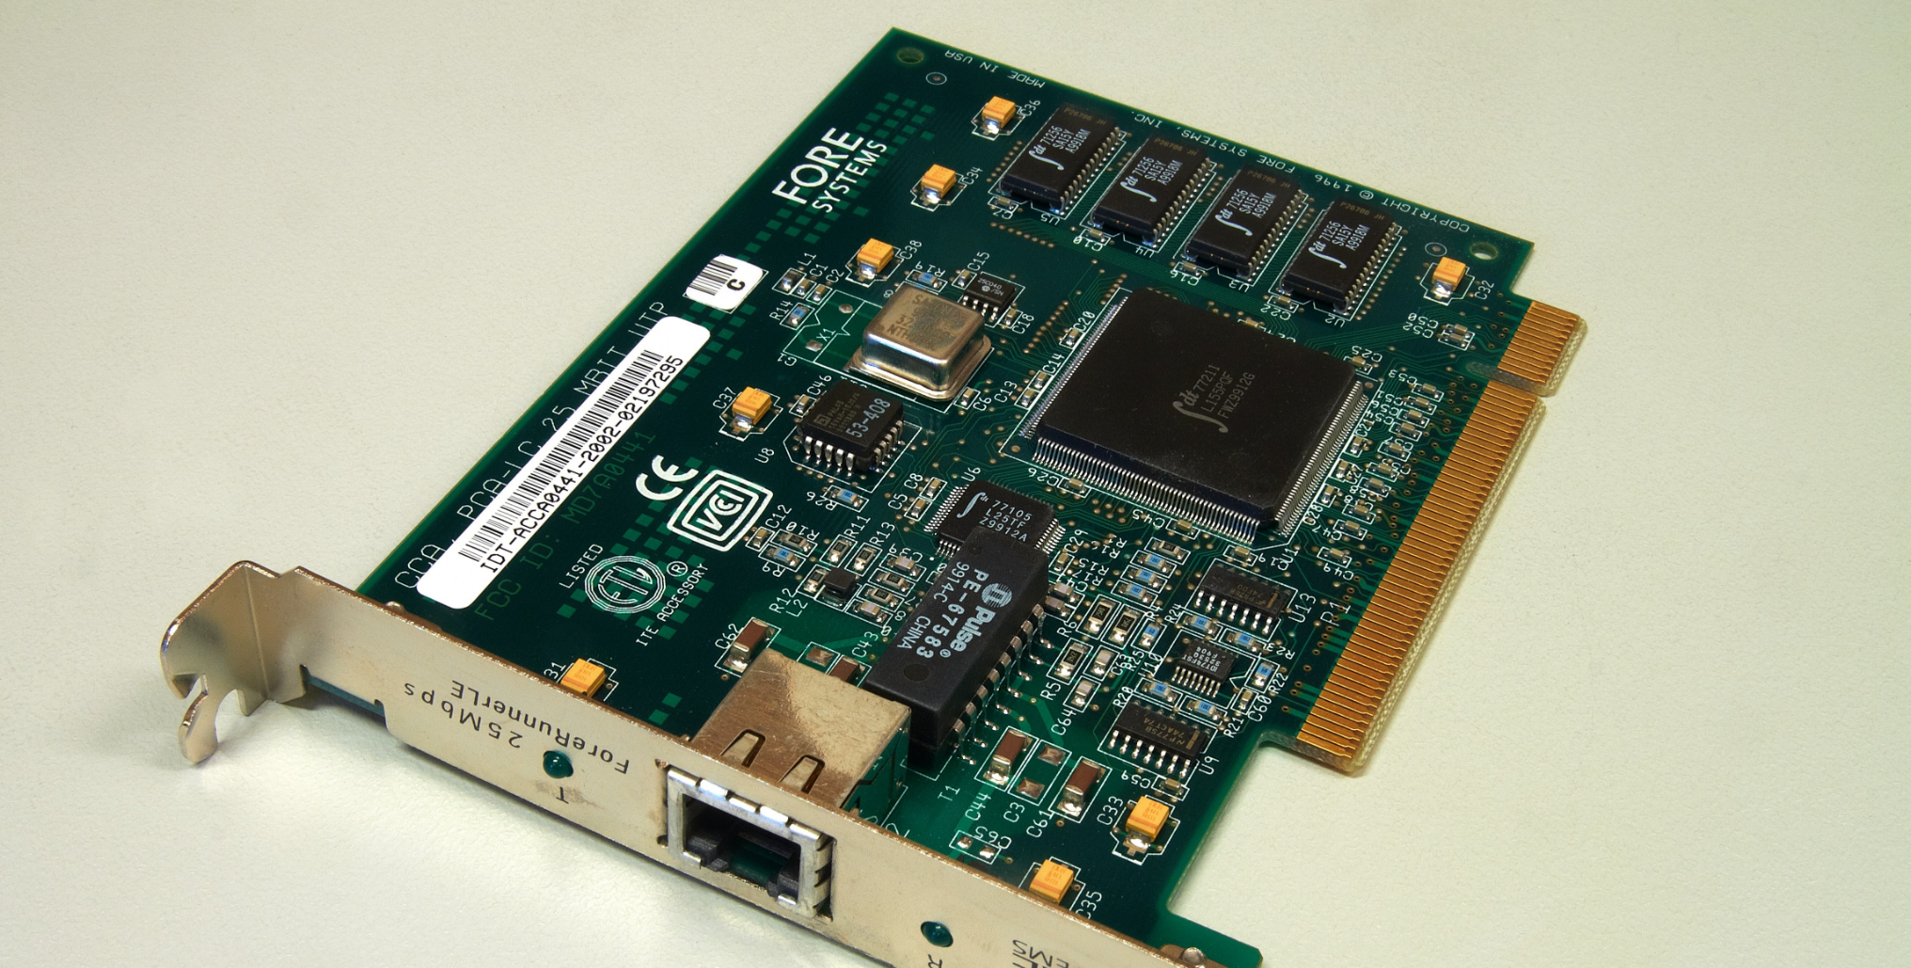
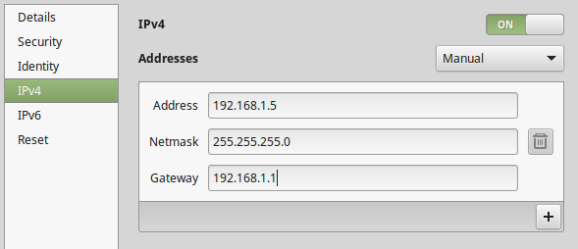
MAC and IP Address
Physical/MAC address
Flat Addressing Scheme
"Burned" into Network Interface
Doesn't change (like a PPS number)
IP Address
Hierarchical Addressing
Software defined
Your devices "mailing" address (ie it usually changes when you move)
You need both...

Slide 13
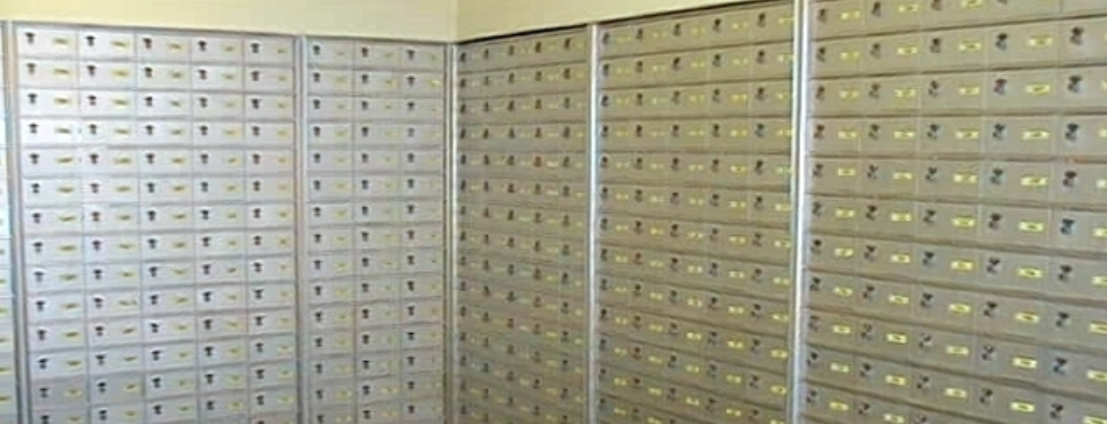
MAC is flat addressing
If the Internet was a flat network with only MAC addresses, switches would need to know the billions of MAC addresses or broadcast the frame as an unknown unicast.

Slide 14
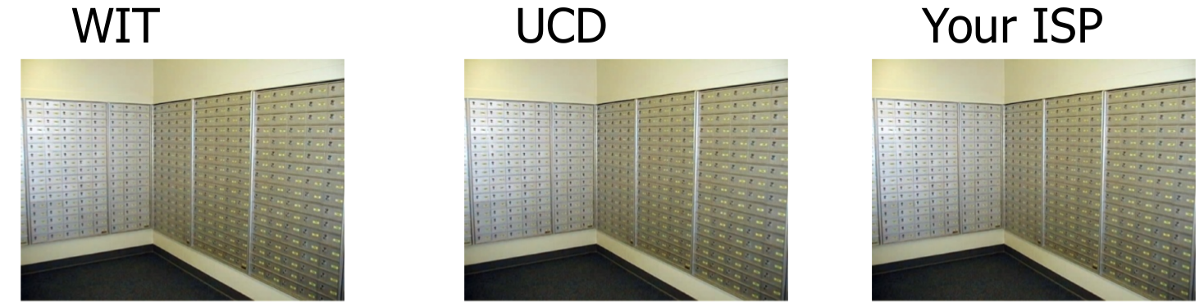
IP is Hierarchical
IP address indicates what network the packet belongs to.
Routers maintain lists of IP network addresses to route the packet to the right network.
SETU

Slide 15
IPv4 Addressing
Which bits refer to network number???
In the past – Classful IP addressing
Value of first octet(8 bits) determined the network/host portion
Currently
Classless IP addressing
Use a subnet mask to determine network portion of address
Classless IP Addressing is what is used within the Internet and in most internal networks.
IPv4 Address
Network
Host
32 bits

Slide 16
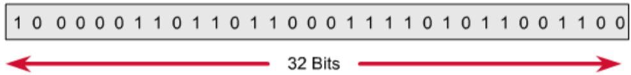
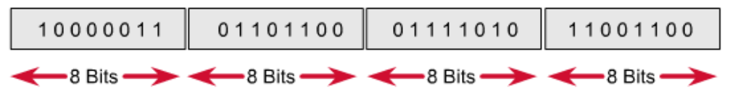
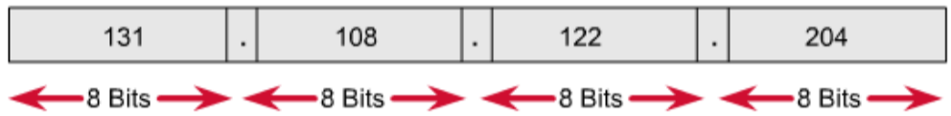
IPv4 Addressing
IPv4 are 32 bits
Divided into four 8 bit sections (octets)
Typically expressed in Dot Decimal Notation
IPv4 Address
Network
Host
32 bits

Slide 17



IPv4 Address: Converting from binary to dot decimal notation
128 | 64 | 32 | 16 | 8 | 4 | 2 | 1

Slide 18
IPv4 Address: Converting from Decimal to Binary
128 | 64 | 32 | 16 | 8 | 4 | 2 | 1

Slide 19
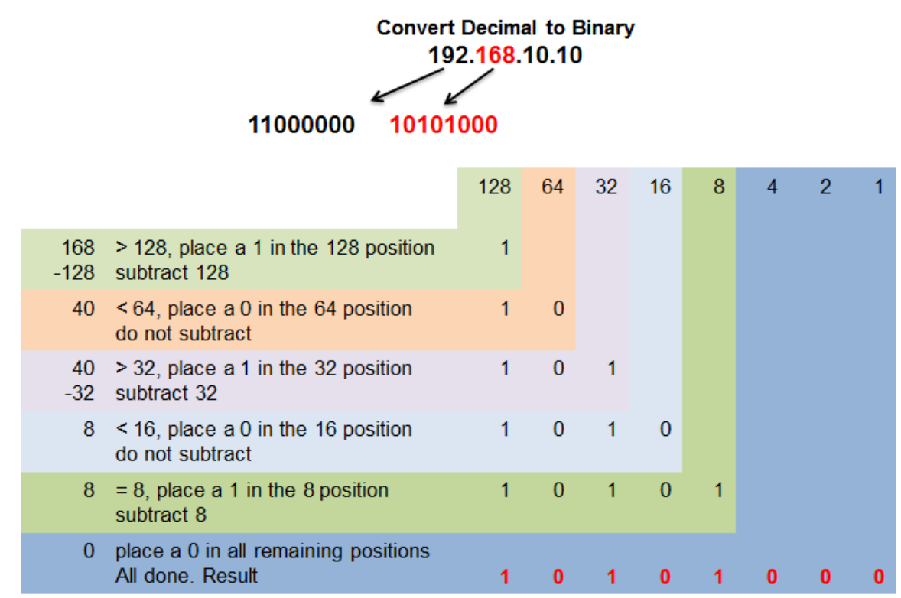
IPv4 Address: Converting Decimal to Binary
192.168.10.10
192
11000000
168
10101000
10
00001010
10
00001010

Slide 20
IPv4 Subnet Mask
A subnet mask is a separate 32-bit pattern used to define the network and host portions of an address.
Shows where the network portion is in the IP.
Subnet mask always has 1s from left to final position of network address. 1s show the location of netawork portion
192
11000000
168
10101000
10
00001010
10
00001010
IPv4 address
255
11111111
255
11111111
255
11111111
0
00000000
Subnet Mask
192
11000000
168
10101000
10
00001010
0
00000000
Network address

Slide 21
IPv4 Address: Subnet Mask – bitwise AND operation
192
11000000
168
10101000
10
00001010
10
00001010
IPv4 address
255
11111111
255
11111111
255
11111111
0
00000000
Subnet Mask
192
11000000
168
10101000
10
00001010
0
00000000
Network address
1 AND 1 = 1
0 AND 1 = 0
0 AND 0 = 0
1 AND 0 = 0

Slide 22
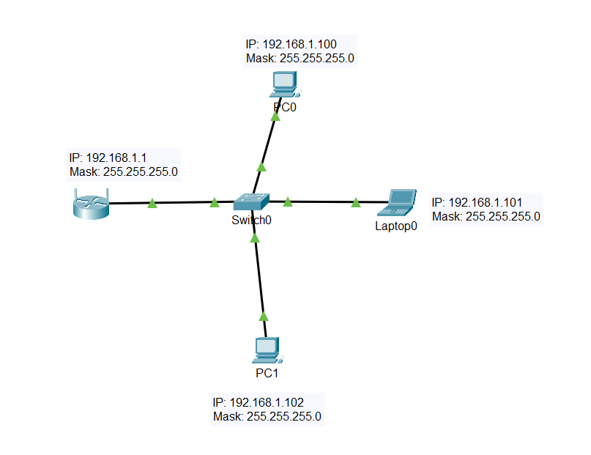
IP Addressing: Network, Host, Broadcast
Network address (host portion all 0s) – Network
In opposite example, 192.168.1.0
Broadcast address (host portion all 1s)
In opposite example, 192.168.1.255
First host address
192.168.1.1
Last host address
192.168.1.254

Slide 23
IP Addressing: Network Address Prefix Length
Alternative way to identify subnet mask.
Known as “slash notation”
Example:
IP Network Address 10.1.0.0/23
Subnet mask is : 255.255.254.0 (11111111.11111111.11111110.00000000)
10.1.0.0 00001010.00000001.00000000.00000000 (network address)
10.1.0.1 00001010.00000001.00000000.00000001 (first host)
10.1.1.254 00001010.00000001.00000001.11111110 (last host)
10.1.1.255 00001010.00000001.00000001.11111111 (broadcast)
Max Number of hosts: 2⁹ –2 = 510 hosts
/23 indicates number of bits "borrowed" for network address
Max number of hosts = 2^{b}-2 where b is the number of bits used for the HOST portion of the IP Address. (take away 2 as you CANNOT use network or broadcast address for hosts.

Slide 24
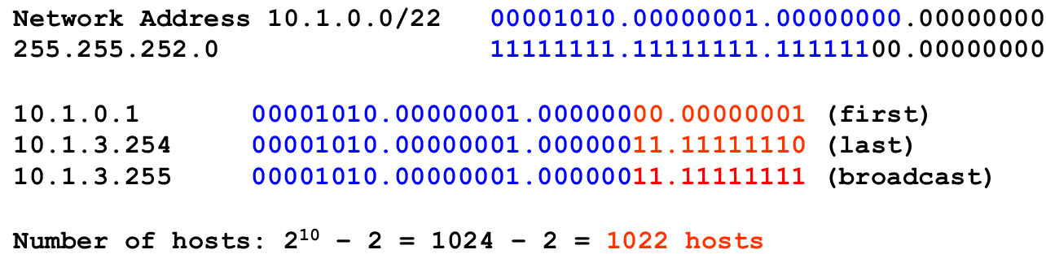
First and Last Host Address

Slide 25
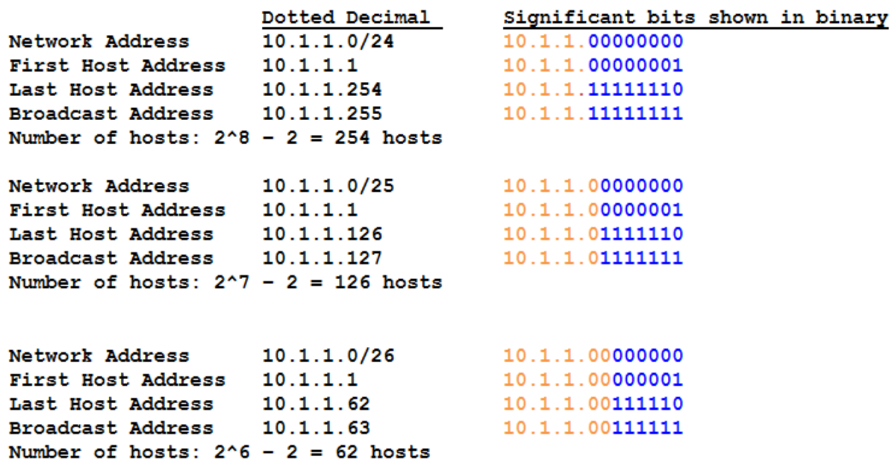
IPv4 Dot Decimal Prefix Notation

Slide 26
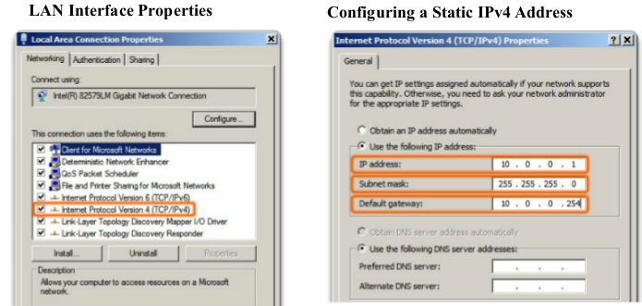
Assigning Static IP to a Host
Windows example

Slide 27
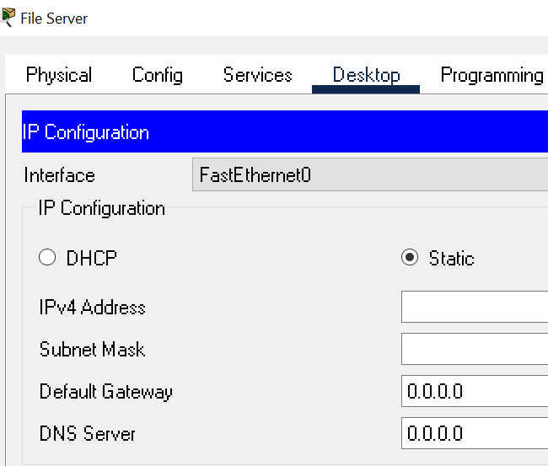
Assigning Static IP to a Host
Packet Tracer

Slide 28

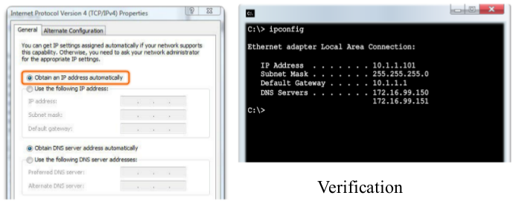
Assigning a Dynamic IP address
DHCP - preferred method of “leasing” IPv4 addresses to hosts on large networks, reduces the burden on network support staff and virtually eliminates entry errors

Slide 29
Routing on a Host
e.g. your computer

Slide 30
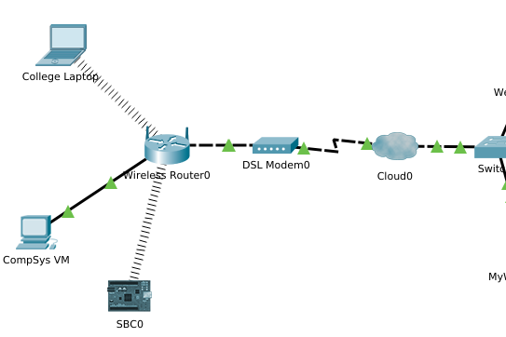
Forwarding: where should it go?
All hosts maintain a Routing Table
The host will send an IP packet to
Itself – loopback address(127.0.0.1)
Local Hosts – Same LAN (part of IP) matching network
Remote Host – On different LAN(different network part of IP)

Slide 31
Forwarding: where should it go?
The Source device determines whether the destination is local or remote using it’s own IP address and subnet mask and destination IP address
Local destination traffic is sent straight out from interface and is handled by Data-Link/layer 2 devices
Remote traffic is forwarded to Default Gateway
The Defaut Gateway will:
Have an IP address on LAN
Accept and route to other networks.
Last Resort Route: if no other route matches
Notes:
Source device determines whether the destination is local or remote using it’s own IP address and subnet mask and destination IP address
Local destination traffic is sent straight out from interface and is handled by Data-Link/layer 2 devices
Remote traffic is forwarded to Default Gateway

Slide 32
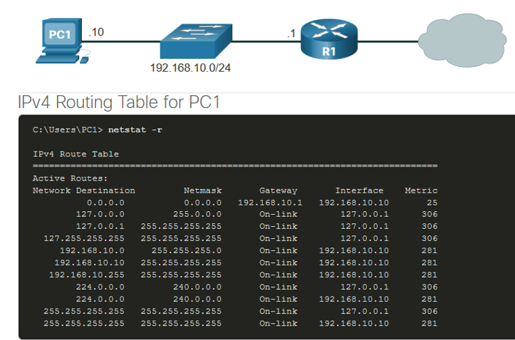


Host Routing Table
route print, route or netstat -r will display the host routing table
IP Address: 192.168.10.10
IP Address: 192.168.10.1
Network Address
Default Gateway

Slide 33
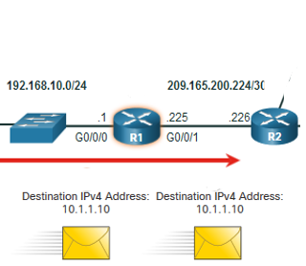
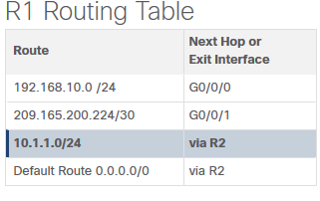
Routers – Packet Forwarding
On receiving frame from host device
Decapsulates/extracts IP Packet from Ethernet Frame
Gets IP destination address
Searches Routing table for best match and finds “next hop”
Encapsulates IP packet back into Ethernet/Data Link Frame
Forwards on to next hop device

Slide 34
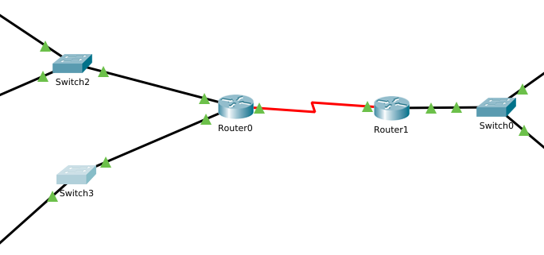
IP Routing Table
Routing tables can contain:
Directly Connected routes: active interfaces automatically added by router
Remote: Not directly connected but entry made either manually (static route) or Dynamically(routing protocol)
Default Route: where to send traffic if no other match found.

Slide 35
Static/Dynamic Routing
Static routes are configured manually
Must be Updated if topology changes
Fine for small, non- redundant networks
Combined with routing protocols for defining default routes.
Dynamic Routing can:
Discover remote networks
Exchange routing info with other routers
Choose the best path to the destination
Handle topology changes, dropped links.

Slide 36
IP Addressing: Types

Slide 37
IP Addressing: Address Types
Public IPv4 addresses are globally routed between internet service provider (ISP) routers.
Private addresses are common blocks of addresses used by most organisations to assign IPv4 addresses to internal hosts.
Not unique
Not routed globally
Network | Range (RFC 1918)
10.0.0.0/8 | 10.0.0.0-10.255.255.255
172.2.16.0.0/12 | 172.16.0.0 – 172.31.255.255
192.168.0.0/16 | 192.168.0.0-192.168.255.255

Slide 38
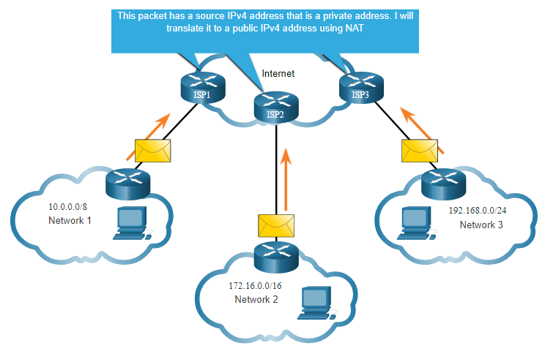
IP Addressing: NAT
Network Address Translation (NAT) translates private IPv4 addresses to public IPv4 addresses.
NAT usually on router connected to internet(it’s on your home router)
Translates between private and public global IP addresses.

Slide 39
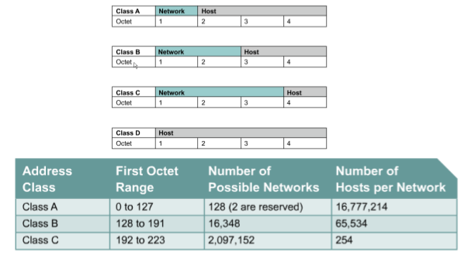
IP Addressing: History
RFC 790 (1981) allocated IPv4 addresses in classes
But no medium size networks
Class A/B addresses depleted quickly
Lots of wasted addresses
REPLACED BY CLASSLESS ADDRESSING

Slide 40
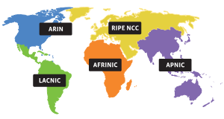
IP Address Assignment
IANA (Internet Assigned Numbers Authority )responsible for global coordination of the Internet Protocol addressing systems. Regional-based and hierarchical...

