Slide 1
IoT Platforms
Frank Walsh

Slide 2
What are IoT platforms
IoT applications combine sensors, devices, data, analytics and integrations in a seamless and unified way
e.g. your project!
IoT Platforms provide software tools and components to:
connect sensors, devices, and data networks
Analyse and store data
Integrate with other apps
So what? We know the tech for that now (I2C, SPI, BLE, MQTT, Python...)
Main selling point of an IoT platform is software that it
accelerates the IoT development process
Focuses on IoT: brings in best of breed features
Provides initial scaffolding for IoT projects

Slide 3
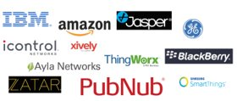
What are IoT Platform
Many(not all) are cloud-based platforms that require subscription
Provide device/language agnostic set of Software Development kits
Arduino/RPi/beagleboard
IoT development is generally iterative:
Starts with initial simple use case
Once operational, data/insights result in new usecased
IoT platforms should promote scalable, iterative development
Allow for quick app development
Ability to adapt/optimise apps quickly

Slide 4
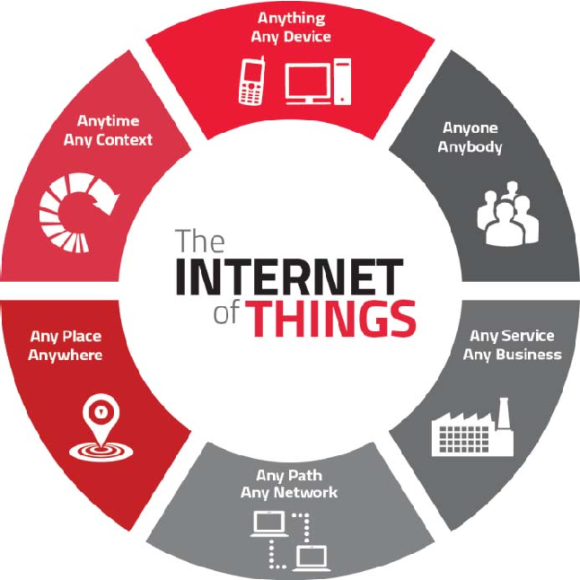
IoT Platform Characteristics
Manage many concurrent device connections
Connectivity across several connection types
"Off-the-peg" IoT protocol stack
Manage/analyse/visualise data
Integrations to other services/apps
App Development

Slide 5

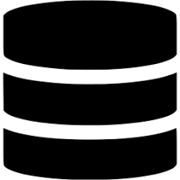






IoT Platform – general architecture
Configure analytics/visuals/apps
Data/commands
IoT Platform
Deploy algorithms to devices

Slide 6
IoT Platform Advantages
Use sofware component that has been pre-built and pre-tested. This increases the reliability of your application and reduces development effort.
IoT frameworks constantly evolve, providing new features, integrations etc.
Encourages better "design pattern" for your IoT app.
Predefined APIs and docs
Great for collaboration
"Baked-in" standards and features:
Security, authentication, scalability...

Slide 7

Which one?
Connectivity
Does the platform provide suitable capability and integrations (WiFi/Cellular/LPWan-Sigfox)
Maturity
In business for long? Critical mass in developer community?
Free
Is there a free tier (handy for evaluation)?
Service type
Platforms try to distinguish themselves – what specialisms/USP does it have?
Security
What security model do they use? Is there security issues reported in past?
Geographic area
Does it operate well at your location (can you select edges/data centres)

Slide 8

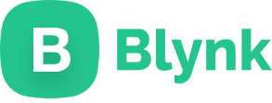
Examples:

Slide 9
Mobile Device IoT using Blynk
Frank Walsh

Slide 10
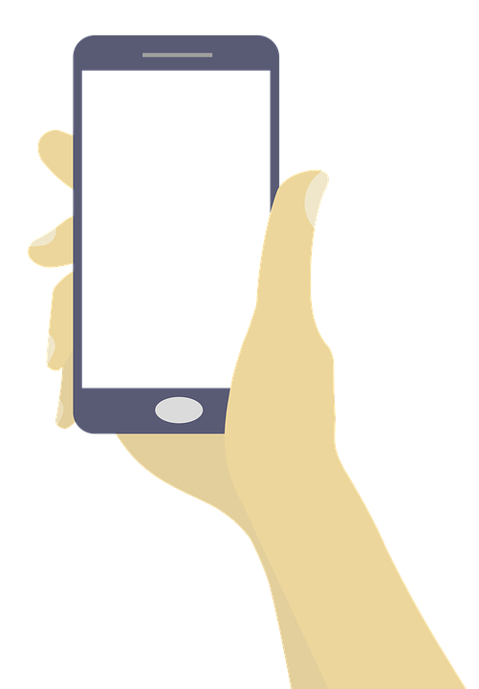
Mobile Devices and IoT
Critical component of many IoT solutions is the mobile phone/tablet.
IOS/Android dominate
>2.6 billion users worldwide
Simple, mobile connection to the internet
Provides nice features for IoT apps
Packed with sensors (Location, accelerometer, camera)
Can connect/interlink other smart devices using Bluetooth, BLE, etc.

Slide 11
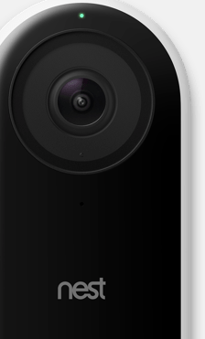
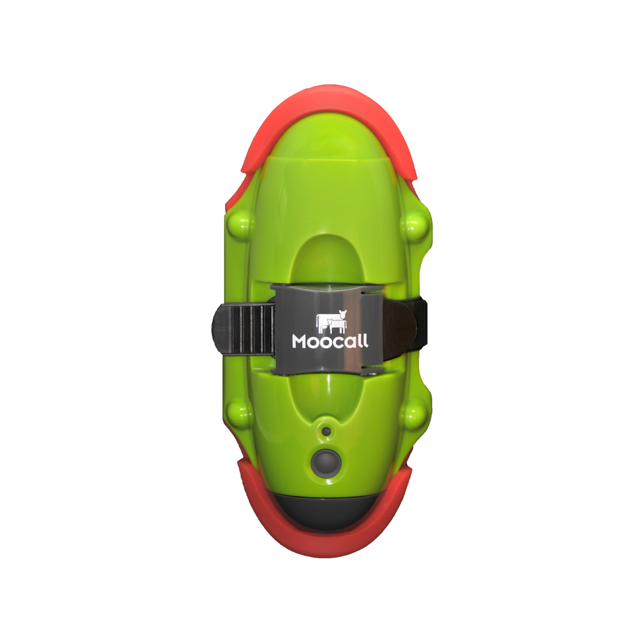
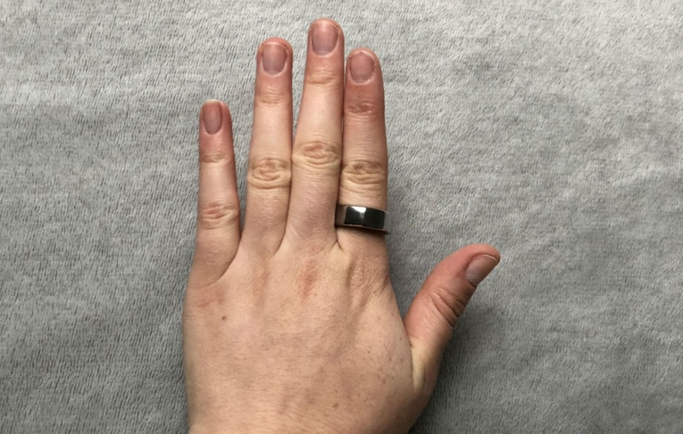
Mobile Apps in IoT, Examples
Wearables
wristwatches, eyeglasses and rings
Healthcare
Medical sensors obtain health data and transfer to a mobile app.
This data can be transferred remotely to doctor/ family members
SmartHome
Nest – see who’s at the door...
AgriTech
MooCall

Slide 12
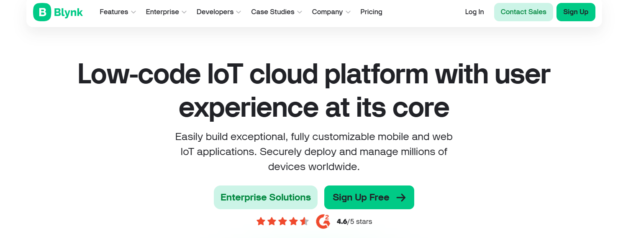

Slide 13

What's Blynk
Yet Another IoT Platform
Specialism: mobile application builder
"Blynk is a full suite of software required to prototype, deploy, and remotely manage connected electronic devices at any scale: from personal IoT projects to millions of commercial connected products."

Slide 14
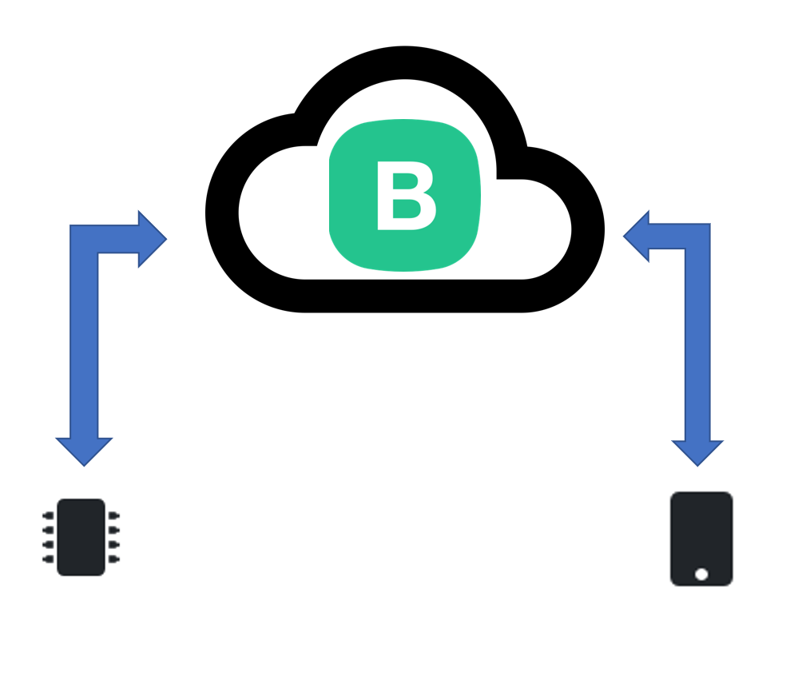


Platform Overview
4 Compnents
Blink.Cloud
Blynk.App
Blynk.Console
Blynk.Edgent (Device Libraries)

Slide 15
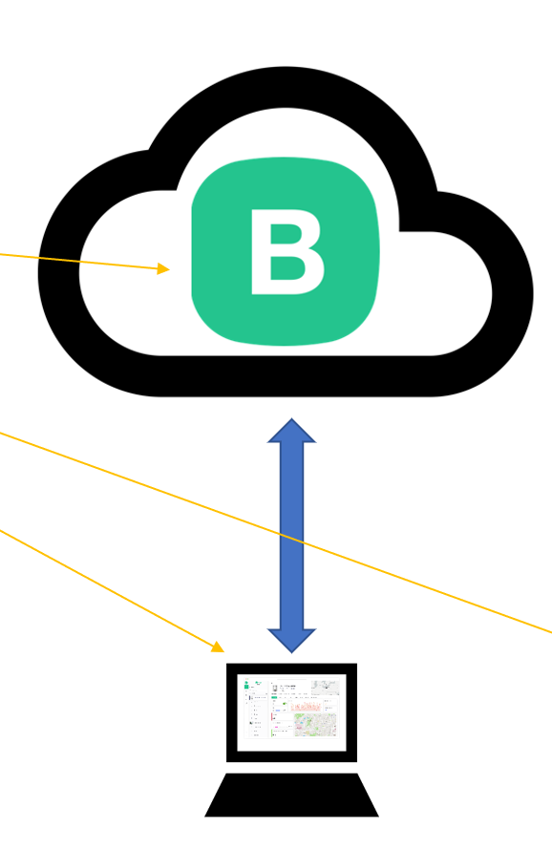
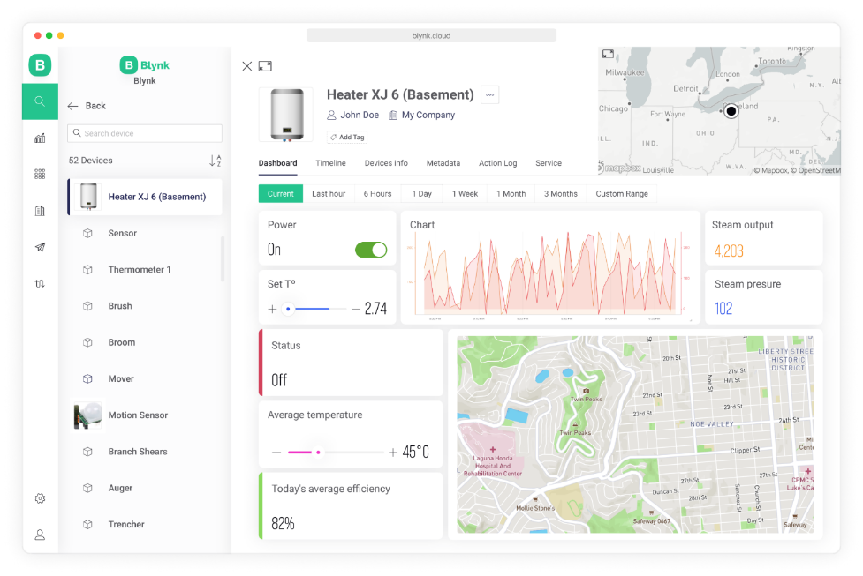
Blynk.Console
Blynk.Console is a feature-rich web application
Register with Blynk to gain access
Use it to:
Configuration of how connected devices work on the platform + application settings.
Management of devices, their data, users, organizations and locations
Remote monitoring and control of devices

Slide 16
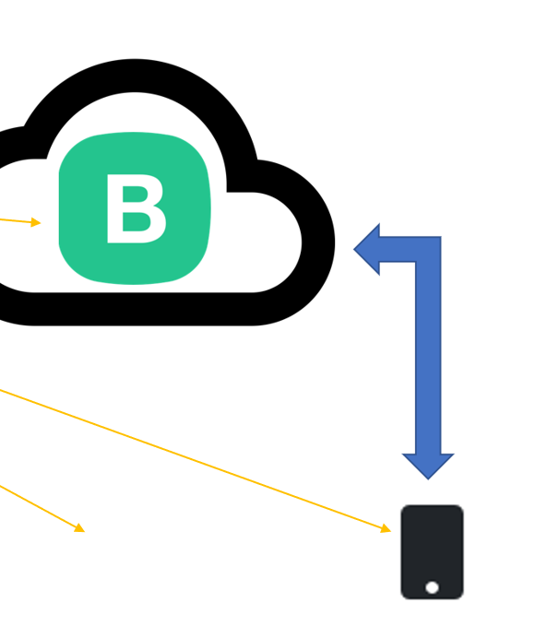
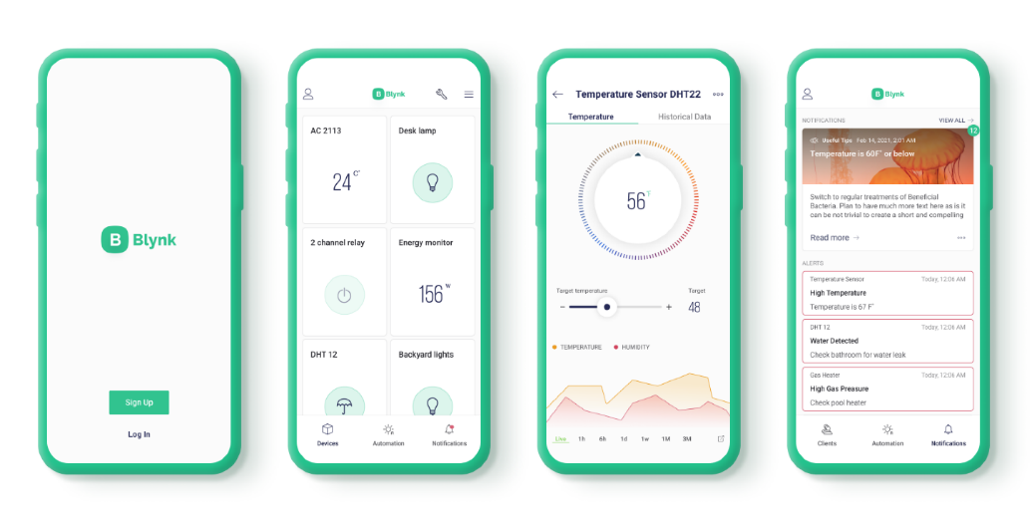
Blynk App
Blynk App is a multi-functional native iOS and Android mobile application
Use it to:
Remote monitoring and control of connected devices that work with Blynk platform
Configuration of mobile UI during prototyping and production stages
Automate work of connected devices
Allows you to create mobile applications using drag and drop
Uses "widgets"
No Code!!!
Don't worry – that comes later

Slide 17
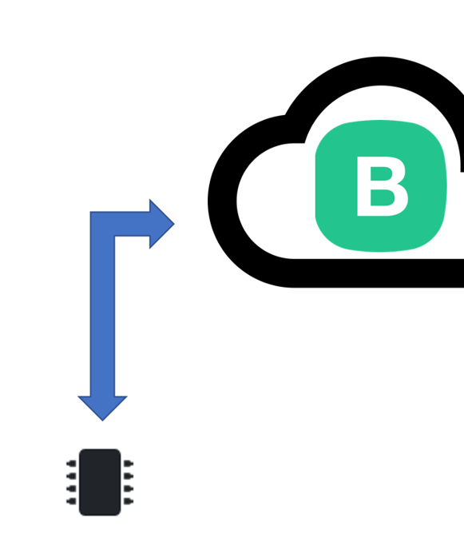
Blynk Library
Lightweight embedded library that runs on over 400 supported hardware models
We’ll use a unsupported python one
Use it to:
bring your device online and authenticating)
Connectivity management (WiFi, Cellular, Ethernet)
Data transfer Over-the-air firmware updates (for selected hardware models)
Available for most popular hardware platforms
RPi, Arduino, ...
Enable communication between the device and cloud API to work with specific Blynk App and Blynk cloud features
Python, Javascript, C++ … on the RPi.

Slide 18
Blynk cloud Platform
Blynk Cloud is a server infrastructure – heart of Blynk IoT platform. Cloud is responsible for binding all the platform components together.
Controls all the communications between the mobile device(e.g. your phone) and hardware (e.g. the RPi)
Remember we talked about the benefits of indirect communication.
It's Cloud-based but you can run your own private Blynk Server
A bit like MQTT...(actually, after peeking at the source code, it uses the same MQTT libraries from the previous lab!)

Slide 19

Benefits
Don’t need to be a mobile app developer
Minimal code
Reasonably mature (around since 2014)
Very quick to create a prototype
If you want, process to publish to App store/Google Play
This Photo by Unknown Author is licensed under CC BY-SA-NC

Slide 20
Features
Similar API & UI for all supported hardware & devices
Connections/ Protocols:
WiFi
Bluetooth and BLE
Ethernet
USB (Serial)
GSM
…
Set of easy-to-use Widgets
Connect device with no code writing
Easy to integrate and add new functionality using virtual pins
History data monitoring via SuperChart widget
Device-to-Device communication using Bridge Widget
Sending emails, tweets, push notifications,

Slide 21
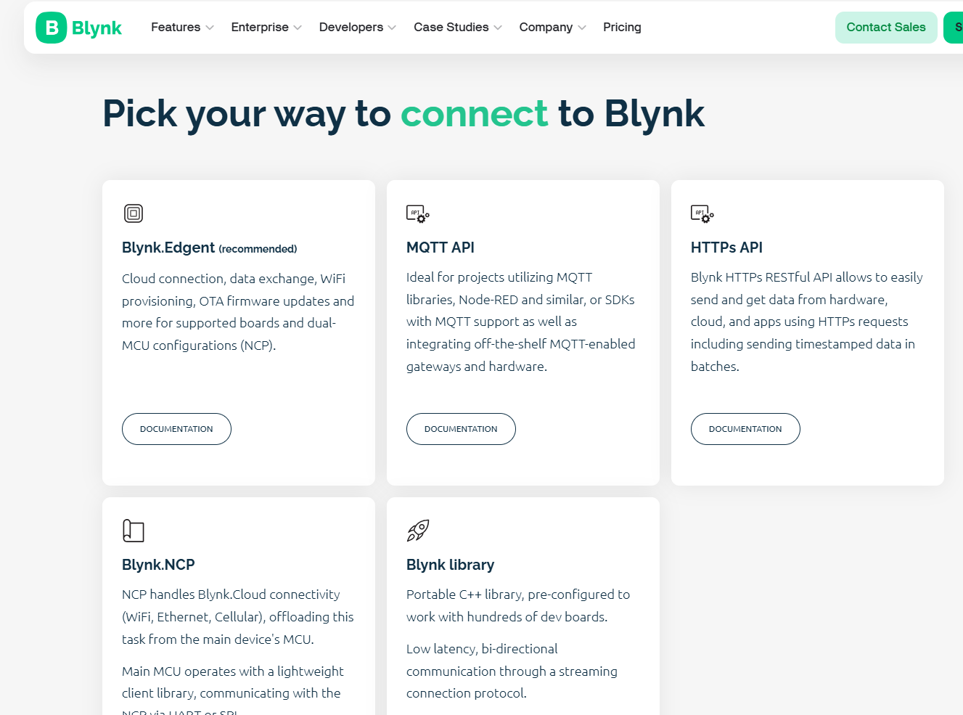

Slide 22
Blynk Concepts
Devices
Templates
Events
Dashboards

Slide 23
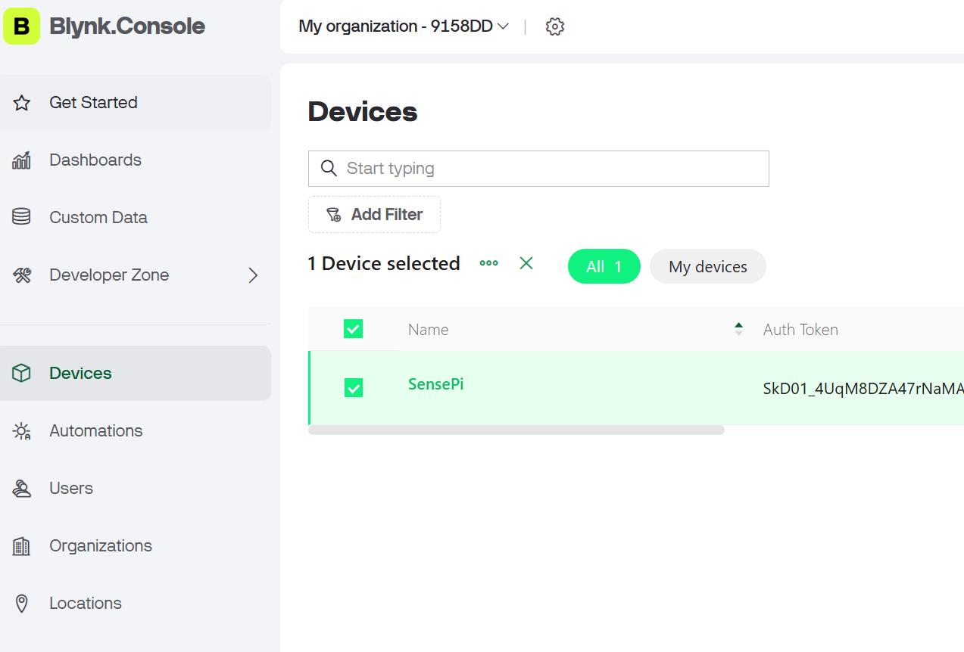
Blynk Concepts: Device
A “device” can be:
A small MicroController based hardware (e.g. Arduino, Raspberry Pi, etc)
A finished physical product like a Smart Air Conditioner, or a virtual service that sends data to Blynk Cloud using REST API.
Each device has an “Authentication Token”. This is a unique identifier generated in Blynk.Cloud
Every device uses a Device Template.

Slide 24
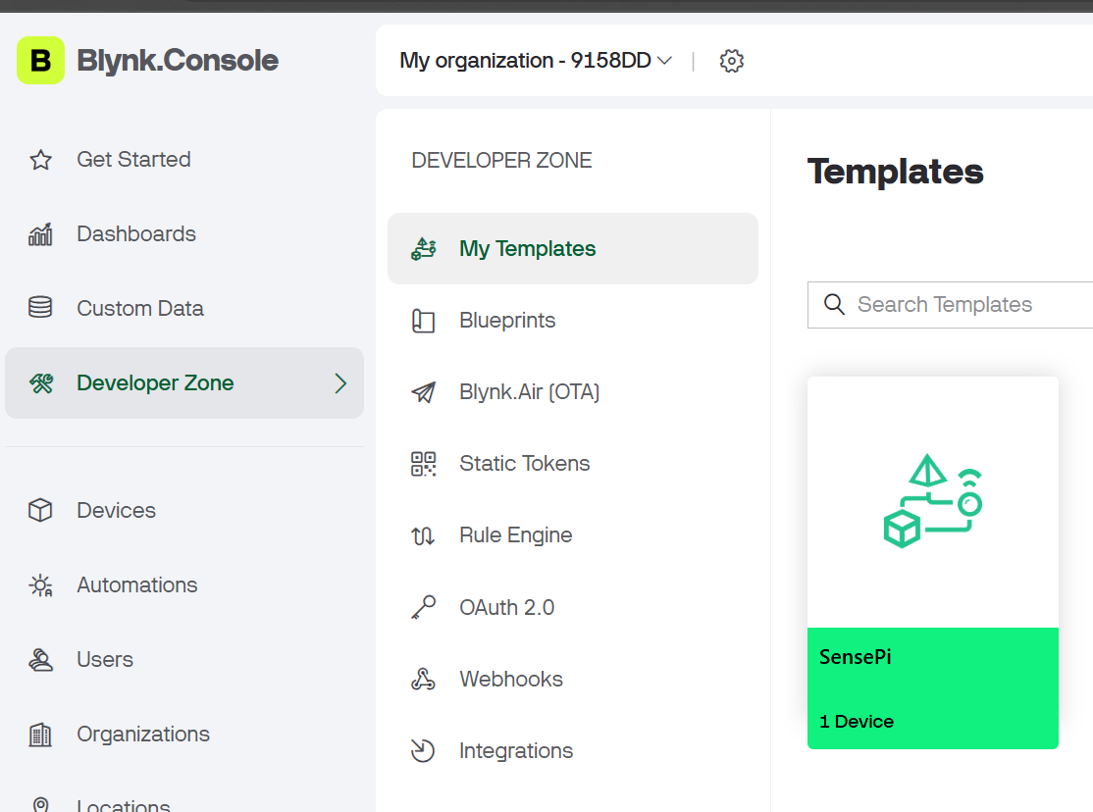
Blynk Concepts: Device Template
A Device Template is a set of configurations used by similar devices.
A device template specifies:
General Settings: general settings of the device(name, ID etc..)
Metadata: Serial Number field, email field to use for email notifications
Datastreams: channels for any data that flows in and out from the device to the cloud. For example sensor data should go through a Datastream. These are also known as “Virtual Pins”.
Events: important events in the life of the device that should be logged and, if needed, used for notifications. Events can be triggered from the device itself or externally using HTTP API
Dashboards: Set of UI elements to visualise data and send commands/data to/from device
There are two dashboards: Web and Mobile

Slide 25
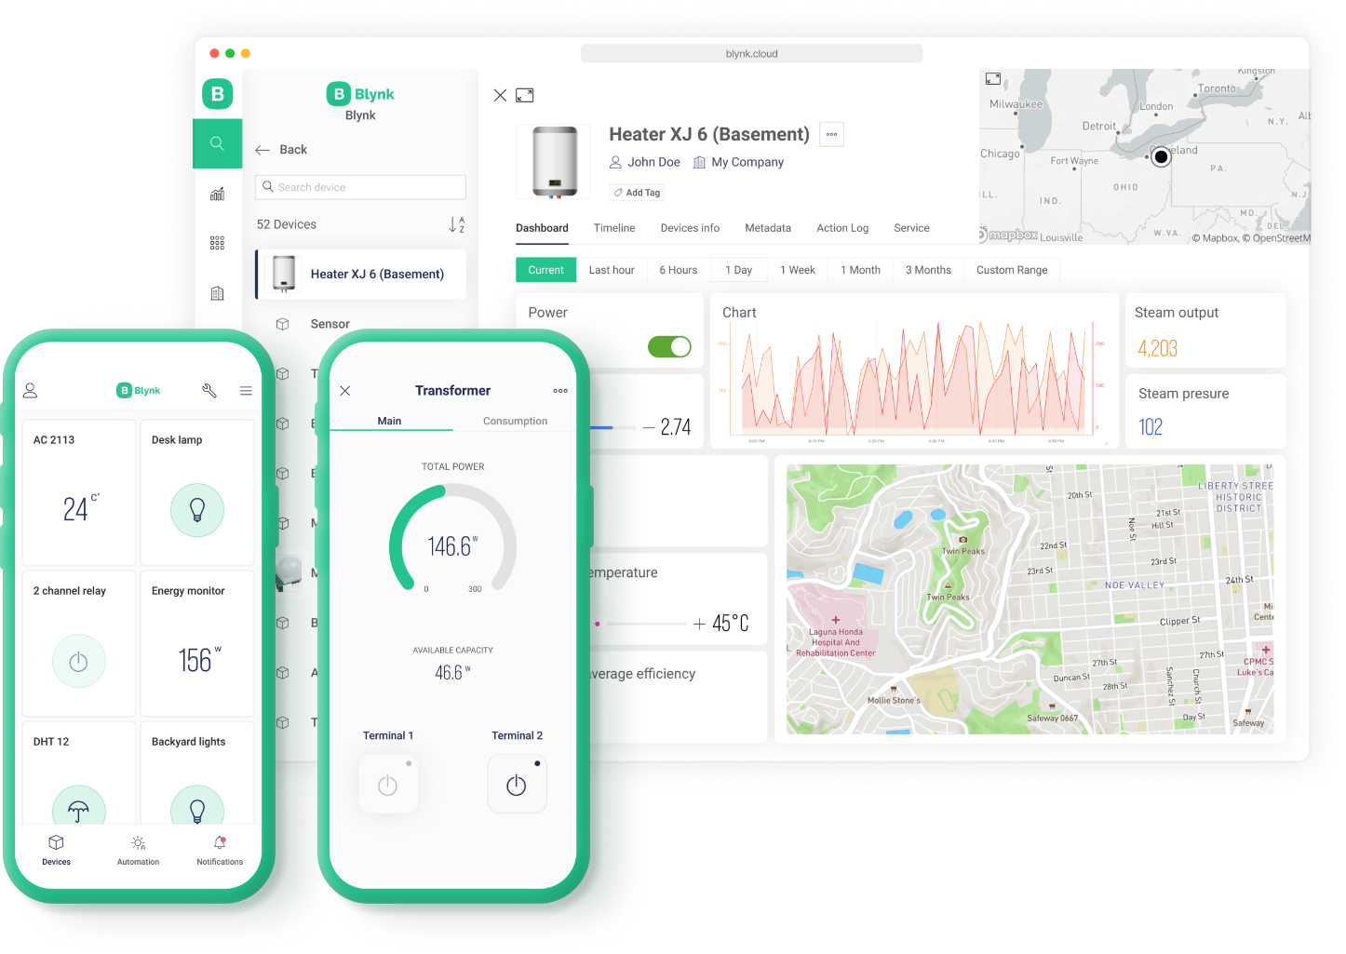

Blynk Concepts: Web Dashboard
a set of UI elements (widgets) to visualize the data from the device accessible for the users in Blynk.Console – a web-based application.

Slide 26

Blynk Concepts: Mobile Dashboard
a set of UI elements (widgets) to visualize the data in Blynk mobile apps for iOS and Android.
Mobile apps also contain a template of how device is represented in the list of devices (tiles)

Slide 27
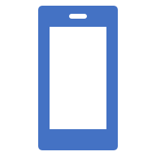
Development Steps
Create an Account with Blynk
Add a Device
Choose your hardware
Create “Template”
This will result in an Authentication Credentials for that Device
Code the Hardware Device(e.g. Rpi) Use the relevant library(e.g. Python Library)
Install Blynk App on Phone
Develop Blynk

Slide 28
Add a Device
Create a new device
Set Notifications:
Specify who gets notifications, which events will trigger notifications, and which channel should be used.
3 options:
E-mail
Push notifications - a push notification is a message that pops up on a mobile device. Users don't have to be in the app to get them
SMS - notification will be delivered as a text message using mobile operator (only available in paid option though…)

Slide 29
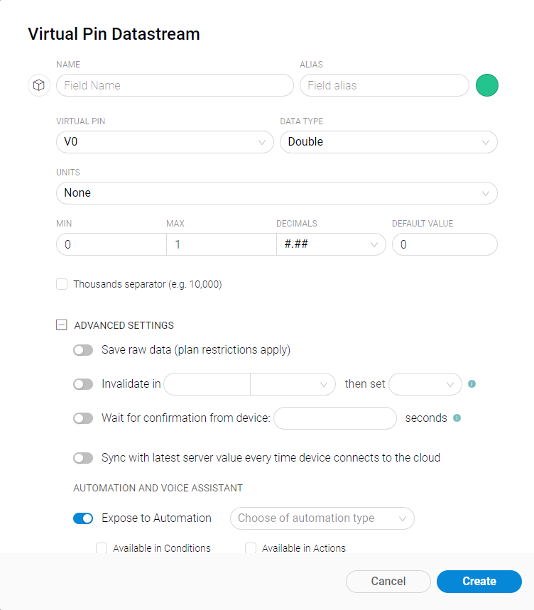
Working with Templates
Datastreams is a way to structure data that regularly flows in an out from device.
Use it for sensor data, any telemetry, or actuators.
Virtual Pin is a concept invented to provide exchange of any data between hardware, web and mobile app.
Virtual pins allow you to interface with any sensor, any library, any actuator.Think about Virtual Pins as a box where you can put any value, and everyone who has access to this box can see this value.
You can set UNITS that will be viewed in the Widget by selecting them from the dropdown menu.
It's a very powerful feature to display and send any data from your hardware to the application.Please make sure you differentiate Virtual Pins from physical GPIO pins on your hardware.

Slide 30
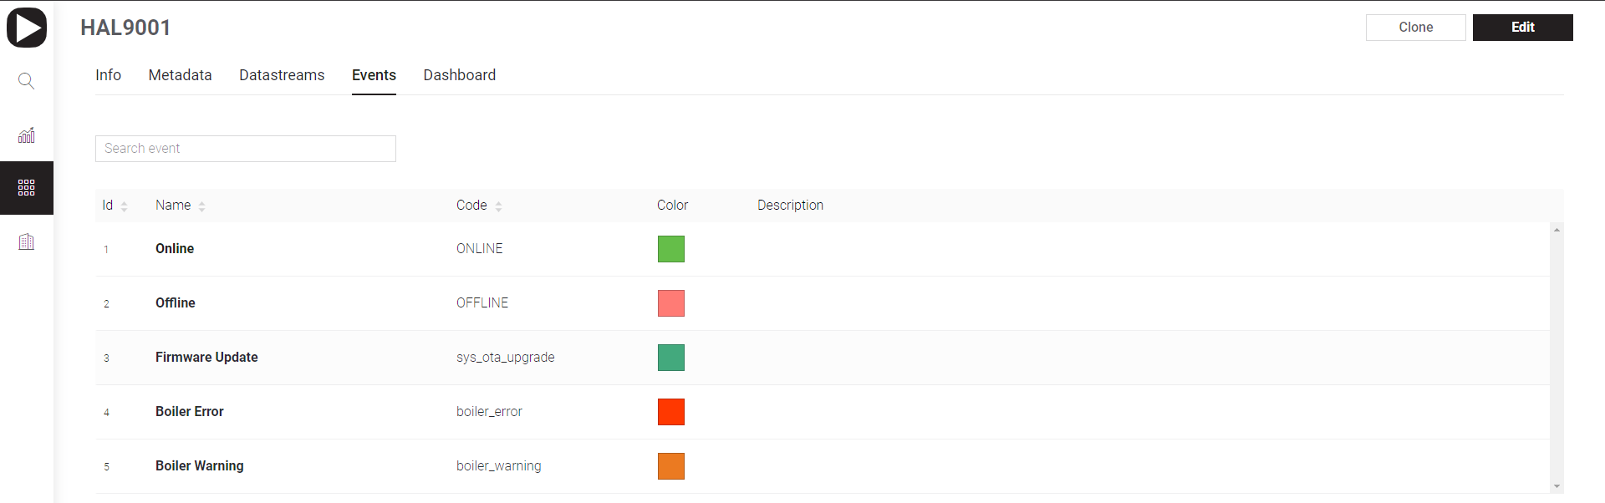
Working with Templates: Events
Events are used to track important events happening on your devices.
Events can trigger notifications which can be
sent over email
delivered as push notifications to user’s phone
SMS
Examples:
log a moment when a temperature reached a certain threshold and send a notification to selected users
You need to log a total working hours of the device. If it approaches or goes beyond a max value, you would need to notify technical support so that they can replace the device

Slide 31
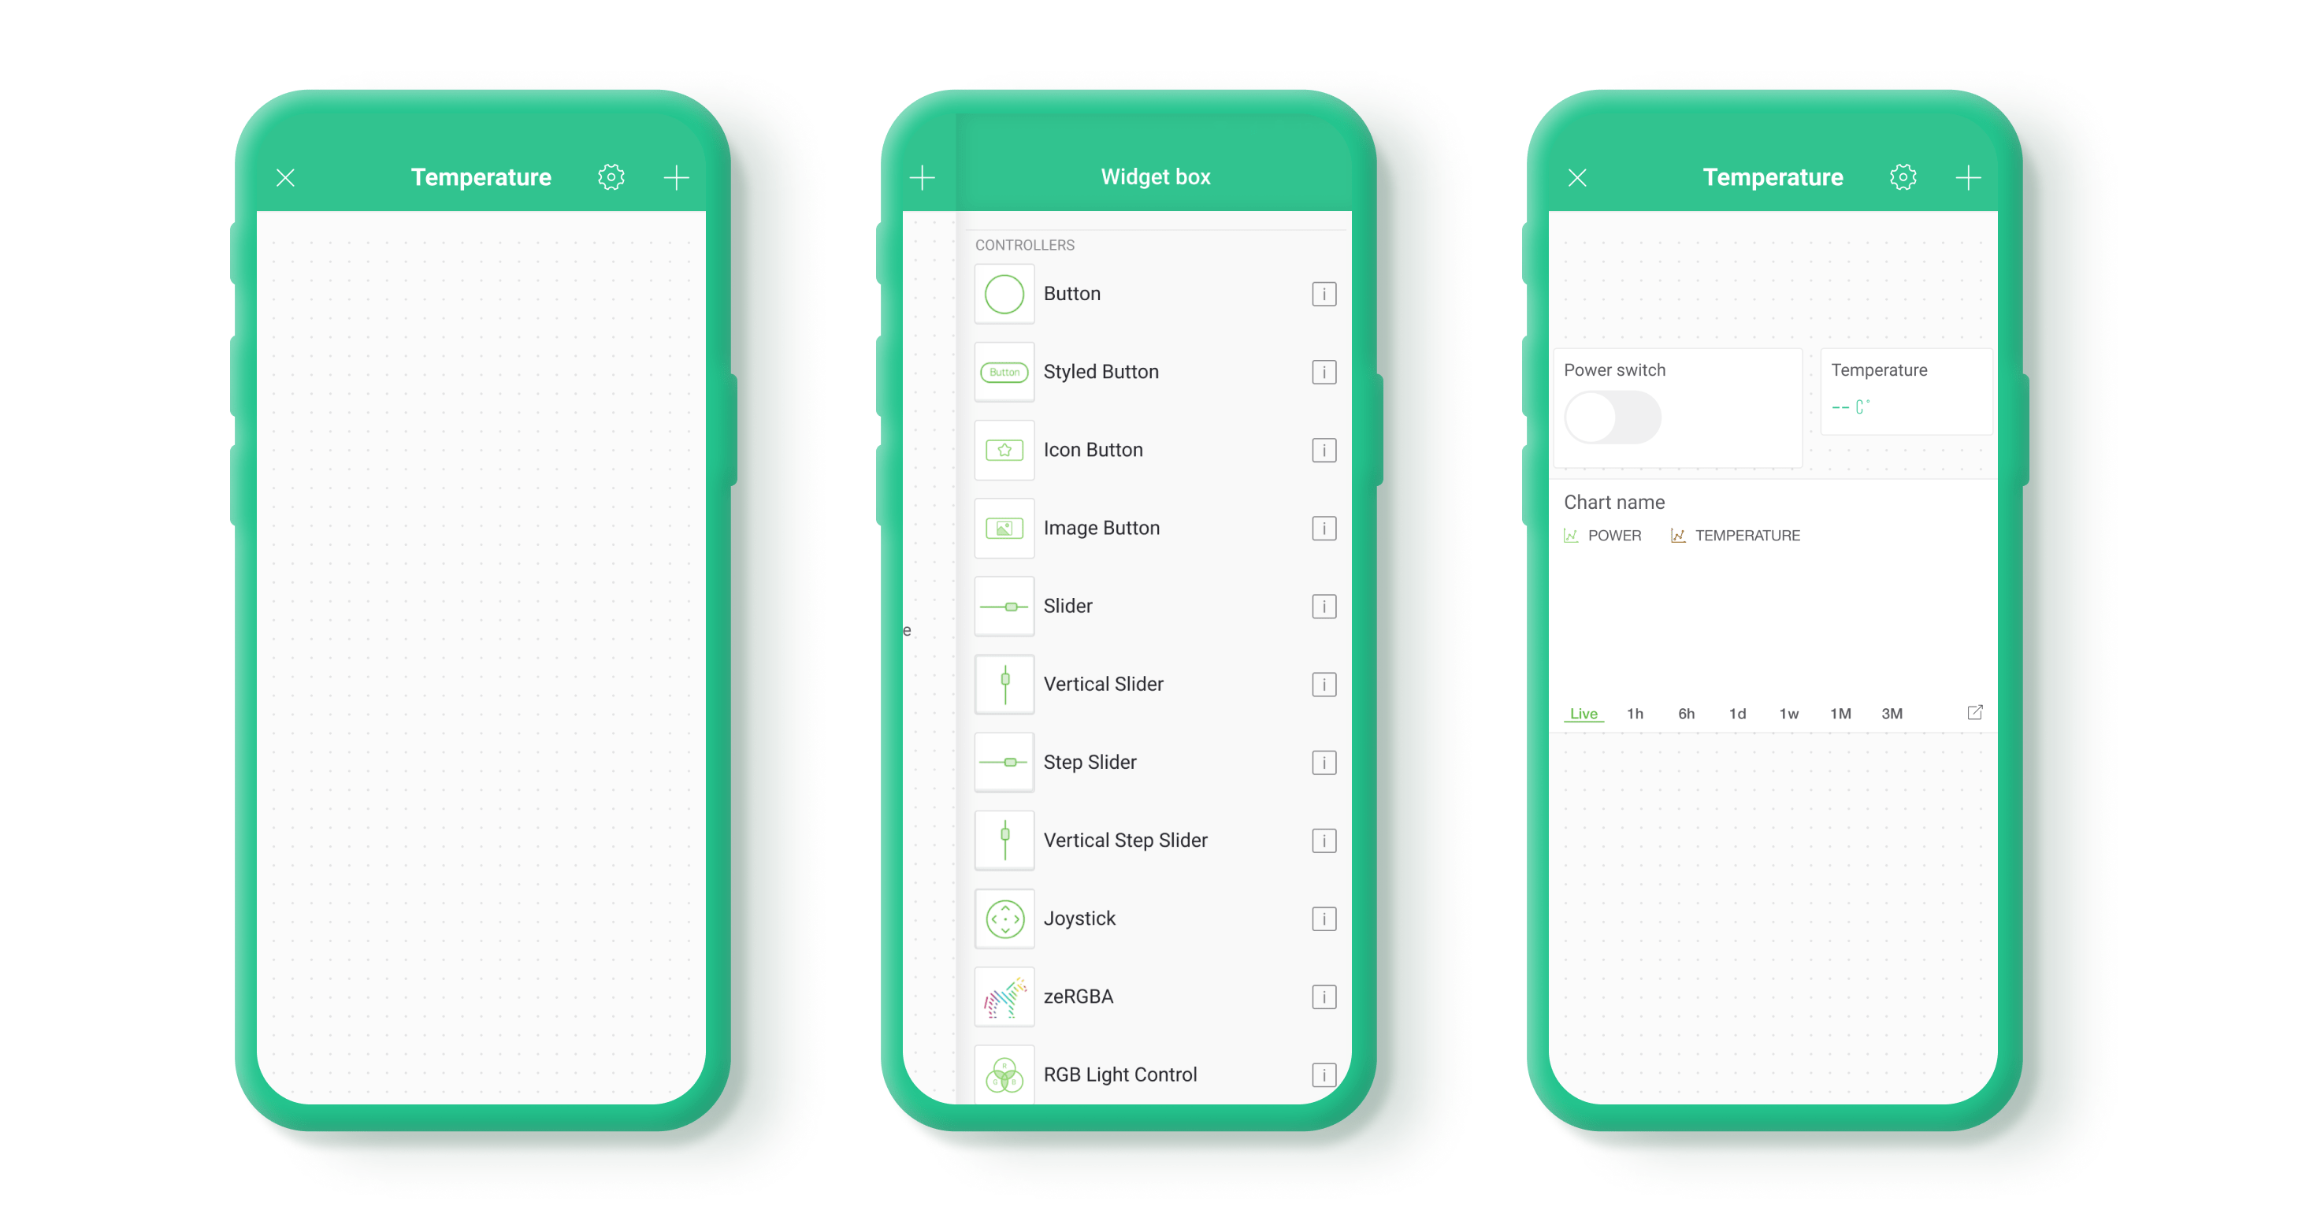

Blynk.Apps
Using the Blynk App, a Mobile Dashboard can be built from Widgets - modular UI elements which can be positioned on the canvas.
To add Widgets to Canvas:
tap anywhere on empty canvas or press PLUS icon in the top right corner of the app.
A Widget Box will open
Find the widget you need and tap on it
Widget will placed in the first empty area required for this widget
Configure Widget.

Slide 32





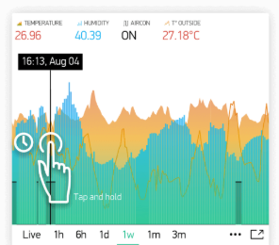

Widgets
Categorised as:
Controllers
Display
Notifications
Interface
Tabs, Menu, Map..

Slide 33
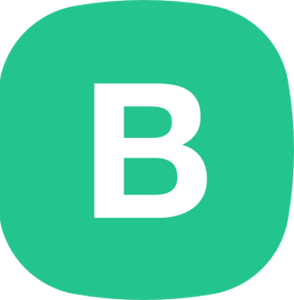
Example
DEMO!!!!!

Slide 34
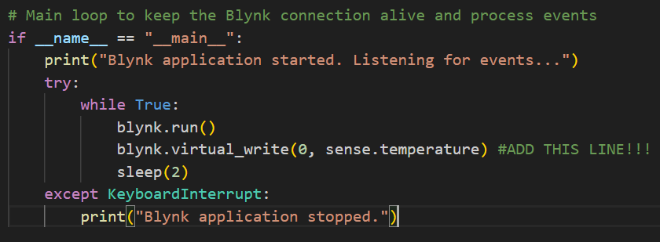
WARNING!!!!
Blynk has gone very commercial
Still has “free tier” but just 200,000 messages allowed
You can burn through that very quickly if you’re not careful
My approach:
Just send messages when you need to
Stop the app immediately on finishing testing

Slide 35
Thingspeak

Slide 36
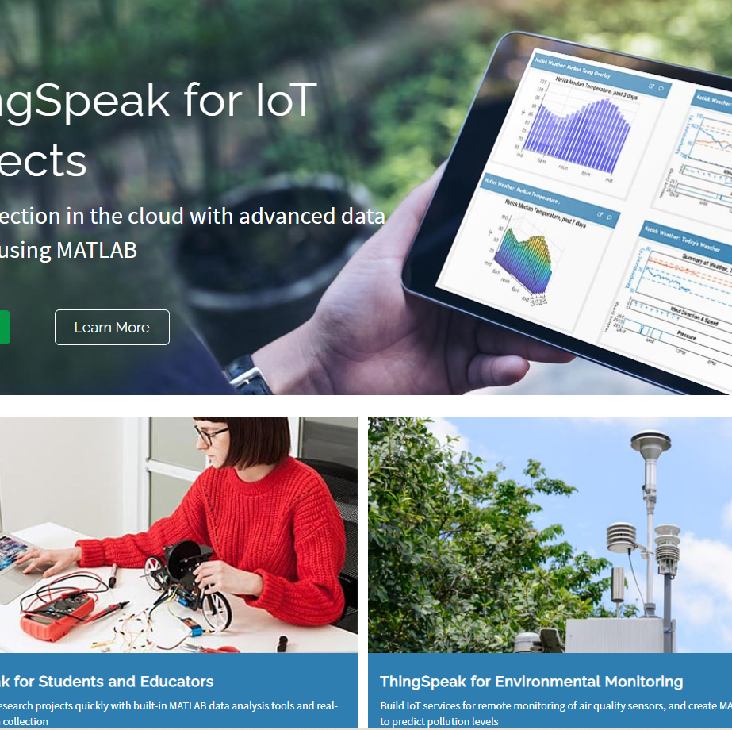
Thingspeak
ThingSpeak is a cloud-based IoT platform to store and retrieve data from devices.
Uses HTTP protocol/Restful APIs
MQTT
"Collect and analyse data quickly and easily"

Slide 37
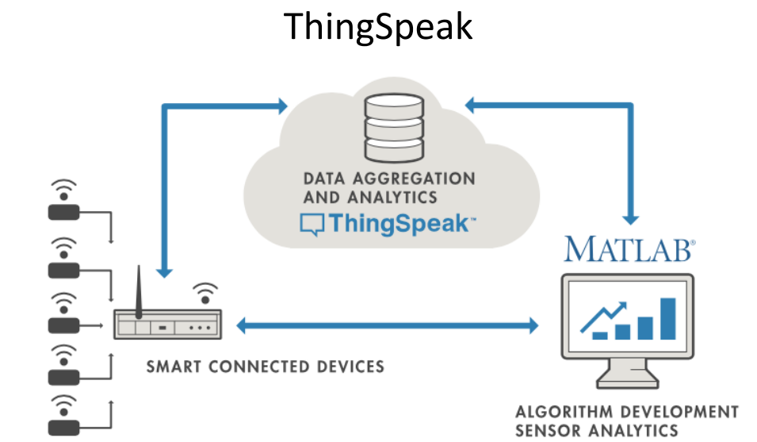
Thingspeak Overview
Account-based
Can create free account online
Brought to you by the people who made Matlab/Simulink
Uses Matlab features/toolboxs
SDKs/librarys for popular languages/devices
Restful API means should work with any device

Slide 38
Thingspeak – basic use
Create a new channel
Test for certain conditions and perform actions
Act on the data
Run analytical algorithms/visualise your data
Analyse the data
Devices write data to channels
Collect data in the channel
Channels collect data

Slide 39
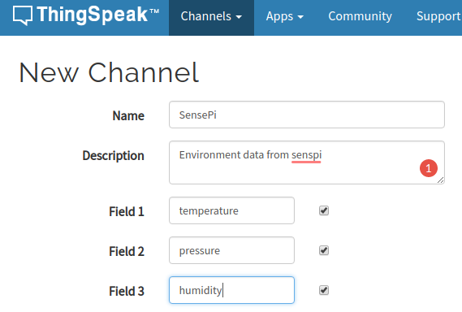
ThingSpeak – Create new channel
Create a new channel to collect data from devices
Define data fields for the channel(max 8)
Can also input location(lat/long) of channel source)

Slide 40
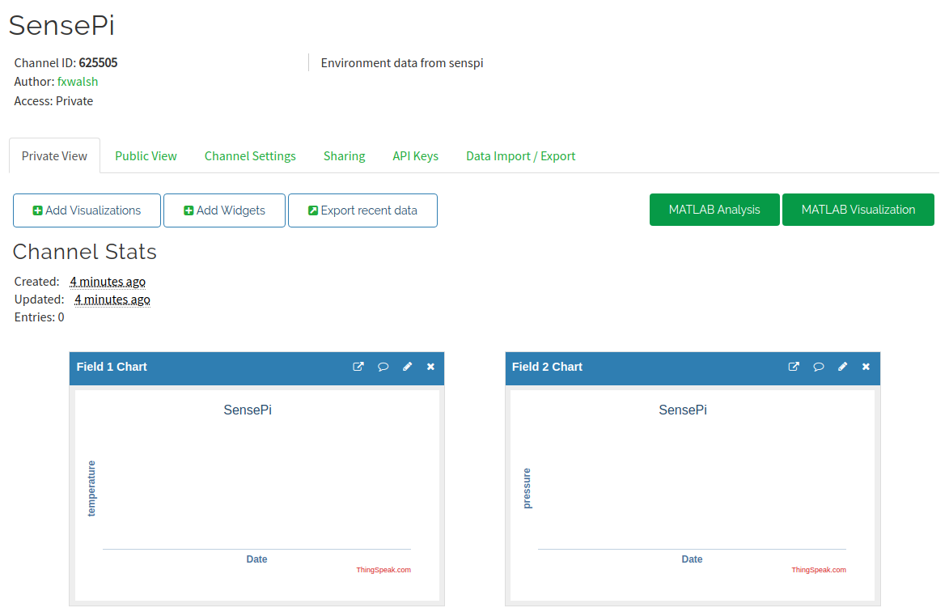
Thingspeak - New channel
Once saved you can access channel page:

Slide 41
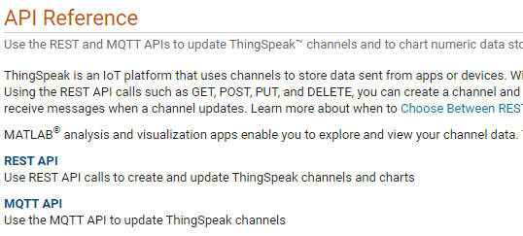
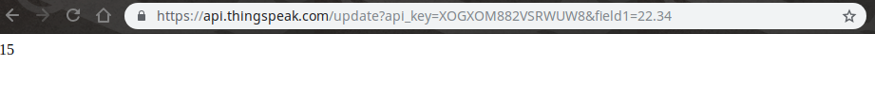
Thingspeak - Add data to channel
Programmatically, many ways!
Construct HTTP GET request and include field values in query string
MQTT (see in Lab)
GET https://api.thingspeak.com/update?api_key=<WRITE-KEY>&field1=12
Using HTTP GET request, can test from a browser:

Slide 42
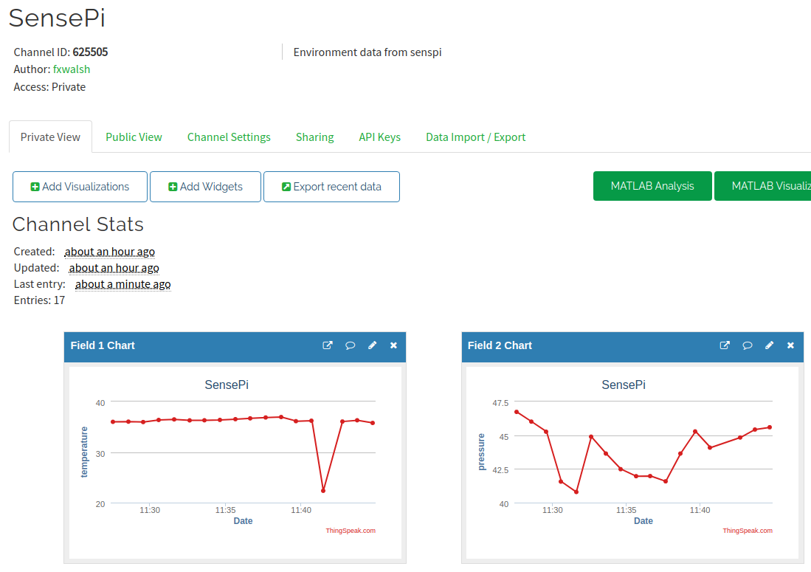
Think Speak – Analyse data
Thingspeak will visualise each field by default in channel view

Slide 43
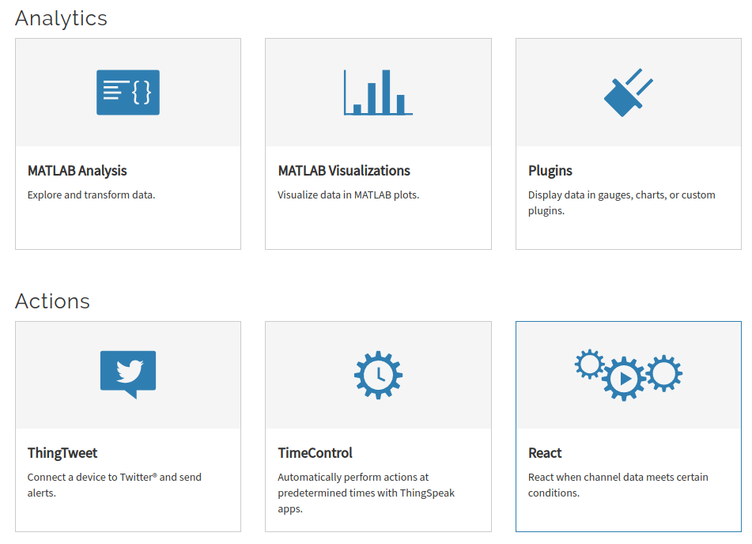
Thingspeak - Apps
The Apps tab provides various mechanism to transform, analyse,visualise and act on data.

Slide 44
ThingSpeak Example: Analysis
Can write Matlab Code to analyse and transform data
Possible uses:
Clean data (remove outliers)
Statistical analysis
Transfomations
Data Fusion
Generally write results to second channel for further analysis/visualisation.

Slide 45
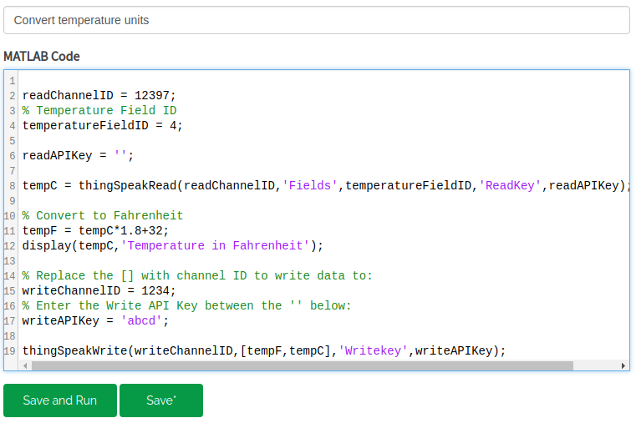
Thinkspeak: Convert Celcius to Fahrenheit

Slide 46
Other Platforms
Ubidots
Amazon Web Services
Microsoft Azure
Evothings

Slide 47
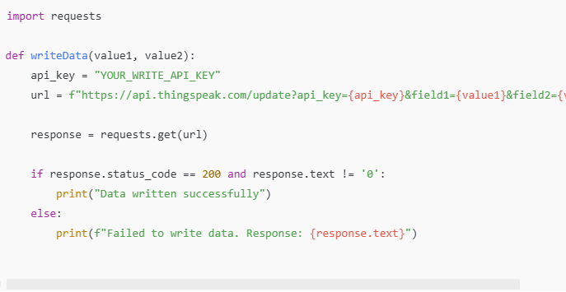
Thingspeak – Add data with HTTP
Make HTTP request from Python:

Slide 48
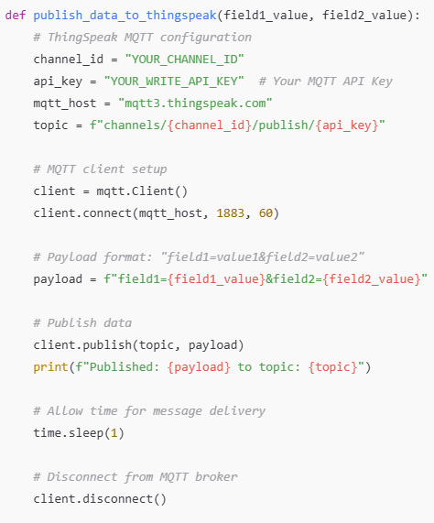
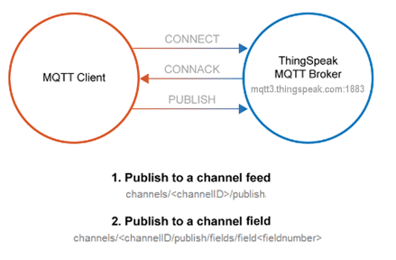
Thingspeak – Add data with MQTT

Slide 49
Which to use: HTTP or MQTT API
HTTP (REST) API
You need to retrieve any historical data, such as data within a defined time range.
You want to Create Channel, Read Settings, Clear Channel, Delete Channel, or Create Chart.
You need a response!
MQTT
Your device is power-constrained, and you want lower battery consumption to send data to ThingSpeak. Also, an MQTT PUBLISH operation is typically faster in this scenario.
Your device connectivity is intermittent, and you have limited bandwidth usage.
You want immediate updates of data posted to a channel.
You want messages pushed to you instead of needing to poll the server for new messages.

