Slide 1
Computer Networks
Frank Walsh

Slide 2

Agenda (1st Part)
Intro
What’s a computer network
Computer Network Components
Device Types
Protocols
Topologies
Internet of Things

Slide 3
Computer System & Networks
TCP/IP Protocol Stack
Link Layer/Ethernet
IP Networks
TCP
Application Layer Protocols
Internet of Things
Physical Computing
Sensing/Acuating
Messaging
IoT Platforms

Slide 4
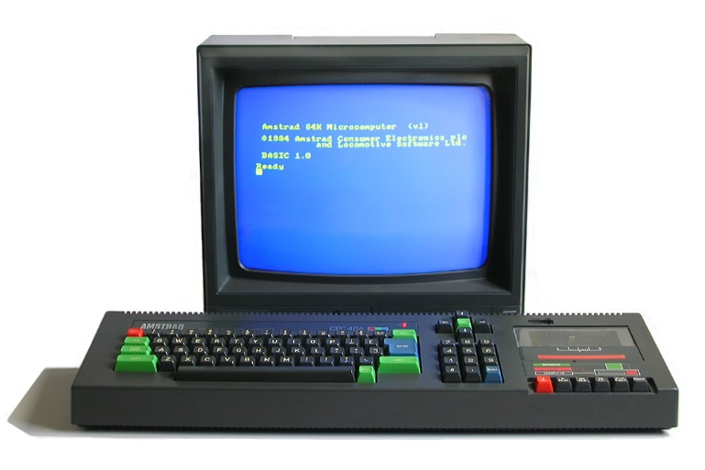
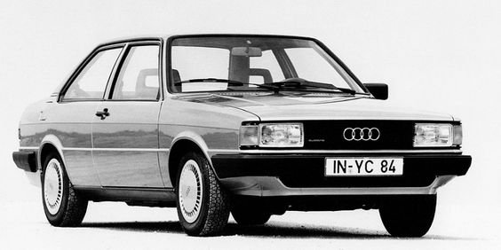
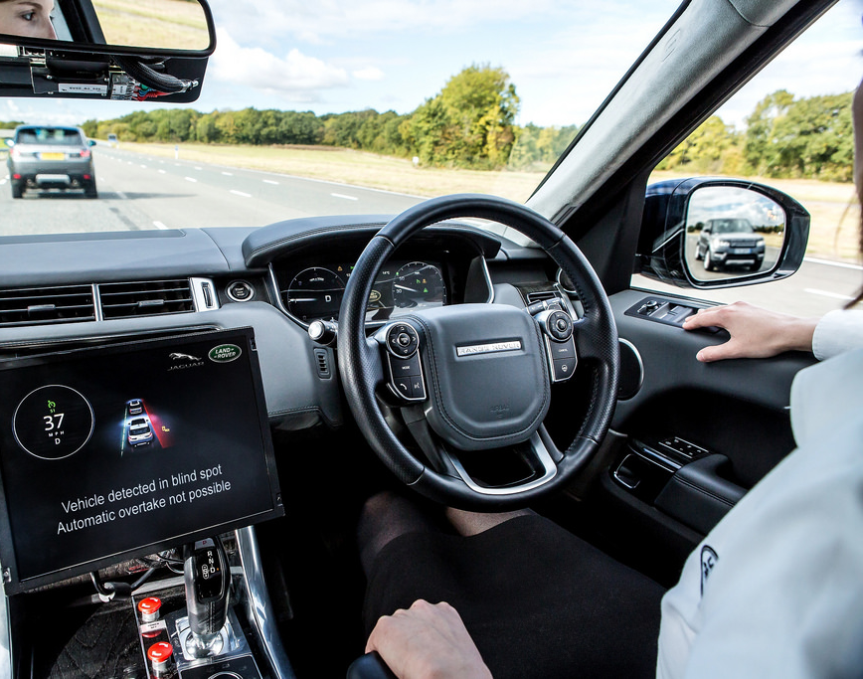
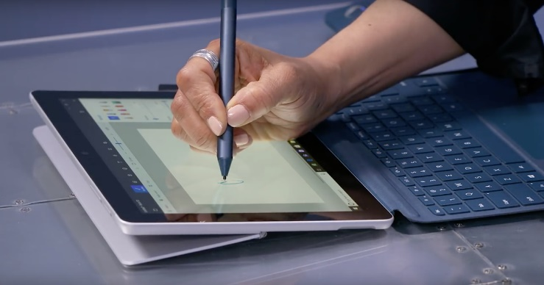
Computer Networks
1984
Devices & Machines are effective/beautiful in isolation...
Connecting machine/ device to a computer network creates amazing possibilities...
Key points:
Computer networks are no longer only used to connect computers
Part of everyday life
“Wired people should know something about wires”
2021
This Photo by Unknown Author is licensed under CC BY-SA
Notes:
Going back a few decades, machines worked in isolation. Cars originally were very electromechanical. Could be thought of as information islands.
Jump forward to today – everything is getting connected, not just computers, but pretty much anything you can think of. Example in modern cars – connect to roadside infrastrure and other cars. Autonamous. Also can react to events (sensors in cars can detect impact/orientation

Slide 5
Intro

Slide 6
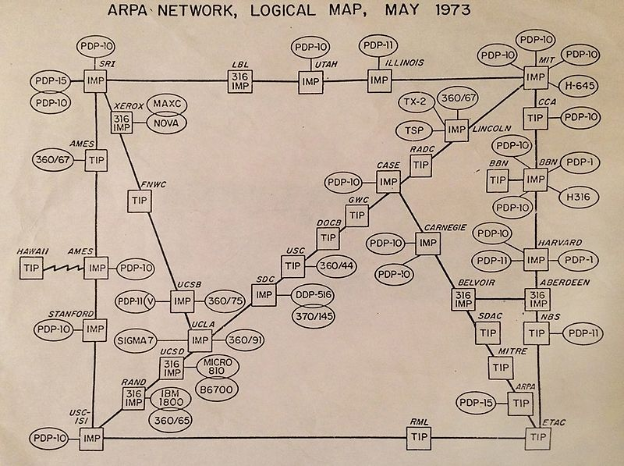
QI: Arpanet
US government responds to launch of Sputnik by setting up ARPA, the Advanced Research Projects Agency
ARPANET created in 1969 connecting computers in UCLA and Stanford
In 1973, it was called the "internetwork" or "internet" for short

Slide 7
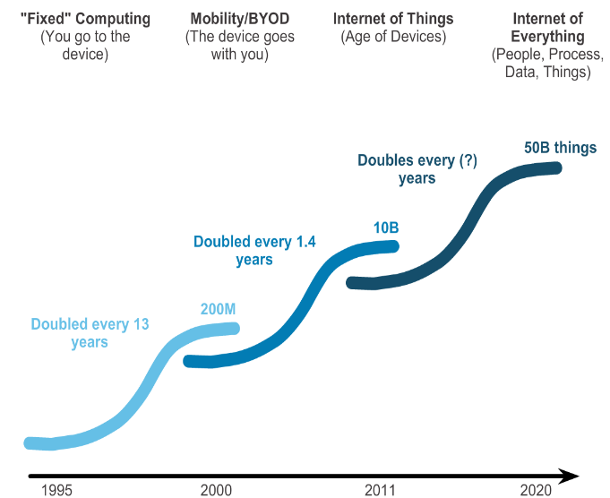
QI: Computer Networks Growth

Slide 8
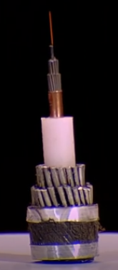

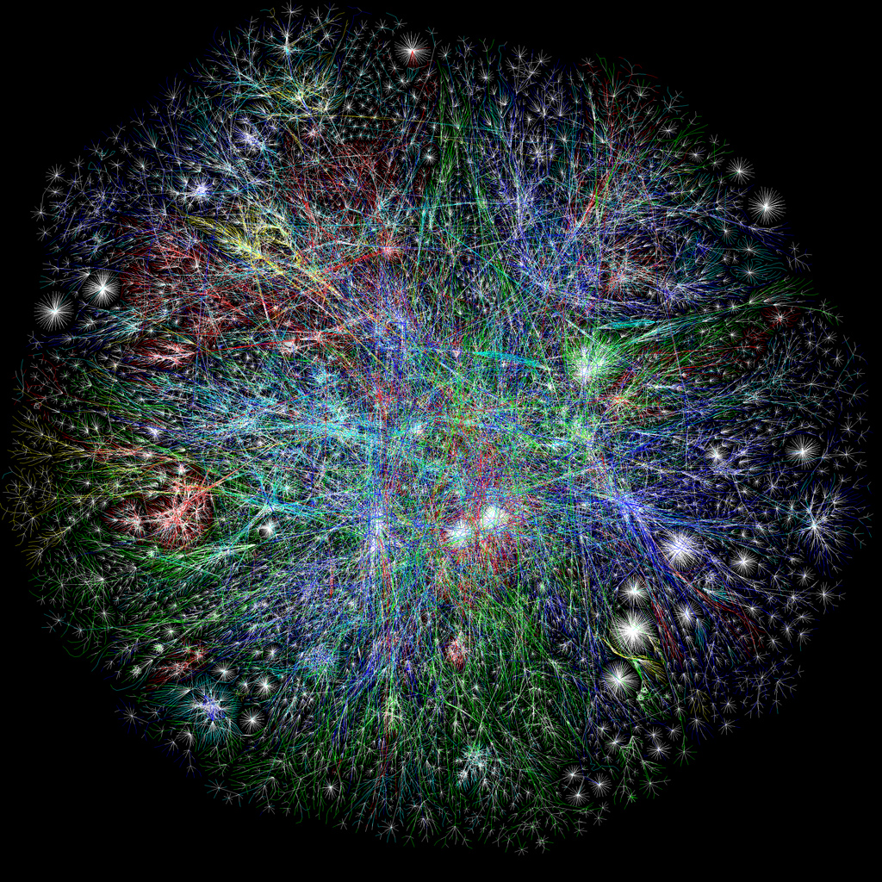

Networks - Under the bonnet
Inherently Physical:
Devices need some form of physical channel to communicate
Devices need specific hardware to use that channel (eg. antenna and associated electronics)

Slide 9

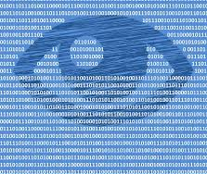
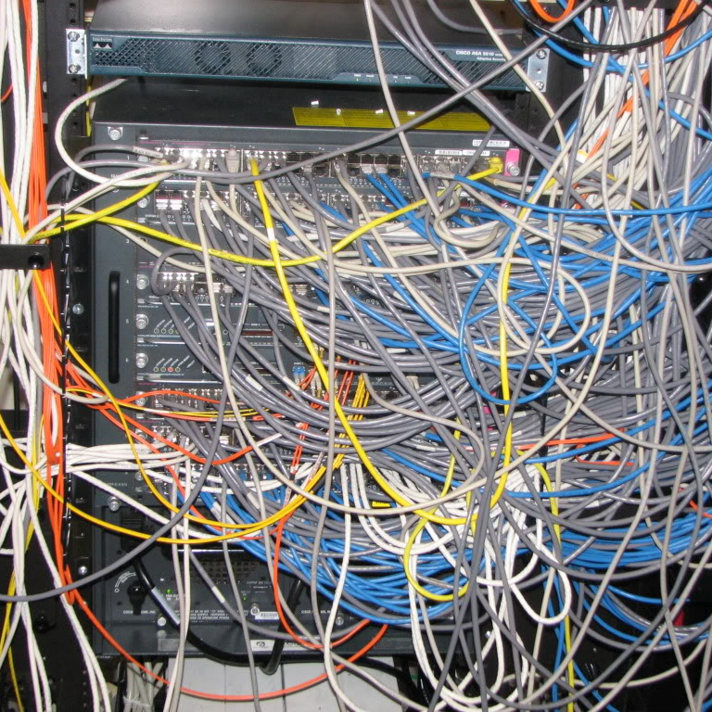
Networks – Under the bonnet
Once connected, it can get complicated!
Sophisticated combination of protocols, software, hardware, algorithms, configurations, policies...
Security, privacy, access, quality of service, wired/wireless...

Slide 10







Infrastructure Devices
Server
End Devices

Slide 11
Components of a Computer Network
Devices
Communicate with one another
Physical Medium
Used to connect devices
Messages
Information travelling over the medium
Rules
Governs how messages flow through a network

Slide 12
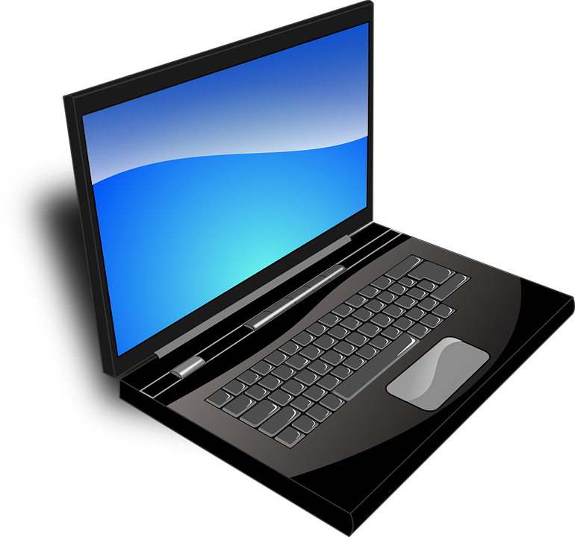

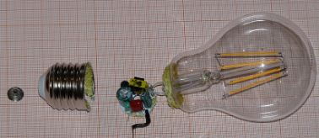
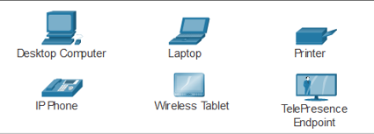
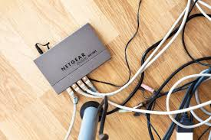
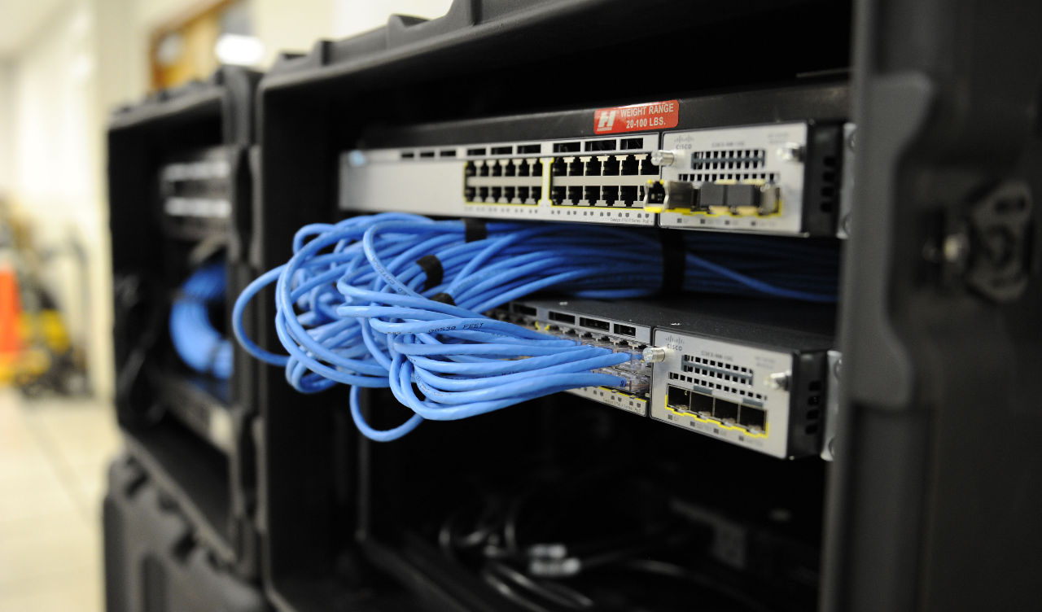
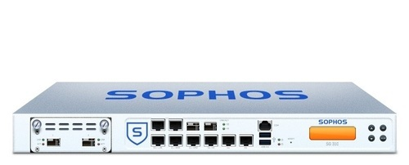

Device Types
End Devices
Infrastructure/intermediary Devices

Slide 13
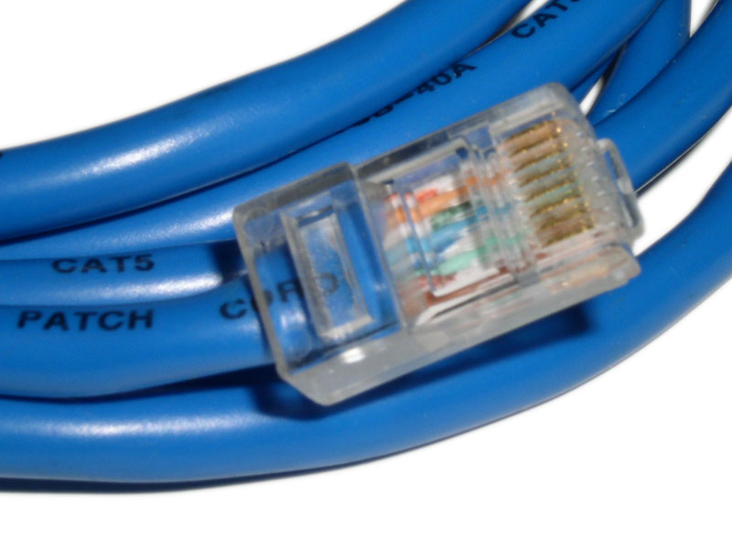
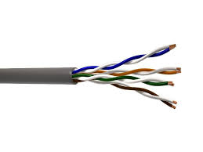
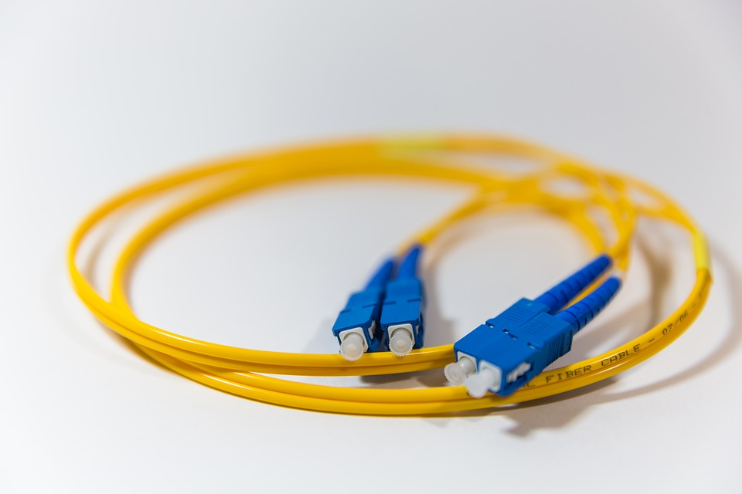
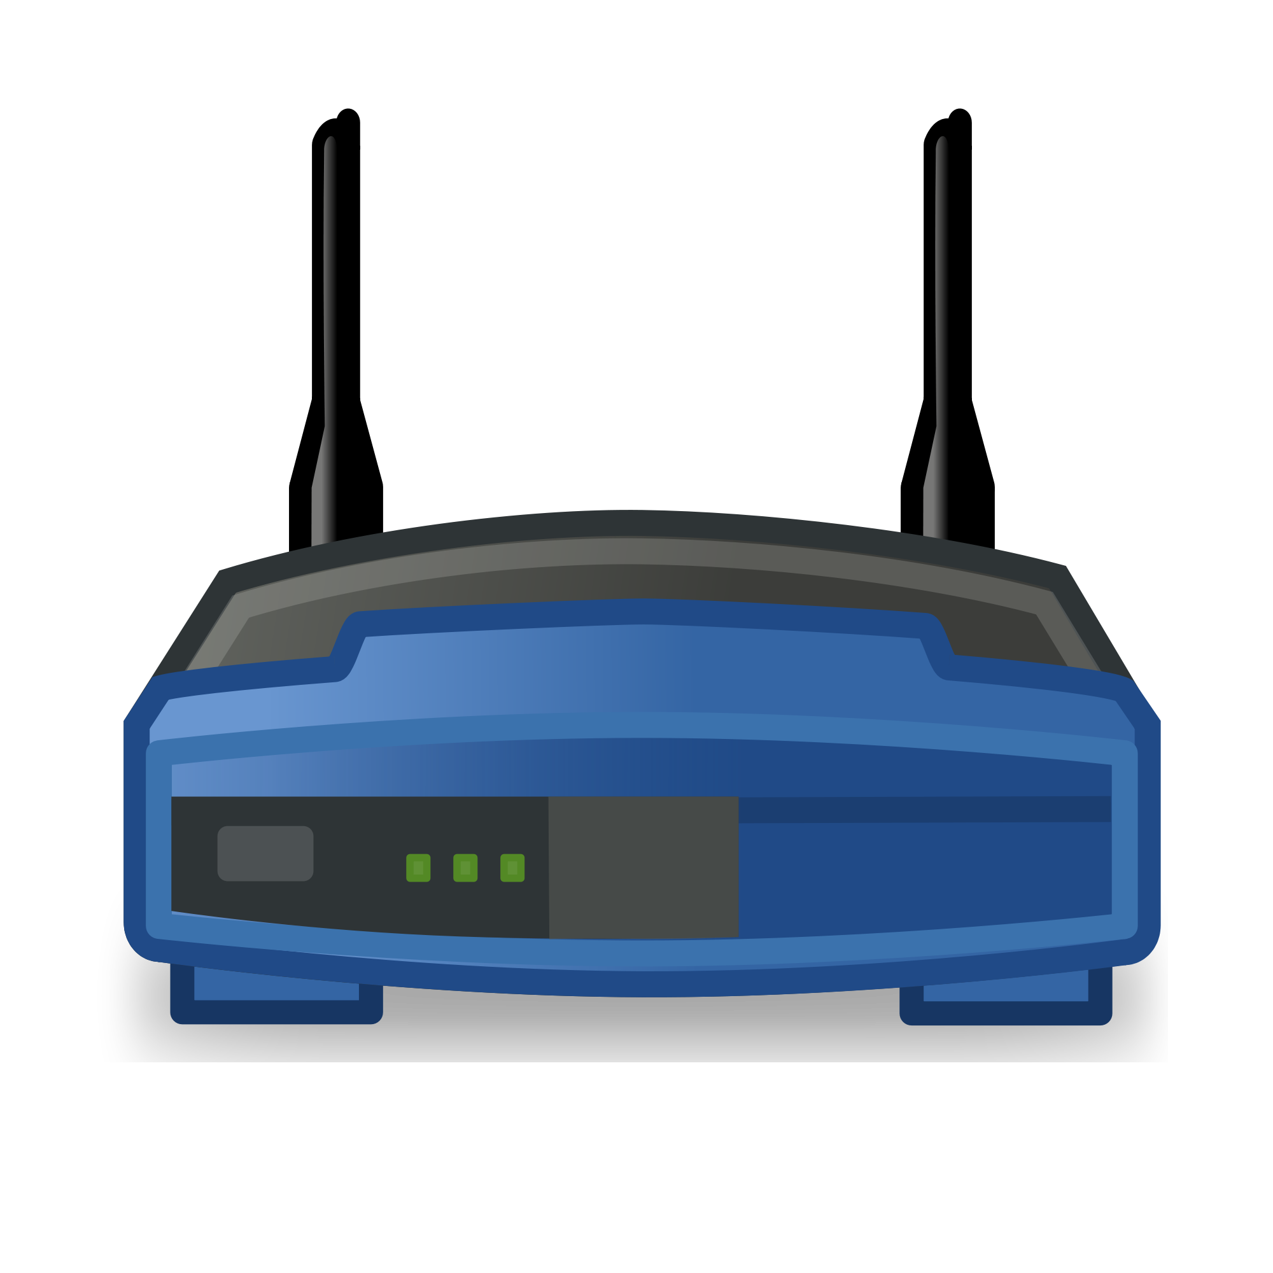
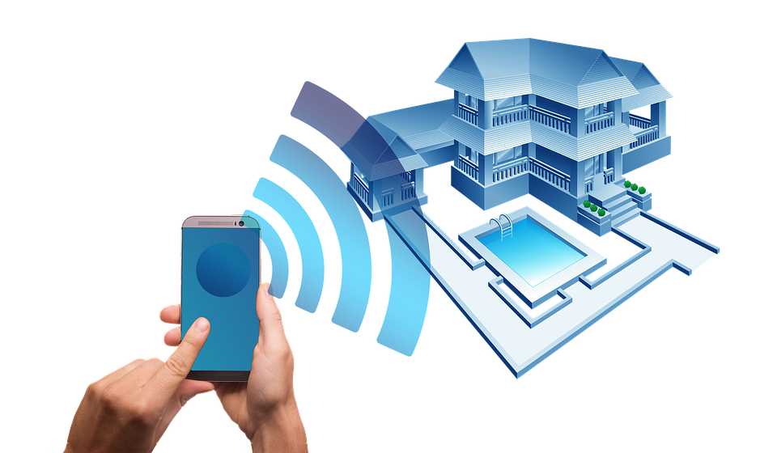
Physical Medium
Wired
Wireless

Slide 14
Messages
Data is divided into smaller parts during transmission
Segmentation
The benefits of doing so:
Many different conversations can be interleaved on the network(multiplexing)
Increases reliability of network communications.
The separate pieces of each message need not travel the same pathway across the network from source to destination
Adds complexity however:
Addressing, labeling, sending, receiving.
Reassembling
NEED RULES FOR THIS...
Application Data
Segment
Segment
Segment
Header
Segment

Slide 15


Rules
Humans have generally accepted protocols for interaction:
Identified sender and receiver
Agreed upon method of communicating (face-to-face, telephone...)
Common language and grammar
Speed and timing of delivery
Confirmation or acknowledgement requirements
All communication activity on the Internet is governed by protocols

Slide 16
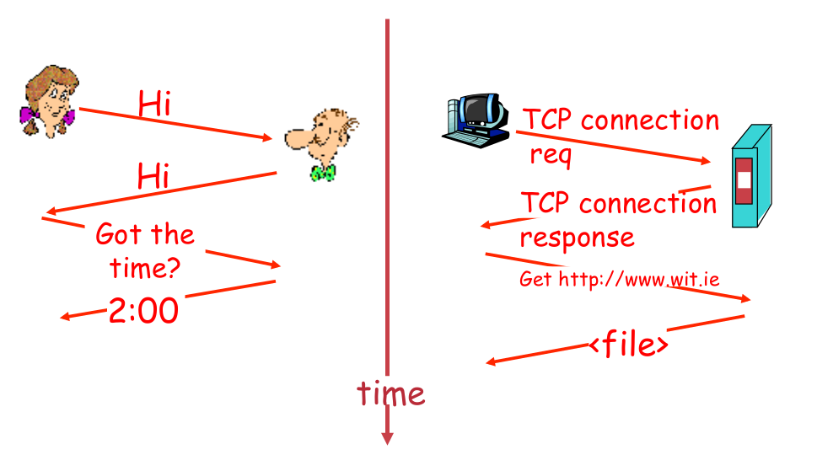
Human Protocol
Network Protocol

Slide 17
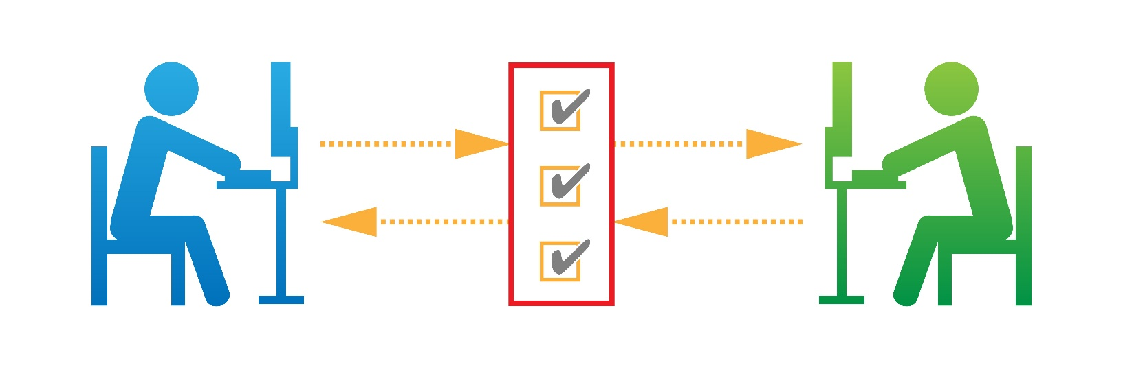
Network Protocols
Machines rather than humans
All communication activity in Internet governed by protocols
Protocols define
Format, order of msgs sent and received among network entities
Actions taken on msg transmission, receipt

Slide 18
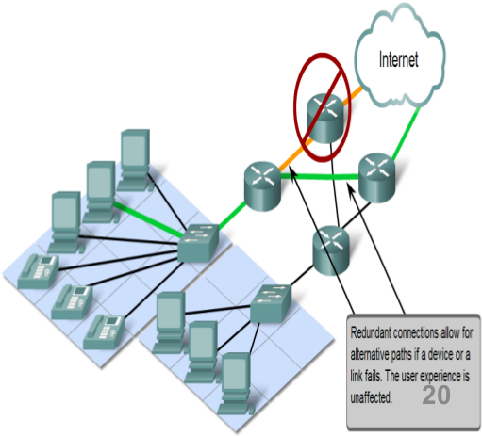
Network Characteristics
Network architecture refers to:
Design of a Network
network's physical components and its organisation
the technologies that support the infrastructure
The programmed services and protocols that move the messages across that infrastructure
4 general characteristics to meet user expectations
Fault tolerance
Scalability
Quality of service (QoS)
Security

Slide 19
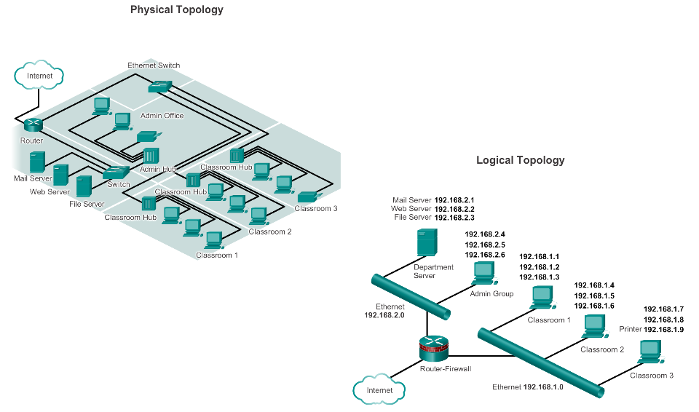
Network Topology and Representations
Network diagrams, often called topology diagrams, use symbols to represent devices within the network.
Physical topology diagrams illustrate the physical location of intermediary devices and cable installation.
Logical topology diagrams illustrate devices, ports, and the addressing scheme of the network.
Notes:
Physical topology diagrams illustrate the physical location of intermediary devices and cable installation.
Logical topology diagrams illustrate devices, ports, and the addressing scheme of the network.

Slide 20
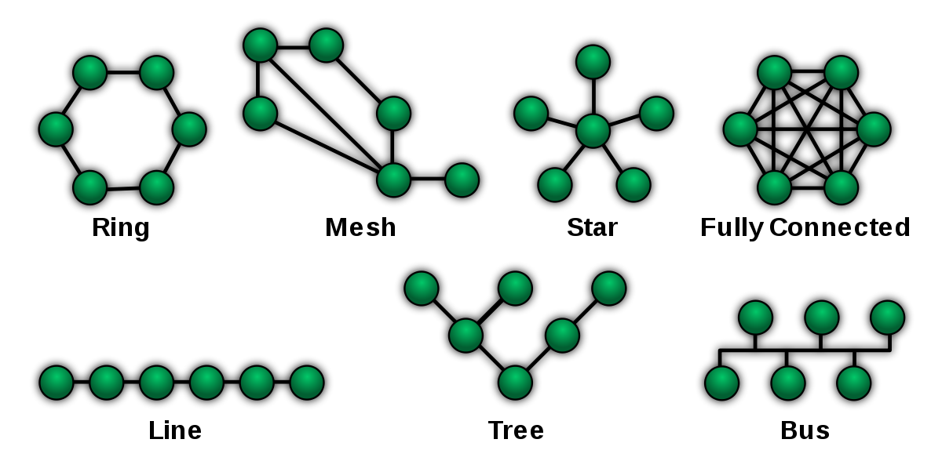
Network Topology
What connection to use? Unorganised….
Centre is single point of failure
Will not scale well
2 devices communicate simultaneously???
What if one device goes down???

Slide 21
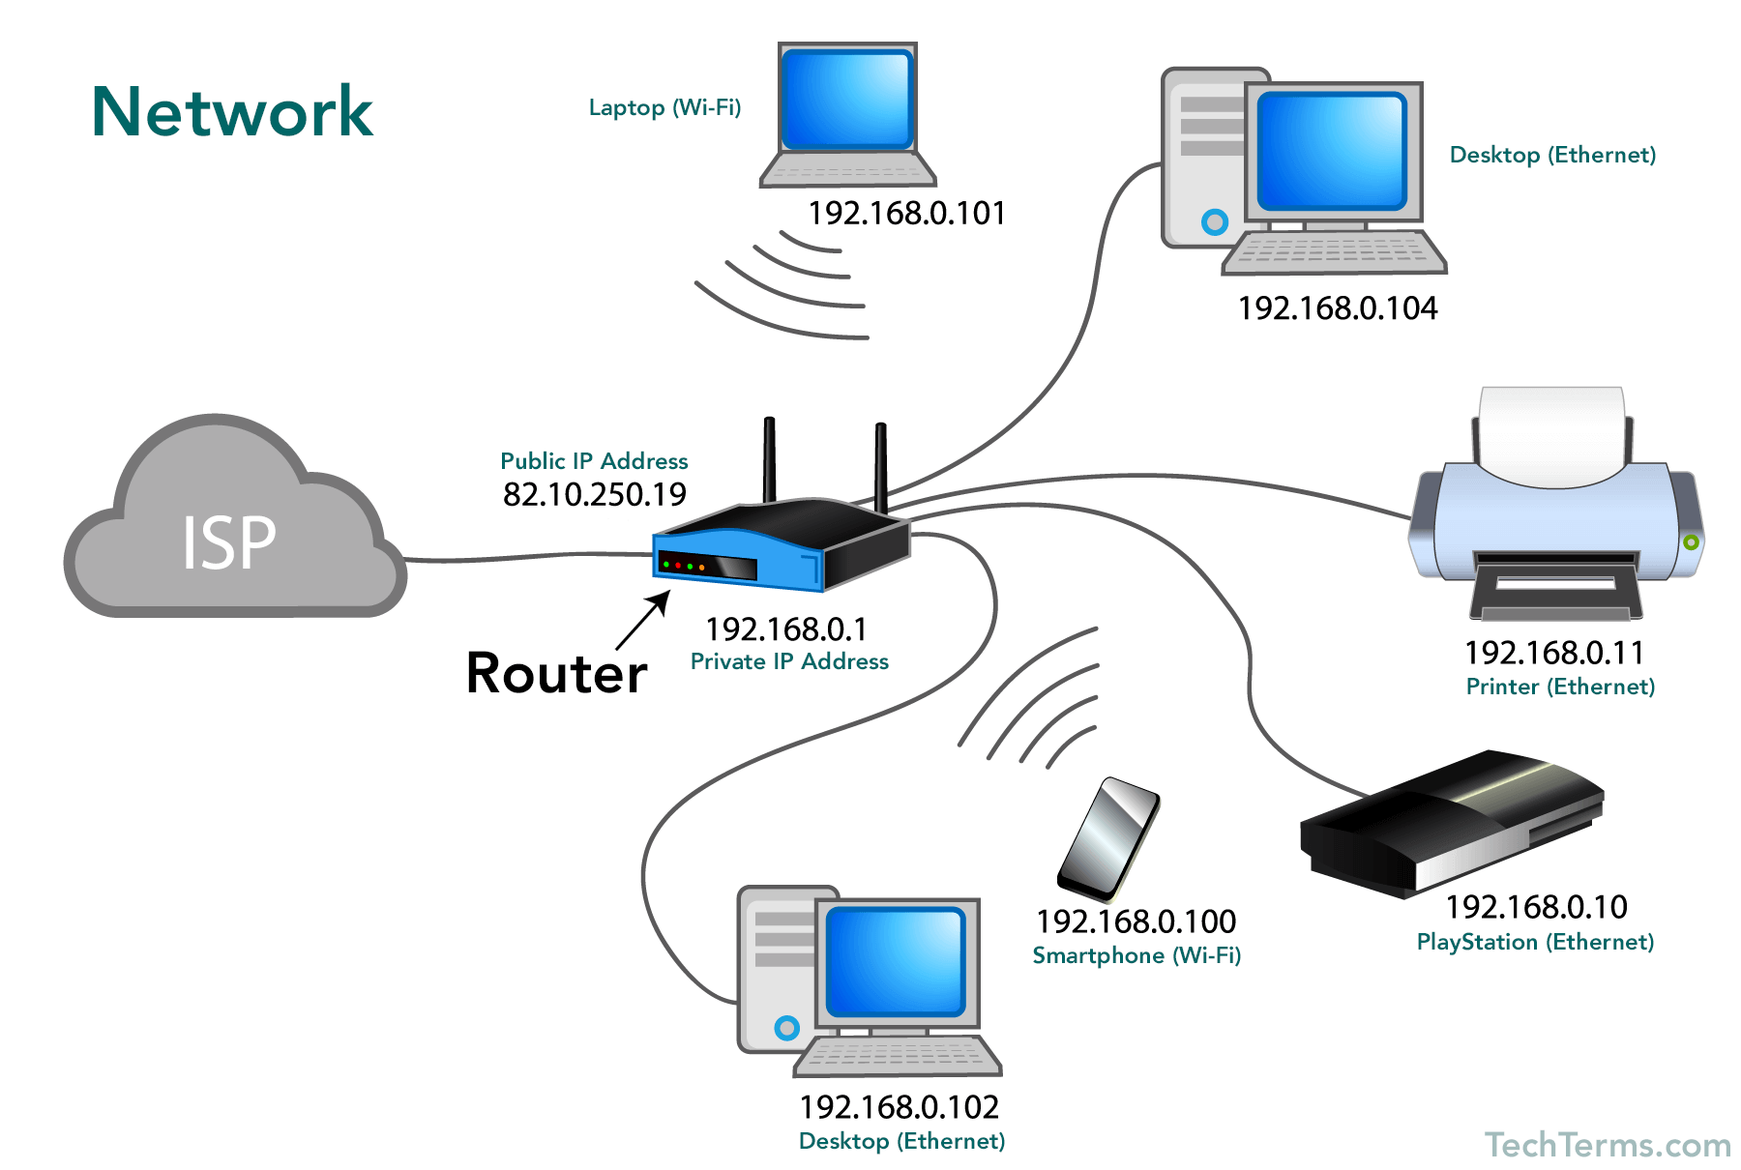
Typical Home Network
Source: https://techterms.com/definition/network

Slide 22
Some Networking Vocabulary
Network Interface/Adapter: any kind of software interface to networking hardware. (e.g. wifi interface and wired interface). A network interface may be associated with a physical device, or it may be a representation of a virtual interface. (e.g. interfaces on your virtual machines)
LAN: Local Area Network refers to a network or a portion of a network that is not publicly accessible to the greater internet.
WAN: Wide Area Network. Much Larger and extensive than a LAN. Often used to refer to the Internet, as a whole.
Node: General term usually for a device on a network. Every node has a unique network address.
Media Access Control(MAC) address: Used to distinguish specific devices. A unique address that each device is assigned during manufacturing. Used to differentiates it from every other device on the internet. Typically, each network interface has a MAC address.
IP: protocols that allow the internet to work. IP addresses are unique on each network and they allow machines to address each other across networks.

Slide 23
Key Points so far
Networks are everywhere
4 Components of every network
Devices
Medium
Protocols (Rules)
Messages (Data)
Networks are connecting everything (not just for PCs/Laptops)
Networks have a Topology
Some key characteristics of a network

Slide 24
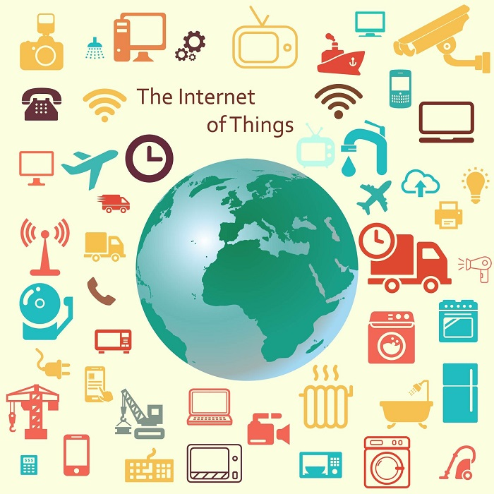
Internet of Things
Internet → The worldwide network of interconnected computer networks, based on a standard communication protocol (TCP/IP).
Thing → An object not precisely identifiable.
Internet of Things (IoT) → A worldwide network of interconnected objects uniquely addressable, based on standard communication protocol.

Slide 25
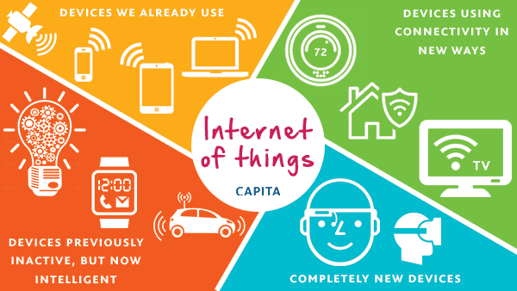
What’s the difference…
Extending the current Internet and providing connection, communication, and inter-networking between devices and physical objects, or "Things,“ (even biological things!)
https://www.capitatranslationinterpreting.com/the-internet-of-things/

Slide 26
IoT Evolution
Started with connectivity among people for sharing information.
Led to a “flat-world” where everyone across the world is connected.
Advancement in cloud computing and immersive experience led towards universal accessibility of data.
Combination of immersive experiences, connectivity and advancement in electronics further leading to Internet of Everything (IoE)
Source: Cisco

Slide 27
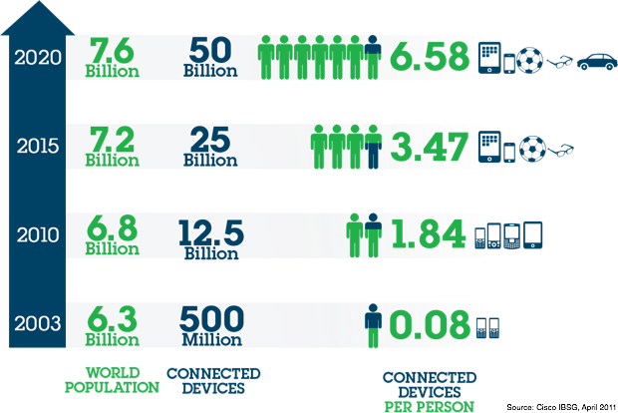
IoT Potential
Conservatively → 20 billion newly connected devices will be deployed.
First public website went live at CERN in 1990.
It took 15 years to reach 1 billion people on earth over the internet.
IoT is looking to add 6 billion connected devices per year.
Economic impact
New revenue streams
Reducing costs
Reducing time to market
Improving supply chain
Reducing production loss
Increasing productivity

Slide 28
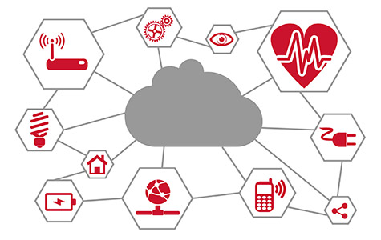
Networking and IoT
The Roles of Networks
Managing connected devices (discovery, join, leave, etc).
Relaying data packets from the source to the destination node in the network.
IoT is a distributed system. All nodes need to perform networking related tasks.
Main concerns as before: Reliability, Performance, Security, QOS, Scalability
http://www.psemi.com/markets/industrial/internet-of-things

Slide 29
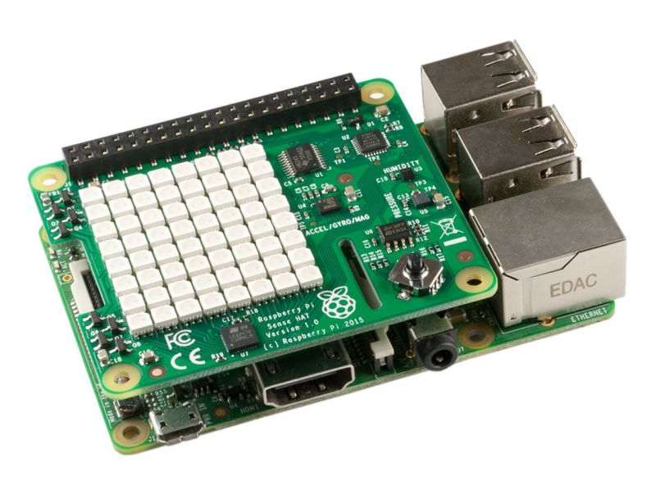
Learning about Networks/IoT
Can't create complex networks at home however you can simulate "virtual networks"
Virtualbox hypervisor
Packet Tracer
Can use programmable, multi-channel, prototyping device to investigate different mediums, protocols, IoT etc.
Raspberry Pi has bluetooth, Wifi, Ethernet, SPI, I2C...

