Slide 1
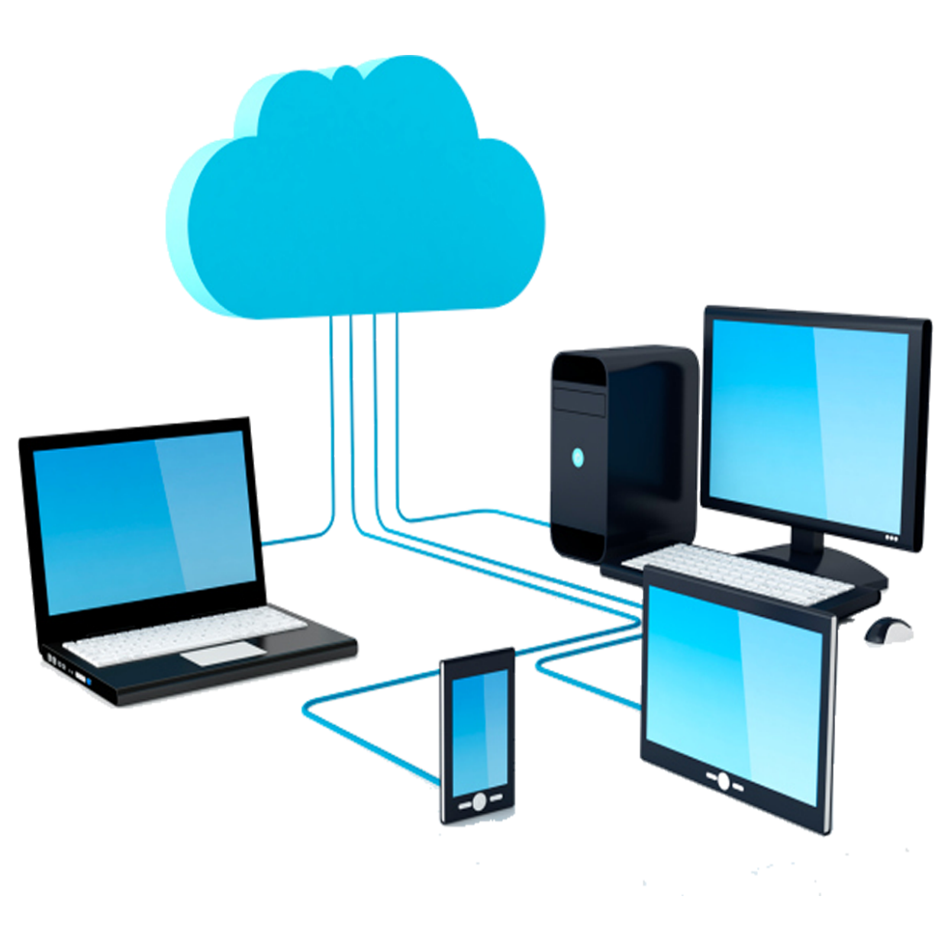
Computer Networks
Frank Walsh 2023
This Photo by Unknown Author is licensed under CC BY-NC

Slide 2

Agenda (1st Part)
Intro
What’s a computer network
Computer Network Components
Device Types
Protocols
Topologies
Reliable Network Characteristics
Internet of Things

Slide 3
Computer System & Networks
TCP/IP Protocol Stack
Link Layer/Ethernet
IP Networks
TCP
Application Layer Protocols
Internet of Things
Physical Computing
Sensing/Acuating
Messaging
IoT Platforms

Slide 4
Intro

Slide 5
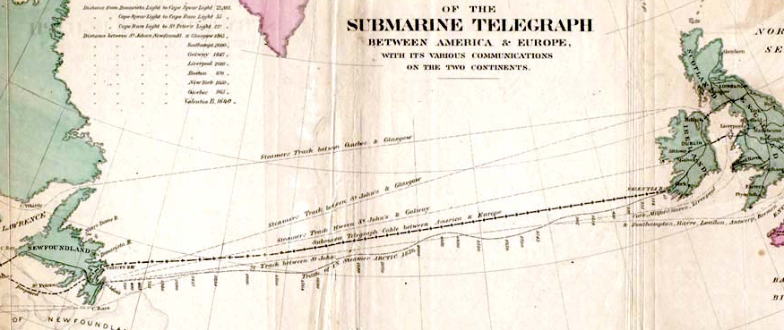
QI: 1850s - Transatlantic Cable
The first cable was laid in the 1850s from Valentia Island to Newfoundland
Messages encoded using Morse Code using electrical signal through cable.
it took 2 minutes to transmit just one character!(Now 30 Tb/s capacity using optical cables(optical signalling))
Encoding is the process of converting data into a specific format or code before transmission.
A Signal refers to the physical manifestation of data. E.g. electrical voltage, light pulses, or electromagnetic waves

Slide 6
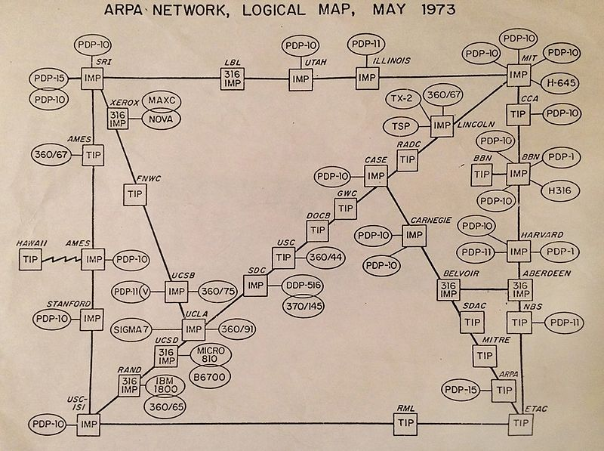
QI: 1960s - Arpanet
US government responds to launch of Sputnik by setting up ARPA, the Advanced Research Projects Agency
ARPANET created in 1969 connecting computers in UCLA and Stanford
In 1973, it was called the "internetwork" or "internet" for short
The internet is 50 years old
1st Wide Area Packet Switched Network
data is divided into small packets for transmission

Slide 7
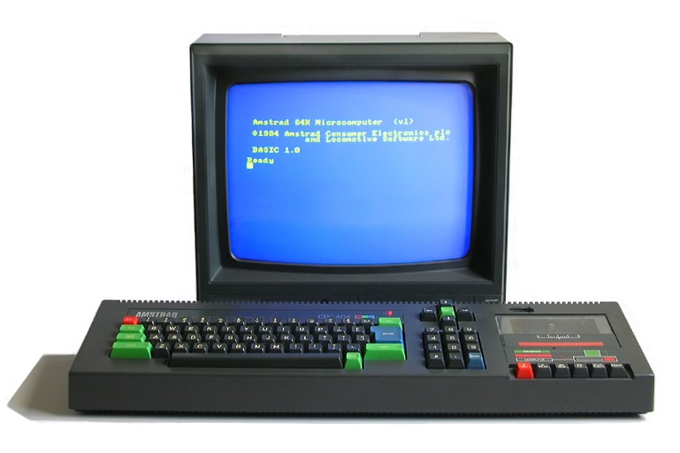
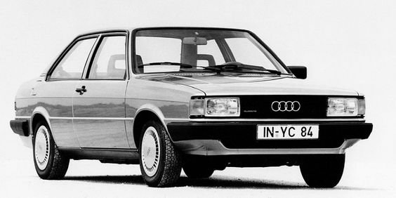
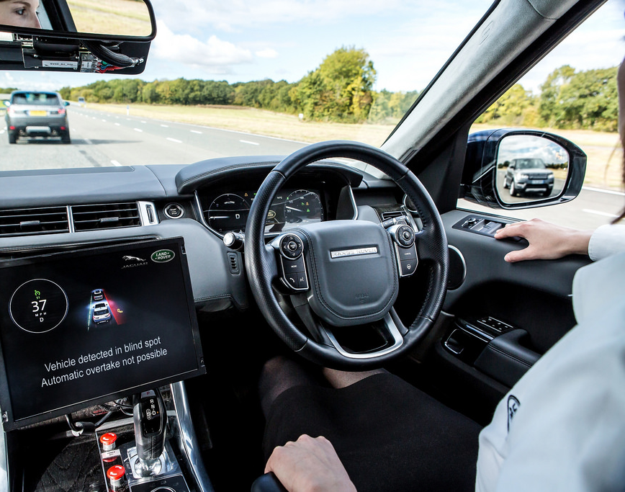
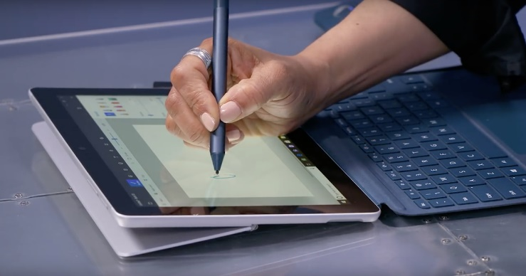
Computer Networks
1984
Devices & Machines are effective/beautiful in isolation...
Connecting a machine to a network creates amazing possibilities/challenges...
Key points:
Computer networks are no longer only used to connect conventional “computers”
Part of everyday life
“Wired people should know something about wires”
2022
This Photo by Unknown Author is licensed under CC BY-SA
Notes:
Going back a few decades, machines worked in isolation. Cars originally were very electromechanical. Could be thought of as information islands.
Jump forward to today – everything is getting connected, not just computers, but pretty much anything you can think of. Example in modern cars – connect to roadside infrastrure and other cars. Autonamous. Also can react to events (sensors in cars can detect impact/orientation

Slide 8
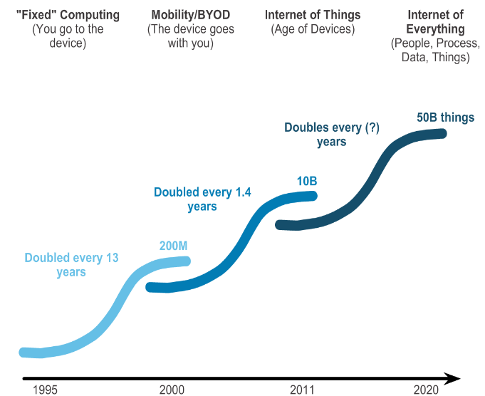
QI: Computer Networks Growth

Slide 9
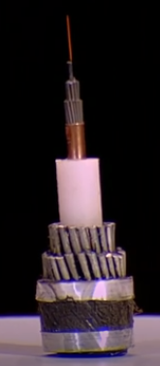

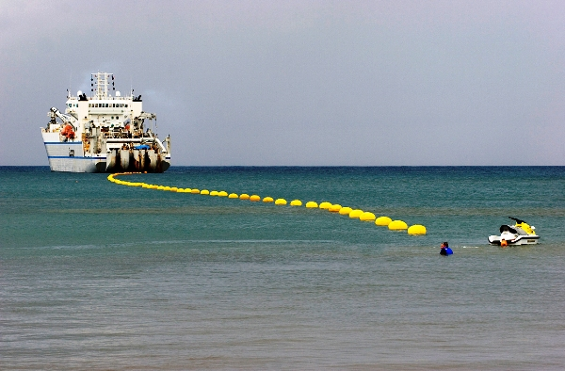
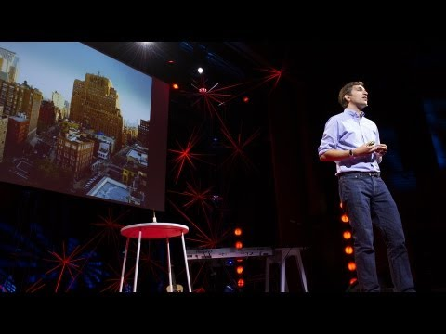
Networks - Under the bonnet
Inherently Physical:
Devices need some form of physical channel to communicate
Devices need specific hardware to interface to that channel (eg. Antenna, adapter, and associated electronics)

Slide 10
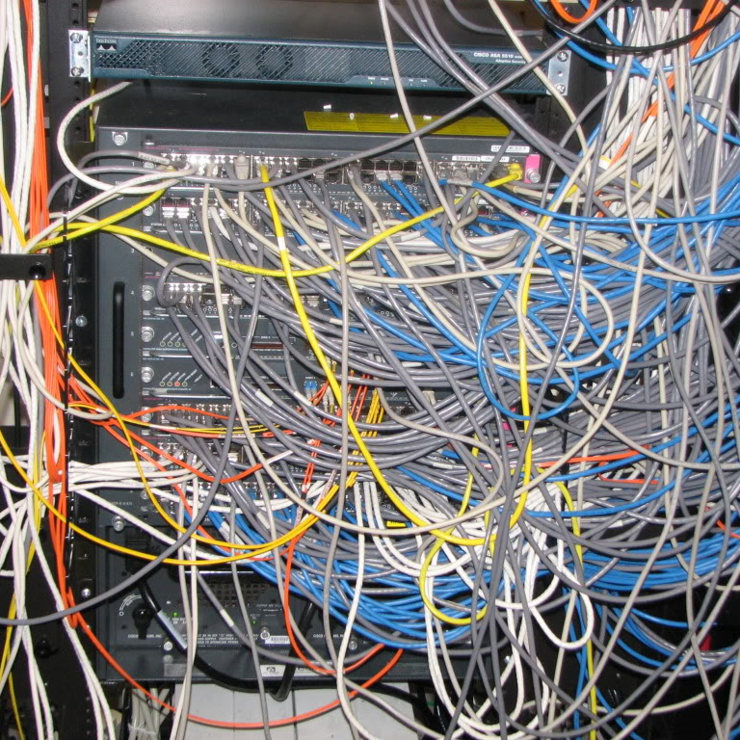
Networks – Under the bonnet
Once connected, it can get complicated!
Sophisticated combination of protocols, software, hardware, algorithms, configurations, policies...
Security, privacy, access, quality of service, wired/wireless...

Slide 11







Infrastructure Devices
Server
End Devices

Slide 12
Components of Computer Networks
Devices
Communicate with one another.
Physical Medium
Used to connect devices
Messages
Information travelling over the medium
Rules
Governs how messages flow through a network

Slide 13
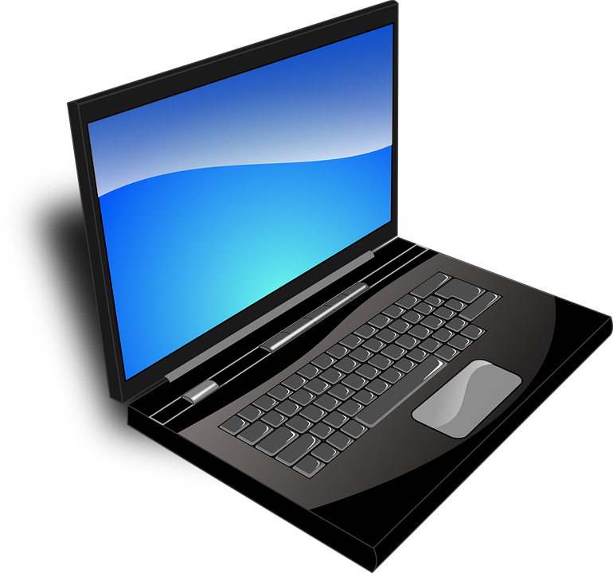

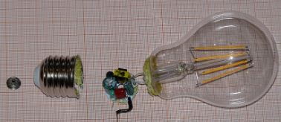
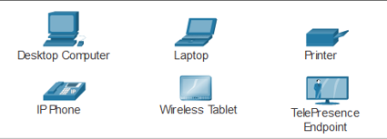
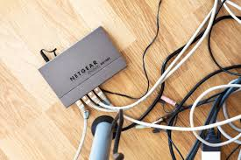
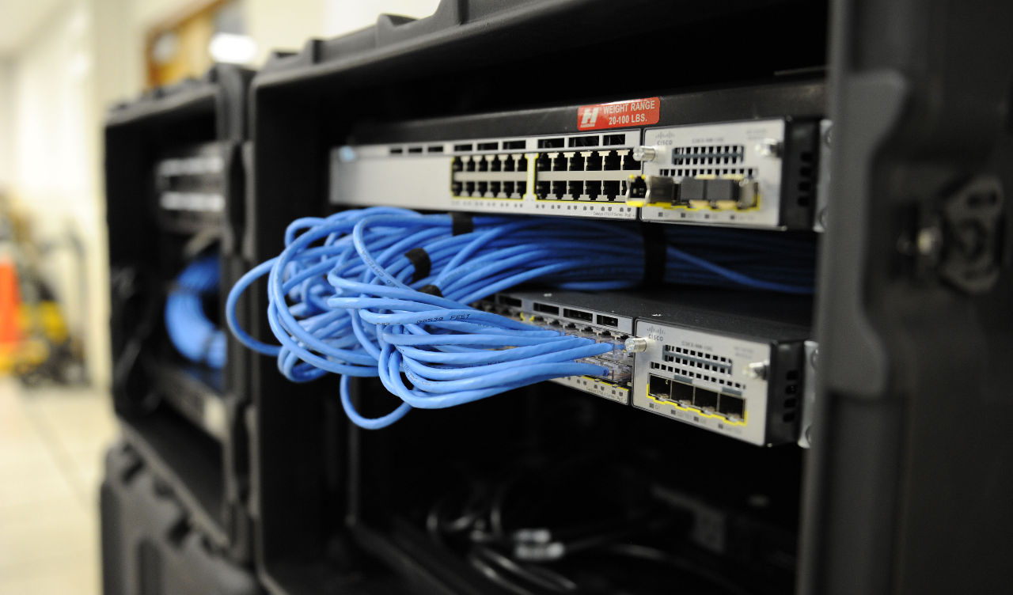
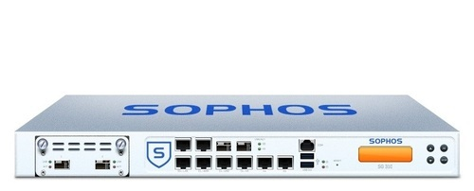

Components of Computer Networks - Device Types
End Devices
Infrastructure/intermediary Devices
Notes:
An end device is where a message originates from or where it is received. Data originates with an end device, flows through the network, and arrives at an end device.
An intermediary device interconnects end devices. Examples include switches, wireless access points, routers, and firewalls.
Management of data as it flows through a network is also the role of an intermediary device, including:
Regenerate and retransmit data signals.
Maintain information about what pathways exist in the network.
Notify other devices of errors and communication failures.

Slide 14
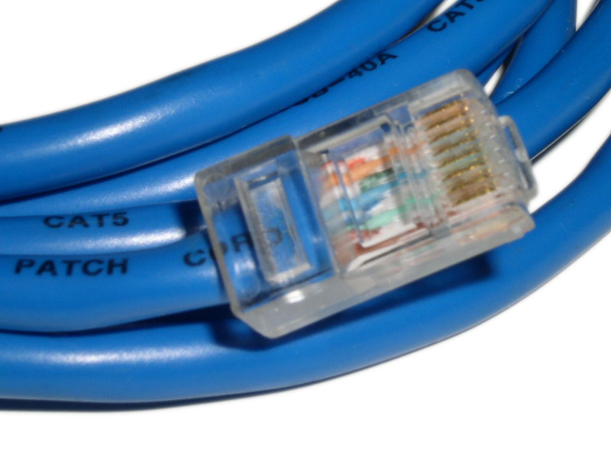
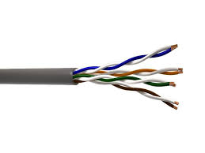
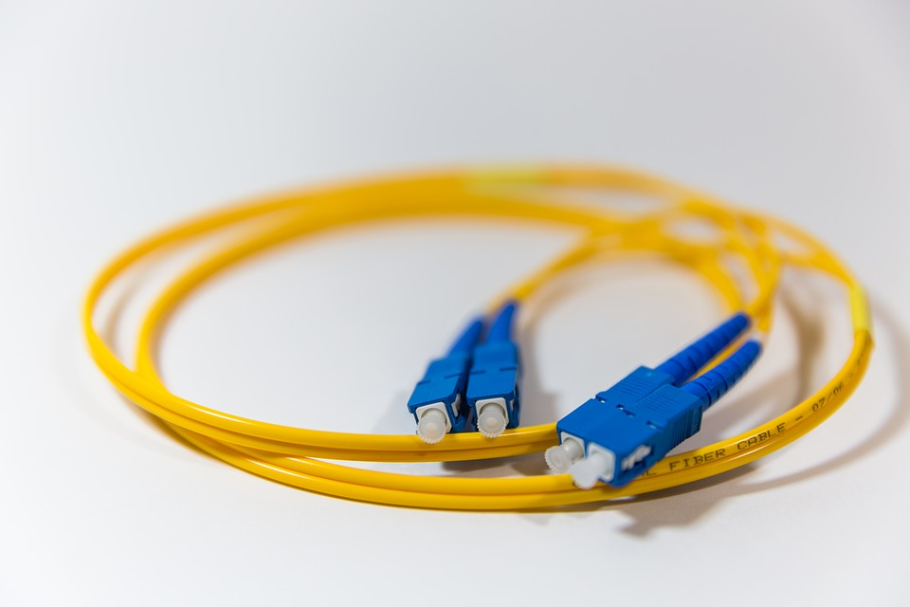
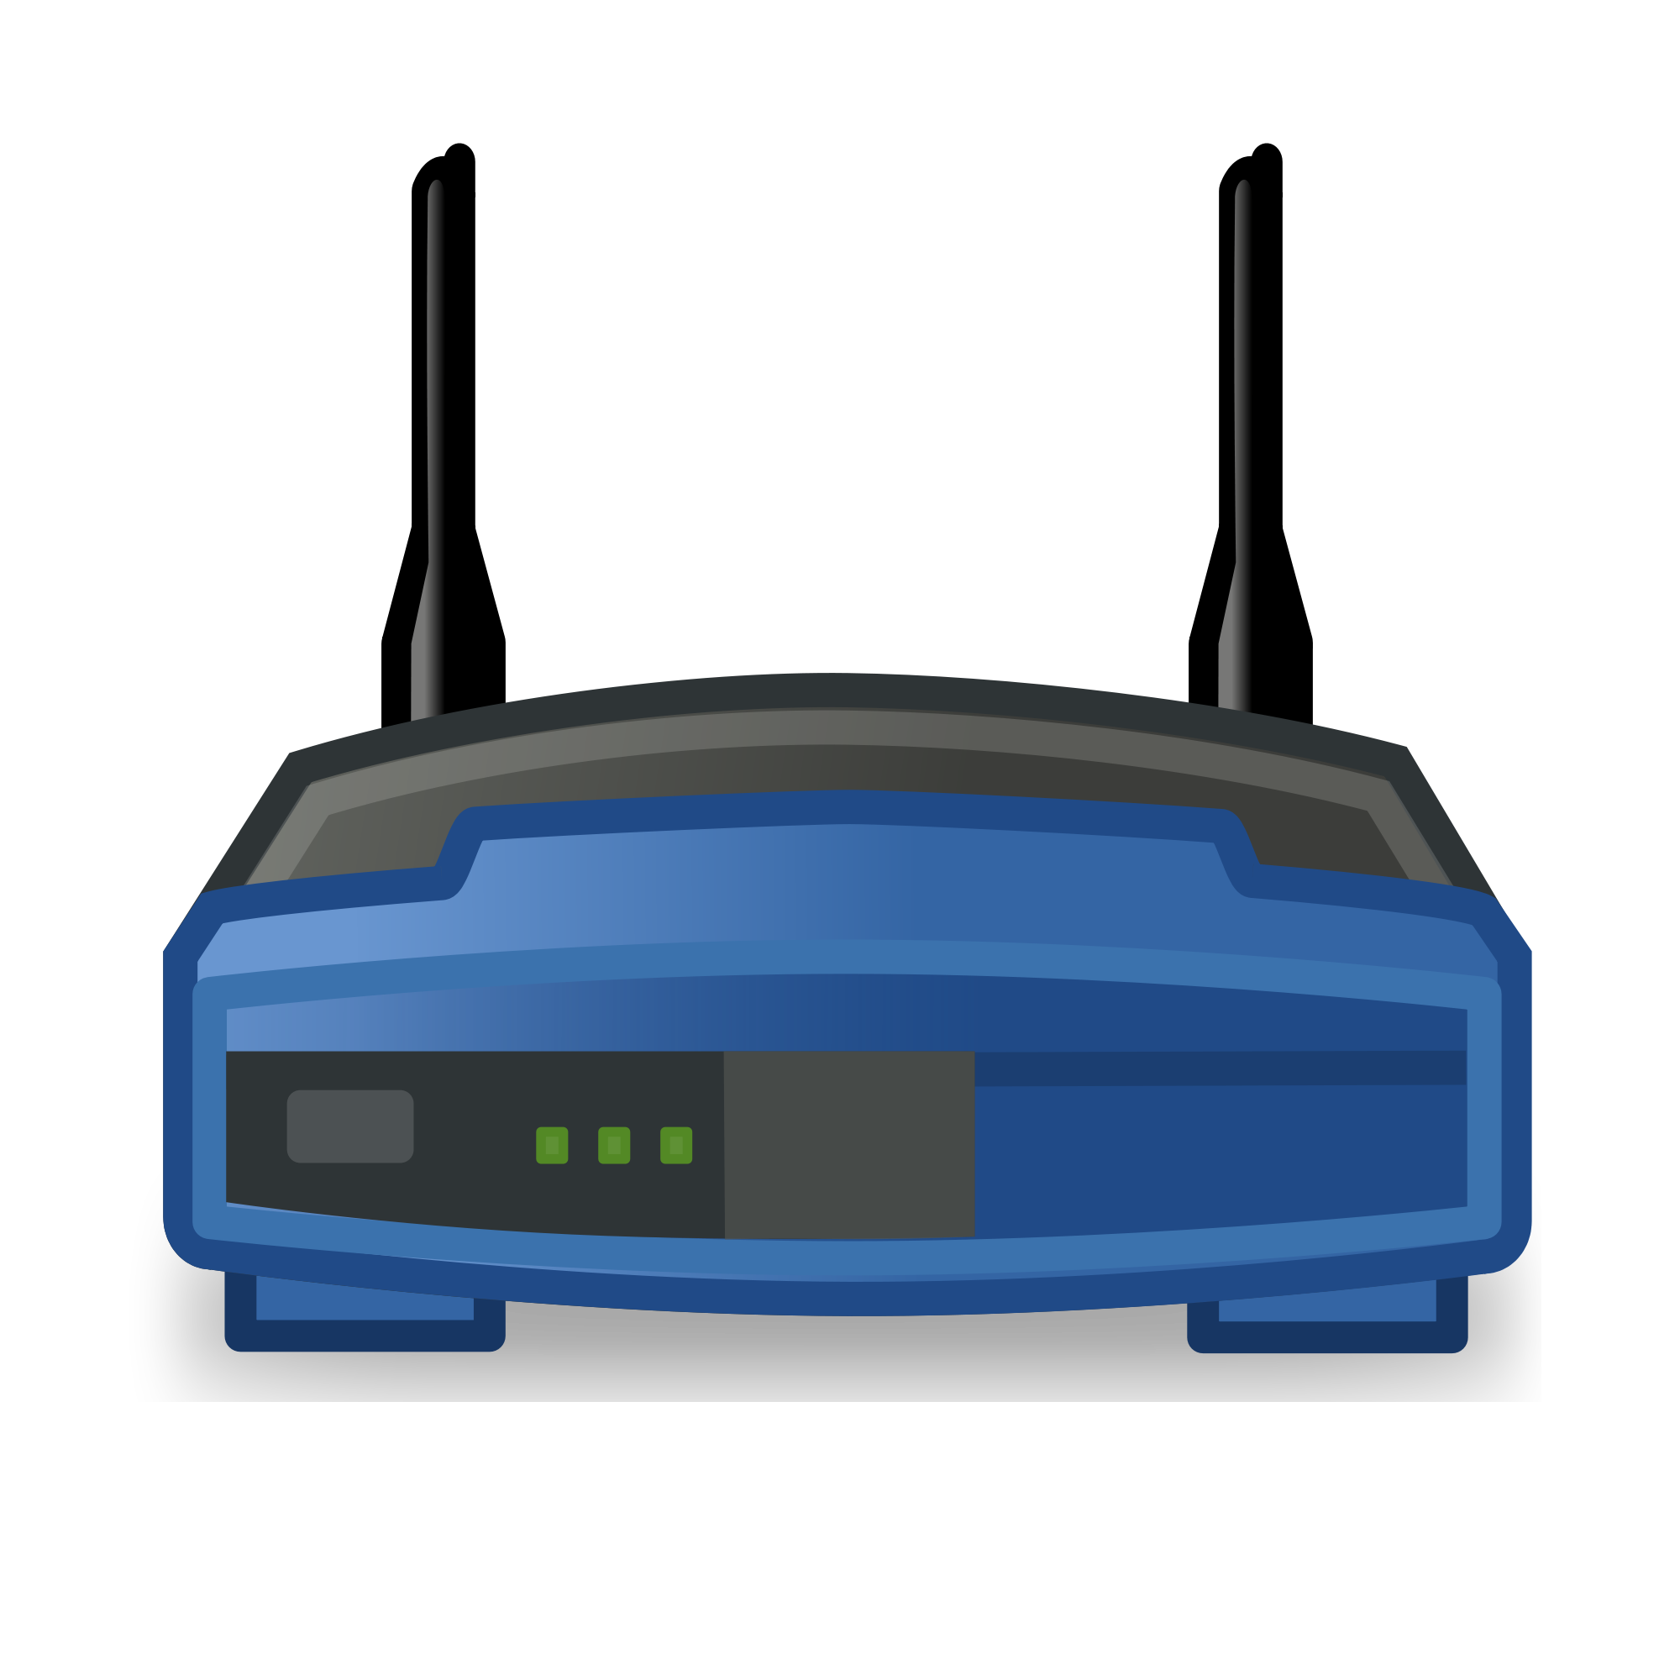
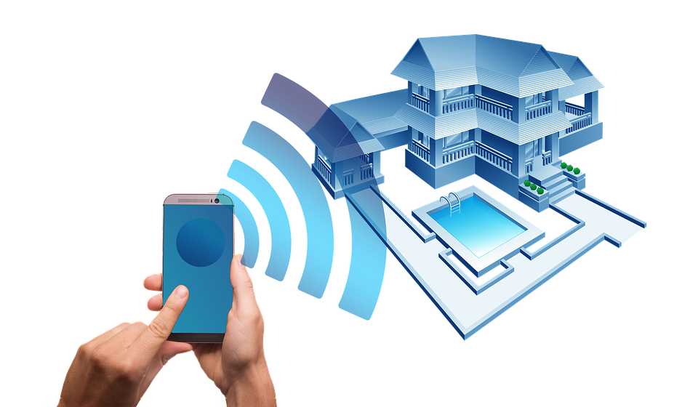
Components of Computer Networks - Physical Medium
Wired
Wireless
Notes:
Communication across a network is carried through a medium which allows a message to travel from source to destination.
Wired - Uses Electrical Impulses/Pulses of light
Wireless – Modulates specific frequencies of Electromagnetic Waves

Slide 15
Components of Computer Networks - Messages
Data is divided into smaller parts during transmission
Segmentation
The benefits of doing so:
Many different conversations can be interleaved on the network(multiplexing)
Increases reliability of network communications.
The separate pieces of each message need not travel the same pathway across the network from source to destination
Adds complexity however:
Addressing, labeling, sending, receiving.
Reassembling
NEED RULES FOR THIS...
Application Data
Segment
Segment
Segment
Header
Segment

Slide 16

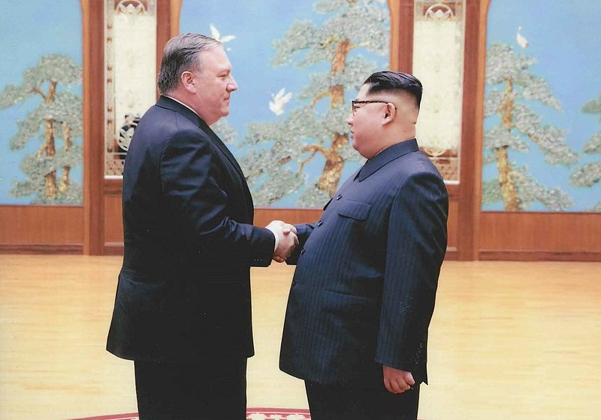
Components of Computer Networks - Rules
Humans have generally accepted protocols for interaction:
Identified sender and receiver
Agreed upon method of communicating (face-to-face, telephone...)
Common language and grammar
Speed and timing of delivery
Confirmation or acknowledgement requirements
All communication activity on the Internet is governed by protocols

Slide 17
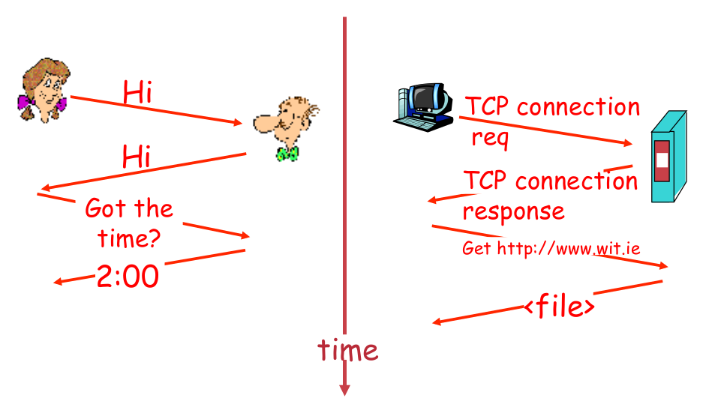
Human Protocol
Components of Computer Networks - Rules
Network Protocol

Slide 18
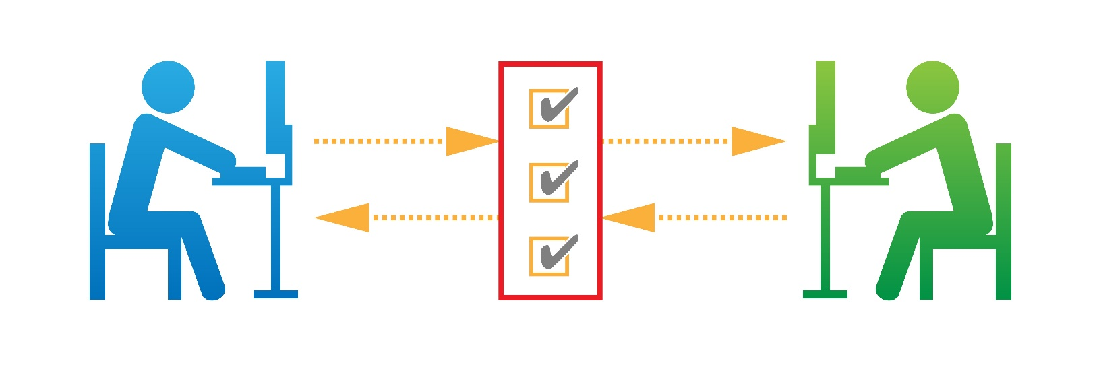
Network Protocols
Machines rather than humans
All communication activity in Internet governed by protocols
Protocols define
Format, order of messsages sent and received among network entities
Actions taken on msg transmission, receipt

Slide 19
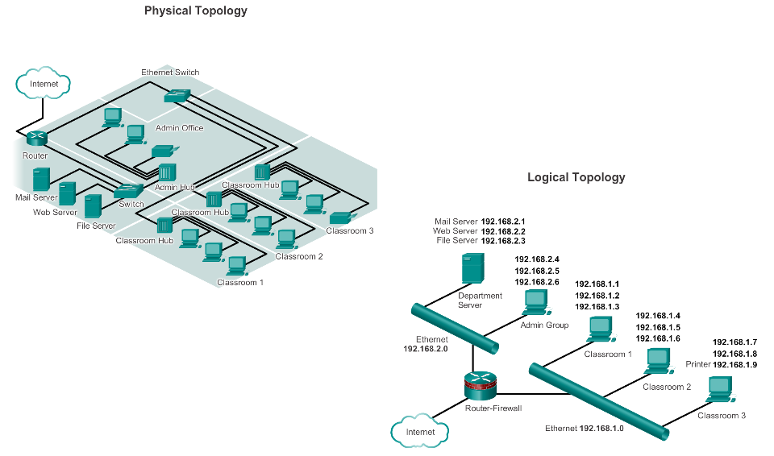
Network Topology and Representations
Network diagrams are called topology diagrams. Use accepted symbols to represent devices within the network.
Physical topology diagrams illustrate the physical location of intermediary devices and cable installation.
Logical topology diagrams illustrate devices, ports, and the addressing scheme of the network.
Notes:
Physical topology diagrams illustrate the physical location of intermediary devices and cable installation.
Logical topology diagrams illustrate devices, ports, and the addressing scheme of the network.

Slide 20
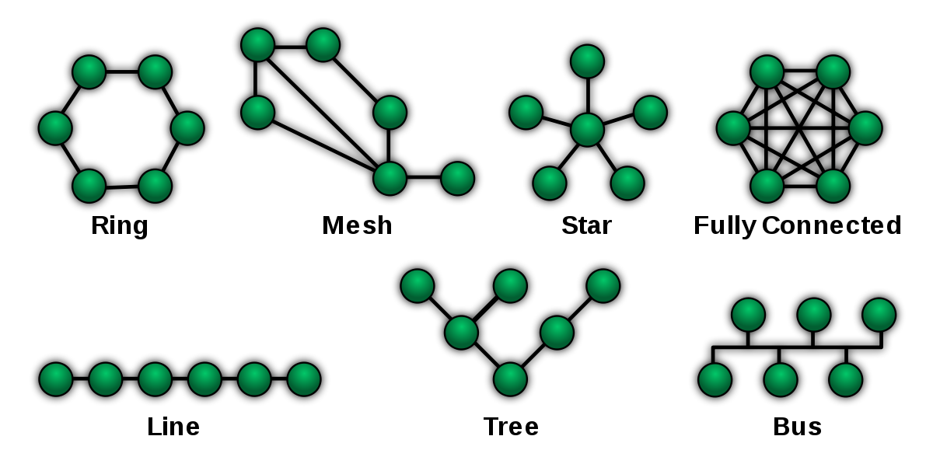
Network Topology
What connection to use? Unorganised….
Centre is single point of failure
Will not scale well
2 devices communicate simultaneously???
What if one device goes down???

Slide 21
Network Types
Small Home Network
A few devices connected to each other and the Internet
Small Office/Home Office
Connects to corporate network
More complex intermediary devices/design(VPN/Firewalls/VLAN)
Medium to Large Network
Many locations/networks. >100 devices
Worldwide Networks
Millions of connected devices via interconnected networks across the globe.
E.g. the Internet

Slide 22
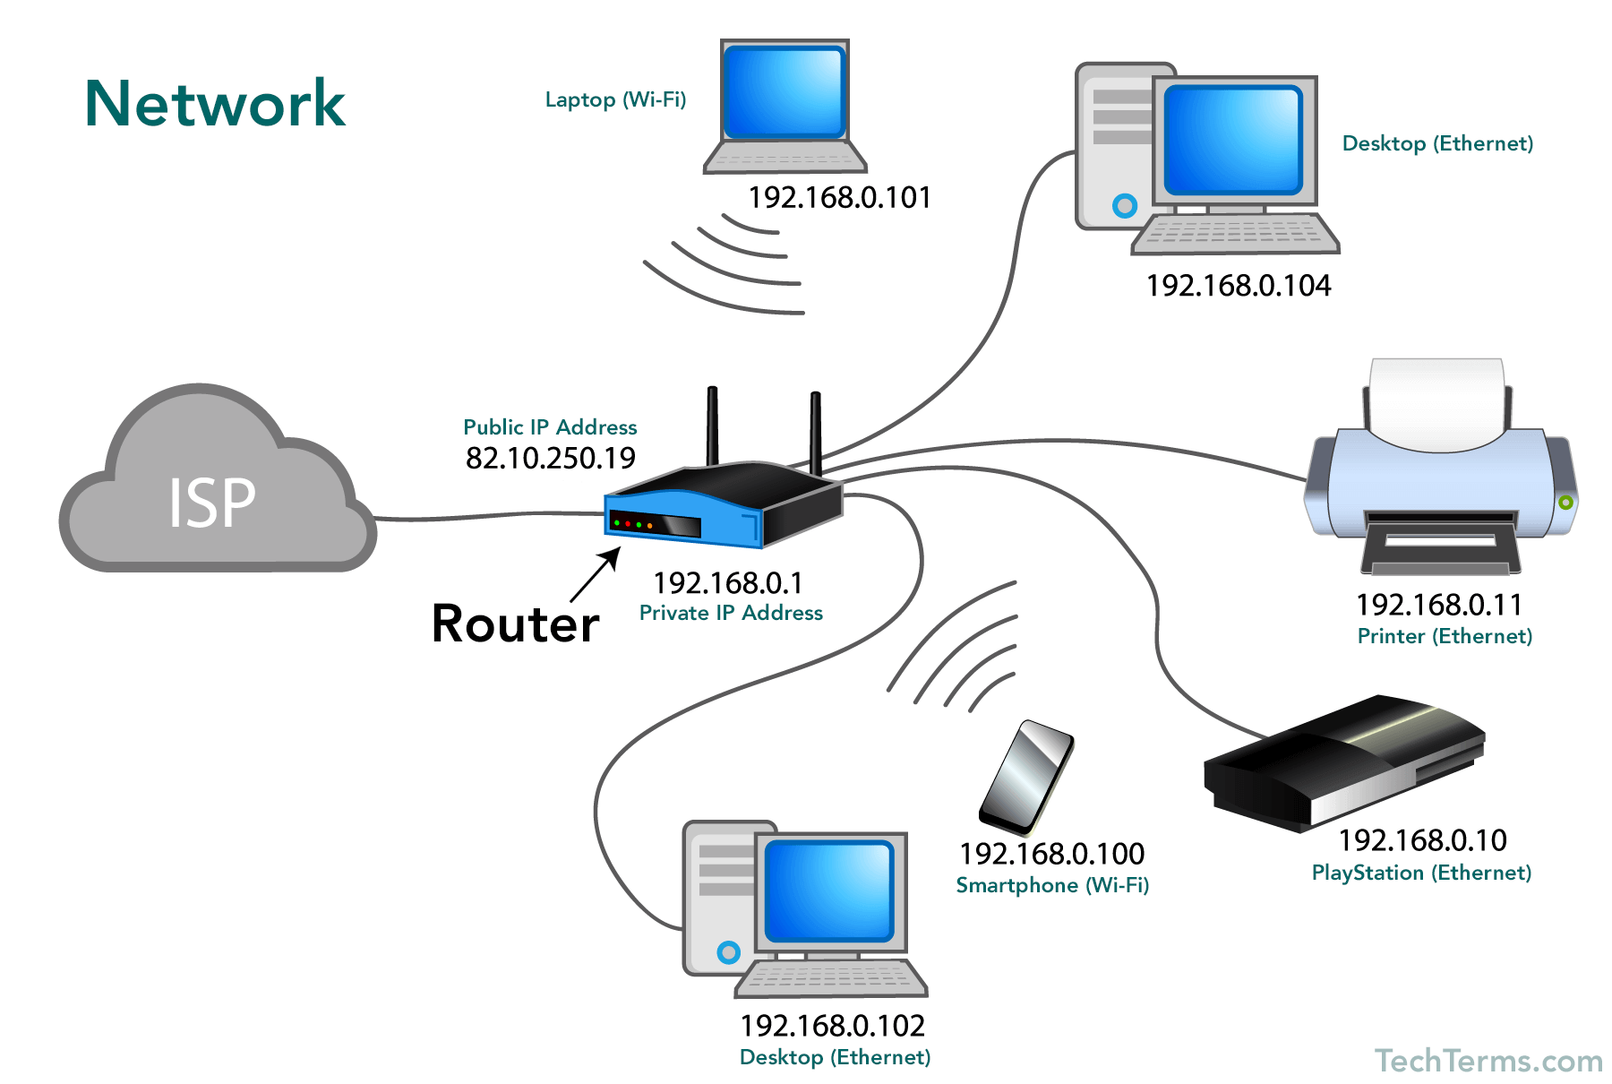
Network Types - Typical Home Network
Source: https://techterms.com/definition/network

Slide 23
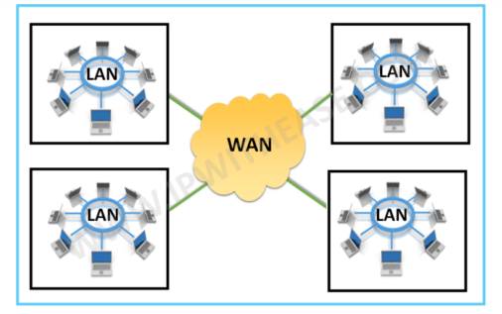
Network Types -
LAN(local area network)
interconnects computers within a limited area, such as a home, office building, school, or campus.
Administered by single person or organisation
WAN(wide area network)
covers a broad area.
Interconnects LANs
Internet
Global collection of interconnected LANS and WANS
No ownership. Groups formed to maintain structure:
IETF
ICANN
Notes:
IETF – Interne Eng Task Force Tech Standards
ICANN - Internet Corporation for Assigned Names and Numbers Namespaces/Domains

Slide 24
Some Networking Vocabulary
Network Interface/Adapter: any kind of software interface to networking hardware. (e.g. wifi interface and wired interface). A network interface may be associated with a physical device, or it may be a representation of a virtual interface. (e.g. interfaces on your virtual machines)
LAN: Local Area Network refers to a network or a portion of a network that is not publicly accessible to the greater internet.
WAN: Wide Area Network. Much Larger and extensive than a LAN. Often used to refer to the Internet, as a whole.
Node: General term usually for a device on a network. Every node has a unique network address.
Media Access Control(MAC) address: Used to distinguish specific devices. A unique address that each device is assigned during manufacturing. Used to differentiates it from every other device on the internet. Typically, each network interface has a MAC address.
IP: protocols that allow the internet to work. IP addresses are unique on each network and they allow machines to address each other across networks.

Slide 25
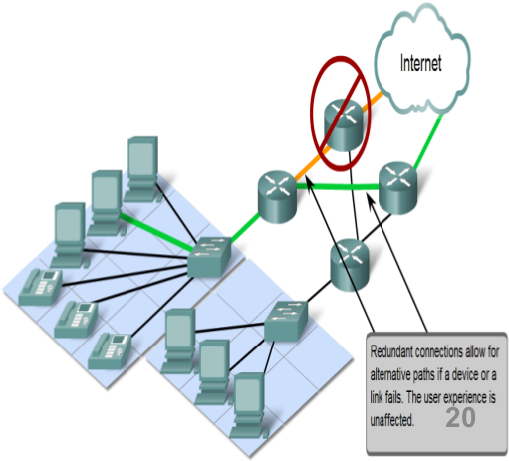
Reliable Networks - Network Characteristics
Network architecture refers to:
Design of a Network
network's physical components and its organisation
the technologies that support the infrastructure
4 general characteristics to meet user expectations
Fault tolerance
Scalability
Quality of service (QoS)
Security

Slide 26
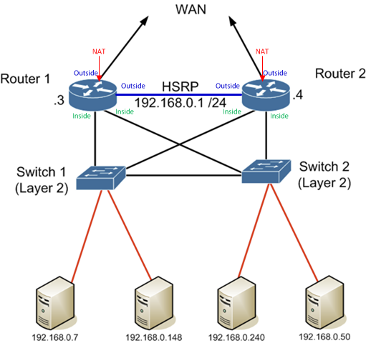
Reliable Networks – Fault Tolerance
Refers to limiting impact failures
Implemented using Packet Switched Networks and Multiple Paths
Packet switching splits transmitted data into packets that are routed individually over a network.
Packets can take different routes from source to destination
Not possible with Circuit Switched Networks (eg old telecoms/phone networks)
Redundant connections provide alternatice paths ifa device or link fails
This Photo by Unknown Author is licensed under CC BY-SA

Slide 27
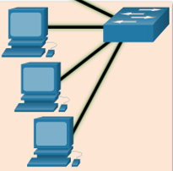


Reliable Networks - Scalability
Networks should be able to scale(grow) easily
Performance should not be affected for existing users
Standards/protocols help to achieve this.
Adding new users/networks without degrading performance
This Photo by Unknown Author is licensed under CC BY-SA

Slide 28
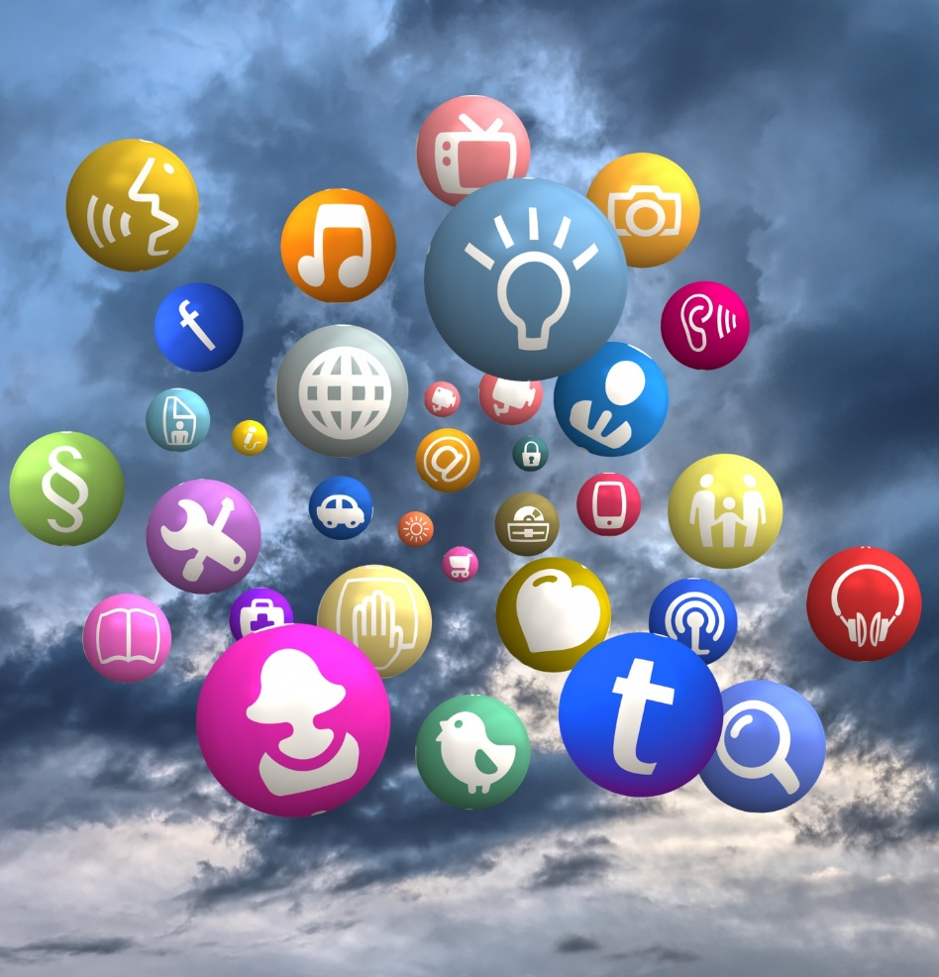
Reliable Networks - QoS
Ever watched laggy/freezing video
Caused by higher demand for Bandwidth available
Certain traffic types require higher performance/bandwidth
Quality of Service used to do this
QoS policy enables routers to manage flow of media traffic(voice/video)
Example: Routers prioritise voice/video traffic over web page traffic

Slide 29

Reliable Networks - Network Security
Network infrastructure security
Preventing unauthorized access to the physical devices
Information Security
Security of data transmitted on network
Confidentiality – only intended recipients can read the data
Integrity – assurance that the data has not be altered with during transmission
Availability – assurance of timely and reliable access to data for authorised users
Login/Password

Slide 30
Key Points so far
Networks are everywhere
4 Components of every network
Devices
Medium
Protocols (Rules)
Messages (Data)
Networks are connecting everything (not just for PCs/Laptops)
Networks have a Topology
Some key characteristics of a network

Slide 31
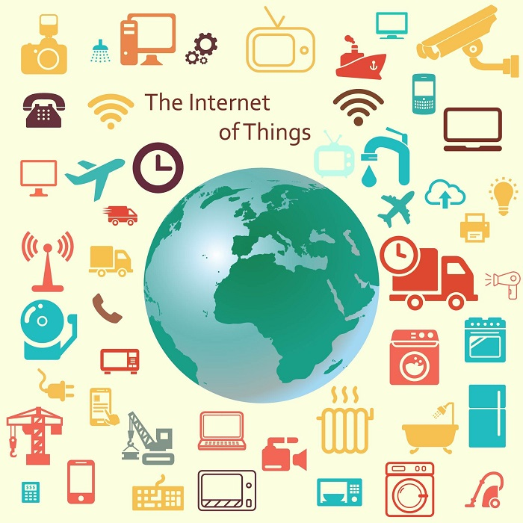
Internet of Things
Internet → The worldwide network of interconnected computer networks, based on a standard communication protocol (TCP/IP).
Thing → An object not precisely identifiable.
Internet of Things (IoT) → A worldwide network of interconnected objects uniquely addressable, based on standard communication protocol.

Slide 32
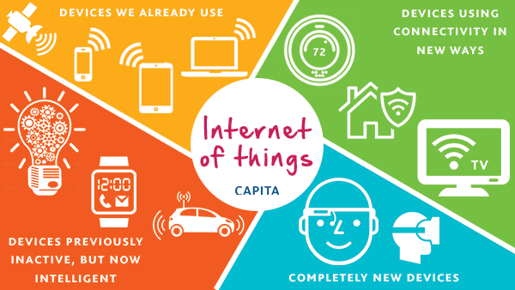
What’s the difference…
Extending the current Internet and providing connection, communication, and inter-networking between devices and physical objects, or "Things,“ (even biological things!)
https://www.capitatranslationinterpreting.com/the-internet-of-things/
Notes:
Biological systems encode and send messages – maybe using chemical and molecules. Concievable we can engineer these types of networks too. In the body, encode and send data using these mechanisms

Slide 33
IoT Evolution
Started with connectivity among people for sharing information.
Led to a “flat-world” where everyone across the world is connected.
Advancement in cloud computing and immersive experience led towards universal accessibility of data.
Combination of immersive experiences, connectivity and advancement in electronics further leading to Internet of Everything (IoE)
Source: Cisco

Slide 34
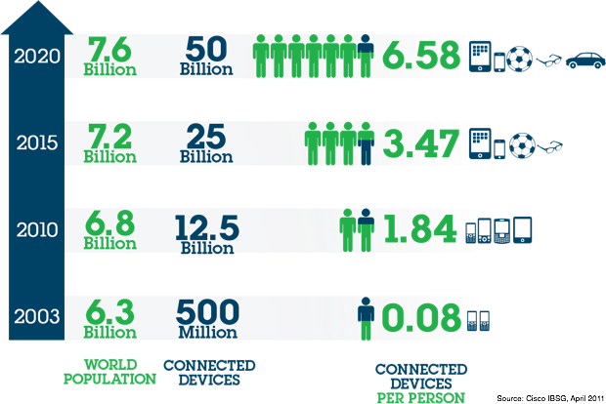
IoT Potential
Conservatively → 20 billion newly connected devices will be deployed.
First public website went live at CERN in 1990.
It took 15 years to reach 1 billion people on earth over the internet.
IoT is looking to add 6 billion connected devices per year.
Economic impact
New revenue streams
Reducing costs
Reducing time to market
Improving supply chain
Reducing production loss
Increasing productivity

Slide 35
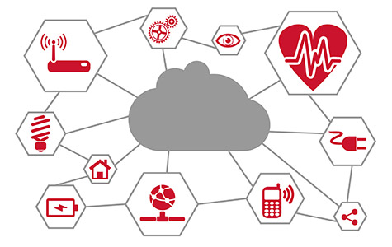
Networking and IoT
The Roles of Networks
Managing connected devices (discovery, join, leave, etc).
Relaying data packets from the source to the destination node in the network.
IoT is a distributed system. All nodes need to perform networking related tasks.
Main concerns as before: Reliability, Performance, Security, QOS, Scalability
http://www.psemi.com/markets/industrial/internet-of-things

Slide 36
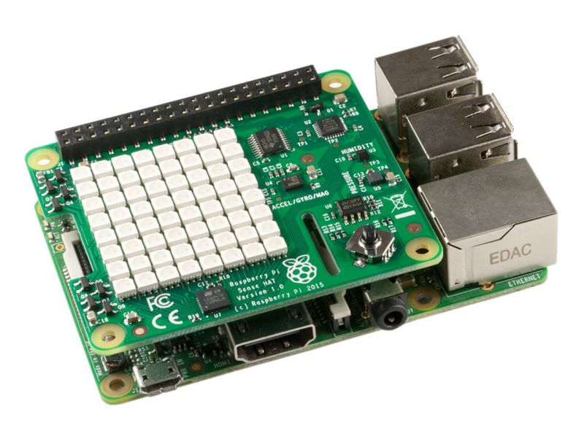
Learning about Networks/IoT
Can't create complex networks at home however you can simulate "virtual networks"
Virtualbox hypervisor
Packet Tracer
Can use programmable, multi-channel, prototyping device to investigate different mediums, protocols, IoT etc.
Raspberry Pi has bluetooth, Wifi, Ethernet, SPI, I2C...

