Slide 1
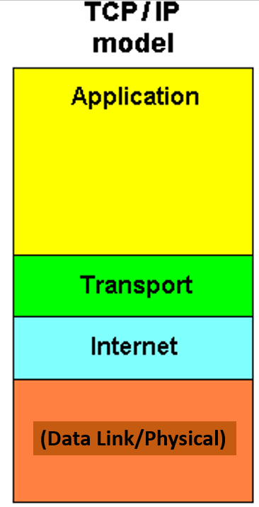

Physical/Data Link Layer

Slide 2

Agenda (1st Part)
Physical Media
Purpose of Data Link Layer
More about topologies
Data Link Frame
Ethernet

Slide 3
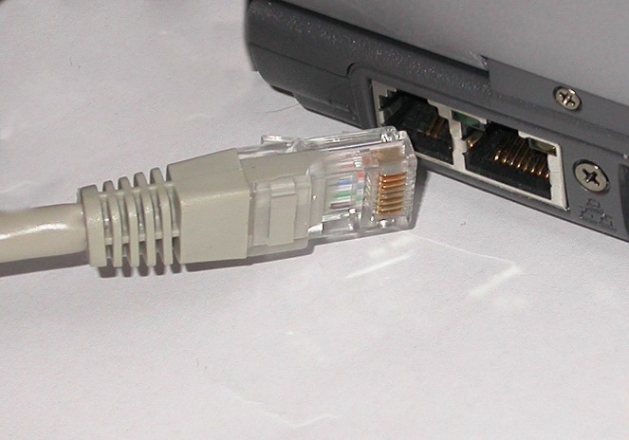
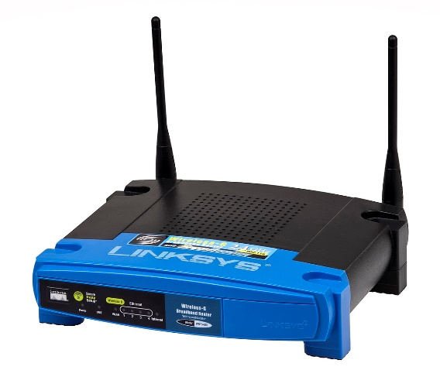






1. Physical Media
RJ 45 Connector
Networks inherently physical
Must have a Physical Connection
A Network Interface Card (NIC)/Network Adapter connects a device to the network.
Some devices may contain more than 1 NIC (How many does your Rpi/Arduino have?)
Can have different performance levels.
Device NIC
This Photo by Unknown Author is licensed under CC BY-SA
Contains
Wireless NIC
This Photo by Unknown Author is licensed under CC BY-SA

Slide 4
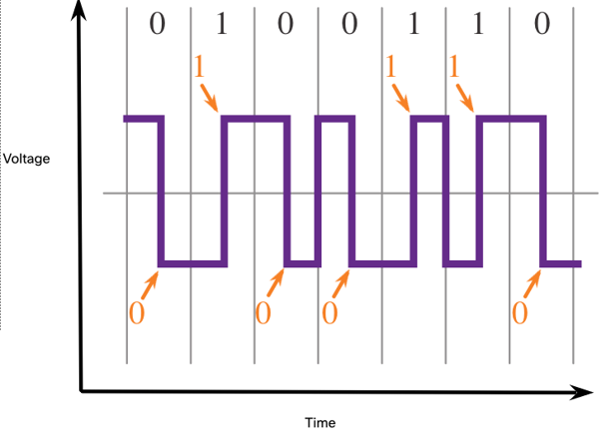
1. Physical Media Characteristics
NICs/cables are specified in standards associated with the physical layer.
Signaling:
the method (voltage, current, RF, light) used to represent binary values on the wire.
Encoding: is how the 1s and 0s will be represented.
Example: Manchester encoding: A “0” is represented by a high to low voltage transition and a “1” is represented as a low to high voltage transition.
Notes:
Manchester encoding (also known as Phase Encoding) is a line code in which each bit of data is represented by at least one voltage level transition, making it a self-clocking signal. It was popularized by its use in early Ethernet standards (10BASE5 and 10BASE2, specifically).

Slide 5
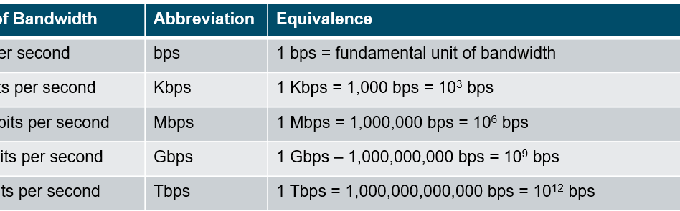
1. Physical Media: Bandwidth, Throughput, Latency
“Never underestimate the bandwidth of a station wagon full of tapes hurtling down the highway” – Andrew Tanenbaum, 1981.
Bandwidth is the max data carrying capacity
Remember last lab: how many bits can be transmitted in a second.
Terminology:
Latency: The time, including delays, for data to travel from one point to another.
Throughput: actual measure of transfer of bits across media in given time.
Throughput is lower than Bandwidth
Sending data via FedEx, theoretically, has better bandwidth than the internet
However, 80,000,000-millisecond ping times (https://what-if.xkcd.com/31/)
Notes:
What Physical media properties, current technologies, and the laws of physics play a role in determining available bandwidth.
What traffic overhead might there be?
Example: Checkout in Supermarket.
Trucks have great throughput because you can carry so much on them, but they are slow to start and stop. Motorcycles have low throughput because you can’t carry much on them, but they start and stop more quickly and can weave through traffic so they have better latency.
throughput is an actual measure of how much data is successfully transferred from source to destination, and bandwidth is a theoretical measure of how much data could be transferred from source to destination.
bandwidth refers to how big the pipe is, and latency is used to measure how fast the contents of the pipe travels to its destination.

Slide 6
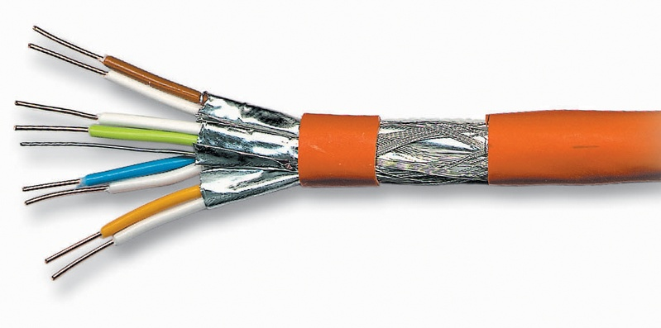
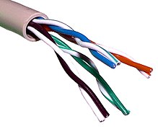
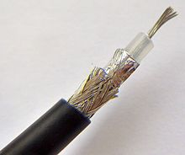
1. Physical Media: Copper Cabling
Shielded Twisted Pair (STP)
Unshielded Twisted-Pair (UTP)
Coaxial Cable

Slide 7
2. Data Link Layer: Main Purpose
Responsible for communication between end device Network Interface Cards(NIC)
Provides access to Physical Media for upper layer protocols (i.e. Network Layer in TCP/IP)
Error Detection and Frame rejection using

Slide 8
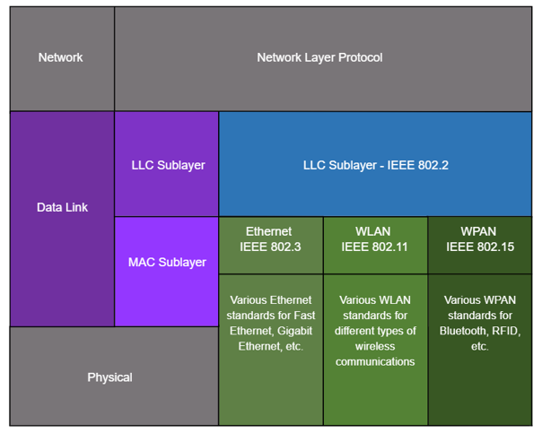
2. Data Link Layer: Standards
The Data Link Layer has two sublayers. Logical Link Control (LLC) and Media Access Control (MAC).
The LLC sublayer communicates between the networking software at the upper layers and the device hardware at the lower layers.
The MAC sublayer is responsible for data encapsulation and media access control.

Slide 9
2. Data Link Layer: Access to Physical Media
Communication between nodes might experience many Data Link Layers and Media Types
For example, Wifi to Ethernet
Each “hop”, a router will carry out the following functions:
Accepts a frame from the network medium
De-encapsulates the frame to expose the encapsulated packet
Re-encapsulates the packet into a new frame
Forwards the new frame on the medium of the next network segment

Slide 10
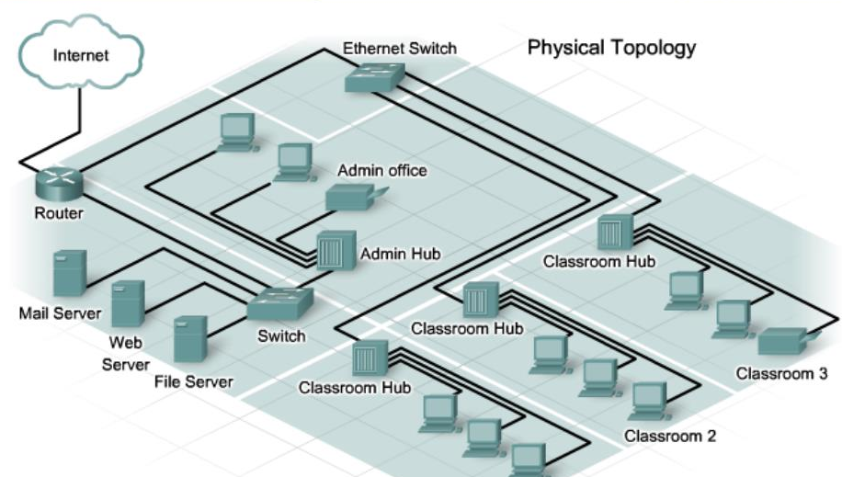
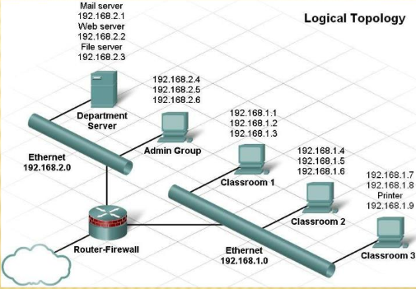
2. Data Link Layer: Topologies
Recap: Network Topology is the arrangement and relationship of nodes and the interconnection between them:
Physical Topology: illustrates physical connections
Logical topology: virtual connections and specifies interfaces and addressing schemes

Slide 11
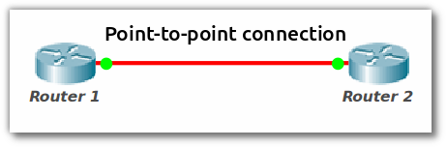
2. Data Link Layer: WAN Topologies
Common WAN topologies are: Point to Point, Hub and Spoke and Mesh
Point to point:
directly connect two nodes
nodes may not share the media with other hosts (means P2P protocols are simple)
This Photo by Unknown Author is licensed under CC BY-SA

Slide 12
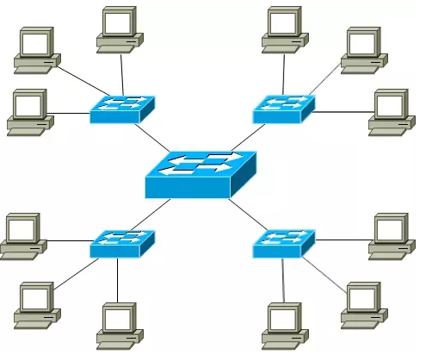
2. Data Link Layer: LAN Topologies
End devices on LANs typically use star/extended stat topology.
Generally easy to scale and troubleshoot.

Slide 13
Data Link Frame

Slide 14
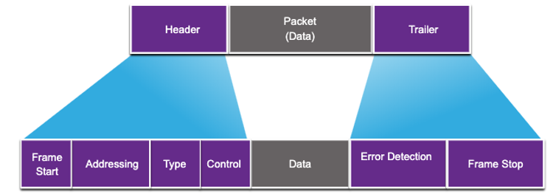
Data Link Layer: Frame Fields:

Slide 15
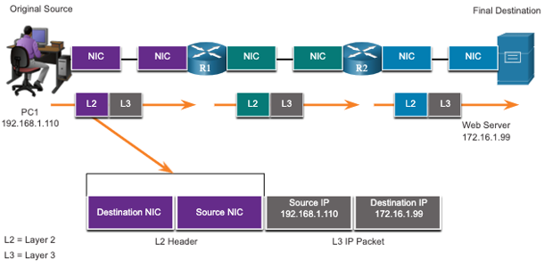
Data Link Layer: Addresses
Also referred to as a physical address or MAC address.
Contained in the frame header.
Used only for local delivery of a frame on the link.
Updated by each device that forwards the frame.

Slide 16
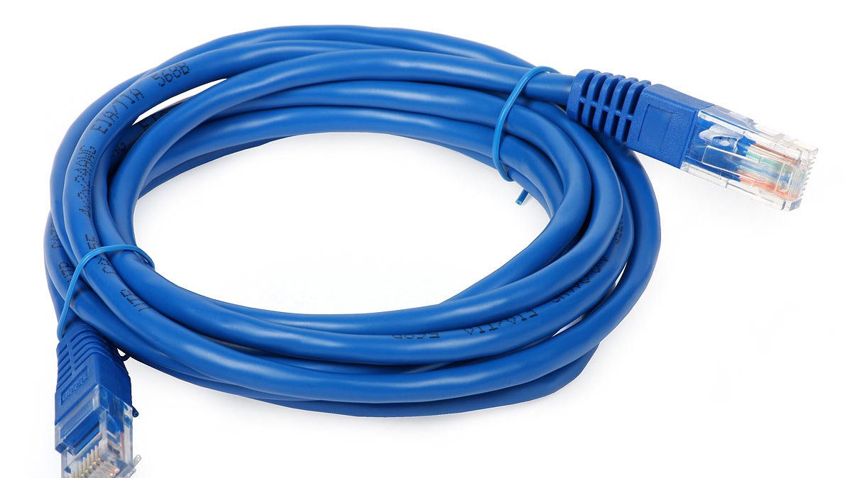
Ethernet
ETHERNET
This Photo by Unknown Author is licensed under CC BY-SA

Slide 17
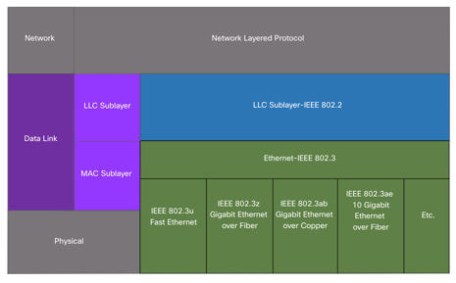
Ethernet: Characteristics
Operates across Data Link/physical layer
Provides the following that pure physical layers do not:
Connects to upper layers (i.e. network)
Provides mechanism to recognise devices
Organises bits into frames
Provides encapsulation into “Frames”
Ethernet Provides Media Access Control
Placement and removal of frames onto media
Media access control for ethernet is CSMA/CD
All devices on network segment share media
All devices receive all frames transmitted on network

Slide 18
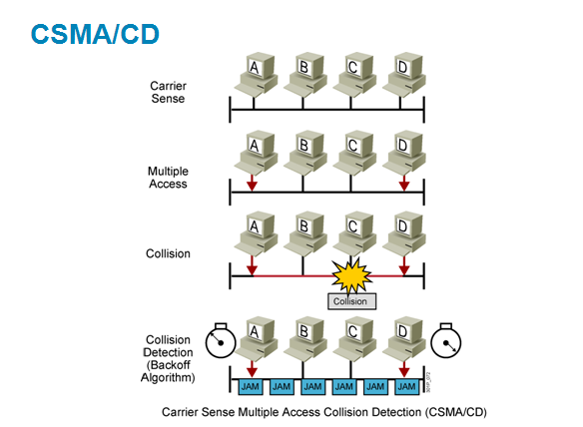
Ethernet: CSMA/CD
Some older Ethernet networks use a bus topology or hubs. In shared medium, uses a contention-based access method, carrier sense multiple access/collision detection (CSMA/CD).
Ethernet LANs of today use switches that operate in full-duplex. Full-duplex communications with Ethernet switches do not require access control through CSMA/CD.

Slide 19
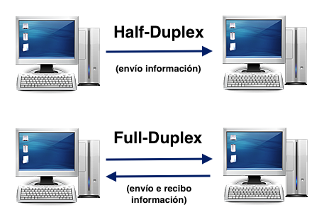
Ethernet Collision Detection
In shared media, only one device can transmit
More devices on network => more collisions
Switches reduce collisions
Switches isolate each port and can send a frame to its destination (if known) rather than every device
Often uses twisted pair cabling:
Allows for one pair for transmission, one for receiving.
The capability to do both simultaneously is called full duplex
No contention for media => no collision domain => No need for CSMA/CD
This Photo by Unknown Author is licensed under CC BY-SA

