Slide 1
Security Lights
Subscribes
Event Broker
Motion Sensor
Camera
Publish
Subscribes
Subscribes
Push Notification
Subscribes
Future Process

Slide 2
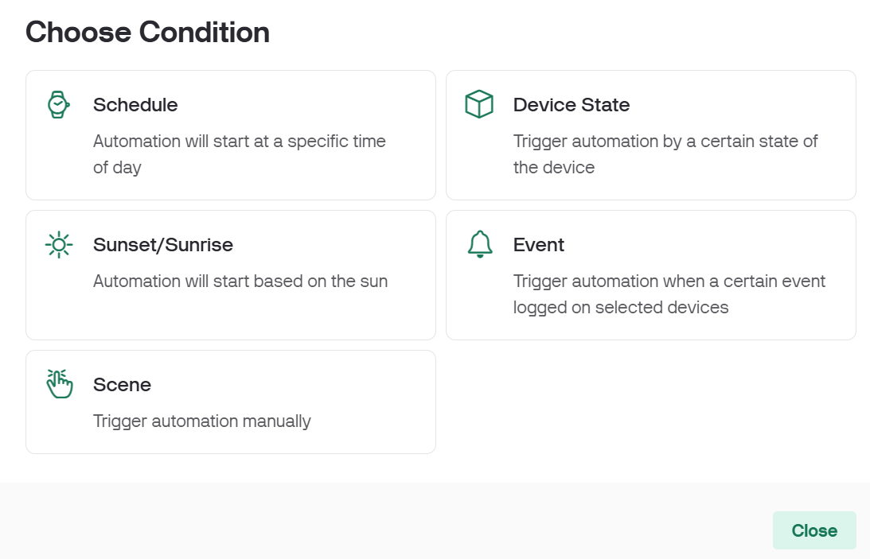
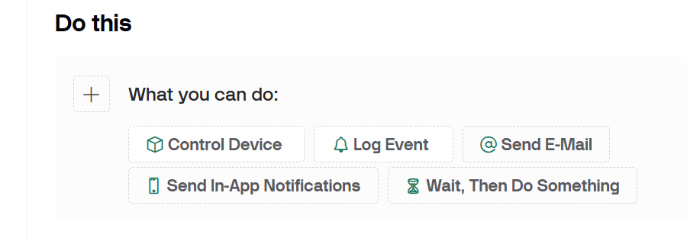
Condition
Action(s)

Slide 3
Security Lights
Request/Resp
Motion Sensor
Camera
Request/Resp
Request/Resp
Push Notification
Future Process

Slide 4
Security Lights
Request/Resp
Motion Sensor
Camera
Request/Resp
Request/Resp
Push Notification
Future Process

Slide 5





Event Producers
Event Consumers
Event Channel
Event DB
Event Processor

