Slide 1
Simulating Sensors in PT
Frank Walsh

Slide 2
Context
You want to create a project but you don’t have all the devices required
You want to test scenarios that are difficult to create/repeat in real world
High/low temperatures and extreme environmental conditions
Repeatable Tests - Test your software/hardware use cases after a change is made
Prototyping/feasibility: test a solution before you purchase/acquire hardware

Slide 3

Asside: Digital Twin
A digital twin is a digital representation of a physical asset (e.g., a sensor, device, or system) that models its behaviour and state, often using live and historical data from the real asset to stay synchronized and support simulation and analysis.
Near Real-Time Operation: reflects the state of a corresponding physical counterpart or simulates it based on defined parameter
Repeatable Testing: Consistent, repeatable testing scenarios, ensuring that edge cases, errors, and performance can be tested
Integration Testing: integrating and testing systems, such as IoT applications, without requiring the actual physical devices to be present in early-stage development.
Scalability and Flexibility: can simulate multiple devices and can be easily modified to adjust parameters or simulate different environmental conditions and various use cases.
Notes:
Packet Tracer provides a virtual sensor simulation environment. It supports digital-twin-style testing for IoT integration, but it is more accurately described as a simulator unless it is linked and synchronized with a specific physical device

Slide 4
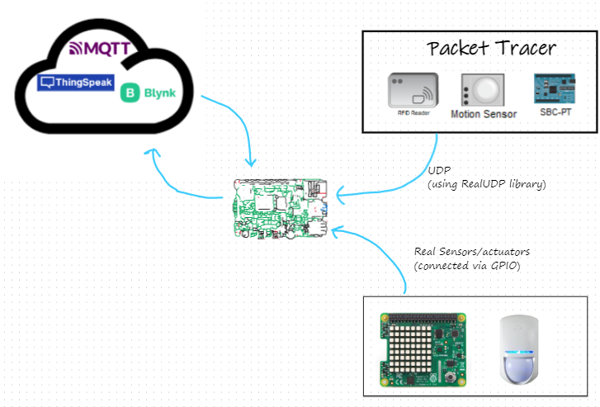
Generalised Design:

Slide 5
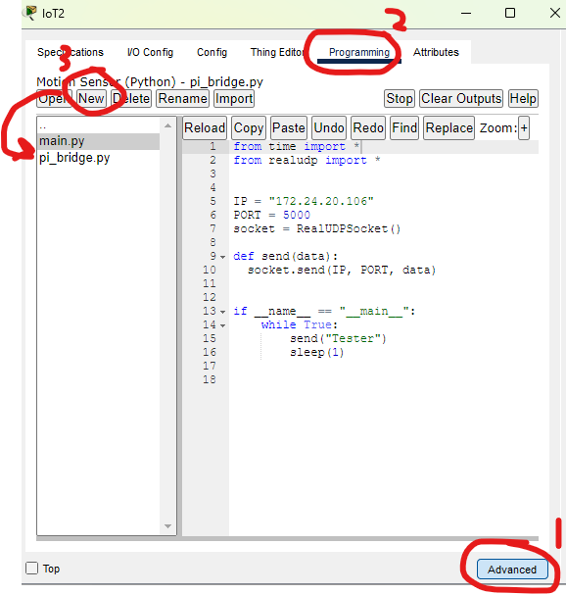
1. Update Sensors
Update PT sensors to send data via UDP
Add sensor to PT workspace.
Open Sensor configuration and click on Advanced
Select “Programming” tab
Select Python version of running program
Add “bridging” module
Sends UDP datagram with sensor data to external UDP server
Import bridging module and call to send data.

Slide 6
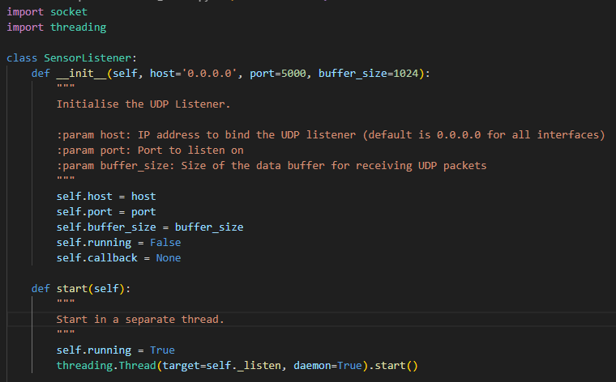
2. Sensor Listener Module
Develop a sensor module that “listens” for PT sensor data and can provide it to other programs
Develop sensor_listener module
Instances receive data from sensors (or other devices) over a network using UDP
Import into other programs to receive sensor data.
Uses Theading to start the UDP listening process separate to the main program
Deploy with main program

Slide 7
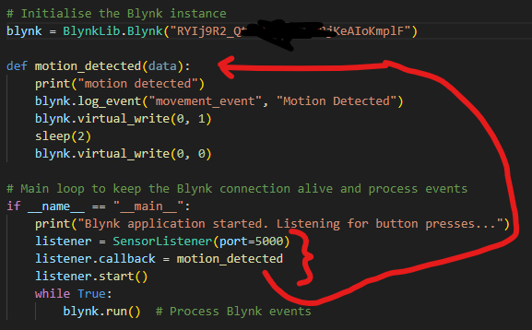
3. Import into Main Program
Import Sensor Listener into main program
Instead/substituting sensor
Create instance and assign “callback” function to handle sensor data events as they occur.

Slide 8
DEMO!
PT Simulation and Code available on Website…

