Slide 1
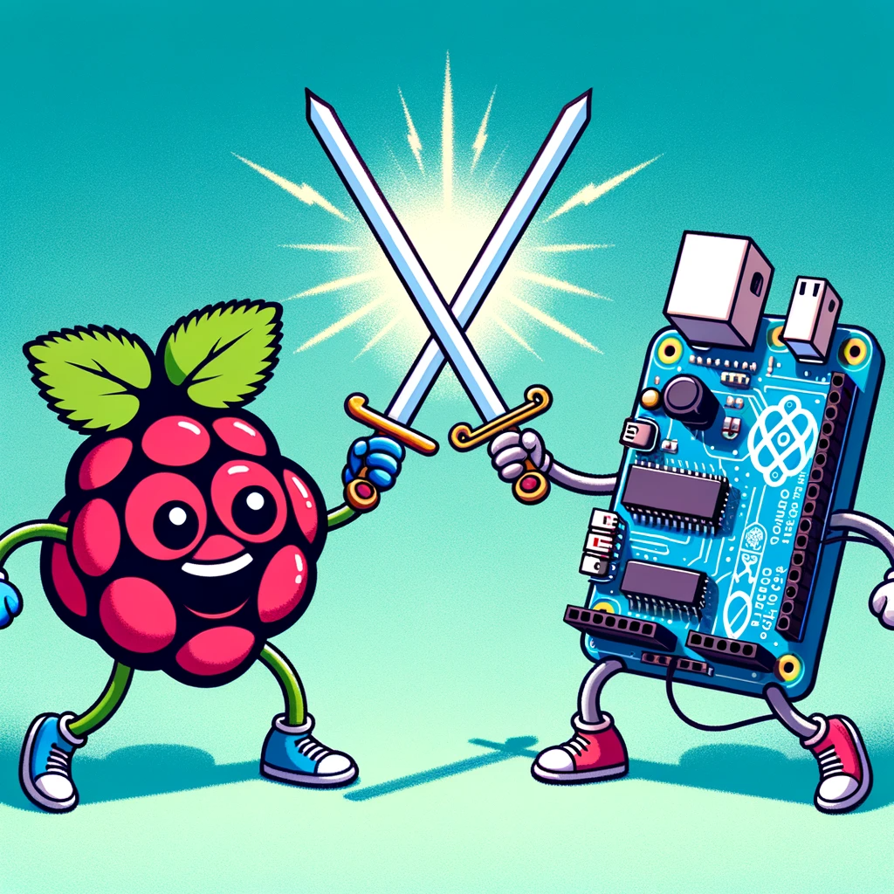
Single Board Computers
Frank Walsh
2025

Slide 2
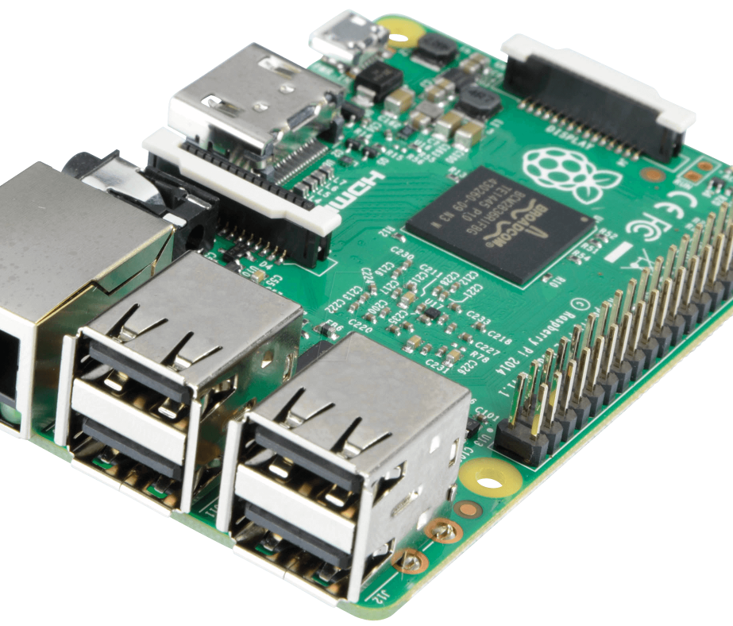
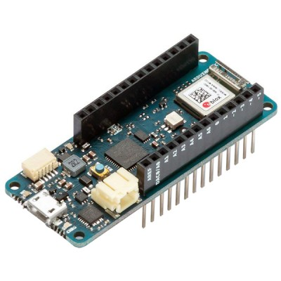
Single Board Computers (and a little about μC!)
Single Board Computer – What
Microcrontrollers
Raspberry Pi(RPi) Introduction
Getting Started with the RPi
Conventional vs Headless+
Connecting Hardware+ SenseHAT
This Photo by Unknown Author is licensed under CC BY-SA-NC
This Photo by Unknown Author is licensed under CC BY-NC

Slide 3
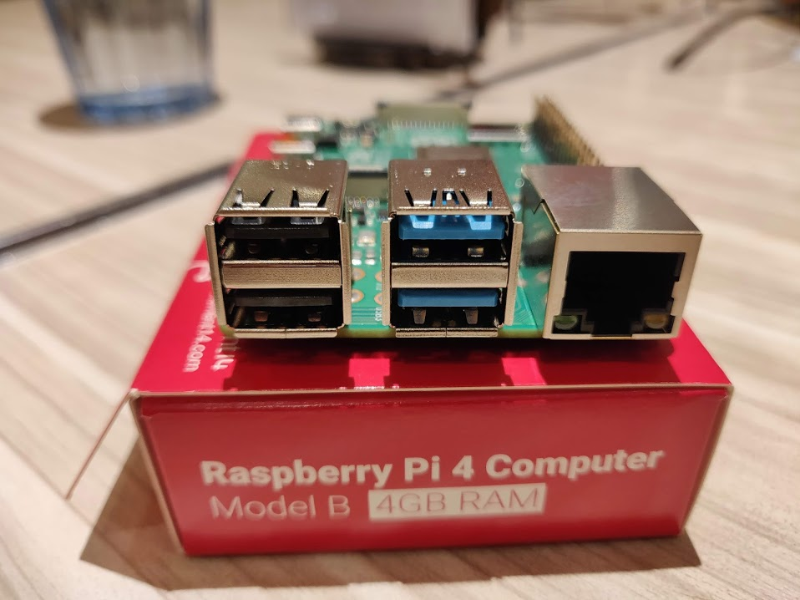
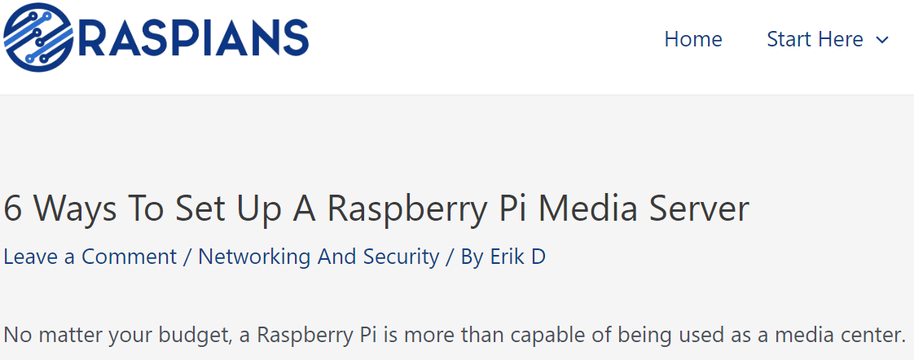
What is a Single Board Computer(SBC)?
A complete computer on a single board
CPU, RAM, storage, and I/O ports.
Runs a full-fledged operating system
Linux distributions
Capable of multitasking, web browsing, and running software applications.
Examples: Rpi 4.
This Photo by Unknown Author is licensed under CC BY-SA

Slide 4
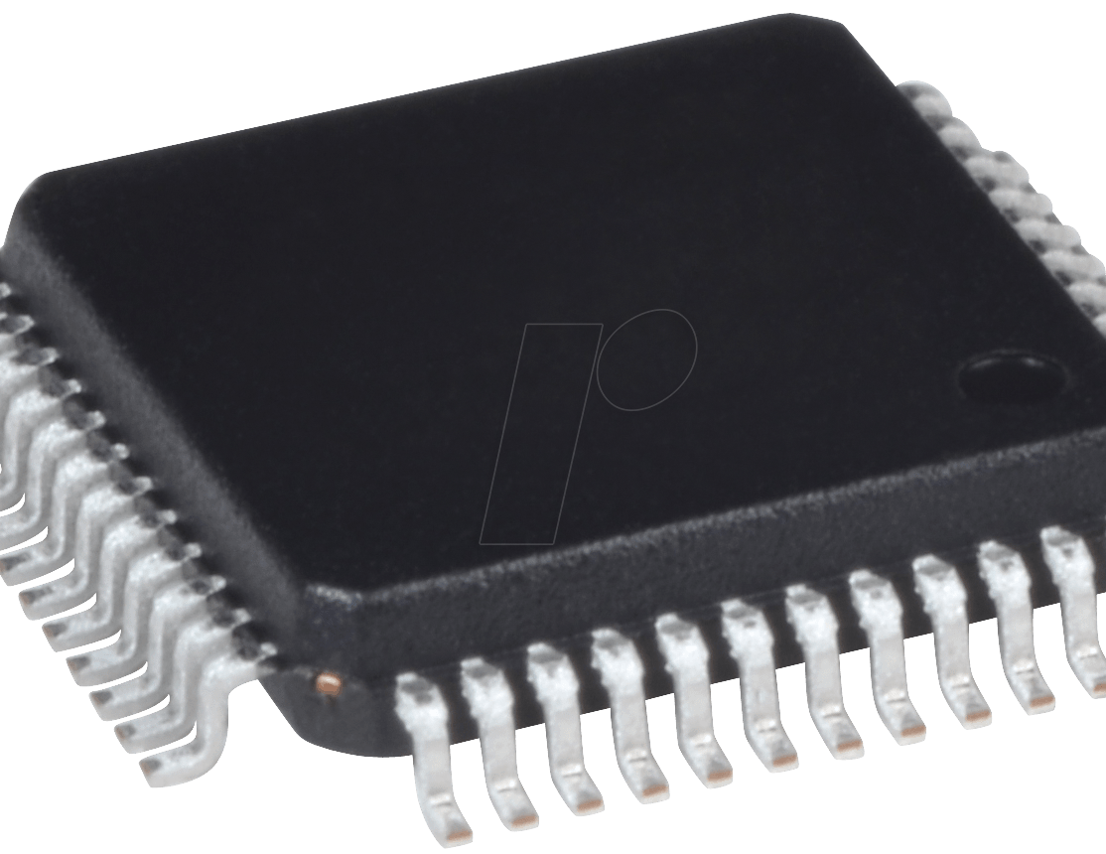
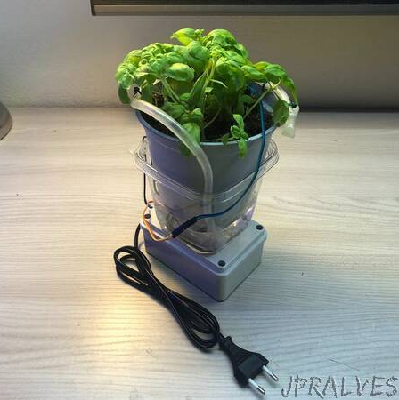
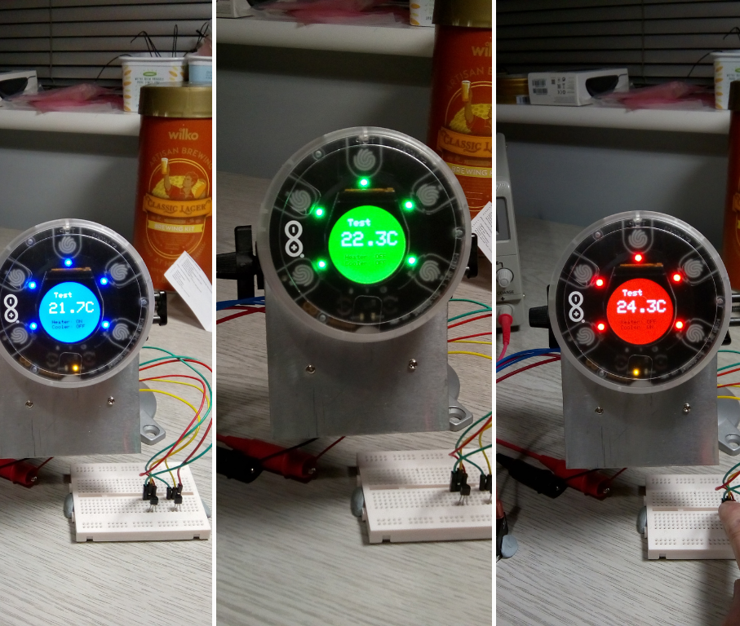
What is a Microcontroller?
A compact computer on a single chip designed for specific operations in embedded systems.
Contains a CPU, small RAM, storage, and operates without a full OS.
Executes pre-programmed tasks, ideal for hardware interactions.
Examples:
Washing machines (to control cycles)
Microwaves (to read buttons and run the timer)
Cars (to monitor engine sensors)
Toys and remote controls
This Photo by Unknown Author is licensed under CC BY-NC
This Photo by Unknown Author is licensed under CC BY-NC-ND

Slide 5
SBCs vs. Microcontrollers Key Differences
Microcontrollers
Designed for specific tasks — no operating system overhead
Continuously loop, waiting for sensor input and responding instantly
Can guarantee predictable response times
Use interrupts to react immediately to events (e.g. triggered by a tilt sensor in a car)
Single-Board Computers (SBCs)
Run full operating systems (e.g. Linux)
Handle many tasks via scheduling and background processes
Response times vary — not suitable for strict real-time control
Summary:
Microcontrollers can operate in real-time SBCs generally cannot

Slide 6
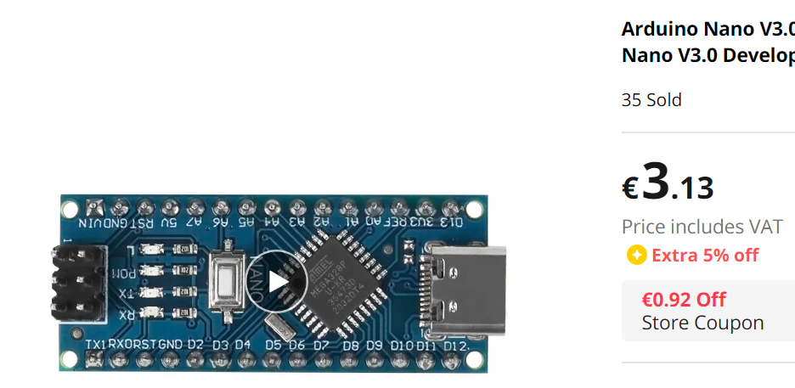
SBCs vs. Microcontrollers Key Differences
Power Consumption: Microcontrollers is more energy-efficient than Raspberry Pi.
Complexity: Raspberry Pi can handle intricate,complex tasks due to its robust CPU architecture, memory resources and OS.
Boot Time: Microcontrollers start nearly instantly, while Raspberry Pi requires boot-up time(like your laptop).
Cost: Microcontrollers are generally cheaper than SBCs.
Development: Raspberry Pi offers a typical Operating System and desktop-like environment, whereas Microconrollers requires external coding and uploading.
Notes:
A simple Arduino doing sensor readings and sending data uses around 0.25 W, which is 12–16× less power than a Raspberry Pi 4. That’s why battery-powered or ultra-low-power IoT devices almost always use microcontrollers instead of full computers like the Raspberry Pi.

Slide 7


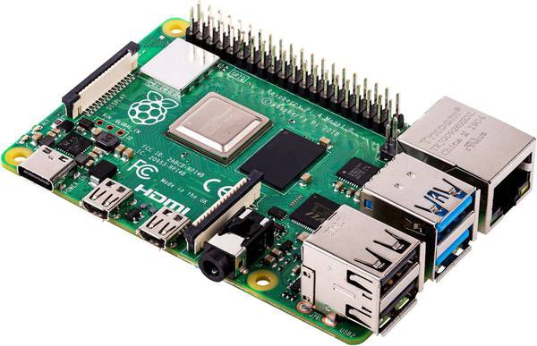
Which one???
Task Simplicity:
Use Microcontroller for simpler, hardware-focused tasks.
Use Raspberry Pi for complex tasks or when a full OS is beneficial (e.g. image processing, DB I/O).
Power Constraints: For battery-operated or energy-efficient systems, Microcontroller is often a better choice.
Integration: Raspberry Pi is ideal for projects that need internet connectivity, computation & processing, or integration with complex software.
Budget: Consider cost implications, especially for large scale or commercial projects.

Slide 8
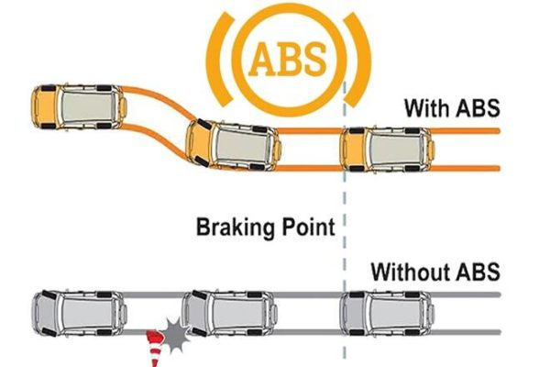
Example Use Case1: ABS
Anti-lock Braking System (ABS)
ABS is a safety anti-skid braking system that prevents the wheels from “locking up” during braking, which helps the driver maintain control.
How it works:
Wheel Speed Sensors constantly measure the speed of each wheel and send this data to the ABS controller.
ABS Controller processes the wheel speed data and determines if a wheel is about to lock up.
If the ABS Controller detects a wheel is about to lock, it decreases the pressure to the brake until the wheel starts moving again.
Safety Critical System: Has to Work Always, Has to be Reliable, Has to be Fast, Can’t be waiting around for processor timeslot
This Photo by Unknown Author is licensed under CC BY-SA-NC

Slide 9
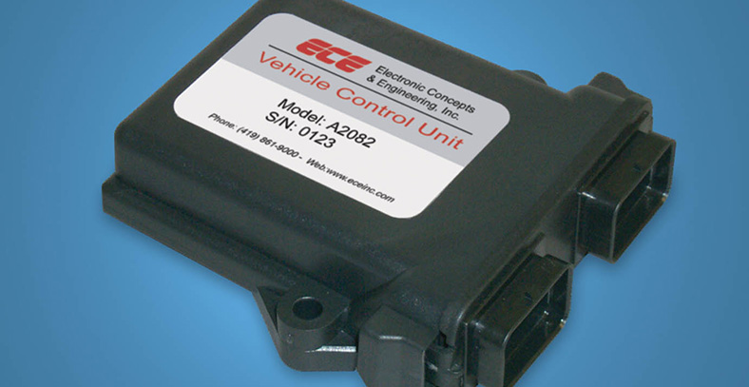
Example Use Case1: ABS
The ABS controller needs to operate in real-time.
When a driver steps on the brake pedal, the ABS must instantly assess and react to wheel slip conditions to prevent skids
A delay in processing could reduce the effectiveness of the ABS, leading to potential accidents.
Microcontroller is the best option here and are used extensively in the automotive industry where safety, performance, and reliability are critical.(Incorporated into ECUs(electronic control units)

Slide 10
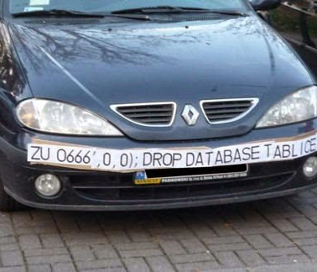
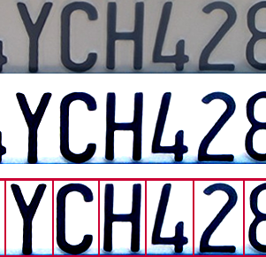
Example Use Case2: Licence Plate Recognition (LPR)
LPR systems automate the process of identifying a vehicle's license plate to manage access, billing, security….
Capture: Cameras take images of vehicles' as they come and go.
Image Processing: The system processes these images to enhance clarity, adjust lighting, and prepare the image for plate extraction.
Plate Extraction: Program identify the rectangular region of the image containing the license plate.
Optical Character Recognition: The system then processes this extracted portion to recognise and read the characters on the license plate.
Database: The licence plate number is used to query/update a DB
This Photo by Unknown Author is licensed under CC BY-SA
This Photo by Unknown Author is licensed under CC BY-NC

Slide 11
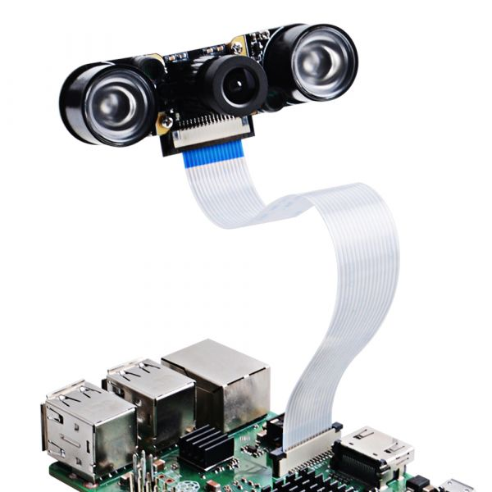
Example Use Case2: Licence Plate Recognition (LPR)
A lot of computationally expensive processing here (image processing). May need a lot of CPU power and memory.
Short period to acquire, process and recognise licence plate is acceptable.
Quick, but not exact real-time processing, is OK.
Nobody will be hurt if it fails – not safety critical.
A networked/connected Single Board Computer connected to Camera is a viable option here.
This Photo by Unknown Author is licensed under CC BY-SA-NC

Slide 12
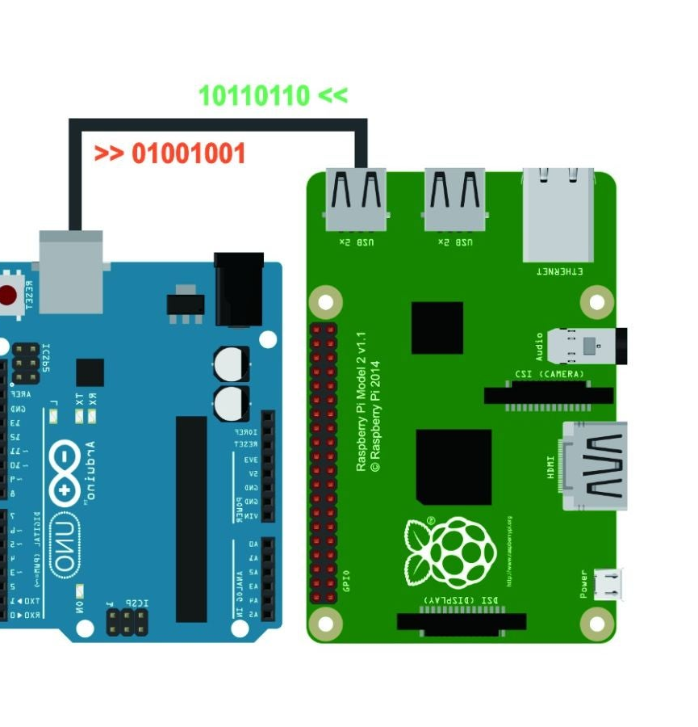
Can you use both together?
Yep! If you want
Why?
Microcontrollers are reliable, real-time and interface well with sensors (analog/digital sensors)
OS on computer have a lot of processing power/software to work on data but can crash and have security vulnerabilities like any computer.
Use Microcontroller to interface/control sensors and actuators
Use SBC to process data/connect to other networks and services.
Notes:
Microcontroller side (low power)
Continuously monitors a PIR motion sensor.
Runs on very little power, so it can stay active all the time.
When motion is detected, it sends a signal to the Raspberry Pi, Wi-Fi, or MQTT.
Single-board computer side (high capability) via serial
Normally in sleep or low-power idle mode to save energy.
When triggered by the microcontroller, it:
Activates the camera.
Records or streams video.
Uses AI (e.g. TensorFlow Lite) for object or face recognition.
Uploads footage to cloud storage or sends a notification to your phone.
⚙️ Why Use Both?
The microcontroller handles real-time sensing efficiently and cheaply.
The Raspberry Pi handles complex processing and network tasks that need more computing power.
This combination gives fast response, low power consumption, and advanced functionality.

Slide 13
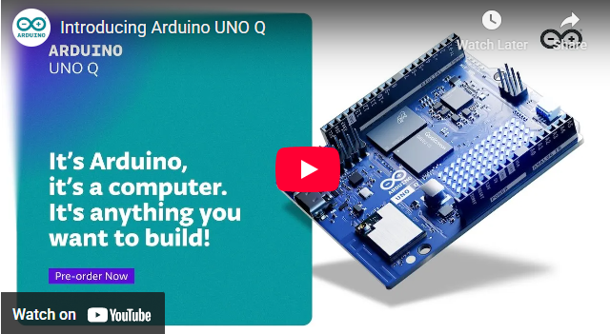
Best of Both Worlds
Arduino Uno Q
"Combines a Linux® Debian-capable Qualcomm® Dragonwing™ QRB2210 microprocessor with a real-time STM32U585 microcontroller (MCU). It’s Arduino, it’s a computer, it’s anything you want to build."

Slide 14

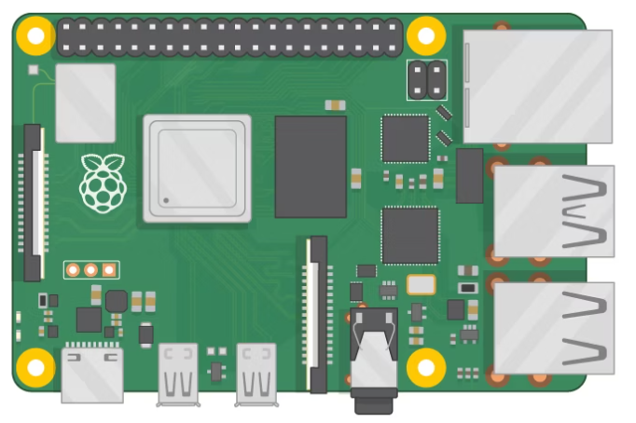
Raspberry Pi 4
Low cost, single board computer
Linux OS
Same features as most laptops/workstations
40 pin GPIO
System on Chip(SoC) including CPU
RJ45 Ethernet
LCD Display
USB Ports
Camera
Power
HDMI
3.5mm audio
Notes:
⚙️ System-on-Chip (SoC): A single chip that integrates the CPU plus other key components like the GPU, memory controller, I/O interfaces, and sometimes even wireless radios. Example: Broadcom BCM2711 (used in RPi 4) integrates:
4× ARM Cortex-A72 CPU cores
VideoCore VI GPU
Memory controller (for LPDDR4 RAM)
USB, Ethernet, HDMI, and peripheral controllers

Slide 15
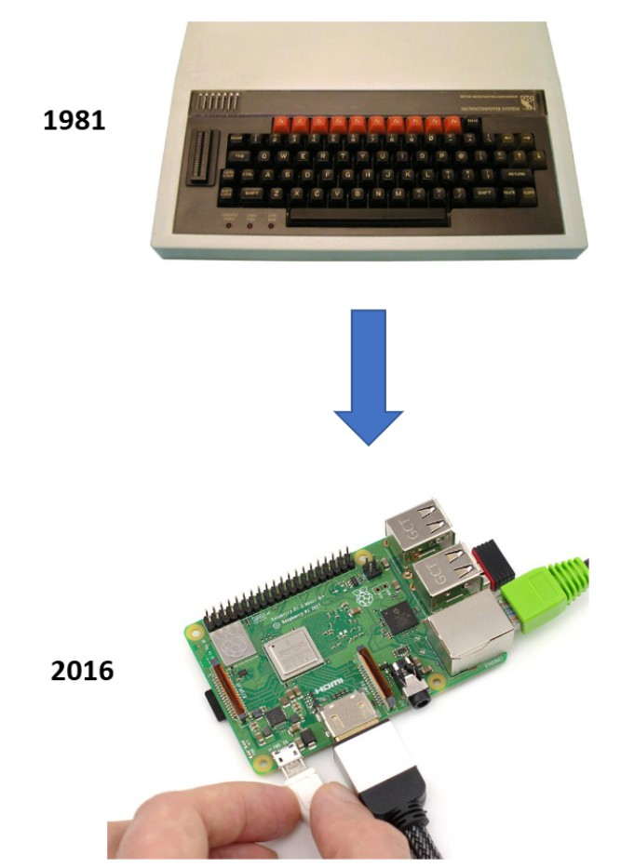
Raspberry Pi History
First launched in 2012 by the Raspberry Pi Foundation in the UK.
Inspired by BBC Micro
Aimed to make computing accessible to everyone.
Evolved from the original Raspberry Pi Model B to the latest Raspberry Pi 4 and Raspberry Pi 400.
Notes:
£399 in 1982
€2,080 in todays money BTW it had 64KB of ram. Your Rpi has 2GB – 32000 times more I’ll not even talk about

Slide 16
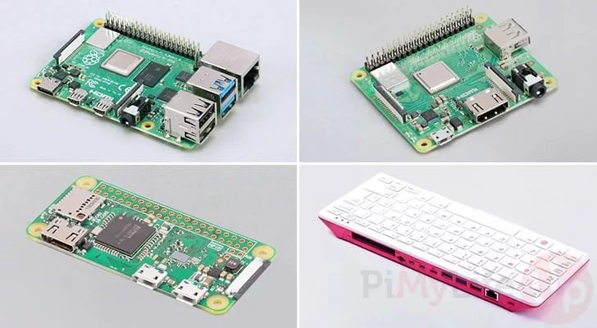
Raspberry Pi Models
Raspberry Pi 4: 2GB, 4GB, or 8GB of RAM
Raspberry Pi 5: 4GB or 8GB of RAM, significantly faster 2.4GHz quad-core Cortex-A76 CPU
Raspberry Pi Zero: Ultra- compact.embedded/ lightweight applications;
Raspberry Pi 400: Keyboard- integrated model containing Pi 4-class hardware, designed for
an all-in-one desktop computing
8

Slide 17
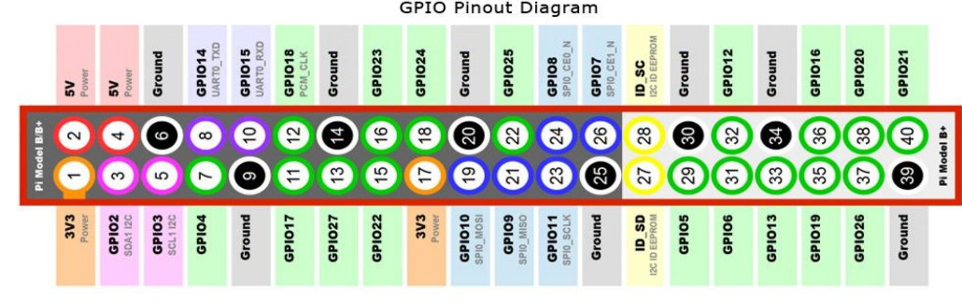
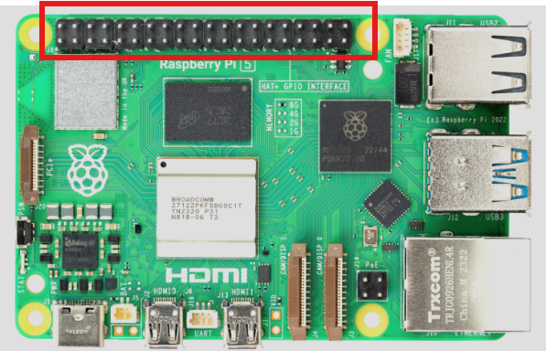
GPIO Pins and Hardware Control
GPIO (General Purpose Input/Output) pins allow control over electronic devices.
Used for:
Sensors
LEDs
Motors Cameras
Makes Raspberry Pi ideal for robotics and IoT projects.
9

Slide 18
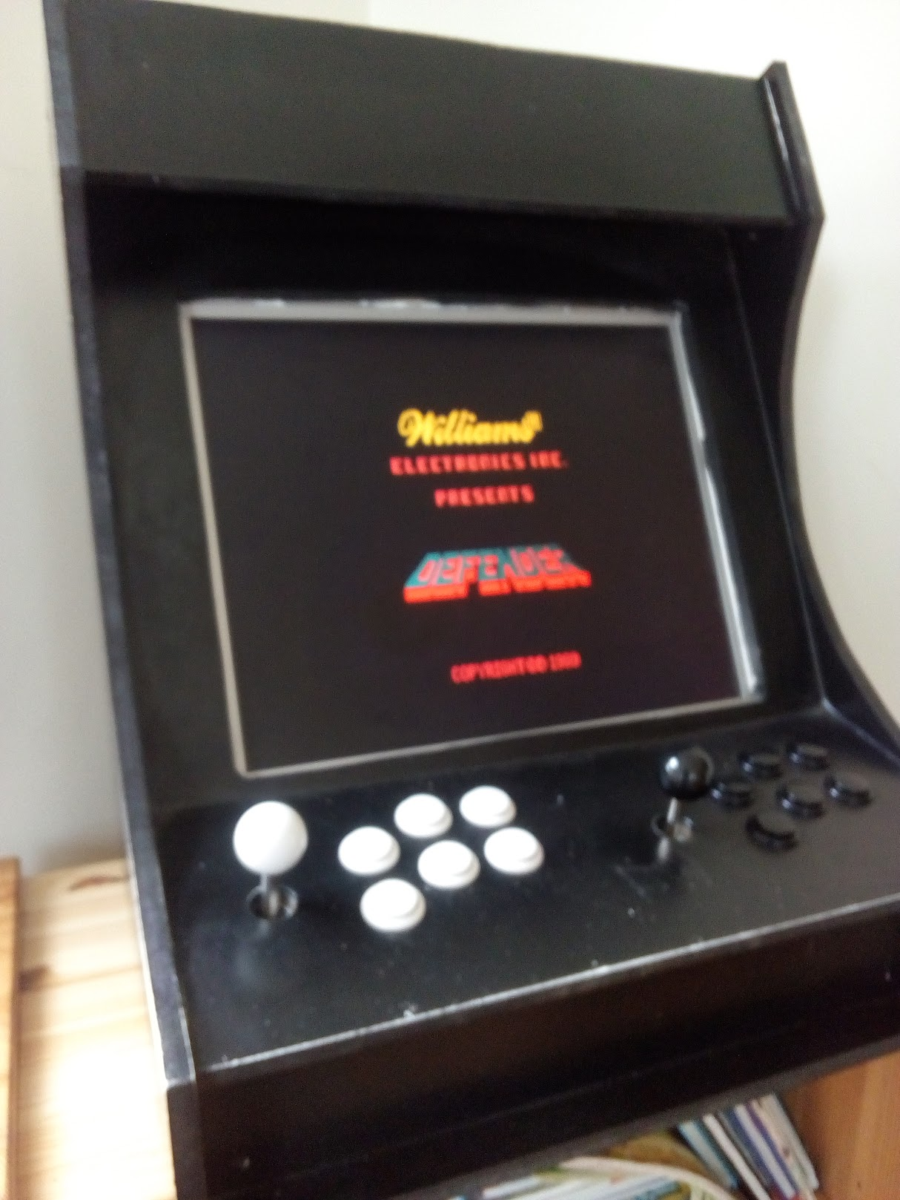
Popular Applications of Raspberry Pi
Education: Teaching programming and computer science.
DIY Projects: Smart home devices, weather stations, robots, etc.
Media Centers: Turn your TV into a smart media center with software like Kodi.
Gaming: Retro gaming consoles using RetroPie.

Slide 19
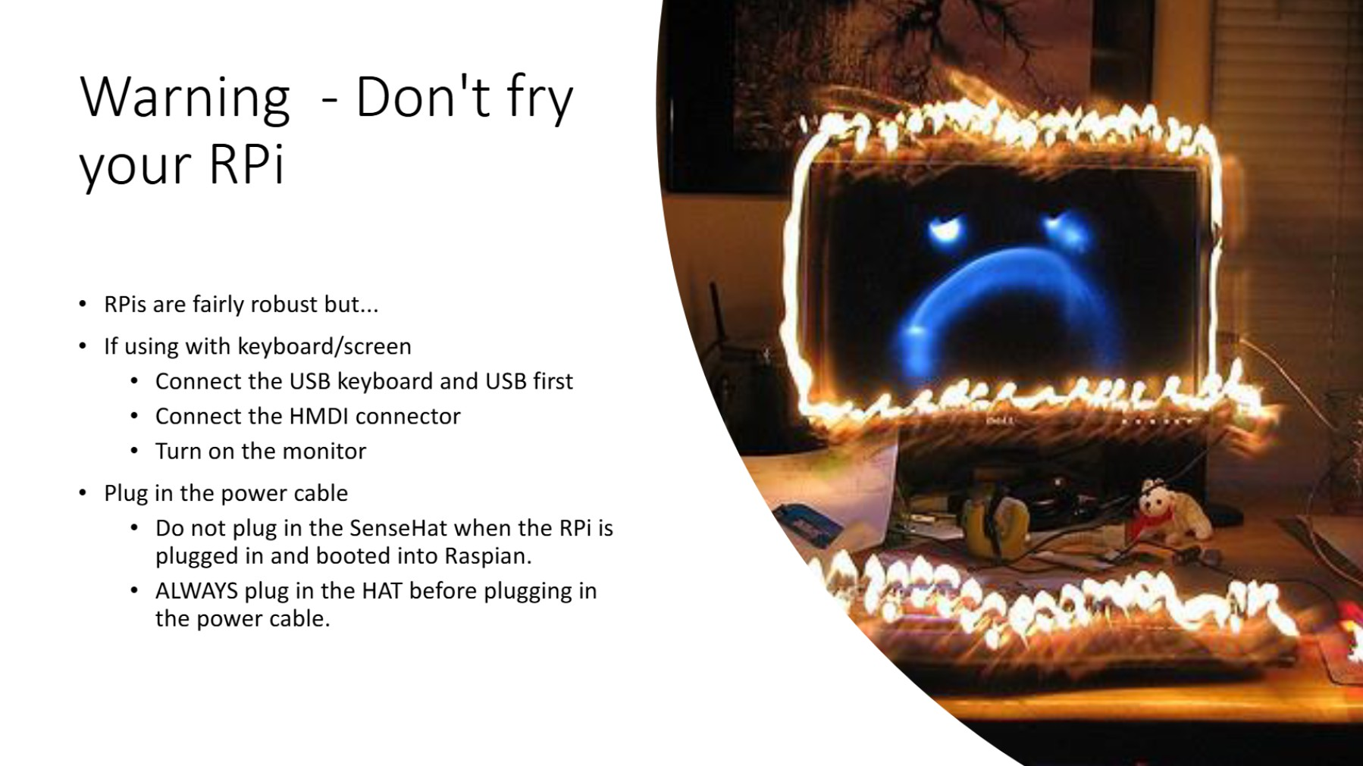

Slide 20
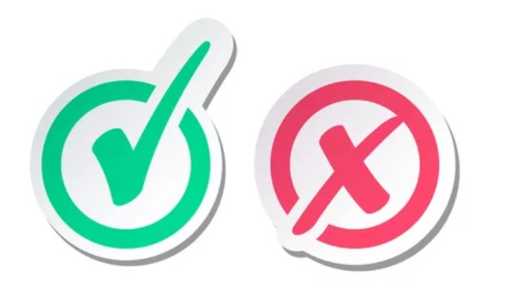
Pros and Cons of Raspberry Pi
Pros:
Affordable
Versatile and customizable Large community and resources
Cons:
Limited processing power compared to full desktops and laptops
Usually need to get more stuff (enclosure, HATs, LCD Screens, cables)

Slide 21
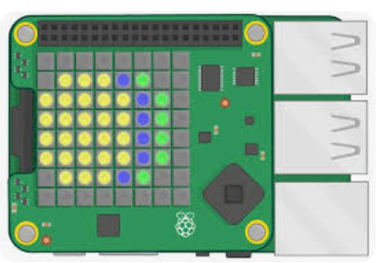
SenseHAT
The Sense HAT (Hardware Attached on Top) is an add-on board for the Raspberry Pi featuring a collection of sensors and a programmable LED matrix
LED Matrix: An 8x8 RGB LED matrix for display and visual output.
Sensors:
Temperature
Humidity Pressure
Gyroscope (orientation)
Accelerometer (movement)
13

Slide 22
Attaching the SenseHAT
See the Lab

Slide 23
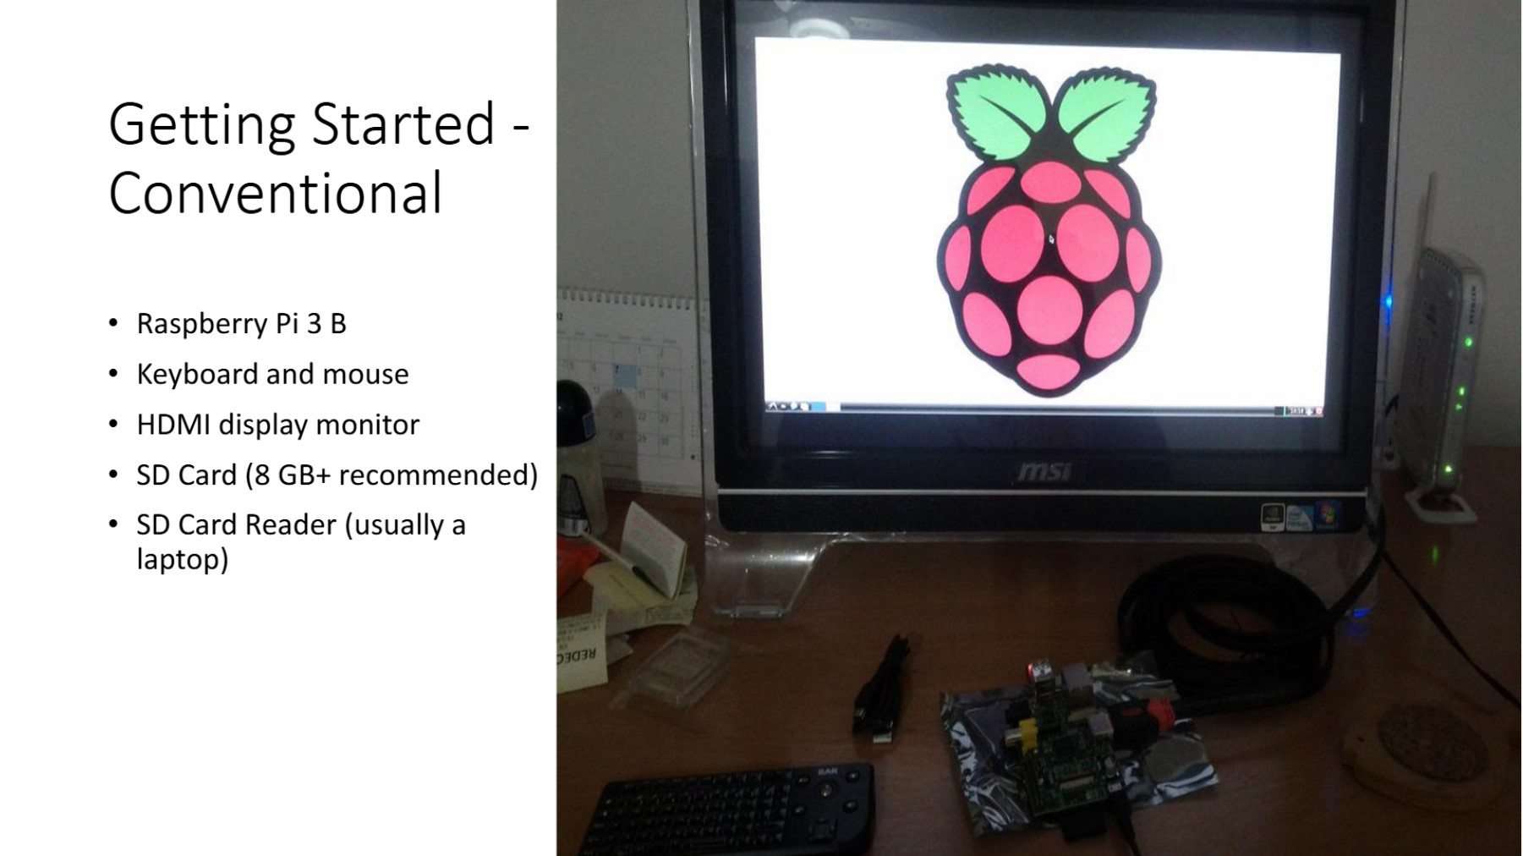

Slide 24
