Slide 1


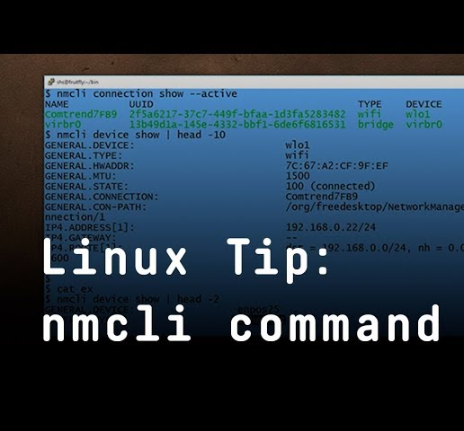
Connecting and Configuring your RPi using SSH, mDNS and Network Manager(nmcli)

Slide 2
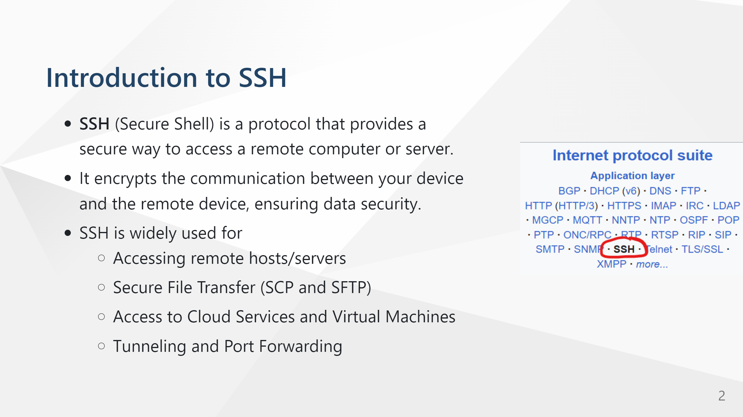

Slide 3
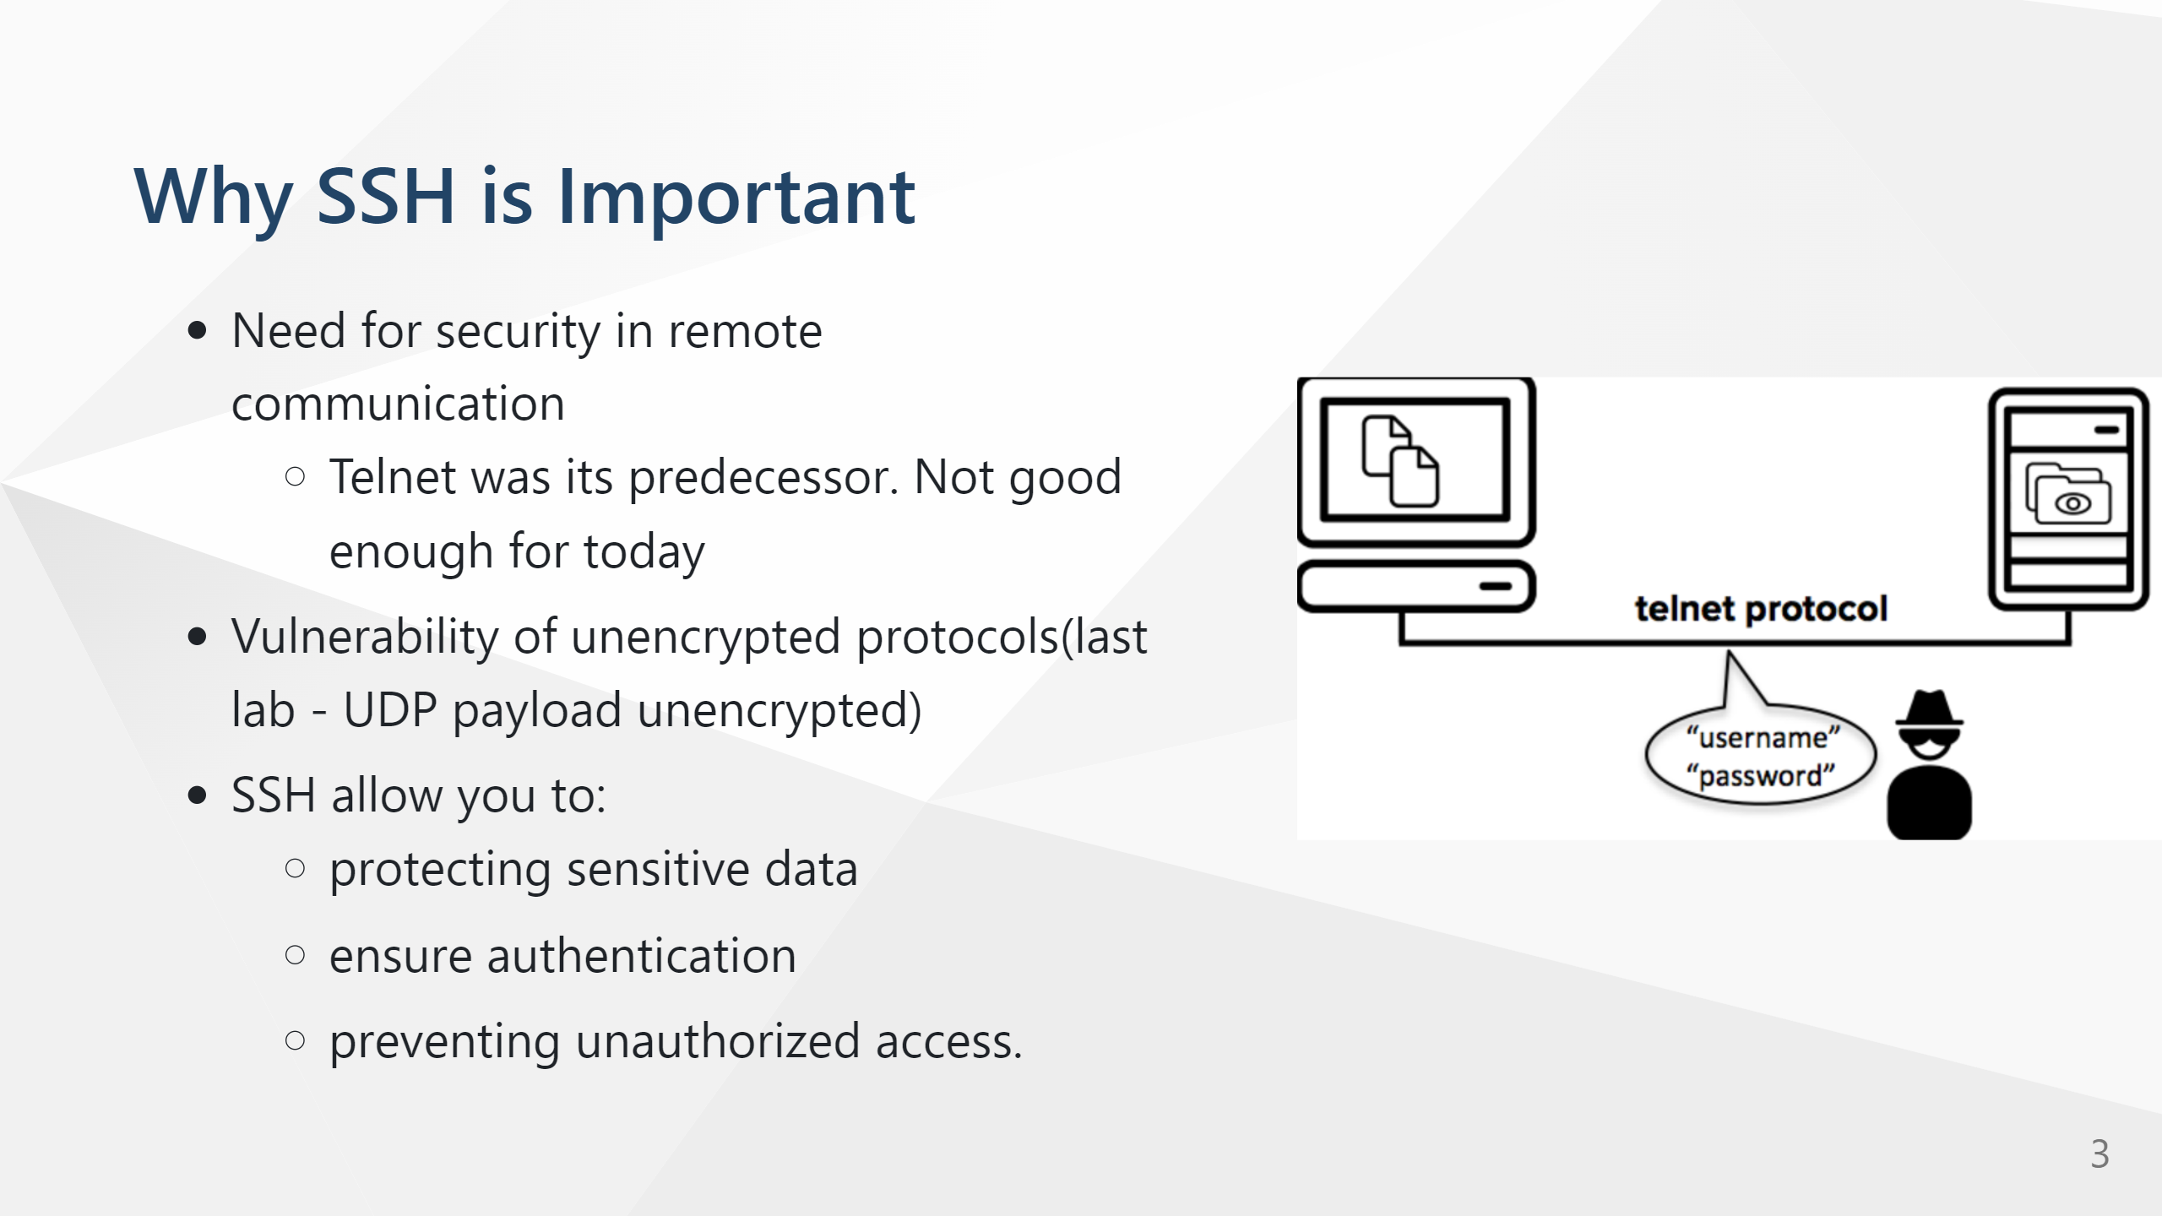

Slide 4
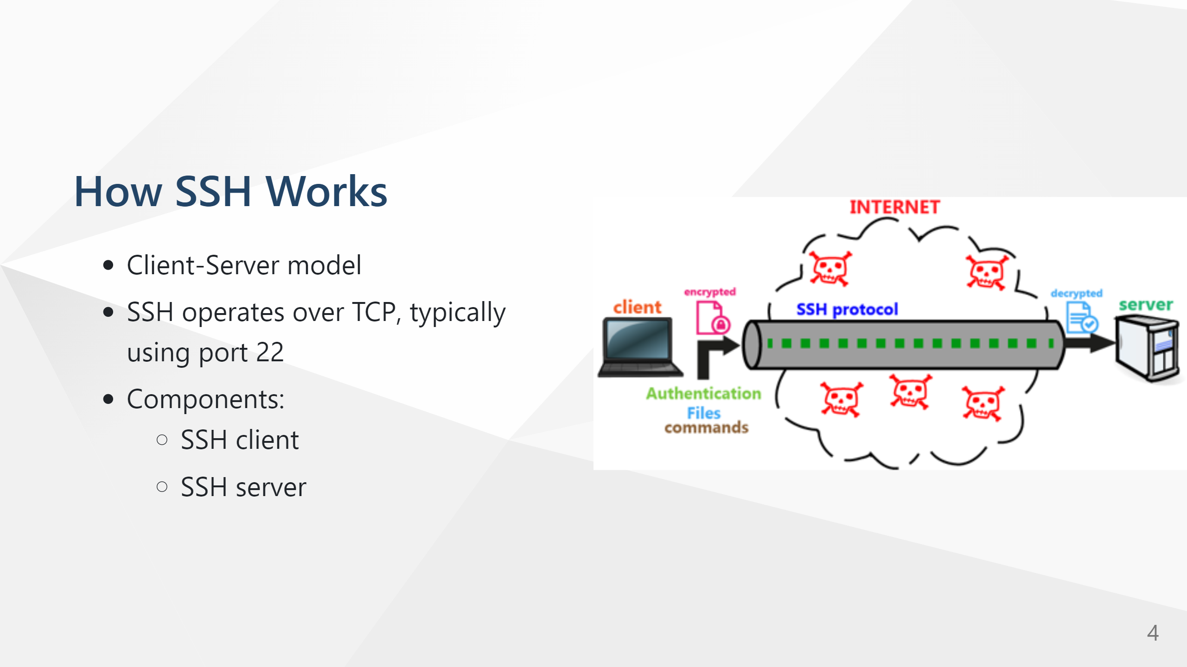

Slide 5
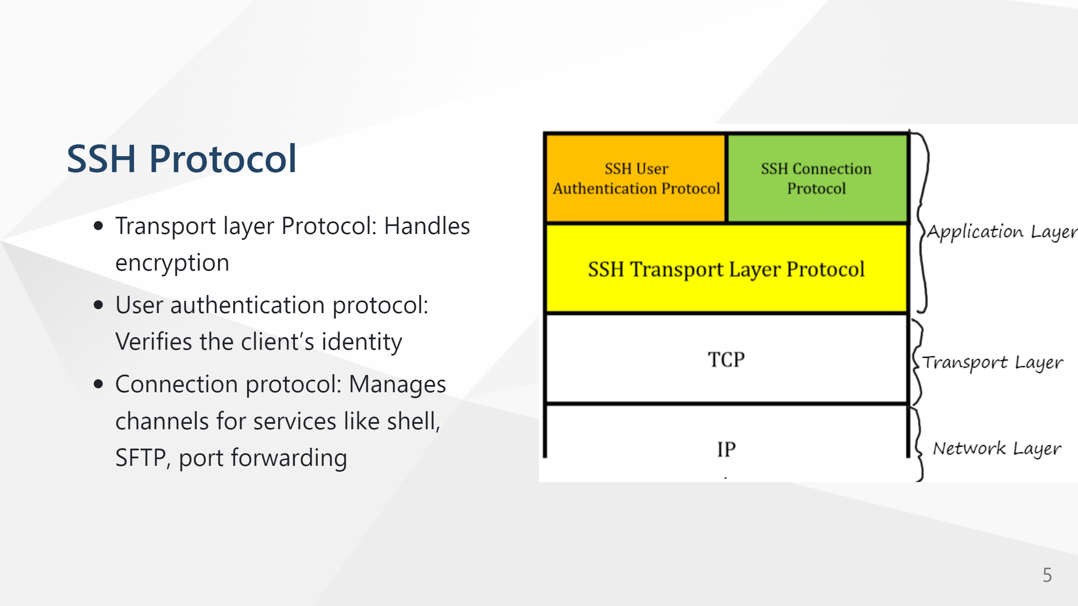

Slide 6
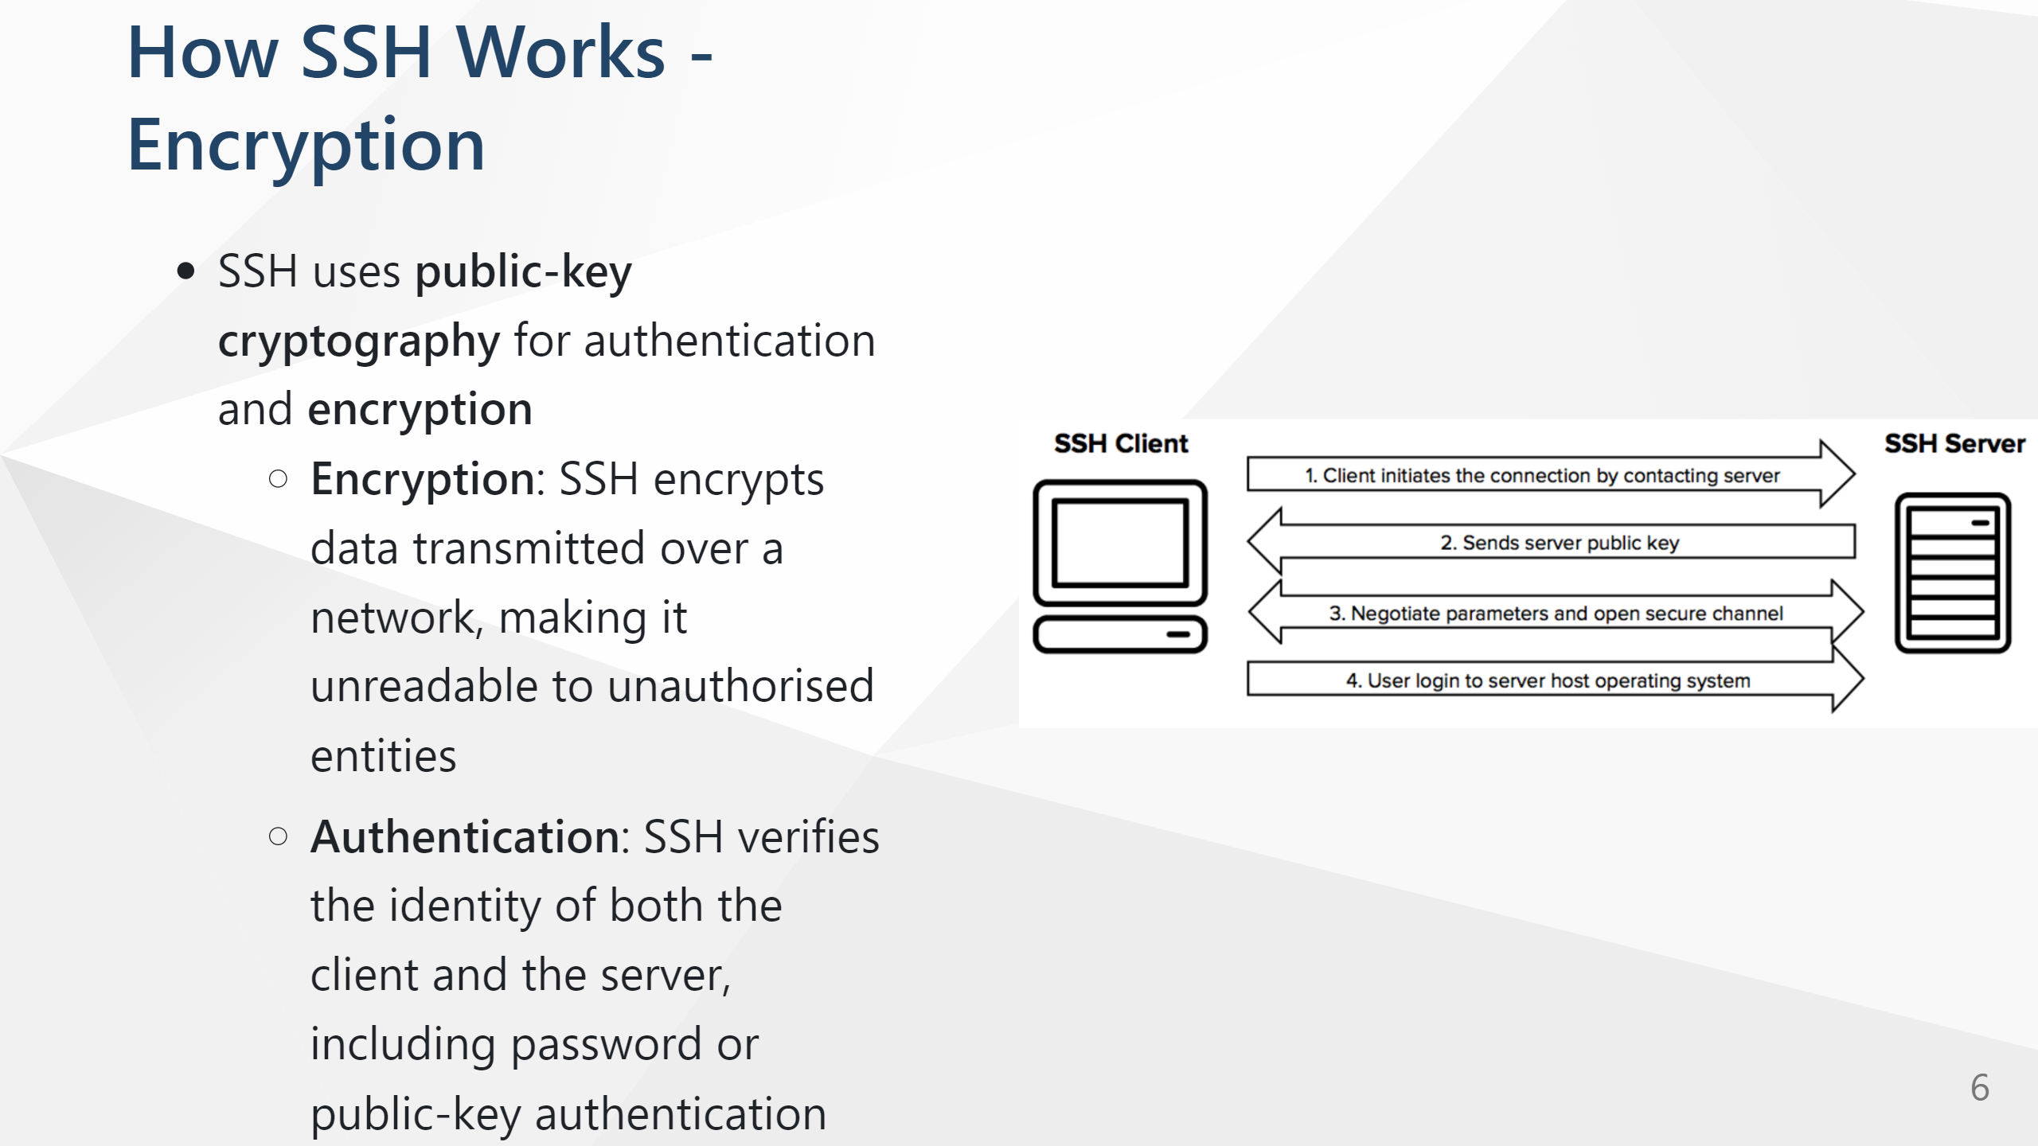
Notes:
In SSH, the server sends its public key to the client during the key exchange process, which occurs right after the connection is initiated and before any sensitive data (such as authentication credentials) is transmitted. Here’s how and why this happens:
Initial Connection and Key Exchange:
When the SSH client connects to the server, they agree on the key exchange algorithm to use, like Diffie-Hellman.
As part of this process, the server sends its public host key to the client. This key is unique to the server and acts as an identifier to help the client verify that it is connecting to the legitimate server.
Host Key Verification:
When the client receives the server’s public host key, it checks this key against a known hosts list (usually stored in the client’s ~/.ssh/known_hosts file).
If the key matches an entry in this file, the client assumes it’s connecting to the legitimate server. If not, the client may issue a warning, and the user can choose to proceed or cancel the connection.
This verification helps protect against man-in-the-middle attacks by ensuring that the client is not connecting to a malicious server impersonating the legitimate one.
Symmetric Key Generation:
After the server’s public key is verified, the client and server use the agreed-upon key exchange algorithm to generate a shared secret based on each other’s public information. This shared secret will be used to create symmetric encryption keys for the session.

Slide 7
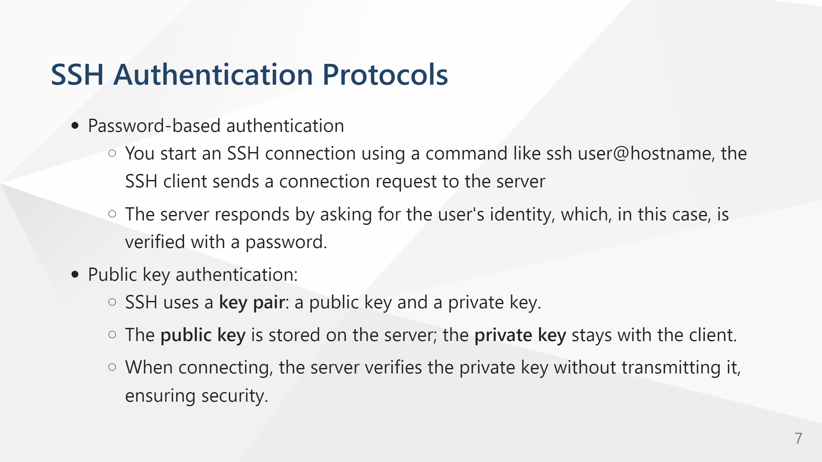

Slide 8
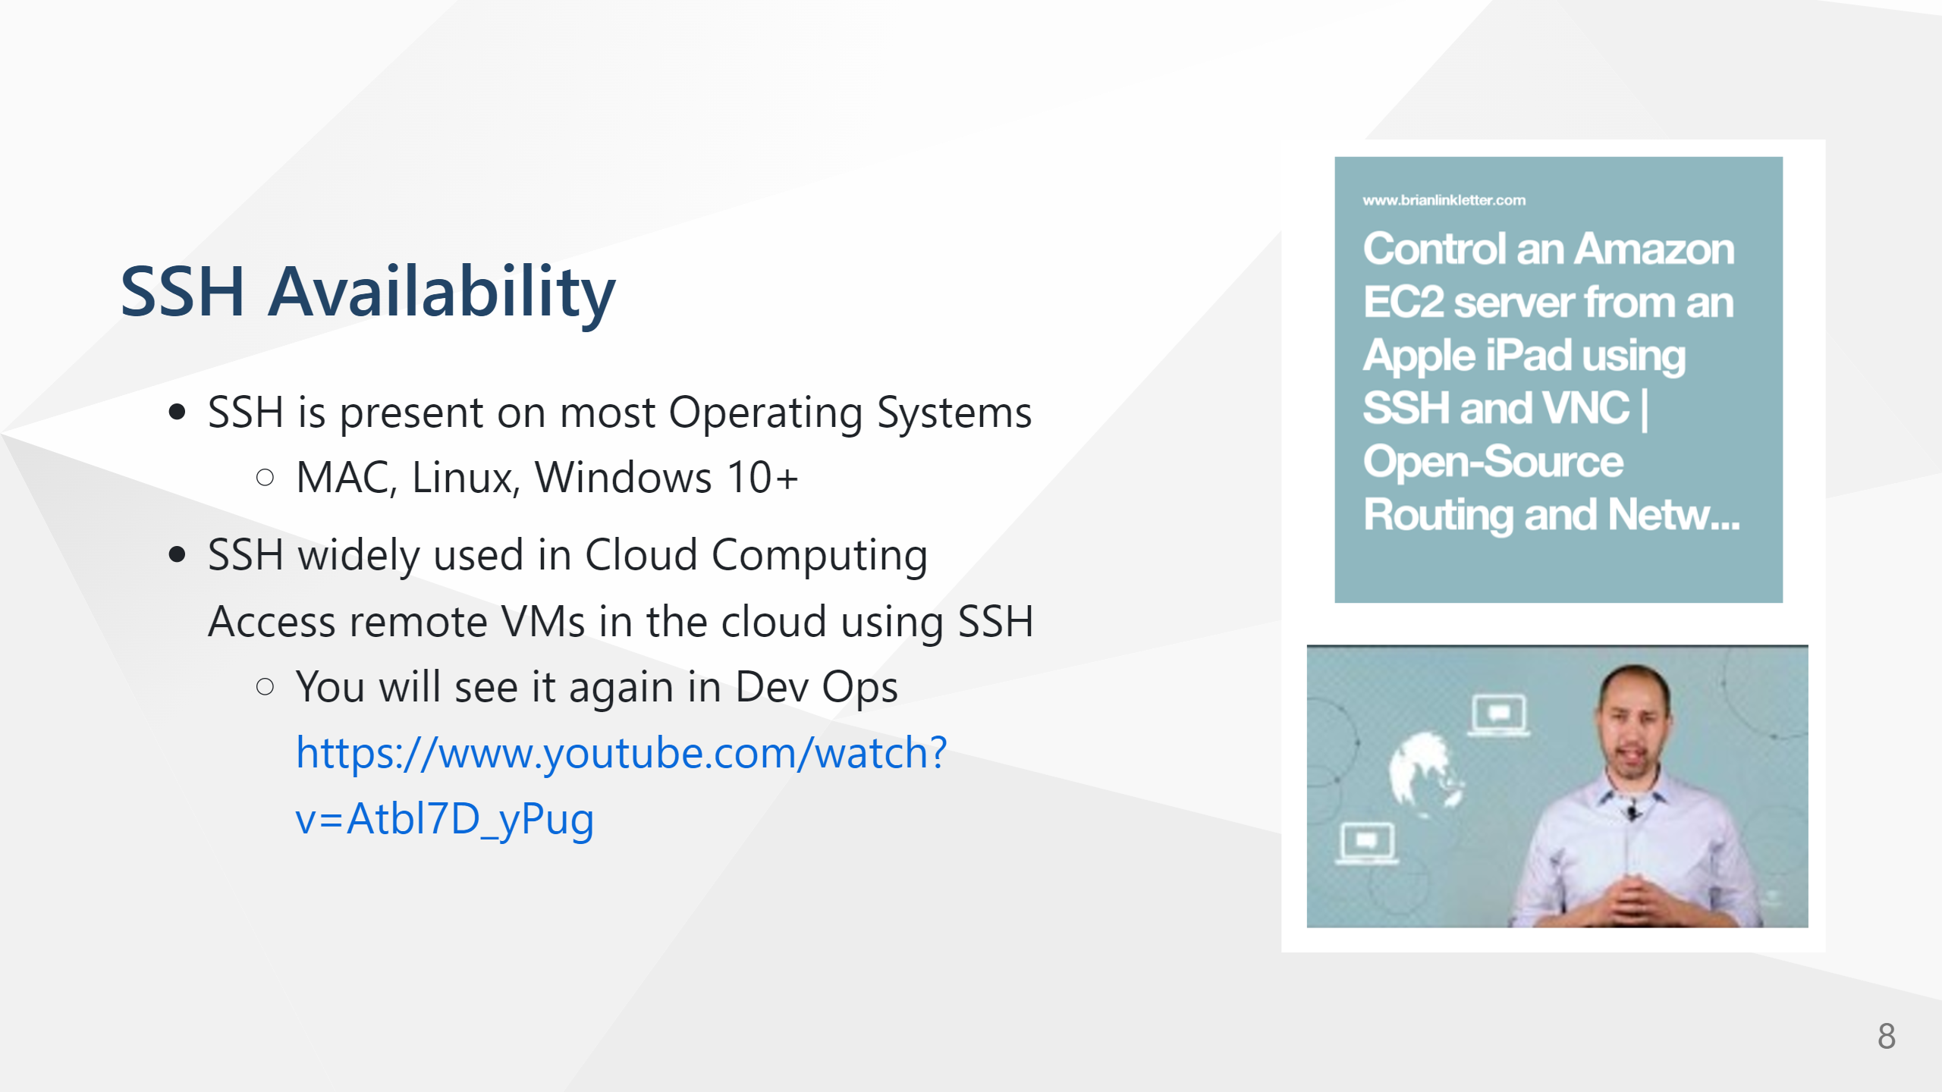

Slide 9
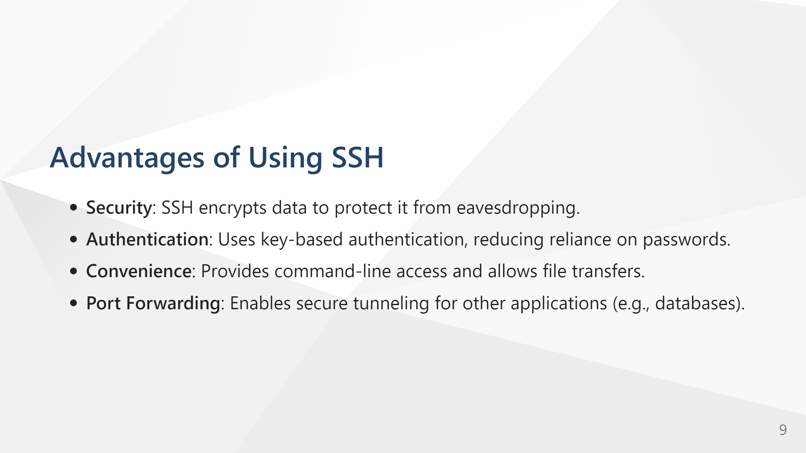

Slide 10
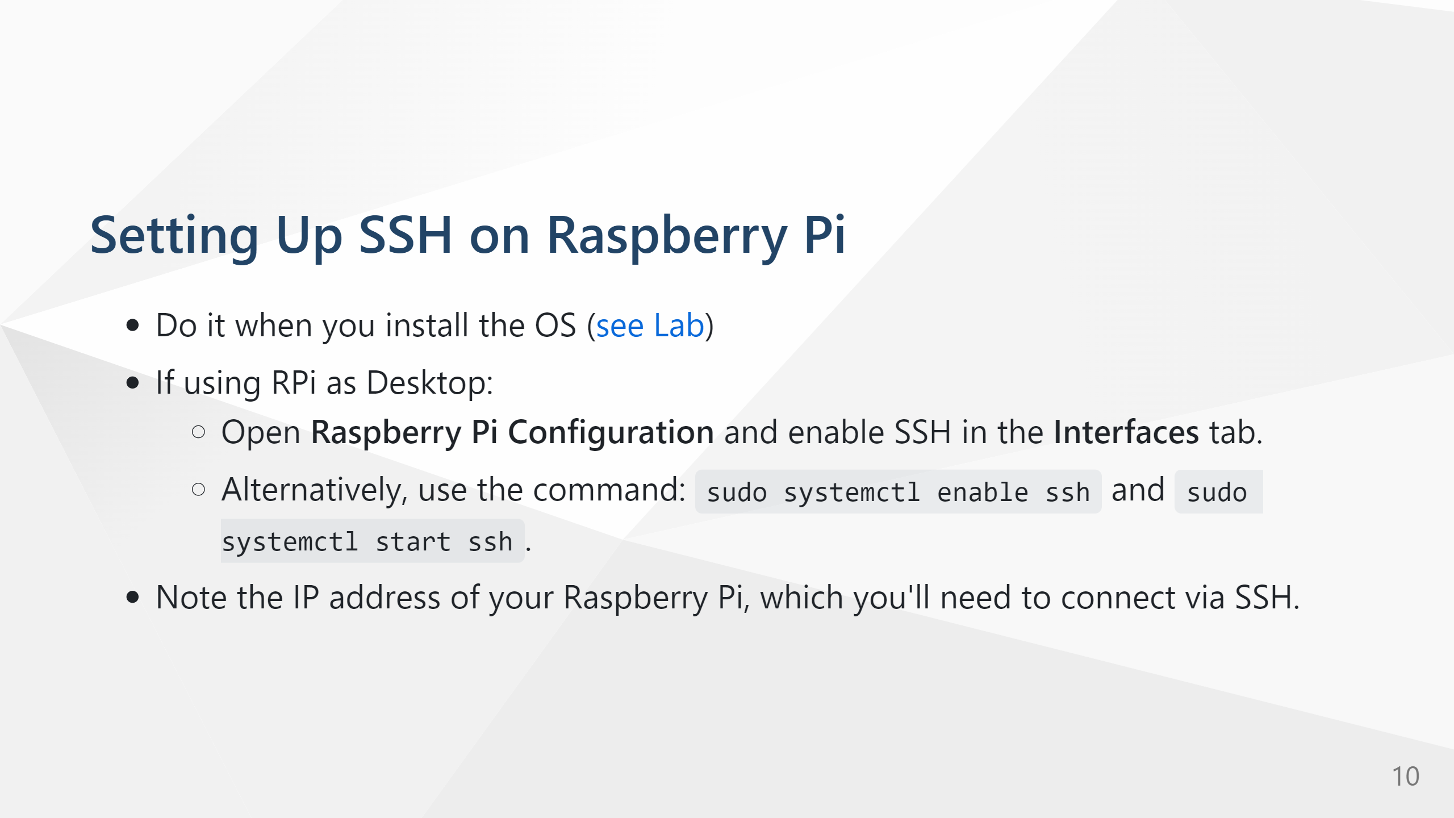

Slide 11
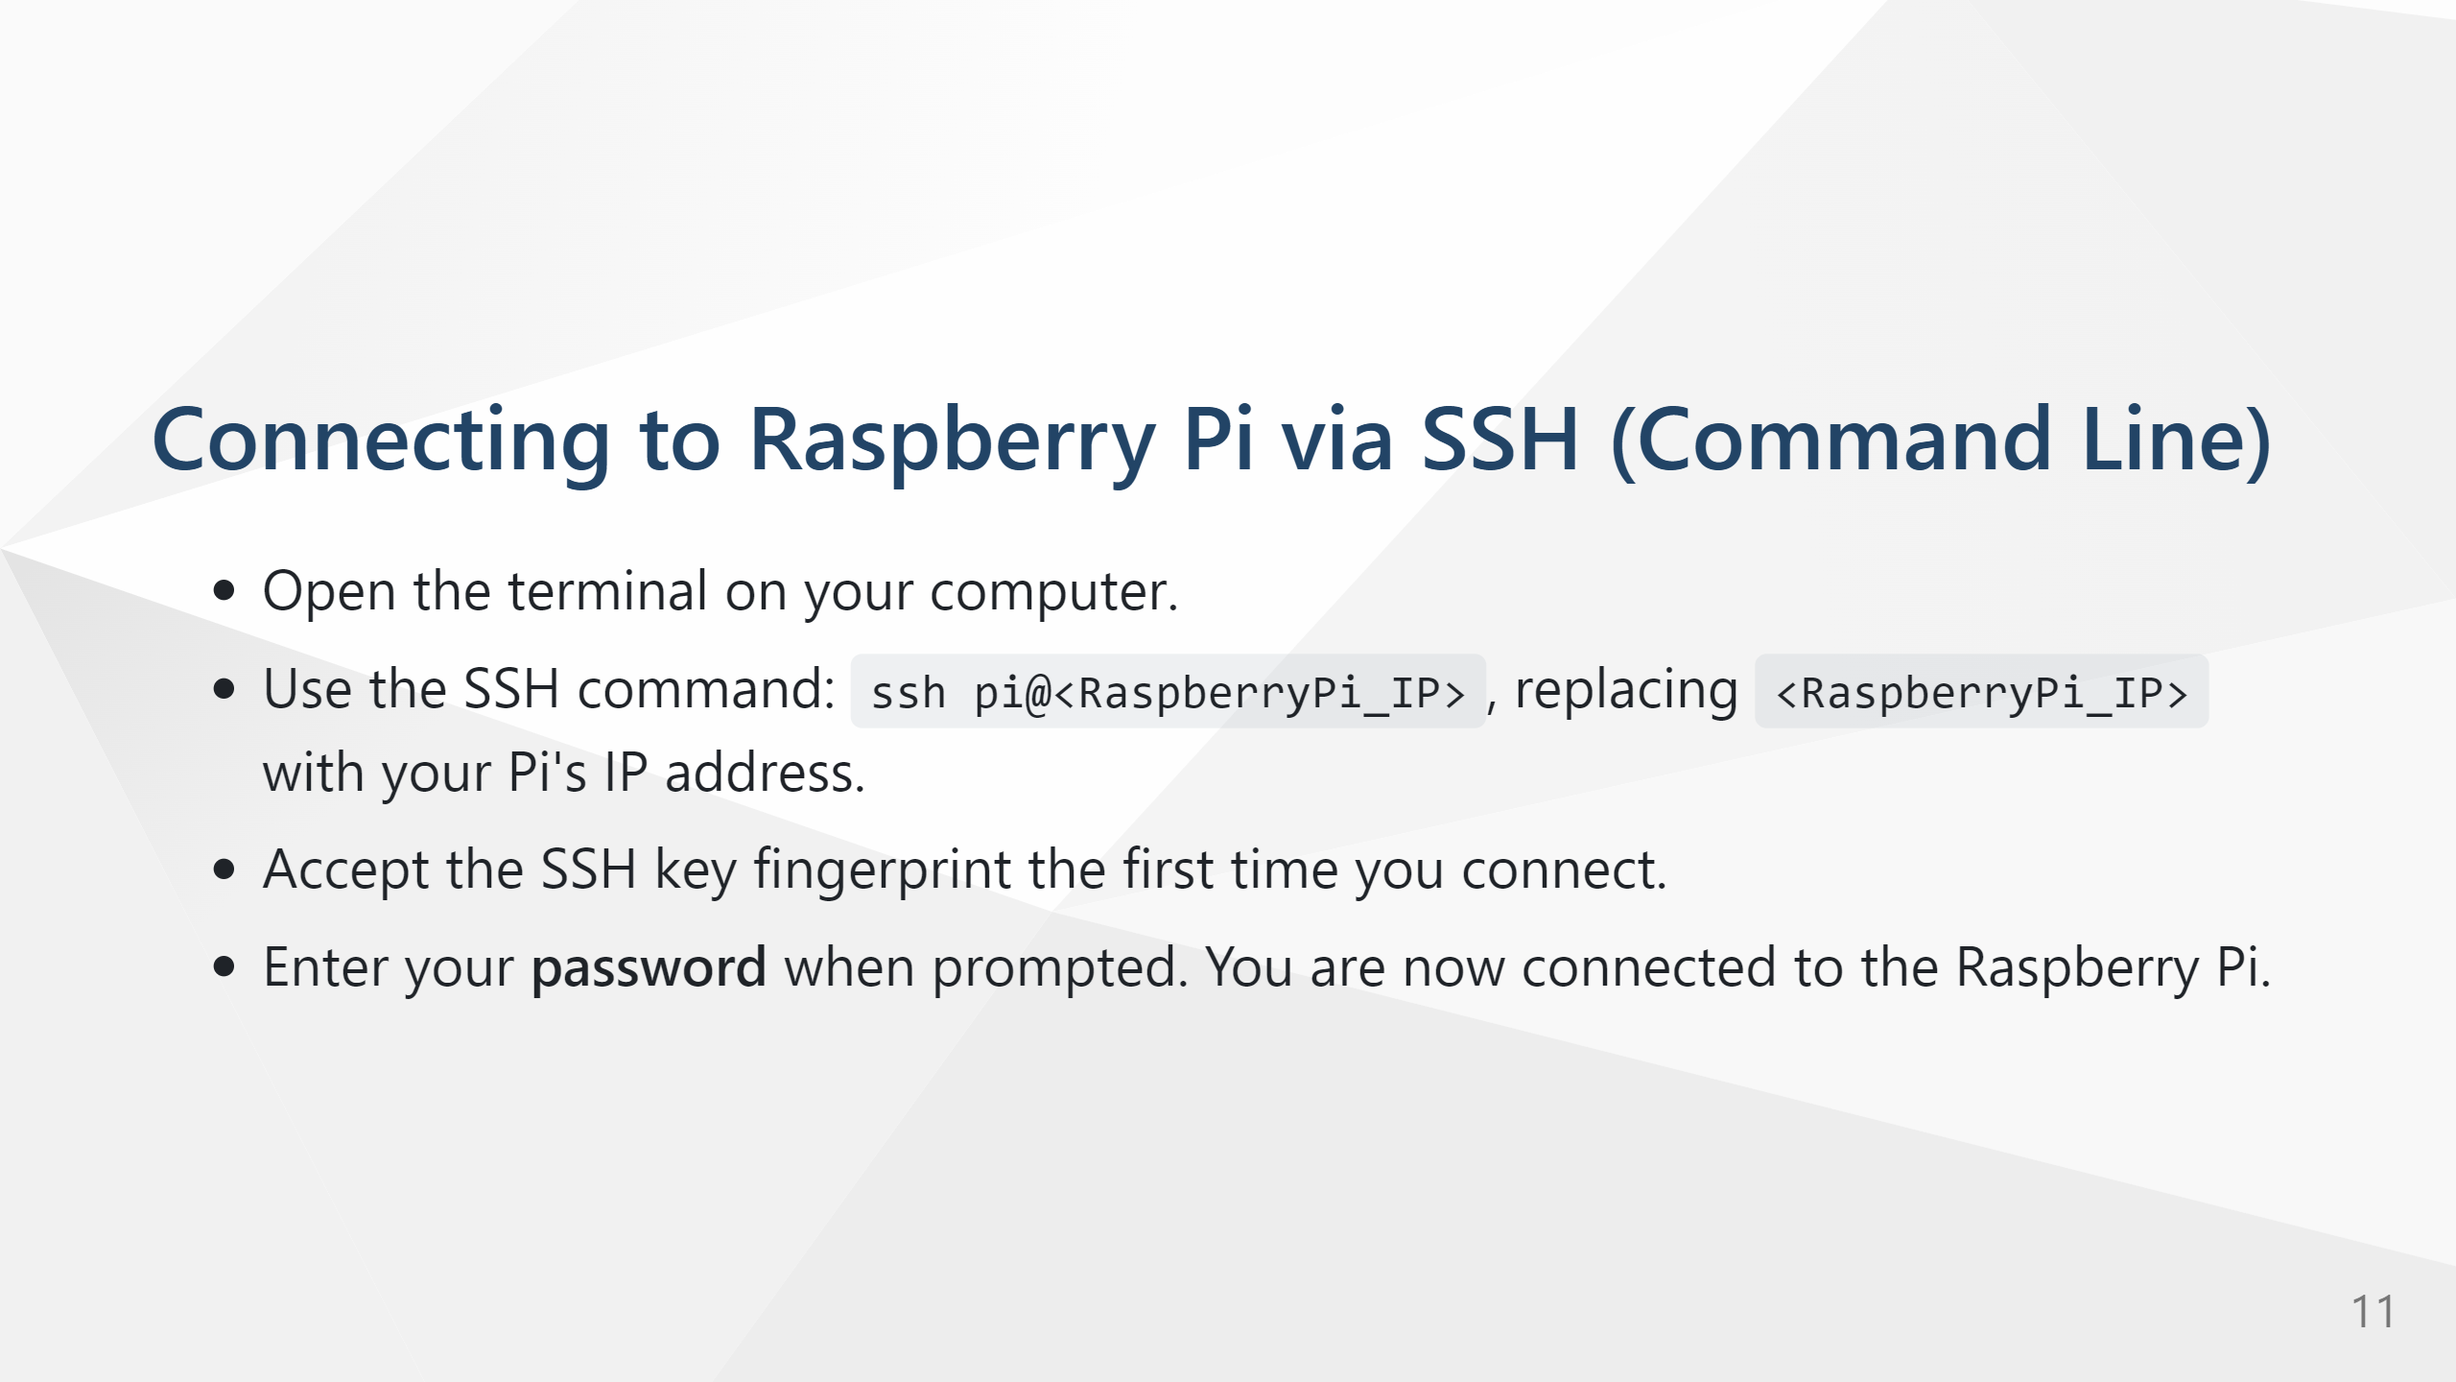
You can also use host name instead of IP address: ssh frank@raspberrypi.local or user@someDomainName
Hostname resolved to IP address using DNS/mDNS – more later

Slide 12
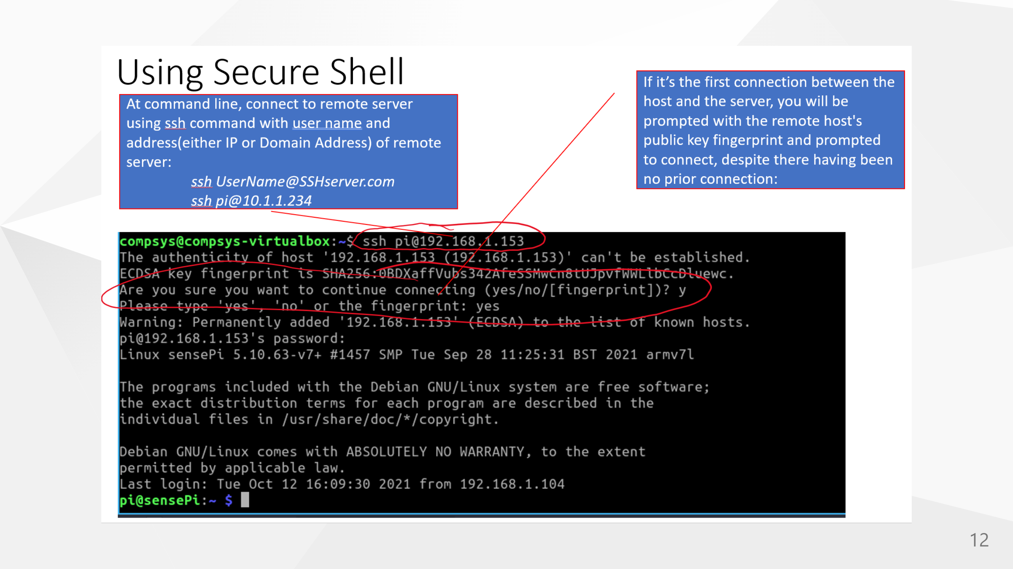

Slide 13
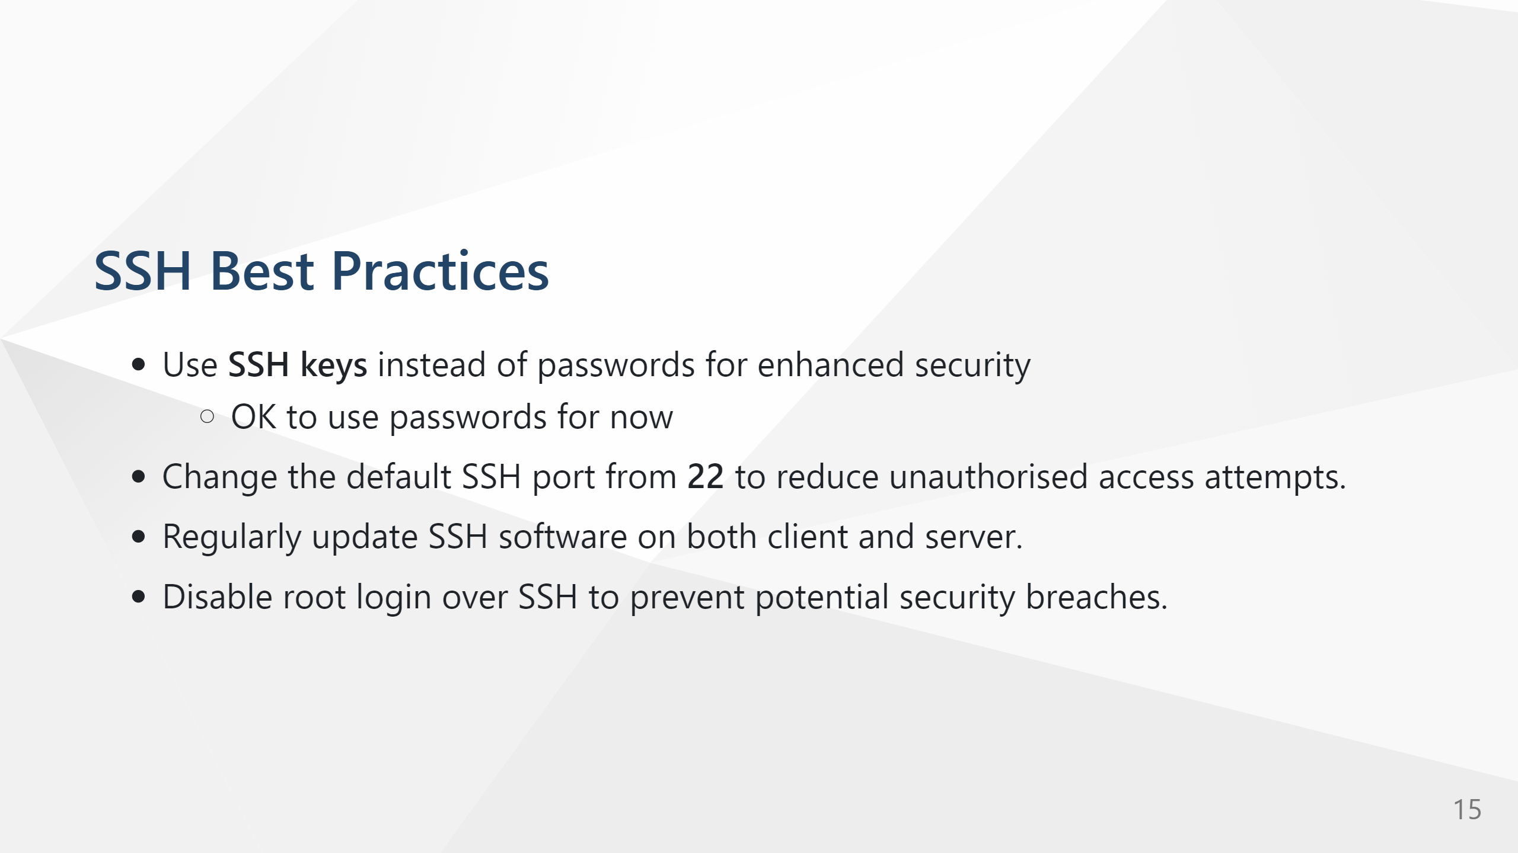

Slide 14
From DNS to mDNS
DNS translates domain names to IP addresses (e.g., example.com → 93.184.216.34)
Covered in previous weeks
Requires a DNS server and usually works across the Internet or large networks
But what about local networks with no DNS server?

Slide 15
Multicast DNS (mDNS) Overview
mDNS = “Multicast DNS”
Works on local networks (LANs) without a DNS server
Devices broadcast queries to find others using a special multicast address
Defined in RFC 6762
Request for Comments used to describe, propose, or standardise aspects of the internet and computer networking.
Notes:
describe, propose, or standardize aspects of the internet and computer networking.

Slide 16
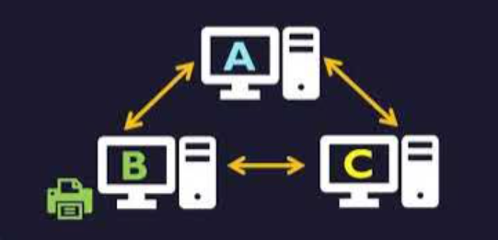
How mDNS Works
Uses UDP port 5353
Multicast IP address: 224.0.0.251 (IPv4)
Devices send queries like 'Who has myprinter.local?'
The device owning that name responds with its IP address
Domain names always end in .local
Notes:
mDNS relies on link-local multicast — a special kind of IP address used only within a local network segment.
These addresses are reserved for mDNS traffic — routers do not forward them, meaning mDNS only works within a single LAN/VLAN. Let’s say your laptop wants to resolve raspberrypi.local:
Query sent via multicast: Your laptop sends a UDP packet to 224.0.0.251:5353 asking, “Who has raspberrypi.local?”
All devices on the LAN receive it: Every device listening on that multicast group gets the query.
The Raspberry Pi recognizes its name: It replies directly via multicast (or sometimes unicast) with a response like:
A QM question tells all devices:
“Who has raspberrypi.local? Please respond to everyone.” This is useful for discovery — e.g., when a new device joins the network.
A QU question says:
“Who has raspberrypi.local? But reply directly to me, not to the whole multicast group.” This reduces traffic, especially when a host already knows who might respond.

Slide 17
mDNS Examples and Uses
Apple’s Bonjour and Linux’s Avahi use mDNS
Smart home and IoT devices (e.g., raspberrypi.local)
Network printers, media servers, and file shares
Simplifies discovery and setup — no need to know IP addresses
Notes:
“Who provides an HTTP service?” “Is there a printer here?” “What devices offer _ssh._tcp.local?”

Slide 18
CLI Network Configuration on Linux – Overview
Content distilled from Red Hat Netowrking Guide – Enterprise Linux

Slide 19
Understanding Network Configuration
Network interfaces identified as eth0, wlan0, etc.
Configuration controls how the device connects to a network
Can be managed via GUI, NetworkManager, or CLI tools
Command line offers speed, flexibility, and automation

Slide 20
Viewing Network Interfaces
ip link show — list all interfaces
ip addr show — show assigned IP addresses
ip route — display routing table
ping 8.8.8.8 or ping raspberrypi.local — test connectivity

Slide 21
Temporary Network Configuration
Assign IP: sudo ip addr add 192.168.1.10/24 dev eth0
Bring interface up/down: sudo ip link set eth0 up / down
Add route: sudo ip route add default via 192.168.1.1
Temporary only — lost after reboot

Slide 22
Managing Network with nmcli
show interfaces : nmcli device status
list saved connections: nmcli connection show
scan for networks: nmcli device wifi list
Connect: sudo nmcli device wifi connect "SSID" password "mypassword"
Modify: sudo nmcli connection modify <name> ipv4.addresses 192.168.1.20/24

Slide 23
Network Troubleshooting Tools
Test connectivity and DNS: ping, traceroute, dig, nslookup
verbose logs: nmcli general logging level DEBUG
view service logs: journalctl -u NetworkManager
reset connections: sudo systemctl restart NetworkManager
Lots more detail at Red Hat Networking Guide for Enterprise Linux: https://docs.redhat.com/en/documentation/red_hat_enterprise_linux/7/html/networking_guide/index

Slide 24


