Slide 1

HDip/Cert in Computer Science Progression Pathways Department of Computing and Mathematics 15/12/2025

Slide 2

What are the options at SETU once I finish the Cert?
Direct Entry onto the Higher Diploma in Computer Science
Specialism Certificate
I’m good thanks – Slán!

Slide 3
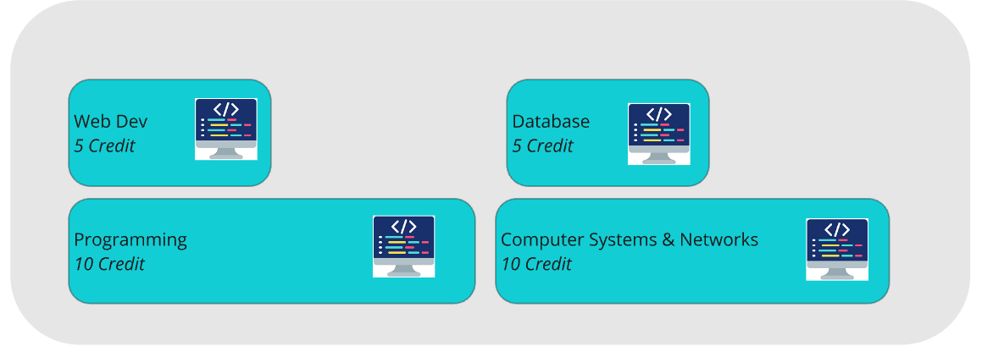
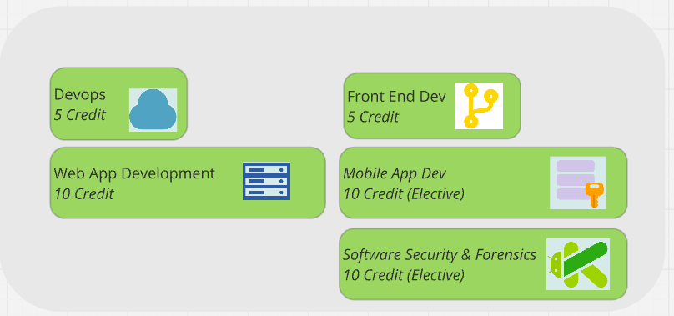
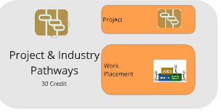
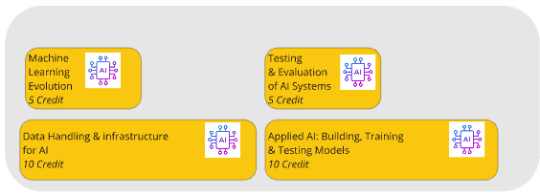
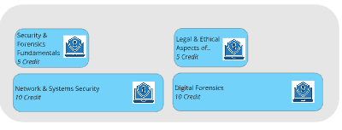
1. Direct Entry onto the Higher Diploma in Computer Science
Advanced Entry to HDip from Cert
No Springboard Funding
Sept 25
Jan 26
Sept 26
Jan 27
June 27 – Dec27
General
Software Engineering
Artificial Intelligence & Machine Learning
Placement timeframe June-Sept
Springboard Funded
1 year Computer Science Fundamentals
Cyber Security and Forensics

Slide 4
2. Cert in Computer Science: Specialism Cert Progression
Cert Required
No Springboard Funding
No Project/Placement
Sept 25
Jan 26
Sept 26
Jan 27
General
Software Engineering
Artificial Intelligence & Machine Learning
Springboard Funded
1 year Computer Science Fundamentals
Cyber Security and Forensics

Slide 5
Software Engineering
Stage 2 of the existing HDip, retaining core modules but redesigned to integrate AI tools, techniques, and industry practices.
Strong industry alignment, with continuous monitoring of trends and guidance from core industry partners.
AI-augmented development
Emphasis on developer expertise and judgement
Practical curriculum covering modern full-stack, cloud, microservices, testing, DevOps, and mobile development, reflecting major changes of the last 5 years.
Elective Choice: Mobile App Dev OR Software Security & Forensics in Sem 2
Software Engineering

Slide 6
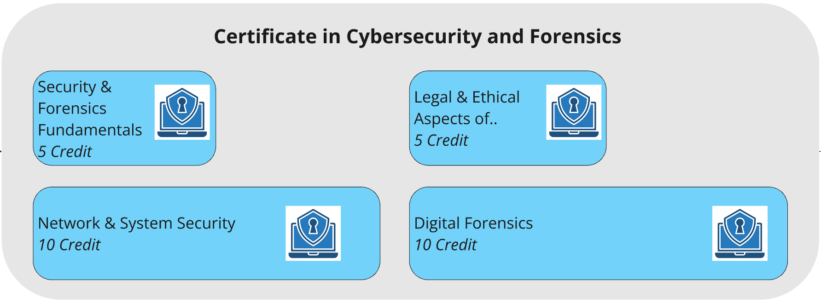
Cybersecurity and Forensics
Hands-on, practical focus on threat detection, secure coding, digital forensics, and regulatory compliance.
Industry-driven curriculum designed to meet current and emerging cybersecurity workforce needs.
Supports reskilling and career transition into high-demand cybersecurity roles.

Slide 7
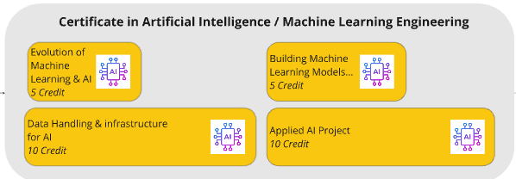
AI and Machine Learning
Hands-on focus on AI model development, data handling, ML infrastructure, and performance optimisation
Industry-aligned curriculum addressing real-world AI/ML engineering needs across sectors
Rigorous, practical learning experience designed for workplace relevance
Supports upskilling and reskilling into high-demand AI engineering roles

