Slide 1


Higher Diploma in Science in Computer Science
Overview of Structure & Purpose of the Online Materials

Slide 2



}
Tutors
Slack
4 Key Web Services
Moodle
Youtube

Slide 3
}
Tutors
Github ID
}
Slack
personal email
}
wit email
Moodle
}
Youtube
open

Slide 4
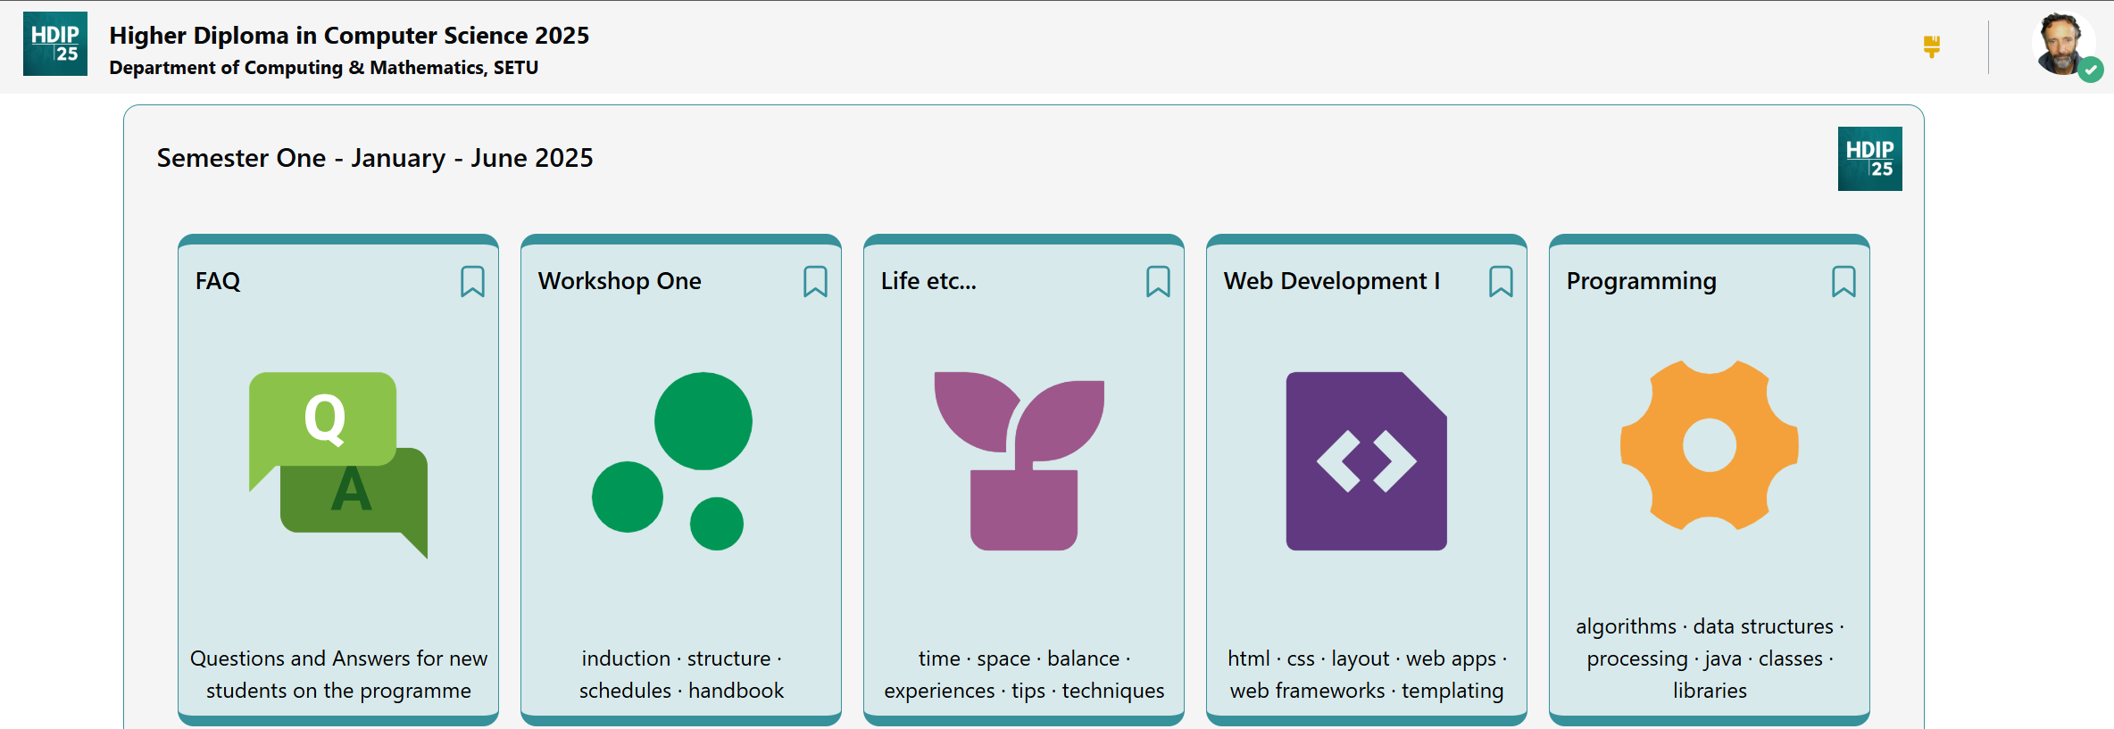
Programme homepage
https://tutors.dev/course/setu-hdip-comp-sci-2025
Links to individual module
Home pages
Notes:
These cards are links to individual module home pages for that semester.

Slide 5
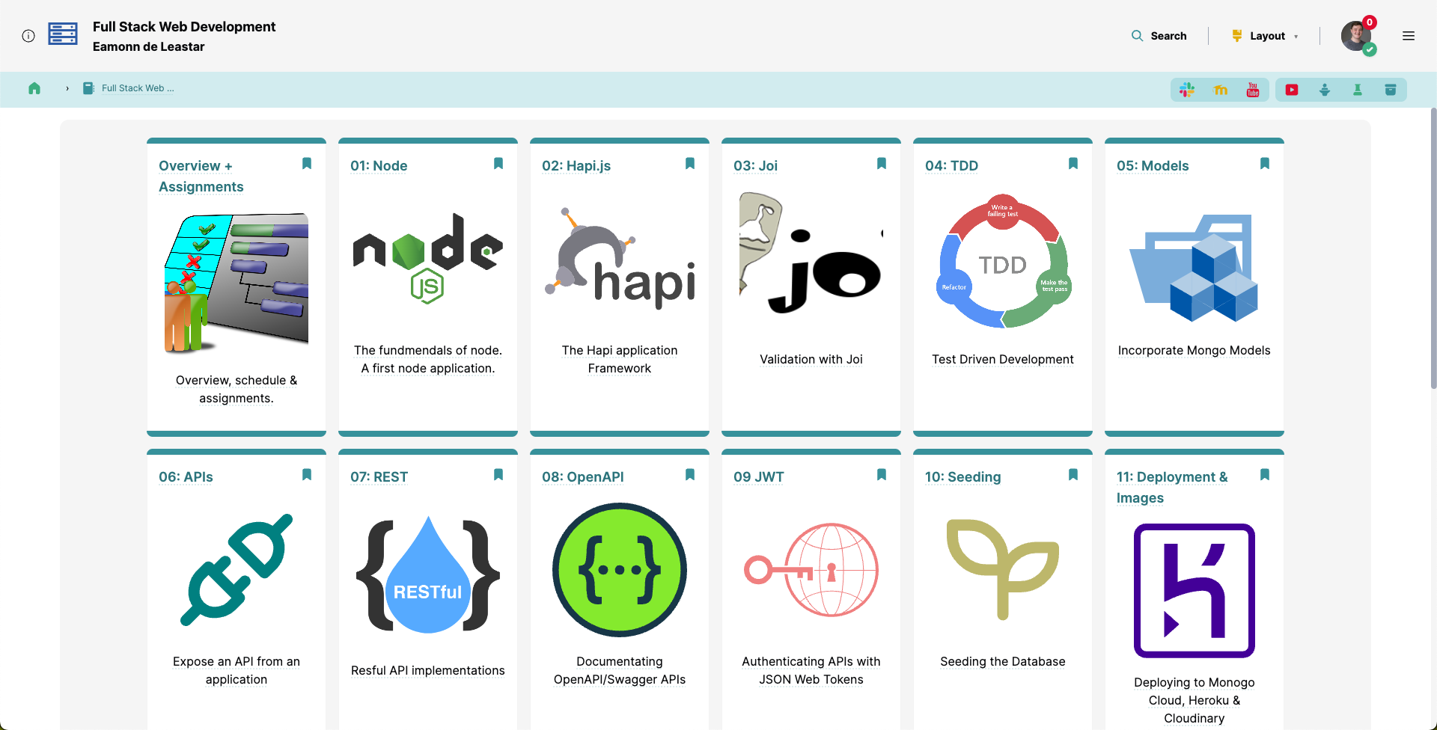
A course homepage
Topics - 1 topic/card for each week
Notes:
When you access a link, you are brought to the course homepage for that module.
This is, again, broken down into cards, and it also has a more useful and contextual navigation bar than on the programme homepage.

Slide 6
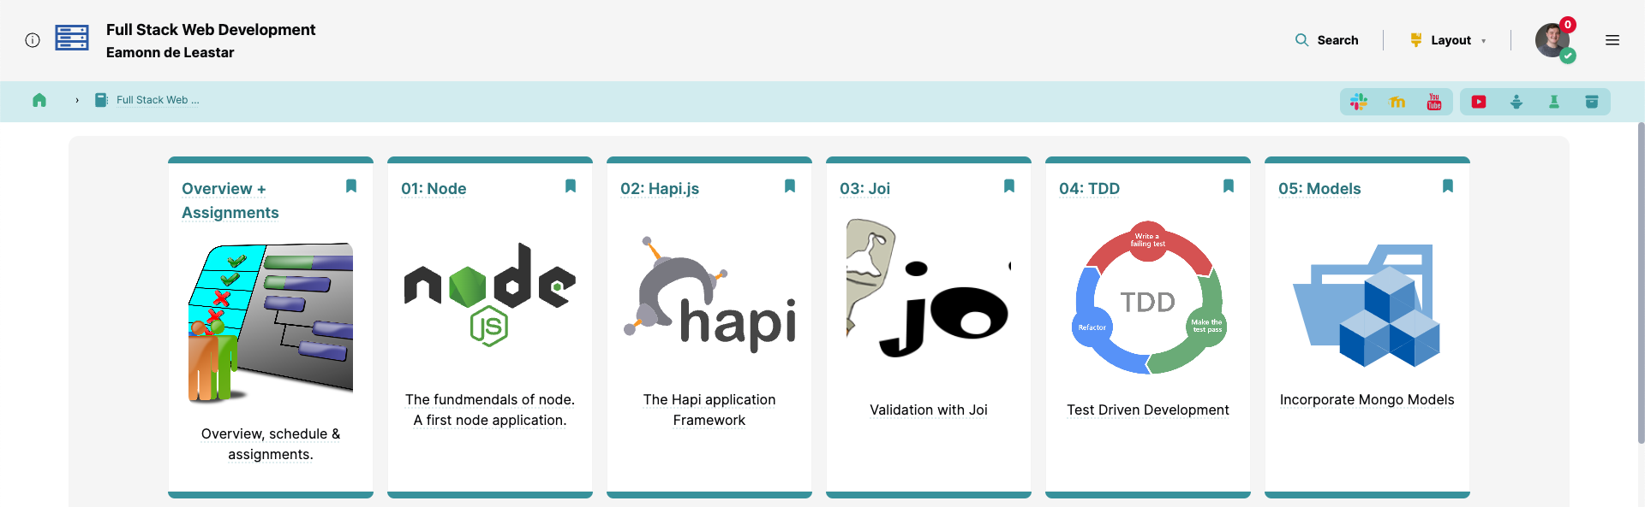
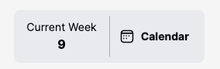
Navigation
Layout & Themes
Full Text Search
Table of
Contents
Course Info
Calendar
Companions
Wall
Breadcrumb
Navigation
Notes:
In the middle of the navigation bar is the course calendar - with the current week and a button to open the sidebar to show the course calendar.

Slide 7
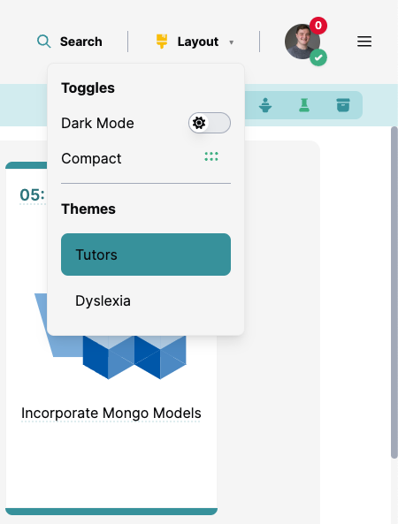
Navigation
Layout & Themes
Notes:
Opens a dropdown allowing the learner to change the look and feel of Tutors, such as …

Slide 8
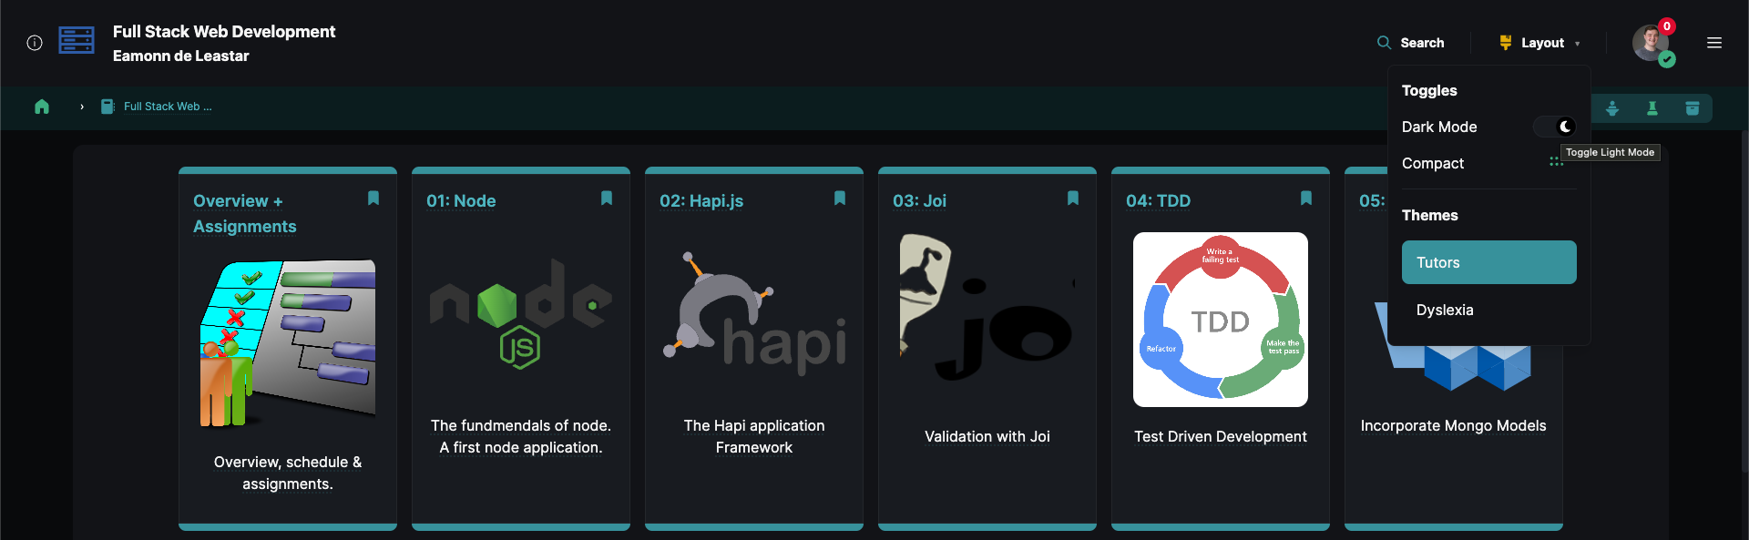
Theme Support
Layout & Themes
Notes:
Toggling light / dark mode, setting a compact UI layout & changing to one of our custom themes

Slide 9
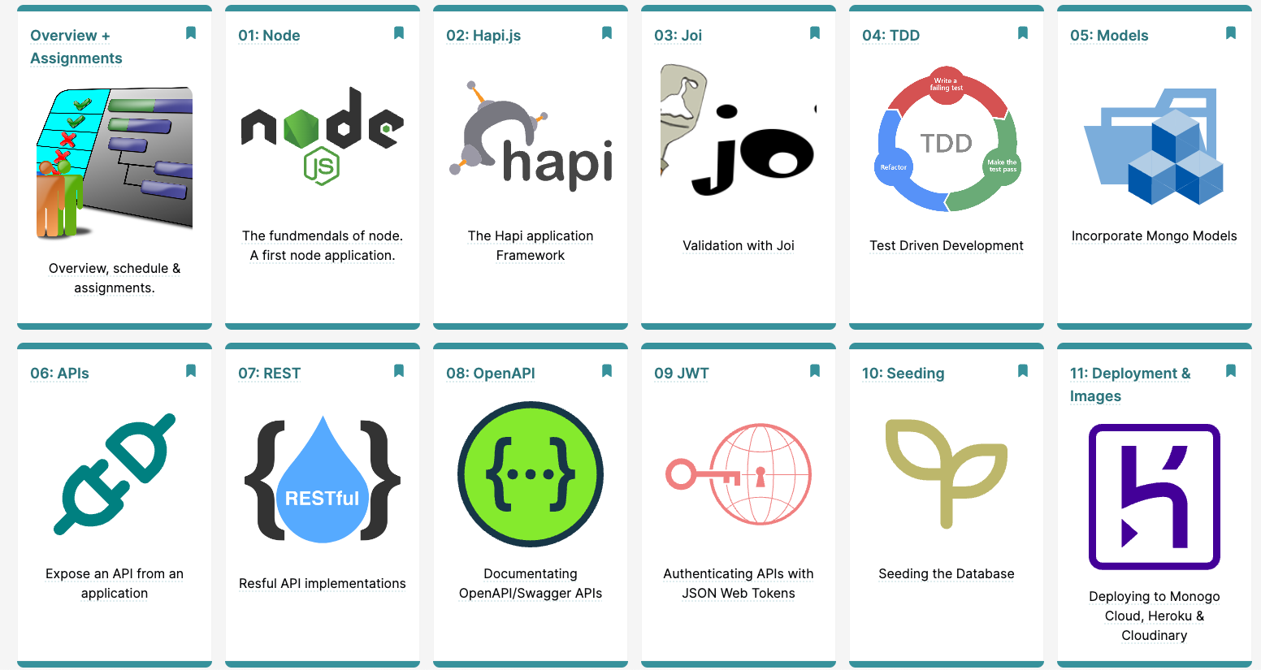
Topics - 1 topic/card for each week
Notes:
On the course homepage, the course os broken down into topic cards, which 1 card representing each topic (or week).

Slide 10
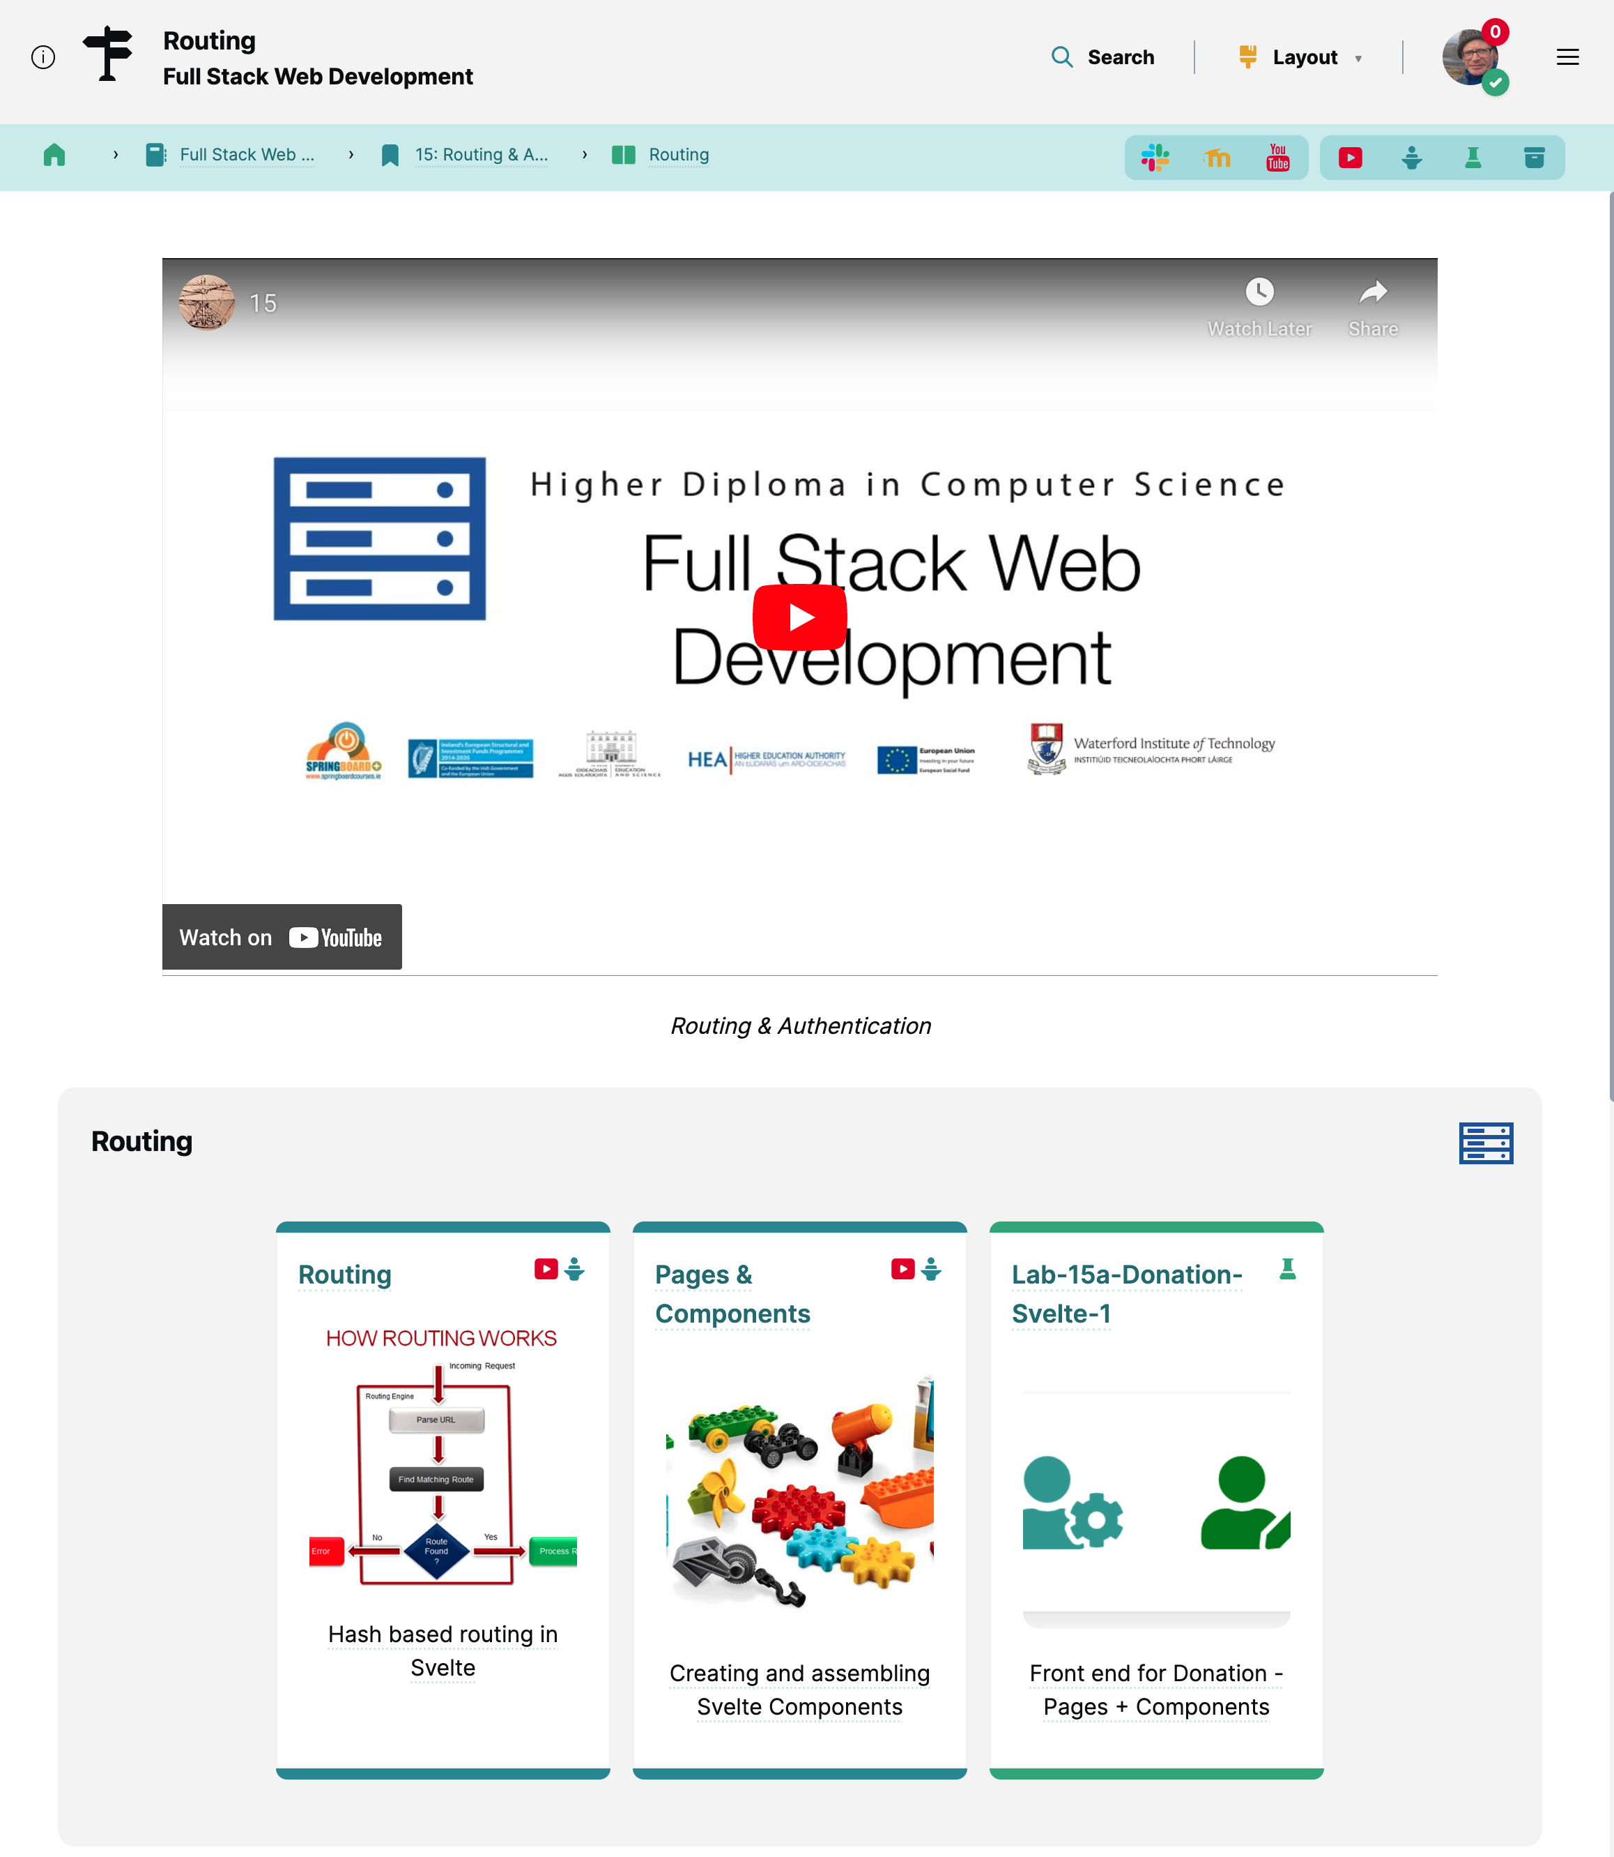
Single
Topic
Topic Video
Pre-recorded or live stream
Sub Topic 1
Notes:
This then goes into the single topic page.
At the top, there is the topic video, which can be a pre-recorded video uploaded to the likes of YouTube, Vimeo, HEAnet..
or a YouTube live stream - which is then recorded for so if a learner misses the live lecture they can playback later & it can be played at different speeds with subtitles etc.
Underneath, there are sub-topic sections.

Slide 11
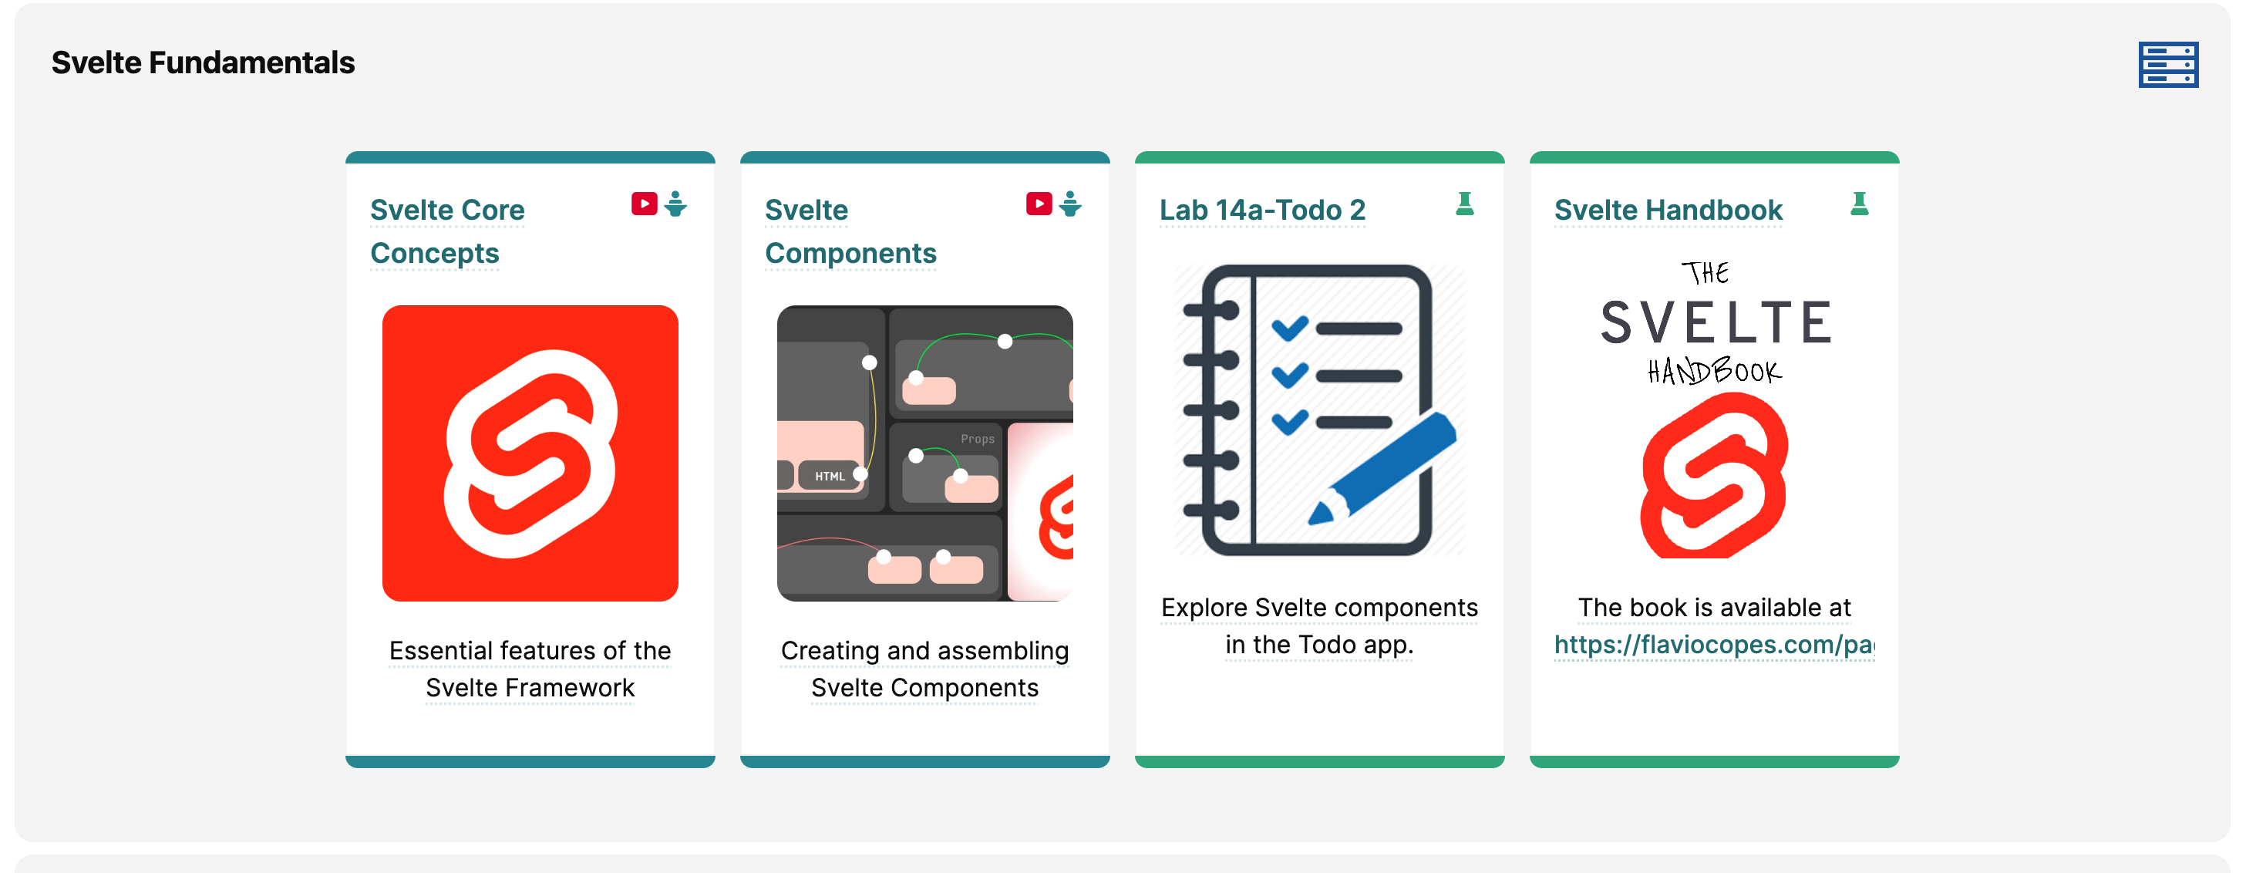
Sub Topic
Single
Video
Talk Slide PDFs
Lab
Notes:
This sub topic is broken down into cards, which can link you to the talk slides, labs - and if the talk slides have a single video, a video icon is shown at the top right of the card.

Slide 12
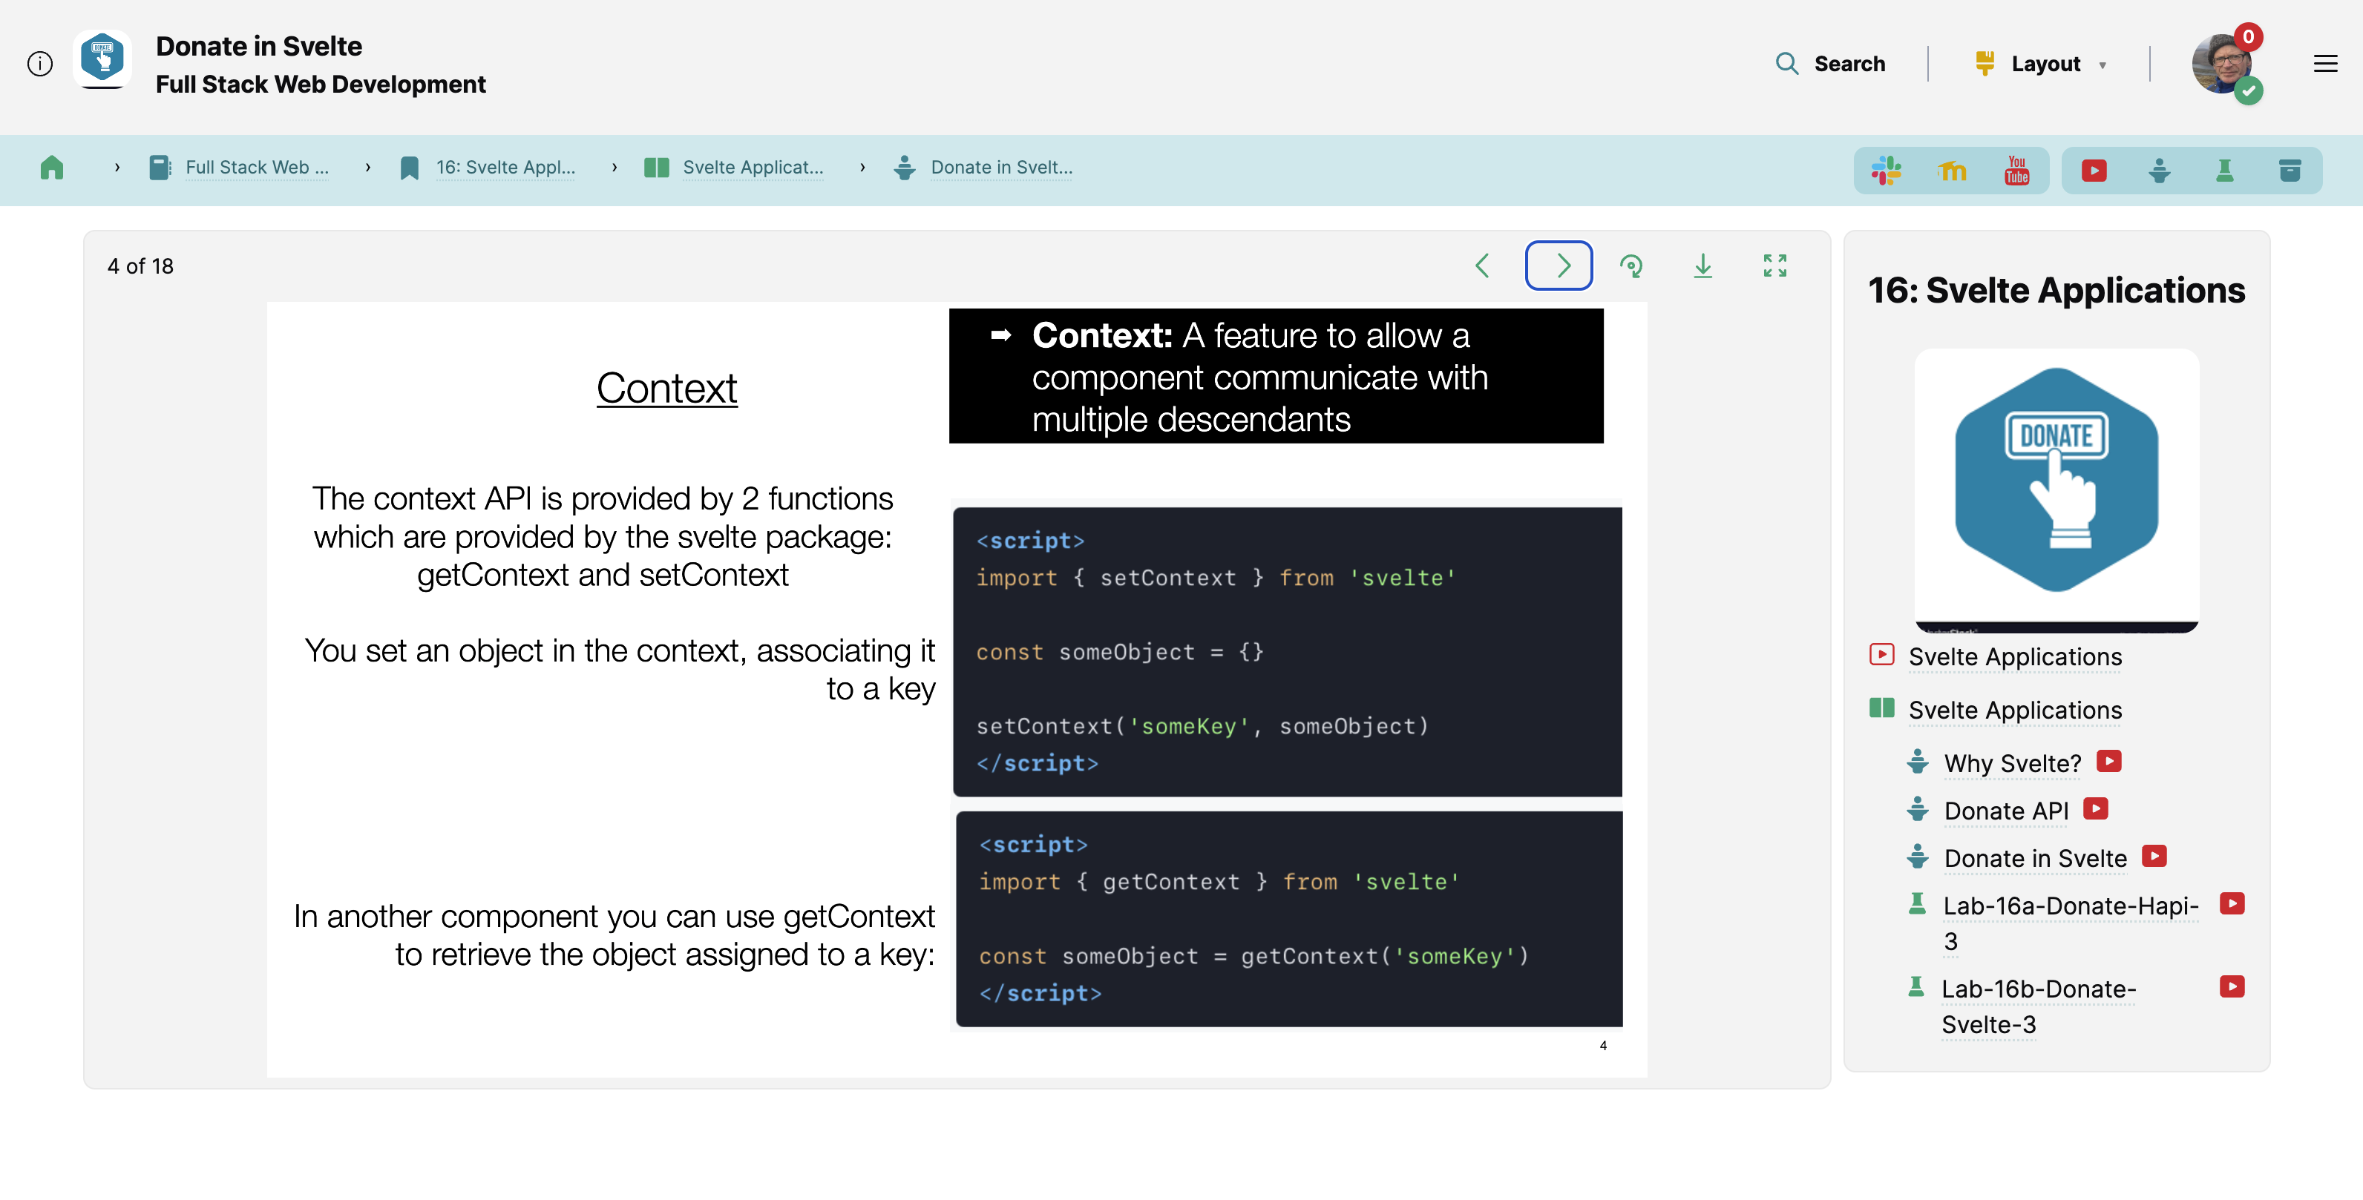
Talk Context - related talks & videos
Embedded PDF reader custom with Navigation
Talk

Slide 13
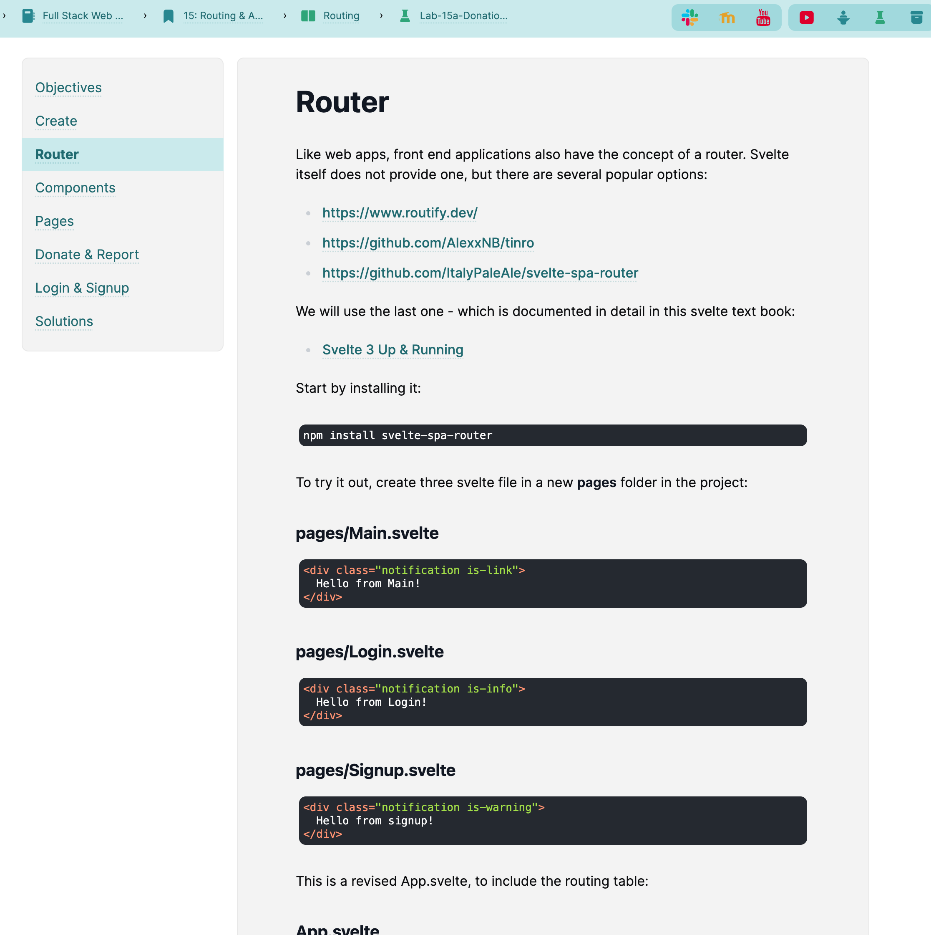
Labs
Markdown formatted text
Lab Steps
Code block syntax highlighting

Slide 14
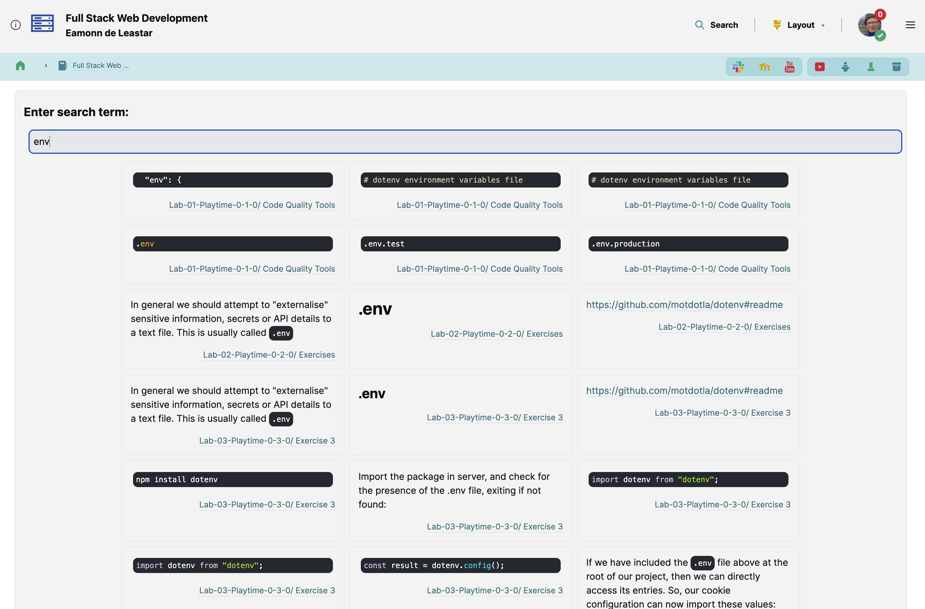
Search

Slide 15
Youtube Live
Live Webinars Delivery

Slide 16
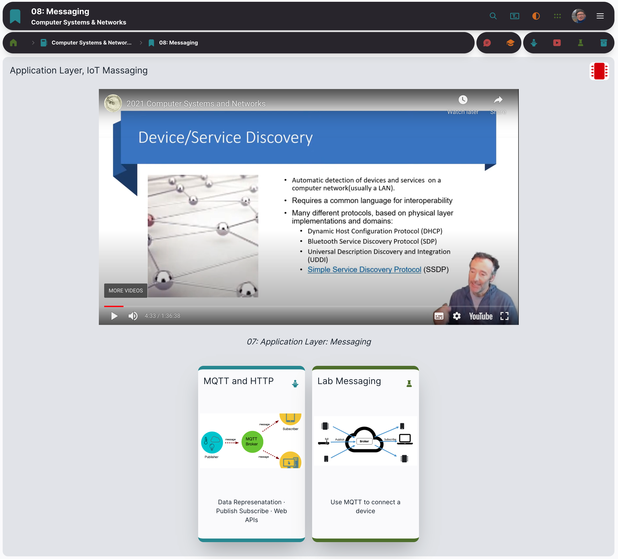
Live Stream
Live stream of webinar for given topic
Slides & Labs for the topic

Slide 17
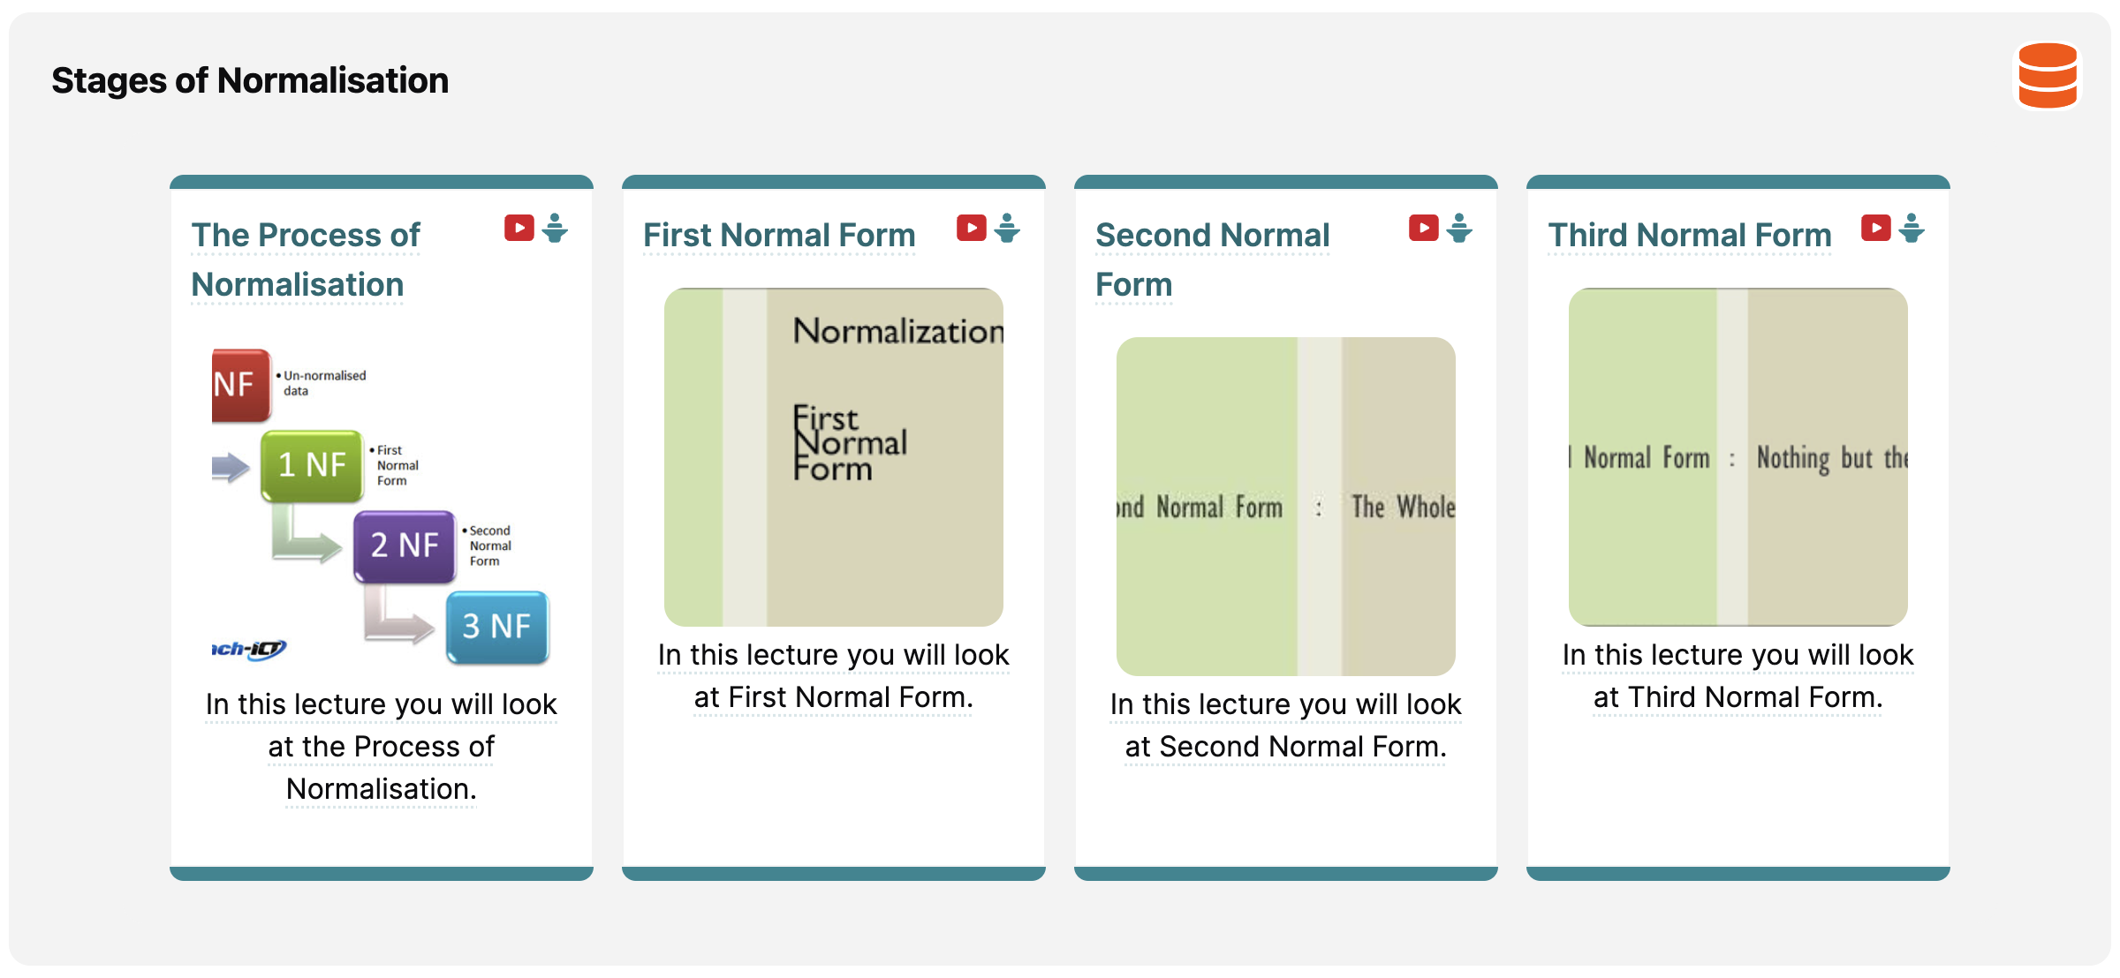
Pre-recorded Videos for selected slides & labs

Slide 18
WIT E-Learning Platform
Used for Assignment Submission + feedback + grades
Occasionally used for additional document distribution
Moodle

Slide 19
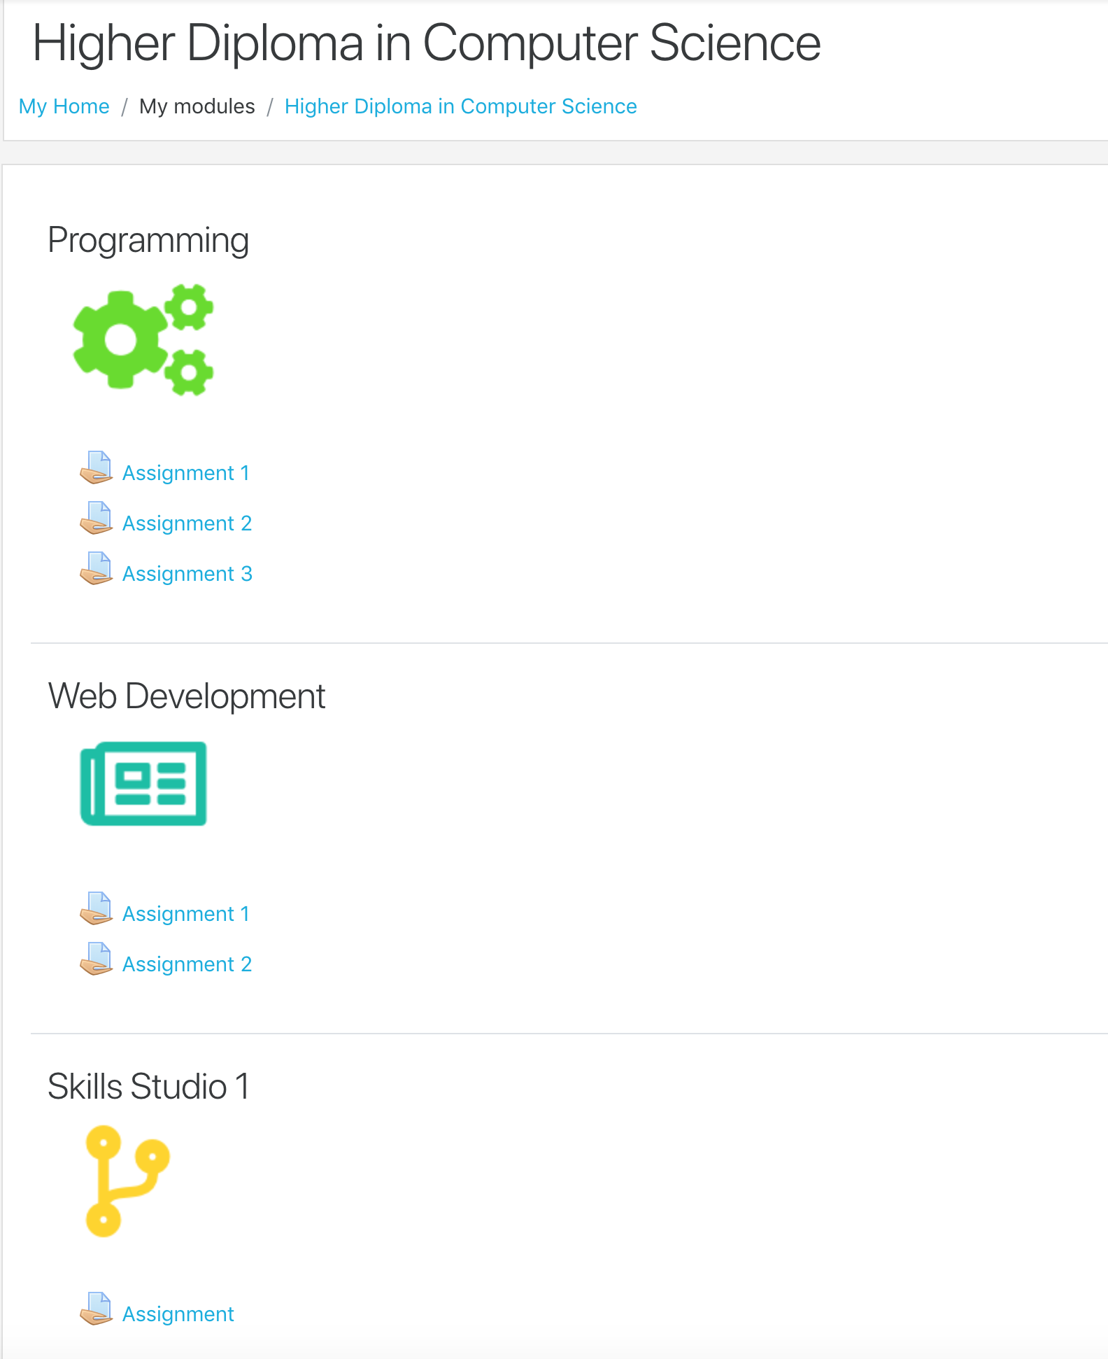
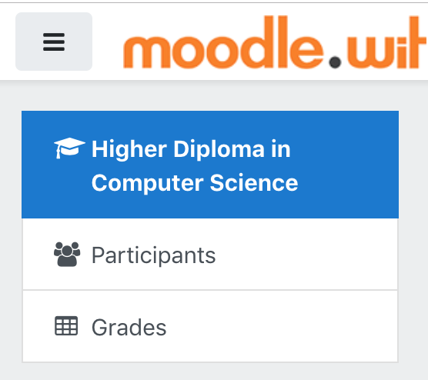
Assignment Submissions
Grades

Slide 20
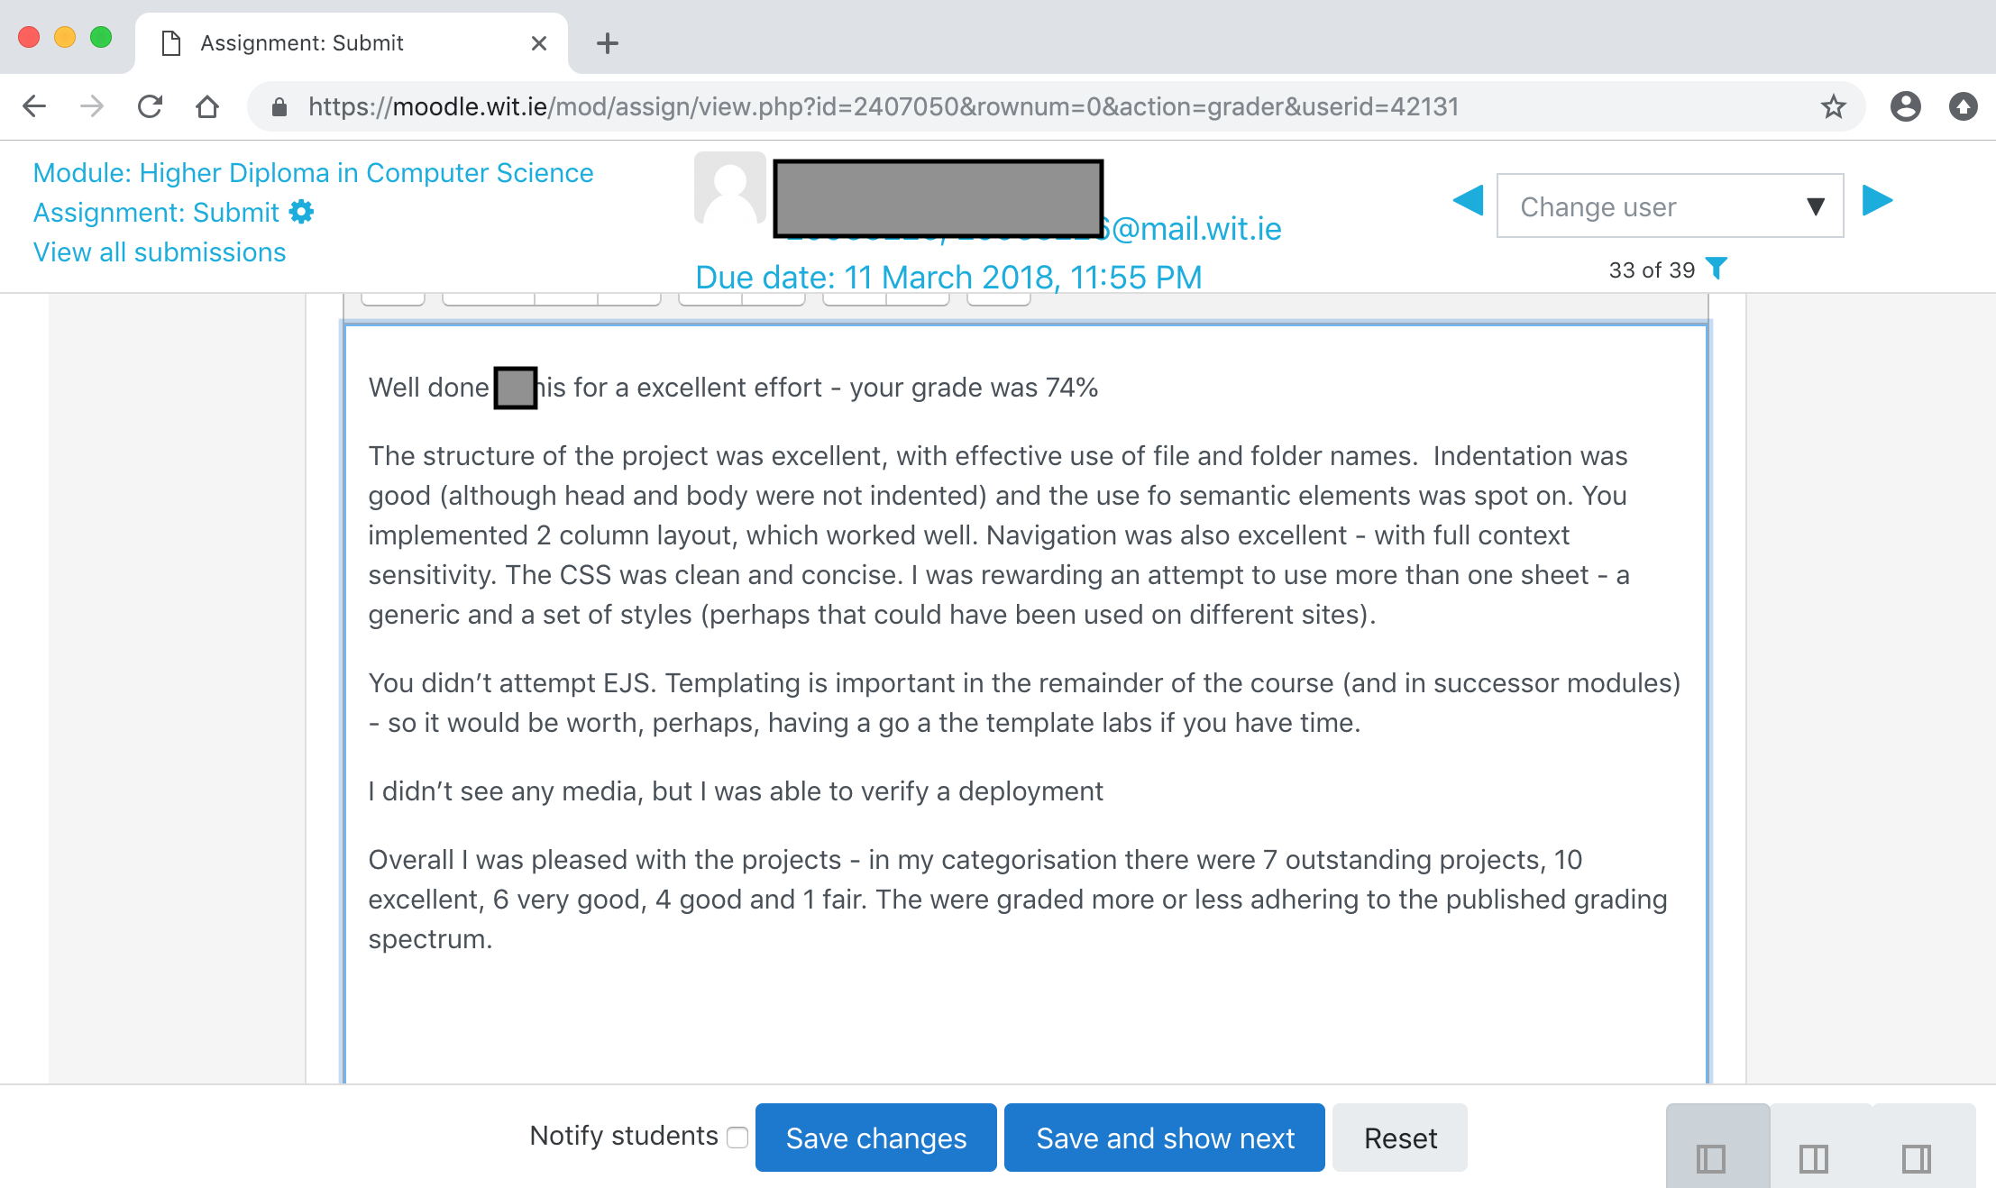
Assessment feedback

Slide 21


TutorsTime
TutorsLive
Tutors

Slide 22
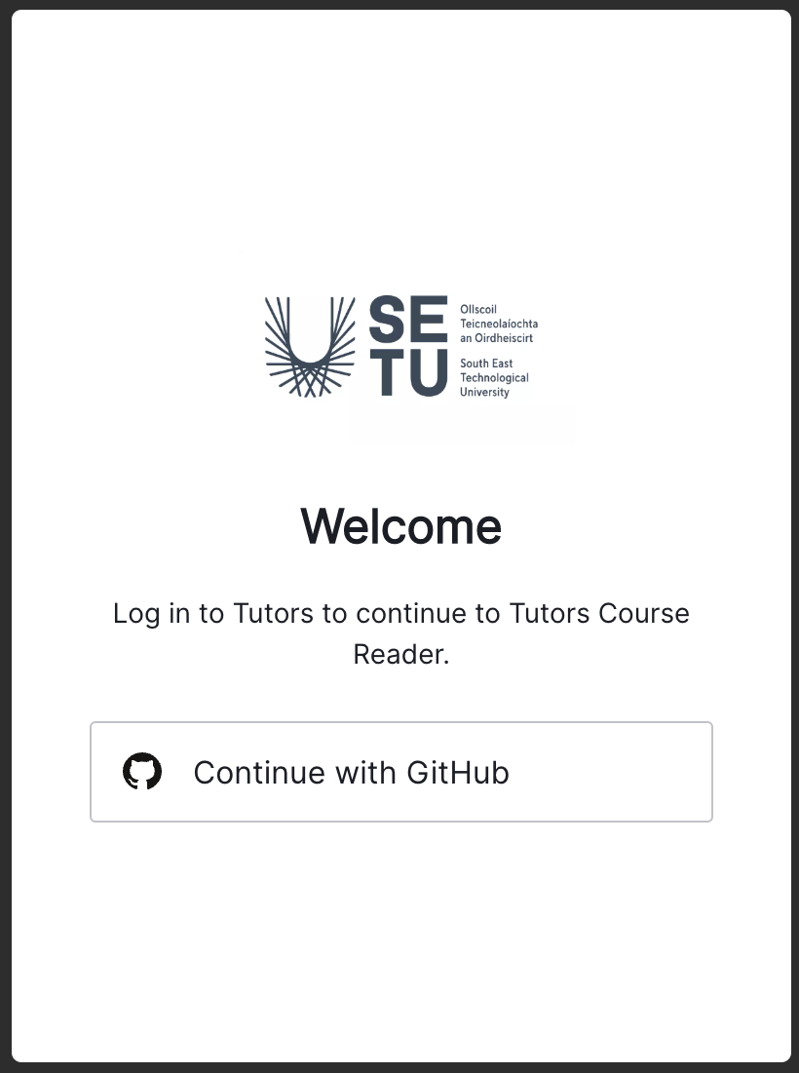
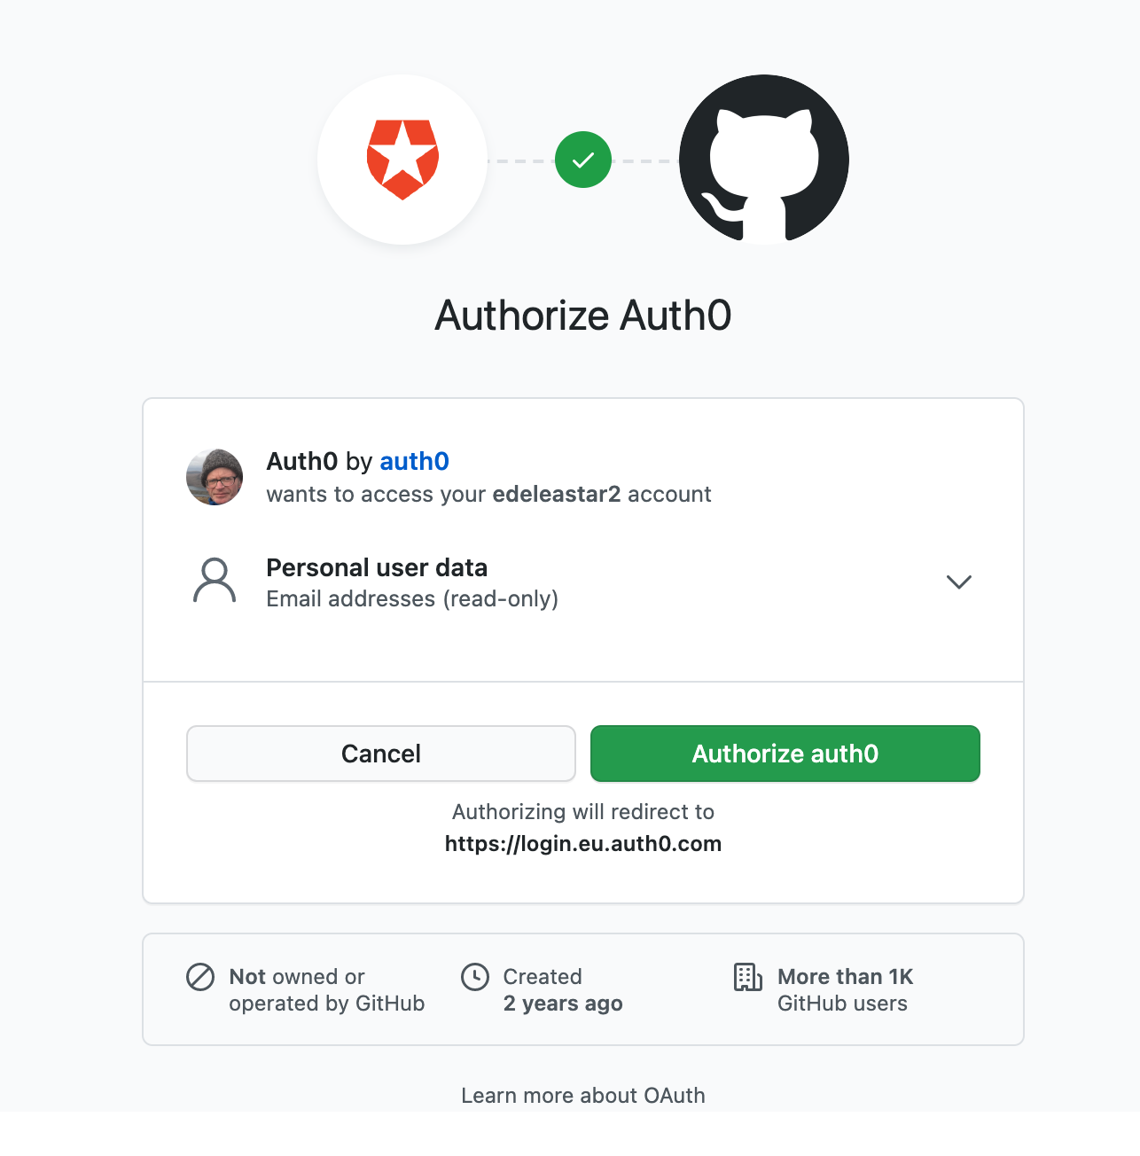
When accessing module, you will be asked to sign in with Github
… first time you will have to authorise …

Slide 23
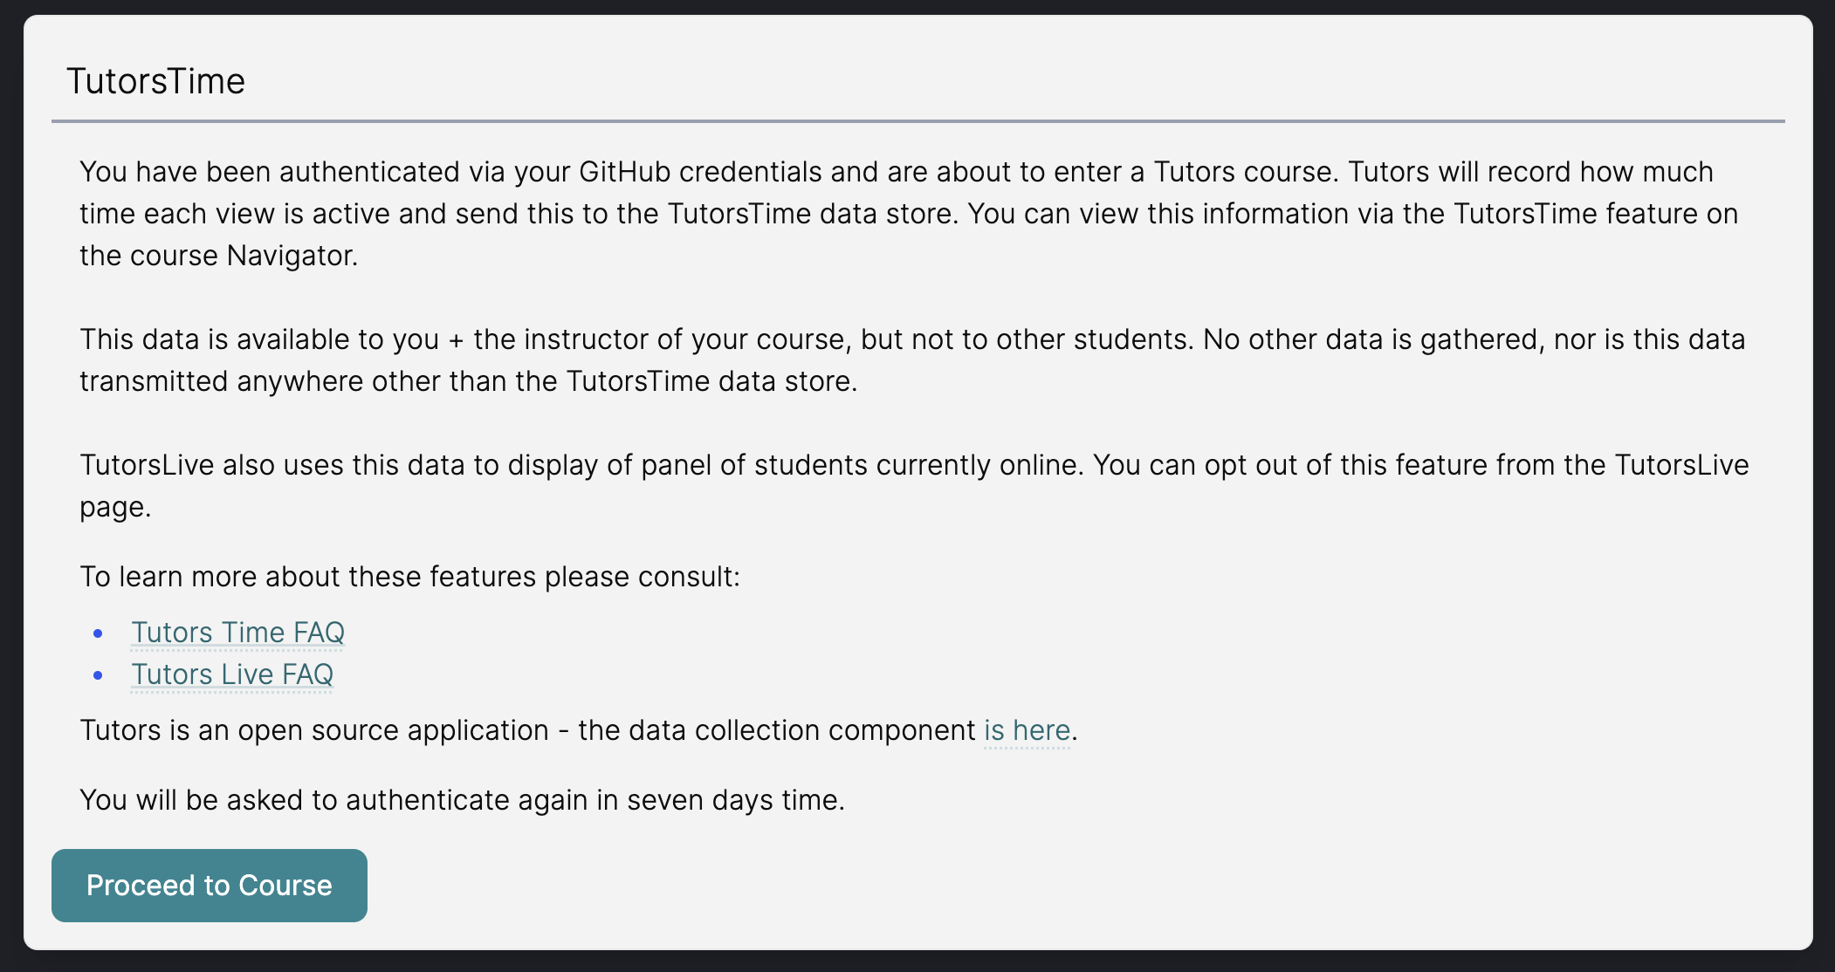

Slide 24
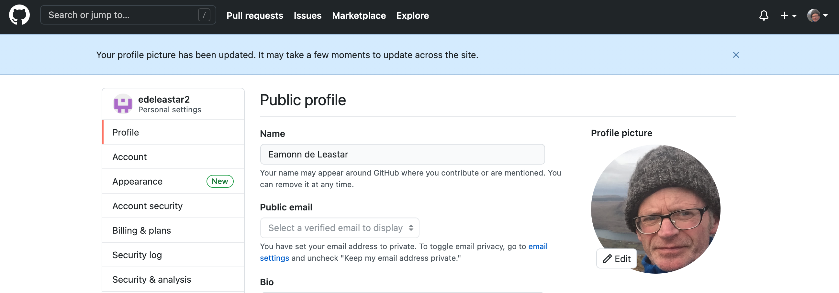
Github Profile

Slide 25
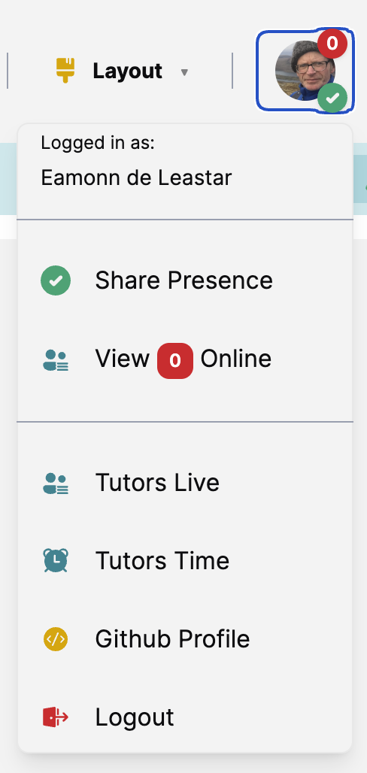
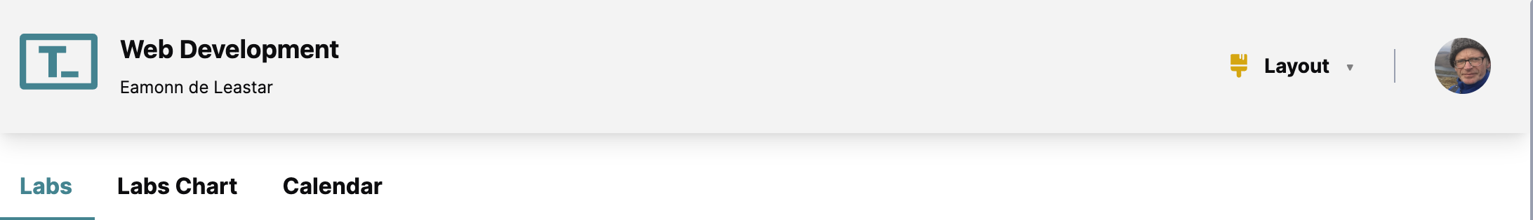
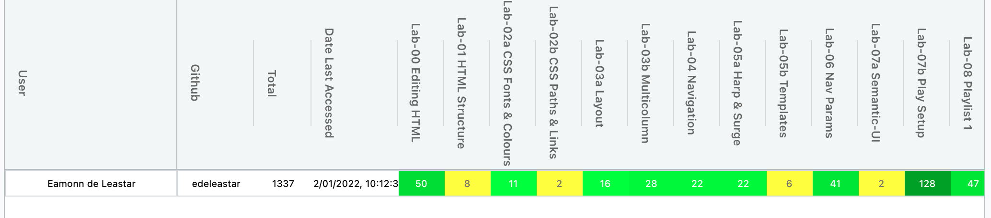
TutorsTime - Labs
Number of minutes the Each lab has been active in your browser (estimate)

Slide 26
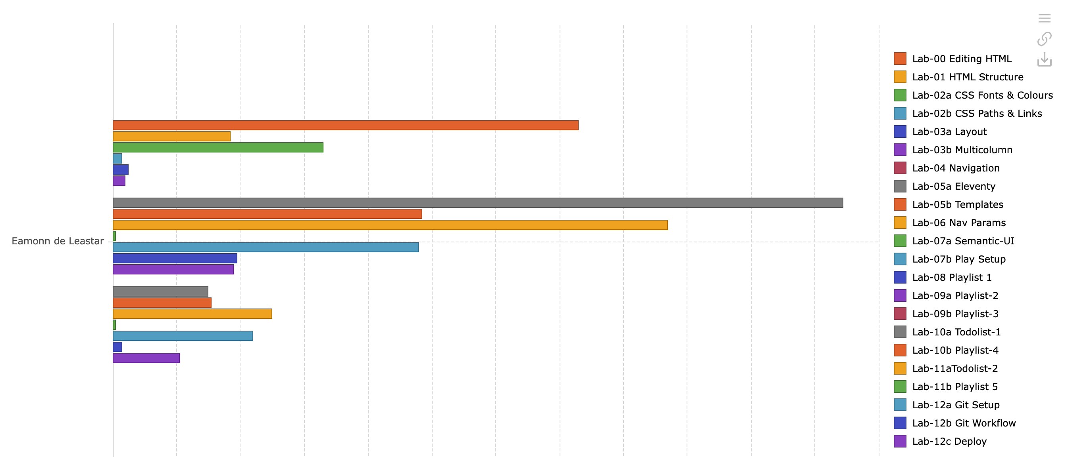
TutorsTime - Chart
At a glance comparative time spent on each labs

Slide 27
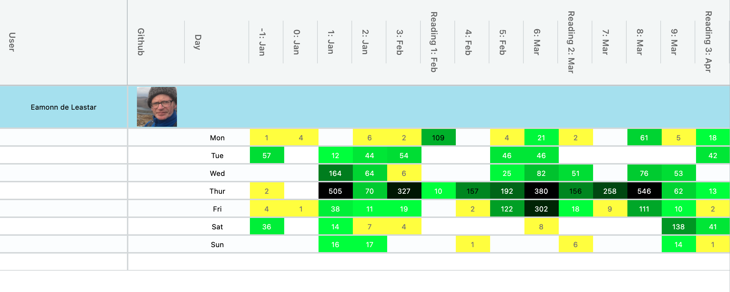
TutorsTime - Calendar
Time online each week of the semester

Slide 28
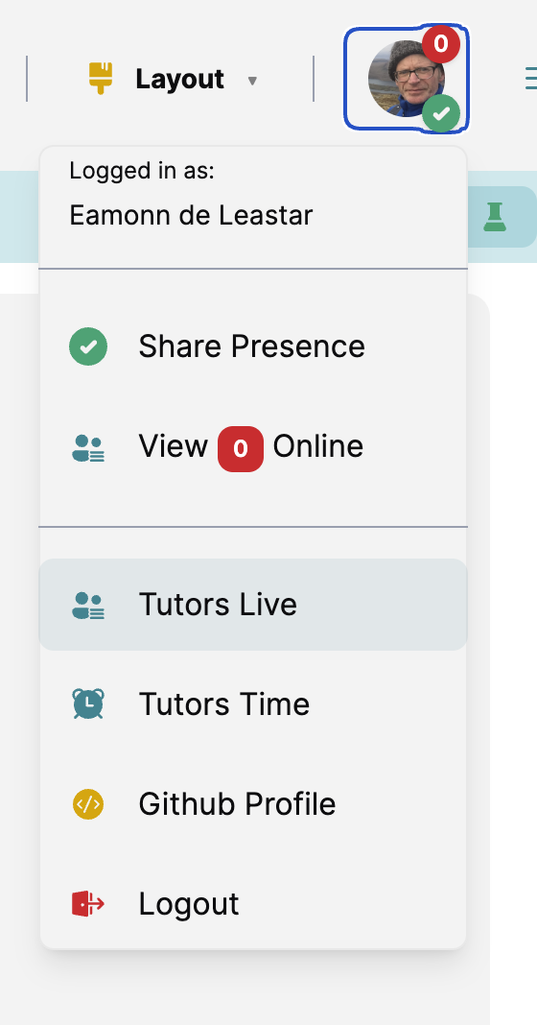
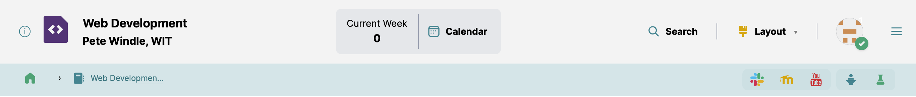
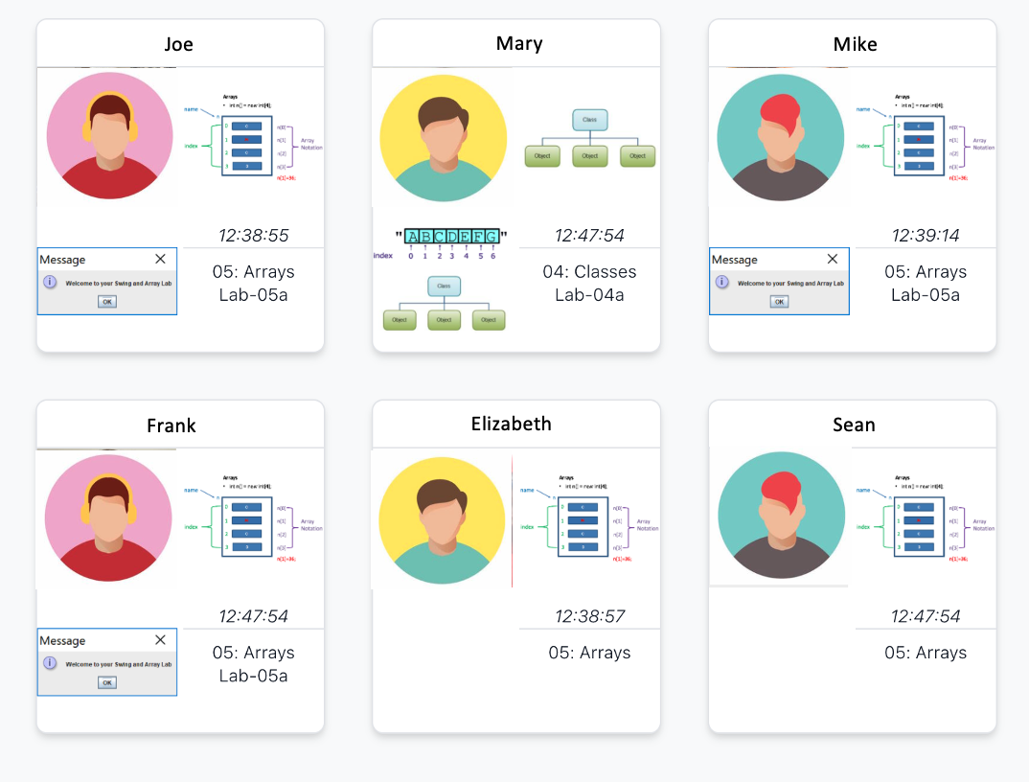
You may choose to not appear on this page if you prefer not share your presence
Any students currently online will appear here, indicating the topic/lab they may be working on

Slide 29
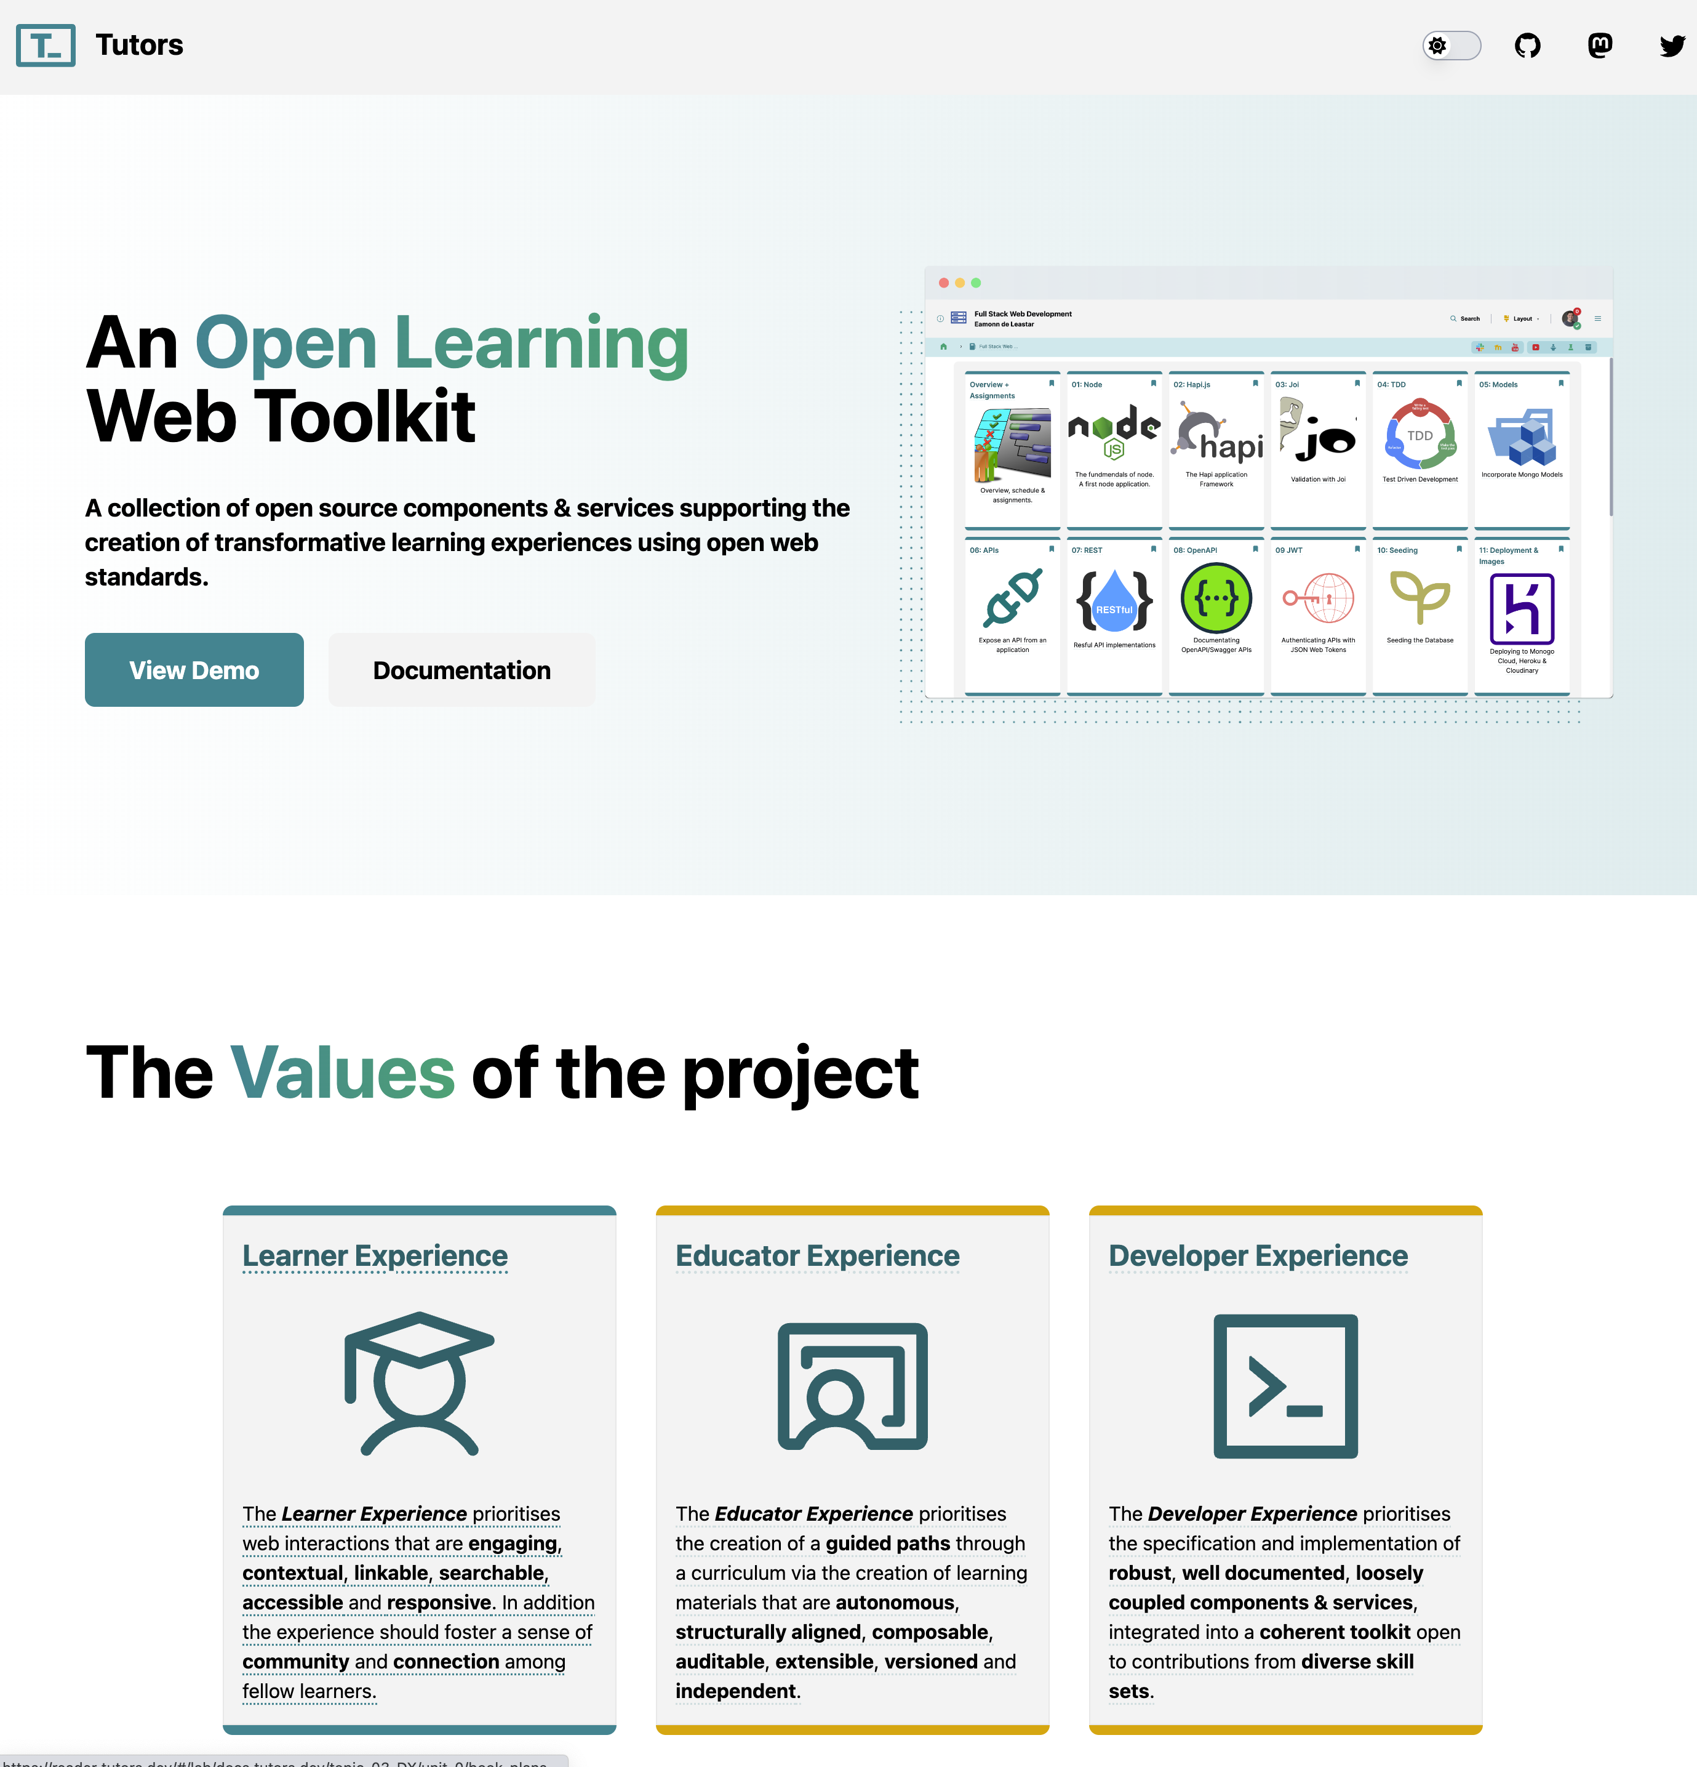
https://tutors.dev

Slide 30
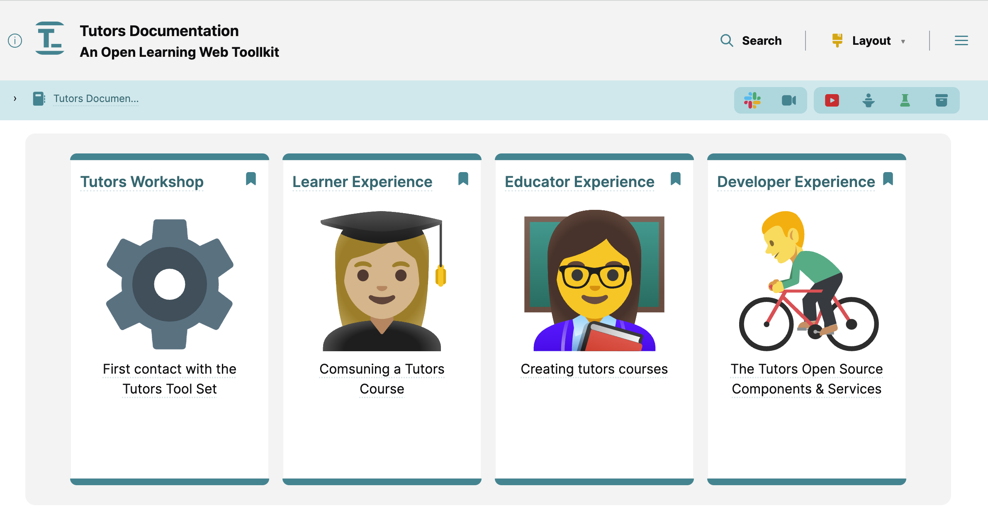
https://reader.tutors.dev/course/tutors-project-site

