Slide 1





Accessing the Tutors Course Webs
Github, Tutors + TutorsTime/Live

Slide 2
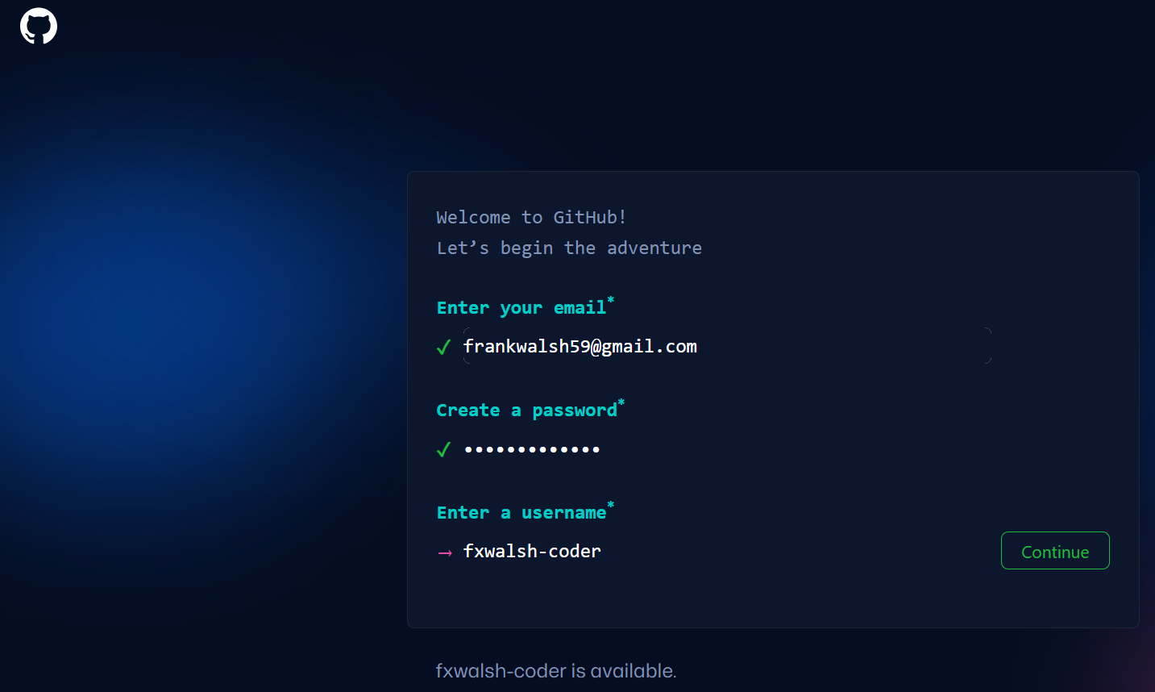
If you do NOT have a Github account visit GitHub.com
& sign up for a new account (instructions on next slides)
Use any Email address you like (you will need to verify)
If you DO have a Github account - please configure your Github profile as shown on slides 7 & 8 below
Use any username you ike

Slide 3
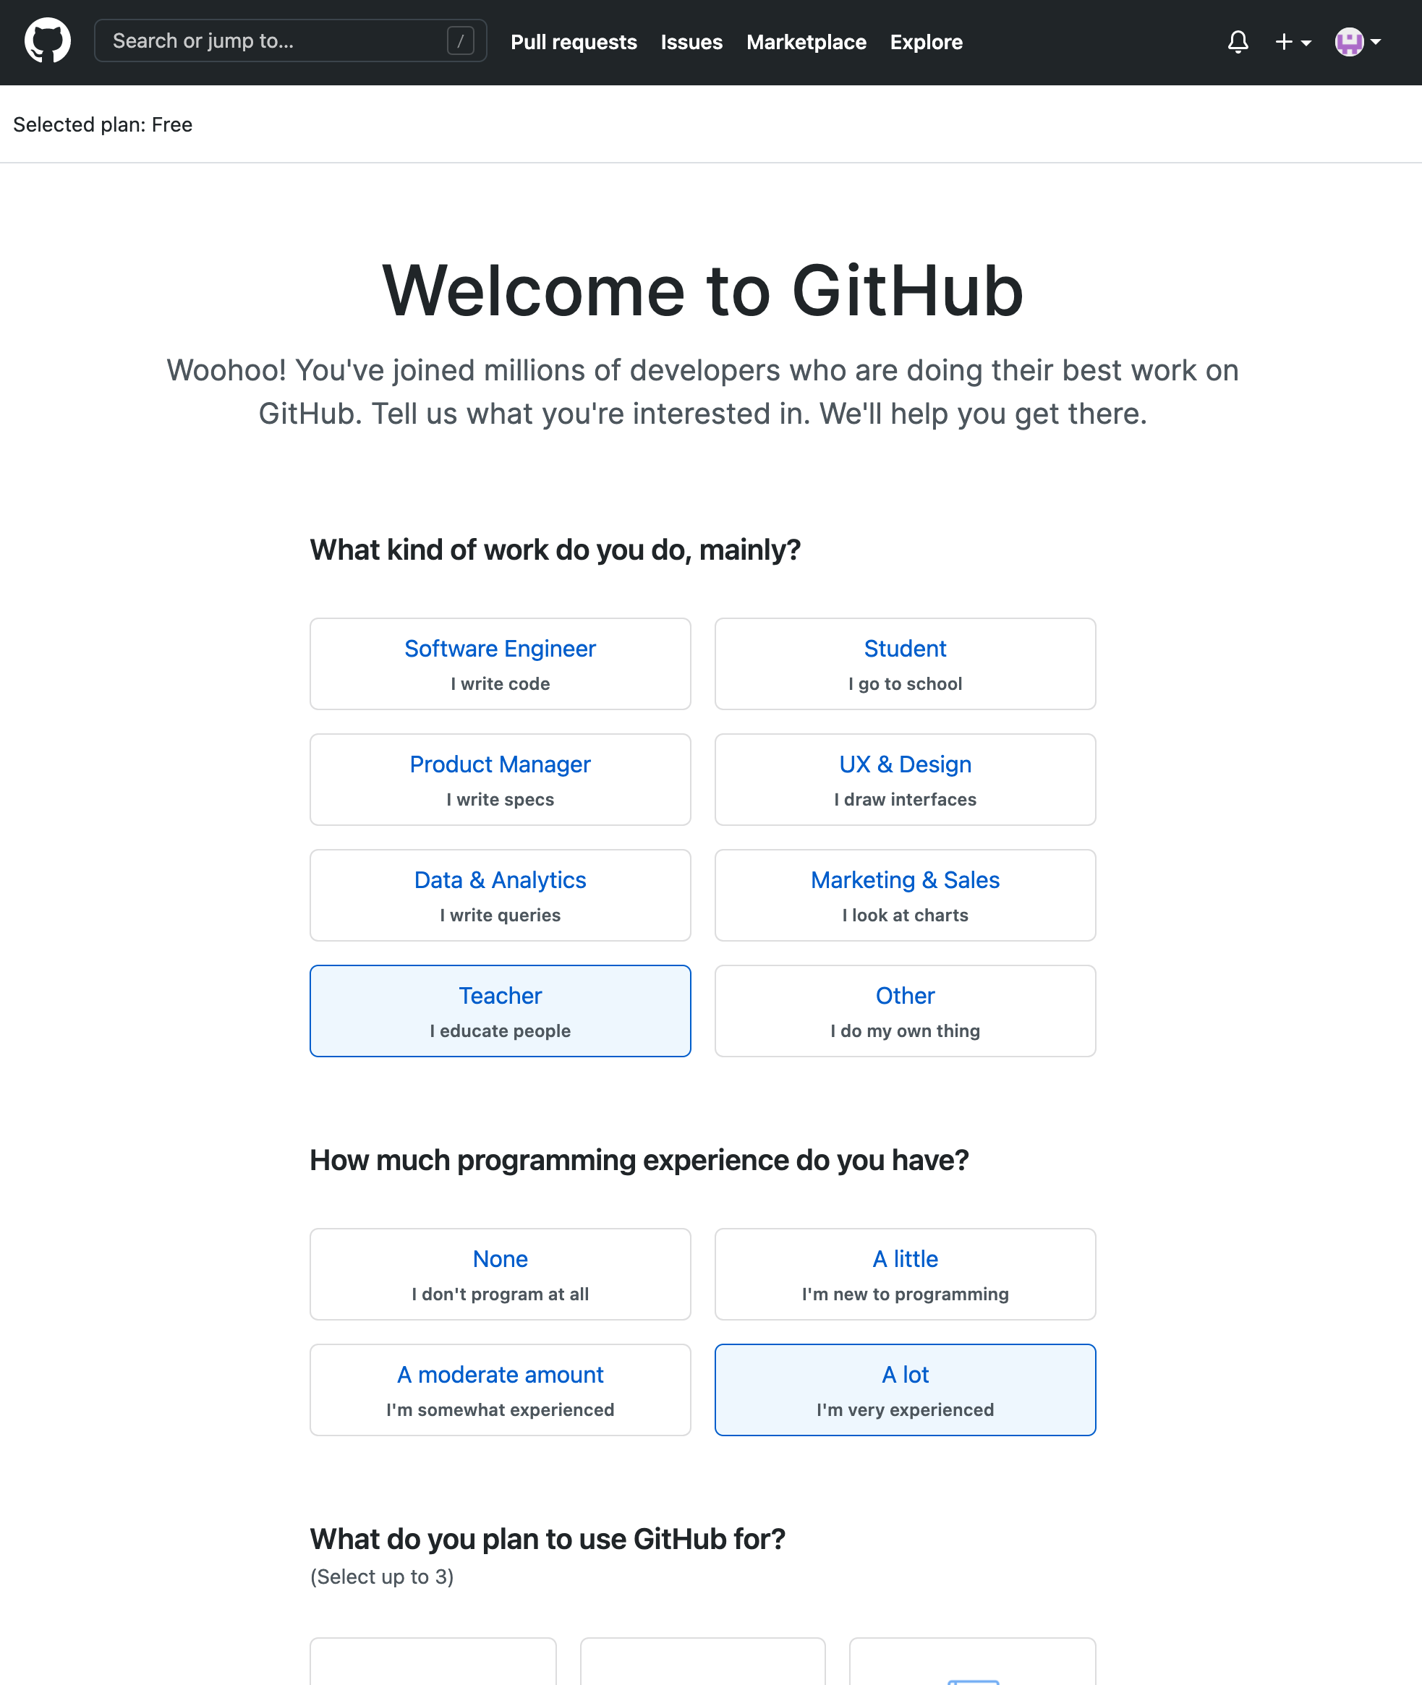
You may be asked to fill out a quick survey
Select any survey responses you like

Slide 4
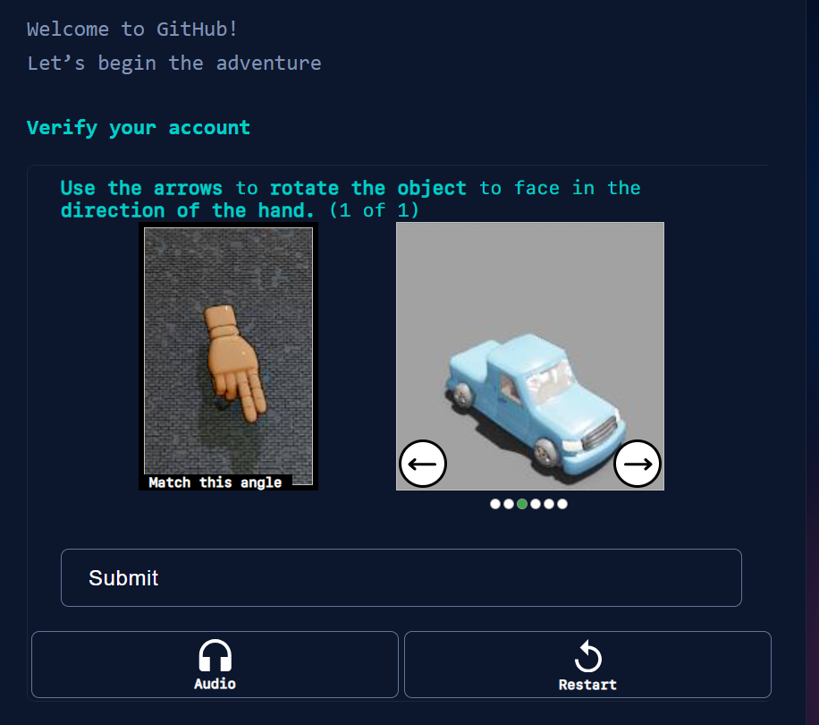
To proceed you may be asked to solve a puzzle

Slide 5
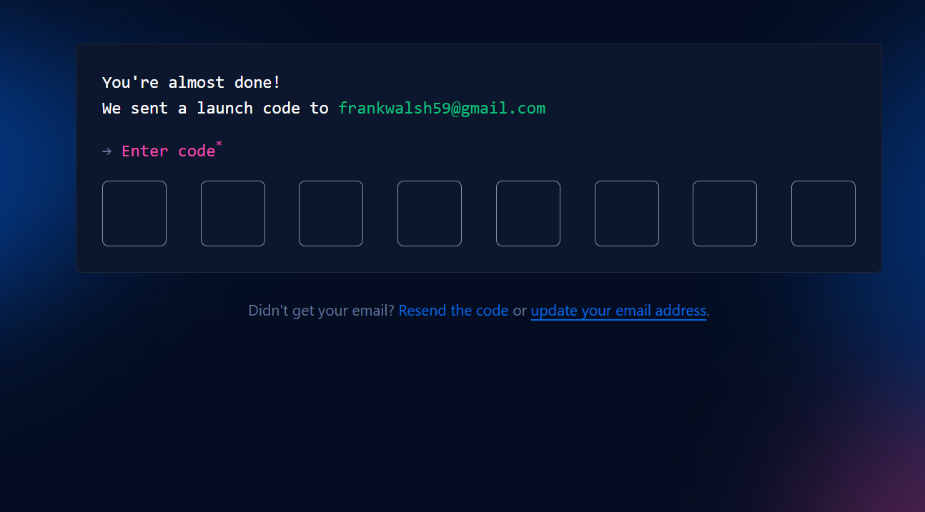
To proceed you will need to verify your email address and retrieve a Launch Code

Slide 6
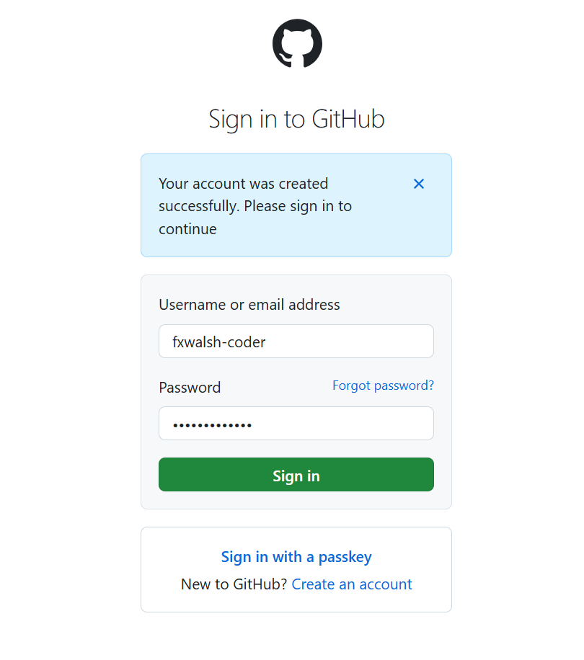
Once verified you can log in

Slide 7
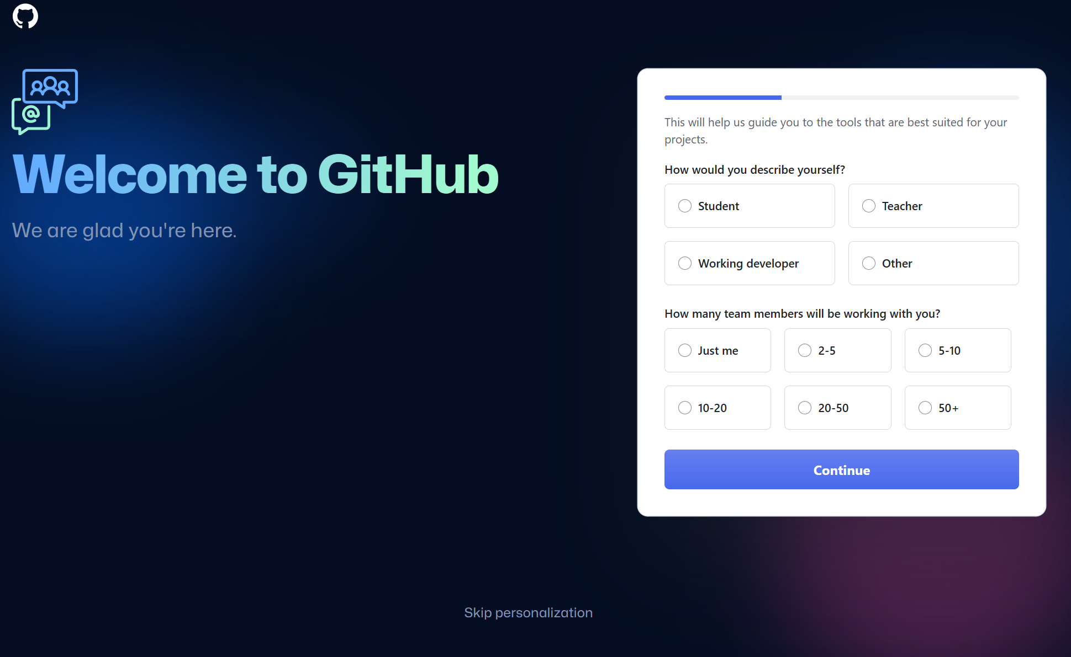
You may be asked a few questions, but you can skip this if you wish…

Slide 8
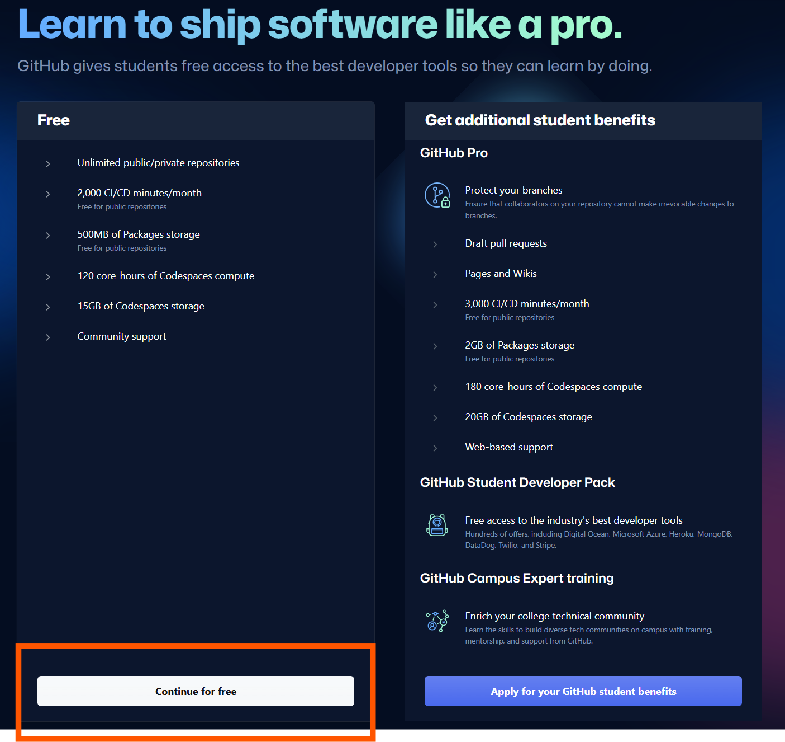
Select the Continue for Free option when offered

Slide 9
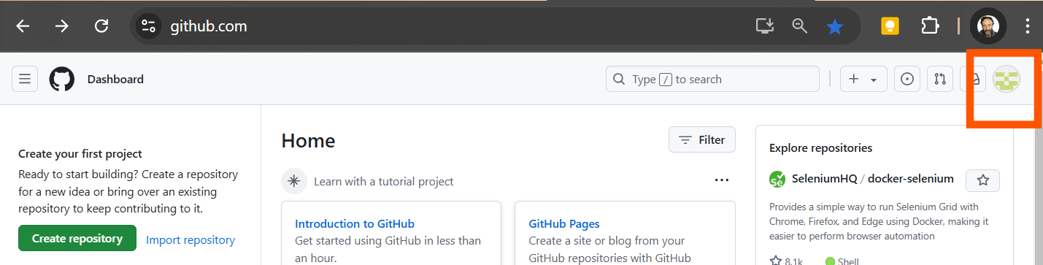
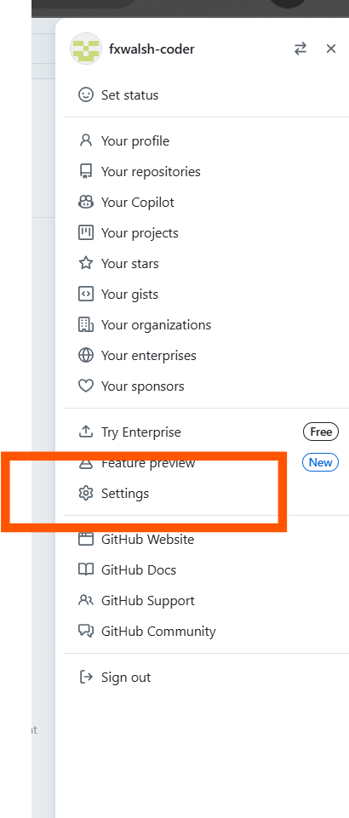
Proceed to Edit your Profile by Clicking on the Default Avatar
Then select “Settings” from the options

Slide 10
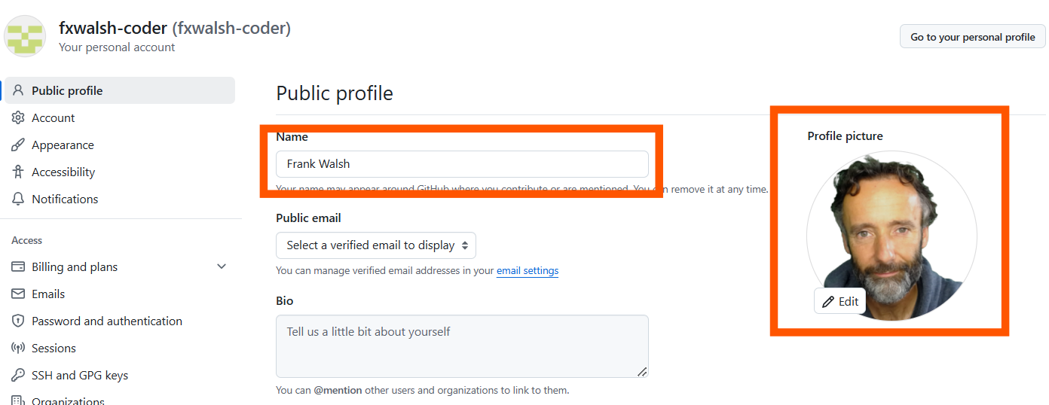
Please use your correct full name - First name followed by Last name
Please also set a profile picture

Slide 11
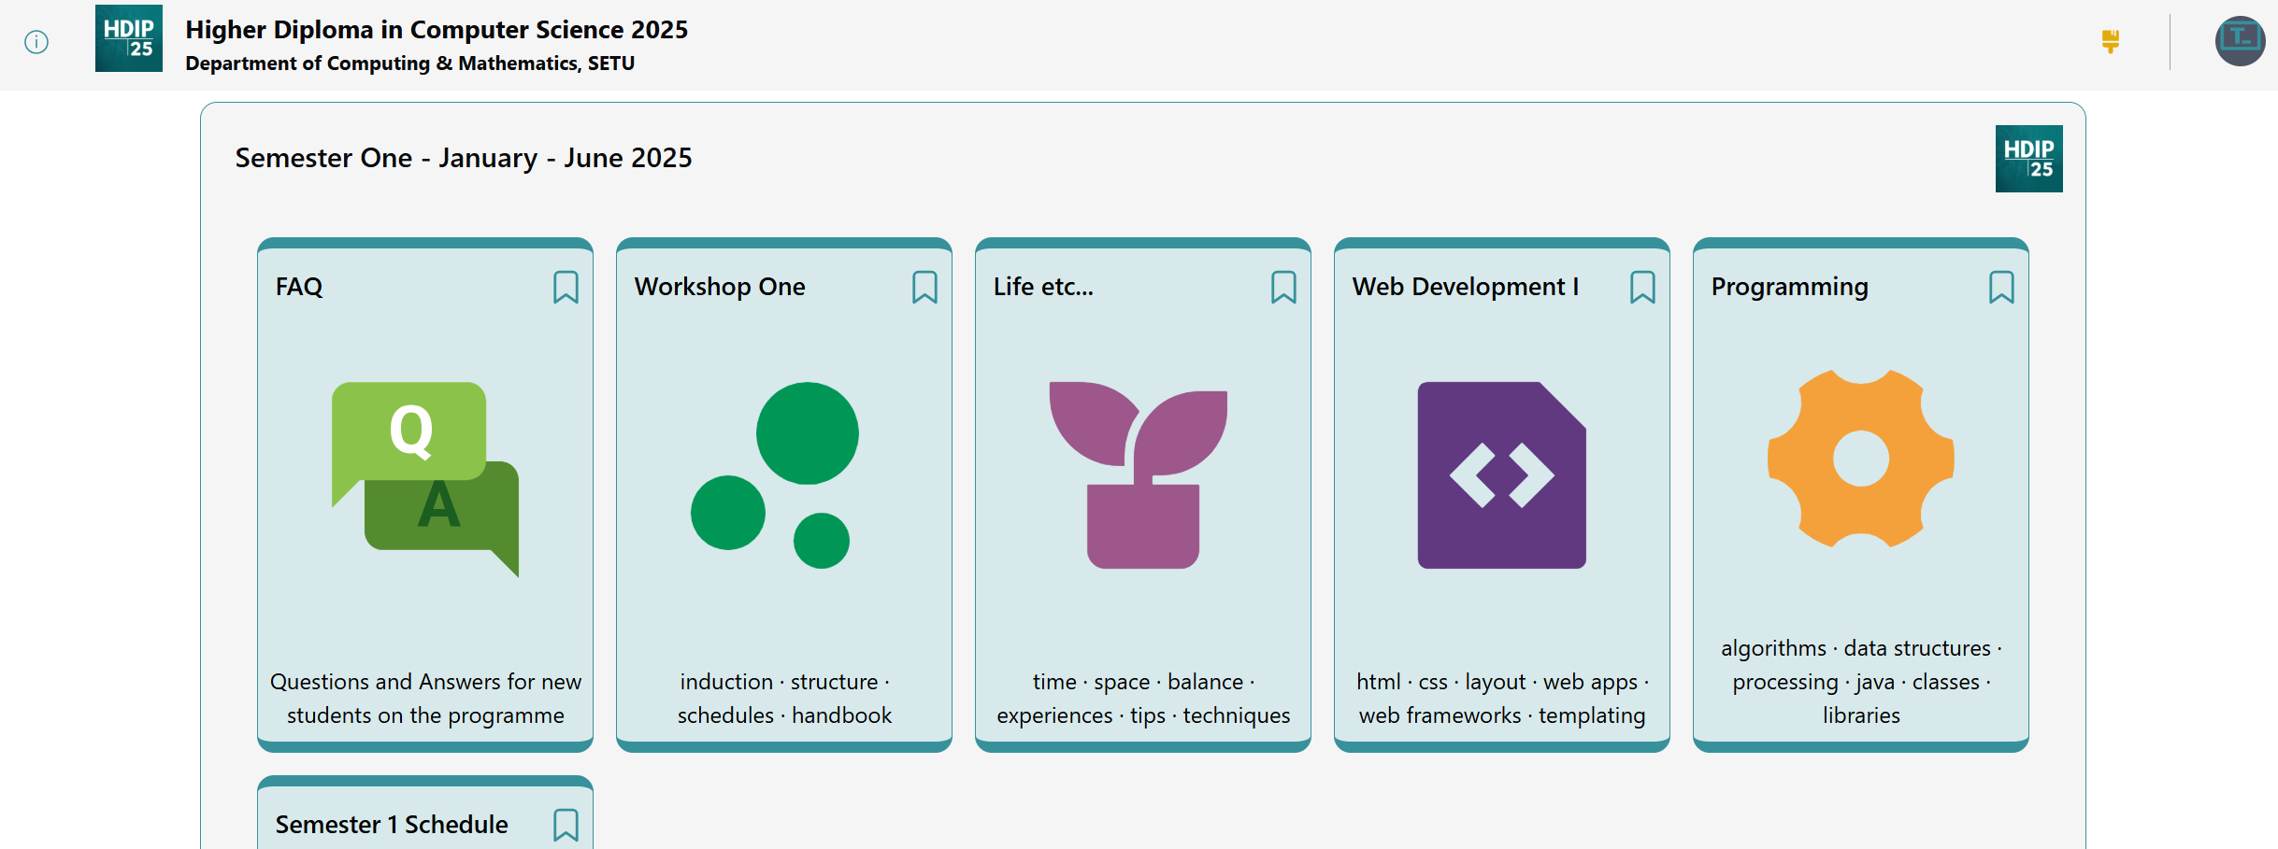
Now Visit:
https://tutors.dev/course/setu-hdip-comp-sci-2025

Slide 12
Select Web Development

Slide 13
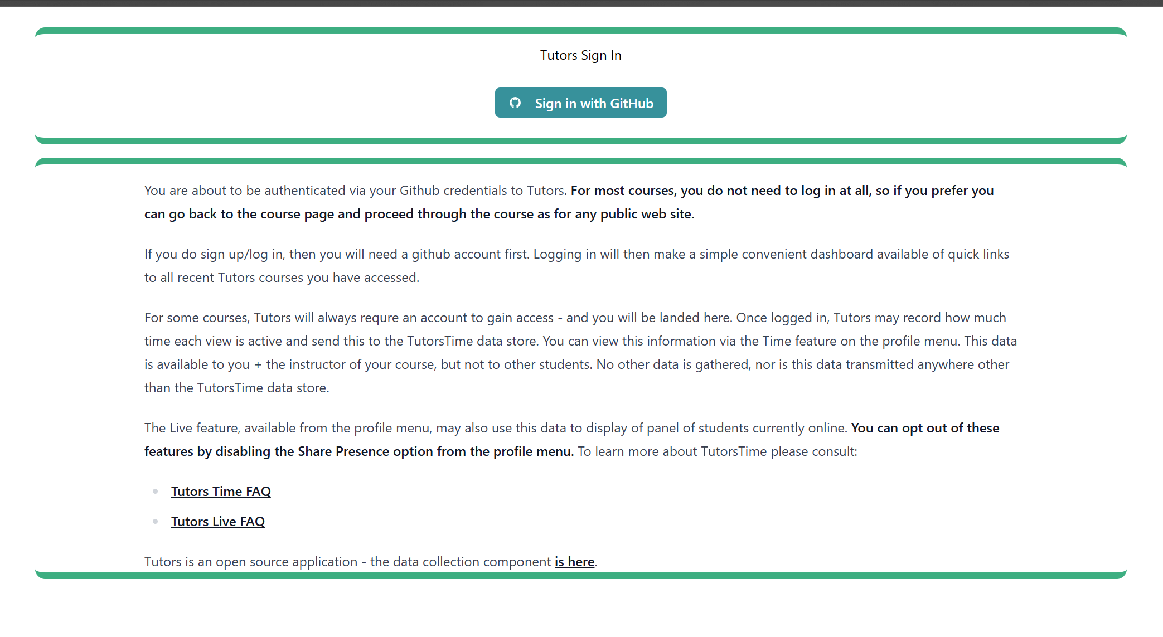
This will trigger a login request…

Slide 14
You will now be authenticated into Tutors your Github credentials
Some usage data will be collected
These FAQ links explain the rationale for this

Slide 15
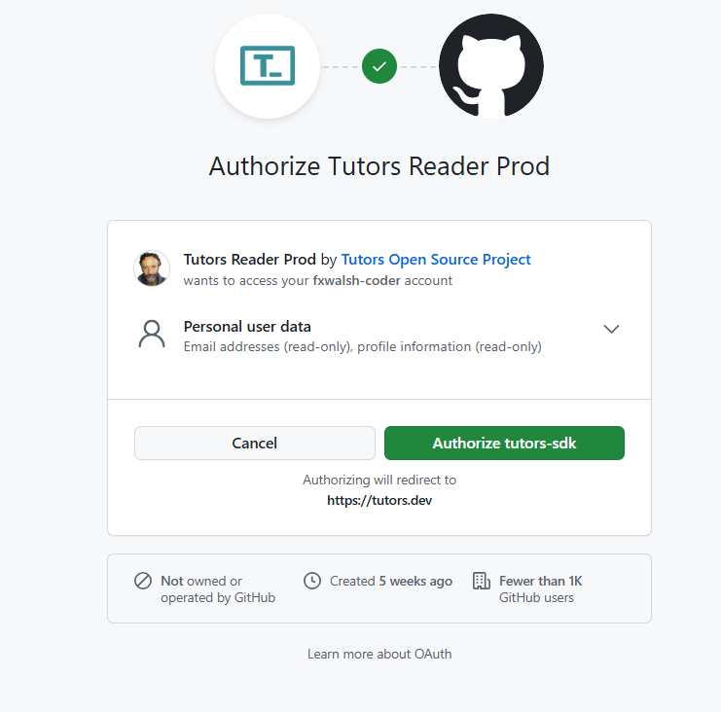
First time in you will be asked to …
… and Authorise your account

Slide 16
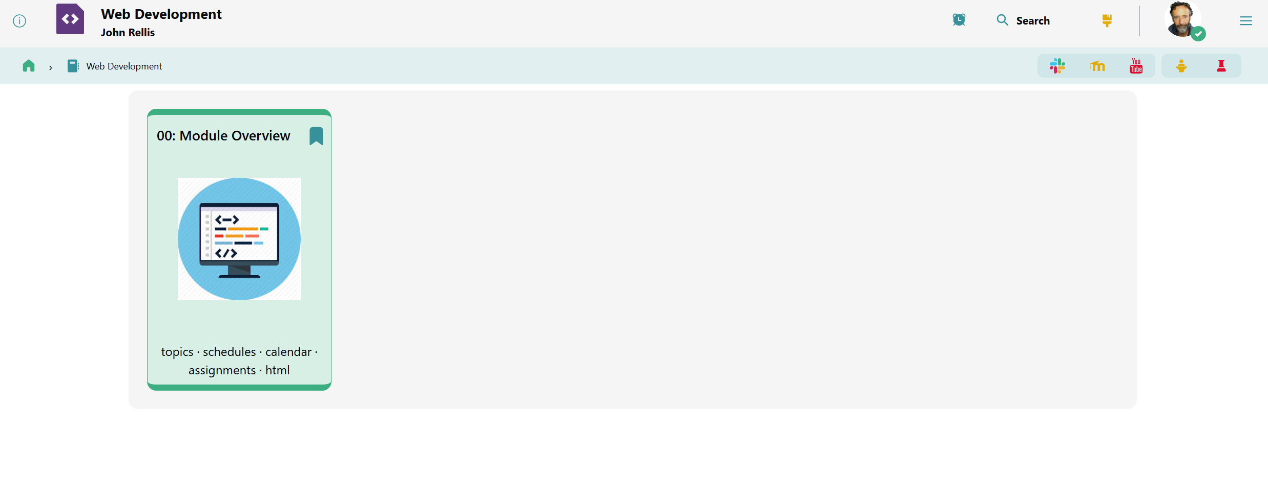
You will be redirected back to Module Tutors Page
List of recent accessed courses

Slide 17
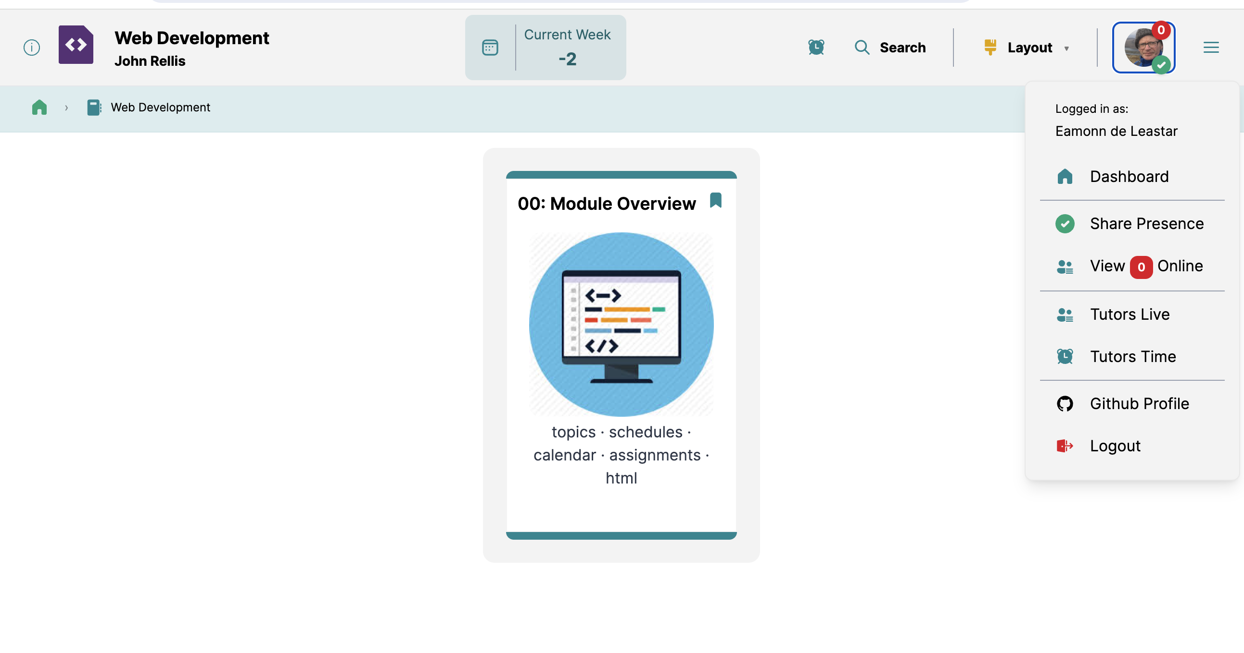
Verify that your correct profile image appears here
… and you correct full name
If these are not appearing correctly, visit and update your Github Profile, logout and log in again

Slide 18
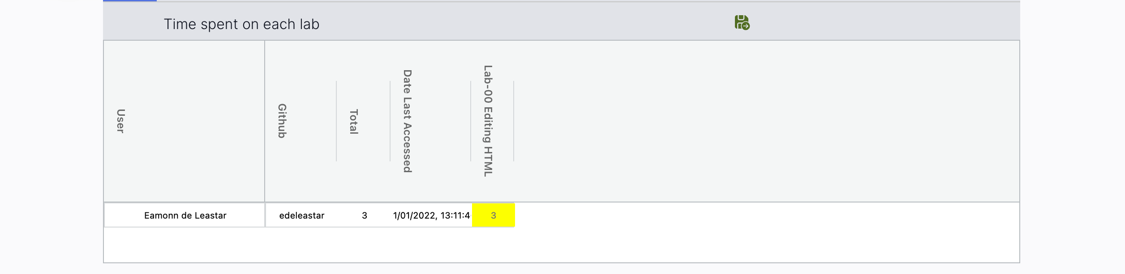
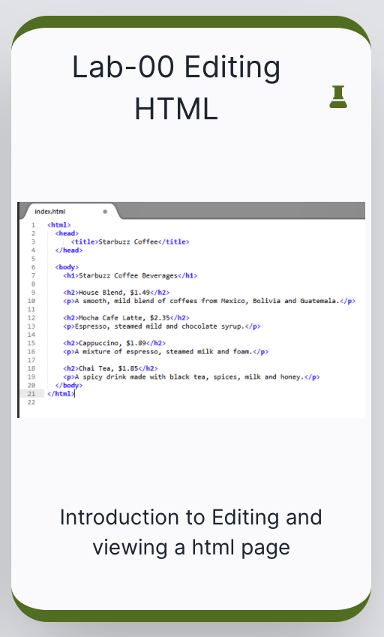
Tutors Time/Labs
Number of minutes the Lab-00 Editing HTML has been active in your browser (estimate)

Slide 19
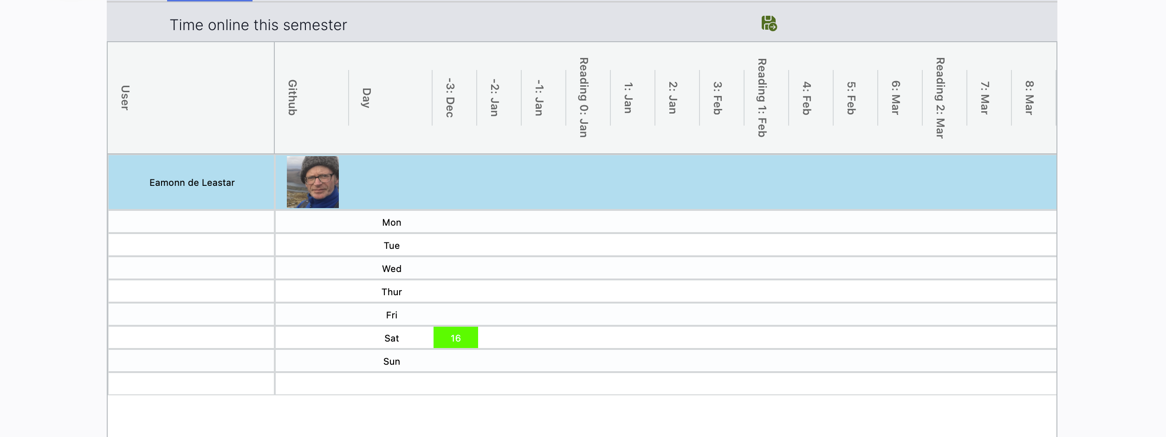
Tutors Time/Calendar
Number of minutes the the Web Development Course has been active in your browser (estimate)

Slide 20
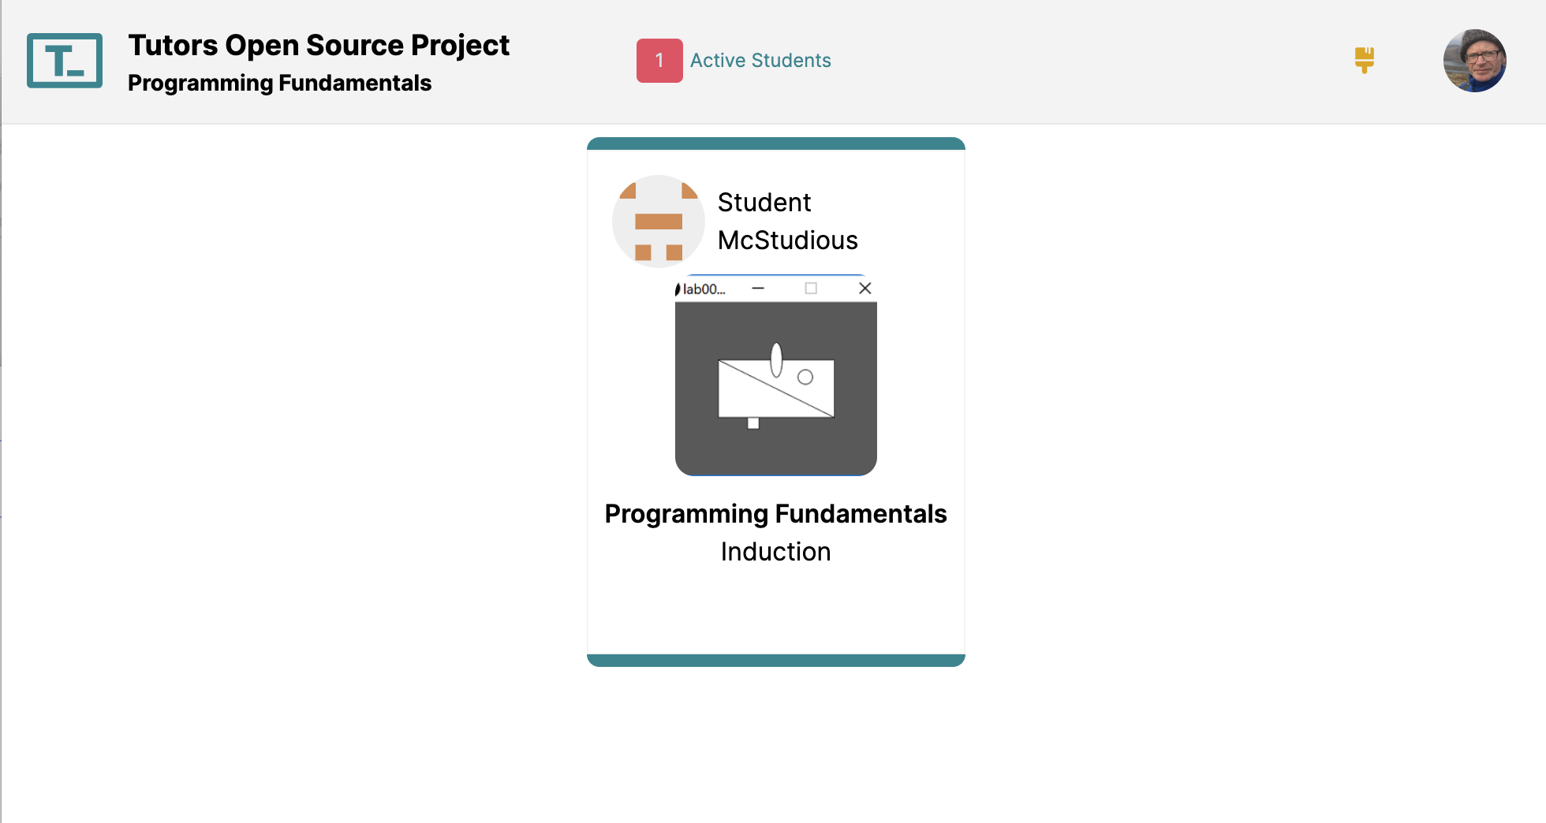
Tutors Live
Any students currently online will appear here, indicating the topic/lab they may be working on
You may choose to not appear on this page
(uncheck Share Presence)

Slide 21
Accessing the Tutors Course Webs
Github, Tutors + TutorsTime/Live

