Slide 1

Higher Diploma in Computer Systems
How to Learn Online & What you’ll be using

Slide 2
WIT Accounts…

Slide 3
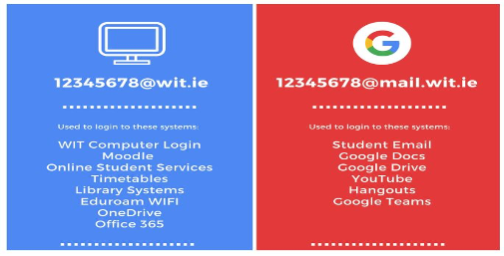
WIT username
WIT E-Mail
Notes:
When you register as a WIT student will will receive 2 computer accounts from Computer Services.
You will receive a WIT username account that you will use to log into Moodle Office 365 and other WIT related computer systems, it tale the format of studentnumber@wit.ie – this is your username to login to Moodle and office 365 etc.
You will also receive an official WIT email account that takes the form studentnumber@mail.wit.ie plese use this email address on all official correspondence to WIT depts
Initially both account will have the same password but its important to note that they are separate accounts and once you change the password for one there is not syncronization between account as regards password, you now have 2 separate passwords

Slide 4
WIT username
WIT E-Mail
Notes:
When you register as a WIT student will will receive 2 computer accounts from Computer Services.
You will receive a WIT username account that you will use to log into Moodle Office 365 and other WIT related computer systems, it tale the format of studentnumber@wit.ie – this is your username to login to Moodle and office 365 etc.
You will also receive an official WIT email account that takes the form studentnumber@mail.wit.ie plese use this email address on all official correspondence to WIT depts
Initially both account will have the same password but its important to note that they are separate accounts and once you change the password for one there is not syncronization between account as regards password, you now have 2 separate passwords

Slide 5


WIT username
WIT E-Mail
Notes:
When you register as a WIT student will will receive 2 computer accounts from Computer Services.
You will receive a WIT username account that you will use to log into Moodle Office 365 and other WIT related computer systems, it tale the format of studentnumber@wit.ie – this is your username to login to Moodle and office 365 etc.
You will also receive an official WIT email account that takes the form studentnumber@mail.wit.ie plese use this email address on all official correspondence to WIT depts
Initially both account will have the same password but its important to note that they are separate accounts and once you change the password for one there is not syncronization between account as regards password, you now have 2 separate passwords

Slide 6


WIT username
WIT E-Mail
Notes:
If you change you intial password you now have 2 separate passwords, one for you WIT username and one for your WIT email

Slide 7

Notes:
Computer services are responsible got all computer accounts and passwords, from the WIT hope page you can navigate to the computer services page – Students Computer Services

Slide 8
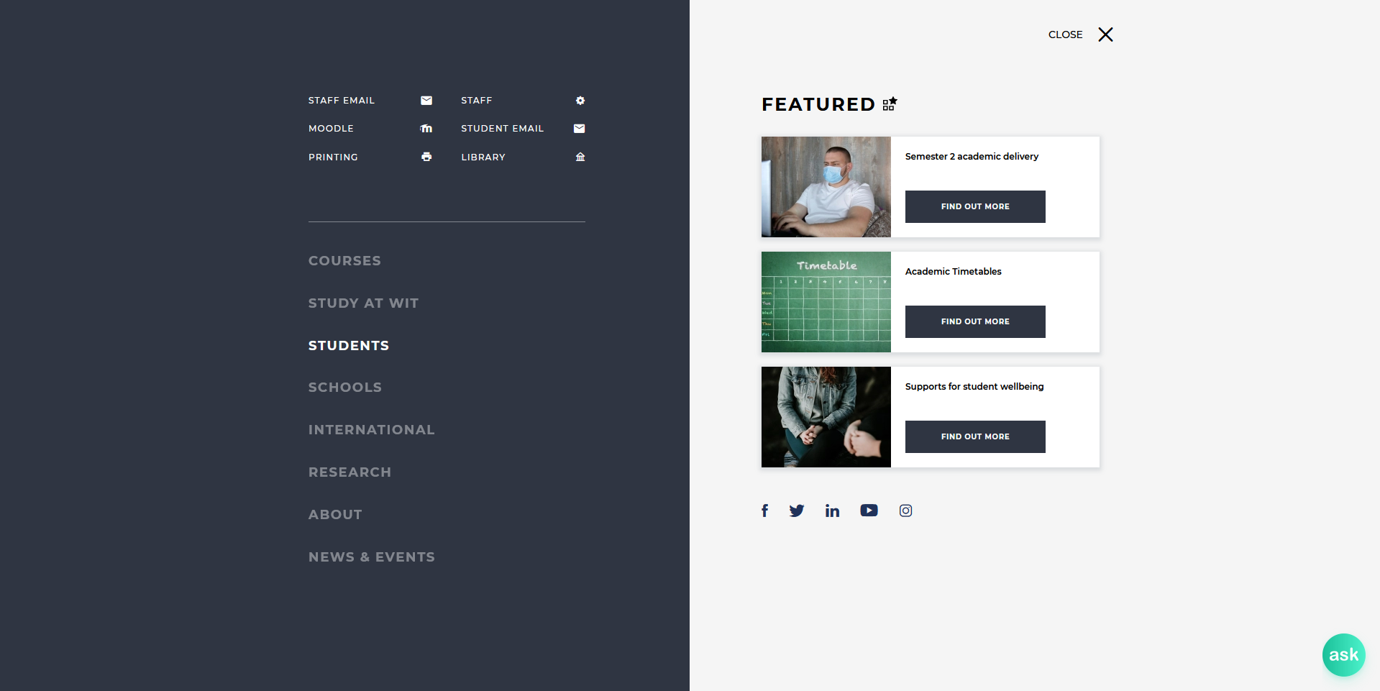

Slide 9
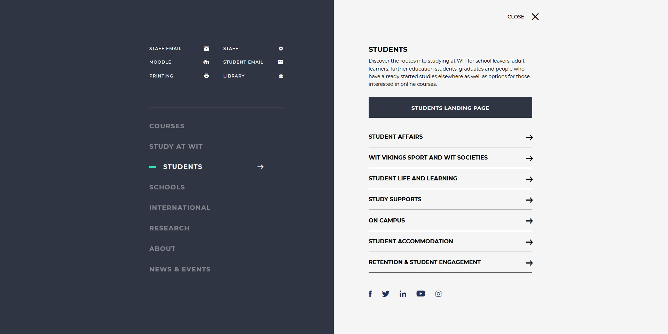

Slide 10
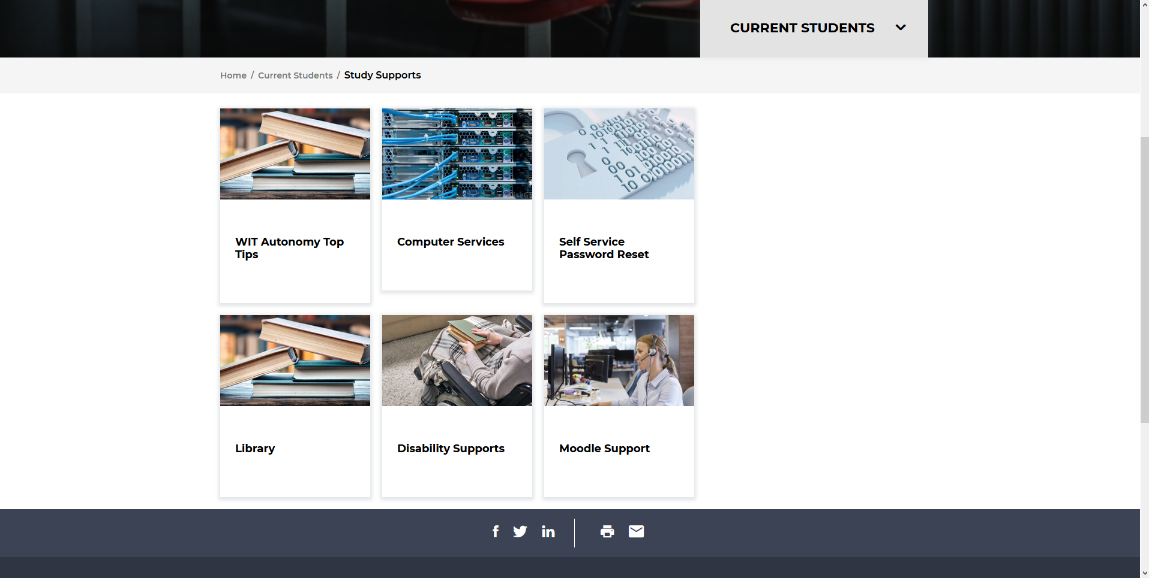

Slide 11






TutorStack2021 – Instructor View
LAYER TITLE TECHNOLOGY
1
Learning Materials
Tutors
2
Communications & Community
3
Assessment & Feedback
4
Media
Notes:
Instruction Materials – plug Eamon’s Tutors
2. Community & screen sharing – plug Slack
3. Assessment & Feedback - Moodle
4. Media – YouTube (Asynch)
5. Broadcast – Connect>OBS (Synch)

Slide 12


Key Tools:
Tutors
Youtube
Moodle
Slack / Zoom

Slide 13
Slack
All Communications on the programme
+ Lab Tuition Support
+ Peer-to-peer communications
+ Self help
+ Community Building

Slide 14

Rosell, 2018
“Without these community structures, education would be a very lonely place. Students wouldn’t be able to work together on group projects, help each other through tricky material or share their interest and passion for certain subjects. Learning communities play a significant role in ensuring that students remain motivated to succeed.”

Slide 15


Slide 16

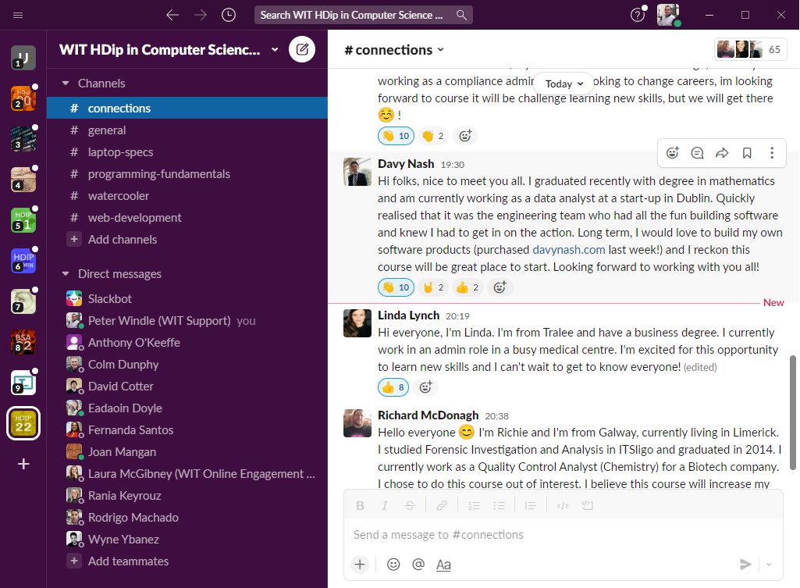
Slack – main things to remember
1. CHANNELS
2. DIRECT
MESSAGES
3. TYPE HERE
4. CLICK TO SELECT FILES/CONTENT TO UPLOAD

Slide 17
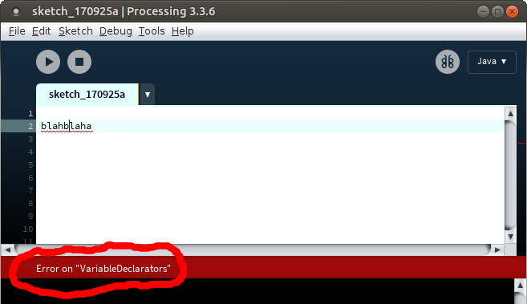
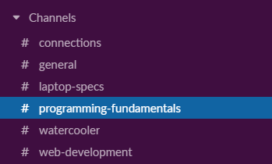
Select the Channel in Slack & post your issue
Notes:
Post on the public channel to get a quick response

Slide 18
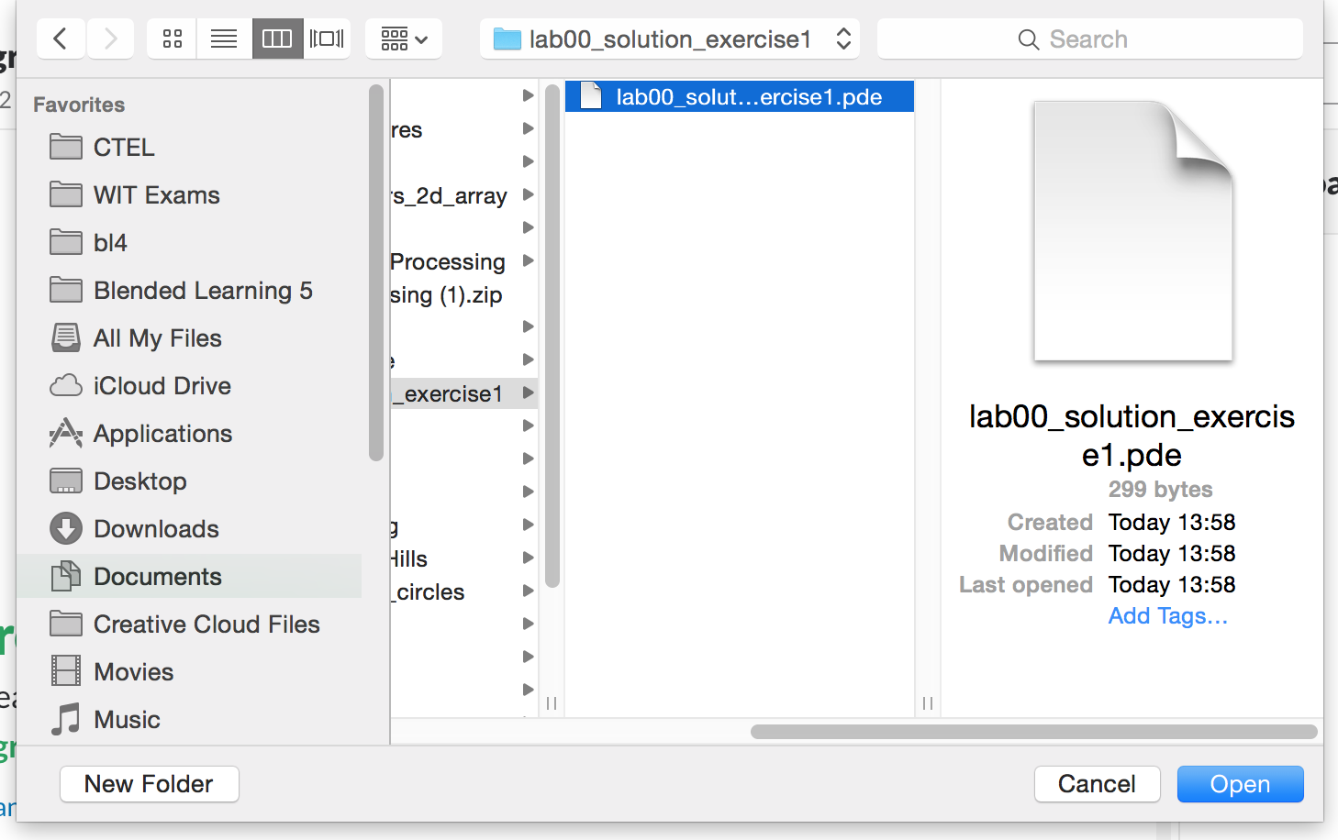
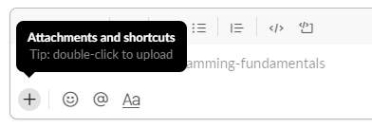
Uploading content for discussion
OR drag n’ drop the file to here

Slide 19
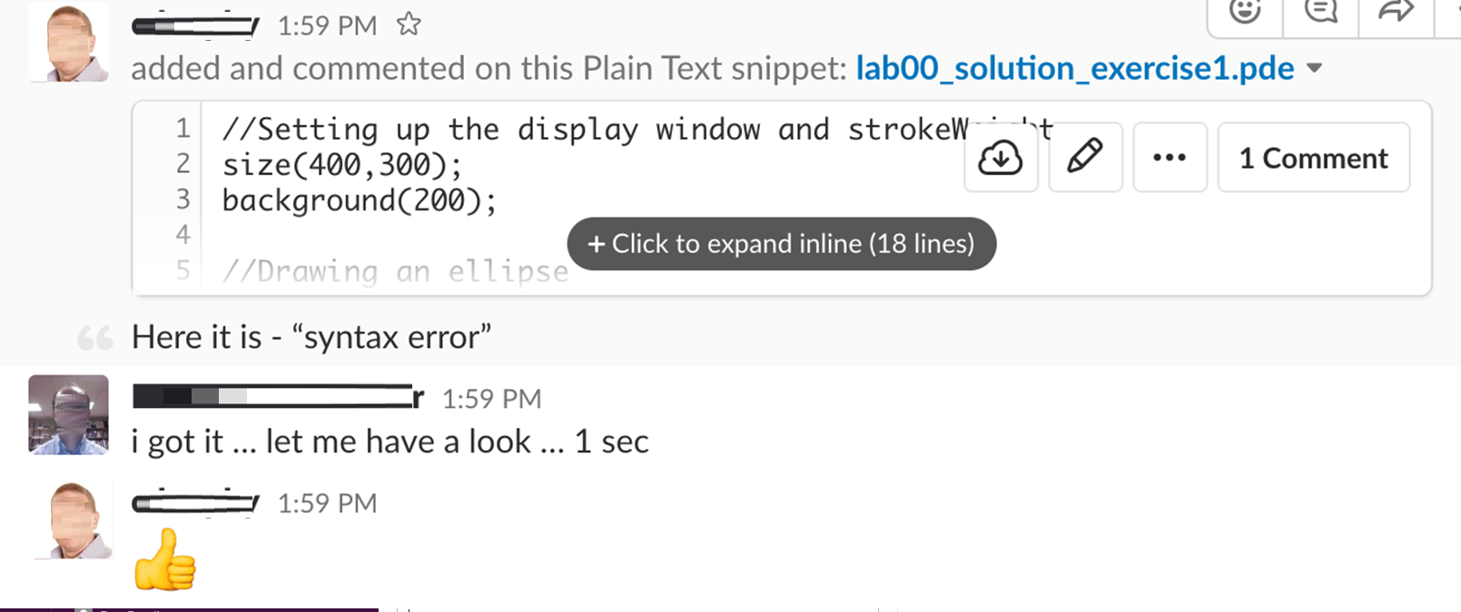
Simple issue resolved on chat text by peers or tutor

Slide 20
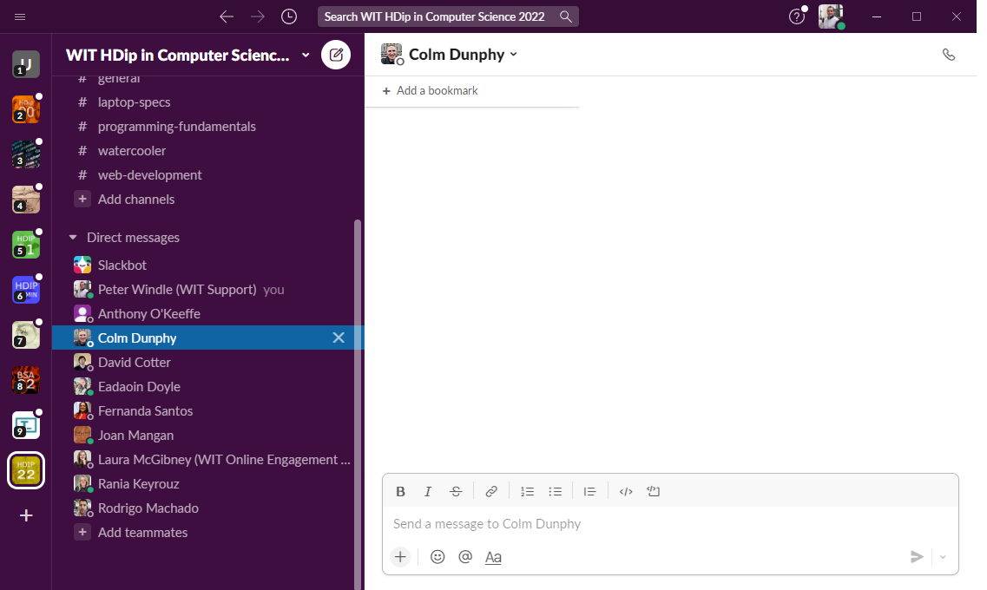
Private 1 on 1 help required -> Direct Message (DM)
Notes:
If you post a DM and we fix your problem you might be asked to post on a public channel so that others don’t have the same problem

Slide 21
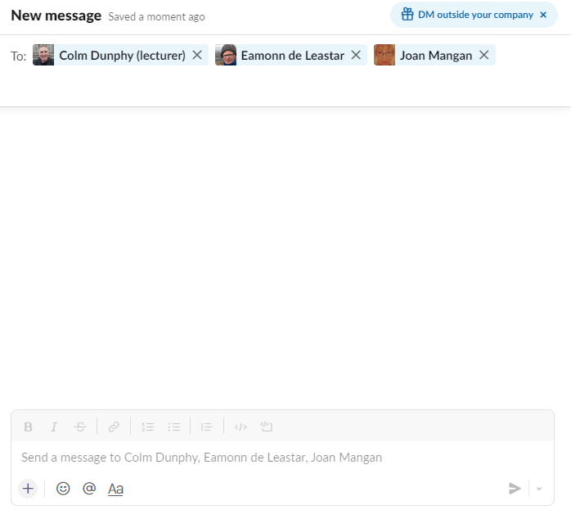
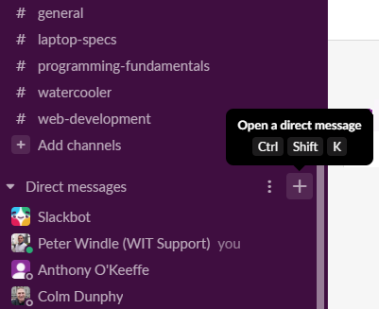
Can’t see who you’re looking for? -> Search for person or start group DM

Slide 22
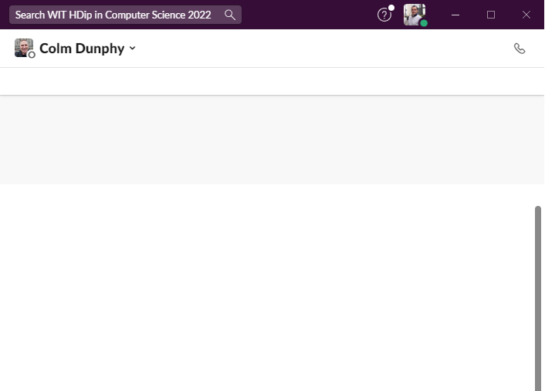
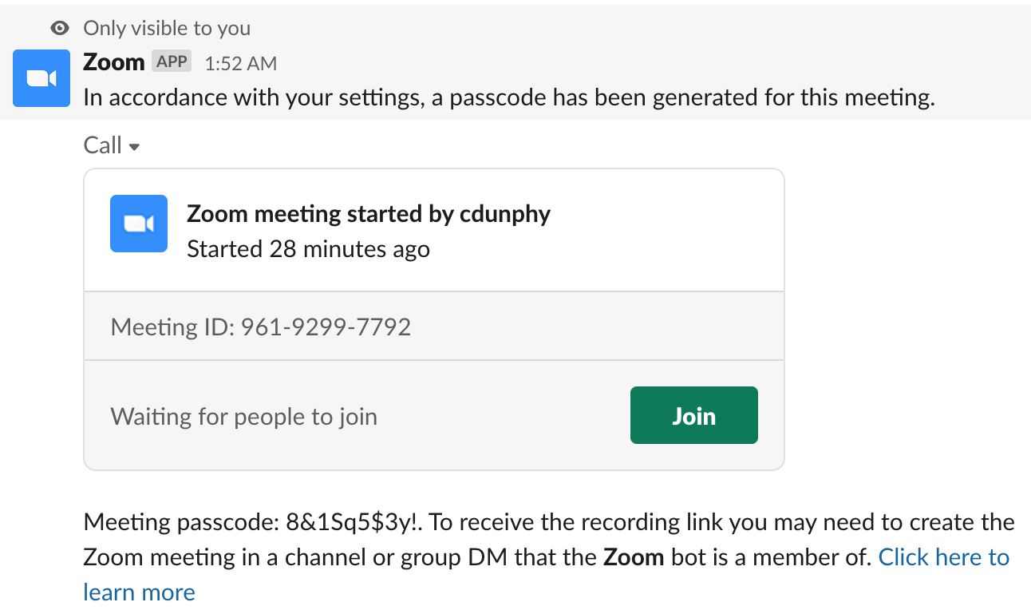
Start Zoom Call From Slack

Slide 23
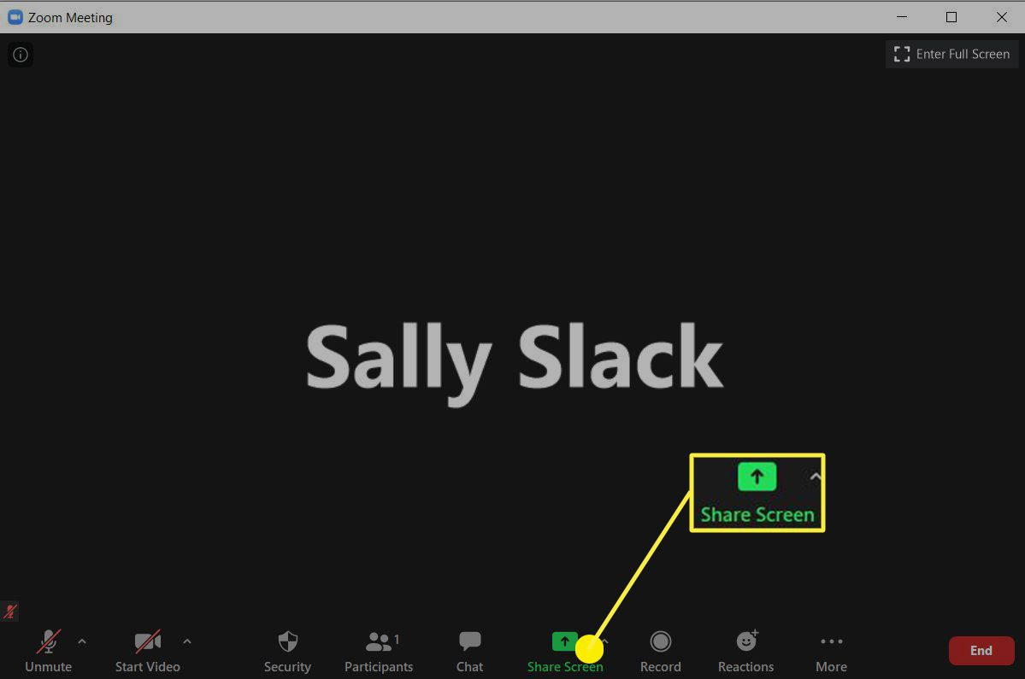
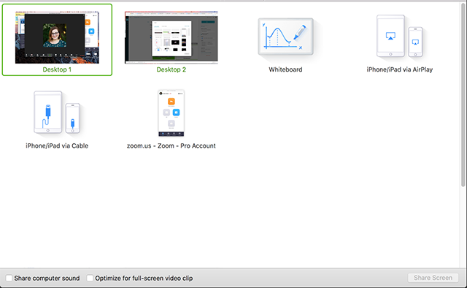
Share Screen on Zoom

Slide 24
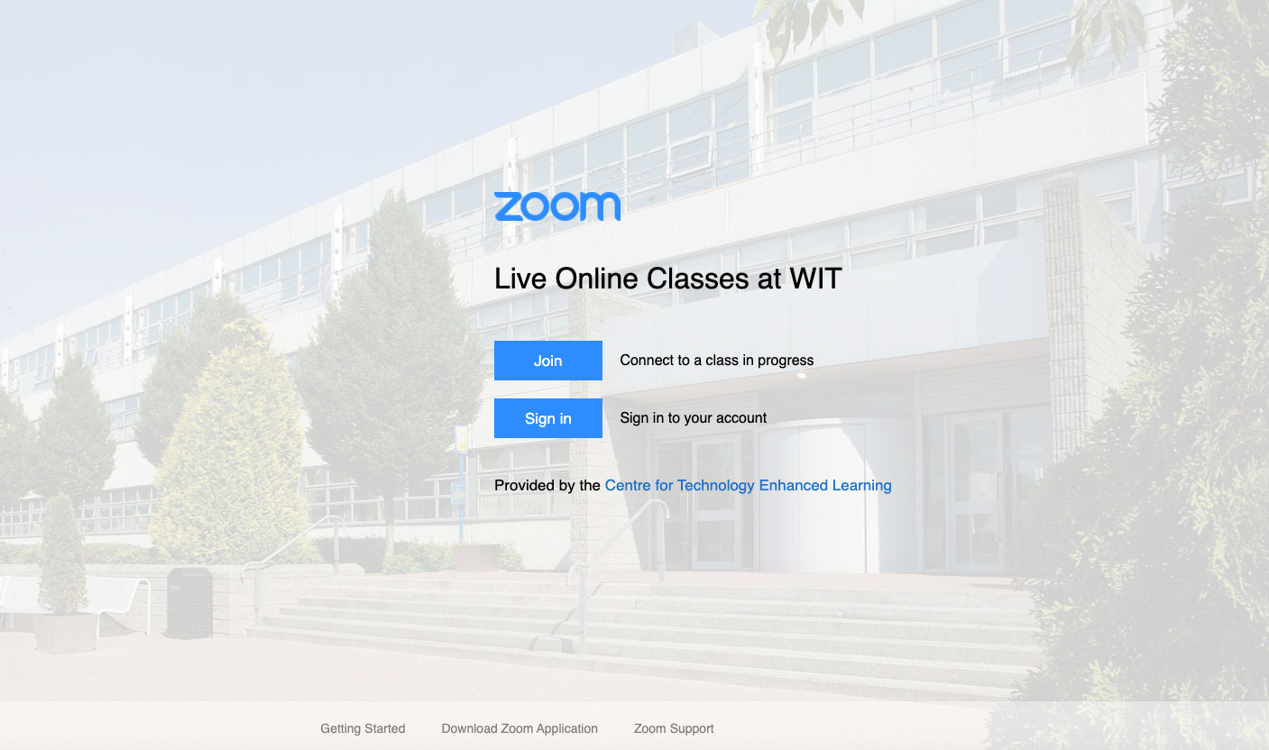
wit-ie.zoom.us

