Slide 1



Certificate/Higher Diploma On-Site
Sept - 2026

Slide 2
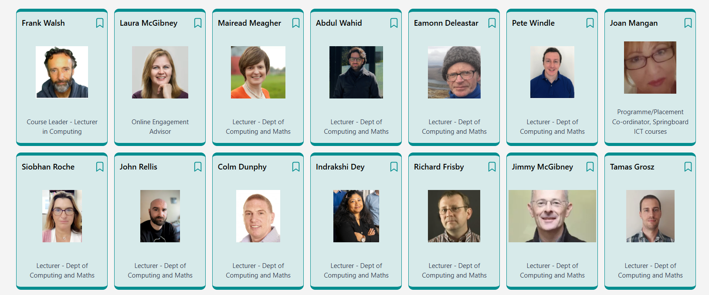
Semester 1 - Team

Slide 3
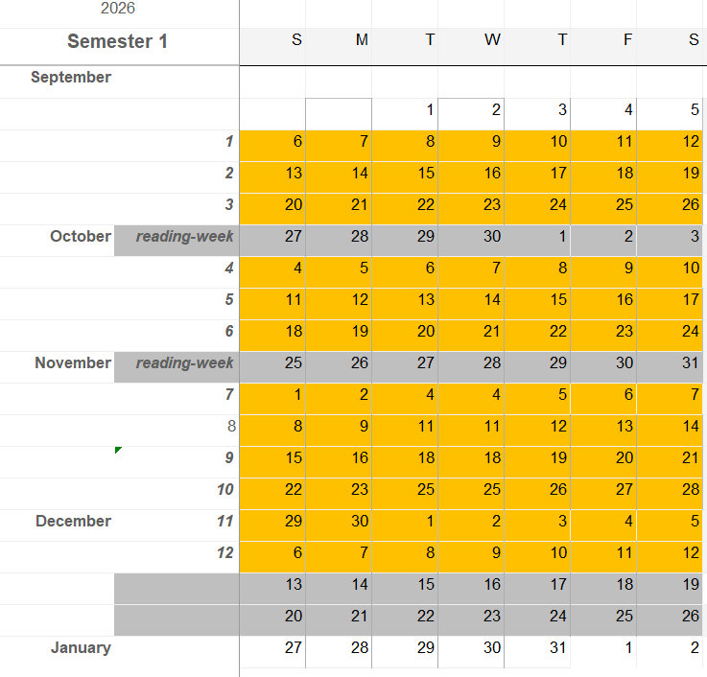
Schedule
There will be another On-Site in January

Slide 4
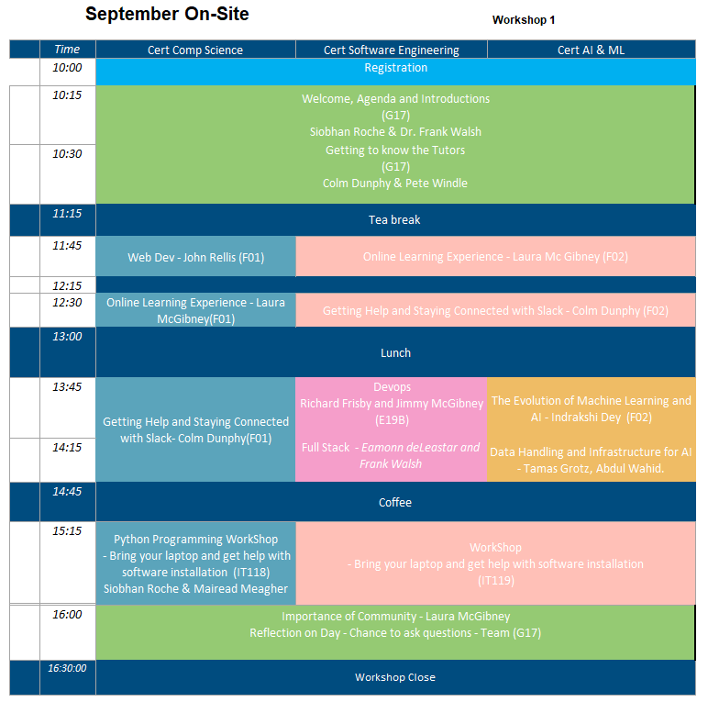

Slide 5
Tutors Link
https://tutors.dev/course/setu-cert-comp-sci-2026
https://tutors.dev/course/setu-cert-ai-ml-2026
https://tutors.dev/course/setu-cert-sw-eng-2026

