Slide 1
Intrusion Detection In MANETs
EE 545
( Mobile Ad-Hoc Networks )
Guided By: Prepared By:
Dr. Fred Daneshgaran Nipun Shah-303233455
Rutu Shah - 304351988
Shwetabahen Patel -304397644

Slide 2
INTRODUCTION
A Mobile Ad hoc Network (MANET) is a self configured network consisting of wireless mobile nodes and it does not rely on the stationary network structure.
Due to their broadcasting nature and altering topology they are highly susceptible to security attacks.
An Intrusion Detection System(IDS) is hence developed which can identify any intrusion and changes in the network.
We studied three methods for IDS on Ad-hoc On demand distance vector
Fuzzy Logic IDS
Local IDS
Application Layer IDS
These formulated schemes provide knowledge on improvement of throughput and to reduce the end to end delay and overhead hence making the network highly efficient and secure.

Slide 3
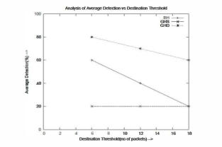
FUZZY LOGIC DETECTION METHOD
Fuzzy logic mechanism is a calculative approximated tool and deals with the following three attack forms and compares them to a threshold value:
Black Hole Attack(BHA)
Total no. of packet dropped > Threshold [symptom 1]
Grey Hole Attack towards Source(GHS)
Total no. of packet dropped > Threshold [symptom 2]
Total no. of packet dropped > Dest. Threshold
from source
Grey Hole Attack towards Destination(GHD)
Total no. of packet dropped > Threshold [symptom 3]
Total no. of packet dropped > Dest. Threshold
from destination

Slide 4
IMPLEMENTATION OF THE FUZZY LOGIC :
The symptoms(S) and attacks(A) are priorly described
Universal set of all nodes(N)
Indication at each node:
Presence of symptom : Rs=NxS
Frequency of occurrence : Ro=SxA
Confirmation of presence : Rc=SxA
Indication defined on (NxA)
Occurrence : R1=Rs o Ro
Confirmability : R2=Rs o Rc
Non occurrence : R3=Rs o (1-Ro)
Non Symptoms : R4=(1-Rs) o Ro

Slide 5
How to Count # of Packet Dropped?
The packet list data structure is used to count number of packet dropped and track the following :
Sequence number
Source
Destination
Packet type
Forwarded
Expire time
The data structure packetlist 1and packetlist 2 consists of :
Destination / Source
No. of packet dropped (npd)
No. of packet forwarded (npf)

Slide 6
Categories of Attacks
Passive Attacks : Include eavesdropping of data, traffic analysis and monitoring.
e.g. eavesdropping attack
Active Attacks: Include replication, modification, insertion, deletion of data to be exchanged, external service attacks.
e.g. Black Hole Attack(BHA)
Destination
N5
Source
N6
N1
N3
Attacker node
N2
N4
Fig. Block Hole Attack

Slide 7
Security Routing Mechanism
Source Intrusion Detection (SID): ID performs via source node.
Detects the BHA(Black Hole Attack).
N5
N5
Source
Destination
Source
Destination
N1
N3
N6
N1
N3
N6
N2
N4
N2
N4
Fig. Propagation of Further Route REQuest (FRREQ) packet
Fig. The path of a Further Route REPly (FRREP) packet

Slide 8
Local Intrusion Detection (LID): ID performs locally using the previous node of the attacker node.
Intermediate
Node (Attacker)
Previous Node
Next Node
Destination
Node
Source
N1
N2
N3
N4
N5
N6
N7
N8
: RREQ Packet
: RREP Packet
: FRREQ Packet
: FRREP Packet
Fig. Proposed Local Intrusion Detection (LID) Security routing mechanism

Slide 9
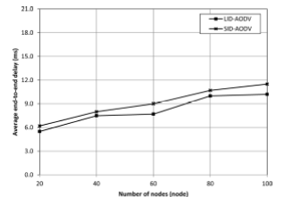
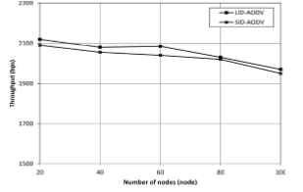
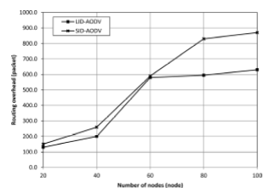
Simulation Results and Evaluation
To simulate and evaluate the performance of SID and LID, GloMoSim 2.03 network simulator is used.
Throughput Vs # of nodes Average end to end delay Vs # of nodes
Routing overhead Vs # of nodes

Slide 10
Design of Application Layer IDS
Application-Level
Activities
Mobile Node
Local IDS
Monitoring and Detection Agent
Local Database
Response Agent
MA
MA
Secure Comm.
Mobile Agent Place
Wireless Ad-Hoc
Network
Fig. The local IDS architecture on a mobile node

Slide 11
Functions of Mobile Agents
Update MAs: add new attack signatures, patch and install programs on mobile nodes.
Analysis MAs: Requesting nodes for further analysis and diagnosis for anomaly behaviors.
Verification MAs: To verify the IDS agents on the nodes and check on the IDS logs and local IDS execution states.

Slide 12
Why are MAs Needed for ID…?
Reducing Network Load
Overcome Network Latency
Making the IDS attack resistant
Autonomous Execution
Dynamic Adaption
Platform Independence
Upgradability
Scalability

Slide 13
Conclusion
We conclude by comparing the three methods with respect to their profits, limitations and future scope.
Fuzzy logic is useful to accurately analyze the intrusion level but is dependent on the threshold value.
LID is an advancement over SID and provides increased throughput and decreased delay and overhead with the limitation of assuming trusted previous nodes which is not always the case.
MAs in IDS augment each node’s intrusion detection capability in the network by updating attack signatures and normal application profiles.

Slide 14
Reference
http://ieeexplore.ieee.org/stamp/stamp.jsp?tp=&arnumber=6203324
http://ieeexplore.ieee.org/stamp/stamp.jsp?arnumber=6021809
http://ieeexplore.ieee.org/stamp/stamp.jsp?tp=&arnumber=5428421

Slide 15
THANK YOU

