Slide 1

Toronto Bike-Sharing Analytics Dashboard Project
Final Group Project – Group 9
Presented by: Setu Chaudhari, Krishna Patel, Poojan Patel, Dhruv Trivedi,Anisha
Presented to: Prof. Ali.el-sharif

Slide 2
Project Overview
Analyzed Toronto bike-share ridership data
Followed Agile methodology over 2 sprints
Built Streamlit analytics dashboard
Implemented data cleaning, analytics and TDD
Used GitHub + Taiga for workflow

Slide 3
Dataset Summary
Dataset includes timestamps, station names, user type etc.
Cleaned timestamps & calculated trip duration
Made dataset analysis-ready

Slide 4
Tools & Technologies
Python : Pandas, NumPy
Streamlit: Plotly/Matplotlib
GitHub , Taiga , Pytest

Slide 5
Sprint 1 Work Summary
Data loading + cleaning pipeline
Timestamp formatting
Calculated ride duration
Added unit tests (TDD)

Slide 6
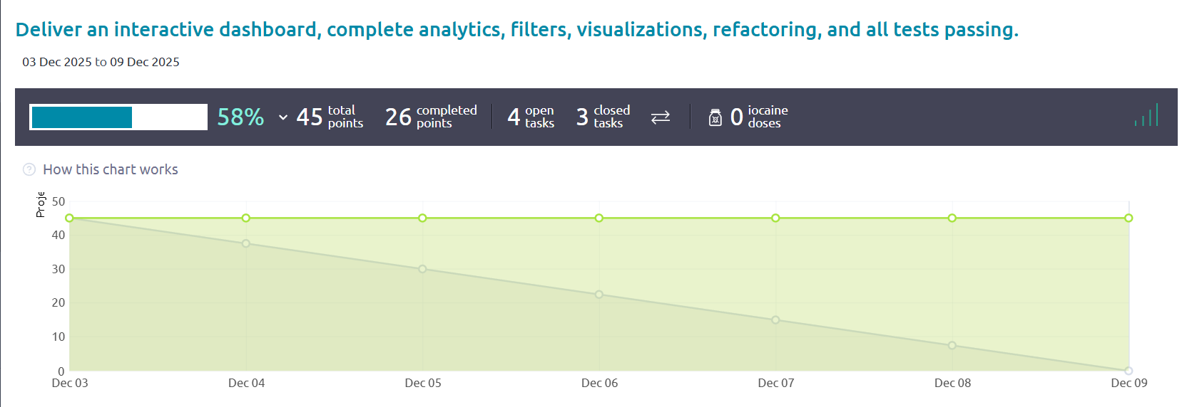
Sprint 1 Burndown Chart

Slide 7
Sprint 2 Work Summary
• Streamlit dashboard built
• KPIs, charts, analytics integrated
• GitHub PR workflow maintained
• Repo cleaned after CSV issue

Slide 8
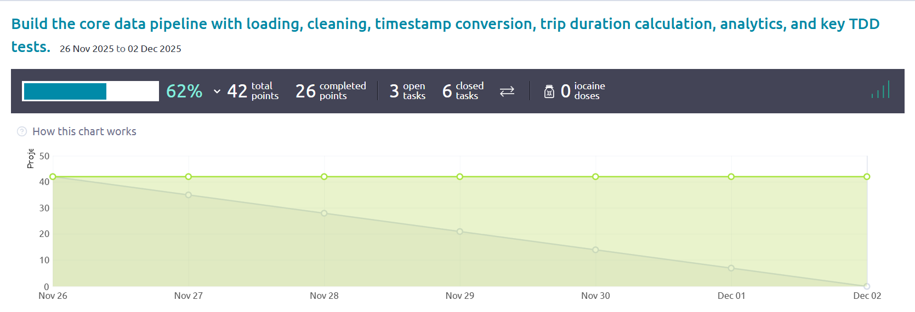
Sprint 2 Burndown Chart

Slide 9
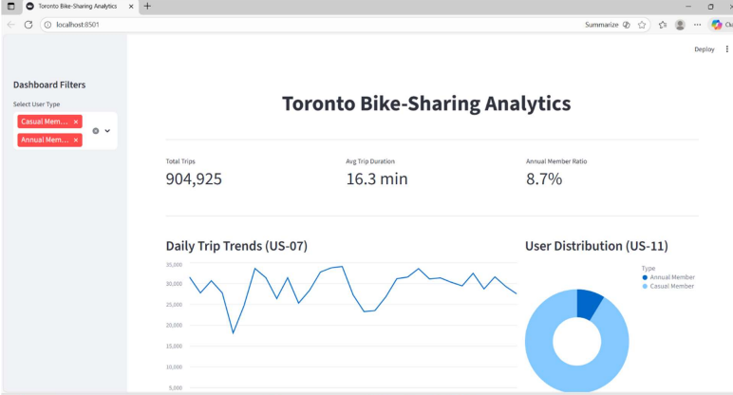
Dashboard Demo

Slide 10
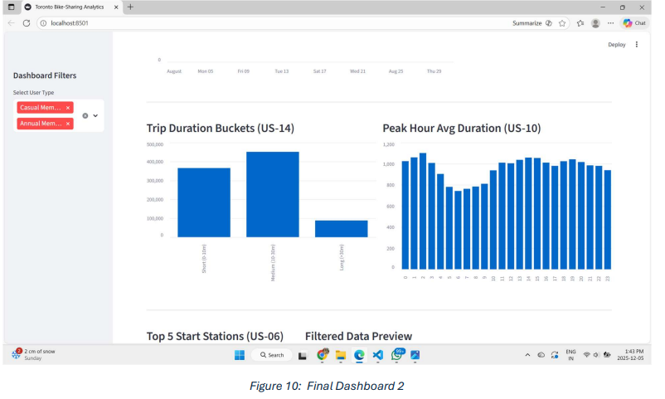
DashBoard-2

Slide 11
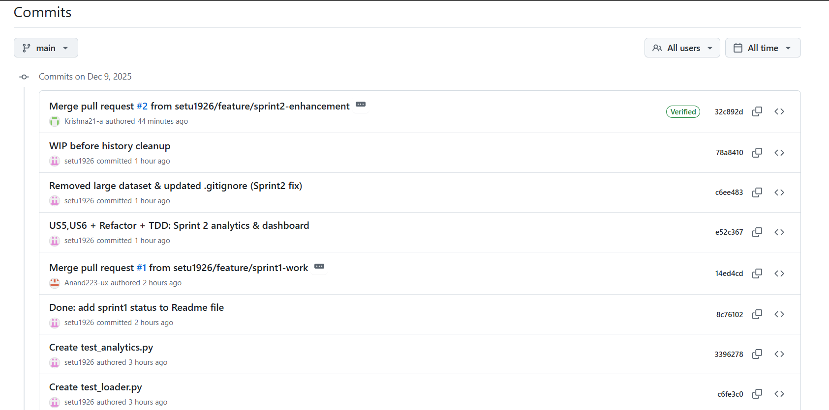
GitHub & Taiga Proof

Slide 12
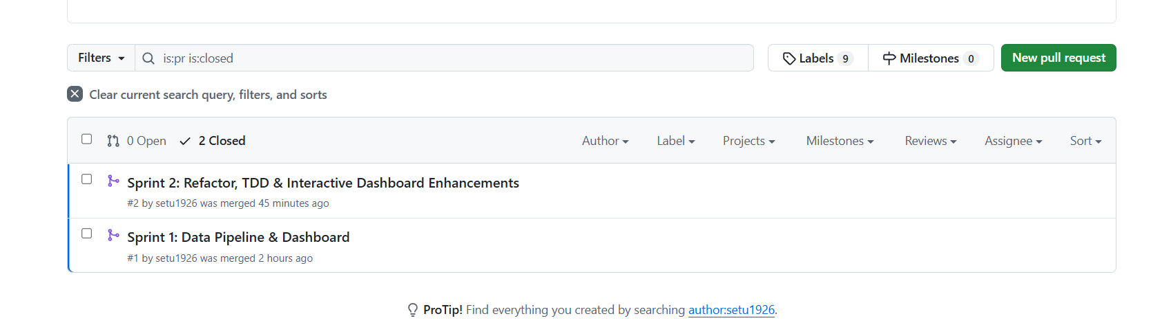
Pull Request

Slide 13
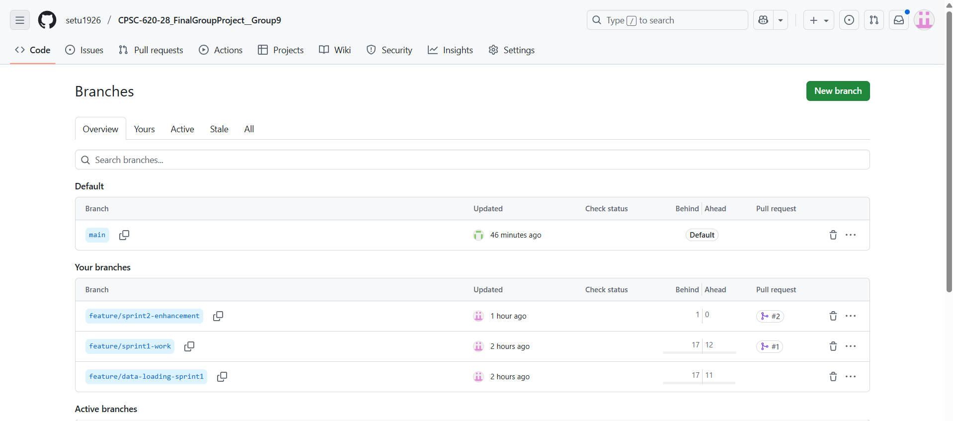
Branch

Slide 14
Insights Observed
Evening usage is highest
Certain stations are busiest
Average ride duration moderate
Useful for city mobility decisions

Slide 15
Challenges Faced
GitHub blocked 118MB CSV
Required cleaning git history
Debugging & testing time required

Slide 16

Learning Outcomes
Hands-on Agile sprint work
Built dashboards in Streamlit
Git PR & version control practice
Understanding data patterns

Slide 17
Conclusion
Built working analytics solution
Agile improved progress tracking
Dashboard reveals mobility patterns
Future scope: forecasting & LLM integration

