Slide 1
Building or planning
a Bitcoin startup?
🙋

Slide 2
C O N G R A T U L A T I O N S . Y O U C H O S E . . .
THE HARDEST
BOSS BATTLE.
Difficulty Level:
500%

Slide 3
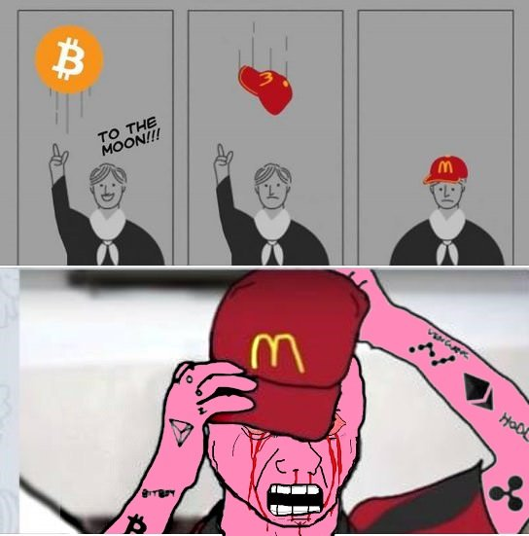
THE EX-BITCOINER PROBLEM
Came for the bull. Went back during the bear.

Slide 4
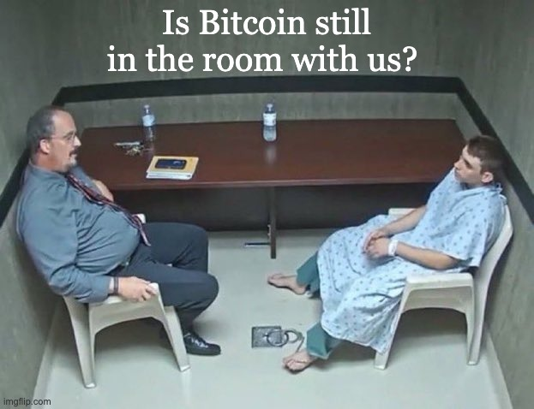
THE NORMIE PROBLEM
The other 1.4 billion Indians? They've never thought about Bitcoin. Not once.

Slide 5
M A R K E T I N G C H A N N E L 1 / 3
Want to run Bitcoin ads?
REJECTED.
G
M
𝕏
Google Ads
Meta / Instagram
Twitter / X
Crypto advertising requires certification & ongoing compliance
Crypto ads require prior written permission. Often denied.
Allowed but requires financial services certification per market

Slide 6
M A R K E T I N G C H A N N E L 2 / 3
Go organic? 📱
🫥
🤖
😮‍💨
Shadow Banning
AI Slop
Social Media Fatigue

Slide 7
M A R K E T I N G C H A N N E L 3 / 3
Pay to play? 💸
🎙️
🌟
Bitcoin Conference
Bitcoin Influencer
10,000+
₹5L – ₹25L
to sponsor a booth/stall
per campaign, per creator
Bitcoin Prague 2026
Top 10 Indian Bitcoin creators
For Coinbase. Not for your seed-stage startup.
No guaranteed conversion. No attribution. No retargeting.

Slide 8



C U R R E N T W O R K A R O U N D S
Smart founders already
figured it out.
B4I Community
Bitcoin Bharat
Bitcoinwaale
↓ powers ↓
↓ powers ↓
↓ powers ↓
Bitcoin Keeper
SwapSo
GetBit
bitcoincierge.in

Slide 9
B U T T H I S M O D E L H A S P R O B L E M S
Building your own community
breaks at scale.
🧠
Org time & energy
🗺️
Physical presence across cities
⚙️
Operations & hiring
✈️
Travel & accommodation budget
📊
End-to-end attribution
bitcoincierge.in

Slide 10
Bitcoincierge
IRL Event and Community Management.
For Bitcoin brands. In India.
D e m o s . W o r k s h o p s . M e e t u p s .
SofB Accelerator Pitch
2026

Slide 11
O u r S o l u t i o n
IRL event & community management
as a service — for Bitcoin brands.
📍
👥
🎤
📊
Venue & Logistics
Curated Audience
Expert Mentors
Attribution Reports
bitcoincierge.in

Slide 12
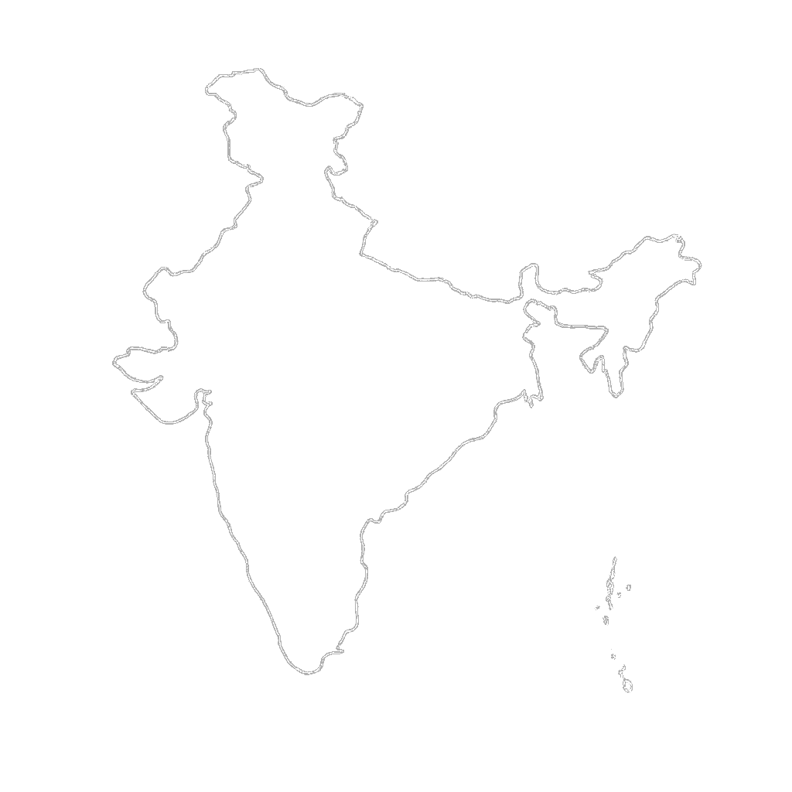
B i t c o i n m e n t o r s a n d c o m m u n i t y a r e s e e d e d i n m a j o r c i t i e s
●
Delhi
7 Cities
Active
Ahmedabad
●
Mentors present, community active,
ready to run activations
Mumbai
●
●
Hyderabad
Goa
●
●
Bangalore
Expanding to
more cities
●
Chennai
bitcoincierge.in

Slide 13
ONLINE
OFFLINE
📱 📱 📱
🤖 🤖 🤖
📲 📲 📲
🙌 🙌 🙌
🤝 🤝 🤝
⚡ ⚡ ⚡
→
— AI-generated content flood
The pendulum is swinging
back offline.
— Crypto ad restrictions
— Doomscrolling & fatigue
People want to meet in person. They want to hold the hardware. They want to feel the experience — not scroll past another post about it.
— Low ROAS, high burnout

Slide 14
T h e M a r k e t A n d T r a c t i o n
India is open to Bitcoin products.
We are just getting started.
1B+
8 / 97
200+
Indians reachable
through IRL activations
Tier-1 cities and
Tier-2 cities in India
Bitcoin products &
services usable in India
2,000+
6 / 1
6
Existing community
members
Tier-1 and Tier-2
cities we cover
Existing brand
partnerships
bitcoincierge.in

Slide 15
G o - t o - M a r k e t
Warm intro → Proof of work → Expand.
01
02
03
04
05
Warm intro or cold outreach
Partner for First Pilot
Pilot event
First activation
Retainer & revenue share
bitcoincierge.in

Slide 16
B u s i n e s s M o d e l
We charge brands. Not participants.
FIXED
VARIABLE
Event Execution Fee
Performance / Revenue Share
₹15,000 – ₹20,000
0.5% – 2%
per event
on attributed sales or activations
—
Venue booking & management
—
KYC completions / deposits
—
Mentor / speaker time
—
Hardware wallet sales
—
Snacks, logistics, ops
—
Loan / custody product sign-ups
—
Post-event summary report
—
Referrals through mentor network
bitcoincierge.in

Slide 17
Getbit
Bitcoin-only exchange from India. 200+ attendees across meetups powered by Bitcoincierge.
bitcoincierge.in

Slide 18
Zebpay
India's leading crypto exchange. Hosted meetups across Mumbai and Delhi, reaching hundreds of attendees.
bitcoincierge.in

Slide 19
Jetking
Reached thousands through in-person meetups and online streams, spreading their Bitcoin treasury story to potential investors.
bitcoincierge.in

Slide 20
Ourpool
3 meetups across Bangalore, Mumbai, and Delhi. Partners and ecosystem providers onboarded to their Bitcoin Mining Academy in Goa, culminating in a paid 30+ attendee cohort.
bitcoincierge.in

Slide 21
Bitasha
Piloted first meetup, sold 5+ BitAxe through Delhi meetup and warmed attendees to visit them at Bitplebs.
bitcoincierge.in

Slide 22
Cryobrick
First user activation through meetups in Goa. Onboarded senior Bitcoiners as beta testers for v1 of the app.
bitcoincierge.in

Slide 23
bitcoincierge.in

