Slide 1
Building or planning
a Bitcoin startup?
🙋

Slide 2
C O N G R A T U L A T I O N S . Y O U C H O S E . . .
THE HARDEST
BOSS BATTLE.
Difficulty Level:
500%

Slide 3
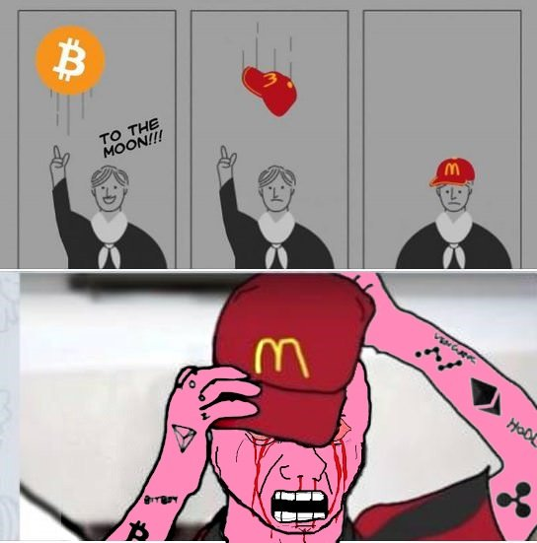
Came for the bull. Went back during the bear.

Slide 4
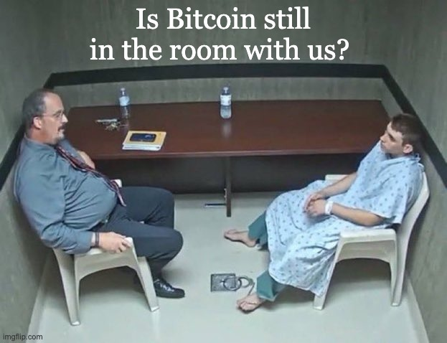
And for rest of 1.4 billion Indians - Bitcoin is still not a real thing!

Slide 5



Performance Media is pain
Google
Meta / Facebook
Twitter / X
Requires certification and compliance
Requires prior permission. Often denied.
Requires certification.

Slide 6
ONLINE
OFFLINE
📱 📱 📱
🤖 🤖 🤖
📲 📲 📲
🙌 🙌 🙌
🤝 🤝 🤝
⚡ ⚡ ⚡
→
— AI-generated content flood
The pendulum is swinging
back offline.
— Crypto ad restrictions
— Doomscrolling & fatigue
People want to meet in person. They want to hold the hardware. They want to feel the experience — not scroll past another post about it.
— Low ROAS, high burnout

Slide 7



Smart founders are figuring
B4I Community
Bitcoin Bharat
Bitcoinwaale
↓ powers ↓
↓ powers ↓
↓ powers ↓
Bitcoin Keeper
SwapSo
GetBit
bitcoincierge.in

Slide 8
Before you jump this route!
🧠
Org time & energy
🗺️
Physical presence across cities
⚙️
Operations & hiring
✈️
Travel & accommodation budget
📊
End-to-end attribution
bitcoincierge.in

Slide 9
Bitcoincierge
IRL Event and Community Management.
For Bitcoin brands. In India.
D e m o s . W o r k s h o p s . M e e t u p s .
SofB Accelerator Pitch
2026

Slide 10
IRL event & community management
as a service — for Bitcoin brands.
📍
👥
🎤
📊
Venue & Logistics
Curated Audience
Expert Mentors
Attribution Reports
bitcoincierge.in

Slide 11

●
Delhi
7 Cities
Active
Ahmedabad
●
Mentors present, community active,
ready to run activations
Mumbai
●
●
Hyderabad
Goa
●
●
Bangalore
Expanding to
more cities
●
Chennai
bitcoincierge.in

Slide 12
We charge brands. Not participants.
FIXED
VARIABLE
Event Execution Fee
Performance / Revenue Share
₹15,000 – ₹20,000
0.5% – 2%
per event
on attributed sales or activations
—
Venue booking & management
—
KYC completions / deposits
—
Mentor / speaker time
—
Hardware wallet sales
—
Snacks, logistics, ops
—
Loan / custody product sign-ups
—
Post-event summary report
—
Referrals through mentor network
bitcoincierge.in

Slide 13
Getbit
Bitcoin-only exchange from India. 200+ attendees across meetups powered by Bitcoincierge.
bitcoincierge.in

Slide 14
Zebpay
India's leading crypto exchange. Hosted meetups across Mumbai and Delhi, reaching hundreds of attendees.
bitcoincierge.in

Slide 15
Jetking
Reached thousands through in-person meetups and online streams, spreading their Bitcoin treasury story to potential investors.
bitcoincierge.in

Slide 16
Ourpool
3 meetups across Bangalore, Mumbai, and Delhi. Partners and ecosystem providers onboarded to their Bitcoin Mining Academy in Goa, culminating in a paid 30+ attendee cohort.
bitcoincierge.in

Slide 17
Bitasha
Piloted first meetup, sold 5+ BitAxe through Delhi meetup and warmed attendees to visit them at Bitplebs.
bitcoincierge.in

Slide 18
Cryobrick
First user activation through meetups in Goa. Onboarded senior Bitcoiners as beta testers for v1 of the app.
bitcoincierge.in

Slide 19
bitcoincierge.in

