Slide 1
CPU Scheduling复习及习题课
张竞慧
jhzhang@seu.edu.cn

Slide 2
Review CPU scheduling
Basic Concepts
Scheduling Criteria
Scheduling Algorithms
Operating System Concepts

Slide 3
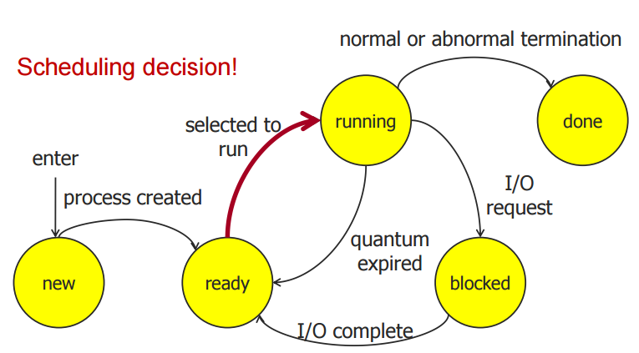
Basic Concepts
Operating System Concepts

Slide 4
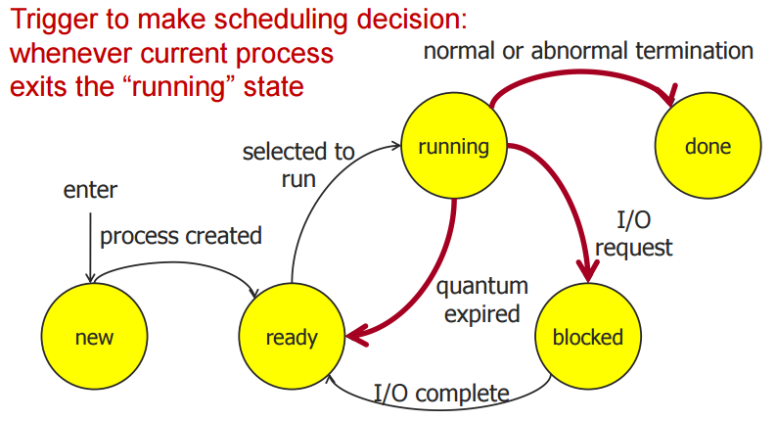
Basic Concepts
Operating System Concepts

Slide 5
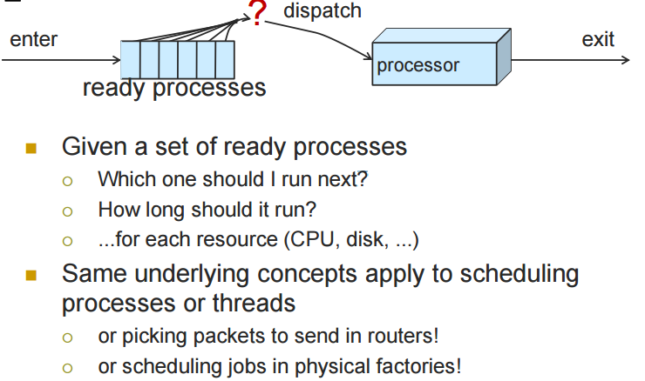
Basic Concepts
Operating System Concepts

Slide 6
Basic Concepts
Maximum CPU utilization obtained with multiprogramming
CPU–I/O Burst Cycle – Process execution consists of a cycle of CPU execution and I/O wait.
Operating System Concepts

Slide 7

Alternating Sequence of CPU And I/O Bursts
Operating System Concepts

Slide 8
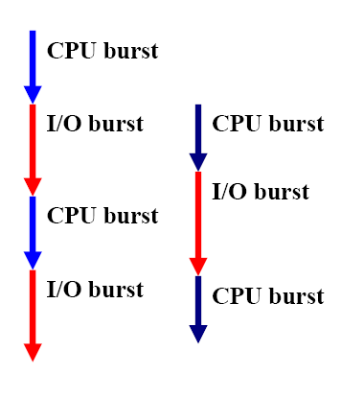
CPU-I/O Burst Cycle
Process execution
repeats the CPU burst and I/O burst cycle.
When a process
begins an I/O burst,
another process can
use the CPU for a
CPU burst.
Operating System Concepts

Slide 9
CPU-bound and I/O-bound
A process is CPU-bound if it generates I/O requests infrequently, using more of its time doing computation. (Example?)
A process is I/O-bound if it spends more of its time to do I/O than it spends doing computation.(Example?)
A CPU-bound process might have a few very long CPU bursts.
An I/O-bound process typically has many short CPU bursts
Operating System Concepts

Slide 10

Operating System Concepts

Slide 11
CPU Scheduler
When the CPU is idle, the OS must select another process to run.
This selection process is carried out by the short-term scheduler (or CPU scheduler).
The CPU scheduler selects a process from the ready queue, and allocates the CPU to it.
The ready queue does not have to be a FIFO one. There are many ways to organize the ready queue.
Operating System Concepts

Slide 12
Preemptive vs. Non-preemptive
Non-preemptive scheduling: scheduling occurs when a process voluntarily enters the wait state or terminates
  Simple, but very inefficient
Preemptive scheduling: scheduling occurs in all possible cases.
Operating System Concepts

Slide 13
Review CPU scheduling
Basic Concepts
Scheduling Criteria
Scheduling Algorithms
Operating System Concepts

Slide 14
Scheduling Criteria
There are many criteria for comparing different scheduling algorithms. Here are five common ones:
  CPU utilization
  Throughput
  Turnaround time
  Waiting time
  Response time
Operating System Concepts

Slide 15
CPU Utilization
We want to keep the CPU as busy as possible.
CPU utilization ranges from 0 to 100 percent. Normally 40% is lightly loaded and 90% or higher is heavily loaded.
You can bring up a CPU usage meter to see CPU utilization on your system.
Operating System Concepts

Slide 16
Throughput
The number of processes completed per time unit is called throughput.
Higher throughput means more jobs get done.
However, for long processes, this rate may be one job per hour, and, for short jobs, this rate may be 10 per minute.
Operating System Concepts

Slide 17
Turnaround Time
The time period between job submission to completion is the turnaround time.
From a user’s point of view, turnaround time is more important than CPU utilization and throughput.
Turnaround time is the sum of
  waiting time before entering the system
  waiting time in the ready queue
  waiting time in all other events (e.g., I/O)
  time the process actually running on the CPU
Operating System Concepts

Slide 18
Waiting Time
Waiting time is the sum of the periods that a process spends waiting in the ready queue.
Why only ready queue?
  CPU scheduling algorithms do not affect the amount of time during which a process is waiting for I/O and other events.
  However, CPU scheduling algorithms do affect the time that a process stays in the ready queue
Operating System Concepts

Slide 19
Response Time
The time from the submission of a request (in an interactive system) to the first response is called response time. It does not include the time that it takes to output the response.
For example, in front of your workstation, you perhaps care more about the time between hitting the Return key and getting your first output than the time from hitting the Return key to the completion of your program (e.g., turnaround time).
Operating System Concepts

Slide 20
Optimization Criteria
Max CPU utilization
Max throughput
Min turnaround time
Min waiting time
Min response time
Operating System Concepts

Slide 21
Review CPU scheduling
Basic Concepts
Scheduling Criteria
Scheduling Algorithms
Operating System Concepts

Slide 22
Scheduling Algorithms
We will discuss a number of scheduling algorithms:
  First-Come, First-Served (FCFS)
  Shortest-Job-First (SJF)
  Priority
  Round-Robin
  Multilevel Queue
  Multilevel Feedback Queue
Operating System Concepts

Slide 23
First-Come, First-Served (FCFS) Scheduling
The process that requests the CPU first is allocated the CPU first.
This can easily be implemented using a queue.
FCFS is not preemptive. Once a process has the CPU, it will occupy the CPU until the process completes or voluntarily enters the wait state.
Need to know CPU burst time?
Operating System Concepts

Slide 24
FCFS Scheduling (Cont.)
Process Burst Time
P₁ 24
P₂ 3
P₃ 3
Suppose that the processes arrive in the order: P₁ , P₂ , P₃
The Gantt Chart for the schedule is:
Average waiting time?
Waiting time?
P₁
P₂
P₃
0
24
27
30
Operating System Concepts

Slide 25
FCFS Scheduling (Cont.)
Suppose that the processes arrive in the order
P₂ , P₃ , P₁ .
The Gantt chart for the schedule is:
Waiting time for P₁ = 6; P₂ = 0; P₃ = 3
Average waiting time: (6 + 0 + 3)/3 = 3
Much better than previous case.
Convoy effect short process behind long process
P₂
P₃
P₁
0
3
6
30
Operating System Concepts

Slide 26
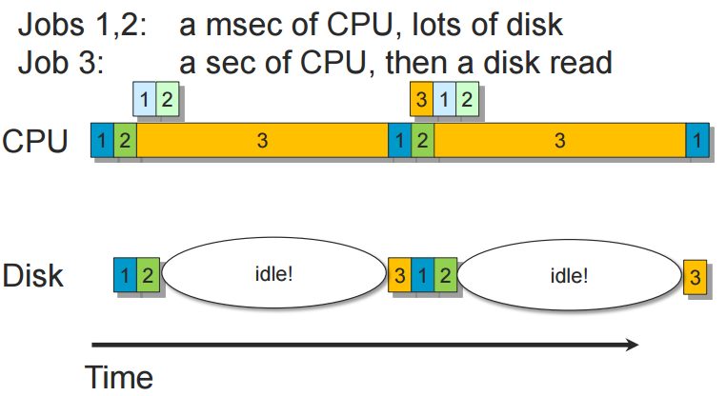
Convoy effect – Low IO
Operating System Concepts

Slide 27
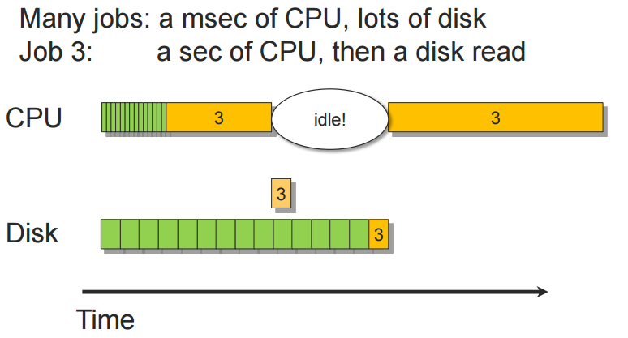
Convoy effect – Low CPU
Operating System Concepts

Slide 28
FCFS Problems
It is easy to have the convoy effect: all the processes wait for the one big process to get off the CPU. CPU utilization may be low.
It is in favor of long processes and may not be fair to those short ones. What if your 1-minute job is behind a 10-hour job?
It is troublesome for time-sharing systems, where each user needs to get a share of the CPU at regular intervals.
Operating System Concepts

Slide 29
Shortest-Job-First (SJF) Scheduling
Associate with each process the length of its next CPU burst. Use these lengths to schedule the process with the shortest time.
When a process must be selected from the ready queue, the process with the smallest next CPU burst is selected.
Thus, the processes in the ready queue are sorted in CPU burst length.
Operating System Concepts

Slide 30
Shortest-Job-First (SJF) Scheduling (Cont.)
SJF can be non-preemptive or preemptive.
  nonpreemptive – once CPU given to the process it cannot be preempted until completes its CPU burst.
  preemptive – if a new process arrives with CPU burst length less than remaining time of current executing process, preempt. This scheme is know as the
  Shortest-Remaining-Time-First (SRTF).
SJF is optimal – gives minimum average waiting time for a given set of processes.
Operating System Concepts

Slide 31
Example of Non-Preemptive SJF
Process Arrival Time Burst Time
P₁ 0.0 7
P₂ 2.0 4
P₃ 4.0 1
P₄ 5.0 4
SJF (non-preemptive)
Average waiting time = (0 + 6 + 3 + 7)/4 = 4
P₁
P₃
P₂
P₄
0
3
7
8
12
16
Operating System Concepts

Slide 32
Example of Preemptive SJF
Process Arrival Time Burst Time
P₁ 0.0 7
P₂ 2.0 4
P₃ 4.0 1
P₄ 5.0 4
SJF (preemptive)
Average waiting time = (9 + 1 + 0 +2)/4 = 3
P₁
P₂
P₃
P₂
P₄
P₁
0
2
4
5
7
11
16
Operating System Concepts

Slide 33
SJF Problems
It is difficult to estimate the next burst time value accurately.
SJF is in favor of short jobs. As a result, some long jobs may not have a chance to run at all. This is starvation.
Operating System Concepts

Slide 34
Priority Scheduling
Each process has a priority.
Priority may be determined internally or externally:
  internal priority: determined by time limits,memory requirement, # of files, and so on.
  external priority: not controlled by the OS (e.g., importance of the process)
The scheduler always picks the process (in ready queue) with the highest priority to run.
FCFS and SJF are special cases of priority scheduling. (Why?)
Operating System Concepts

Slide 35
Round Robin (RR)
RR is similar to FCFS, except that each process is assigned a time quantum.
All processes in the ready queue is a FIFO list.
When the CPU is free, the scheduler picks the first and lets it run for one time quantum.
If that process uses CPU for less than one time quantum, it is completed.
Otherwise, when one time quantum is up, that process is preempted by the scheduler and moved to the tail of the list.
Operating System Concepts

Slide 36
Example of RR with Time Quantum = 20
Process Burst Time
P₁ 53
P₂ 17
P₃ 68
P₄ 24
The Gantt chart is:
P₁
P₂
P₃
P₄
P₁
P₃
P₄
P₁
P₃
P₃
0
20
37
57
77
97
117
121
134
154
162
Operating System Concepts

Slide 37
RR Scheduling: Some Issues
If time quantum is too large, RR reduces to FCFS
If time quantum is too small, RR becomes processor sharing
Context switching may affect RR’s performance
  Shorter time quantum means more contextswitches
Turnaround time also depends on the size of time quantum.
In general, 80% of the CPU bursts should be shorter than the time quantum
Operating System Concepts

Slide 38

Time Quantum and Context Switch Time
Operating System Concepts

Slide 39
RR example
Assume 3 processes, each need 10 time units,
  if time quantum =1, what is the average turnaround time?
  if time quantum =10, what is the average turnaround time?
Operating System Concepts

Slide 40

Turnaround Time Varies With The Time Quantum
How to calculate when time quantum = 1?
when time quantum = 6?
Operating System Concepts

Slide 41
Multilevel Queue
Ready queue is partitioned into separate queues:
foreground (interactive)
background (batch)
Each process is assigned permanently to one queue based on some properties of the process (e.g., memory usage, priority, process type)
Each queue has its own scheduling algorithm,
foreground – RR
background – FCFS
Operating System Concepts

Slide 42
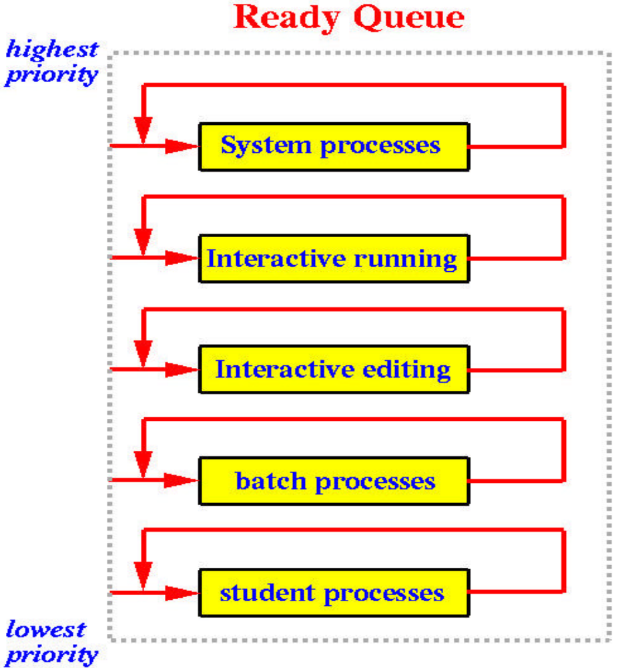
A process P can run only if all queues above the queue that contains P are empty.
When a process is running and a process in a higher priority queue comes in, the running process is preempted.
Operating System Concepts

Slide 43
Multilevel Queue (Cont.)
Scheduling must be done between the queues.
  Fixed priority scheduling; (i.e., serve all from foreground then from background). Possibility of starvation.
  Time slice – each queue gets a certain amount of CPU time which it can schedule amongst its processes; i.e., 80% to foreground in RR, 20% to background in FCFS
Operating System Concepts

Slide 44
Multilevel Feedback Queue
Multilevel queue with feedback scheduling is similar to multilevel queue; however, it allows processes to move between queues.
  aging can be implemented this way
If a process uses more (resp., less) CPU time, it is moved to a queue of lower (resp., higher) priority.
As a result, I/O-bound (resp., CPU-bound) processes will be in higher (resp., lower) priority queues.
Operating System Concepts

Slide 45
Example of Multilevel Feedback Queue
Three queues:
  Q₀ – time quantum 8 milliseconds
  Q₁ – time quantum 16 milliseconds
  Q₂ – FCFS
Scheduling
  A new job enters Q₀ which is served FCFS. When it gains CPU, job receives 8 milliseconds. If it does not finish in 8 milliseconds, job is moved to Q₁.
  At Q₁ job is again served FCFS and receives 16 additional milliseconds. If it still does not complete, it is preempted and moved to queue Q₂.
Operating System Concepts

Slide 46

Multilevel Feedback Queues
Operating System Concepts

Slide 47
习题1
Consider a multi-level feedback queue in a single-CPU system. The first level (queue 0) is given a quantum of 8 ms, the second one a quantum of 16 ms, the third is scheduled FCFS. Assume jobs arrive all at time zero with the following job times (in ms): 4, 7, 12, 20, 25 and 30, respectively. Assume the context switch overhead is zero unless otherwise stated.
  (a) Show the Gantt chart for this system.
  (b) Compute the average waiting and turnaround time.
  (c) Suppose the context switch overhead is 1 ms. Compute the average turnaround time.
Operating System Concepts

Slide 48
习题2
假定有四个进程 (P1 - P4)，到达时刻分别是0、10、20和40，优先级分别是1、2、3和4，执行时间分别是30、20、50和20毫秒， 这些进程在一个双CPU机器上被调度执行，系统中只有一个就绪队列（ready queue），假定上下文切换的开销为0。当分别采用以下可抢占调度算法时，画出按每种调度算法调度的甘特图，并计算其平均等待时间和平均周转时间。
(i) 优先级（Priority）调度； (ii) 最短作业优先 （Shortest Job First）。
Operating System Concepts

Slide 49
习题3
假定有三个进程 (P1, P2, P3)，P1有1个线程T11，P2有3个线程T21, T22和T23，P3有2个线程T31和T32。这些线程的CPU运行时间如下表所示。假设所有线程同时到达，采用时间片轮转调度算法，时间片为5，画出下列两种条件的甘特图，计算每一个进程的等待时间和周转时间,并计算其平均等待时间和平均周转时间。（1）线程是用户级线程（2）线程是内核级线程。
进程 | 线程 | 运行时间
P1 | T11 | 7
P2 | T21 | 4
 | T22 | 2
 | T23 | 4
P3 | T31 | 6
 | T32 | 3
Operating System Concepts

