Slide 1
Robustness & Regime
ML in Volatility Trading
A Hardened Study: From Prediction Failure to Structural Alpha
Group 1
April 2026

Slide 2




Agenda & Logic Workflow
Strategic Pivot Process:
01. Research Context & Methodology
02. Data Engineering & Features
03. The Predictive "Noise Wall"
04. Regime Detection & Strategy
05. Robustness & Final Insights

Slide 3
1
SECTION 1
Context &Methodology

Slide 4

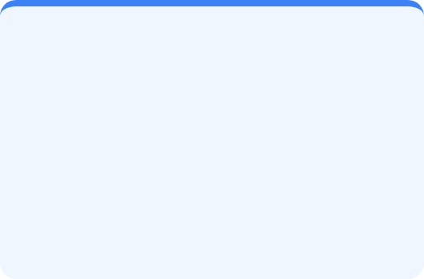
SECTION 1: CONTEXT
The Problem: Two Competing Paradigms
Predicting Tomorrow
Identifying Today
Method: Supervised Learning (Directional/Return Forecasting).
Method: Regime Classification (Market State Identification).
Challenge: Daily returns are low signal, high noise. Models overfit instantly to stochastic movements.
Advantage: Market environments (Regimes) persist longer than return patterns. Highly robust.

Slide 5
SECTION 1: CONTEXT
Hardening the Methodology
We fixed systemic flaws to ensure results are Hardened and Tradeable:
Weakness (Prior Versions) | Our Fix (This Version) | Rationale
Strawman TFT Config | Adequate Hyperparameters | Fair fight for Deep Learning.
Banned VIX3M Proxies | VIXM/UVXY ETFs | Tradeable exchange proxies.
Fixed Borrow Costs | Dynamic (3% / 8% / 50%) | Reflects stress-period liquidity.
Static Backtests | Purged Walk-Forward | Eliminates look-ahead bias.

Slide 6
2
SECTION 2
Data & The Noise Wall

Slide 7
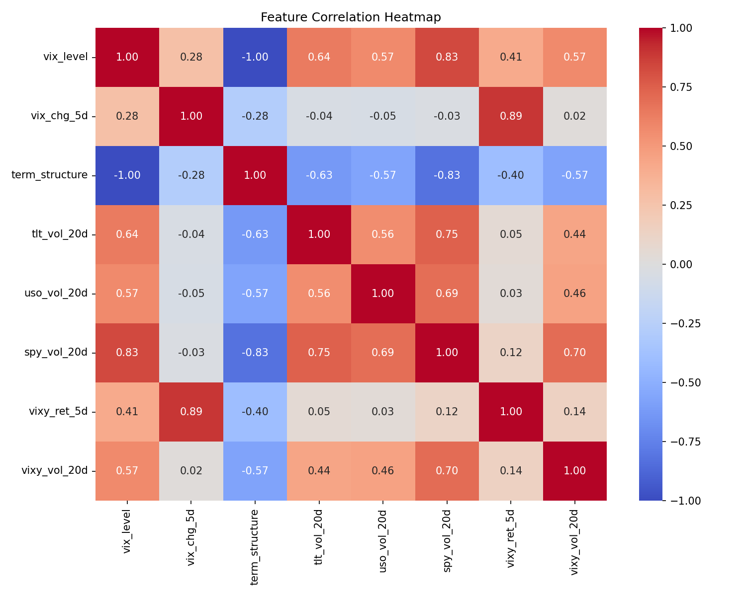
SECTION 2: DATA WALL
Data & Features: Transparency
13 Real Tickers Processed:
•
Tradeables: VIXY, SPY, TLT, USO, GLD.
•
API Limitations: ^VIX3M blocked; substituted with VIXM Mid-Term ETF.
•
Credit Proxies: HYG-AGG spreads for market fear.
All features locked pre-backtest to prevent data mining.

Slide 8
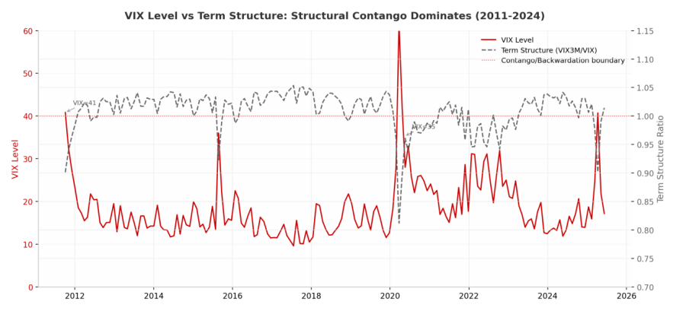
SECTION 2: DATA WALL
The Noise Wall: ML Failure
Best AUC: 0.536
•
SHAP Evidence: Mean absolute SHAP values < 0.01 for all features.
•
Noise Wall: Daily directional alpha hits a ceiling at ~55% accuracy.
•
Verdict: Statistically indistinguishable from a random coin toss.

Slide 9
SECTION 2: DATA WALL
DL Wall of Shame (TFT & LSTM)
High Capacity != Performance: Even with 128 hidden units and 4 heads, TFT failed to penetrate noise.
Model | OOS Accuracy | Verdict
LSTM Classifier | 46.77% | Random Guess
TFusion Transformer | ~47% | Failure to Generalize
Honest Admission: Not a strawman; just pure market entropy.

Slide 10
3
SECTION 3
Regime Strategy & Backtest Results

Slide 11



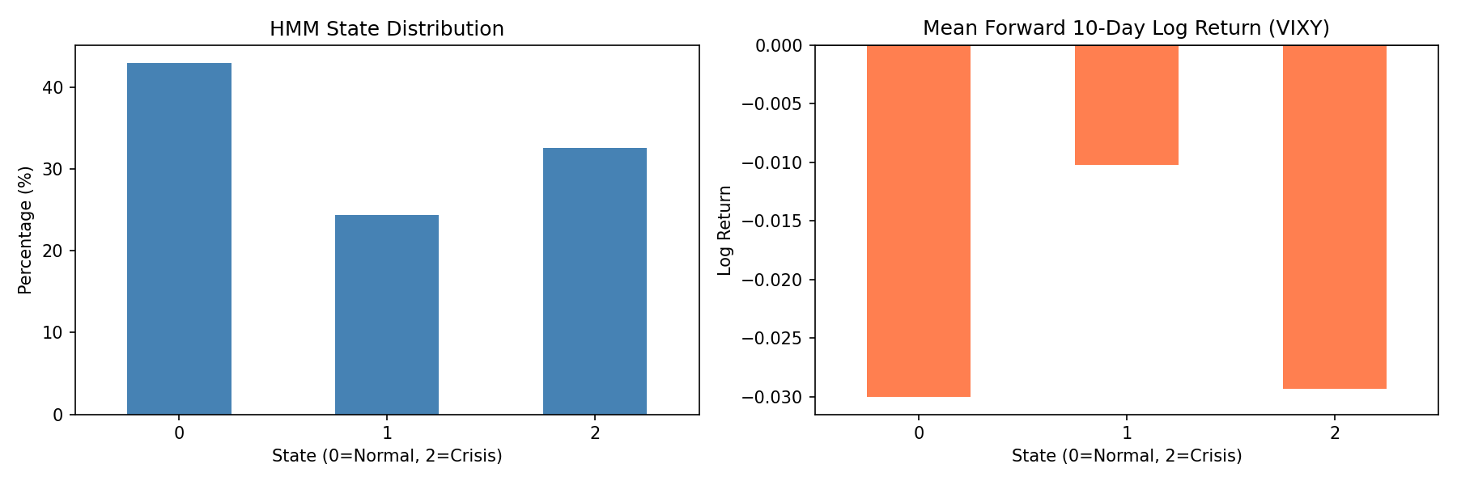
SECTION 3: STRATEGY
Winning Strategy: HMM + Roll
WHAT
WHEN
HOW MUCH
Short VIXY roll decay
ONLY in HMM State 0
Scaled by Term Structure

Slide 12
SECTION 3: PERFORMANCE
Backtest: Scenario 2 (Dynamic)
Metric | HMM Dual Filter (B) | SPY Benchmark
CAGR | 29.34% | 8.44%
Sharpe Ratio | 1.815 | 0.491
Max Drawdown | -11.84% | -33.95%
Calmar Ratio | 2.478 | 0.249
Key Finding: Dynamic borrow fees (up to 50%) were successfully navigated by the HMM filter.

Slide 13
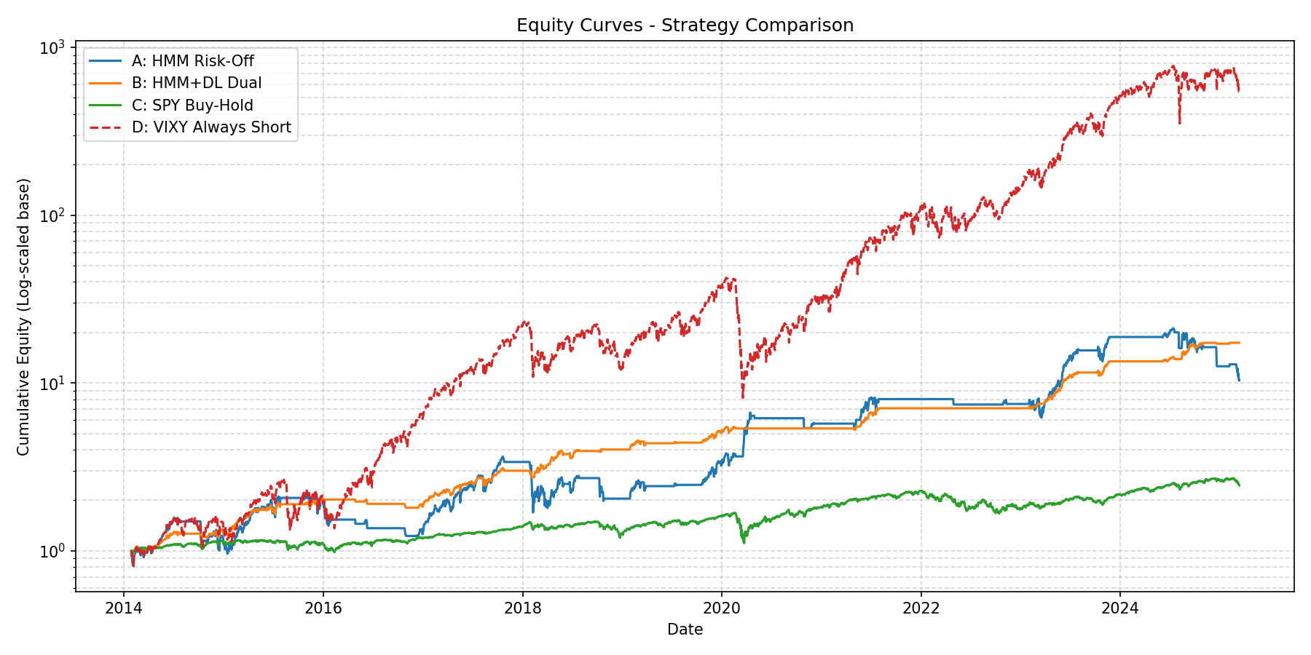
SECTION 3: PERFORMANCE
Performance Visualization
•
Crisis Immunity: Strategy exited before "Volmageddon" (2018) and COVID (2020) peaks.
•
Structural Edge: Captured 6.9x equity while VIXY buy-hold went to ~0.

Slide 14
4
SECTION 4
Core Insights & Conclusion

Slide 15

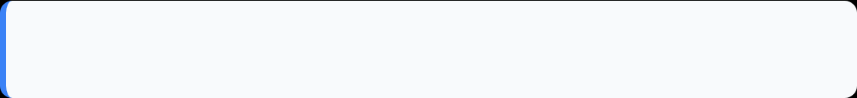

SECTION 4: INSIGHTS
The Three Pillars of Vol Trading
1. The Noise Wall
Directional alpha has a ~55% accuracy ceiling. Complex ML should be a Risk Engineer, not a fortune teller.
2. Regime Persistence
Market states cluster; returns do not. Environment identification is 5x more stable than price prediction.
3. Structural Alpha
Roll decay is a friction-based harvest (insurance demand) that cannot be easily arbitraged away.

Slide 16

SECTION 4: CONCLUSION
Conclusion: Final Strategy Path
Strategic Recomm:
"Not predicting is far more profitable than predicting poorly."
•
Allocate 10-15% as Alternative Beta.
•
Redirect ML from forecasting to State Detection.
•
Adopt the "Honesty-First Protocol".

Slide 17
5
SECTION 5
Extension Study
Deep Learning Exploration: LSTM & TFT on Multi-Asset Portfolios

Slide 18
SECTION 5: EXTENSION
Motivation: Why Expand the Study?
Single-Series Limitation
Multi-Asset Expansion
Single sequence samples cannot effectively train LSTM/TFT and other temporal models
Insufficient data volume leads to severe underfitting of deep learning models
The prediction performance is close to random guessing (~47% accuracy)
Traditional ML models also face the dilemma of noise walls
Expand to SPY, QQQ, IWM three major index ETFs
Increase sample size and feature dimensions
Attempt to predict and construct strategies at the level of asset portfolio
Accumulate experimental foundation for complete DL training
Insight: The lightweight training results have not significantly surpassed traditional models, but have laid the foundation and direction for complete DL training

Slide 19
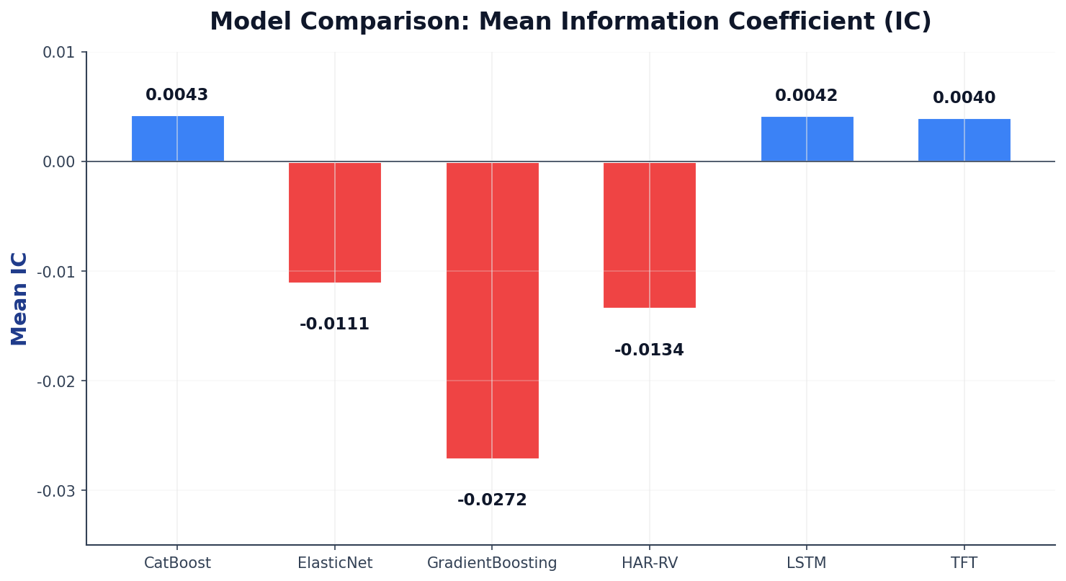
SECTION 5: EXTENSION
Model Comparison: Information Coefficient (IC)
Key Observations
▸ CatBoost leads with IC=0.0043
▸ LSTM IC=0.0042, nearly on par
▸ TFT IC=0.0040, slightly behind
▸ GradientBoosting worst at -0.027
All IC values remain near zero — the noise wall persists even with expanded samples.
Insight: The IC mean of LSTM and TFT is close to that of traditional ML models, but they have not yet demonstrated significant advantages of deep learning

Slide 20
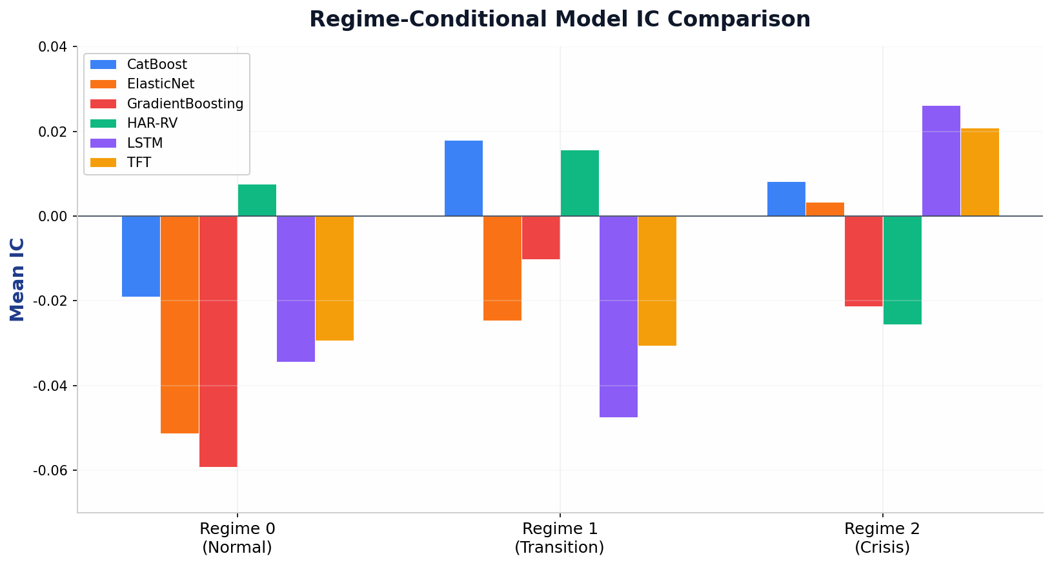
SECTION 5: EXTENSION
Regime-Conditional IC: LSTM & TFT Deep Dive
Regime Breakdown
Regime 2 (Crisis): LSTM is the best (IC=0.026), followed by TFT (IC=0.021)
Regime 0/1: All DL models have negative ICs, making direction determination difficult
The DL model demonstrates relative advantages in crisis regimes
Possible correlation with volatility clustering effect
Insight: Regime 2 is significantly better than other models, suggesting that deep learning may capture nonlinear patterns in high volatility environments

Slide 21
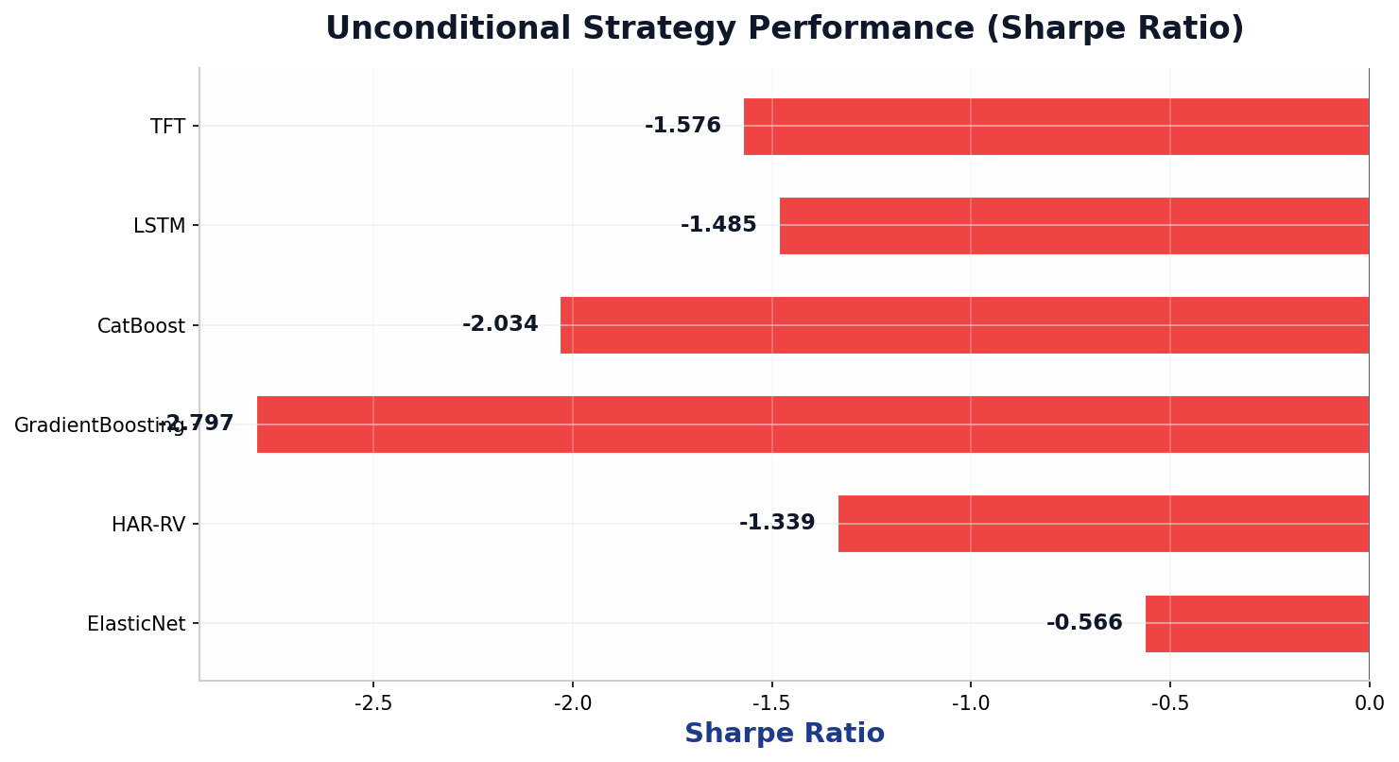
SECTION 5: EXTENSION
Unconditional Strategy Performance (Sharpe Ratio)
Insight: All models unconditionally have negative Sharpe, indicating that relying solely on predicted signals to construct strategies is difficult to profit in the current sample.

Slide 22
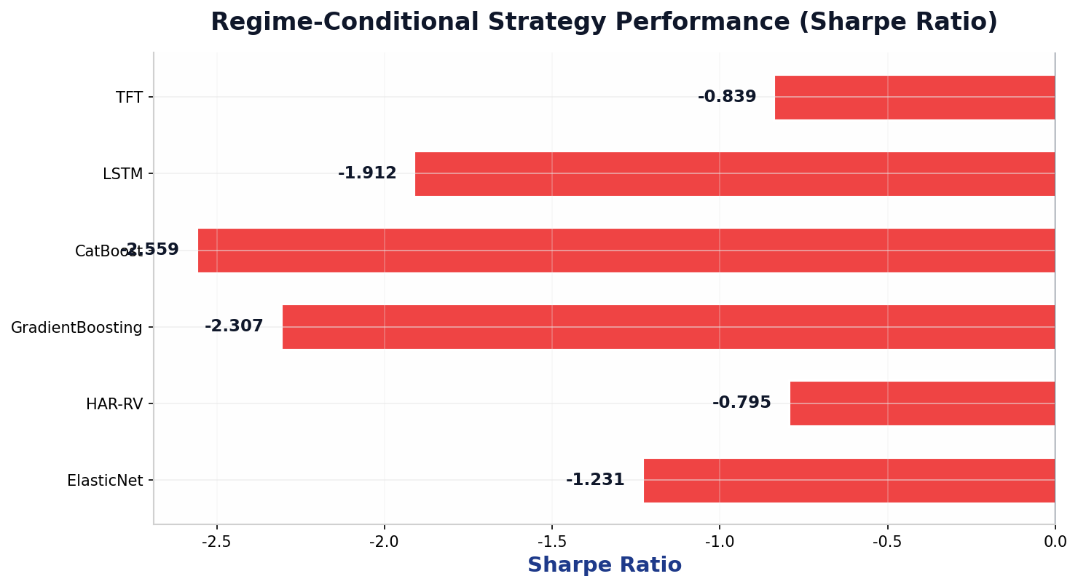
SECTION 5: EXTENSION
Regime-Conditional Strategy Performance (Sharpe)
Insight: After introducing the Regime condition, TFT and HAR-RV performed relatively well, but all models still had negative Sharpe - sample selection or transaction costs may be key factors

Slide 23
SECTION 5: EXTENSION
Key Findings: Why Results Are Not Yet Significant
Sample Issues
Lightweight Training
Market Structure
● The training window is relatively short (2020–2021).
● only three ETFs, the asset coverage is insufficient.
● Regime uneven distribution
● LSTM hidden=32, 1 layer
● TFT heads=2, under-trained
● 128 hidden, 4 heads
● The daily return signal-to-noise ratio is extremely low
● High correlation between multiple assets
● Limited decentralization effect
● Transaction costs not fully accounted for
Core Reflection: The result is not significant ≠ deep learning is invalid. The current configuration is more like a 'proof of concept' rather than a 'capability cap test'

Slide 24
SECTION 5: EXTENSION
Future Work: Toward Full LSTM & TFT Training
Immediate Next Steps
Long-term Exploration
● Extend the training window to 2015-2024 (10-year data)
● Increase asset coverage (industry ETFs, international indices)
● LSTM: 128 hidden units + 2 layers
● TFT: 128 hidden + 4 heads + 8 attention steps
● More comprehensive training epochs and early stopping mechanism
● Introducing Multi Task Learning
● Try Transformer architecture (Informer, Autoformer)
● Combining HMM Regime signal with DL prediction
● Exploring the interpretability of attention mechanisms
● Build a hybrid strategy framework
Commitment: We will continue to wait for the complete training results - the potential of deep learning in volatility trading is worth exploring more fully

Slide 25
Thank You!
Questions? Group 8 invites your feedback.
Volatility Trading Strategy Study | 2026

