Slide 1
EXPENSEIQ
AI-Powered Business Expense Management System
Project documentation, implementation & testing
Toluwanimi Akinyemi
AI Automation Diploma | Instructor: Ogbu Princewill
1 October 2026
Notes:
Introduce ExpenseIQ: an AI-assisted expense system for a Nigerian small business, built with Lovable, Supabase and Make.com.

Slide 2




From manual to automated expenses
The problem
The ExpenseIQ solution
Repetitive data entry
Employees submit through a Lovable web app
Supabase stores the authoritative record and fires webhooks
Make.com handles receipts, AI categorisation, routing and email
Managers approve, reject or ask for clarification
Weekly summaries go to Google Sheets and management
Receipts lost or handled by hand
Manual categorisation
Slow approval routing and follow-up
Notes:
Expense processing involves repeated data entry, receipt handling, categorisation, routing, notifications and reporting. ExpenseIQ connects all of this.

Slide 3






What ExpenseIQ delivers
The complete expense lifecycle, in six steps
Submit
Categorise
Route
Form with receipt upload; missing receipts are flagged, not blocked
AI suggests category, summary, duplicate risk and a reviewer note
Expenses of NGN 100,000 or more go to a manager
Decide
Notify
Report
Approve, reject or request clarification
Employee is emailed the outcome with manager notes
Weekly totals by status, category and department
Notes:
These six steps map to the three Make.com scenarios: intake, manager decision, weekly summary.

Slide 4
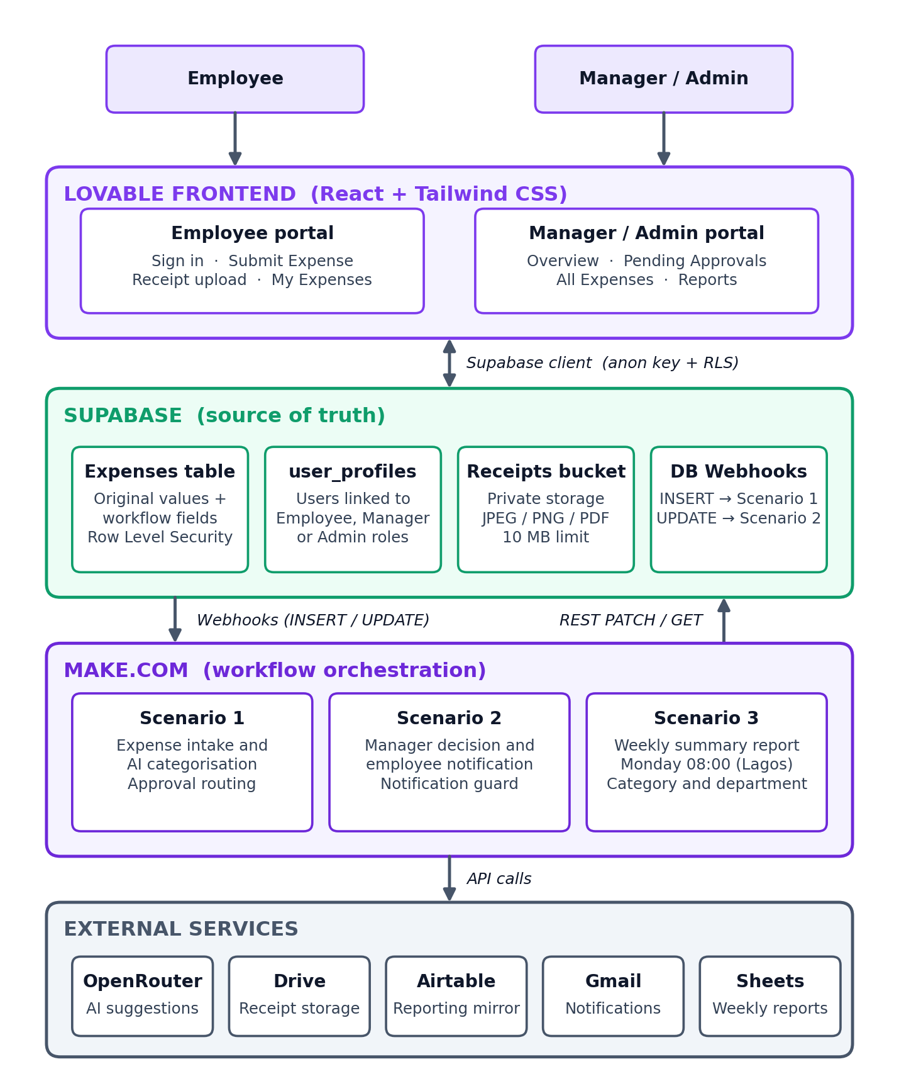
System architecture
Frontend
Lovable (React + Tailwind): employee and manager portals
Database
Supabase: records, roles, private receipts bucket, webhooks
Automation
Make.com: three scenarios orchestrate every step
Services
OpenRouter, Google Drive, Airtable, Gmail, Google Sheets
Notes:
Walk the diagram top to bottom: users, Lovable, Supabase, Make.com, external services. Supabase is the source of truth; Make.com reacts to its webhooks.

Slide 5





Technology stack
Lovable
Supabase
Make.com
OpenRouter
React + Tailwind frontend
Database, auth, storage, webhooks
Automation and orchestration
AI categorisation (Nemotron 3 Ultra)
Google Drive
Airtable
Gmail
Google Sheets
Durable receipt storage
Downstream reporting mirror
Approval and status emails
Weekly summary reporting
Notes:
Supabase is the primary database and source of truth. Make.com runs the background automation.

Slide 6
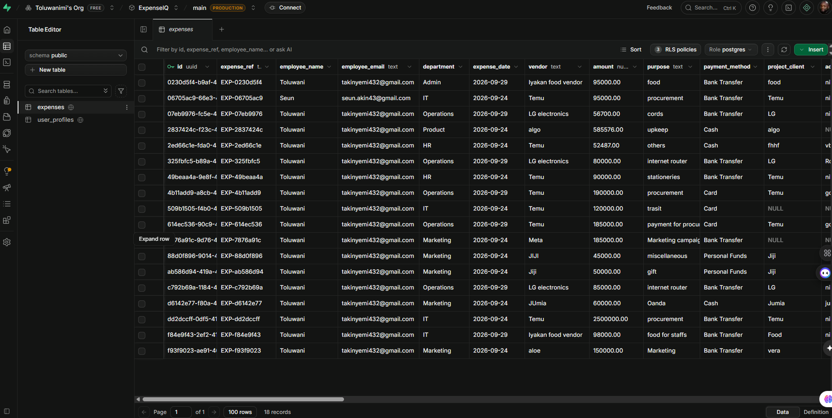
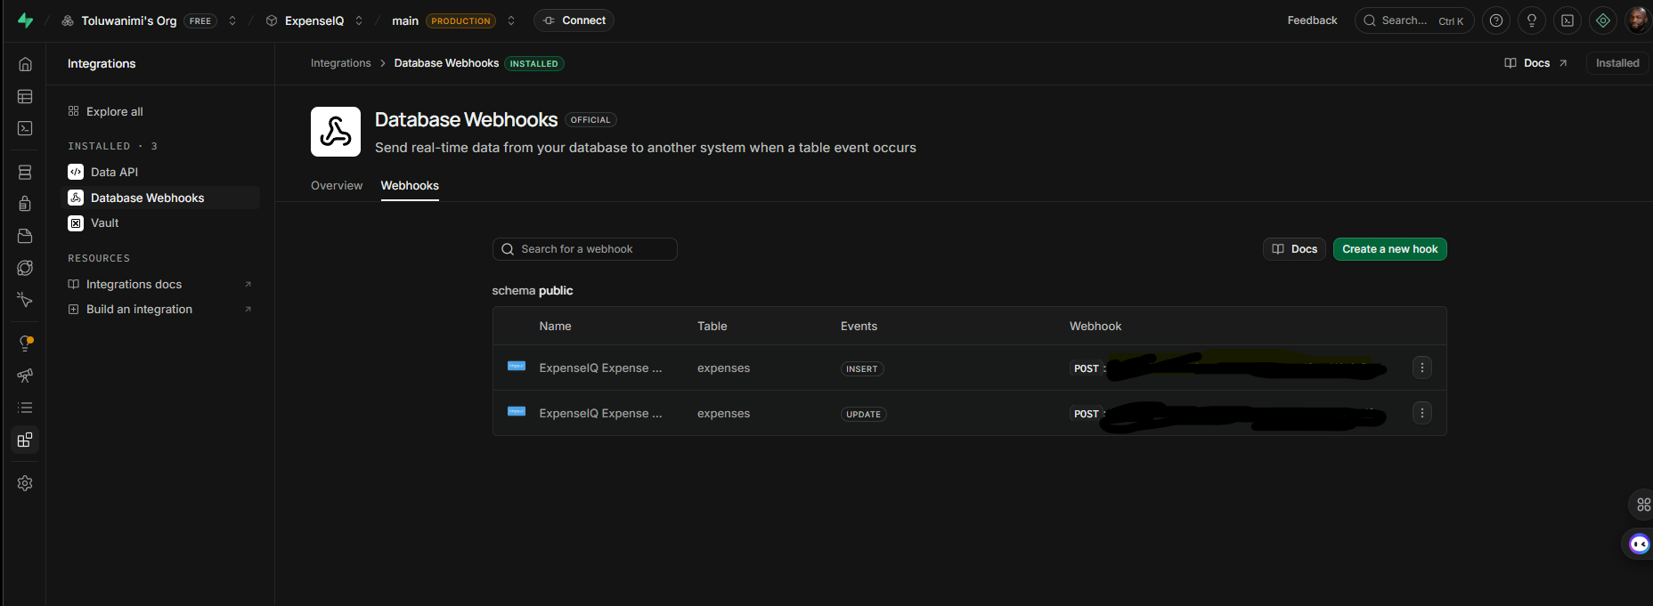
Supabase: the source of truth
Expenses table
Original submission plus AI and workflow fields
Roles and RLS
Employees see their own records; managers and admins see more
Private receipts bucket
JPEG, PNG or PDF, 10 MB limit
Database Webhooks
INSERT starts Scenario 1; status UPDATE starts Scenario 2
Expenses table
INSERT and UPDATE webhooks (URLs redacted)
Notes:
Database Webhooks are used instead of Realtime. The service-role key is only used by Make.com server-side modules.

Slide 7
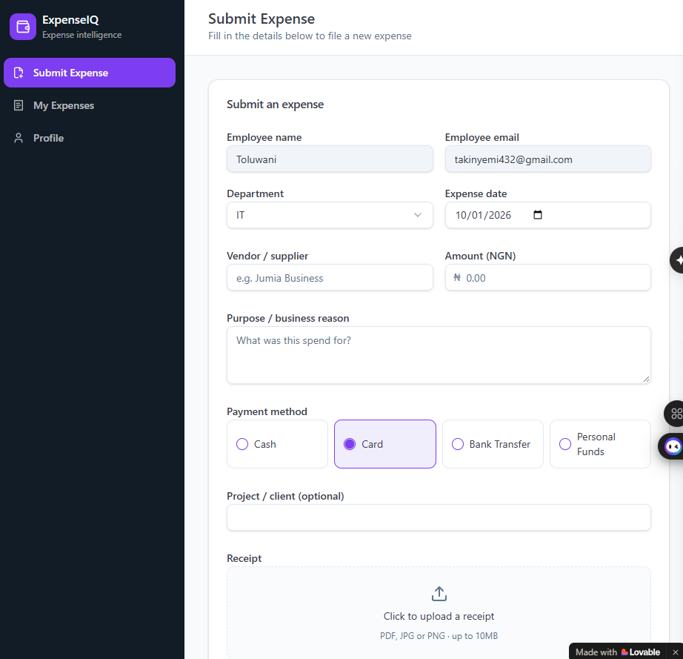
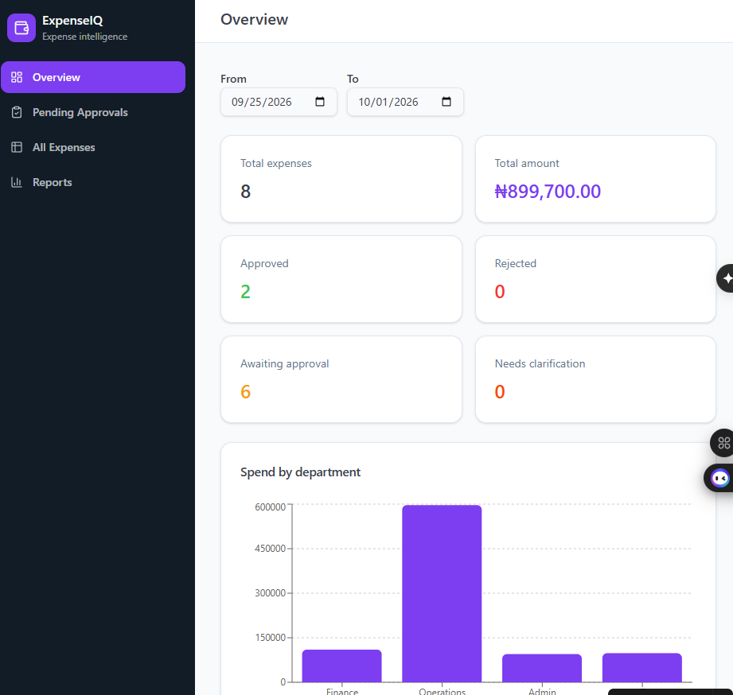
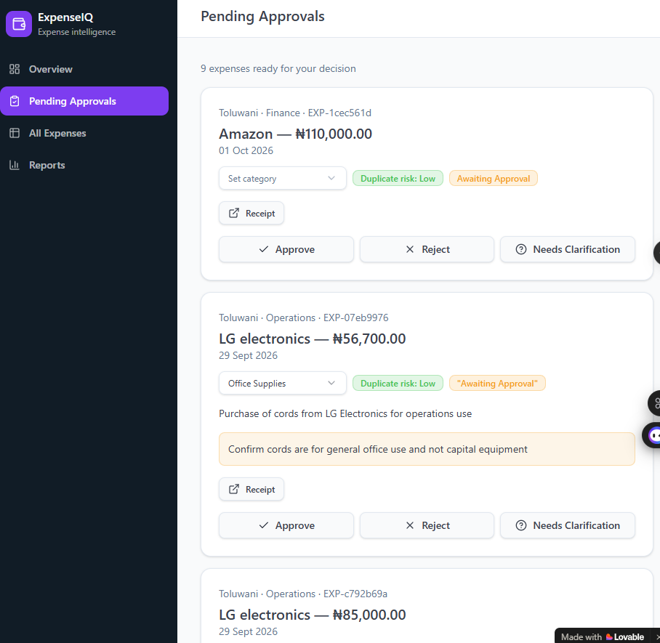
Lovable frontend
Role-based portals; accounts are created by an administrator
Employee: submit expense
Manager: overview
Manager: pending approvals
A missing receipt shows a warning but does not block submission; the record is flagged receipt_missing.
Notes:
Employees: Submit Expense, My Expenses, Profile. Managers: Overview, Pending Approvals, All Expenses, Reports. AI category is a suggestion the manager can change.

Slide 8
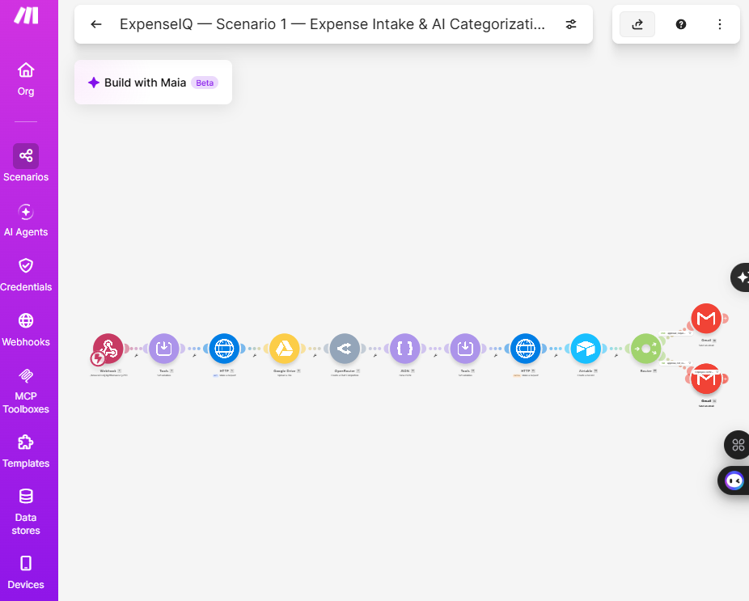
Scenario 1: intake and AI categorisation
1
2
3
4
5
6
Webhook receives the INSERT
Receipt copied to Google Drive
OpenRouter suggests category
Results PATCHed to Supabase
Record mirrored to Airtable
Router applies the approval rule
AI returns JSON only
category from a fixed list of 11
subcategory and short summary
duplicate_risk: Low or Review
reviewer_note for unclear details
Prompt forbids approving, rejecting or tax judgments
Scenario 1 canvas in Make.com
Notes:
Categories: Marketing, Travel, Meals, Software, Office Supplies, Training, Professional Services, Logistics, Utilities, Equipment, Other.

Slide 9


AI suggests. People decide.
The AI only
The AI does not
Suggests a category and subcategory
Approve or reject expenses
Writes a concise summary
Make payment decisions
Flags duplicate risk: Low or Review
Give tax or legal conclusions
Writes a reviewer note
Override the approval threshold
Notes:
The approval decision is an explicit Make.com business rule, not an AI output. Human managers remain responsible for financial decisions.

Slide 10
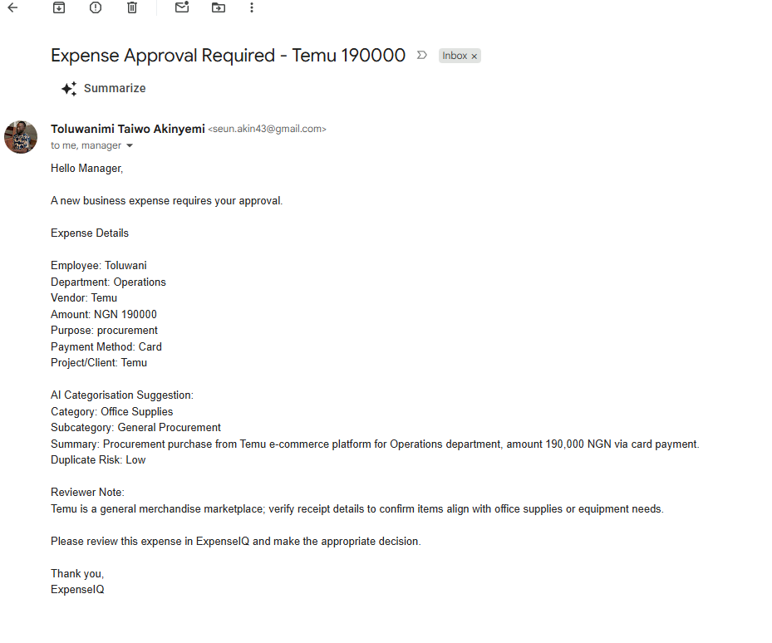
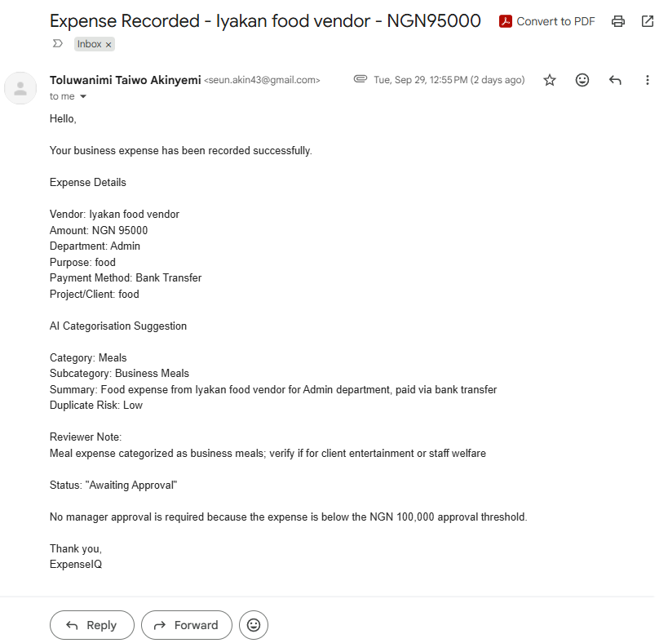
One explicit rule routes every expense
NGN 100,000
approval threshold
Amount ≥ 100,000
Awaiting Approval; manager receives an approval email
Manager approval request (NGN 190,000)
Employee confirmation (NGN 95,000)
Amount < 100,000
Auto-recorded; employee receives a confirmation email
Both route filters run on the numeric amount, so the decision never depends on the AI.
Notes:
Missing receipt: submission continues with receipt_missing = true. Only Approved expenses may proceed to payment.

Slide 11
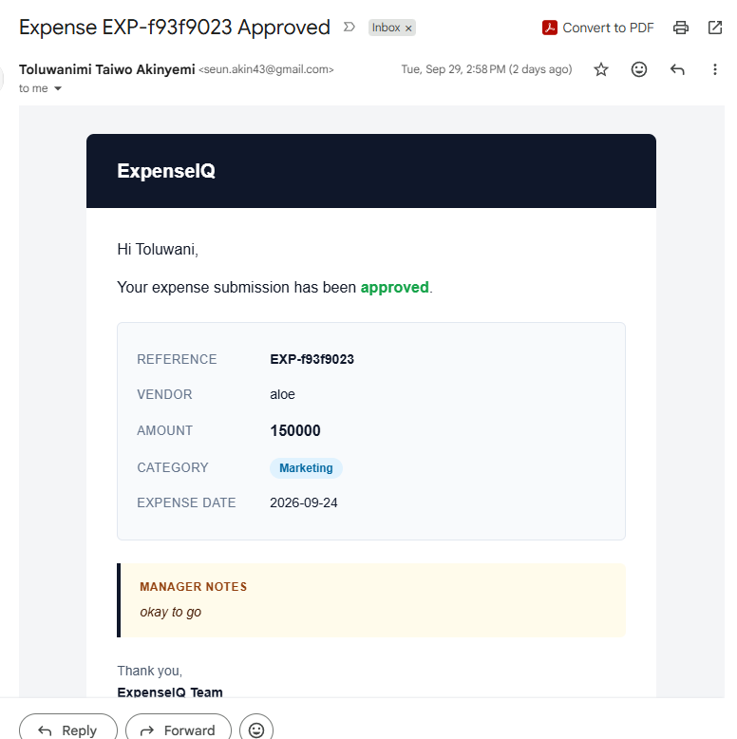
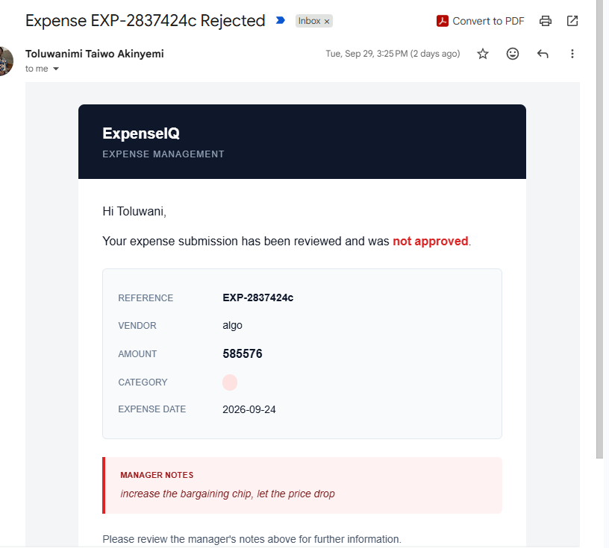
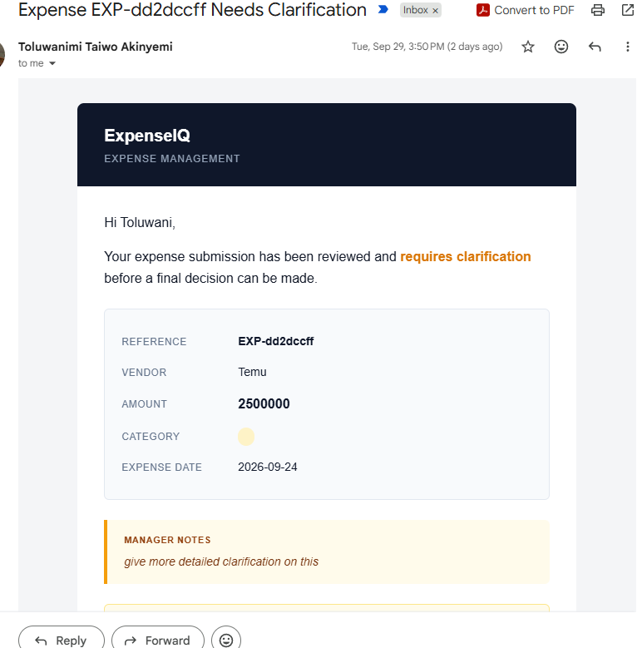
Scenario 2: manager decision and notification
Status UPDATE webhook
Notification Guard filter
Router by status
notification_sent = true
Gmail to employee
The guard passes only a real status change with notification_sent = false, so the scenario’s own update cannot send a second email.
Approved
Rejected
Needs Clarification
Notes:
Each email repeats reference, vendor, amount, AI category and date, with the manager notes in a colour-coded panel.

Slide 12
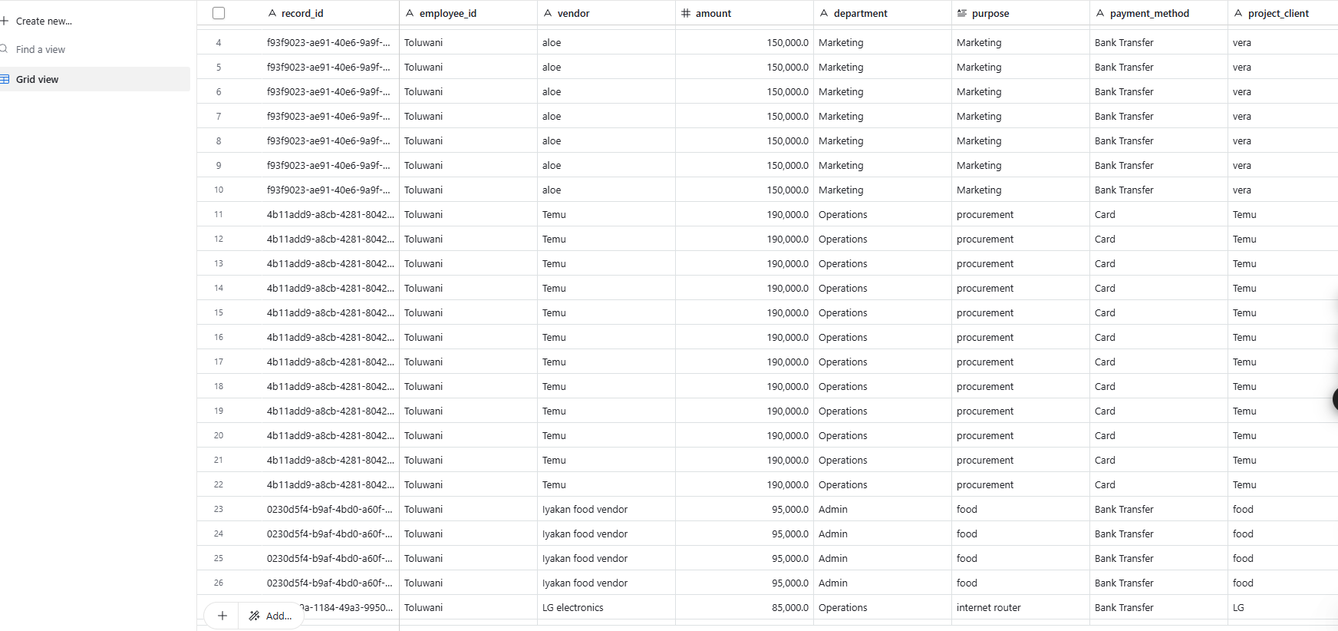
Airtable reporting mirror
Written by Make.com after Supabase is updated
Holds submission fields, AI fields, approval flags and status
Does not start any workflow
Repeated rows come from repeated test runs
Expenses table in the ExpenseIQ Airtable base
Notes:
Supabase remains the single source of truth; Airtable is a downstream mirror.

Slide 13
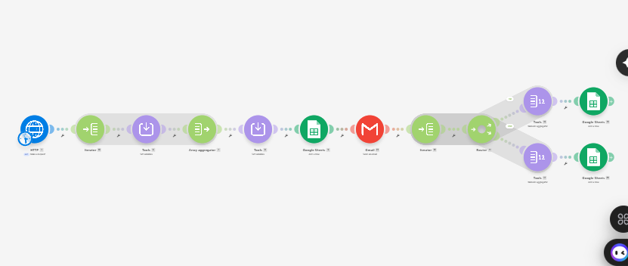

Scenario 3: weekly summary report
Scenario 3 canvas in Make.com
Monday 08:00
Africa/Lagos schedule; run on demand in testing
Last 7 days
Expenses fetched from Supabase by HTTP GET
Three sheet tabs
Weekly Summary, By Category, By Department
Notes:
Aggregators sum amounts grouped by AI category and by department; a Gmail module sends the management email.

Slide 14
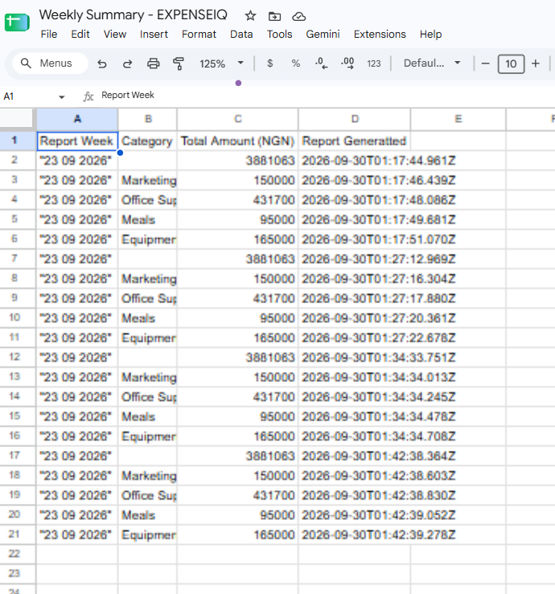
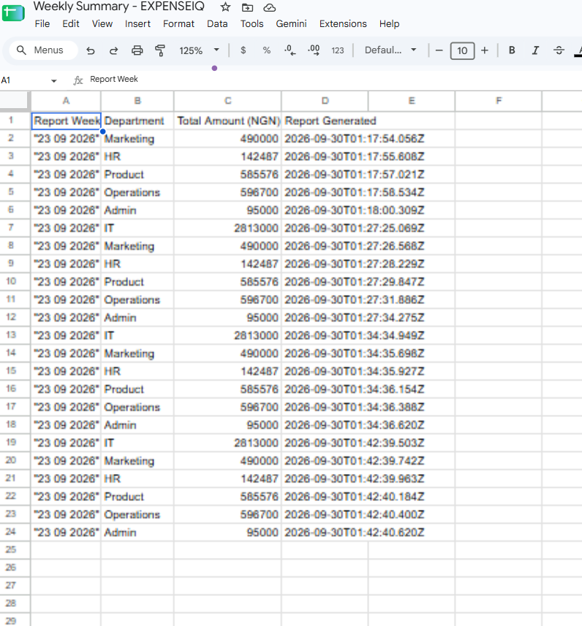
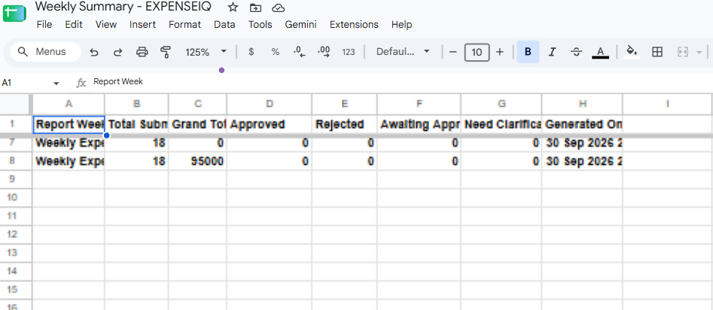
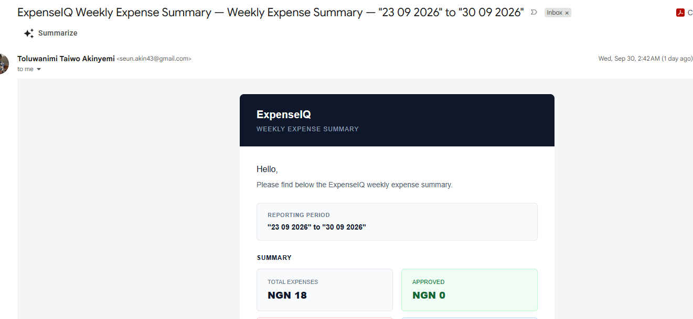
Weekly reports delivered
Weekly Summary tab
By Category
By Department
Management email
Notes:
The sheets contain rows from several successive test runs.

Slide 15
Testing and results
12
test cases
3
manager decisions
2
approval routes
29
evidence figures
Test | Input | Result
Above threshold | Temu, NGN 190,000 | Manager approval email
Below threshold | Iyakan food vendor, NGN 95,000 | Confirmation email; Meals / Business Meals
Missing receipt | Form without a file | Warning shown; submission continues
Manager approves | aloe, NGN 150,000 | Approved email with notes
Manager rejects | algo, NGN 585,576 | Rejected email with notes
Needs clarification | Temu, NGN 2,500,000 | Clarification email with notes
Weekly report | Scenario 3 run | Three sheet tabs and management email
Notes:
Each result is backed by a figure in the project documentation.

Slide 16


Safeguards and next steps
Security safeguards
Next improvements
RLS limits employees to their own records
Receipts bucket is private
Service-role key only in Make.com server-side modules
notification_sent prevents duplicate emails
Original values kept; decision fields appended
Immutable decision-history table
Paid status and payment-ready queue
Historical duplicate detection and configurable thresholds
Retry and error reporting across services
Tighten Scenario 1 and 3 expressions; upsert Airtable rows
Notes:
Limitations are refinements to expressions and controls, not changes to the architecture.

Slide 17
AI suggests.
Rules route.
People decide.
ExpenseIQ automates the full expense lifecycle: submission, AI categorisation, approval routing, human decision, employee notification and weekly reporting.
Thank you | Toluwanimi Akinyemi
Notes:
Close with the separation between AI suggestions and human financial decisions.

