Slide 1


Slide 2
Performance OpenGL
Platform Independent Techniques
Dave Shreiner
Brad Grantham

Slide 3
What You’ll See Today …
  An in-depth look at the OpenGL pipeline from a performance perspective
  Techniques for determining where OpenGL application performance bottlenecks are
  A bunch of simple, good habits for OpenGL applications

Slide 4
Performance Tuning Assumptions
  You’re trying to tune an interactive OpenGL application
  There’s an established metric for estimating the application’s performance
    Consistent frames/second
    Number of pixels or primitives to be rendered per frame
  You can change the application’s source code

Slide 5
Errors Skew Performance Measurements
OpenGL Reports Errors Asynchronously
  OpenGL doesn’t tell you when something goes wrong
    Need to use glGetError() to determine if something went wrong
    Calls with erroneous parameters will silently set error state and return without completing

Slide 6
Checking a single command
Simple Macro
  Some limitations on where the macro can be used
    can’t use inside of glBegin() / glEnd() pair
#define CHECK_OPENGL_ERROR( cmd ) \
cmd; \
{ GLenum error; \
while ( (error = glGetError()) != GL_NO_ERROR) { \
printf( "[%s:%d] '%s' failed with error %s\n", \
__FILE__, __LINE__, #cmd, \
gluErrorString(error) ); \
}

Slide 7
The OpenGL Pipeline
(The Macroscopic View)
Transformation
Application
Rasterization
Framebuffer

Slide 8
Performance Bottlenecks
Bottlenecks are the performance limiting part of the application
  Application bottleneck
    Application may not pass data fast enough to the OpenGL pipeline
  Transform-limited bottleneck
    OpenGL may not be able to process vertex transformations fast enough

Slide 9
Performance Bottlenecks (cont.)
  Fill-limited bottleneck
    OpenGL may not be able to rasterize primitives fast enough

Slide 10
There Will Always Be A Bottleneck
Some portion of the application will always be the limiting factor to performance
  If the application performs to expectations, then the bottleneck isn’t a problem
  Otherwise, need to be able to identify which part of the application is the bottleneck
  We’ll work backwards through the OpenGL pipeline in resolving bottlenecks

Slide 11
Fill-limited Bottlenecks
System cannot fill all the pixels required in the allotted time
  Easiest bottleneck to test
  Reduce number of pixels application must fill
    Make the viewport smaller

Slide 12
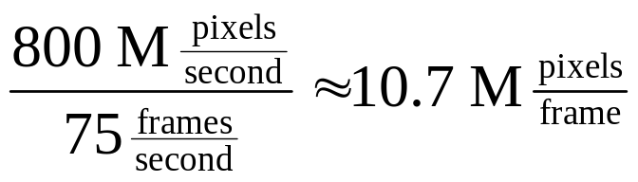
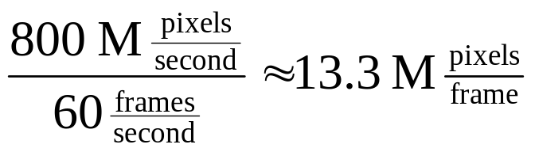
Reducing Fill-limited Bottlenecks
The Easy Fixes
  Make the viewport smaller
    This may not be an acceptable solution, but it’s easy
  Reduce the frame-rate

Slide 13
A Closer Look at OpenGL’s Rasterization Pipeline
Point
Rasterization
Line
Rasterization
Triangle
Rasterization
Texture
Mapping
Engine
Color Sum
(Sep. Specular
Color)
Fog
Engine
Bitmap
Rasterization
To
Fragment Tests
Pixel
Rectangle
Rasterization

Slide 14
Reducing Fill-limited Bottlenecks (cont.)
Point
Rasterization
Line
Rasterization
Triangle
Rasterization
Texture
Mapping
Engine
Color Sum
Fog
Engine
Rasterization Pipeline
  Cull back facing
  polygons
    Does require all primitives have same facediness
  Use per-vertex fog, as compared to per-pixel
Bitmap
Rasterization
Pixel
Rectangle
Rasterization
To
Fragment Tests

Slide 15
A Closer Look at OpenGL’s Rasterization Pipeline (cont.)
Fragments
(from previous
stages)
Framebuffer
Pixel
Ownership
Test
Scissor
Test
Alpha
Test
Stencil
Test
Depth
Buffer
Test
Blending
Dithering
Logical
Operations

Slide 16
Reducing Fill-limited Bottlenecks (cont.)
Pixel
Ownership
Test
Scissor
Test
Alpha
Test
Stencil
Test
Fragment Pipeline
  Do less work per pixel
    Disable dithering
    Depth-sort primitives to reduce depth testing
    Use alpha test to reject transparent fragments
      saves doing a pixel read-back from the framebuffer in the blending phase
Depth
Buffer
Test
Blending
Dithering
Logical
Operations

Slide 17
A Closer Look at OpenGL’s Pixel Pipeline
Pixel
Rectangle
Pixel
Unpacking
Type
Conversion
Pixel Map
Pixel Scale
&
Bias
Clamp
Framebuffer
Texture
Memory

Slide 18
Working with Pixel Rectangles
Texture downloads and Blts
  OpenGL supports many formats for storing pixel data
    Signed and unsigned types, floating point
  Type conversions from storage type to framebuffer / texture memory format occur automatically

Slide 19
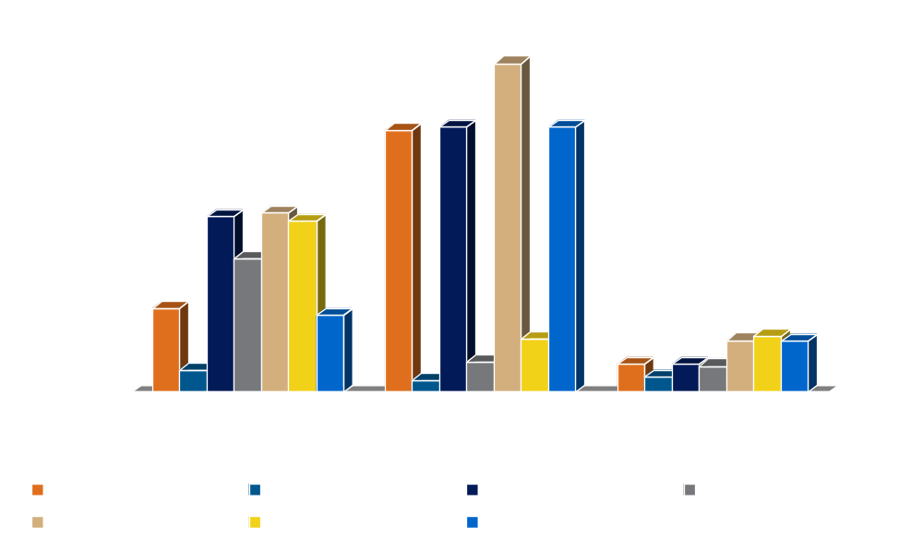
Pixel Data Conversions

Slide 20
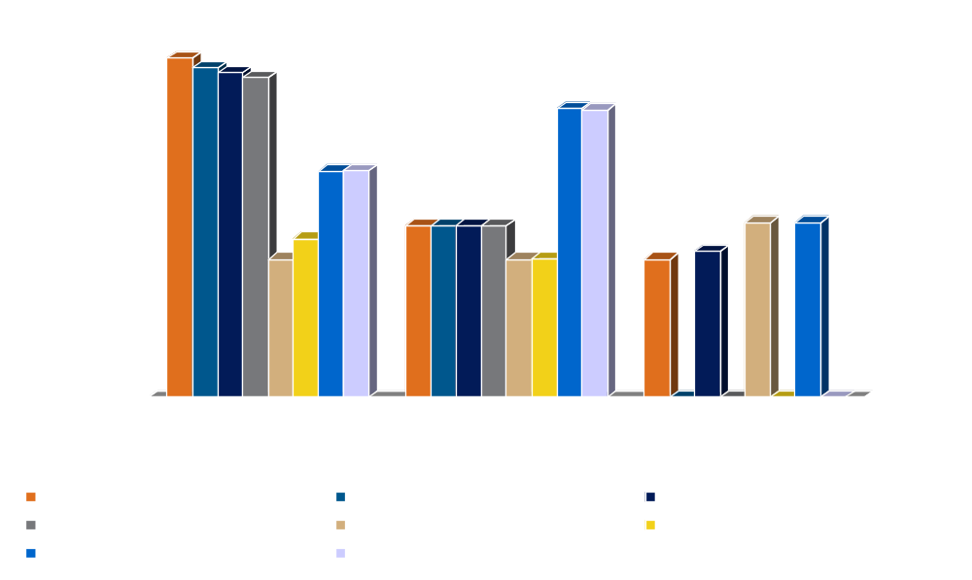
Pixel Data Conversions (cont.)

Slide 21
Pixel Data Conversions (cont.)
Observations
  Signed data types probably aren’t optimized
    OpenGL clamps colors to [0, 1]
  Match pixel format to window’s pixel format for blts
    Usually involves using packed pixel formats
    No significant difference for rendering speed for texture’s internal format

Slide 22
Fragment Operations and Fill Rate
The more you do, the less you get
  The more work per pixel, the less fill you get

Slide 23
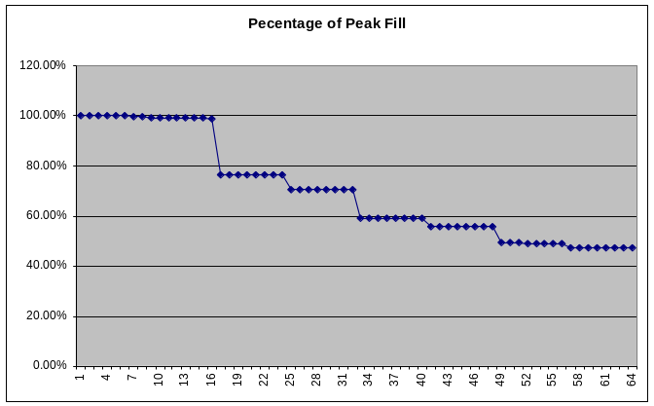
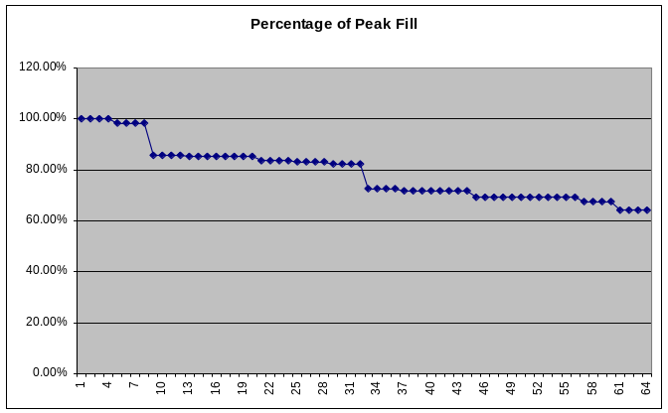
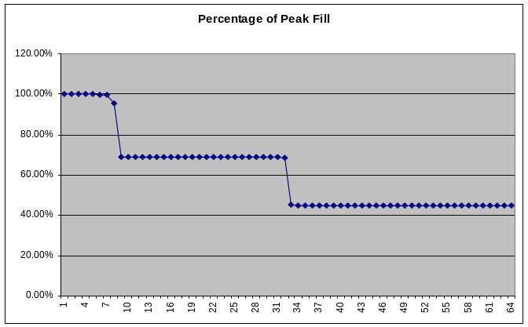
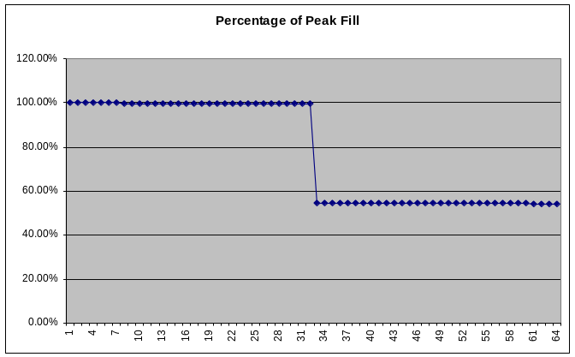
Fragment Operations and Fill Rate (cont’d)
Machine 1
Machine 3
Machine 2
Machine 4

Slide 24
Texture-mapping Considerations
Use Texture Objects
  Allows OpenGL to do texture memory management
    Loads texture into texture memory when appropriate
    Only convert data once
  Provides queries for checking if a texture is resident
    Load all textures, and verify they all fit simultaneously

Slide 25
Texture-mapping Considerations (cont.)
Texture Objects (cont.)
  Assign priorities to textures
    Provides hints to texture-memory manager on which textures are most important
  Can be shared between OpenGL contexts
    Allows one thread to load textures; other thread to render using them
  Requires OpenGL 1.1

Slide 26

Texture-mapping Considerations (cont.)
Sub-loading Textures
  Only update a portion of a texture
    Reduces bandwidth for downloading textures
    Usually requires modifying texture-coordinate matrix

Slide 27
Texture-mapping Considerations (cont.)
Know what sizes your textures
need to be
  What sizes of mipmaps will you need?
  OpenGL 1.2 introduces texture level-of-detail
    Ability to have fine grained control over mipmap stack
      Only load a subset of mipmaps
      Control which mipmaps are used

Slide 28
What If Those Options Aren’t Viable?
  Use more or faster hardware
  Utilize the “extra time” in other parts of the application
    Transform pipeline
      tessellate objects for smoother appearance
      use better lighting
    Application
      more accurate simulation
      better physics

Slide 29
Transform-limited Bottlenecks
System cannot process all the vertices required in the allotted time
  If application doesn’t speed up in fill-limited test, it’s most likely transform-limited
  Additional tests include
    Disable lighting
    Disable texture coordinate generation

Slide 30
A Closer Look at OpenGL’s Transformation Pipeline
Color
Texture
Coordinate
Transform
Texture
Coordinates
Texture
Coordinate
Generation
Lighting
Normals
ModelView
Transform
Lighting
Projection
Transform
Clipping
Vertex
Coordinates

Slide 31
Reducing Transform-limited Bottlenecks
Do less work per-vertex
  Tune lighting
  Use “typed” OpenGL matrices
  Use explicit texture coordinates
  Simulate features in texturing
    lighting

Slide 32
Lighting Considerations
  Use infinite (directional) lights
    Less computation compared to local (point) lights
    Don’t use GL_LIGHTMODEL_LOCAL_VIEWER
  Use fewer lights
    Not all lights may be hardware accelerated

Slide 33
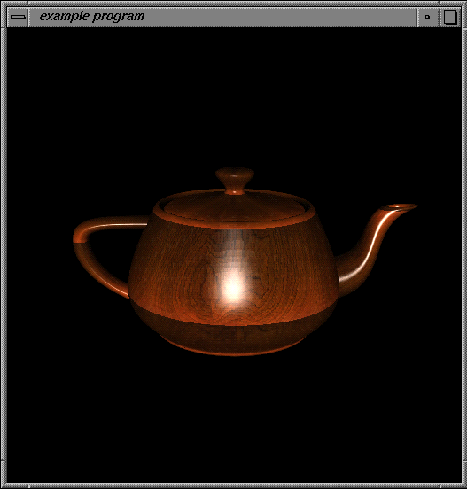

Lighting Considerations (cont.)
  Use a texture-based lighting scheme
    Only helps if you’re not fill-limited

Slide 34
Reducing Transform-limited Bottlenecks (cont.)
Matrix Adjustments
  Use “typed” OpenGL matrix calls
    Some implementations track matrix type to reduce matrix-vector multiplication operations
“Typed”
“Untyped”
glRotate*()
glScale*()
glTranslate*()
glLoadIdentity()
glLoadMatrix*()
glMultMatrix*()

Slide 35
Application-limited Bottlenecks
When OpenGL does all you ask, and your application still runs too slow
  System may not be able to transfer data to OpenGL fast enough
  Test by modifying application so that no rendering is performed, but all data is still transferred to OpenGL

Slide 36
Application-limited Bottlenecks (cont.)
  Rendering in OpenGL is triggered when vertices are sent to the pipe
  Send all data to pipe, just not necessarily in its original form
    Replace all glVertex*() and glColor*() calls with glNormal*() calls
      glNormal*() only sets the current vertex’s normal values
      Application transfers the same amount of data to the pipe, but doesn’t have to wait for rendering to complete

Slide 37
Reducing Application-limited Bottlenecks
  No amount of OpenGL transform or rasterization tuning will help the problem
  Revisit application design decisions
    Data structures
    Traversal methods
    Storage formats
  Use an application profiling tool (e.g. pixie & prof, gprof, or other similar tools)

Slide 38
The Novice OpenGL Programmer’s View of the World
Set
State
Render

Slide 39
What Happens When You Set OpenGL State
  The amount of work varies by operation
  But all request a validation at next rendering operation
Turning on or off a feature (glEnable()) | Set the feature’s enable flag
Set a “typed” set of data (glMaterialfv()) | Set values in OpenGL’s context
Transfer “untyped” data (glTexImage2D()) | Transfer and convert data from host format into internal representation

Slide 40
A (Somewhat) More Accurate Representation
Validation
Set
State
Render

Slide 41
Validation
OpenGL’s synchronization process
  Validation occurs in the transition from state setting to rendering
  Not all state changes trigger a validation
    Vertex data (e.g. color, normal, texture coordinates)
    Changing rendering primitive
glMaterial( GL_FRONT, GL_DIFFUSE, blue );
glEnable( GL_LIGHT0 );
glBegin( GL_TRIANGLES );

Slide 42
What Happens in a Validation
  Changing state may do more than just set values in the OpenGL context
    May require reconfiguring the OpenGL pipeline
      selecting a different rasterization routine
      enabling the lighting machine
    Internal caches may be recomputed
      vertex / viewpoint independent data

Slide 43
The Way it Really Is (Conceptually)
Validation
Different
Rendering
Primitive
Set
State
Render

Slide 44
Why Be Concerned About Validations?
Validations can rob performance from an application
  “Redundant” state and primitive changes
  Validation is a two-step process
    Determine what data needs to be updated
    Select appropriate rendering routines based on enabled features

Slide 45
How Can Validations Be Minimized?
Be Lazy
  Change state as little as possible
  Try to group primitives by type
  Beware of “under the covers” state changes
    GL_COLOR_MATERIAL
      may force an update to the lighting cache ever call to glColor*()

Slide 46
How Can Validations Be Minimized? (cont.)
Beware of glPushAttrib() / glPopAttrib()
  Very convenient for writing libraries
  Saves lots of state when called
    All elements of an attribute groups are copied for later
  Almost guaranteed to do a validation when calling glPopAttrib()

Slide 47
State Sorting
Simple technique … Big payoff
  Arrange rendering sequence to minimize state changes
  Group primitives based on their state attributes
  Organize rendering based on the expense of the operation

Slide 48
State Sorting (cont.)
Texture Download
Most Expensive
Modifying Lighting
Parameters
Matrix Operations
Vertex Data
Least Expensive

Slide 49
A Comment on Encapsulation
An Extremely Handy Design Mechanism, however …
  Encapsulation may affect performance
    Tendency to want to complete all operations for an object before continuing to next object
      limits state sorting potential
      may cause unnecessary validations

Slide 50
A Comment on Encapsulation (cont.)
  Using a “visitor” type pattern can reduce state changes and validations
    Usually a two-pass operation
      Traverse objects, building a list of rendering primitives by state and type
      Render by processing lists
    Popular method employed by many scene-graph packages

Slide 51
“Scene Graph” Lessons
Can you use pre-packaged software?
  Save yourself some trouble
Lessons learned from scene graphs
  Inventor OpenRM Performer
  DirectModel Cosmo3D OpenSG
  DirectSceneGraph/Fahrenheit
Notes:
Smarter people than you and I have tried to design and build the best interactive 3D package
Each of these has different goals
Showcase features in proprietary architecture
Ease of use
Most have good ideas in them for performance

Slide 52
Scene Graph Lessons
Organization is the key
  Organize scene data for performance
  E.g. by transformation & bounding hierarchy
All about balance (like all high-perf coding)
  Speed versus convenience
  Portability versus speed
Notes:
Transform and Bounding hierarchy are not identical
But they tend to be related
Using transform hierarchy for bound hierarchy usually ok
OpenGL as a library needs special attention and coding style
Because it’s interactive
Because you’re transferring lots of data
Maybe because you’ve paid big $$ for your interactive setup
Infinite Reality
Graphics Cluster
etc

Slide 53
Performance Goals
Identify performance techniques and goals
  Sort to eliminate costly state changes
  Evaluate state lazily
    Don’t set state if won’t draw geometry
  Eliminate redundance
    Don’t set “red” if material is already “red”

Slide 54
Feature Goals
Identify algorithms and requirements
  E.g. Sort alpha/transparent shapes back-to-front
Identify multiple rendering passes
  Shadow texture
  Environment Map
Will you need threading?

Slide 55
Scene Graph Lessons
Put units of work in nodes/leaves
  Speed of traversal vs. convenience
    Instancing
  e.g. Vertex Arrays, Material, Primitives
Do work where you have the information needed
  e.g. don't require leaf info before traversal

Slide 56
Scene Graph Lessons
Data (“Nodes”) versus operation (“Action”)
  VertexSet::Draw() might be too inflexible
  Renderer::draw(Node*)allows more flexibility
  Write new Renderer without changing nodes
Notes:
Map data as closely as possible without being unnecessarily rigid
Keep future architectures and uncertainty in your mind

Slide 57
Scene Graph Lessons
Data (“Nodes”) versus operation (“Action”)
  Might take a little thought - but beneficial
  Gives you flexibility for future
  Need to keep careful eye on performance
Notes:
Map data as closely as possible without being unnecessarily rigid
Keep future architectures and uncertainty in your mind

Slide 58
Example Data Structure
Directed Graph / Tree
  Internal and leaf Nodes
  Subclassing
Render Traversal
  Use bounding volumes
  OpenGL state management

Slide 59
Example
Group
Group
VertexSet
Shape
PixelState
VertexState

Slide 60
Internal Nodes
Represent spatial organization
  Bounding hierarchy, spatial grid, etc…
Might encode some functionality
  Animation
  Level of Detail

Slide 61
Internal Nodes
Opportunities from bounding volumes
  View frustum cull (early if using a hierarchy)
  Screen space size estimation
    e.g. for level-of-detail or subdivision
  Ray/picking optimizations

Slide 62
Leaf Nodes
Make leaf data approximate OpenGL state
  Rapid application from leaf to OpenGL
But encode some abstraction
  Inventor’s SoComplexity
  EnvironmentMap instead of assuming GL_SPHERE_MAP
  Allow optimizations on specific platforms

Slide 63

Example: VertexSet
class VertexSet {
GLenum fmt
float *verts;
int vertCount;
};

Slide 64
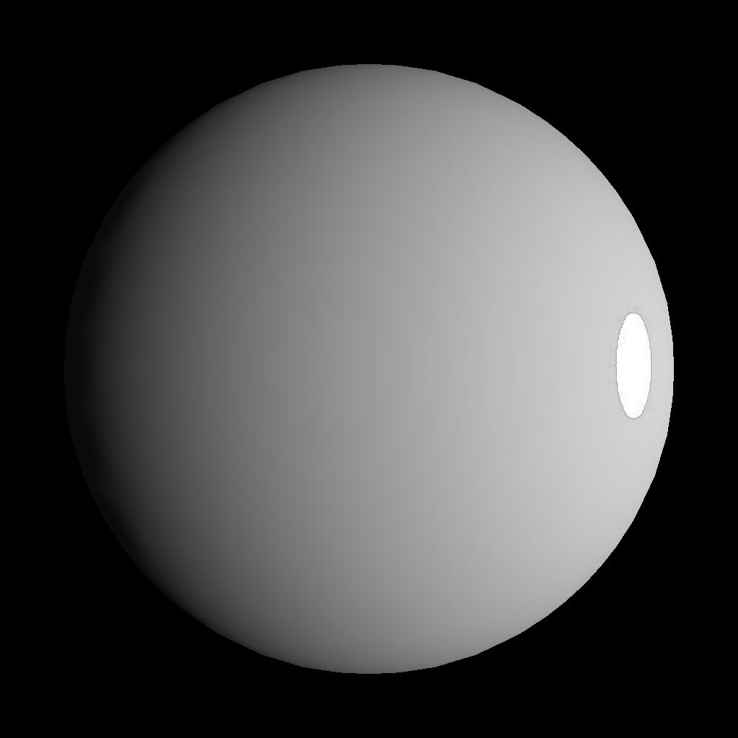
Example: VertexState
class VertexState {
Material *Mtl;
Lighting *Lighting;
ClipPlane *Planes;
...
};

Slide 65
Example: Node
class Node {
Volume Bounds;
...
};

Slide 66

Example: Shape
class Shape : Node {
VertexSet *Verts;
VertexState *VState;
PixelState *PState;
int PrimLengths[];
Glenum PrimTypes[];
int *PrimIndices;
...
};

Slide 67

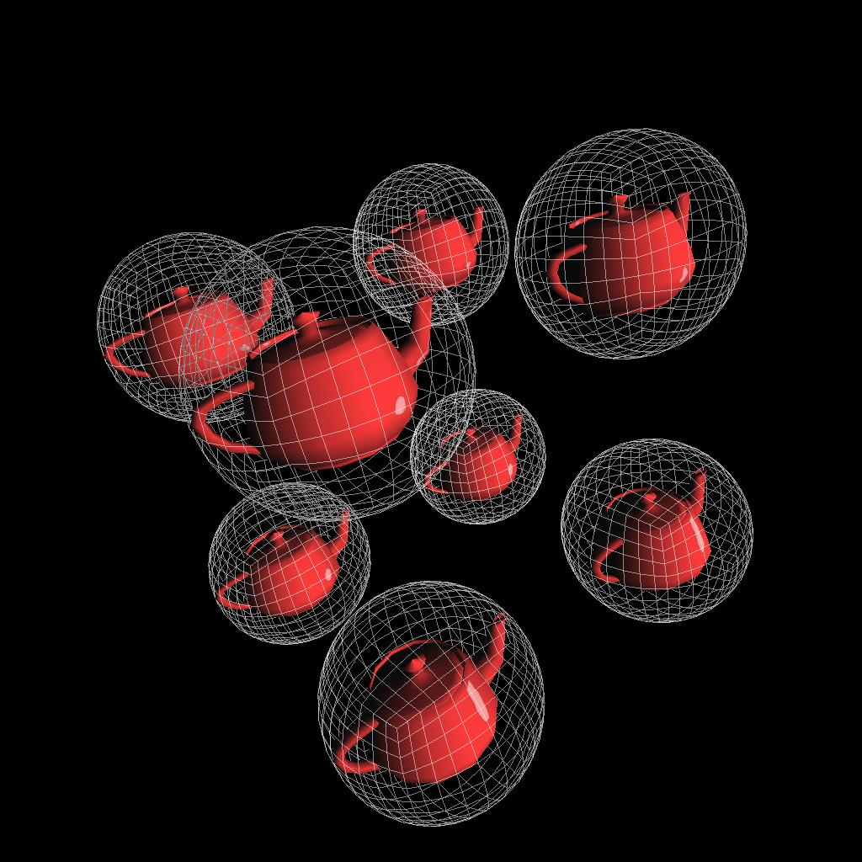
Example: Group
class Group : Node {
int ChildCount;
Node Children[];
...
};

Slide 68
OpenGL Context Encapsulation
Bundles of OpenGL state
  Items commonly changed together
  texture fragment ops
  lighting material
  vertex arrays shaders

Slide 69
Example: OpenGLRenderer
This is where you evaluate lazily and skip redundant state changes
class OpenGLRenderer : Traversal {
virtual void Traverse(Node *root);
private:
void Schedule (float mtx[16],
Shape *shape);
void Finish(void);
...
};

Slide 70
Example: OpenGLRenderer
OpenGLRenderer::Traverse(root)
Recursive traversal - call from app
Check bounding volume
Accumulate transformation matrix
private OpenGLRenderer::Schedule(mtx, shape)
Schedule a shape for rendering
private OpenGLRenderer::Finish()
State sort by bundle
Sort transparent objs back to front
Draw all the objects

Slide 71
Case Study: Rendering A Cube
More than one way to render a cube
  Render 100000 cubes
Render six
separate quads
Render two
quads, and one
quad-strip

Slide 72
Case Study: Method 1
Once for each cube …
glColor3fv( color );
for ( i = 0; i < NUM_CUBE_FACES; ++i ) {
glBegin( GL_QUADS );
glVertex3fv( cube[cubeFace[i][0]] );
glVertex3fv( cube[cubeFace[i][1]] );
glVertex3fv( cube[cubeFace[i][2]] );
glVertex3fv( cube[cubeFace[i][3]] );
glEnd();
}

Slide 73
Case Study: Method 2
Once for each cube …
glColor3fv( color );
glBegin( GL_QUADS );
for ( i = 0; i < NUM_CUBE_FACES; ++i ) {
glVertex3fv( cube[cubeFace[i][0]] );
glVertex3fv( cube[cubeFace[i][1]] );
glVertex3fv( cube[cubeFace[i][2]] );
glVertex3fv( cube[cubeFace[i][3]] );
}
glEnd();

Slide 74
Case Study: Method 3
glBegin( GL_QUADS );
for ( i = 0; i < numCubes; ++i ) {
for ( i = 0; i < NUM_CUBE_FACES; ++i ) {
glVertex3fv( cube[cubeFace[i][0]] );
glVertex3fv( cube[cubeFace[i][1]] );
glVertex3fv( cube[cubeFace[i][2]] );
glVertex3fv( cube[cubeFace[i][3]] );
}
}
glEnd();

Slide 75
Case Study: Method 4
Once for each cube …
glColor3fv( color );
glBegin( GL_QUADS );
glVertex3fv( cube[cubeFace[0][0]] );
glVertex3fv( cube[cubeFace[0][1]] );
glVertex3fv( cube[cubeFace[0][2]] );
glVertex3fv( cube[cubeFace[0][3]] );
glVertex3fv( cube[cubeFace[1][0]] );
glVertex3fv( cube[cubeFace[1][1]] );
glVertex3fv( cube[cubeFace[1][2]] );
glVertex3fv( cube[cubeFace[1][3]] );
glEnd();
glBegin( GL_QUAD_STRIP );
for ( i = 2; i < NUM_CUBE_FACES; ++i ) {
glVertex3fv( cube[cubeFace[i][0]] );
glVertex3fv( cube[cubeFace[i][1]] );
}
glVertex3fv( cube[cubeFace[2][0]] );
glVertex3fv( cube[cubeFace[2][1]] );
glEnd();

Slide 76
Case Study: Method 5
glBegin( GL_QUADS );
for ( i = 0; i < numCubes; ++i ) {
Cube& cube = cubes[i];
glColor3fv( color[i] );
glVertex3fv( cube[cubeFace[0][0]] );
glVertex3fv( cube[cubeFace[0][1]] );
glVertex3fv( cube[cubeFace[0][2]] );
glVertex3fv( cube[cubeFace[0][3]] );
glVertex3fv( cube[cubeFace[1][0]] );
glVertex3fv( cube[cubeFace[1][1]] );
glVertex3fv( cube[cubeFace[1][2]] );
glVertex3fv( cube[cubeFace[1][3]] );
}
glEnd();
for ( i = 0; i < numCubes; ++i ) {
Cube& cube = cubes[i];
glColor3fv( color[i] );
glBegin( GL_QUAD_STRIP );
for ( i = 2; i < NUM_CUBE_FACES; ++i ) {
glVertex3fv( cube[cubeFace[i][0]] );
glVertex3fv( cube[cubeFace[i][1]] );
}
glVertex3fv( cube[cubeFace[2][0]] );
glVertex3fv( cube[cubeFace[2][1]] );
glEnd();
}

Slide 77

Case Study: Results

Slide 78
Rendering Geometry
OpenGL has four ways to specify vertex-based geometry
  Immediate mode
  Display lists
  Vertex arrays
  Interleaved vertex arrays

Slide 79
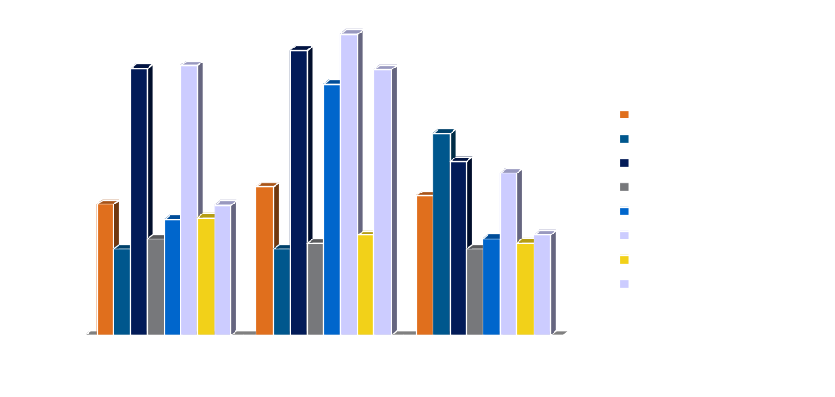
Rendering Geometry (cont.)
Not all ways are created equal

Slide 80
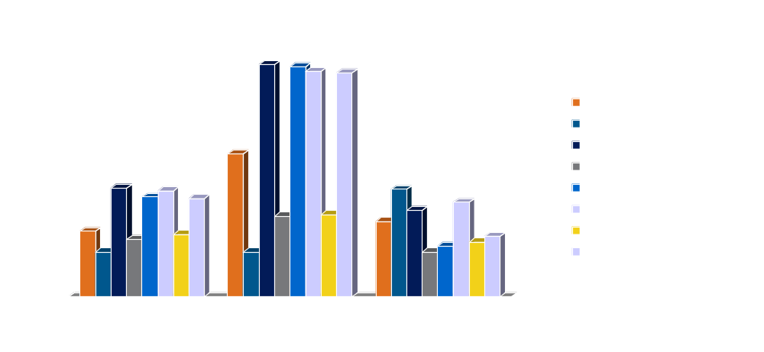
Rendering Geometry (cont.)
Add lighting and color material to the mix

Slide 81
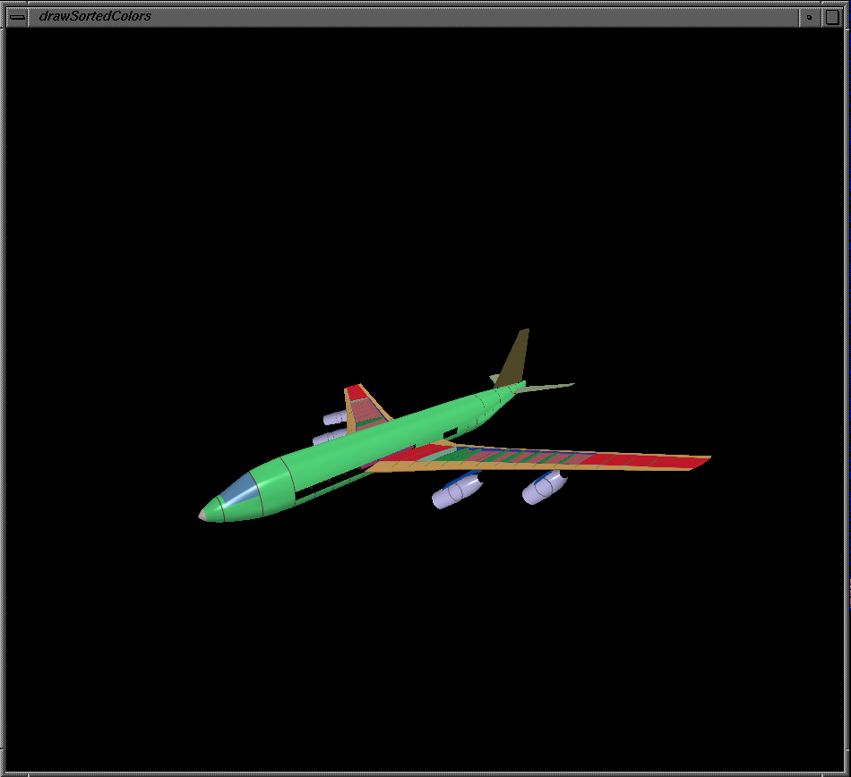
Case Study: Application Description
  1.02M Triangles
  507K Vertices
  Vertex Arrays
    Colors
    Normals
    Coordinates
  Color Material

Slide 82
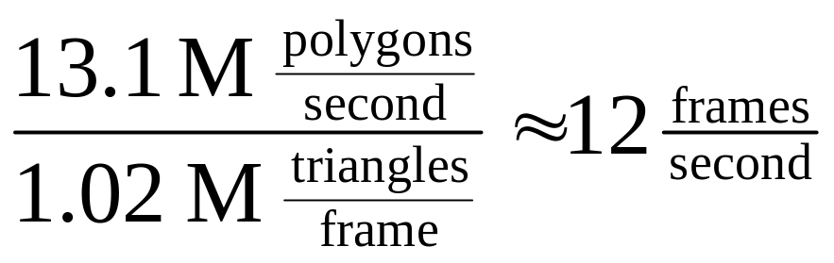
Case Study: What’s the Problem?
Low frame rate
  On a machine capable of 13M polygons/second application was getting less than 1 frame/second
  Application wasn’t fill limited

Slide 83
Case Study: The Rendering Loop
  Vertex Arrays
  glDrawElements() – index based rendering
  Color Material
    glColorMaterial( GL_FRONT,
    GL_AMBIENT_AND_DIFFUSE );
glVertexPointer( GL_VERTEX_POINTER );
glNormalPointer( GL_NORMAL_POINTER );
glColorPointer( GL_COLOR_POINTER );

Slide 84
Case Study: What To Notice
  Color Material changes two lighting material components per glColor*() call
  Not that many colors used in the model
    18 unique colors, to be exact
    (3 * 1020472 – 18) = 3061398 redundant color calls per frame

Slide 85
Case Study: Conclusions
A little state sorting goes a long way
  Sort triangles based on color
  Rewriting the rendering loop slightly
  Frame rate increased to six frames/second
    500% performance increase
for ( i = 0; i < numColors; ++i ) {
glColor3fv( color[i] );
glDrawElements( …, trisForColor[i] );
}

Slide 86
Summary
Know the answer before you start
  Understand rendering requirements of your applications
    Have a performance goal
  Utilize applicable benchmarks
    Estimate what the hardware’s capable of
  Organize rendering to minimize OpenGL validations and other work

Slide 87
Summary (cont.)
Pre-process data
  Convert images and textures into formats which don’t require pixel conversions
  Pre-size textures
    Simultaneously fit into texture memory
    Mipmaps
  Determine what’s the best format for sending data to the pipe

Slide 88
Questions & Answers
Thanks for coming
  Updates to notes and slides will be available at
  http://www.plunk.org/Performance.OpenGL
  Feel free to email if you have questions
Dave Shreiner
shreiner@sgi.com
Brad Grantham
grantham@sgi.com

Slide 89
References
  OpenGL Programming Guide, 3rd Edition
  Woo, Mason et. al., Addison Wesley
  OpenGL Reference Manual, 3rd Edition
  OpenGL Architecture Review Board, Addison Wesley
  OpenGL Specification, Version 1.4
  OpenGL Architecture Review Board

Slide 90
For More Information
  SIGGRAPH 2002 Course # 3 - Developing Efficient Graphics Software
  SIGGRAPH 2000 Course # 32 - Advanced Graphics Programming Techniques Using OpenGL

Slide 91
Acknowledgements
A Big Thank You to …
  Peter Shaheen for a number of the benchmark programs
  David Shirley for Case Study application

