Slide 1




EPL Predictor
Sungbae Lee, Steve Woo, Gideon Victor, Johnseth Chong

Slide 2


















Agenda
Our Project Mission
Tools for Analysis
Our Code
Our Project

Slide 3
Project Mission
“I want people to understand, gambling is not a bad thing if you do it within the framework of what it’s meant to be, which is fun and entertaining.”
– Michael Jordan
Casino Gambling
The house is always favored
Ability to solve for the probability of any given outcome mathematically
Sports Betting
Probability of winning or losing a sporting event is less certain
Numerous factors influence the outcome
A sportsbook’s goal when they set the odds of a contest is to entice bettors to place an equal amount of wagers on each side
Player vs Player rather than Player vs House
Gather English Premier League (EPL) scoring data for each team and create a model to accurately predict the outcome of each game

Slide 4
Tools For Analysis
EPL’s Data for 2019-2020 Season
http://football-data.co.uk/englandm.php
API-Football
https://rapidapi.com/api-sports/api/api-football
Obtaining upcoming schedule
Flask
Web framework to build web application
AWS
Deploy our Flask App
HTML/CSS
Create website and stylize it
JavaScript
Create page animations
statsmodels
To utilize Poisson Regression Model

Slide 5
Our Code

Slide 6
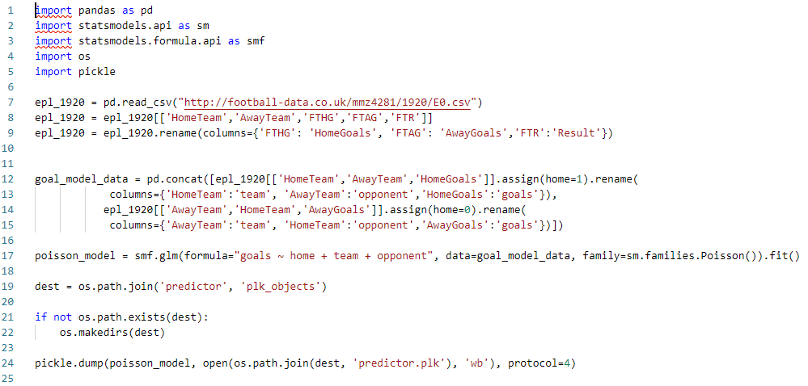
Poisson Distribution Model

Slide 7
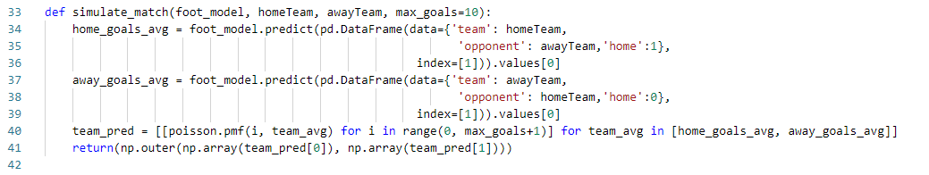
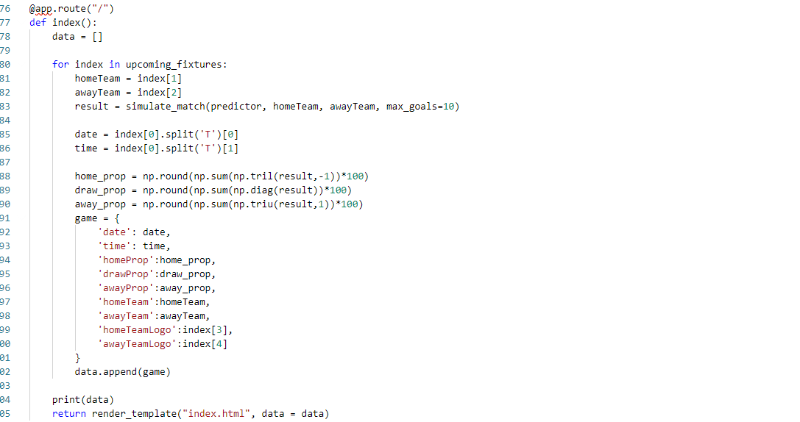
Application

Slide 8
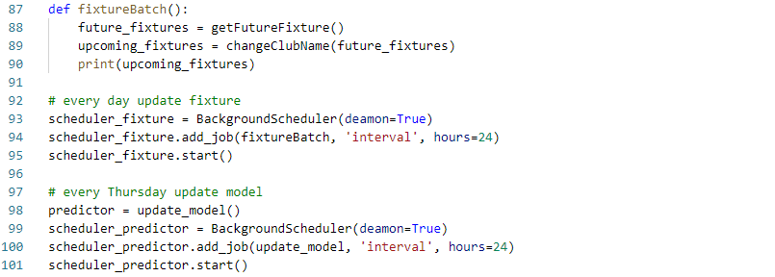
Application

Slide 9

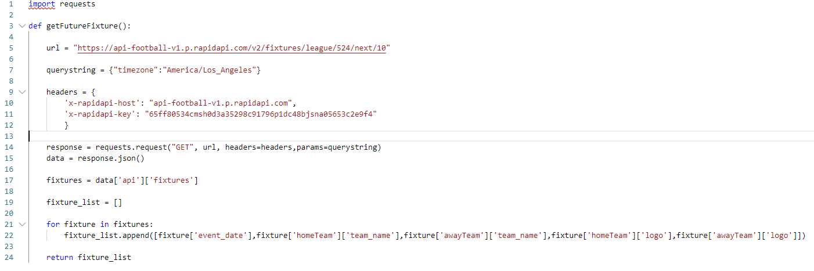
API Request

Slide 10
Our Project

Slide 11
Thank you!

