Slide 1
Analysis of Mushroom Edibility through Machine Learning
By: Brendan, Susan, Mohammad, Magbdy

Slide 2
Introduction
Our project: we are predicting if a mushroom with varying attributes can be determined to be edible or poisonous through machine learning.
The data set was taken from OpenML.org and has over 8000 mushroom samples.
There were over 22 different attributes (cap size, color, etc.) and two classes (poisonous or edible).
For our analysis we used the following machine learning algorithms:
K-Nearest Neighbors
Support Vector Machines
Decision Trees
Logistic Regression
We then compared our results to see which algorithm was best for predicting the mushroom type.

Slide 3
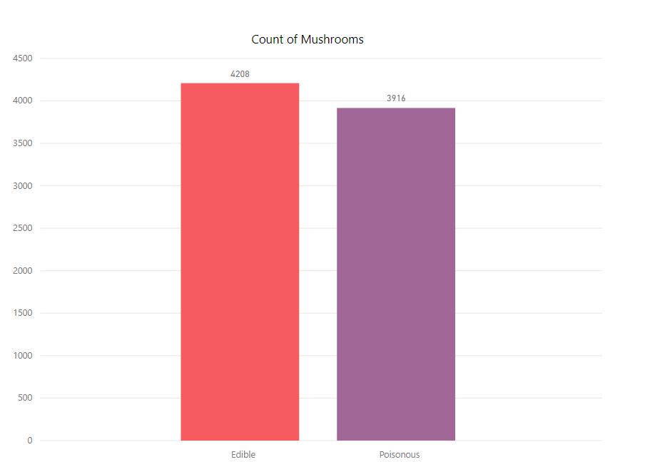
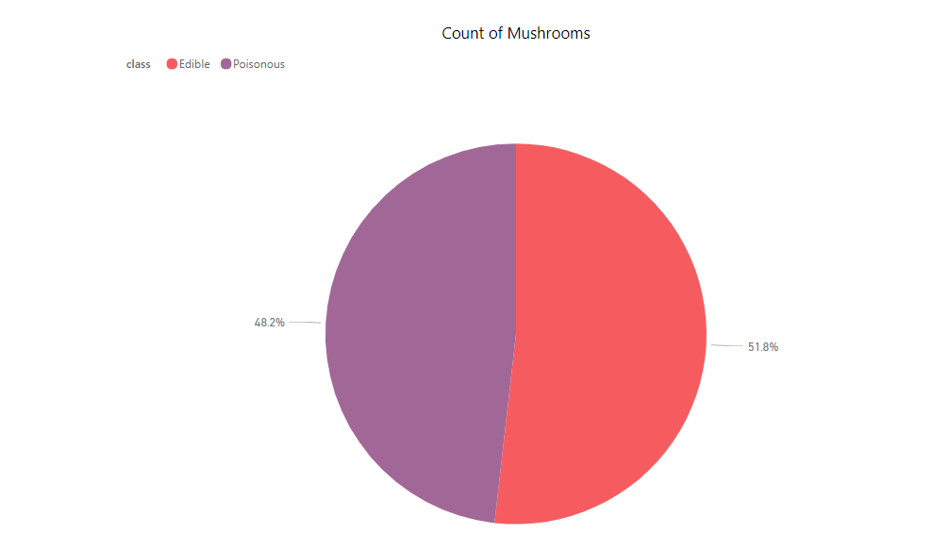
Characteristics

Slide 4
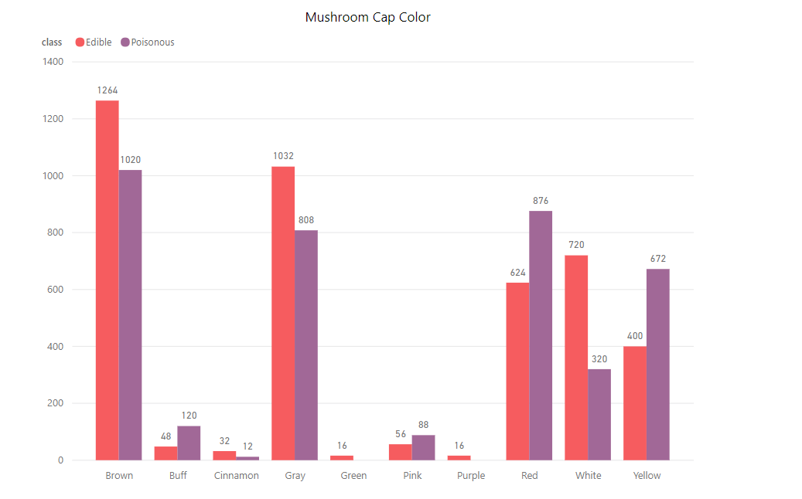
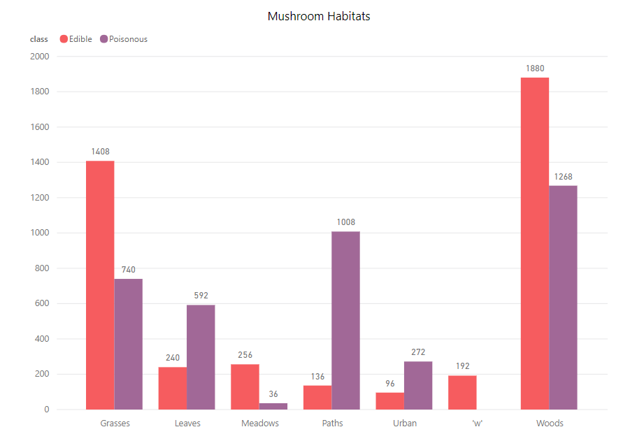
Characteristics

Slide 5
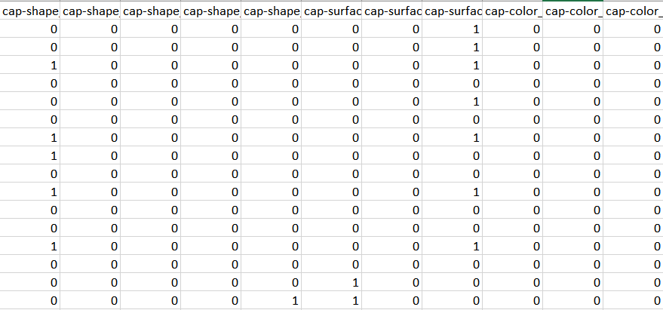
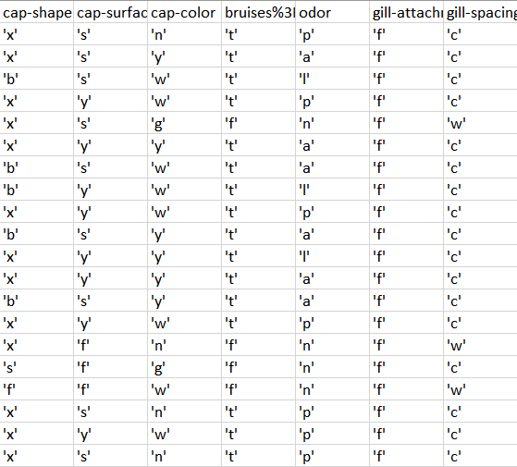
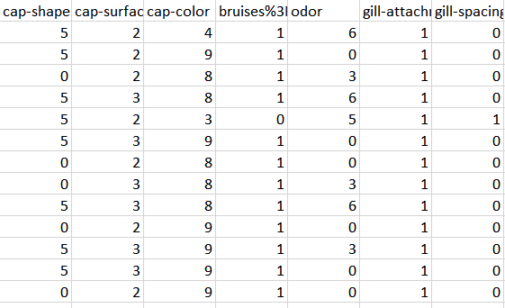
Data Encoding- One Hot Encoding vs. Label Encoder
One Hot Encoding
Original Dataset
Label Encoder

Slide 6
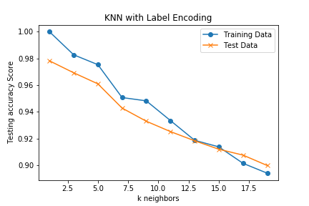
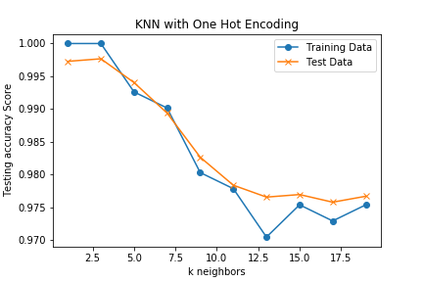
Knn Results
Notes:
First problem we all ran into was the fact that our data was string values to represent the mushroom qualities. I decided to try both the one hot encoding and label encoding methods to see if either would have a better result when using the KNN algorithm.

Slide 7
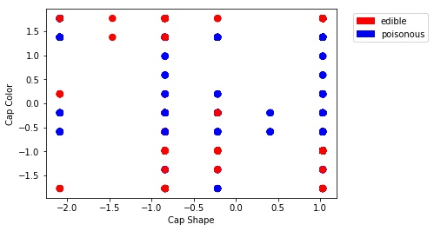
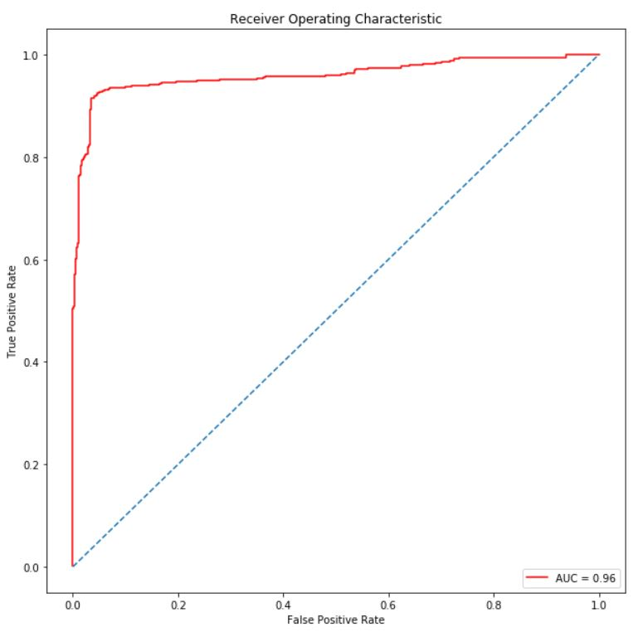
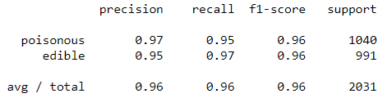
SVM Results
Notes:
Support Vector Machine is a supervised learning where SVM algorithm is based on finding the hyperplane that gives the largest minimum distance to the training examples.
To test SVM, I used label encoder to convert the string attributes to numbers. Label encoder worked better than one hot encoding because it gave an accuracy of 1.0. I also used the Standard Scaler function from sklearn so that a higher number did not have a greater or "better" value than the other. The Standard Scaler standardizes features by removing the mean and scaling to unit variance.
The scatter plot with Cap Color vs. Cap Shape is just two out of the 21 attributes graphed against each other.
Linear Discriminant Classifier graph did not work to show the SVM results because we cannot graph something with 21 attributes. If we wanted to, we would have to do Principal Component Analysis. But for the purpose of this project, it was not necessary. However, if we were to expand more on this project, PCA is something we would look into.
The test accuracy is 0.963 using SVM. SVM is a good fit for this dataset.
The Receiver Operating Characteristics (ROC) graph shows the accuracy of the SVM test by plotting y test as the false positive rate and y predicted as the true positive rate.
(The closer the curve follows the left-hand border and then the top border of the ROC space, the more accurate the test.)

Slide 8
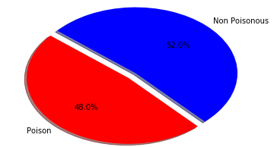
Logistic Regression Test Results

Slide 9
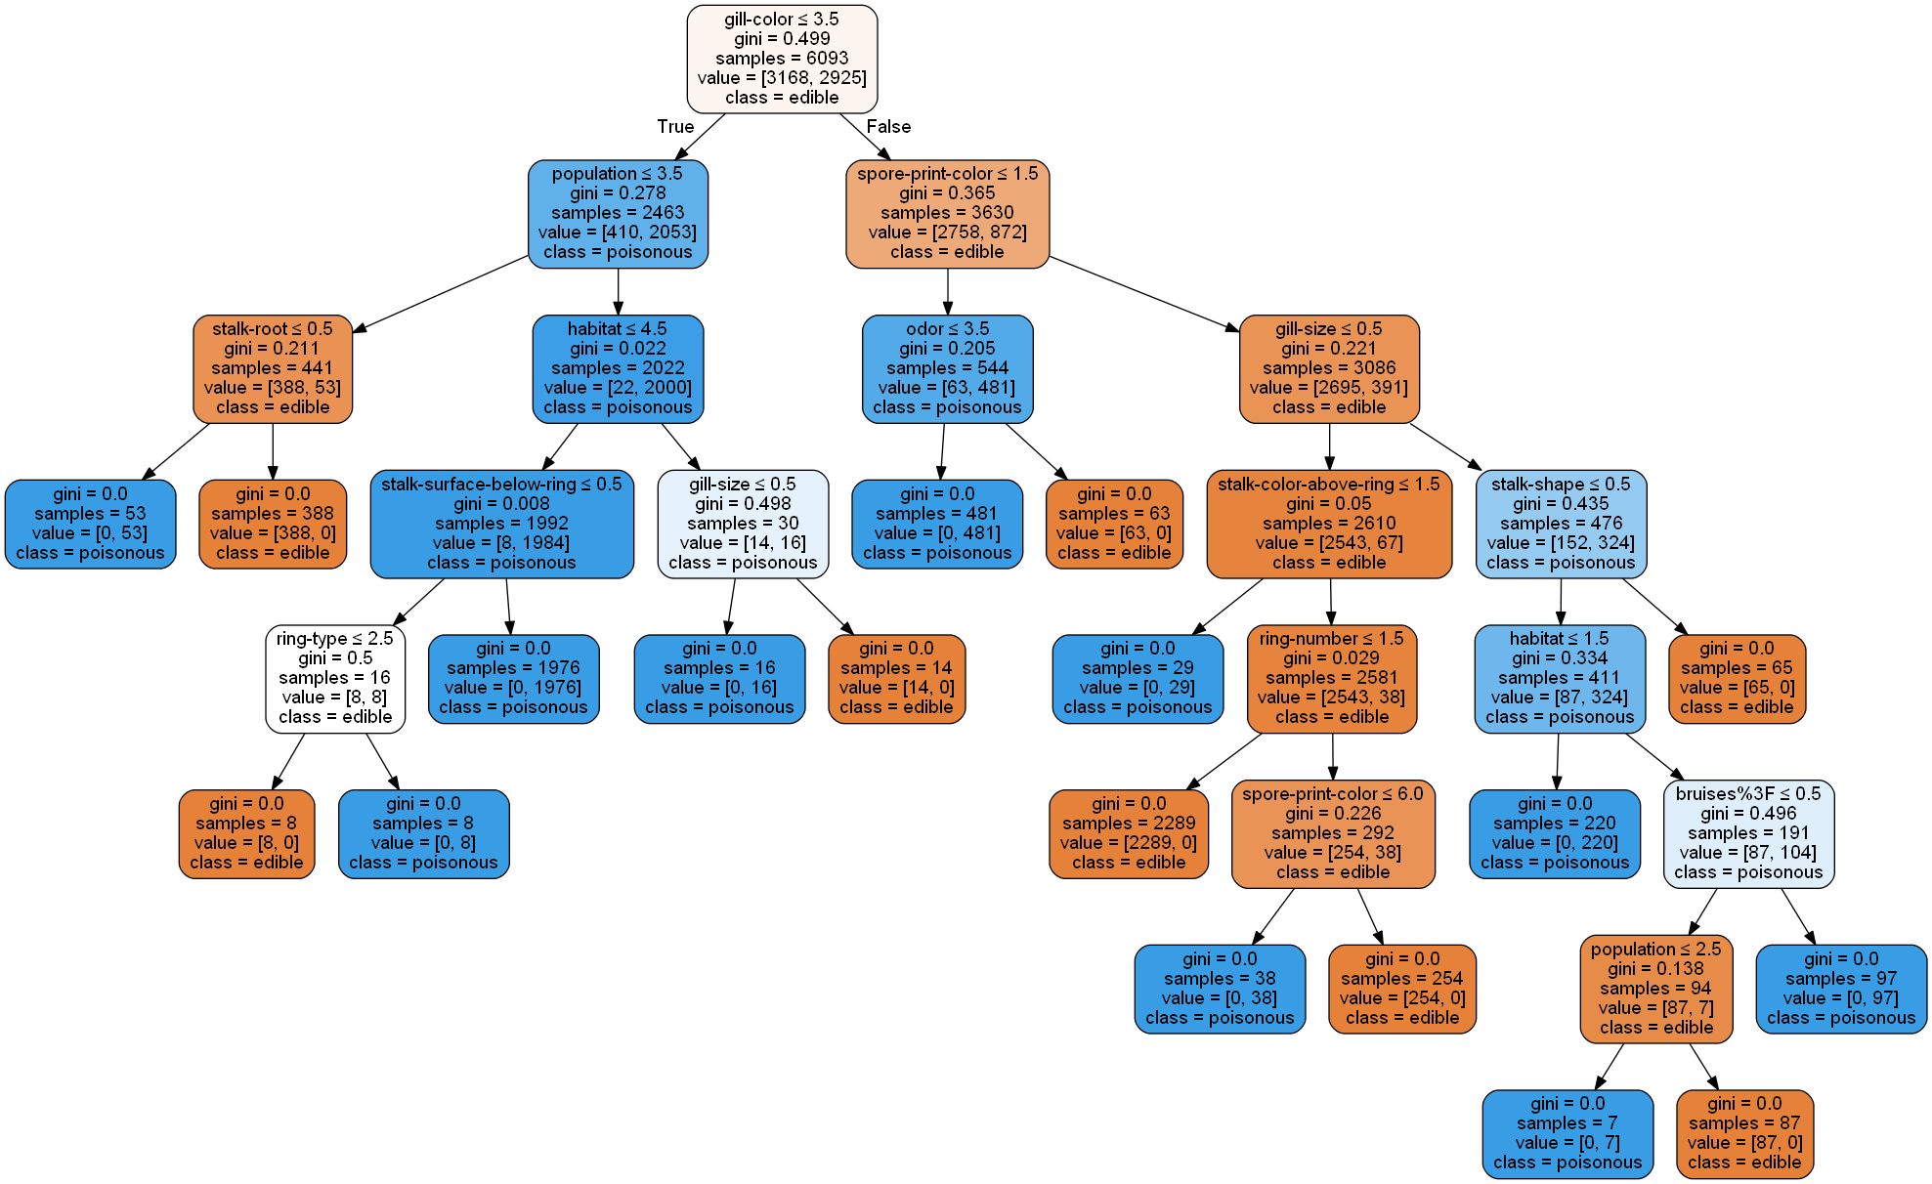
Decision Tree Results - Label Encoding

Slide 10
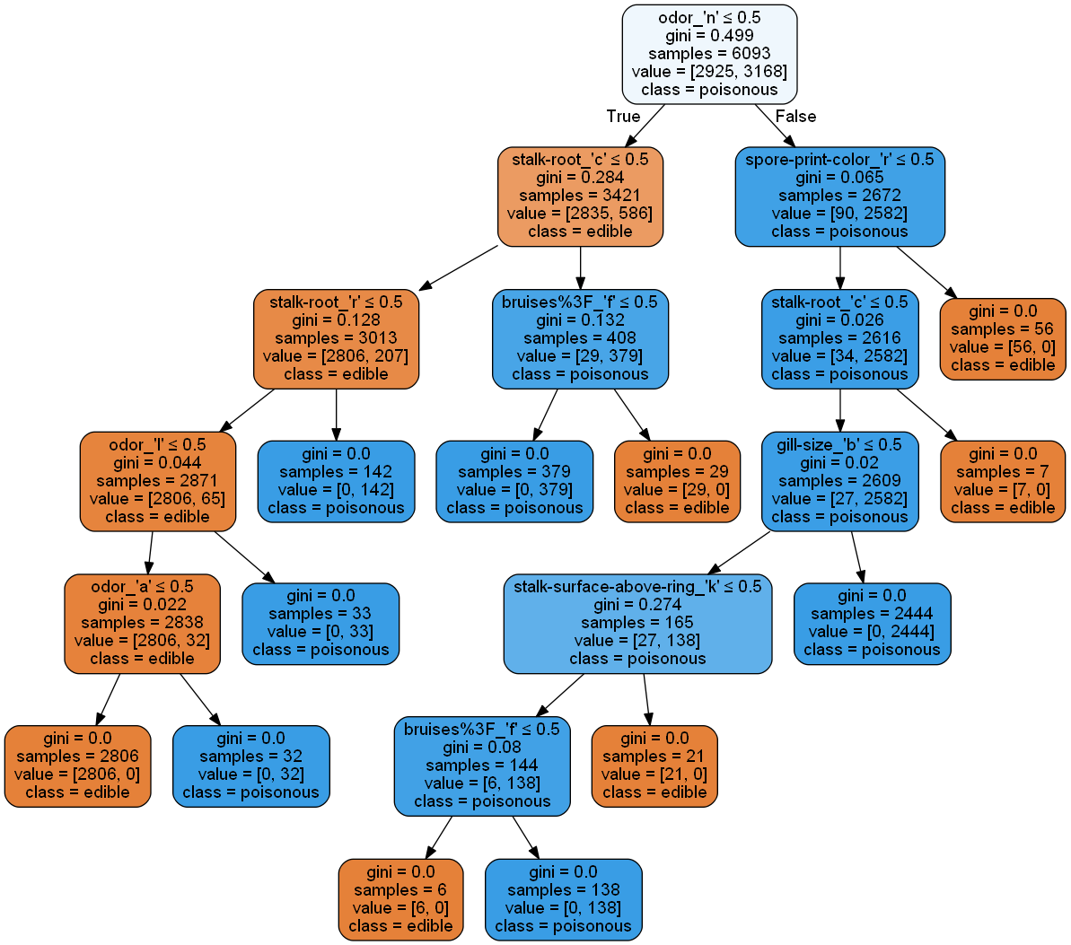
Decision Tree Results - One Hot Encoding

Slide 11
Conclusion
We hypothesized that we were going to find one machine learning algorithm would perform better than the rest; however, all our algorithms returned very high accuracies. This may be due to:
Nature of dataset: categorical instead of numeric.
Label and hot encoding - produced very simple values to test with.
Ideally, we would have mushroom names and their characteristics
If we were to revisit this project, we would prefer a dataset that assigns weights to specific mushroom characteristics based on how often they appear within each of the two categories (edible and poisonous). This would allow us to assign a level of certainty using values tied to the likelihood of falling within either category.

Slide 12
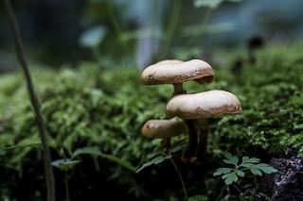
Next Steps
We would take this analysis further by running tests on each of the machine learning algorithms using real Mushrooms in the hopes of measuring the effectiveness of each method.
Apply these machine learning tests to other similar datasets to see if results are similar

