Slide 1
fastText

Slide 2
Class Lab - Schedule & Assignment
We extend the due date of the third word2vec assignment by a week (~11/20)
Enriching Word Vectors with Subword Information (~11/27)
Bag of Tricks for Efficient Text Classification (~12/4)

Slide 3
Word2Vec
We release an answer source code of the second assignment

Slide 4
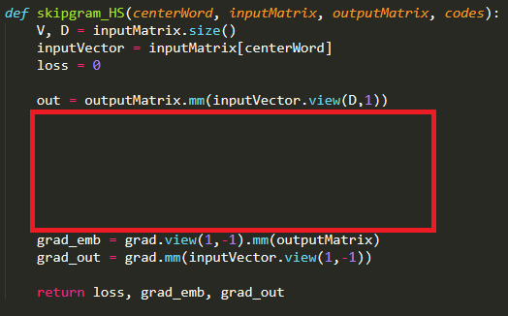
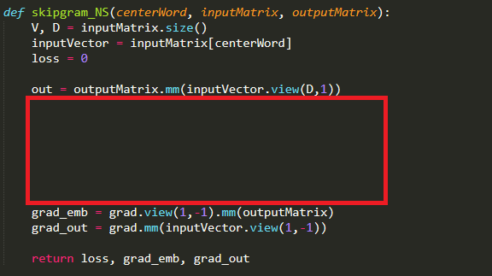
Word2Vec
Hint for the third assignment

Slide 5


Word2Vec
Heavy overhead
The reason is…
Output dimension : V
Feature dimension : D
Complexity : O(V x D)
$$W_{emb}$$
$$W_{out}$$

Slide 6
Word2Vec
Heavy overhead
The reason is…
Output dimension : V
Feature dimension : D
Complexity : O(V x D)
$$W_{emb}$$
$$W_{out}$$
The idea is…
Use a portion of the output vector

Slide 7







Word2Vec
Hierarchical Softmax
The probability of a word is the product of nodes on the way
0
0
1
$$σ(y_{0})$$
$$1−σ(y_{0})$$
2
1
2
$p\left(cherry\right)= σ(y_{0})$ $(1−σ\left(y_{1}\right))$ $σ(y_{4})$
3
$$σ(y_{1})$$
$$1−σ(y_{1})$$
4
5
3
4
5
6
6
$$σ(y_{4})$$
cherry

Slide 8





Word2Vec
Hierarchical Softmax
Apple
Banana
Cherry
…
Watermelon
0
0
0
1
1
$$σ(y_{0})$$
$$1−σ(y_{0})$$
2
2
1
2
3
3
$$σ(y_{1})$$
$$1−σ(y_{1})$$
4
4
5
5
3
4
5
6
6
6
$$σ(y_{4})$$
cherry
Naïve Softmax
Vocabulary
Hierarchical Softmax
Hierarchical Tree

Slide 9

Word2Vec
Hierarchical Softmax
Weights connected to the activated nodes are updated
$p\left(cherry\right)= σ(y_{0})$ $(1−σ\left(y_{1}\right))$ $σ\left(y_{4}\right)$
$L=−log p\left(cherry\right)$
$=−log σ\left(y_{0}\right)−log \left(1−σ\left(y_{1}\right)\right)−log σ\left(y_{4}\right)$
$\frac{∂L}{∂y_{0}}=σ\left(y_{0}\right)−1$
$\frac{∂L}{∂y_{1}}=σ\left(y_{1}\right)$
$\frac{∂L}{∂y_{4}}=σ\left(y_{4}\right)−1$
0
1
2
3
4
5
6

Slide 10



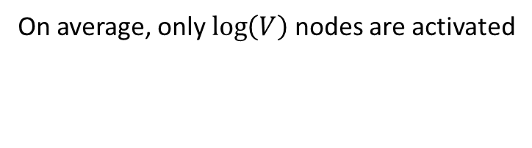



Word2Vec
Hierarchical Softmax
0
0
On average, only $\log\left(V\right)$ nodes are activated
1
$$σ(y_{0})$$
$$1−σ(y_{0})$$
With 840B dataset
Output dimension : 2.2M
Feature dimension : 300
Average activated nodes : 21
6.3k operation to calculate
$y={softmax(W_{out}}^{T}W_{emb}[k])$
Basic softmax : 660M
2
1
2
3
$$σ(y_{1})$$
$$1−σ(y_{1})$$
4
5
3
4
5
6
6
$$1−σ(y_{3})$$
banana

Slide 11
Word2Vec
Negative Sampling
0
1
2
1 of positive sample
V-1 of negative samples
Approximate the softmax function
only using k negative samples
3
4
5
6

Slide 12

Word2Vec
Negative Sampling
How many samples
5~15 samples recommended
3~5 samples enough on big corpus
0
1
2
Sigmoid output
k negative samples
3
$$σ\left(x\right)=\frac{1}{1+e^{−x}}=\frac{e^{x}}{e^{x}+1}$$
1
2
4
How to sample
Frequency^(3/4)
4
5
6

Slide 13

Word2Vec
Negative Sampling
Design loss function to maximize the positive and to minimize the negatives
L = -log( ) - log((1- )(1- )(1- ))
5
1
2
4
1 positive sample
Then the gradient descent algorithm optimizes the network
5
0
1
$L$ $=−log σ\left(y_{5}\right)−log \left(1−σ\left(y_{1}\right)\right)−log \left(1−σ\left(y_{2}\right)\right)−log \left(1−σ\left(y_{4}\right)\right)$
$\frac{∂L}{∂y_{5}}=σ\left(y_{5}\right)−1$
$\frac{∂L}{∂y_{1}}=σ\left(y_{1}\right)$
$\frac{∂L}{∂y_{2}}=σ\left(y_{2}\right)$
$\frac{∂L}{∂y_{4}}=σ\left(y_{4}\right)$
k negative samples
2
3
1
2
4
4
5
6

Slide 14

Word2Vec
Negative Sampling
With 840B dataset
Output dimension : 2.2M
Feature dimension : 300
Average activated nodes : 1 + 5
1.8k operation to calculate
$y={softmax(W_{out}}^{T}W_{emb}[k])$
Basic softmax : 660M
Hierarchical softmax : 6.3k
0
1
2
Only k nodes are activated
3
4
5
6

Slide 15
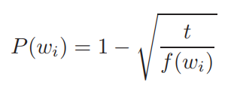
Word2Vec
Subsampling
The orange is the fruit of the citrus species Citrus × sinensis in the family Rutaceae. It is also called sweet orange, to distinguish it from the related Citrus × aurantium, referred to as bitter orange. The sweet orange reproduces asexually varieties of sweet orange arise through mutations.
Discard frequent words with probability

Slide 16
Beyond word embedding

Slide 17
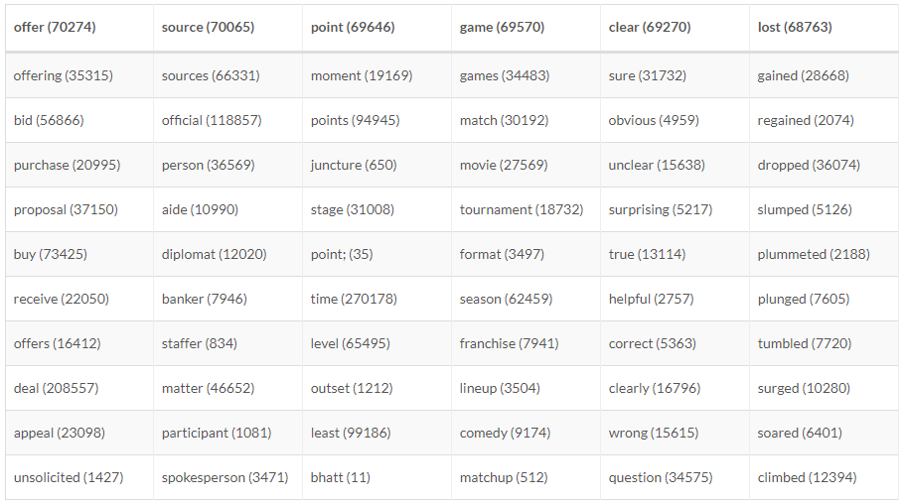
Word Embedding
Word embedding can do everything?
Works well with frequent words

Slide 18
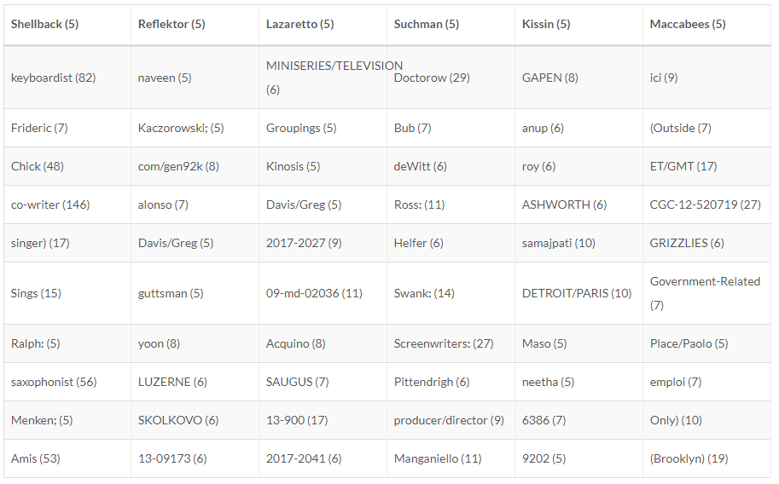
Word Embedding
Word embedding can do everything?
Works badly with rare words

Slide 19
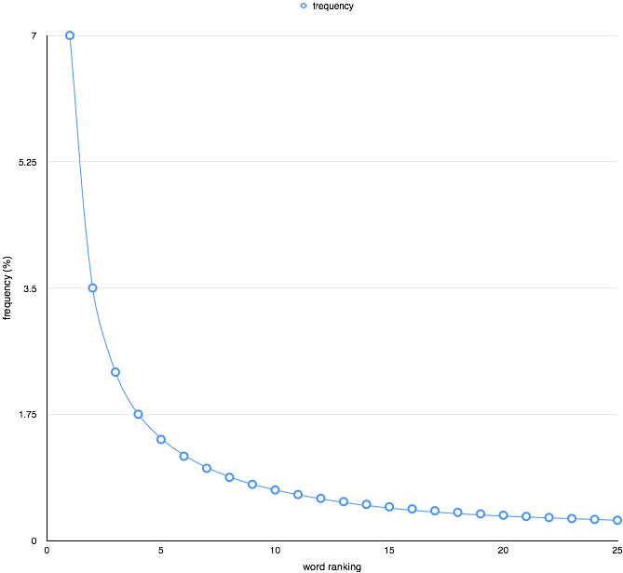
Word Embedding
Rare word problem
Zipf’s law

Slide 20
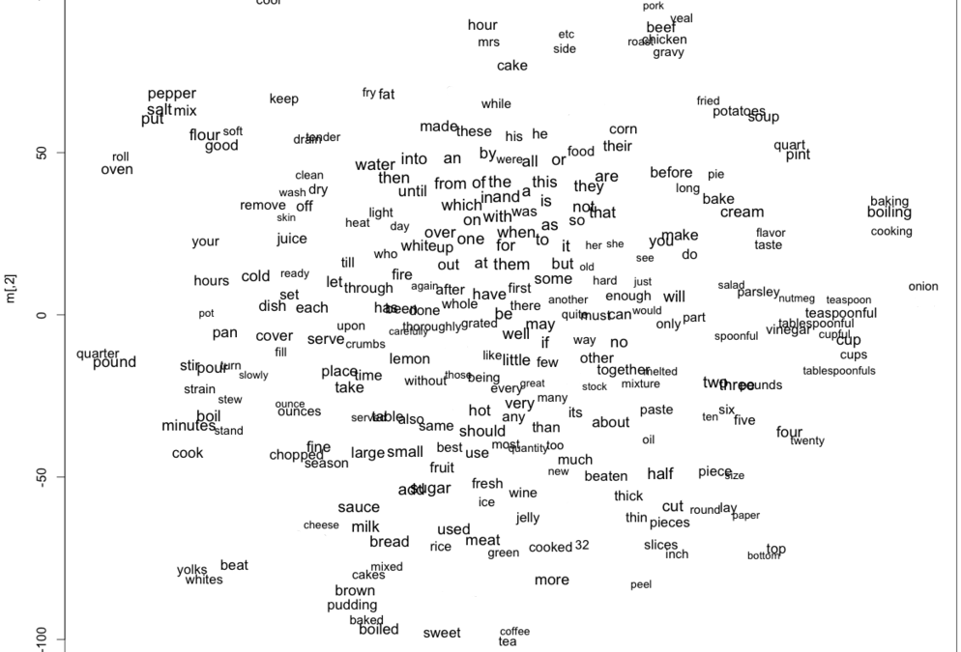
Word Embedding
Rare word problem
Frequent words are trained earlier

Slide 21
Word Embedding
Rare word problem
Other words are adapted to those

Slide 22
Word Embedding
Rare word problem
Rare words are hardly trained

Slide 23
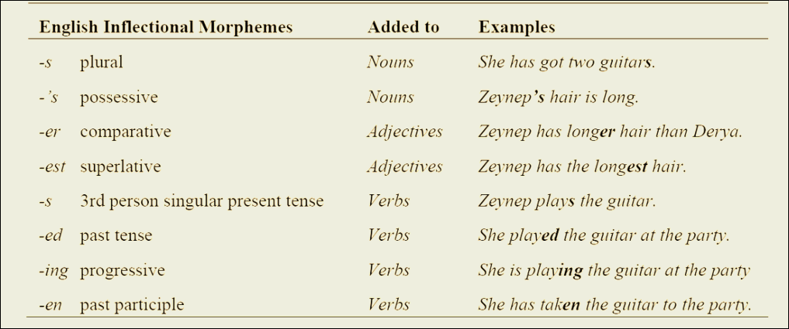
Word Embedding
Rare word problem
Inflected form

Slide 24
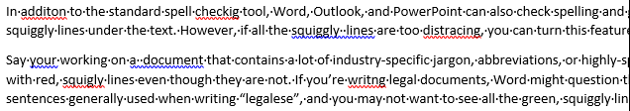
Word Embedding
Rare word problem
Typo

Slide 25
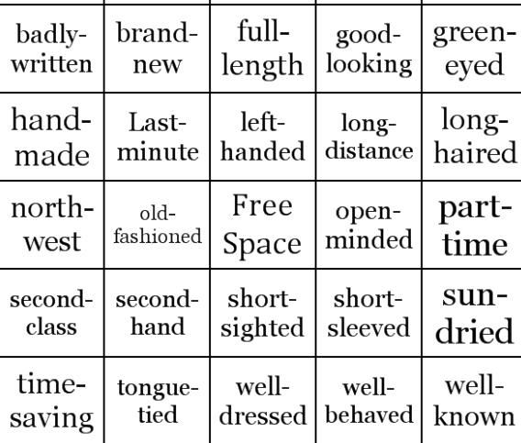
Word Embedding
Rare word problem
Compound word

Slide 26
Subword Embedding
Sharing the parameters
Word-level
Frequent word
Rare word
Subword-level
Shared parameters

Slide 27
Subword Embedding
Sharing the parameters
Word-level
Frequent word
Rare word
Training on frequent words help to represent rare words
Subword-level
Shared parameters

Slide 28
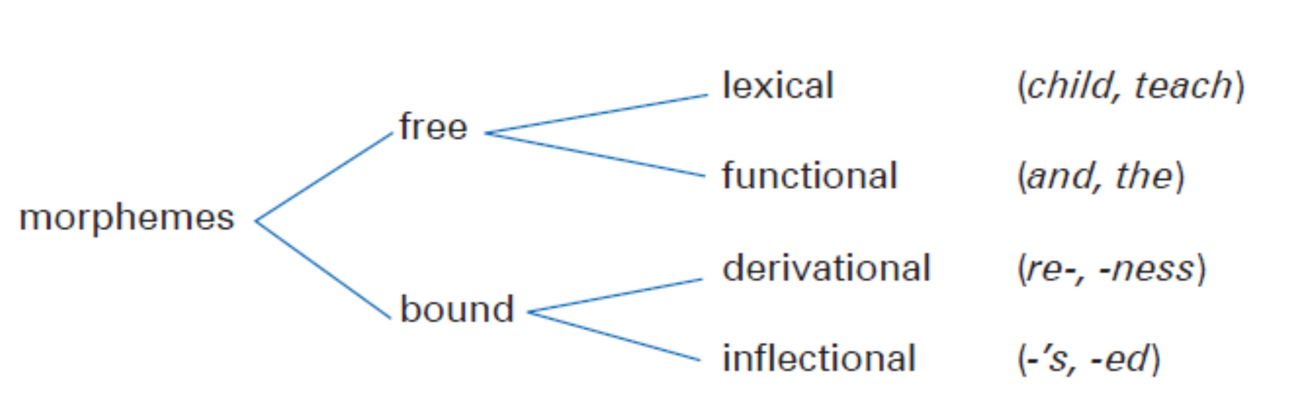
Subword Embedding
Morpheme
The smallest grammatical unit in a language

Slide 29
Subword Embedding
Morpheme
The smallest grammatical unit in a language
u n h e a l t h y
Affix
Base
Suffix

Slide 30
Subword Embedding
Morpheme
Inflected form
Typo
Compound word
p l a y / i n g
a d d / i / t o n
w e l l / - / k n o w / n

Slide 31
Subword Embedding
Morpheme
Inflected form
Typo
Compound word
p l a y / i n g
How to catch
a d d / i / t o n
w e l l / - / k n o w / n

Slide 32
Subword Embedding
Try all n-grams
< u n h e a l t h y >
A word with a start token and an end token

Slide 33
Subword Embedding
Try all n-gram tokens
< u n h e a l t h y >
3-grams
< u n , u n h , n h e , h e a , e a l , a l t , l t h , t h y , h y >
4-grams
< u n h , u n h e , n h e a , h e a l , e a l t , a l t h , l t h y , t h y >
5-grams
< u n h e , u n h e a , n h e a l , h e a l t , e a l t h , a l t h y , l t h y >
6-grams
< u n h e a , u n h e a l , n h e a l t , h e a l t h , e a l t h y , a l t h y >
special
< u n h e a l t h y >

Slide 34
Subword Embedding
Try all n-grams token
Word
N-gram features are trained to represent a word
Character n-grams

Slide 35
Subword Embedding
Architecture
SUM
Input Word
Skip-gram
Word
…
N-grams embedding
Word embedding
Output

Slide 36
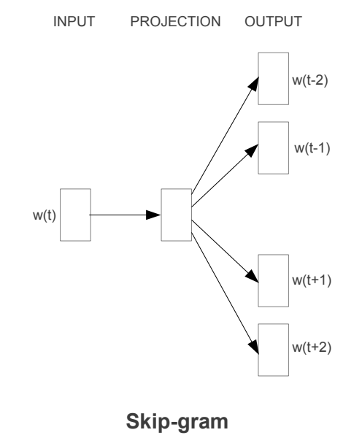
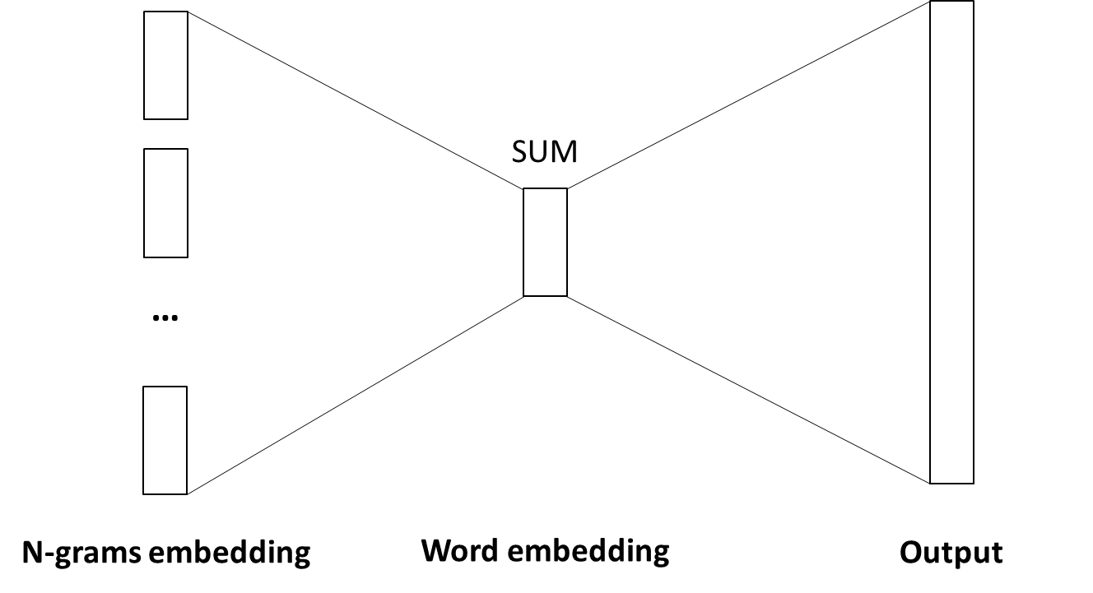
Subword Embedding
Training of the subword model (vs skip-gram)
More computation needed

Slide 37
Subword Embedding
Training of the subword model (vs skip-gram)
3-gram
5-gram
6-gram
Word
Word
4-gram
More memory needed

Slide 38

Subword Embedding
Training of the subword model
How many samples
5~15 samples recommended
3~5 samples enough on big corpus
0
1
Sigmoid output
k negative samples
2
3
1
2
4
4
How to sample
Frequency^(3/4)
L = -log( ) - log((1- )(1- )(1- ))
5
1
2
4
5
6
Negative Sampling

Slide 39
Subword Embedding
Training of the subword model
How many samples
5~15 samples recommended
3~5 samples enough on big corpus
0
1
Sigmoid output
k negative samples
2
3
1
2
4
4
How to sample
Frequency^(3/4)
L = -log( ) - log((1- )(1- )(1- ))
5
1
2
4
5
6
It doesn’t reduce the computation of combining n-grams
Negative Sampling

Slide 40
Subword Embedding
Training of the subword model
How many samples
5~15 samples recommended
3~5 samples enough on big corpus
0
1
Sigmoid output
k negative samples
2
3
1
2
4
4
How to sample
Frequency^(3/4)
L = -log( ) - log((1- )(1- )(1- ))
5
1
2
4
5
6
Negative Sampling
Slower than skip-gram

Slide 41
Subword Embedding
Training of the subword model
Byte Sequence
“H”
“E”
“L”
“L”
“O”
FNV offset basis
XOR(Lower)
Multiply prime number
Hash
Hash(“H”)
Hashing(FNV-1a)

Slide 42
Subword Embedding
Training of the subword model
Byte Sequence
“H”
“E”
“L”
“L”
“O”
Hash(“H”)
XOR(Lower)
Multiply prime number
Hash
Hash(“HE”)
Hashing(FNV-1a)

Slide 43
Subword Embedding
Training of the subword model
Byte Sequence
“H”
“E”
“L”
“L”
“O”
Hash(“HE”)
XOR(Lower)
Multiply prime number
Hash
Hash(“HEL”)
Hashing(FNV-1a)

Slide 44
Subword Embedding
Training of the subword model
Byte Sequence
“H”
“E”
“L”
“L”
“O”
Hash(“HEL”)
XOR(Lower)
Multiply prime number
Hash
Hash(“HELL”)
Hashing(FNV-1a)

Slide 45
Subword Embedding
Training of the subword model
Byte Sequence
“H”
“E”
“L”
“L”
“O”
Hash(“HELL”)
XOR(Lower)
Multiply prime number
Hash
Hash(“HELLO”)
Hashing(FNV-1a)

Slide 46
Subword Embedding
Training of the subword model
Byte Sequence
“H”
“E”
“L”
“L”
“O”
Hash(“HELL”)
XOR(Lower)
K numbers of entries for n-grams
(2.10 x 10^6 in paper)
Multiply prime number
Hash
Hash(“HELLO”)
Hashing(FNV-1a)

Slide 47
Subword Embedding
Overall procedures
NS
Word dictionary
(special)
Center Word
Context Word
Hashing
function
(n-grams)

Slide 48
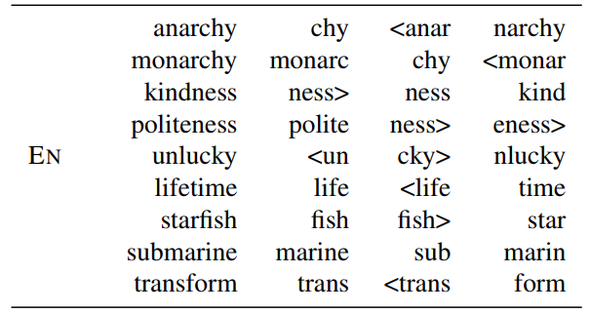
Subword Embedding
Results

Slide 49
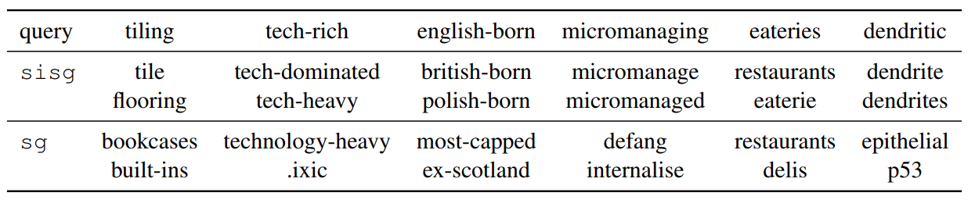
Subword Embedding
Results

Slide 50
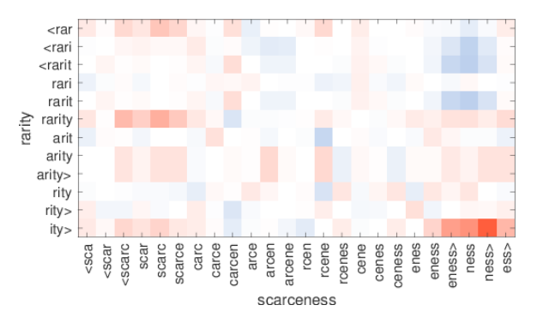
Subword Embedding
Results
Syntactic
Semmantic

Slide 51
What can we do “only with” embedding?

Slide 52
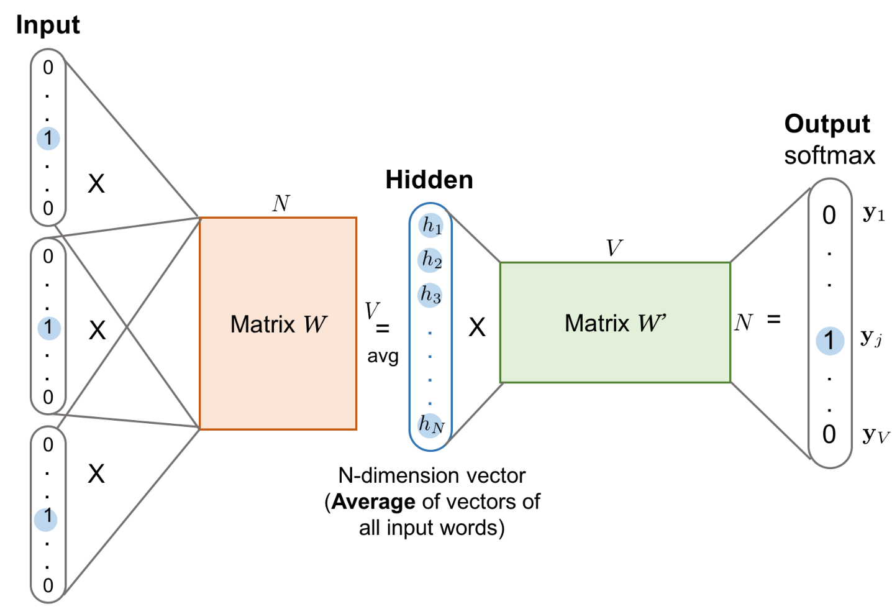
Text Classification
Linearity of word embedding
No activation

Slide 53
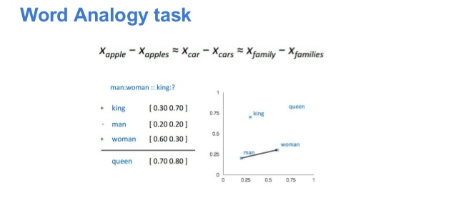
Text Classification
Linearity of word embedding
We can combine words just using addition

Slide 54
Text Classification
Text representation
Nice to meet you
Word
Word
Word
Word
If representation of each word has linearity?

Slide 55
Text Classification
Text representation
Nice to meet you
Average
Text representation

Slide 56
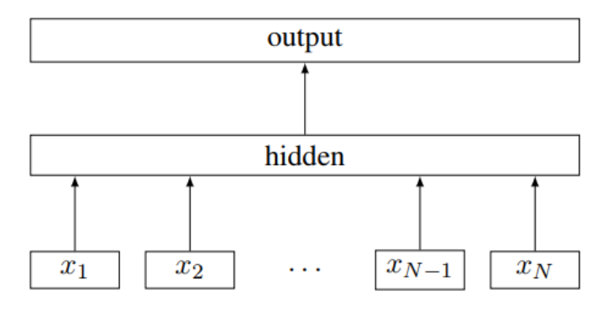
Text Classification
Text representation
Label
Text
Words

Slide 57
Text Classification
N-gram features
Mike raises a puppy
Word order information is important
A puppy raises Mike

Slide 58
Text Classification
N-gram features
Mike raises a puppy
A puppy raises Mike
Averaging cannot catch the order

Slide 59
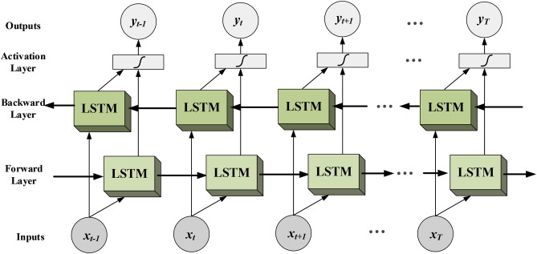
Text Classification
N-gram features
Mike raises a puppy
A puppy raises Mike
Computationally expensive

Slide 60
Text Classification
N-gram features
Mike raises a puppy
A puppy raises Mike
Averaging cannot catch the order

Slide 61
Text Classification
N-gram features
Bi-gram features
Mike-raises
raises-a
a-puppy
Mike raises a puppy
Using N-gram embeddings,
we can capture local word order
A puppy raises Mike

Slide 62
Text Classification
N-gram features
Bi-gram features
Mike-raises
raises-a
a-puppy
Mike raises a puppy
The model can distinguish
2 sentences using bi-gram
Bi-gram features
A-puppy
puppy-raises
raises-Mike
A puppy raises Mike

Slide 63
Text Classification
N-gram features
Uni-gram
V words
Bi-gram
VxV words
Tri-gram
VxVxV words
We need extensive memory to represent N-gram features

Slide 64
Text Classification
N-gram features
Hash function
Bi-gram
VxV words
K items
Use hashing trick

Slide 65
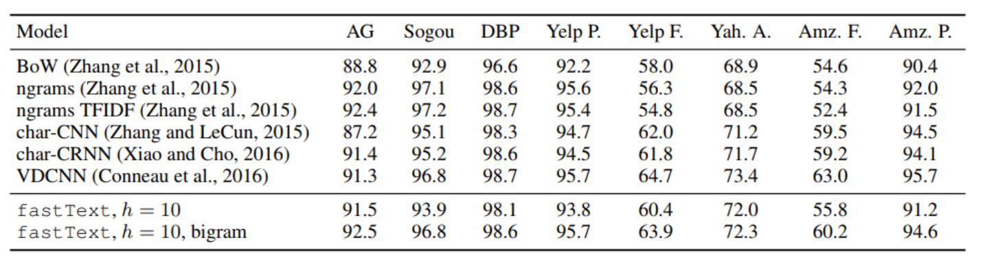
Text Classification
Linear models work well
Hidden layer dimension is only 10

Slide 66
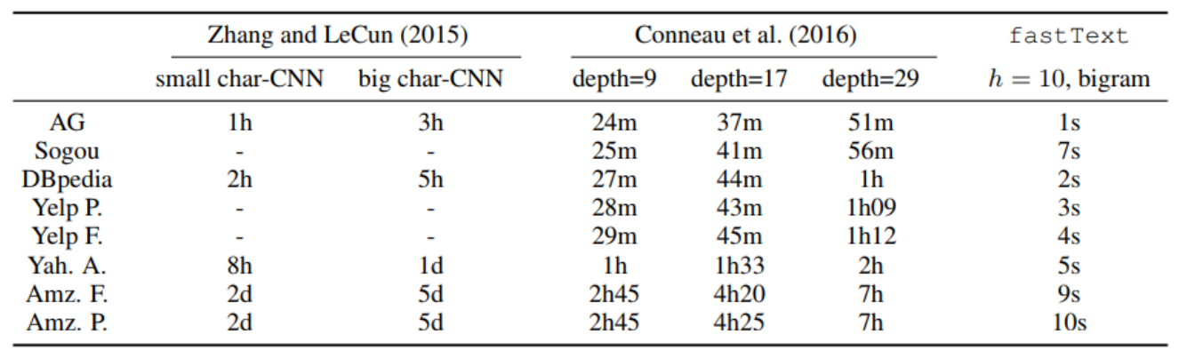
Text Classification
“Fast”Text

Slide 67
Assignment
fastText implementation
Subword embedding model
Text classification model
Both assignments use different n-grams!!!
Subword embedding model using character n-grams
Text classification model using word n-grams
Based on your word2vec code

Slide 68
Assignment
Strongly recommend reading the following papers
Piotr Bojanowski∗, Edouard Grave∗, Armand Joulin, Tomas Mikolov, “Enriching Word Vectors with Subword Information”, ACL 2017
https://arxiv.org/pdf/1607.04606.pdf
Armand Joulin, Edouard Grave, Piotr Bojanowski, Tomas Mikolov, “Bag of Tricks for Efficient Text Classification”, ACL 2017
https://arxiv.org/pdf/1607.01759.pdf

Slide 69

Assignment
Subword Model Experiment
Find 5 most similar words :
Ignore missing tokens
narrow-mindedness
department
campfires
knowing
urbanize
imperfection
principality
abnormal
secondary
ungraceful
Word2vec assignments

Slide 70
Submission
Due Date : ~11/27(수) 23:59
Submission : Online submission on blackboard
Your code file + Screenshot of the result
You must implement the components yourself!
File name : StudentID_Name.zip

Slide 71
Assignment
Classification Model Experiment
AG News Classification
Classify news into 4 classes (World, Sports, Business, Sci/Tech)
train.csv for training, test.csv for validation
Example
Alphabet only, lowercase, title and description
Title
"3","Wall St. Bears ","Reuters - Short-sellers, Wall Street's dwindling\band of ultra-cynics, are seeing green again."
Label(1~4)
Description

Slide 72
Submission
Due Date : ~12/4(수) 23:59
Submission : Online submission on blackboard
Your code file + Test set classification result(.txt)
You must implement the components yourself!
File name : StudentID_Name.zip

Slide 73
Q&A
Data intelligence lab.
irish07@korea.ac.kr (박준형)
saga9017@korea.ac.kr (이욱진)

