Slide 1
Word2vec
박준형
데이터인텔리전스 연구실
irish07@korea.ac.kr

Slide 2
Class Lab - Schedule & Assignment
Neural Network Introduction (~10/14)
2. Skip-gram / CBOW (~10/30)
(Basic) Softmax
3. Hierarchical Softmax / Negative sampling (~11/13)
Subsampling

Slide 3
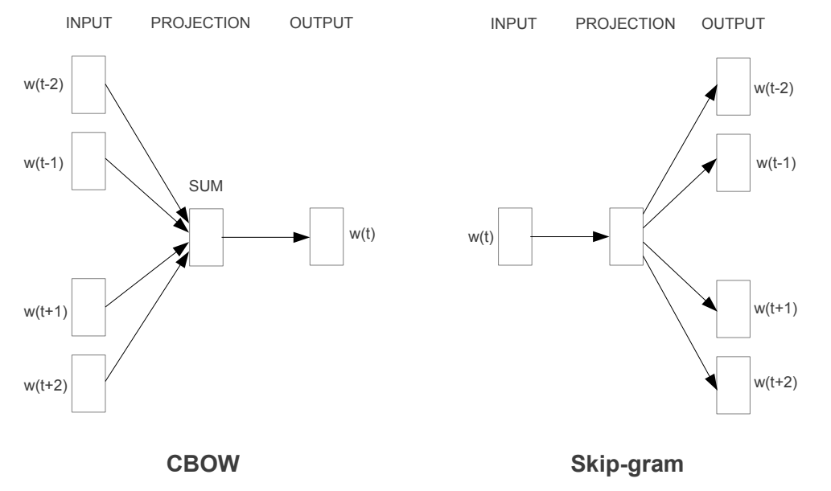
Class Lab - Schedule & Assignment
T. Mikolov, K. Chen, G. Corrado, J. Dean, “Efficient Estimation of Word Representations in Vector Space”, ICLR 2013

Slide 4
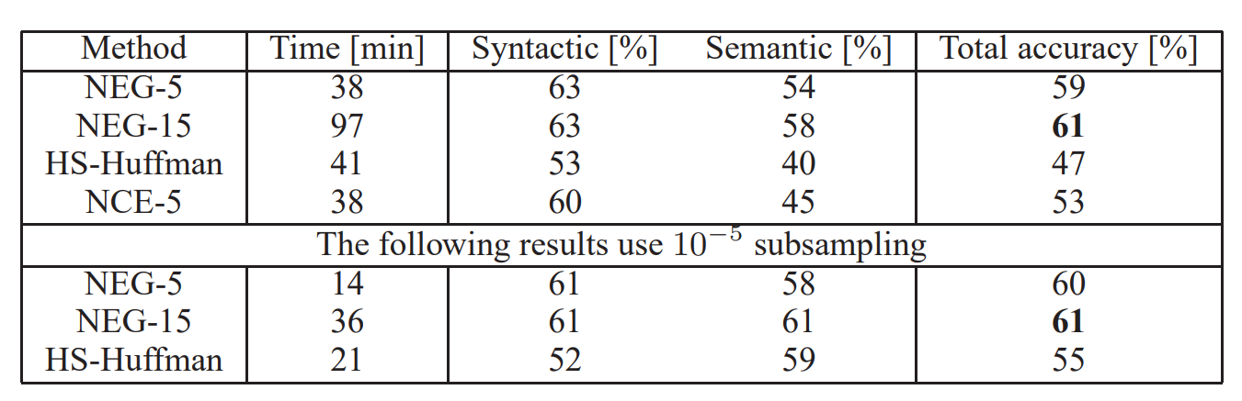
Class Lab - Schedule & Assignment
T. Mikolov, I. Sutskever, K. Chen, G. Corrado, J. Dean, “Distributed Representations of Words and Phrases and their Compositionality”, NIPS 2013

Slide 5
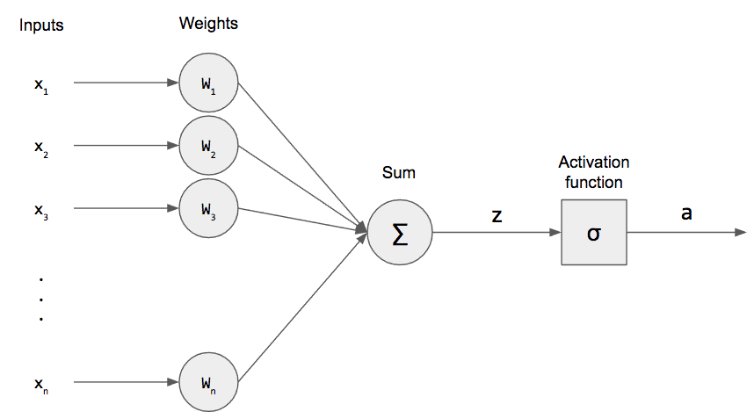
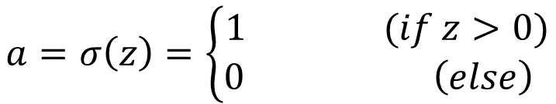

Perceptron
$$z=w_{1}x_{1}+w_{2}x_{2}+…+w_{n}x_{n}+b$$
$$z=WX+b$$
$$a=σ\left(z\right)=\left\{\begin{aligned}1 (if z>0) \\ 0 \left(else\right) \end{aligned}\right.$$

Slide 6
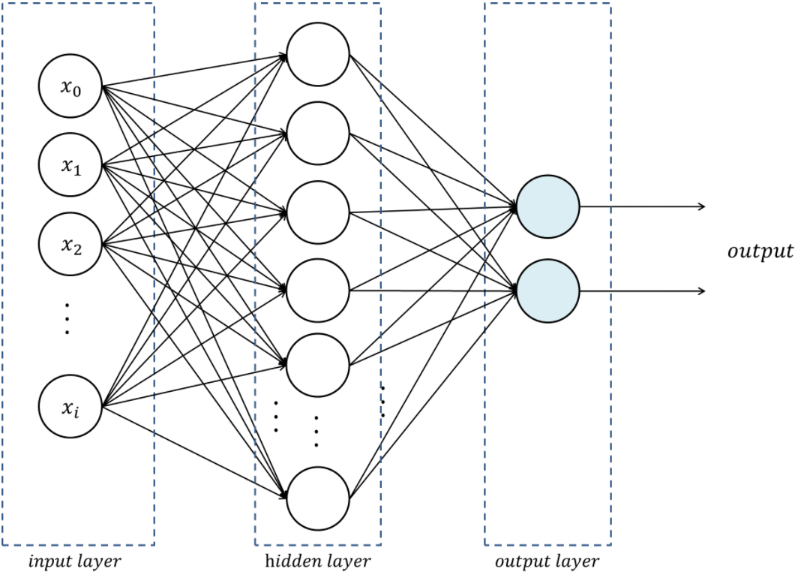

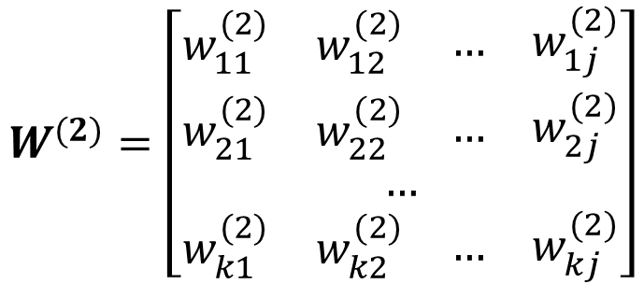
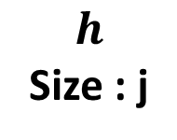
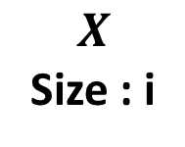
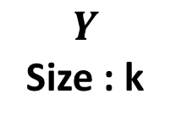

Multi-layer Perceptron
Stack of perceptron
$$h=σ\left(W^{(1)}X+b^{(1)}\right)$$
$$Y=σ\left(W^{(2)}h+b^{(2)}\right)$$
$$W^{(2)}=\left[\begin{aligned}\begin{matrix}\begin{matrix}w_{11}^{(2)} & w_{12}^{(2)}\end{matrix} & \begin{matrix}… & w_{1j}^{(2)}\end{matrix}\end{matrix} \\ \begin{matrix}\begin{matrix}w_{21}^{(2)} & w_{22}^{(2)}\end{matrix} & \begin{matrix}… & w_{2j}^{(2)}\end{matrix}\end{matrix} \\ … \\ \begin{matrix}\begin{matrix}w_{k1}^{(2)} & w_{k2}^{(2)}\end{matrix} & \begin{matrix}… & w_{kj}^{(2)}\end{matrix}\end{matrix}\end{aligned}\right]$$
$$X$$
Size : i
$$h$$
Size : j
$$Y$$
Size : k
( k x j ) matrix

Slide 7
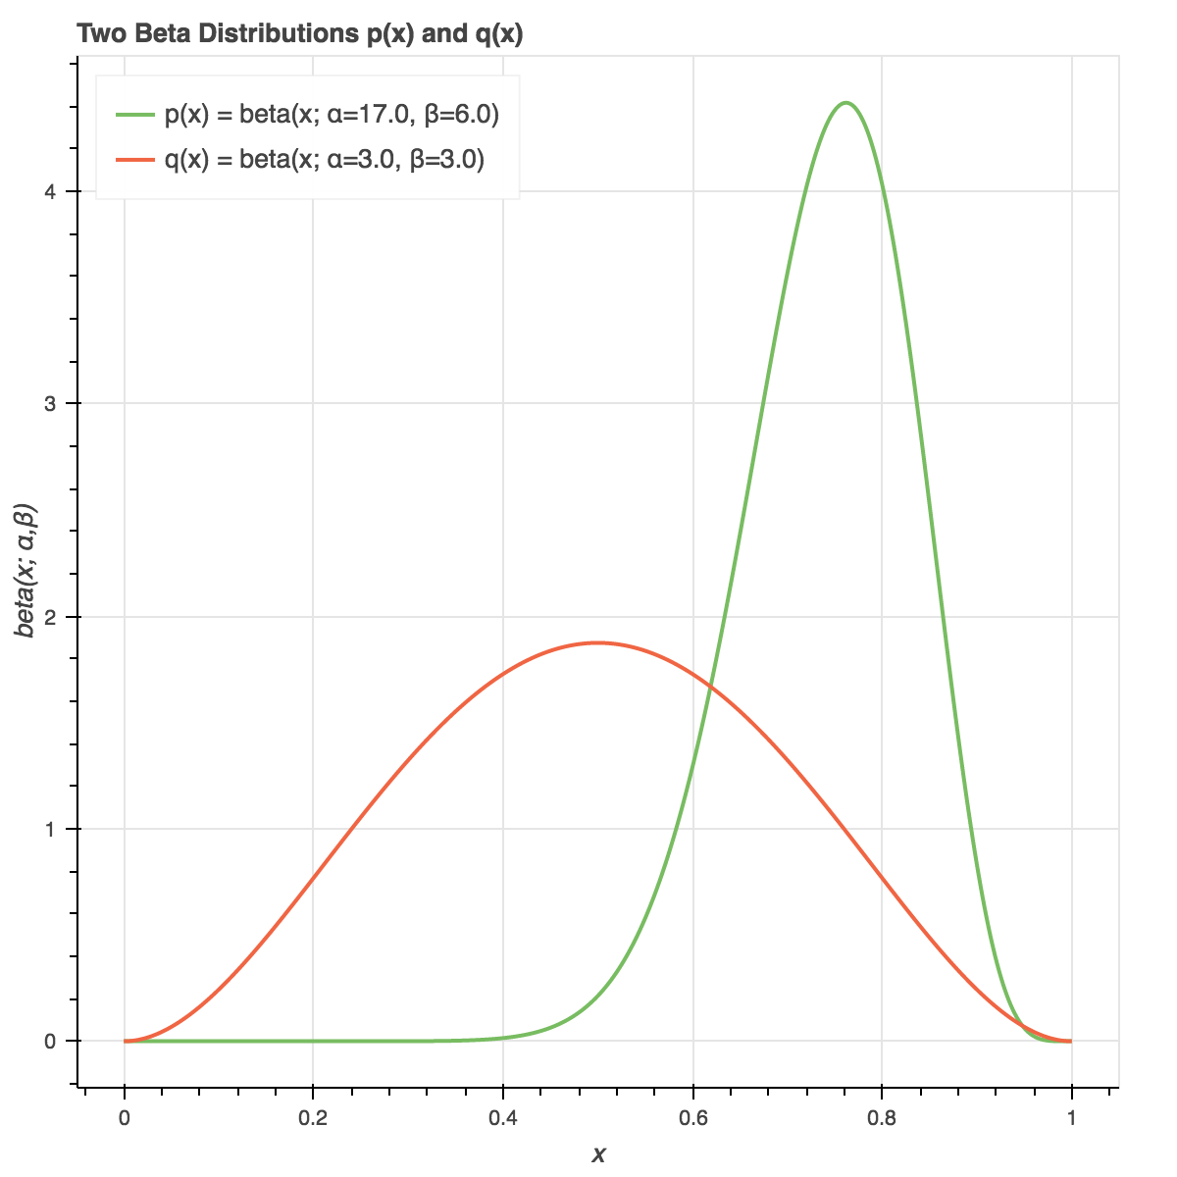
Backpropagation
Loss(=cost) : A real number that represents how wrong it is
Output: 3.4
Answer: 3.7
Loss : 4
Loss : 0.09
Loss : 1.7

Slide 8
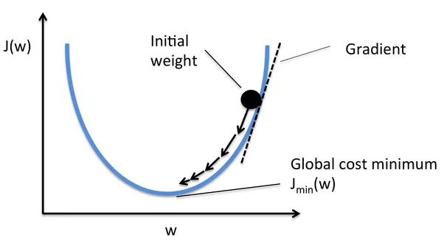
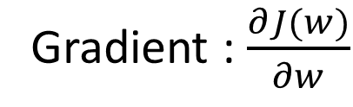
Backpropagation
We should minimize the loss function using differentiation
Gradient : $\frac{∂J(w)}{∂w}$

Slide 9






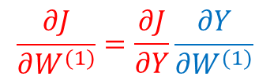










Backpropagation
Backpropagation: Using chain rule, calculate gradient step- by-step
$$\frac{∂J}{∂X}=\frac{∂J}{∂Y}\frac{∂Y}{∂X}$$
$$\frac{∂J}{∂Y}=0.105$$
$0.9$
$$Y=W^{(1)}X$$
$×$
$0.63$
$0.7$
$$\frac{∂Y}{∂X}=W^{(1)}$$
$$\frac{∂Z}{∂W^{(1)}}=X$$
$+$
$0.83$
$σ$
$0.70$
$$\frac{∂J}{∂W^{(1)}}=\frac{∂J}{∂Y}\frac{∂Y}{∂W^{(1)}}$$
$0.2$
$$\frac{∂J}{∂a}=0.5$$
$$\frac{∂J}{∂Z}=0.105$$
$$\frac{∂J}{∂b^{(1)}}=0.105$$

Slide 10
Gradient Descent
Take a small step proportional to the negative of the gradient at current point
Current Gradient
Step
Current Loss
Loss Surface
(We don’t know)
Current Point

Slide 11
Gradient Descent
Take a small step proportional to the negative of the gradient at current point
Current Gradient
Step
Loss Surface
(We don’t know)
Current Loss
Current Point

Slide 12


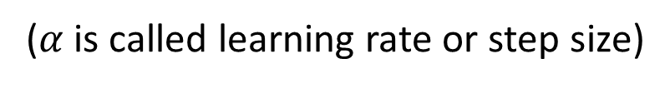
Gradient Descent
Gradient Descent
$$∇w=\frac{1}{N}\sum_{e}^{\begin{aligned}Training \\ examples\end{aligned}}{δ(e, w_{t})}$$
Calculating gradients of
all training examples is
expensive!
Iteration :
$$w_{t+1}=w_{t}−α∇w$$
($α$ is called learning rate or step size)

Slide 13
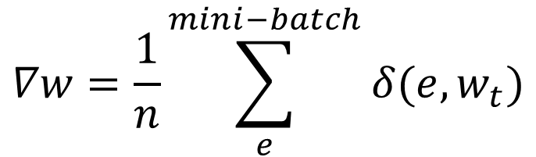
Gradient Descent
Stochastic Gradient Descent(SGD)
$$∇w=\frac{1}{n}\sum_{e}^{mini−batch}{δ(e, w_{t})}$$
Use mini-batch,
random sampled from
training examples
Iteration :
$$w_{t+1}=w_{t}−α∇w$$

Slide 14
How to represent words

Slide 15
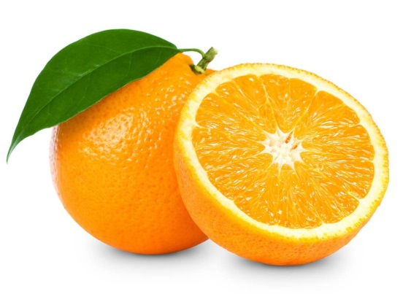
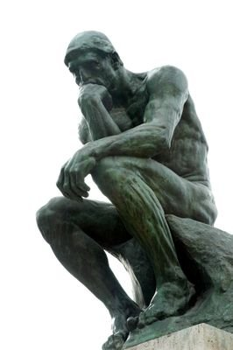
Word Representation
What is “Orange”?

Slide 16

Word Representation
? ? ?
What is “Orange”?

Slide 17
Word Representation
Orange
Representation

Slide 18
Word Representation
Atomic Word Representation
000000
100000
000100
apple
banana
One-hot encoding
grape
orange
strawberry
watermelon
vector
apple
orange

Slide 19
Word Representation
Atomic Word Representation
All vectors are independent
100000
000100
apple
orange

Slide 20
Word Representation
Atomic Word Representation
But words are dependent
100000
Semantic Relation
000100
Syntactic Relation
apple
orange

Slide 21
Word Representation
Atomic Word Representation
100000
Semantic Relation
000100
Syntactic Relation
apple
orange

Slide 22
Word Representation
Distributed Representation
Word
Continuous Feature Space

Slide 23
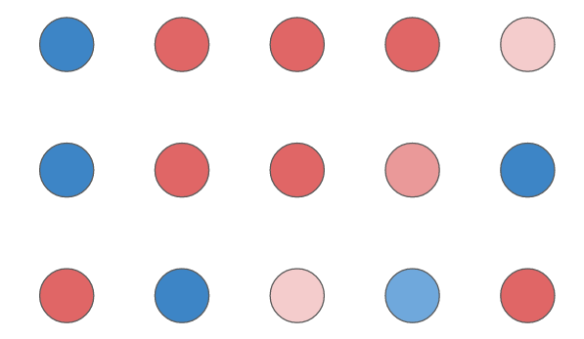

Word Representation
Distributed Representation
Word A
Word B
Word C

Slide 24
Word Representation
Distributed Representation
sweet
0.8
0.2
0.0
0.9
0.2
0.1
sweet
0.7
0.3
0.0
0.6
0.5
0.1
sour
Taste
sour
Taste
hot
hot
red
red
green
Color
green
Color
blue
blue
apple
orange

Slide 25
Word Representation
Distributed Representation
0.7
0.3
0.0
0.6
0.5
0.1
sweet
0.8
0.2
0.0
0.9
0.2
0.1
sweet
0.7
0.3
0.0
0.6
0.5
0.1
Similar taste
Different color
Taste
sour
Taste
sour
hot
hot
red
red
green
Color
green
Color
blue
blue
apple
orange

Slide 26
Word Representation
Distributed Representation
???
?
?
?
?
?
?
???
How to set features and values of them
???
???
???
???
Word

Slide 27
Word Representation
Distributed Representation
???
?
?
?
?
?
?
???
How to set features and values of them
???
???
???
Manually?
???
Word

Slide 28
Word Representation
Distributed Representation
???
?
?
?
?
?
?
???
How to set features and values of them
???
???
???
English words
More than 1 million
1 new word every 98 minutes
???
Word

Slide 29
Word Representation
Distributed Representation
???
?
?
?
?
?
?
???
How to set features and values of them
???
???
???
Manually? Impossible
???
Word

Slide 30
Word Representation
Distributed Representation
???
?
?
?
?
?
?
???
How to set features and values of them
???
???
???
With Neural Networks
???
Word

Slide 31
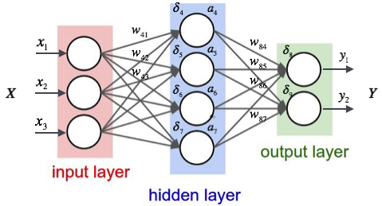
Neural Network
Automatically Detect Features

Slide 32
Neural Network
Automatically Detect Features

Slide 33

Neural Network
Automatically Detect Features
$$Y=F(X)$$

Slide 34

Neural Network
Automatically Detect Features
Loss
$L=J\left(F\left(X\right), Y^{′}\right)$
Adjust the parameters
to minimize the loss

Slide 35
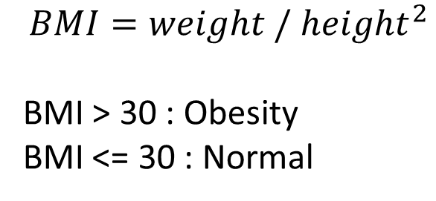
Neural Network
Ex) Obesity with height and weight
$$BMI=weight / {height}^{2}$$
BMI > 30 : Obesity
BMI <= 30 : Normal
Height(m) | Weight(kg) | Obesity
1.81 | 70 | False
1.63 | 68 | False
1.75 | 95 | True
1.55 | 46 | False
1.78 | 103 | True

Slide 36


Neural Network
Ex) Obesity with height and weight
Input : Height, Weight
Output : Probabilities of True or False
$$h= σ(W_{1}x+b_{1})$$
$$y= σ(W_{2}h+b_{2})$$
Neural network
with randomly initialized parameters

Slide 37
Neural Network
Ex) Obesity with height and weight
1.8
0.6
0.0
$$h= σ(W_{1}x+b_{1})$$
$$y= σ(W_{2}h+b_{2})$$
The first output will be very different
72
0.4
1.0
Answer

Slide 38
Neural Network
Ex) Obesity with height and weight
Update parameters with
Backpropagation and
Gradient descent
1.8
0.6
$$h= σ(W_{1}x+b_{1})$$
$$y= σ(W_{2}h+b_{2})$$
72
-0.6
Gradient

Slide 39
Neural Network
Ex) Obesity with height and weight
1.8
0.4
0.0
$$h= σ(W_{1}x+b_{1})$$
$$y= σ(W_{2}h+b_{2})$$
The second output will be
closer to the answer
72
0.6
1.0
Answer

Slide 40
Neural Network
Ex) Obesity with height and weight
1.8
0.1
0.0
After repeat of training,
the neural network will
approximate the obesity function
$$h= σ(W_{1}x+b_{1})$$
$$y= σ(W_{2}h+b_{2})$$
72
0.9
1.0
Answer

Slide 41


Neural Network
Ex) Obesity with height and weight
Output is inferred from the hidden layer
1.8
0.1
$$h= σ(W_{1}x+b_{1})$$
$$y= σ(W_{2}h+b_{2})$$
72
0.9
input
hidden
output

Slide 42
Neural Network
Ex) Obesity with height and weight
The important features will be represented
in the hidden layer
1.8
0.1
$$h= σ(W_{1}x+b_{1})$$
$$y= σ(W_{2}h+b_{2})$$
72
0.9
input
hidden
output

Slide 43
Neural Network
Determine forms of input and output
Define loss function
Training

Slide 44
Word2Vec
Determine forms of input and output
Define loss function
Training

Slide 45
Word2Vec
Input
Word Representation
Output
Automatically determined
Word
???

Slide 46
Word2Vec
I eat an apple every day (O)
I eat an orange every day (O)
I eat a car every day (X)

Slide 47
Word2Vec
I eat an apple every day (O)
I eat an orange every day (O)
I eat a car every day (X)

Slide 48
Word2Vec
I eat an apple every day (O)
I eat an orange every day (O)
I eat a car every day (X)
Co-occur frequently
Co-occur frequently
Co-occur rarely

Slide 49
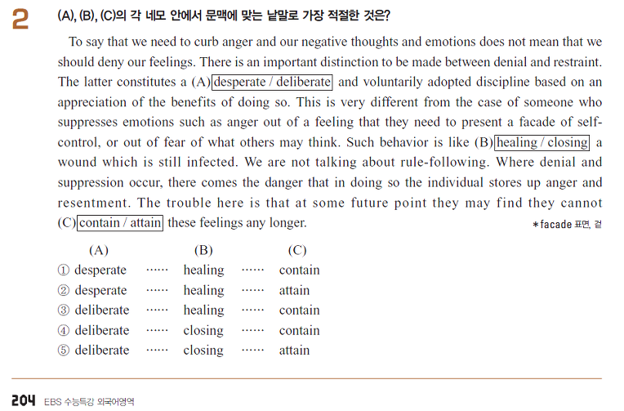
Word2Vec

Slide 50
Word2Vec
Co-occurrence probabilities have three important properties
Each word has its own unique distribution
Similar words have similar distributions
Different words have different distributions

Slide 51
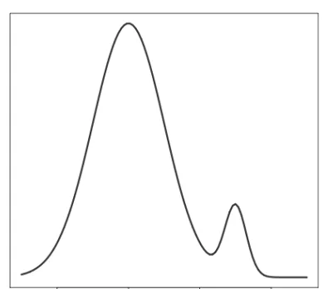
Word2Vec
Word2Vec uses co-occurrence probabilities as outputs
Input
Word Representation
Output
Automatically determined
Word

Slide 52
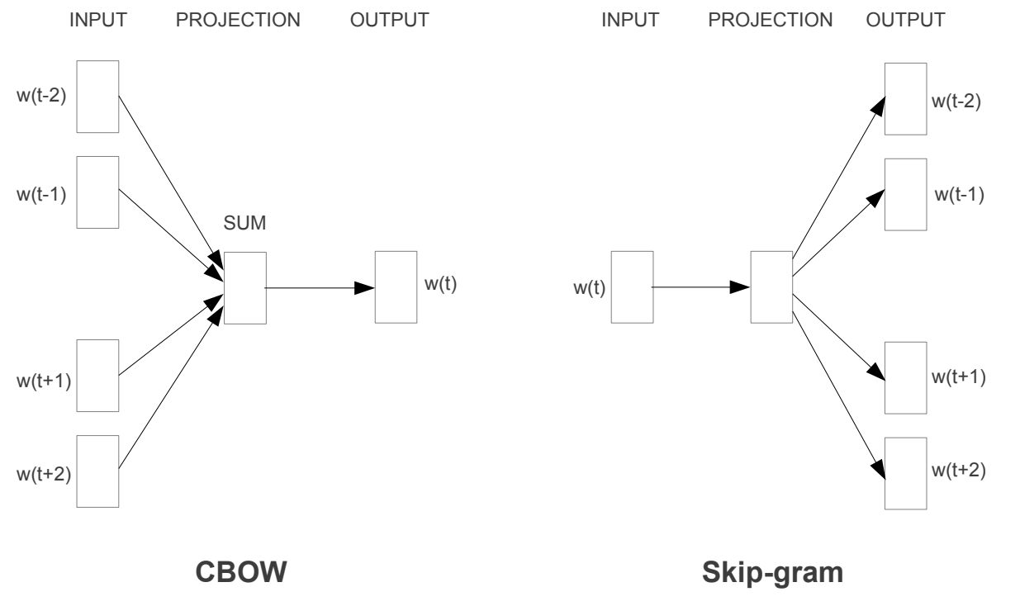
Word2Vec

Slide 53
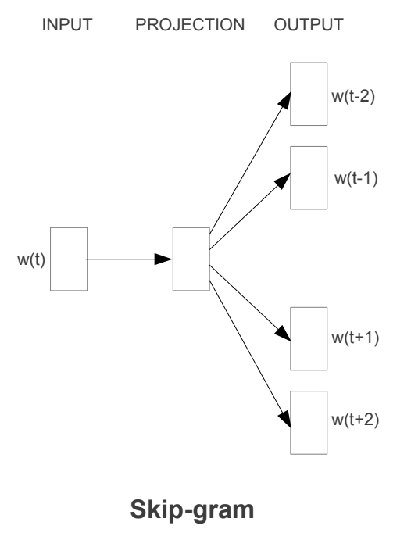
Word2Vec
Skip-gram
Predict context words using a center word
I eat an orange every day.
context words
context words
Predict the probability
???
???
???
orange
???
???

Slide 54
Word2Vec
Skip-gram
1. Word encoding
I eat an orange every day.
orange
Parameterize
Word vector

Slide 55
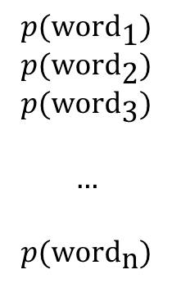
Word2Vec
Skip-gram
2. Predict
Weight Matrix
$$p(\text{wor}{\text{d}}_{\text{1}})$$
$$p(\text{wor}{\text{d}}_{\text{2}})$$
$$p(\text{wor}{\text{d}}_{\text{3}})$$
$$…$$
$$p(\text{wor}{\text{d}}_{\text{n}})$$
softmax
Word vector
Probabilities
Each element represent probability of a word

Slide 56
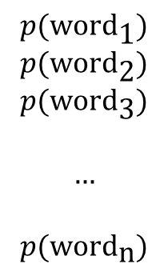
Word2Vec
Skip-gram
3. Update
I eat an orange every day.
Answer: I
$$p(\text{wor}{\text{d}}_{\text{1}})$$
$$p(\text{wor}{\text{d}}_{\text{2}})$$
$$p(\text{wor}{\text{d}}_{\text{3}})$$
$$…$$
$$p(\text{wor}{\text{d}}_{\text{n}})$$
HW1
Weight Matrix
Negative Log Likelihood Loss
Backpropagation
Stochastic Gradient Descent
Probabilities

Slide 57
Word2Vec
Skip-gram
3. Update
I eat an orange every day.
Answer: eat
$$p(\text{wor}{\text{d}}_{\text{1}})$$
$$p(\text{wor}{\text{d}}_{\text{2}})$$
$$p(\text{wor}{\text{d}}_{\text{3}})$$
$$…$$
$$p(\text{wor}{\text{d}}_{\text{n}})$$
HW1
Weight Matrix
Negative Log Likelihood Loss
Backpropagation
Stochastic Gradient Descent
Probabilities

Slide 58
Word2Vec
Skip-gram
3. Update
I eat an orange every day.
Answer: an
$$p(\text{wor}{\text{d}}_{\text{1}})$$
$$p(\text{wor}{\text{d}}_{\text{2}})$$
$$p(\text{wor}{\text{d}}_{\text{3}})$$
$$…$$
$$p(\text{wor}{\text{d}}_{\text{n}})$$
HW1
Weight Matrix
Negative Log Likelihood Loss
Backpropagation
Stochastic Gradient Descent
Probabilities

Slide 59
Word2Vec
Skip-gram
3. Update
I eat an orange every day.
Answer: every
$$p(\text{wor}{\text{d}}_{\text{1}})$$
$$p(\text{wor}{\text{d}}_{\text{2}})$$
$$p(\text{wor}{\text{d}}_{\text{3}})$$
$$…$$
$$p(\text{wor}{\text{d}}_{\text{n}})$$
HW1
Weight Matrix
Negative Log Likelihood Loss
Backpropagation
Stochastic Gradient Descent
Probabilities

Slide 60
Word2Vec
Skip-gram
3. Update
I eat an orange every day.
Answer: day
$$p(\text{wor}{\text{d}}_{\text{1}})$$
$$p(\text{wor}{\text{d}}_{\text{2}})$$
$$p(\text{wor}{\text{d}}_{\text{3}})$$
$$…$$
$$p(\text{wor}{\text{d}}_{\text{n}})$$
HW1
Weight Matrix
Negative Log Likelihood Loss
Backpropagation
Stochastic Gradient Descent
Probabilities

Slide 61
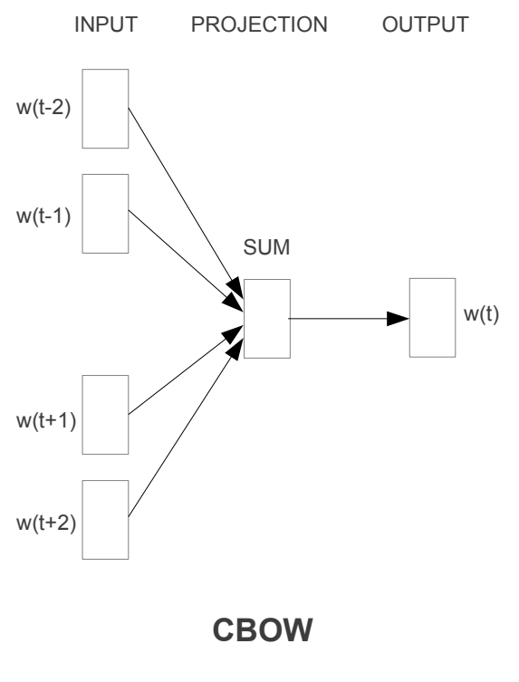
Word2Vec
Continuous Bag of Words
How frequent the center word occurs in some context?
I eat an orange every day.
center word
Predict the probability
I eat an ??? every day.

Slide 62
Word2Vec
Continuous Bag of Words
1. Context encoding
I
eat
an
every
day
I eat an ??? every day.
Context

Slide 63
Word2Vec
Continuous Bag of Words
1. Context encoding
word
I
eat
an
every
day
I eat an ??? every day.
Context

Slide 64
Word2Vec
Continuous Bag of Words
1. Context encoding
I
eat
an
every
day
I eat an ??? every day.
Parameterize
Context

Slide 65
Word2Vec
Continuous Bag of Words
1. Context encoding
I
eat
an
every
day
I eat an ??? every day.
sum
Context
Context vector

Slide 66
Word2Vec
Continuous Bag of Words
2. Prediction
HW1
Weight Matrix
$$p(\text{wor}{\text{d}}_{\text{1}})$$
$$p(\text{wor}{\text{d}}_{\text{2}})$$
$$p(\text{wor}{\text{d}}_{\text{3}})$$
$$…$$
$$p(\text{wor}{\text{d}}_{\text{n}})$$
softmax
Context vector
Probabilities
Each element represent probability of a word

Slide 67
Word2Vec
Continuous Bag of Words
3. Update
I eat an ??? every day.
Answer: orange
$$p(\text{wor}{\text{d}}_{\text{1}})$$
$$p(\text{wor}{\text{d}}_{\text{2}})$$
$$p(\text{wor}{\text{d}}_{\text{3}})$$
$$…$$
$$p(\text{wor}{\text{d}}_{\text{n}})$$
Weight Matrix
HW1
Negative Log Likelihood Loss
Backpropagation
Stochastic Gradient Descent
Probabilities

Slide 68




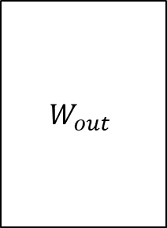
Word2Vec
$$y=softmax\left(W_{out}h\right)$$
$$W_{out}$$
$$h$$
$$W_{out}$$
o
$$=$$
Word/Context
Embedding
(V x 1)
(V x D)
(D x 1)
Word probabilities
V: vocabulary size
h: embedding dimension

Slide 69


Word2Vec
$$y=softmax\left(W_{out}h\right)$$
$$W_{out}$$
o
o’
y
exp
norm
Word/Context
Embedding
Word probabilities

Slide 70
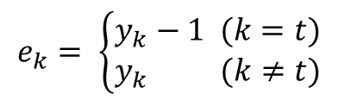

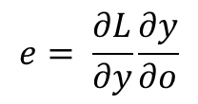

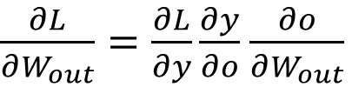

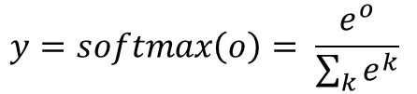
Word2Vec
$$o=W_{out}h$$
$$y=softmax\left(o\right)= \frac{e^{o}}{\sum_{k}{e^{k}}}$$
$$L=NLL\left(y, t\right)=−\log\left(y_{t}\right)$$
$\frac{∂L}{∂h}=\frac{∂L}{∂y}\frac{∂y}{∂o}$ $\frac{∂o}{∂h}$
$$e= \frac{∂L}{∂y}\frac{∂y}{∂o}$$
$\frac{∂L}{∂W_{out}}=\frac{∂L}{∂y}\frac{∂y}{∂o}$ $\frac{∂o}{∂W_{out}}$
$$e_{k}= \left\{\begin{aligned}y_{k}−1 (k=t) \\ y_{k} (k≠t)\end{aligned}\right.$$

Slide 71



Word2Vec
$$o=W_{out}h$$
$$y=softmax\left(o\right)= \frac{e^{o}}{\sum_{k}{e^{k}}}$$
$$L=NLL\left(y, t\right)=−\log\left(y_{t}\right)$$
$$\frac{∂L}{∂h}=W_{out} e$$
$$\frac{∂L}{∂W_{out}}=he^{T}$$

Slide 72










Word2Vec
CBOW
Skip-gram
$$o=W_{out}h$$
$$h= w_{k}$$
$$h= w_{a}+w_{b}+w_{c}+w_{d}$$
$$y=softmax\left(o\right)= \frac{e^{o}}{\sum_{k}{e^{k}}}$$
$\frac{∂h}{∂w_{a}}$, $\frac{∂h}{∂w_{b}}$, $\frac{∂h}{∂w_{c}}$, $\frac{∂h}{∂w_{d}}=1$
$$w_{k}=w_{k}−η\frac{∂L}{∂h}$$
$$L=NLL\left(y, t\right)=−\log\left(y_{t}\right)$$
$$w_{a}=w_{a}−η\frac{∂L}{∂w_{a}}$$
$$W_{out}=W_{out}−η\frac{∂L}{∂W_{out}}$$
$$w_{b}=w_{b}−η\frac{∂L}{∂w_{b}}$$
$$\frac{∂L}{∂h}=W_{out} e$$
$$w_{c}=w_{c}−η\frac{∂L}{∂w_{c}}$$
$$\frac{∂L}{∂W_{out}}=he^{T}$$
$$w_{d}=w_{d}−η\frac{∂L}{∂w_{d}}$$
$$W_{out}=W_{out}−η\frac{∂L}{∂W_{out}}$$

Slide 73
Word2Vec
*Xin Rong. word2vec Parameter Learning Explained
CBOW
Skip-gram
$$o=W_{out}h$$
$$h= w_{k}$$
$$h= w_{a}+w_{b}+w_{c}+w_{d}$$
$$y=softmax\left(o\right)= \frac{e^{o}}{\sum_{k}{e^{k}}}$$
$\frac{∂h}{∂w_{a}}$, $\frac{∂h}{∂w_{b}}$, $\frac{∂h}{∂w_{c}}$, $\frac{∂h}{∂w_{d}}=1$
$$w_{k}=w_{k}−η\frac{∂L}{∂h}$$
$$L=NLL\left(y, t\right)=−\log\left(y_{t}\right)$$
$$w_{a}=w_{a}−η\frac{∂L}{∂w_{a}}$$
$$W_{out}=W_{out}−η\frac{∂L}{∂W_{out}}$$
$$w_{b}=w_{b}−η\frac{∂L}{∂w_{b}}$$
$$\frac{∂L}{∂h}=W_{out} e$$
$$w_{c}=w_{c}−η\frac{∂L}{∂w_{c}}$$
$$\frac{∂L}{∂W_{out}}=he^{T}$$
$$w_{d}=w_{d}−η\frac{∂L}{∂w_{d}}$$
$$W_{out}=W_{out}−η\frac{∂L}{∂W_{out}}$$

Slide 74
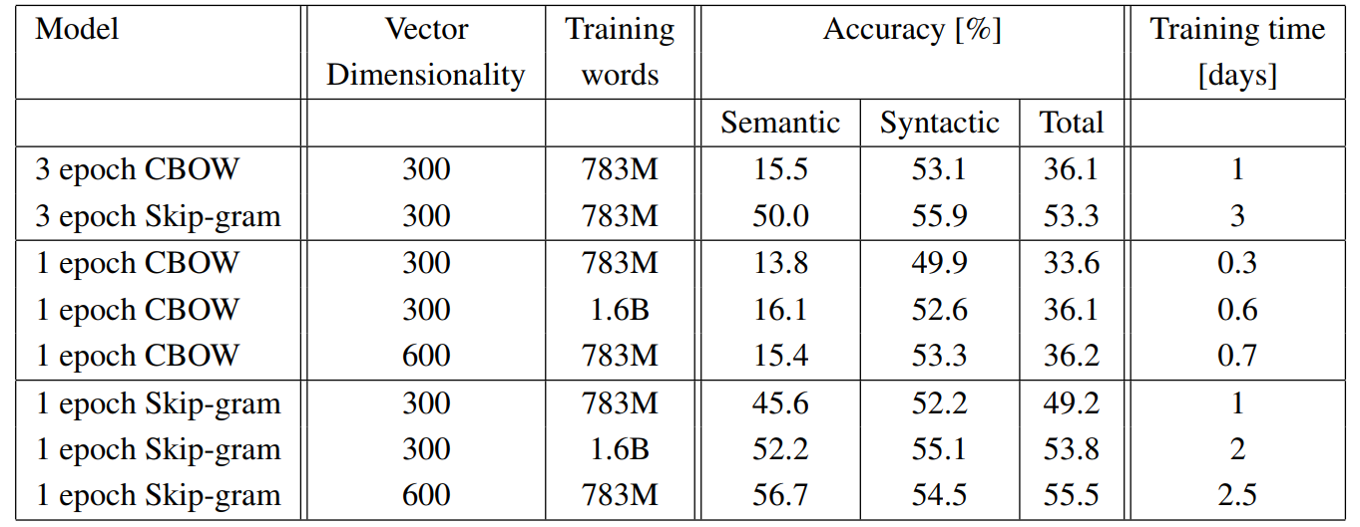
Word2Vec
CBOW vs Skip-gram

Slide 75
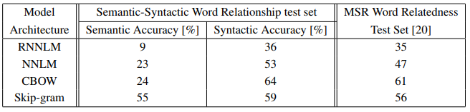
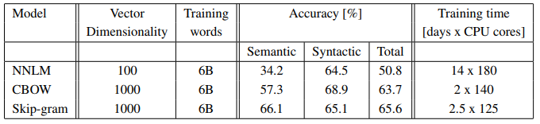
Word2Vec
Better and Faster

Slide 76
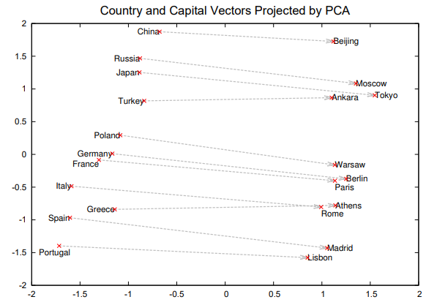
Word2Vec
Additive Compositionality
vec(“Paris”) - vec(“France”)
= vec(“Berlin”) - vec(“Germany”)

Slide 77
Assignment 2
Word2Vec Implementation
CBOW and Skip-gram
Forward path
Backward path
Return : cost value and gradient of two word vectors

Slide 78
Submission 2
Due date : ~10/30(수) 23:59
Submission : Online submission on blackboard
word2vec.py + 2 screenshots of results (Skip-gram / CBOW)
You must implement the components yourself!
File name : StudentID_Name.zip

Slide 79
Q&A
Data intelligence lab.
irish07@korea.ac.kr (박준형)
saga9017@korea.ac.kr (이욱진)

